Slide 1
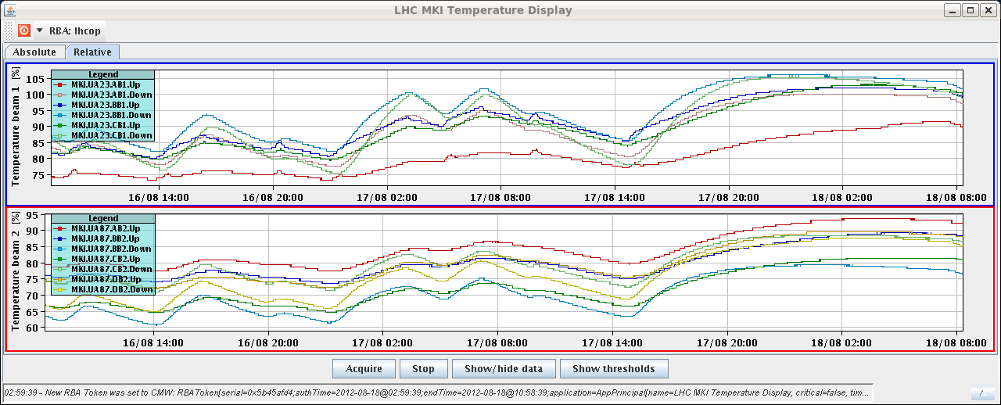
Saturday 18.8. – Morning
7:36 beams dumped
~30 minutes extra waiting time for B1 MKI B and C cooling down:
About 40 min to reduce by by 2 %
8:53 injecting physics beam for Fill 2984
1.59E11 average bunch intensity
Emittances again very good: mostly below 1.6um

Slide 2
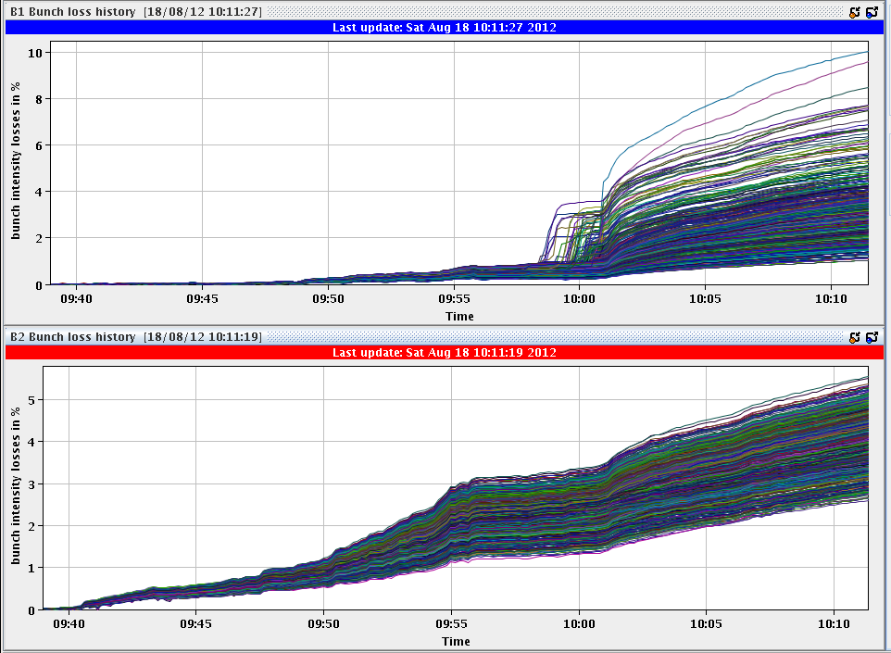
Fill 2984 cont.
Very few losses (ramp, squeeze, adjust)
B1 instability during the collision beam process → losses up to ~5% on individual bunches
10:04 stable beam fill 2984
ATLAS max lumi ~7.4 x 10^33 cm^-2s-1
CMS max lumi ~7.2 x 10^33 cm^-2s-1

Slide 3
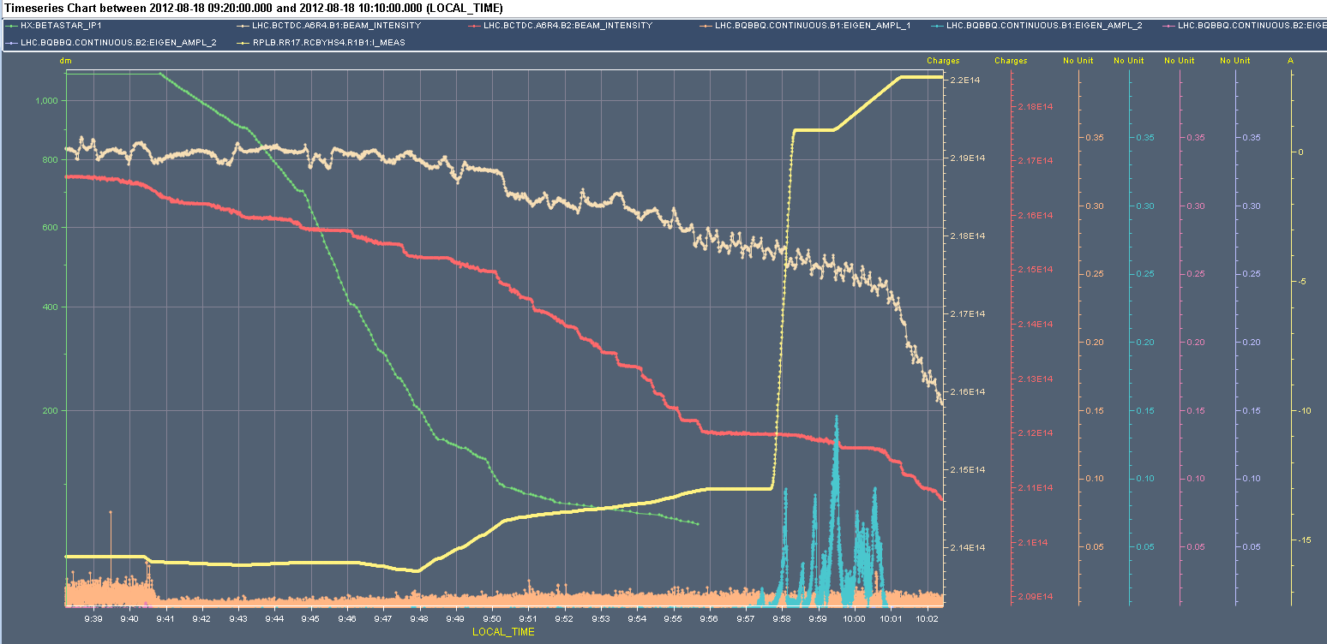
Instability B1 V during collision beam process
Some bunches of B1 oscillating in the V-plane after the squeeze and during adjust.
For next fill: Trimmed vertical chromaticity +2 units in the V-plane (both beams) during the end of ramp, squeeze and adjust.
Now we are running during the end of ramp and squeeze with +13 units in H and +15 units in V.
During the adjust the chromaticity is still decreasing by two units in both planes we might review this for the next fill as the effect on lifetime seems so far negligible.

Slide 4
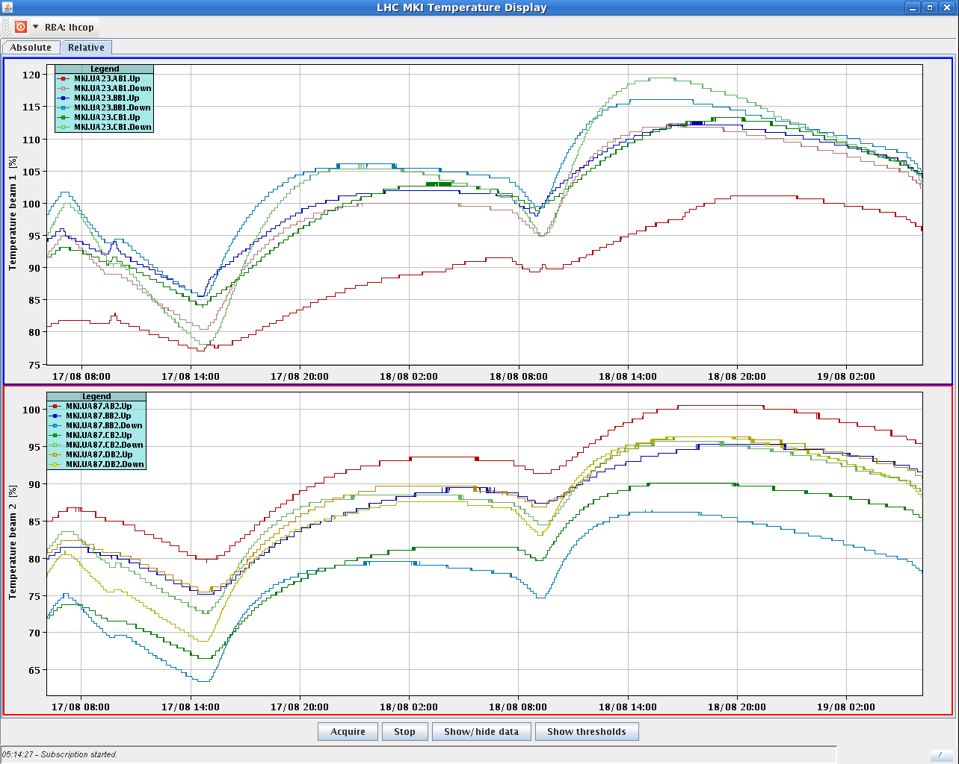
Sunday morning
20:11 In total from start of collisions, we decrease the chrom by 5 units in H plane and 9 units in V plane and the octupole knob to -1.7
4:33 leveling offset reduced to zero for LHCb
5:14 dump by OP
Integrated lumi ~223 pb-1 in 19 h stable beams
6:08 injecting probes
6:30 injection of physics beam delayed by MKI2 temperature

Slide 5
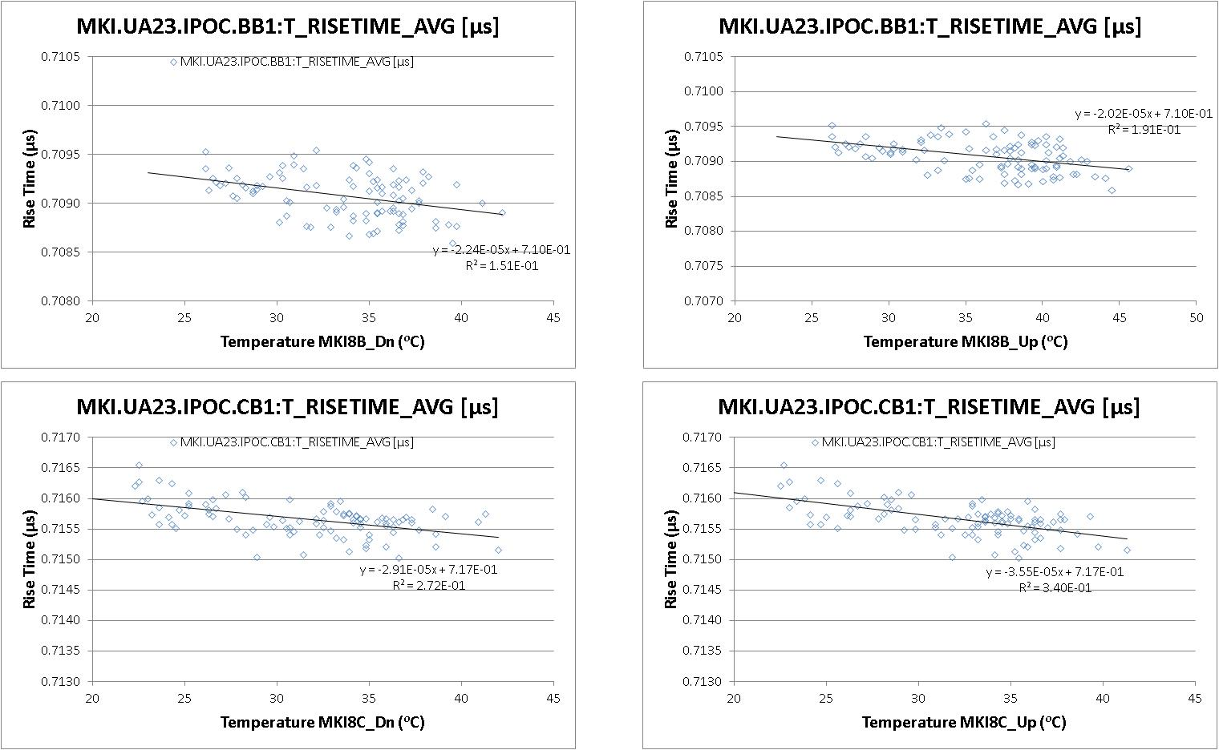
MKI2 temperature
Rise time vs temperature (soft-start data) has been analyzed last evening by Vasco Namora.
Re-analyze with the even increased temperatures of tonight
→ Check whether to increase the SIS temperature limit.
Beam positions on the pilots which have been injected with the MKIs over threshold have been checked → no clear effect seen (injection lines drift as well)
Possible test: bunch lengthening to check if that reduces heating

