Slide 1
Tuesday 15.8. – Morning and Evening
8:00 – 9:20 Loss maps at 450 GeV injection protection out: betatron and +1000 Hz
9:50 – 15:40 Injection protection set-up
Pt2 TDI/TCLI protection was set-up and validated OK
Settings found are compatible with last years settings
14:25 CMS solenoid back at nominal current
16:17 Undulator RU.L4 tripped and the cryo was lost in ML4
17:00 cryo back; start pre-cycling and ramping up the undulator
18:00 – 18:30 no beam from PS (POPS power supply down)
ALFA and TOTEM movement tested OK (in preparation for loss maps)
18:45 fill for TCT set-up in collision and loss maps
20:20 IP1, IP2 and IP5 collisions optimized
21:15 collimator alignment finished
21:22 IP8 collisions optimized (had to steer manually the separation plane by 220 um before getting a clear signal from the published lumi)

Slide 2
Tuesday Night
21:50 loss maps with TOTEM and ALFA roman pots in physics settings: B1V, B2V and off-momentum -500 Hz → dump
23:00 – 0:44 fill for loss maps in collision: B1H, B2H and +500 Hz
Orbit corrected, Luminosities optimized
Roman pots IN
1:30 – 3:00 fill for asynchronous dump test
Orbit corected, Luminosities optimized
Roman pots IN
4:00 – 5:40 loss maps and asynchronous dump at injection with injection protection IN: H and V for both beams, +1000 Hz, -1000 Hz
Till 6:00 loss map positive off momentum at injection with inj. protection out: -1000Hz
6:00 start angular alignment of TDI in IP8

Slide 3
Collimator set-up and Loss maps after ALICE polarity inversion
Alignment
Loss Maps- all done. To be confirmed OK by Collimation team
Alignment | Injection | Flat-top | Squeezed, separated | Collision
IP2 TCTVs + TCTHs | done | done | done | done
 | Injection, inj prot. IN | Injection, inj prot. OUT | Flat-top | Squeezed, separated | Collision, RP in physics settings
Betatronic-H | Done | Done | Done | Done | Done
Betatronic-V | Done | Done | Done | Done | Done
Neg. off-mom | +1000 Hz | +1000 Hz | -- | -- | +500 Hz
Pos. off-mom | -1000 Hz | -1000 Hz | -- | -500 Hz | -500 Hz
Asynch dump | Done | -- | -- | -- | Done

Slide 4
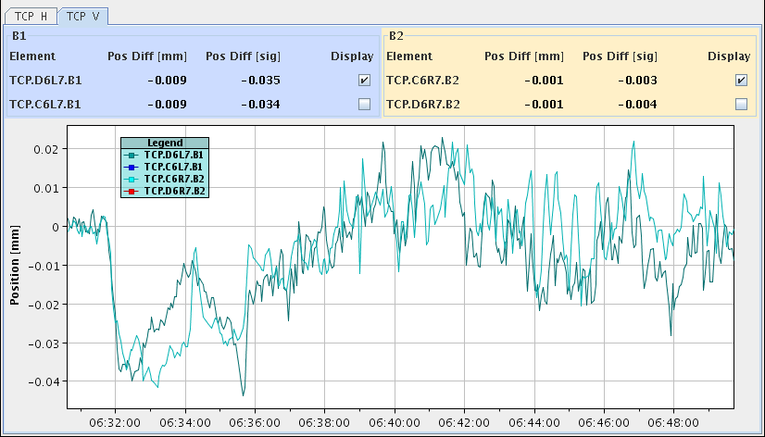
Orbit
Joerg, Laurette: Orbit stability at the TCPs during the squeeze from Monday night, In the V plane the OFB has problems to follow and correct some leakage. The RT trims have been fed-forward (ramp and squeeze, IR2 CODs).
→ next squeeze (Tue evening) large 40um orbit excursions mostly gone. Another feed-forward performed.

Slide 5
TDI – IP8 from Jan Uythoven
TDI IP8 LVDT position readings over the last 8 days investigated
On Tuesday 7th August we spend about 1 hour with high intensity beams at injection to test the filling with opposite octupole polarity.
During this time there was a large vacuum rise, as signaled by Vincent.
This beam was dumped at injection as two pilots were supposed to be taken up the ramp.
However, they were dumped on beam losses on the TDI when moved to parking (and probably one side got stuck)...
This was the first time that the TDI problem encountered last week was signaled. During this one hour at injection a deformation of the structure, seen as ‘drifts’ on the LVDT readings, much stronger than normal is seen for the LVDT Right UP. Clearly due to the heating at injection with the TDIs at injection settings.
For the TDI IP8 right DOWN basically no movement is seen during this period at injection. However, this LVDT shows a big jump in position when going for the first physics fill on early Sunday morning: this is when the recalibration of the TDI is done.

Slide 6
TDI – IP8 from Jan Uythoven cont.
The positioning problem encountered with the TDI in point 8 is most likely due to a strong deformation at injection, just before.
One should take great care to minimize the time with the TDIs at injection and large beam currents in the machine

Slide 7
TDI IP8 – for Roberto Losito, Mario Di Castro
“On our side, thanks to the analysis of Mario Di Castro we suspect a permanent deformation, due to the efforts developed during the strong skew angle, of the Right Downstream axis about 100 microns towards the beam. I think today’s realignment with beam is welcome to confirm this hypothesis. Not sure the deformation at the level of the jaw is really so strong, but at least we see a drift of the LVDT reading and therefore a modification of the reference position. The deformation is most probably in the mechanism outside (much weaker than the jaw itself).

Slide 8
Plan
After TDI set-up and verification:
Full cycle with low intensity (78 bunches) up to collision to verify quality of the orbit. Orbit in the squeeze might have to be optimized with additional test ramp
If everything OK: Intensity ramp-up and stable beams (474 bunches/1374 bunches)

