Slide 1
Wednesday 1.8. - Morning
8:42 - 11:30 end of fill study - octupole polarity inversion (Elias, Tatiana, Alexey, Georges, …):
Goal: study the effect of the opposite sign in the Landau octupoles in collision and separated beams, as this sign could lead to some lifetime degradation (larger tune footprint) and instabilities (depending on the current).
Initial luminosity of ~2E33 for IP1&5
Bunch intensities of ~1E11 p/b
Transverse emittances of ~ 3.5 microm (from luminosity)
Chromas should be at ~1.5-2 units in both planes both beams (According to recent measurements and trims)

Slide 2
Octupole study, cont.
1st study: Beam in collisions and we change the octupoles current by steps starting from the initial case (from physics): -475 A for B1 and -509 A for B2: -220 A, -100 A, +100 A, +200 A, +300 A, +400 A, +500 A.
In every step, the chromas were trimmed (approximately) based on past (linear) measurements of the chroma dependence on octupoles' current.
Results:
Essentially no change of lifetime (some dips observed at the time of the changes and then recovering) except for the
last 2 steps were the lifetime was certainly worse => To be checked but could be what we were looking for (due to larger wings in the tune footprint).
Furthermore, some effect on the bunch length was also observed which should be studied in detail.

Slide 3
Octupole study, cont.
2nd study:
+150 A octupoles (with chromas trimmed)
Then separated IP1&5 by steps of 0.5 sigmas from 0 till 4 sigmas ➔ No problem
Then separated in IP8 from 0 till 4 sigmas ➔ No problem
3rd study:
+50 A octupoles (with chromas trimmed); experiments still separated ➔ No problem
IP1 & IP5 & IP8 back in collision in 1 step ➔ No problem seen and the IP1&5 lumi was ~ 1.8E33, also after re-optimization. (Reminder: was ~2E33 at the start of the study)

Slide 4
Octupole study, cont.
4th study:
Reduced octupoles' current to 0 A (with no chromas trimmed) ➔ No problem
Then separated IP1&5&8 to 4 sigmas in 1 step ➔ No problem
Finally, did some steps in chromas:
Delta of +5 in both planes both beams ➔ Dip (as usual) and then it tried to come back but the final lifetime was reduced
Delta of -10 (i.e. - 5 compared to the initial situation) done at 11:25 ➔ Dip (as usual) and then it came back to a lifetime even better. However, 4 minutes later we started to see some activities/instabilities on the 6 IP8 bunches (i.e. head-on collisions only in IP8 but a certain number of long-range interactions from other IPs) ➔ To be studied in detail.

Slide 5
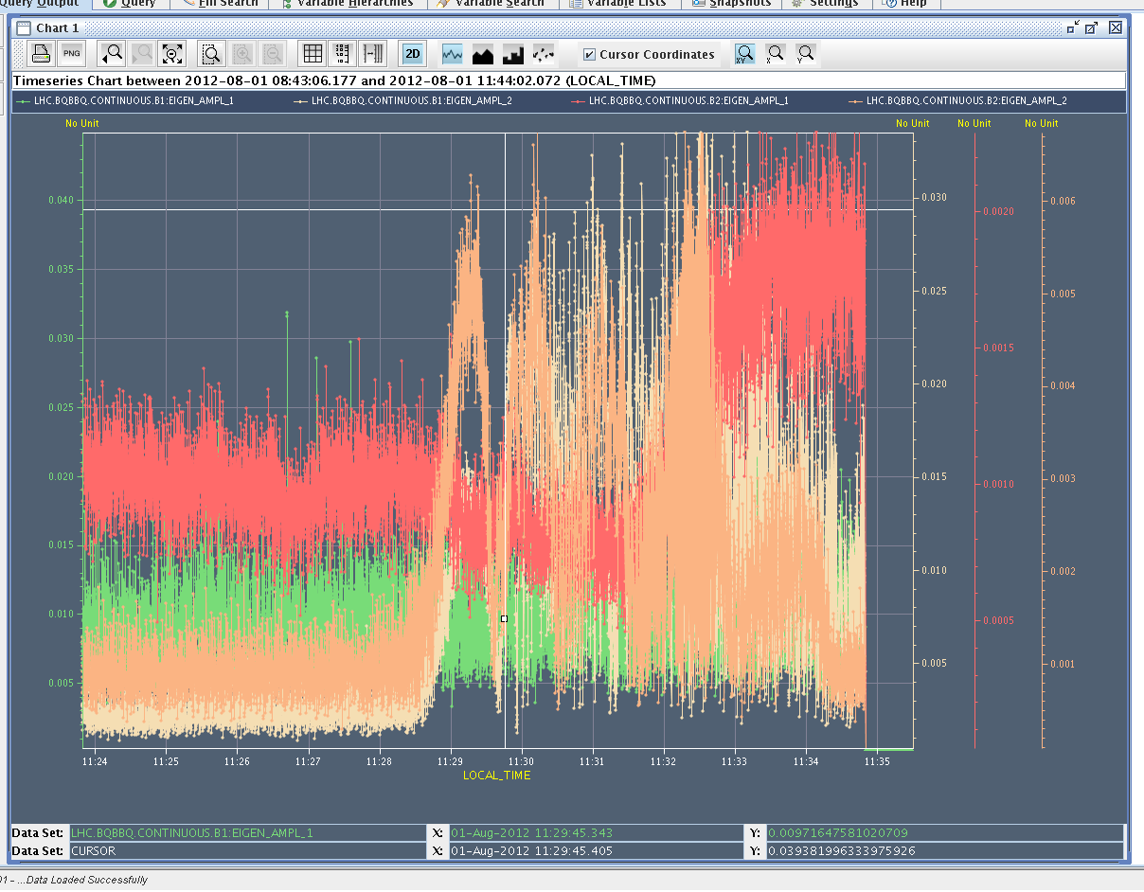
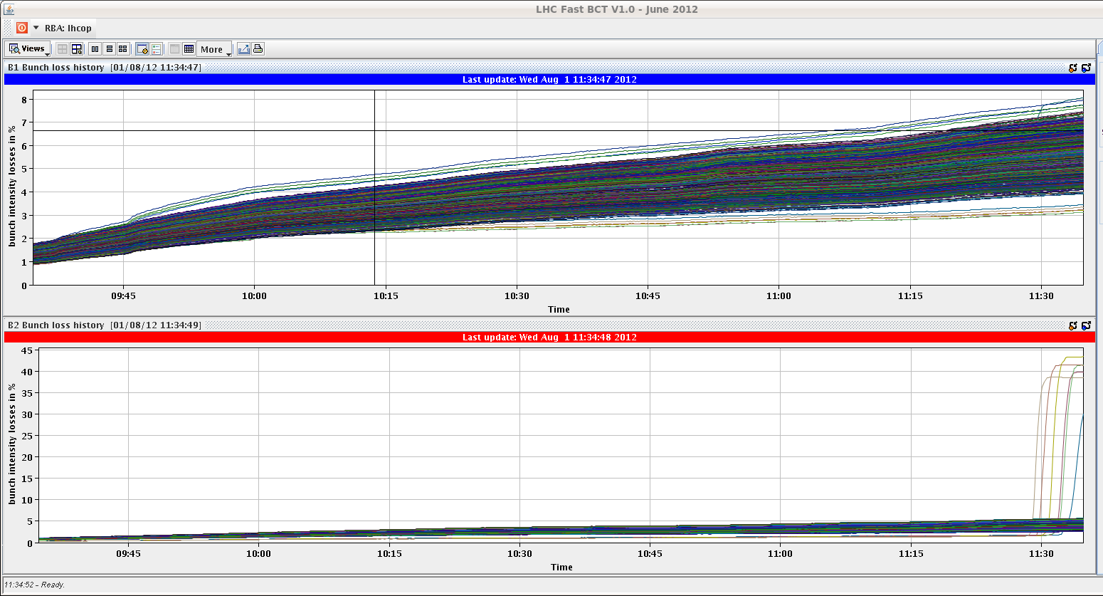
“IP8 bunches”
3-4 minutes after changing chroma by -10 (therefore most likely chroma was negativ) activity in Beam 1 and Beam2. Beam 2 IP8-only-collision bunches lose intensity (~40%) one after the other (1 minute interval) in the order of their long-range interactions in IP1 and 5 (first the bunch with 3 LR interactions, then the bunch with 4, …). Activity starts on BBQ V B2. Then colliding companions of B1 also lost.

Slide 6
ADT tune measurement test at injection energy
11:30 beams dumped by OP after end-of-fill study
12:30 – 14:00 test to measure tune with ADT (Daniel V, Wolfgang H)
B1 vertical plane
Used only the already existing infrastructure (Abort gap cleaning, gain modulation, bunch observation etc.) with new software

Slide 7
ADT tune measurement test – Daniel, Wolfgang
Method 1 (Evian 2011)
ADT gain modulation within the turn, BBQ should get more signal from the less damped bunches (first 12).
Passive observation, moderate effort needed. Method tested after TS1, no significant improvement (for BBQ) → would require gating BBQ.
Method 2 (Evian 2011)
Q extraction from the ADT residual noise.
Passive observation of all bunches, significant effort needed. Long term proposal
Method 3 (RF coffee table 2012)
Active excitation of few bunches by the ADT, measure the oscillation damping transient and calculate the tune.
Moderate effort needed. Results are presented

Slide 8
ADT tune measurement test – Daniel, Wolfgang
Method:
Excite the first 6 bunches by the damper (abort gap cleaning infrastructure) and full amplitude (=1). 4 turn excitation results into ~100um peak oscillation in our pickup Q7R4.
Normalized gain set to 0.03, similar conditions as through the ramp and flat top
Observe each individual bunch of the 6-bunch train
FFT of data for each observed bunch, average the spectra, find the peak
Similar measurements could be obtained with 2 turn excitation (~50um, ~23dB S/N, vs. ~28dB with 4 turn excitation).

Slide 9
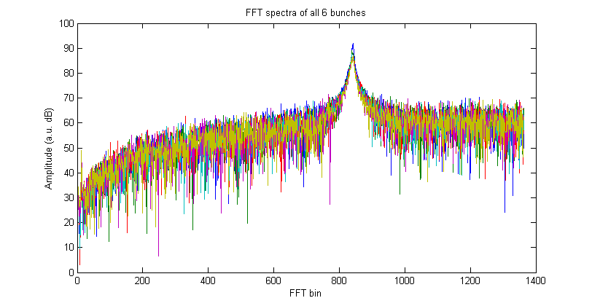
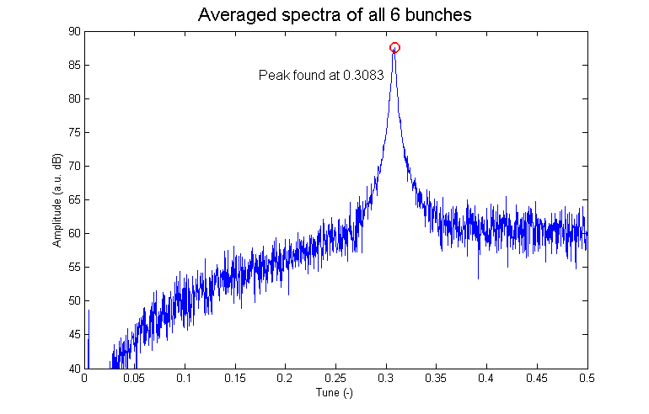
ADT tune measurement test – Daniel, Wolfgang

Slide 10
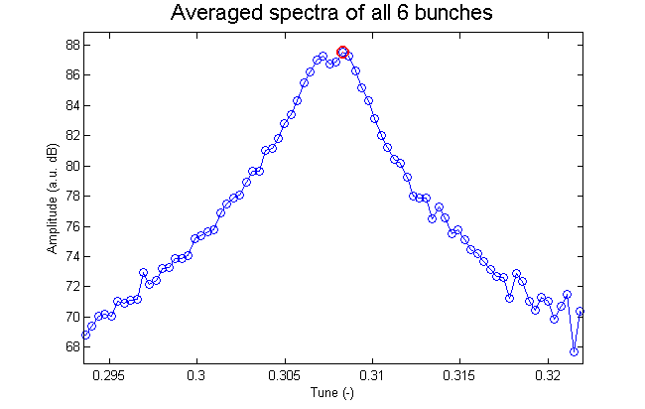
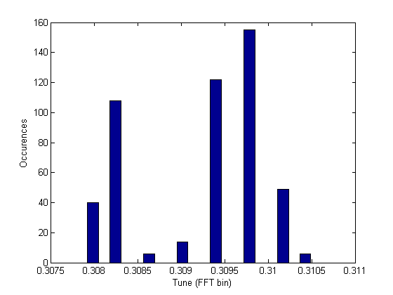
ADT tune measurement test – Daniel, Wolfgang
The method allows to observe the tune of each individual bunch
FFT resolution ~4Hz (3.6e-4 Q)
Two “peaks” spaced by ~20Hz were observed, well visible in the histogram of 500 measurements.
Impact on life time (BLM) negligible (drop from 200 hrs to 20 hrs with continuous strong excitation every 3 s)
Impact on 6-bunch emittance growth still to be analyzed

Slide 11
ADT tune measurement test – Daniel, Wolfgang
ADT tune measurement test summary:
Selective bunch excitation with ADT with extraction of the tune from the transient was demonstrated as feasible (at 450GeV).
The method uses already available infrastructure (abort gap cleaning, gating, observation).
The method could be tested through a dedicated ramp.
Impact on emittance growth and life time of the 6 bunches to be studied in this dedicated ramp.
The data contain very valuable diagnostic information for the ADT system (damping times, phase advances etc.).
There is a potential to extract the chromaticity from the transients (Wolfgang is evaluating).

Slide 12
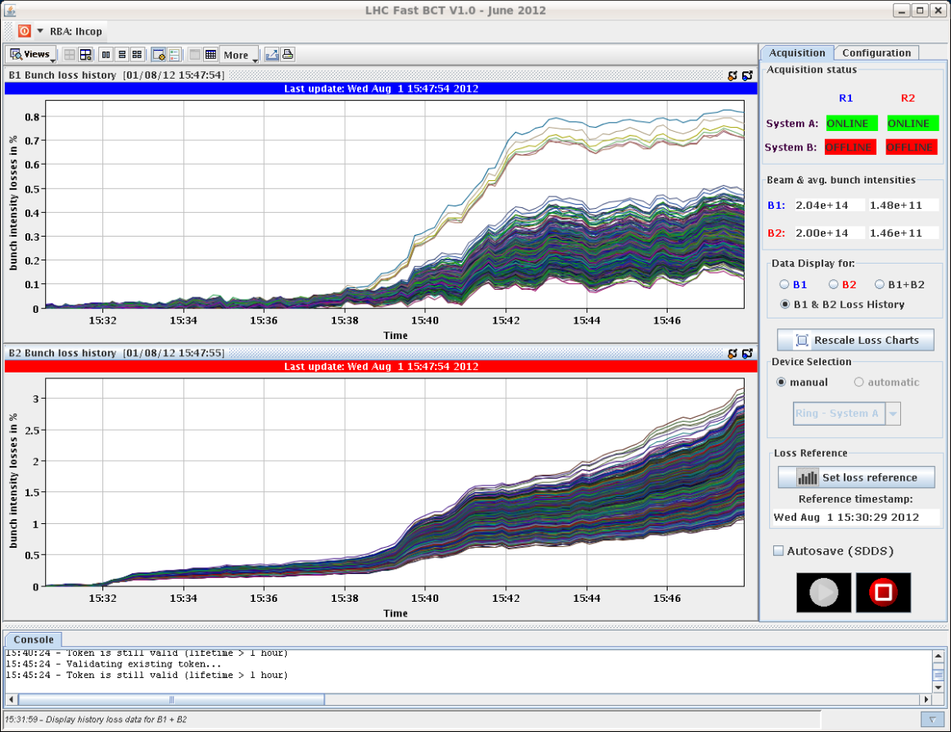
Afternoon
15:59 stable beams fill 2900
Same conditions as fill 2898
~1.51 ppb
No warning from BLMs during ramp, squeeze and adjust
Initial L ~6.0E33 cm-2s-1
3.5 hours in stable beams
Integrated lumi: ~60 pb-1
Bunch losses during squeeze

Slide 13
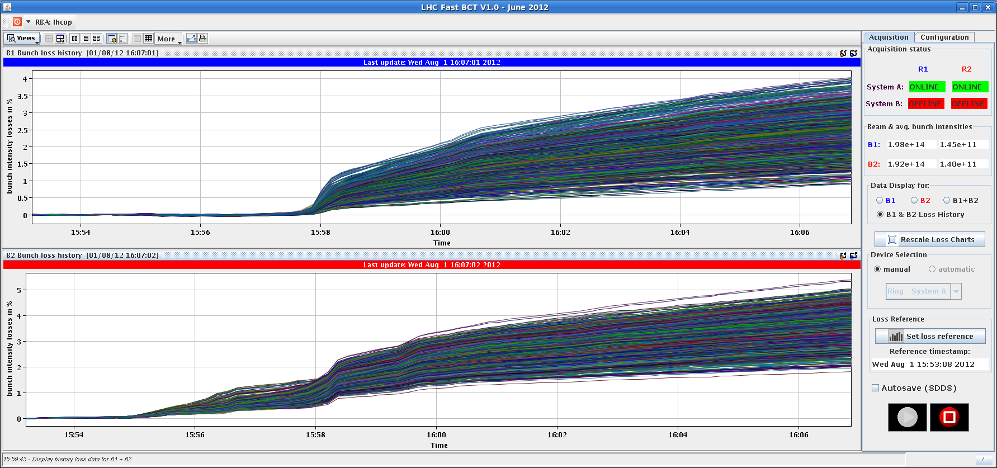
Bunch losses going into collisions

Slide 14
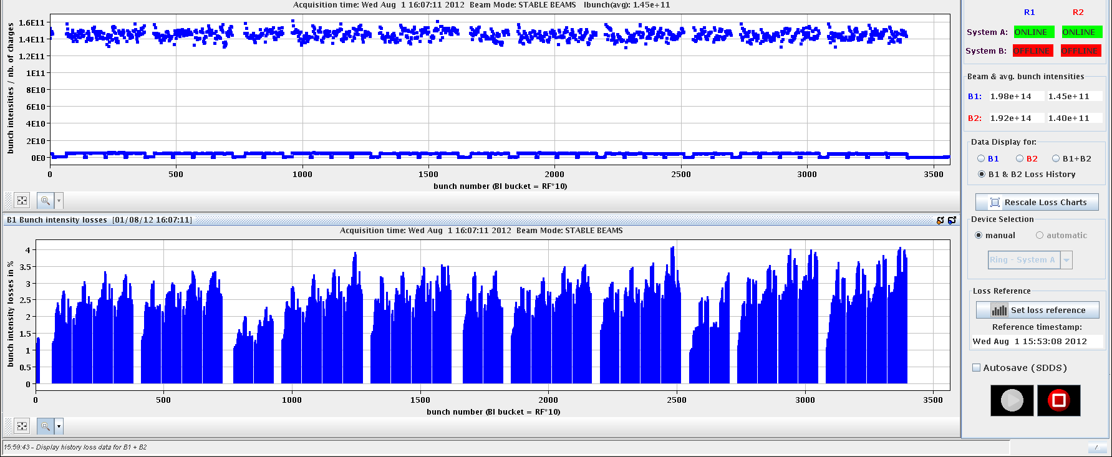
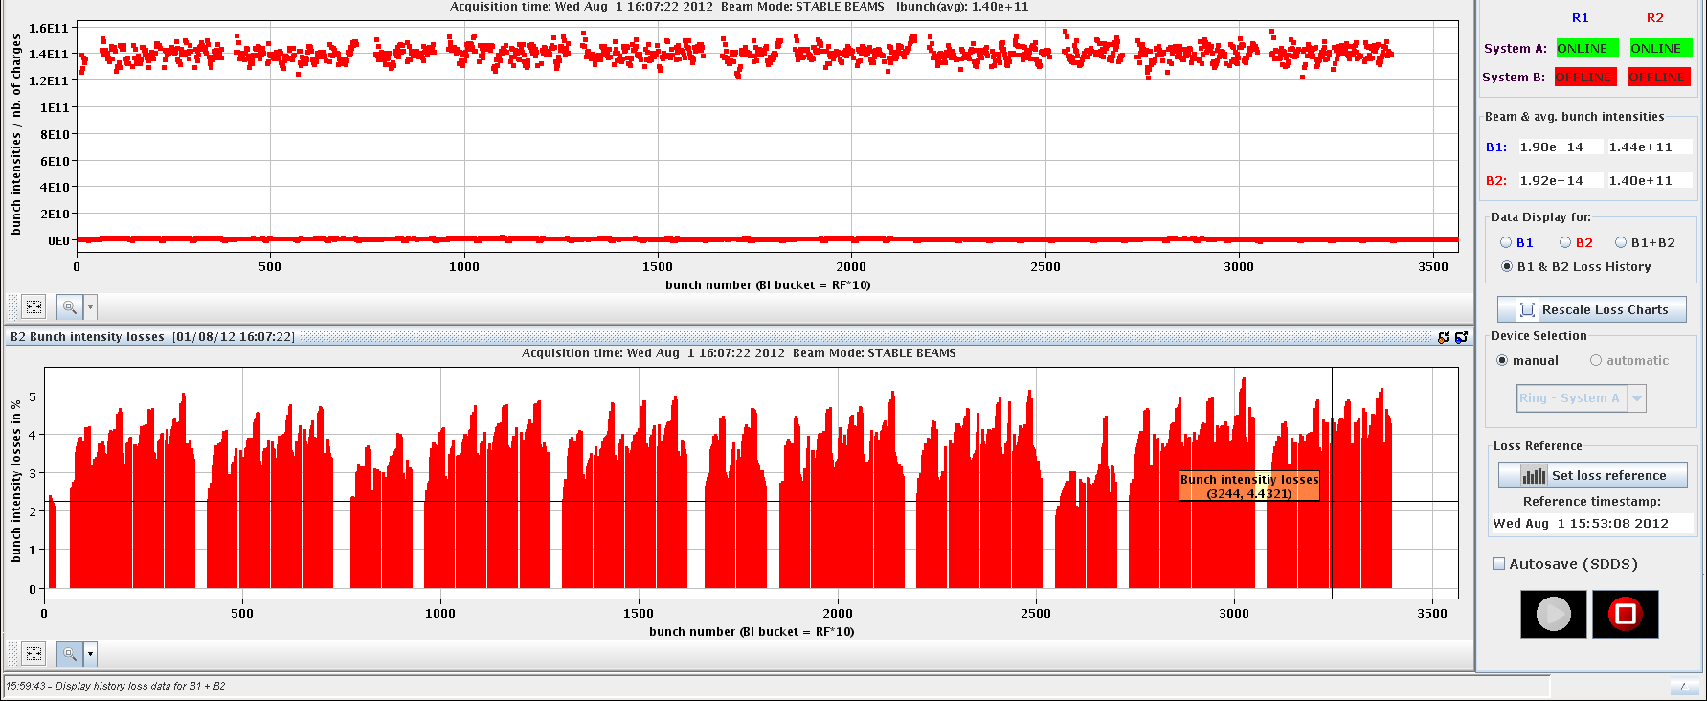
Bunch losses

Slide 15
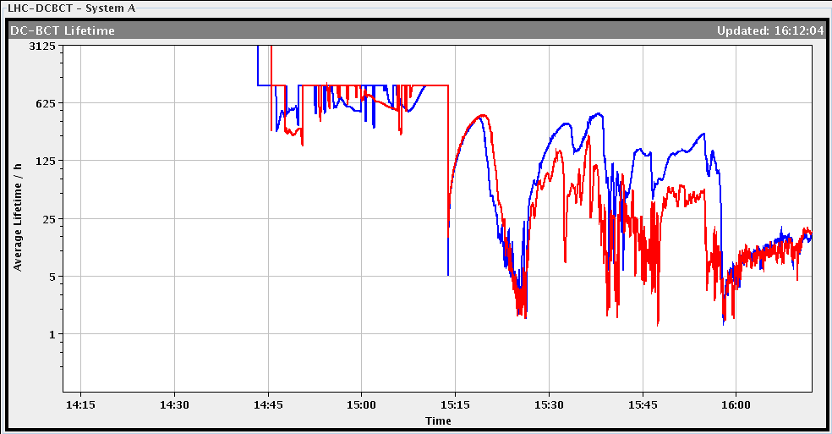
Lifetime and longitudinal bunch length
squeeze

Slide 16
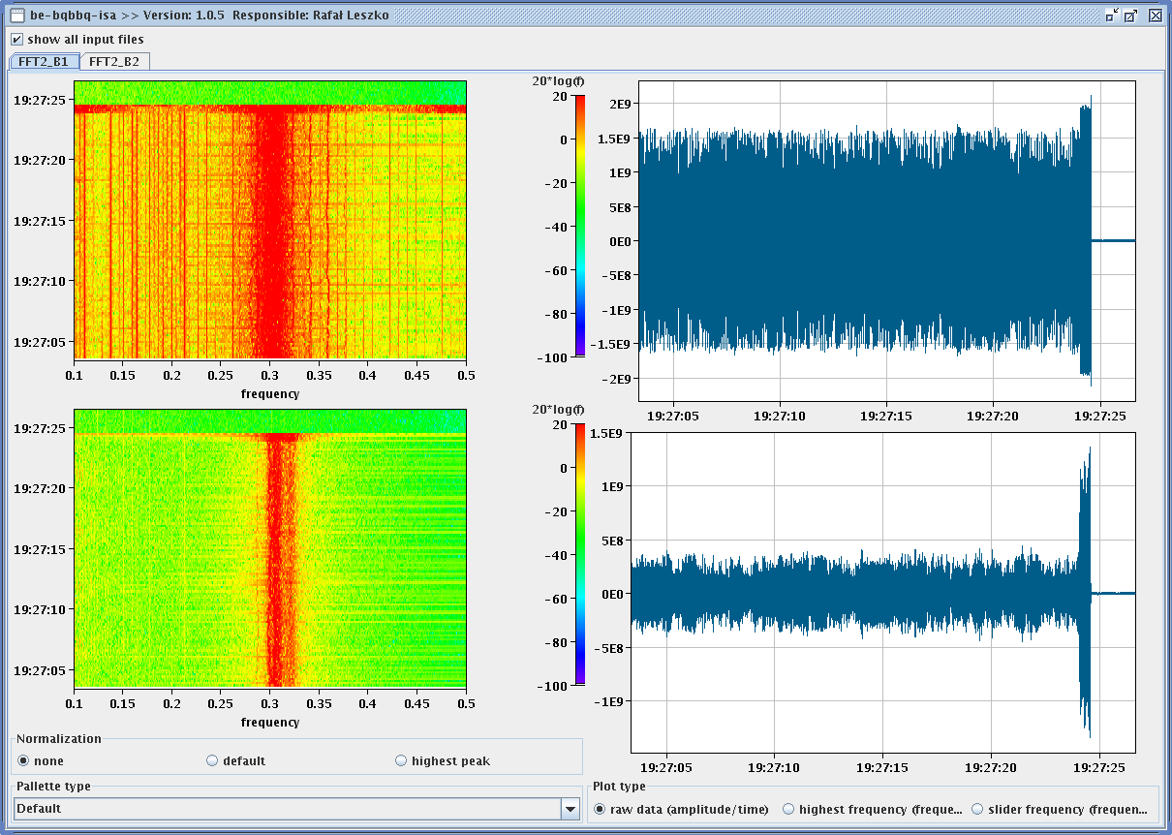
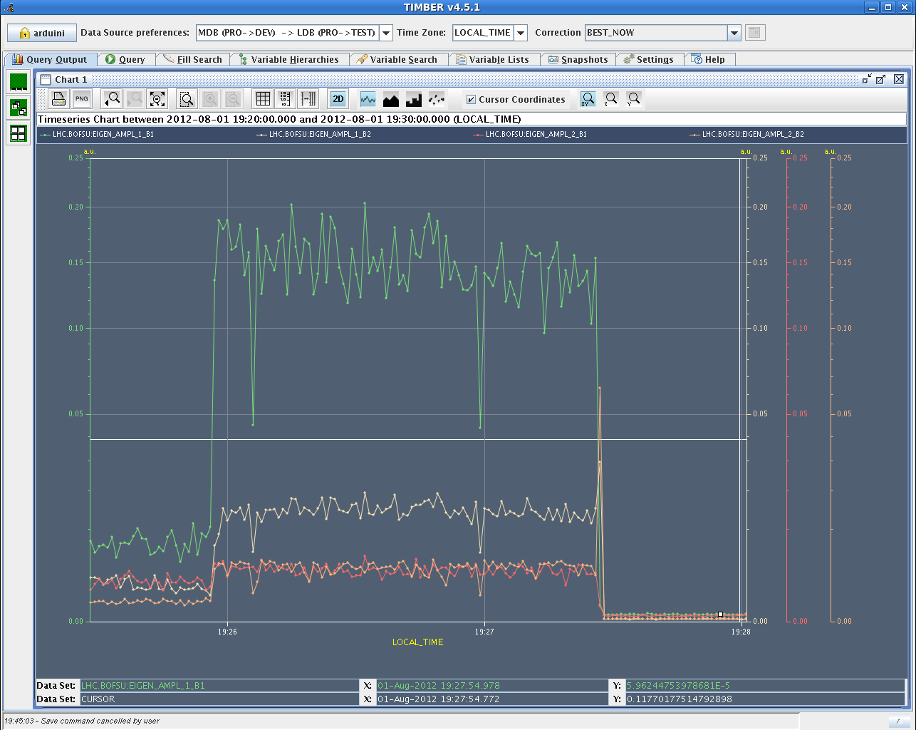
Evening
19:27 beam dump: Beam instability, mostly losses on beam 2
All bunches both beams oscillating
20:20 re-injection: problems with ADT B2 H: “very high error rate on the gigabit link between the beam position and one of the signal processing units”

Slide 17
B2, fill 2900, ADT H bunch positions – from Benoit

Slide 18
B1, fill 2900, ADT H bunch positions – from Benoit

Slide 19
Night
23:32 stable beams fill 2902
~1.50 ppb
Initial L ~6E33 cm-2s-1
Varia:
MKI B2 temperature interlock level reached
The values for the separation in CMS should be incorporated to avoid being too much off
ATLAS had to switch off for nearly 90min during the fill, which explains the difference in integrated luminosity during this fill. → ATLAS needs some warning before the beam dump to call an expert and fix the problem.
Next Fill:
try scraping with collimators at the end of injection
Reduce octupole currents for B2 from -509A to -475A (to the same values as B1)
Reduce H B1 ADT gain (to the same value as H B2)

