Slide 1
LHC progress
Week 30 summary 30th July 2012
Coordination: Mike Lamont & Bernard Holzer

Slide 2
Overview

Slide 3
Week 30
Fill | End | Stable | Peak | Int fb-1 | Dump
2872 | Mon 10:20 | 15h5m | 5.58 | 166 | OP
2873 | Tues 10:15 | 12h0m | 5.83 | 151 | OP
2875 | Wed 09:10 | 15h24m | 5.72 | 172 | OP
2880 | Thu 13:21 | 9h17m | 5.49 | 118 | Triplet R1 – QPS SEU (tbc)
2882 | Thu 21:50 | 30m | 5.7 | 9 | Trip of LHC dipole
2883 | Fri 01:50 | 4m | 2.6 | 0.3 | Beam loss B1
2884 | Fri 14:11 | 9h40m | 5.42 | 119 | OP
2886 | Sat 03:00 | 3h43m | 5.65 | 61 | Collimation communication
2887 | Sat 10:30 | 4h47m | 5.88 | 76 | Network controller – point 5 collimators – access system
2888 | Sun 08:30 | 15h48m | 6.08 | 182 | OP
2891 | Mon 00:23 | 6h9m | 6.13 | 98 | Spurious switch opening RQF.A12
2892 | Ongoing |  | 6.17

Slide 4
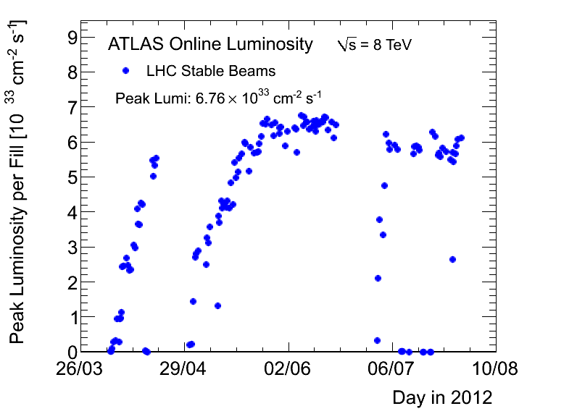
Luminosity

Slide 5
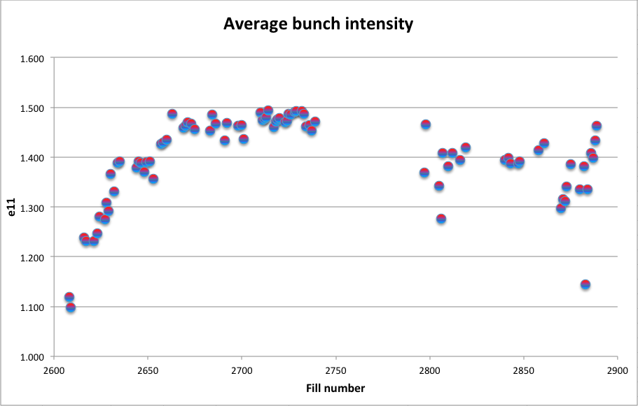

Slide 6
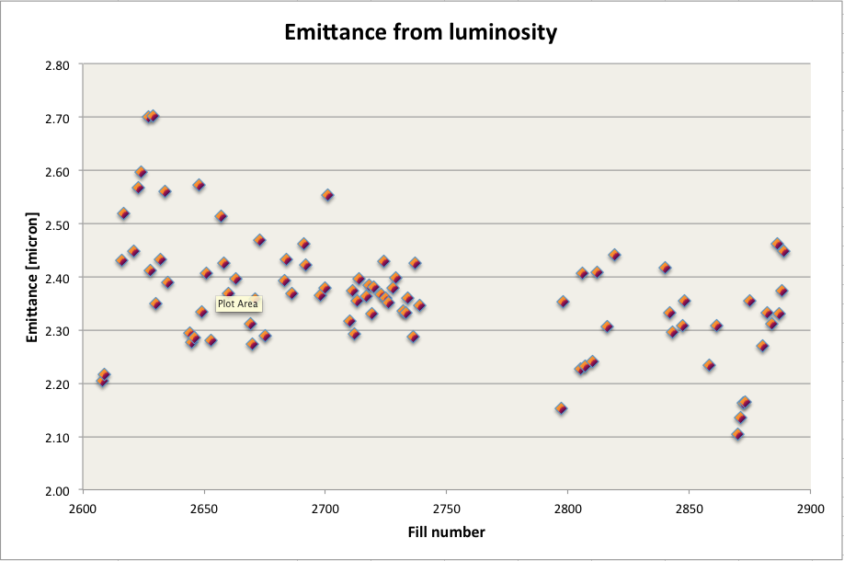

Slide 7
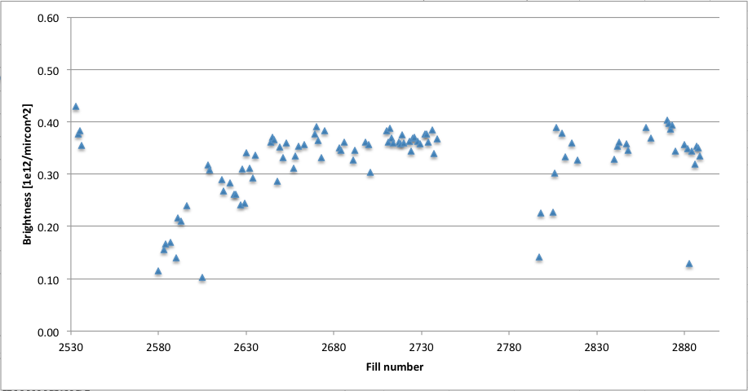
Brightness

Slide 8
Timeouts
Monday | 11:15 Access for fire brigade ... electrical problem in water cooling pump 18:40 restart
Tuesday | ADT gain calibration at 450 GeV
Wednesday | AM Morning: switch LHCb polarity and test ramp 14:00 access - various 16:00 restart, precycle ... trip of RQ10.R8 (converter fault) Restart 20:25
Thursday | Access for cryogenics valve at D4L5 on the DSL line for the main circuits of S45 (in shadow of triplet recovery) Injection optimization by Chiara and Wolfgang
Friday | 15:30 h=9 low emittance beam test 16:00 beam dump due to open access door 20:00 controls problem in PS 21:00 back to standard physics fill
Saturday | 10:06 beam dump: loss of network communication, access needed to reset switch 15:20 injection for physics
Sunday | Test ramps for chromaticity

Slide 9
Instabilities, beam loss etc.

Slide 10
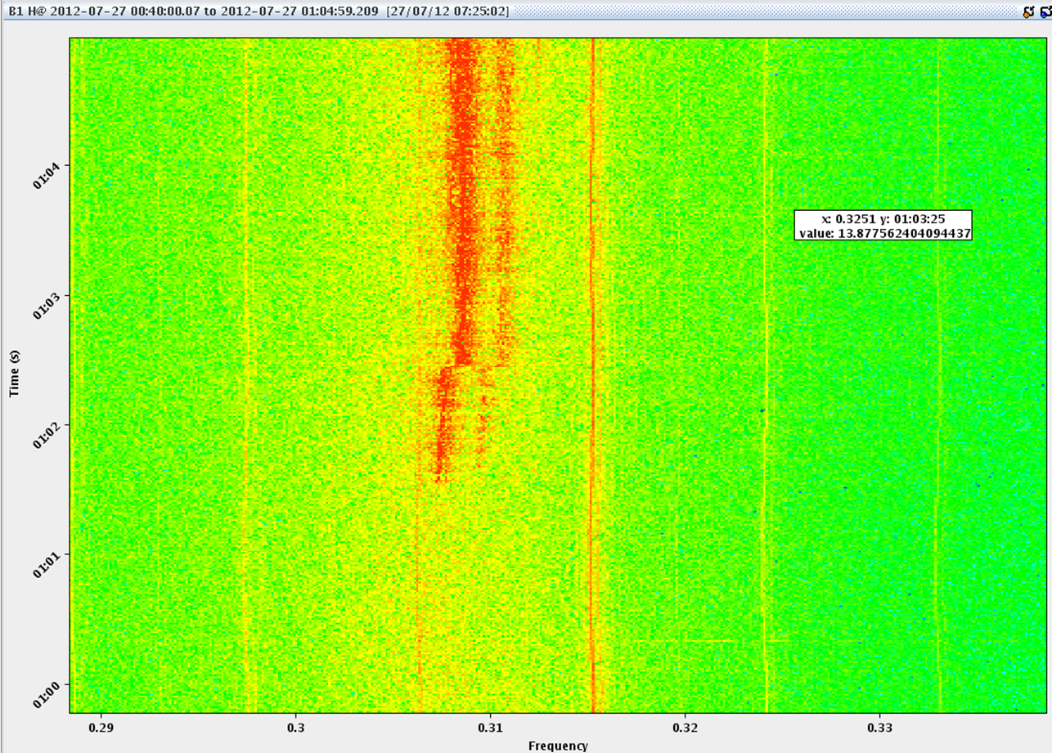
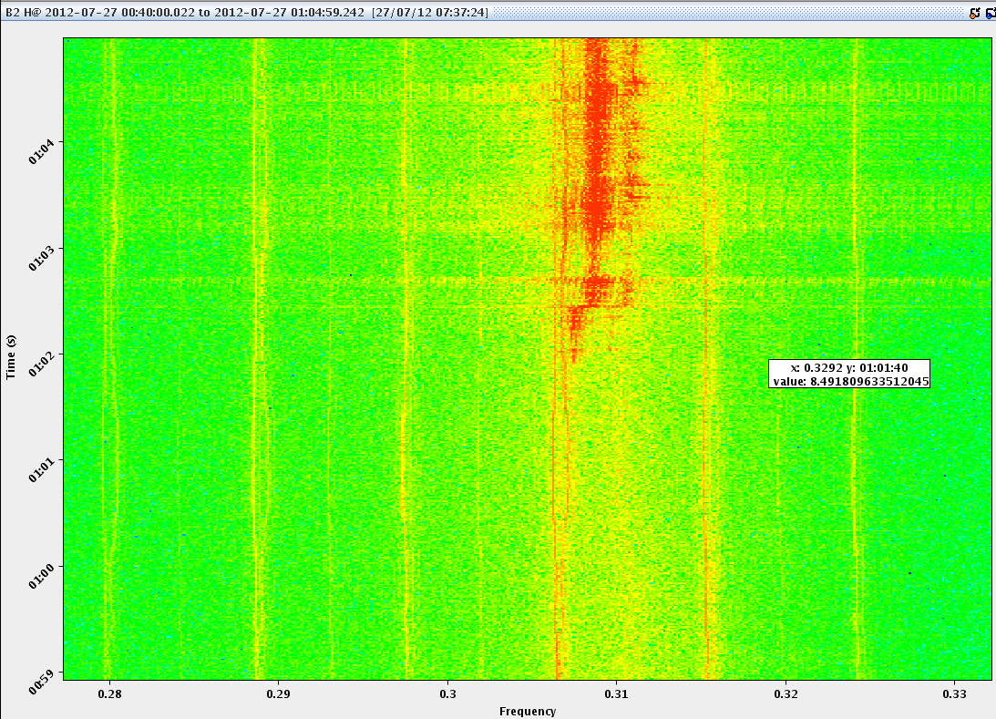
2883 – early Friday morning
Tune Shift
100 Hz
100 Hz
Activity kicks off on beam 1 – end of squeeze
Sustained beam loss both beams – finally dumping on collimator temperature interlock
QH B1 low – on or near 100 Hz

Slide 11
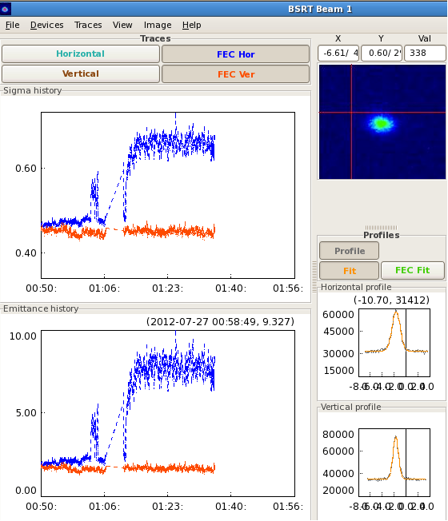
Associated beam size increase
Federico Roncarolo

Slide 12
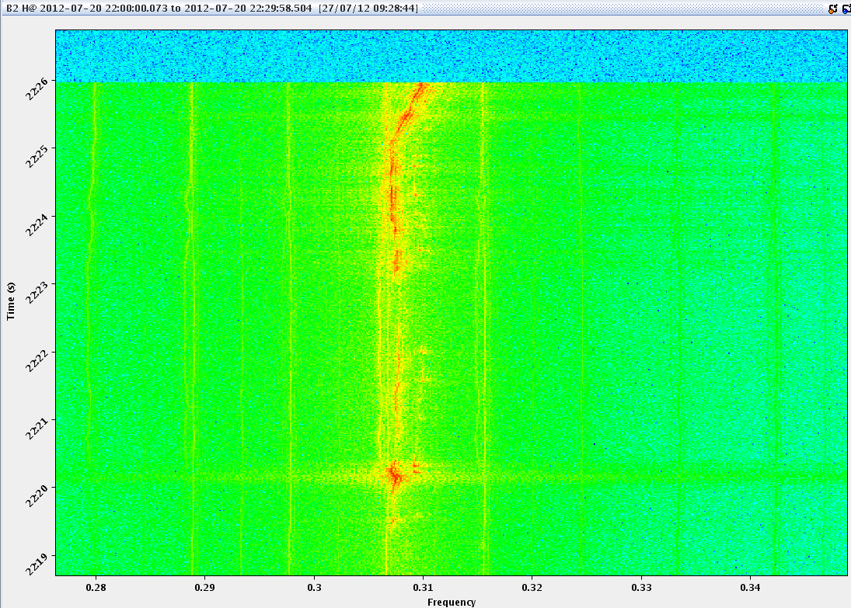
2859 – end squeeze
Stepping back a little over a week…

Slide 13
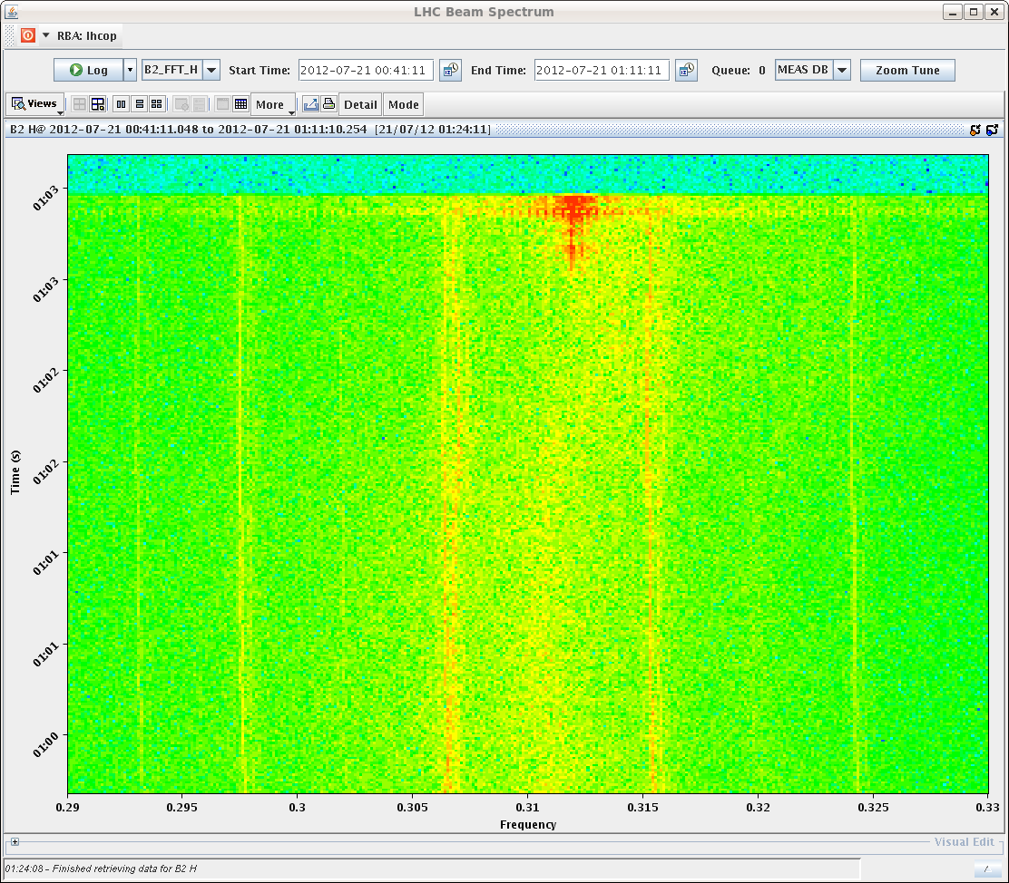
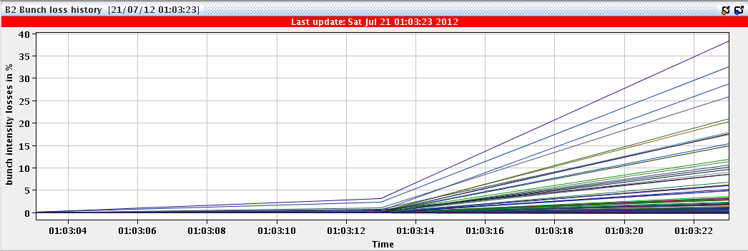
2860 – collision beam process
Instability B1H – losses on B2
Faster (~ 25 s)

Slide 14
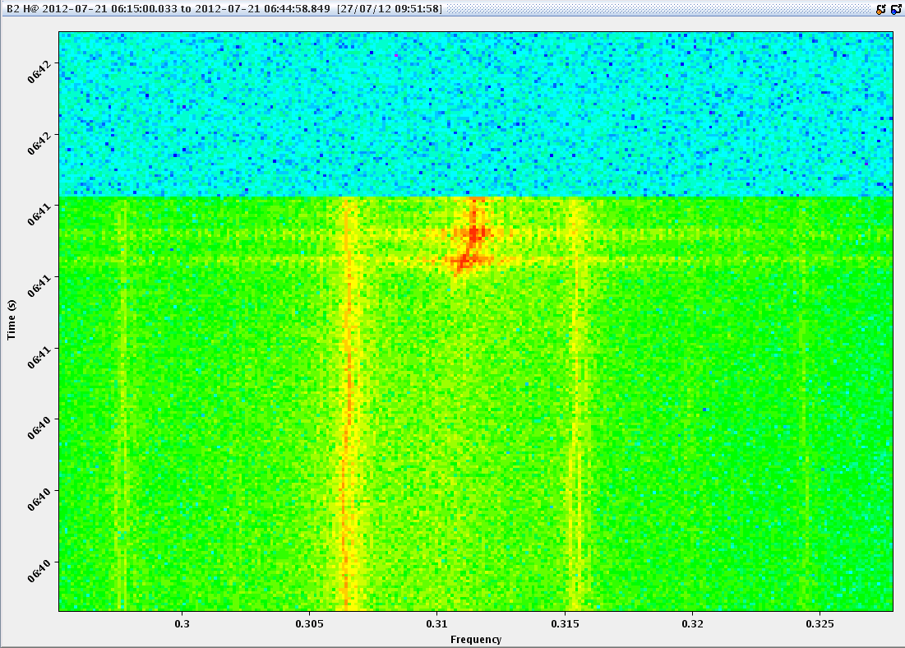
2862 – collision beam process
Similar…
Instability B2H & B1H
Haven’t seen this since

Slide 15
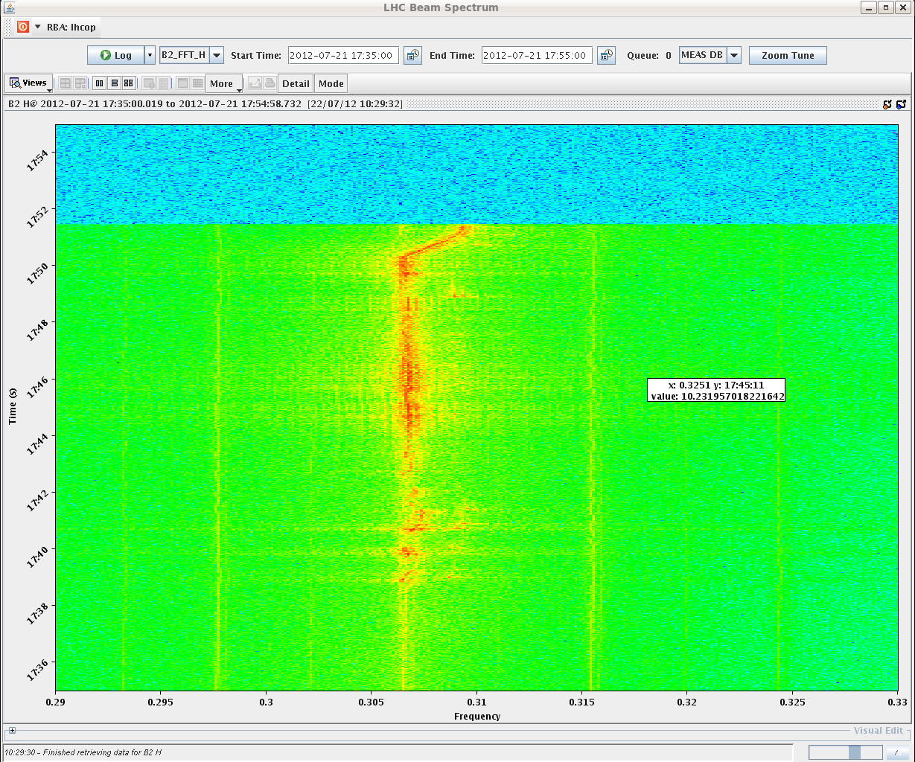
2866 – B2H end squeeze
100 Hz

Slide 16
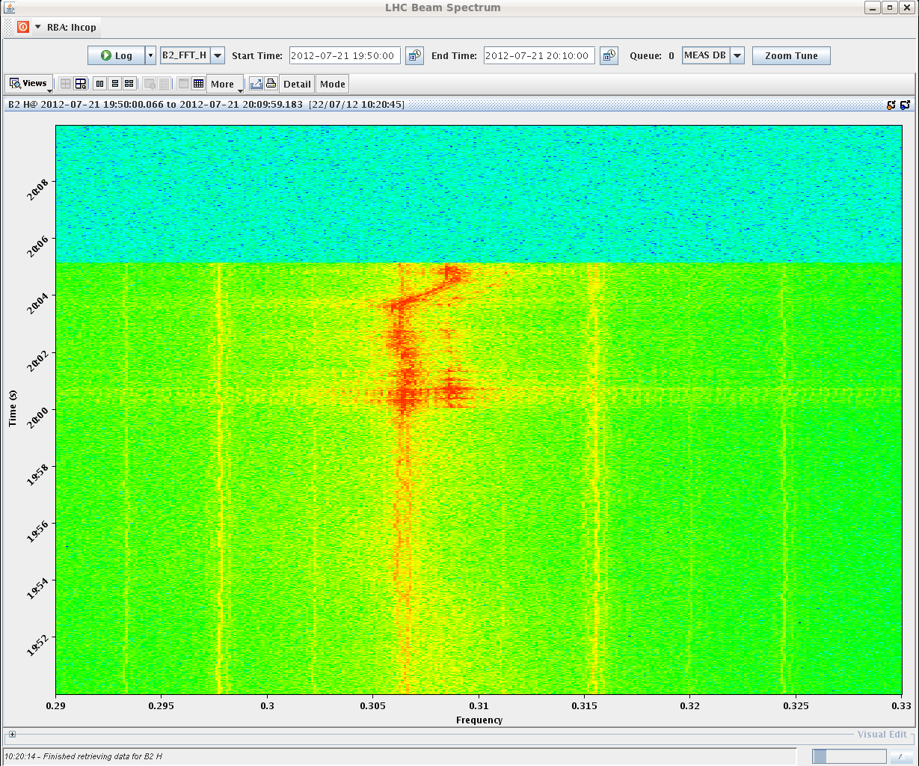
2867 – B2H end squeeze
100 Hz
Now taking a lot of care not to put the tune on 0.3068 (3450 Hz)

Slide 17
Tunes@ injection&ramp
0.28 = 3149 Hz
Up to now take a lot of care to keep horizontal tunes on this value (QFB)
Yesterday moved QHB2 to 0.282 at injection & ramp…
Sample size = 2:
Reduced losses at end ramp (perhaps)
Not reflected in BSRT fast scan…

Slide 18
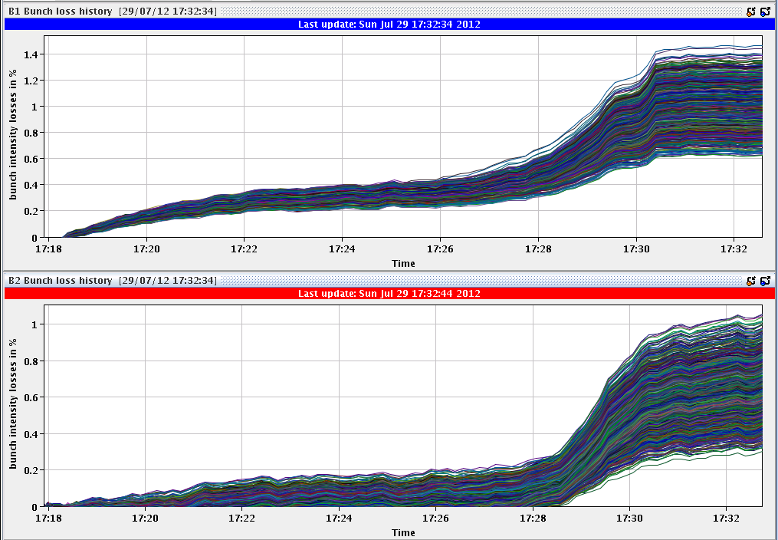
2891 – end ramp

Slide 19
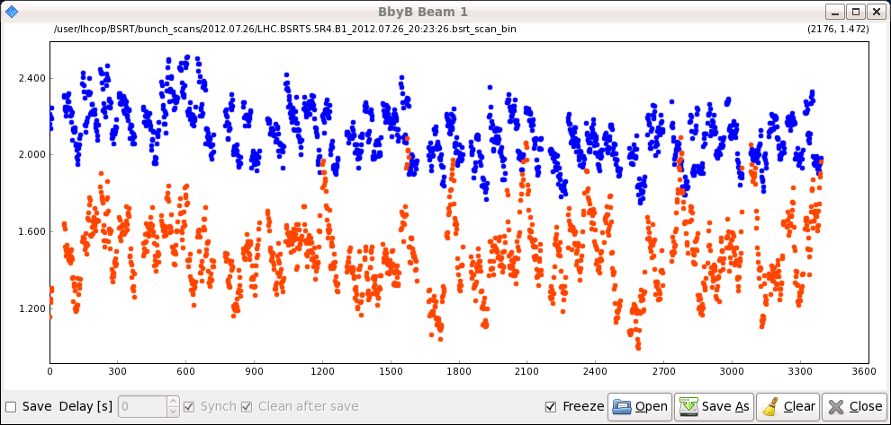
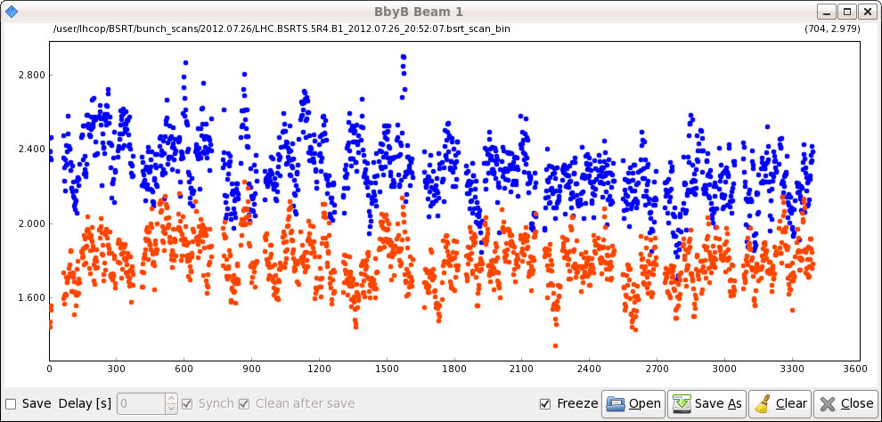
BSRT beam 1

Slide 20
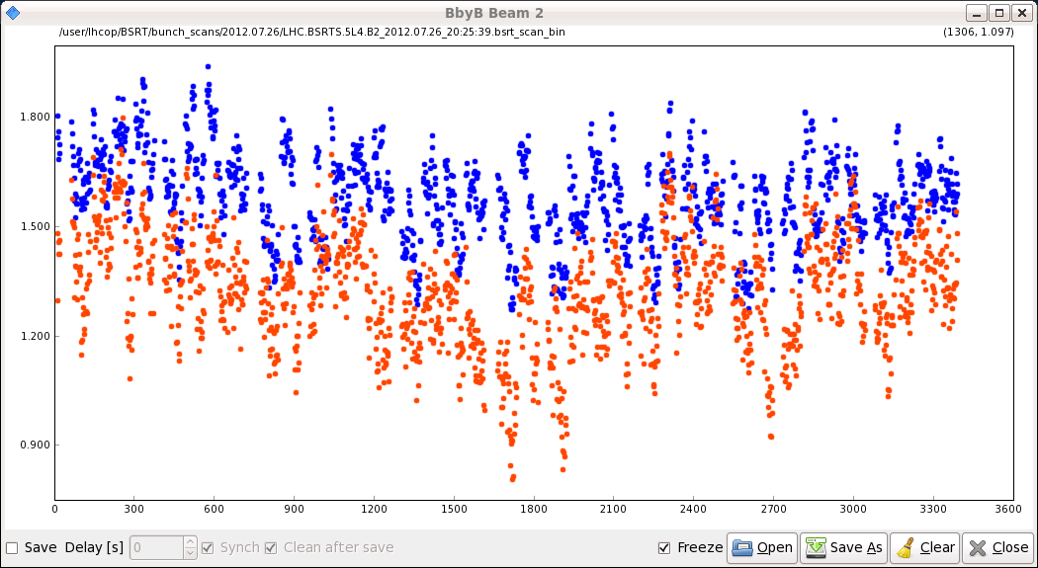
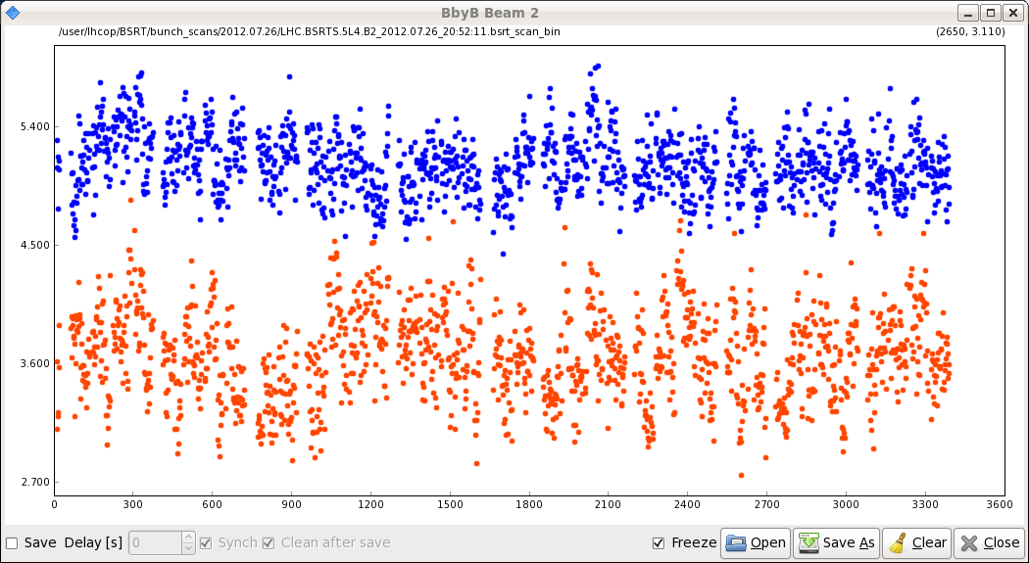
BSRT Beam 2

Slide 21
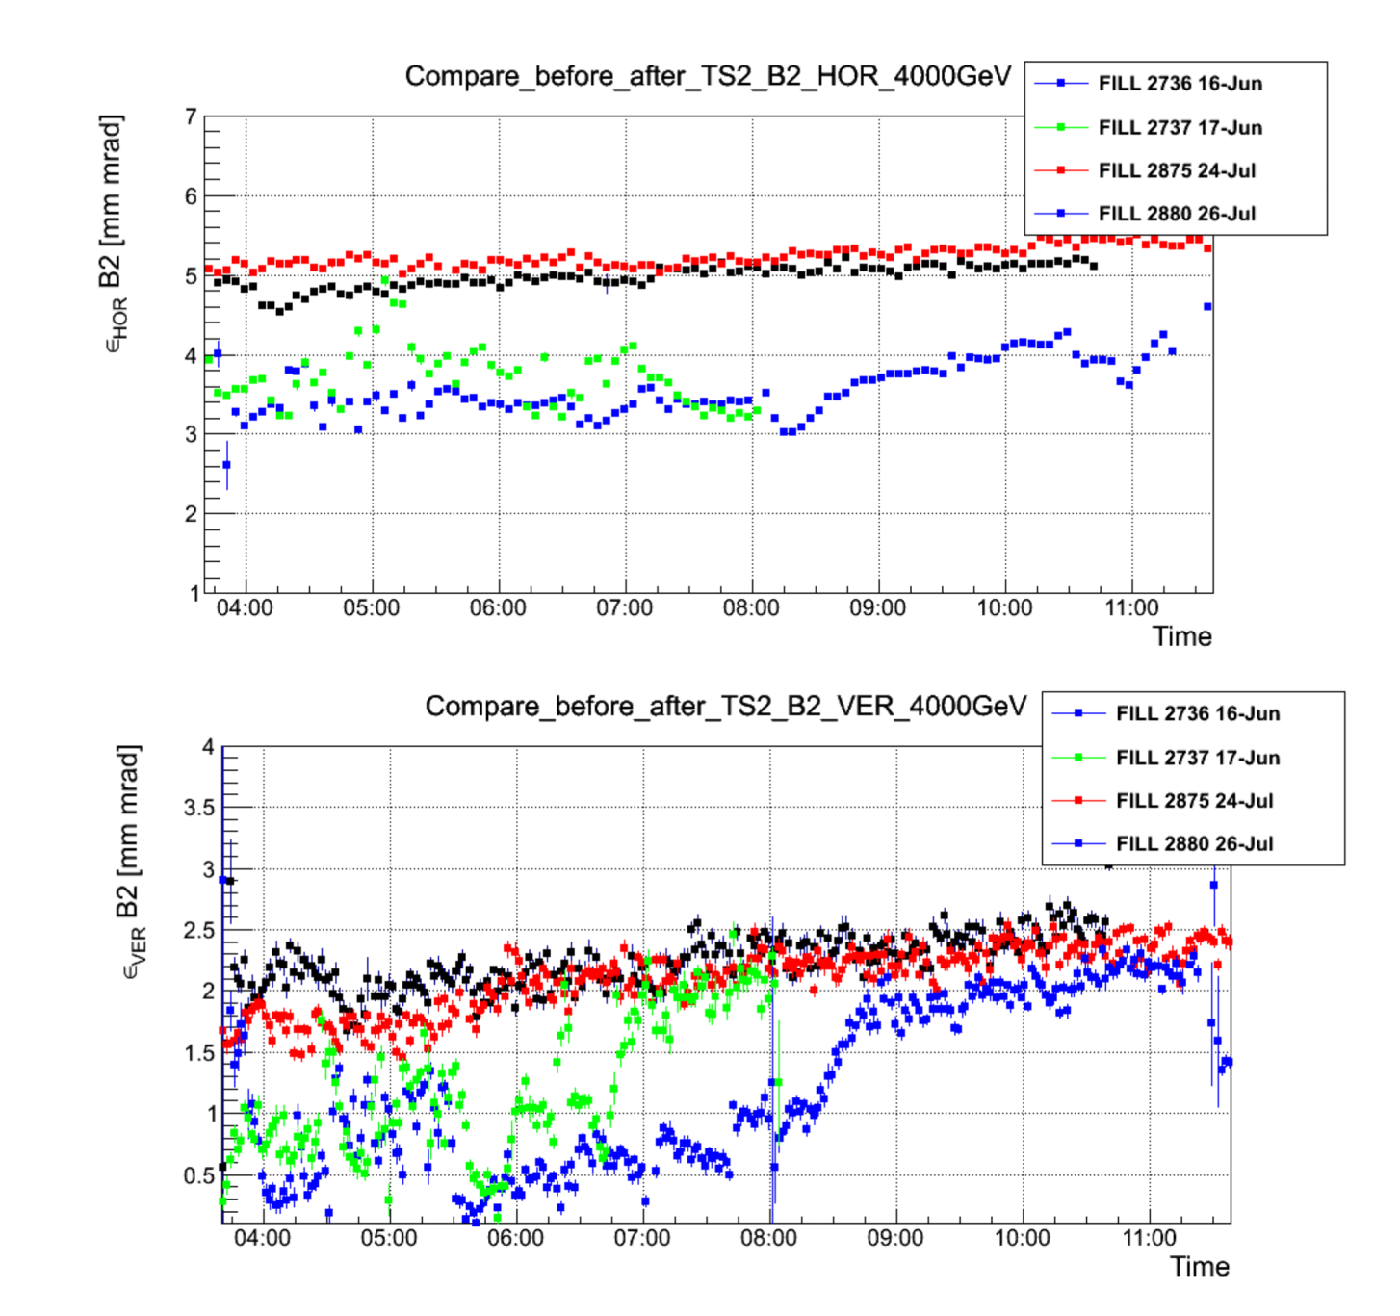
Beam sizes before/after TS
B2 H and V seems to have changed, even though the BSRT meas. are biased by a larger noise
Federico Roncarolo

Slide 22
50 Hz
Not instrumentation – not there without beam – seen in all 3 BBQ
Horizontal plane – both beams
Limited number of sources – narrow line, no sidebands
Probably dipole field, don’t see it on the tune…

Slide 23
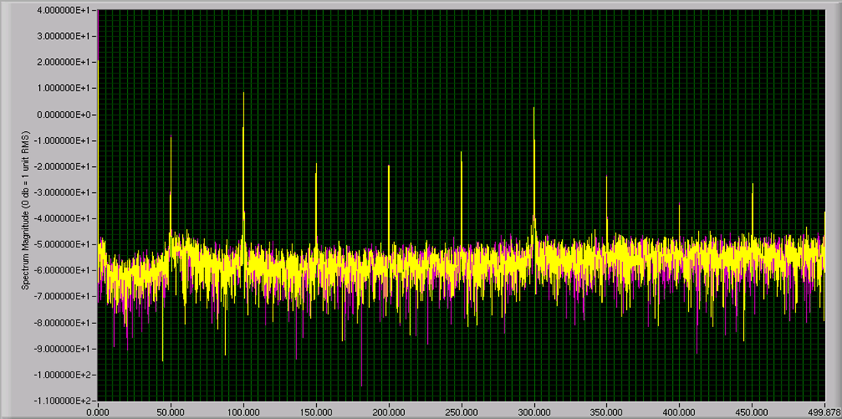
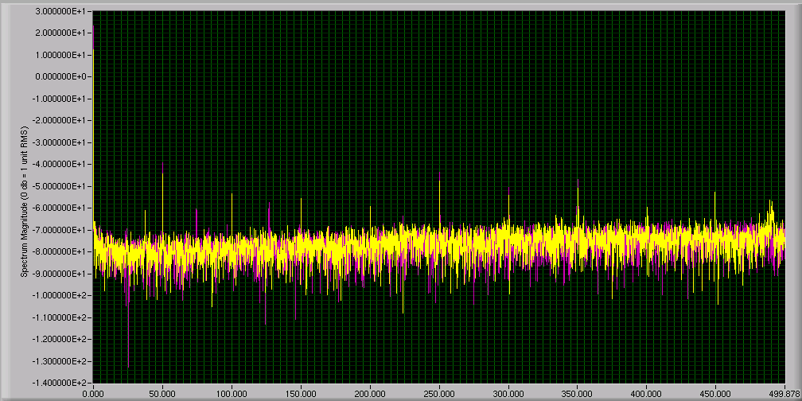
RB.A34
ALICE SOLENOID
Plus a few others

Slide 24
Summary
Ramp, squeeze and collide looking smoother
As always if there are losses, it’s B2
Usual lifetime dip at the moment of collisions
B2 down to 1 hour, 5-6% beam loss – tunes?
Emittances from luminosity look a little large
B2 between 450 GeV and collisions?
Chromaticity measurement to be analyzed

Slide 25
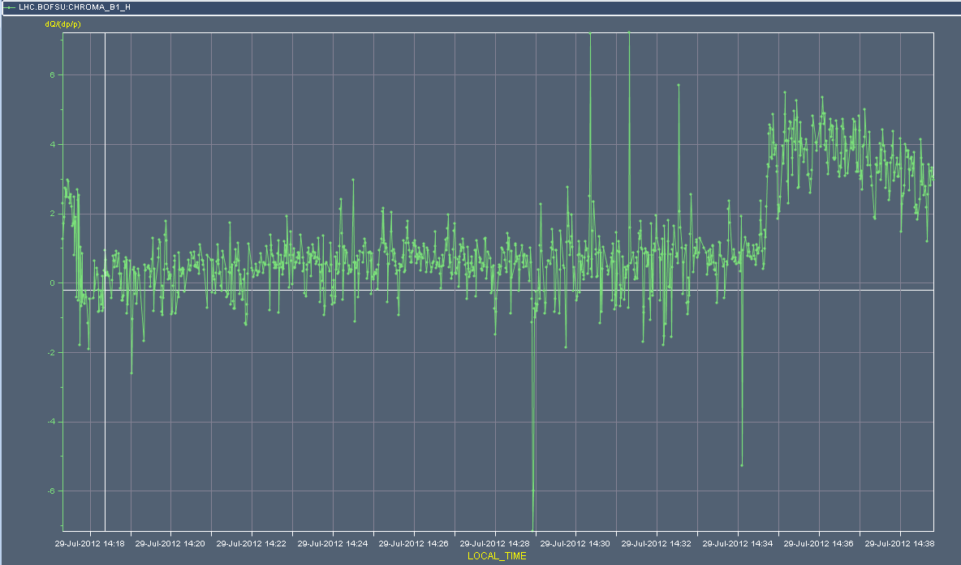
Q’H B1

Slide 26
Changes
Longitudinal blow-up
Programmed bunch length increased from 1.2 to 1.3 ns
Transverse feedback
Gain calibration
B2H gain reduced during squeeze by 25%
Injection and ramp B2H tune to 0.282
LHCb polarity
Injection sequence modification for Alice

Slide 27
OF NOTE

Slide 28
Summary of the ADT Gain renormalization
The calibration constants which were used in the system until today date from 2010. As the tetrodes in the power amplifiers are ageing and being replaced, and the Beam Position Readings change with the beam intensity settings variations have occurred since.
Since the last technical stop in June 2012 all power systems are populated with new tubes and back to nominal power gain.
From the measurements we have programmed new calibration factors today:
HB1 old 9213 new 10000
VB1 old 8804 new 9199
HB2 old 11466 new 7942
VB2 old 6197 new 5167
The effective gain of the Horizontal Beam 2 system was therefore lowered by 31% and it should be now consistent again with the "normalized gain" knob.
Wolfgang Hofle, Daniel Valuch

Slide 29
RF phase noise – CCC diagnostic
Plus accompanying tutorial
Thanks to Fabian Follin, Michael Jaussi, Themistoklis Mastoridis

Slide 30
32 bunch h=9 test
Attempt dogged by unrelated problems
But previous emittances of 1 micron with 1.2e11 ppb on flat top of SPS could not be re-established
Indications that problem also effects nominal 50 ns beam
PS/TT10 matching a suspect (Karel)
Might also been there already at injection in PS
Could explain decreased brightness

Slide 31
Incoming
Gianluigi & Barbara
VIP this afternoon – dump beams ~14:30..
Octupoles…
h=9

Slide 33
In our midst…
We have a multi-talented, intelligent, good natured, humble, hard working physicist.
Over the years he has made a profound contribution to the success of the LHC and many other projects.
He has nurtured a generation of students, fellows and young physicists with good humour and empathy.
As a founding member of the LHC coordination team he’s been in the thick of over the last few years and it’s been a real pleasure working with him..

Slide 34
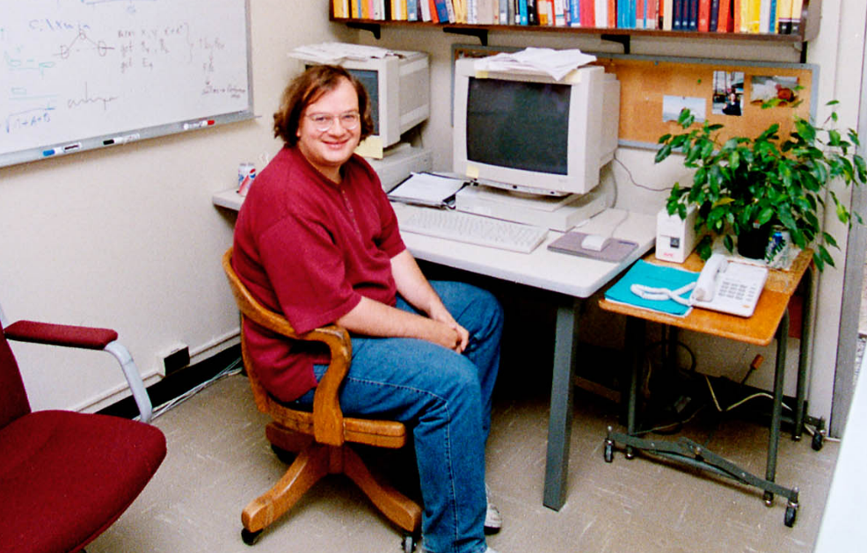
This man is…

