Slide 1
Friday 20.7.2012
During the night from Thursday to Friday: by mistake, SPS longitudinal blow-up was not active
→ Smaller transverse emittance from the SPS
Blow-up necessary for longitudinal stability
06:40 – 20:20 Stable beams fill 2858
Average bunch intensity at injection ~1.44e11
Almost no losses during squeeze, less than 1% for B2.
2% bunch losses during adjust, ~ same for B1 and B2
Initial L ~6.2E33 cm-2s-1, highest lumi since last TS.
13:35 hours in stable beams
Integrated lumi: ~176 pb-1
LHC Emittances144 bunches: B1H = 1.59 B1V = 1.49 B2H = 1.66 B2V = 1.96

Slide 2
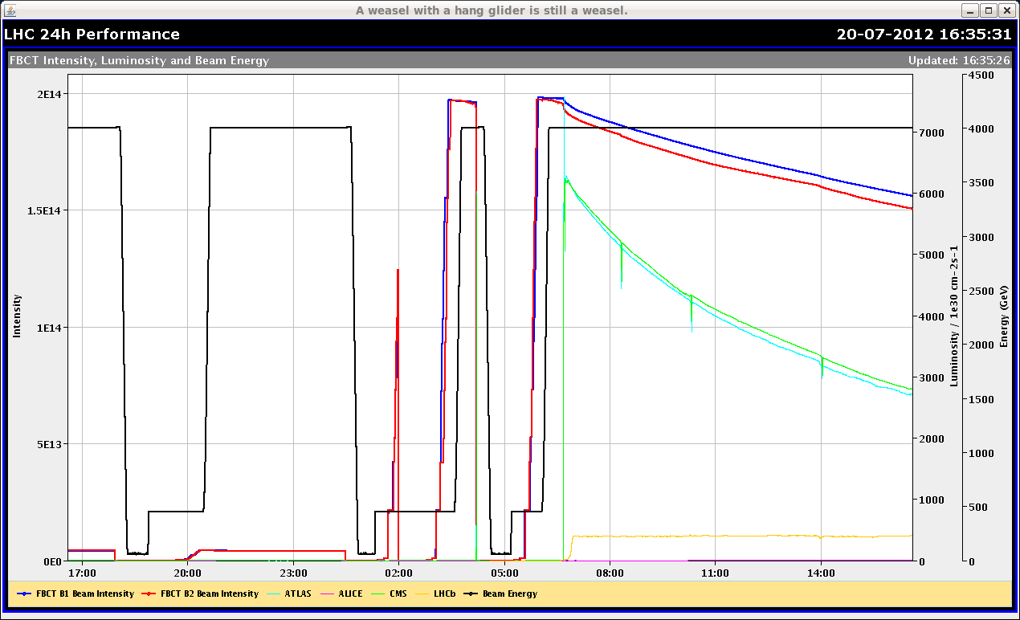
Bunch length B2
14:00

Slide 3
Friday Evening
Fill 2859:
SPS longitudinal blow-up switched back on – but not to full strength.
Average bunch intensity at injection ~1.48e11
Emittances
B1H = 1.59
B1V = 1.83
B2H = n.a.
B2V = 1.95
Squeeze: losses up to 30% of BLM thresholds
22:25 Dump at the beginning of Adjust due to high losses B2
BLM: 20.9s RS TCTH.4R5.B2

Slide 4
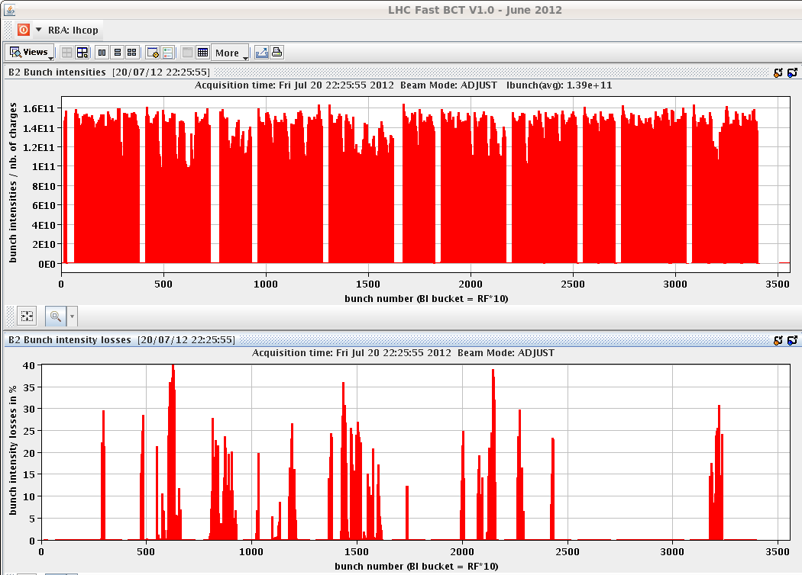
Bunch intensity losses

Slide 5
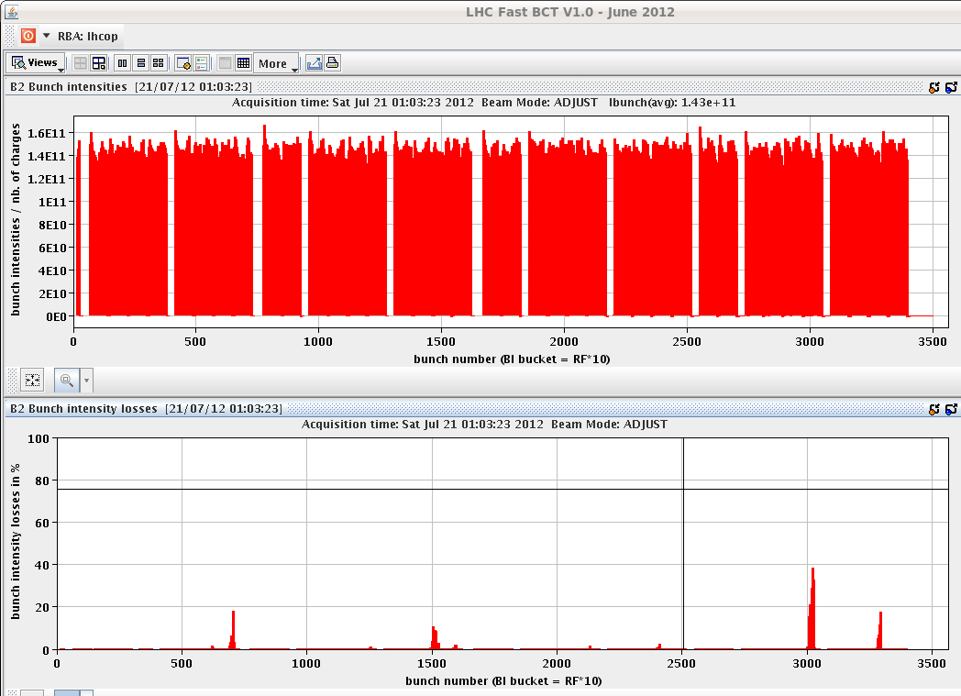
Night
Fill 2860:
Emittances B1H = 1.86 B1V = 1.82 B2H = 1.68 B2V = 1.72
1:06 Dump at the beginning of Adjust due to B2 losses – up to 40% of bunch intenisity on idividual bunches
Average bunch intensity at injection ~1.45e11

Slide 6
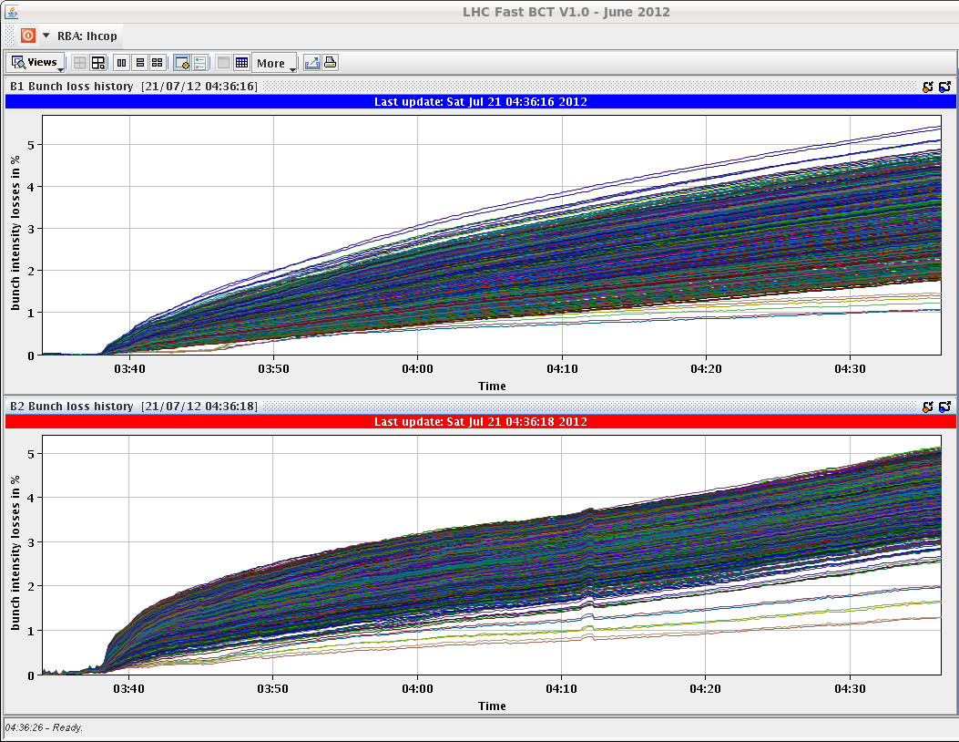
Saturday
3:39 Fill 2861 stable beams
Average bunch intensity at injection ~1.45e11
No losses in squeeze and Adjust
Initial L ~6.2E33 cm-2s-1
4:36 Dump: “Looks like a self triggering of BLM at point 7: there are no losses and the PM is indicating BLM_UNM@7”
00:57 hours in stable beams
Integrated lumi: ~19 pb-1

Slide 7
Fill 2862
Emittances B1H = 1.66 B1V = 1.51 B2H = 1.62 B2V = 1.92
6:41 Dump at the beginning of Adjust on losses at the TCTH.4R5.B2 (third fill this night). Again, it looks like beam instability.

