Slide 1
Thursday morning
08:45 Stable beams fill 2855 for ATLAS/CMS VdMs.
Scans the whole day long…
18:00 Beam dumped by SIS – beam position in TCSG6.
Probably systematic issues after a long fill.

Slide 2
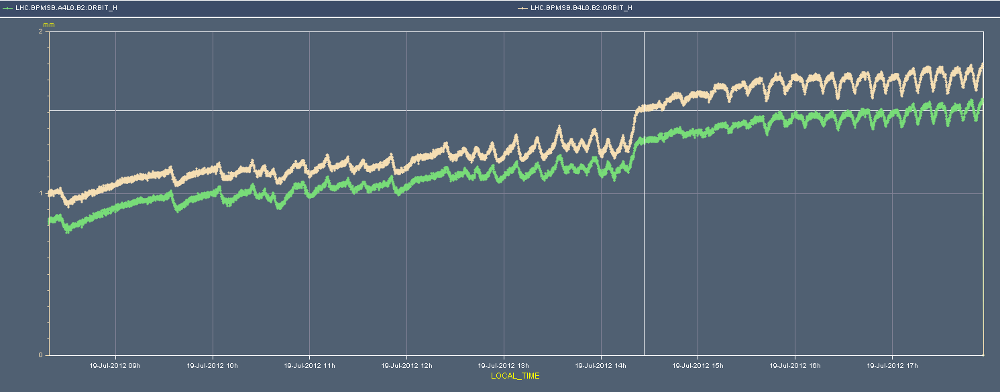
SIS dump
Large drift + kink at ~14:20. Structure from VdM scans (leakage)? TBC
Threshold of 0.96 mm (wrt reference position).
0.8 mm

Slide 3
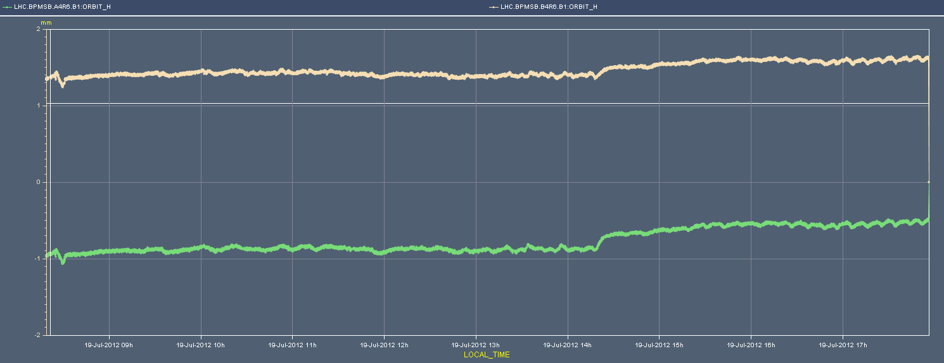
SIS dump
For B1 the drifts were much smaller…
Same ‘kink’ at ~14:20.
0.8 mm

Slide 4
Thursday evening
20:50 Stable beams fill 2856 for ATLAS/CMS VdMs.
Finish length scale calibration and repeat some scans.
00:30 End of last VdM fill.
Switching back to 50 ns.
Injecting 50 ns. SPS now scraping more in V.
Suggested by Verena’s SPS wire-scan analysis
02:00 Vac. valves closed around LHCb at 450 GeV. Sudden pressure spike.
Valves on left side triggered closure due to lower thresholds. G. Lanza equalized the thresholds (upwards). Valves re-opened.

Slide 5
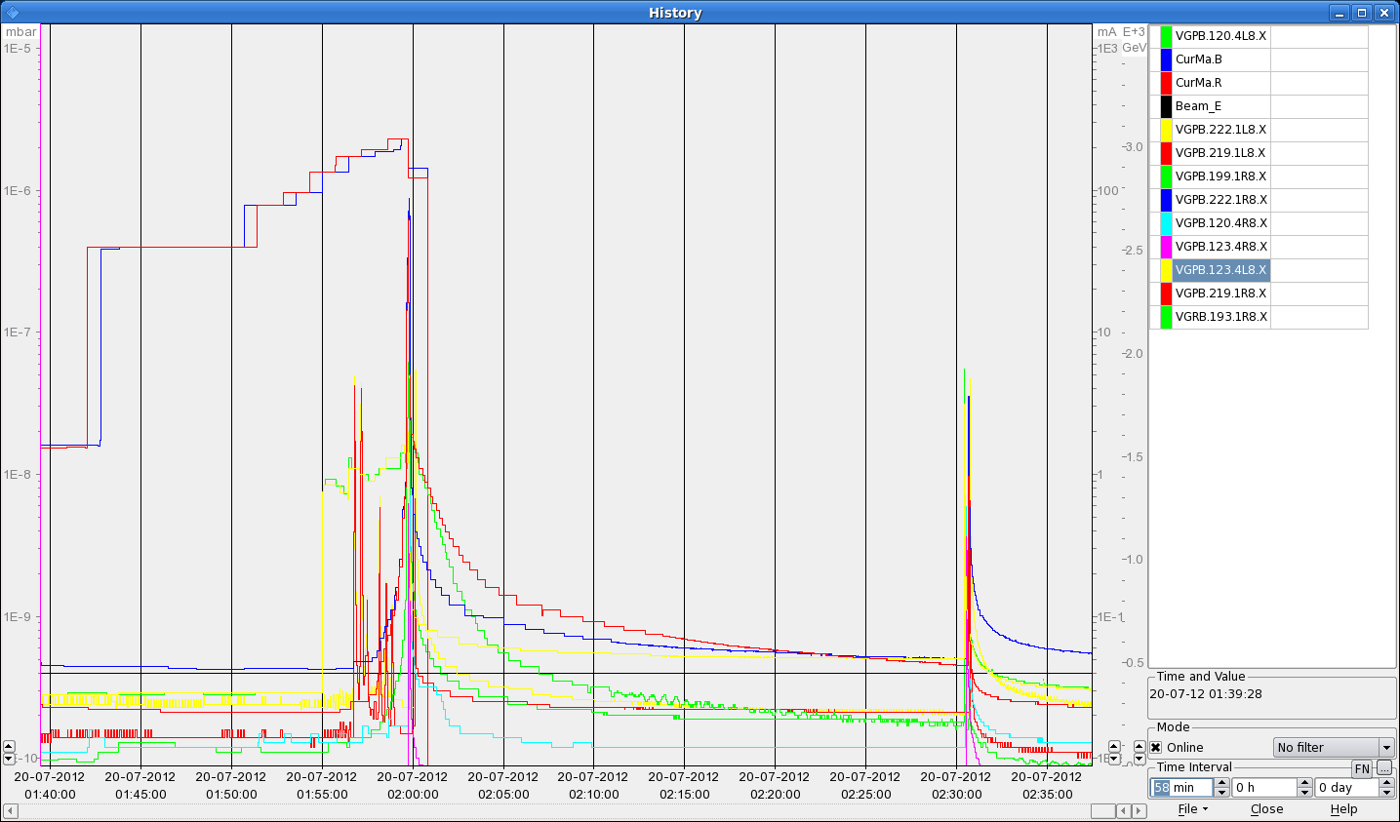

Slide 6
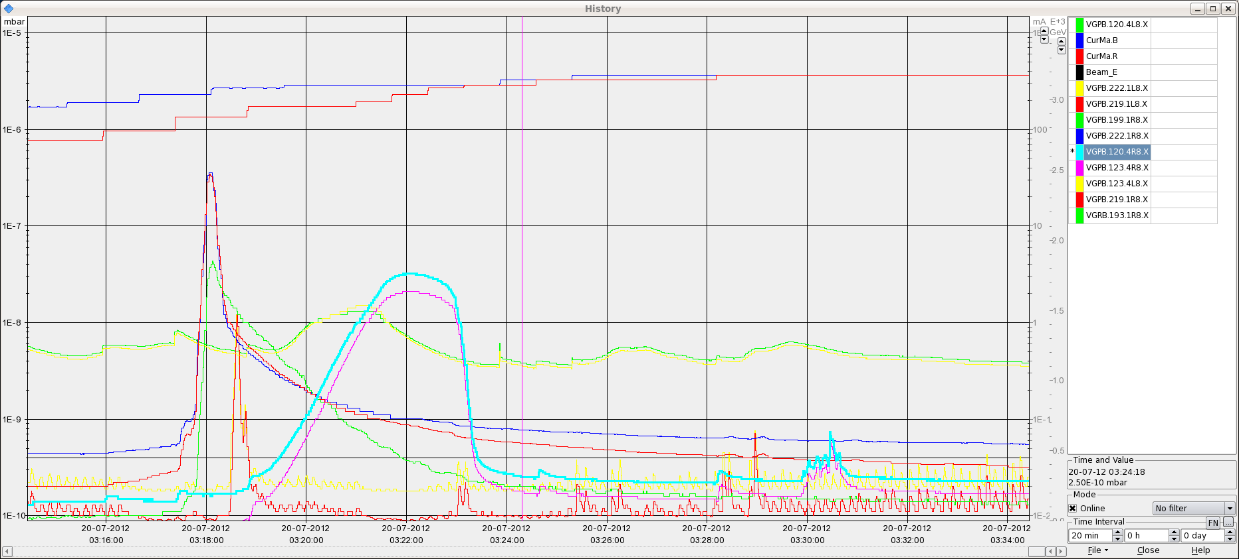
Night
Refilling –some vacuum activity in IR8.

Slide 7
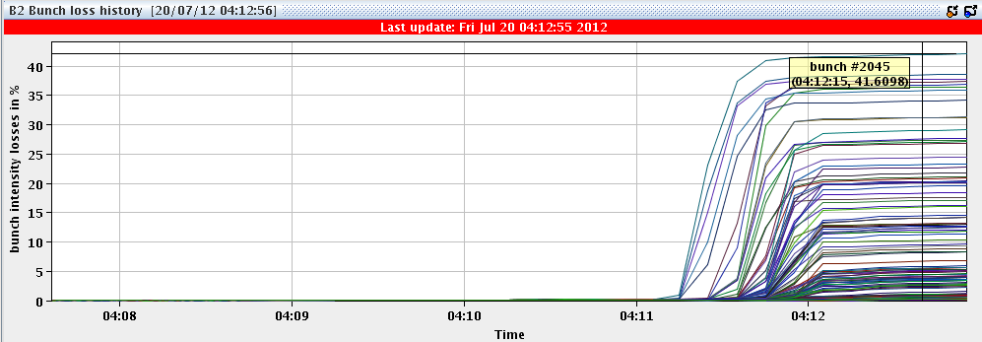
Night
Clean squeeze.
04:10 Colliding – but Q6.R7 trip just before declaring stable beams. Heavy losses on B2.
Reset OK.
05:20 Filling again.

Slide 8
Early morning
Almost no losses during squeeze, less than 1% for B2.
06:40 Stable beams fill 2858 – highest lumi since last TS.
2% bunch losses during adjust, ~ same for B1 and B2

Slide 9
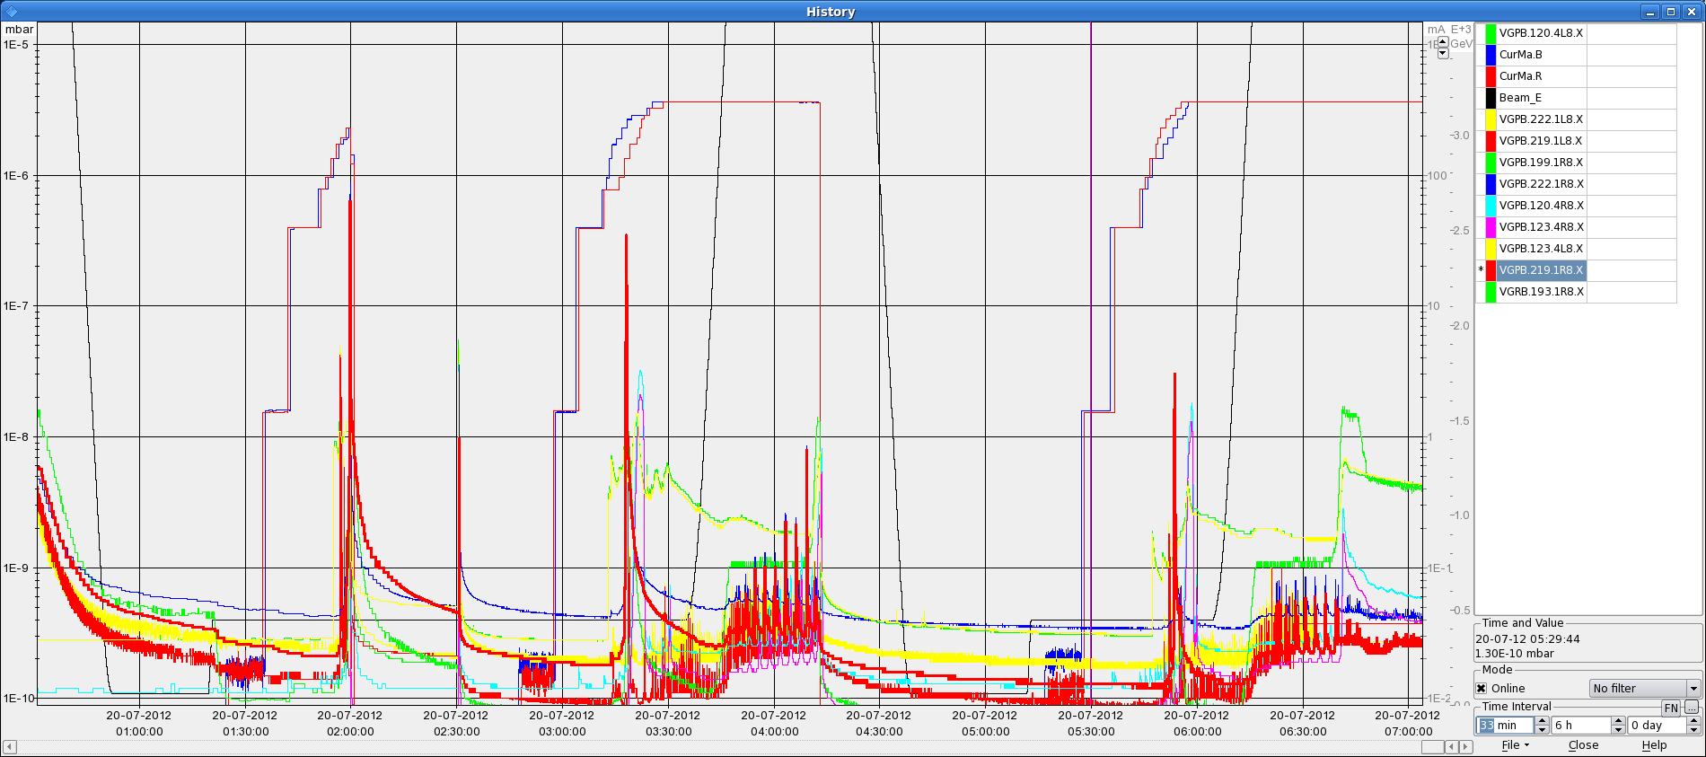
Vacuum history IR8 for last night

Slide 10
Today and weekend
Physics 50 ns.
Planned to insert test of beam scrapping by collimators (injection/flat top) when we fill at a convenient time (also WE)… but now the losses were low again !
Test of 2 step collision BP + inverted octupole polarity (Q’ check).
Access/interventions:
Hopefully transparent intervention on a UPS system at Pt5 (surface) – end of the morning.
Intervention needed for cryo P18?

