Slide 1
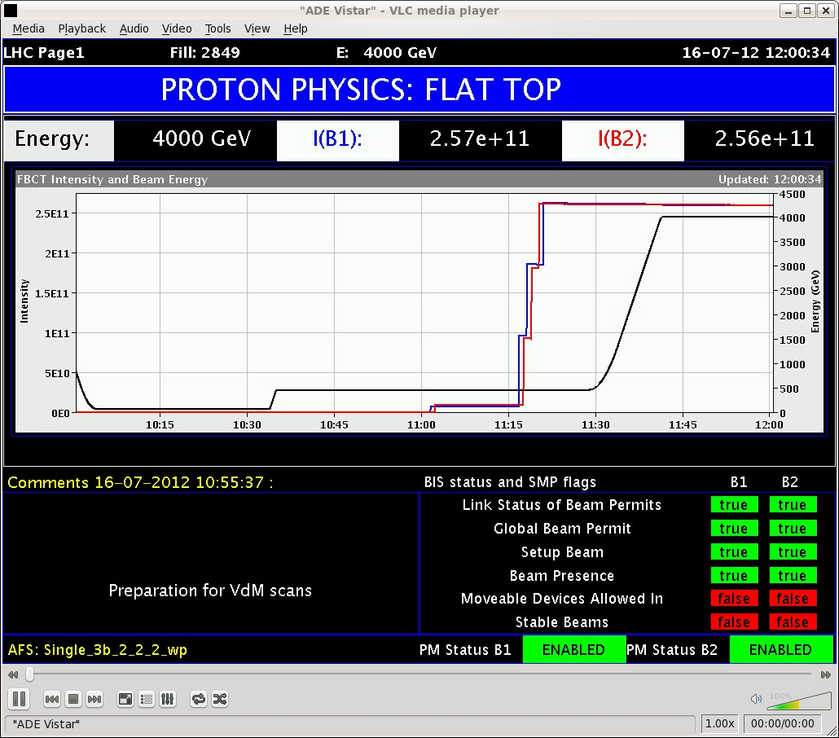
Monday morning
09:40 Dump fill 2838, integrated ~130 pb-1.
11:00 Injecting 1 probe +3 indiv bunches of 9E10 ppb.
Blow in PS-SPS line (TT10).
Emittances in the LHC 3-3.2 um.
11:40 At flat top, opening TCTs for first collisions in VdM configuration.
TCPs at 5.3 sigma.
No losses in ramp.

Slide 2
Monday afternoon
12:10 Colliding beams. Problem with the tune that did not change from injection to physics values.
We realized that in our collision sequence we do not drive the main /matching quadrupoles. Drove the quadrupoles some time later and adapted the sequence…
After orbit correction, we actually had some luminosity in each IP to bootstrap.
Easily optimized each IP in turn.
Define SIS interlock settings with margins for VdM.
13:40 TCT setup starting.
15:20 TCT alignment finished.

Slide 3
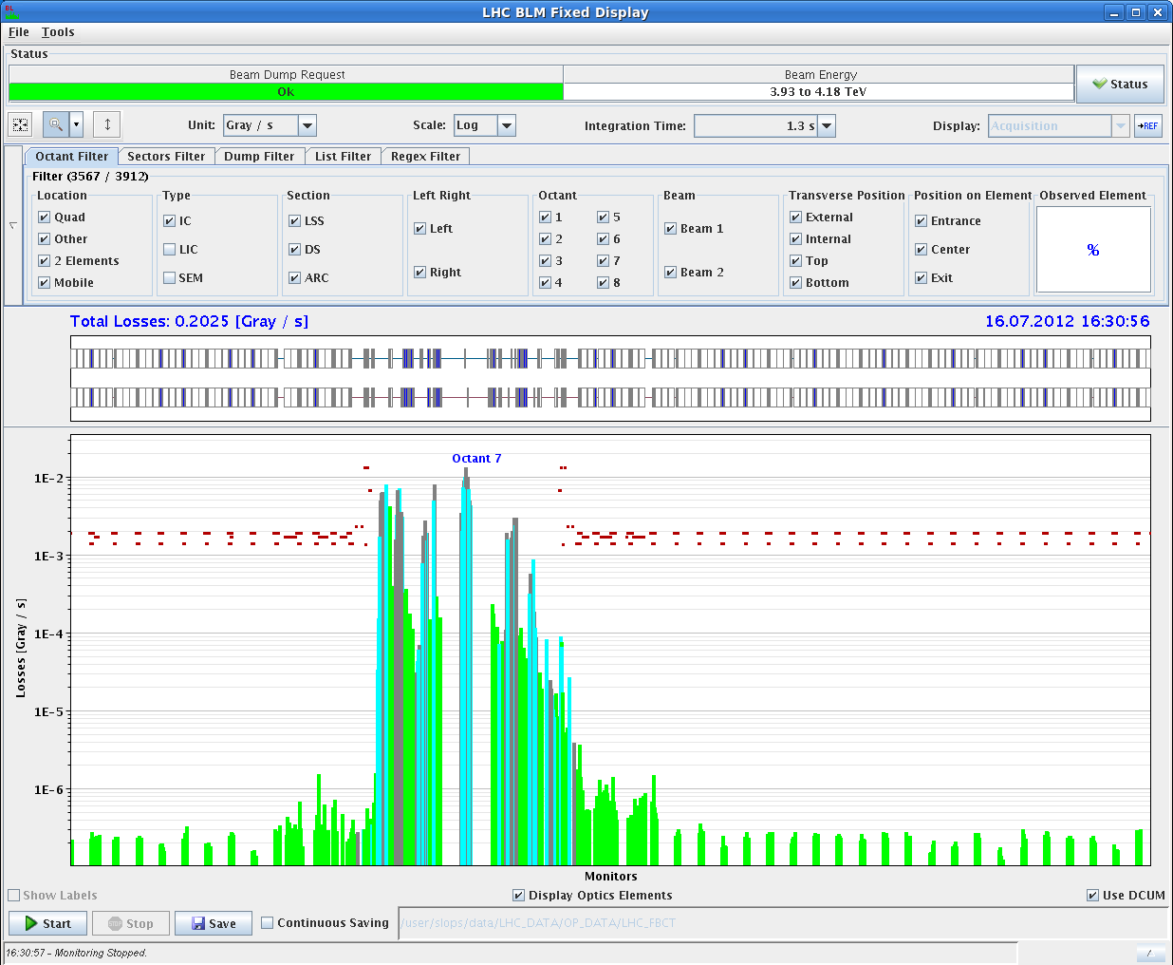
Monday afternoon
TCTs to 30 sigma (TCPs 5.3 sigma), beams re-separated with lumi-scan knobs to 4.5 sigma for ADT loss map.
In the meantime trip of RF module M2B1 (crowbar).
Loss maps.
Looking good, except B1V with in-correct hierarchy. But good cleaning.

Slide 4
Setup of collimators
The setup is declared sufficient for the VdM given that:
the cleaning is still very good (and we will have 40 times less intensity than the standard physics fills!);
the hierarchy issue occurs in the vertical plane;
the VdM scans will be done with bunches spaced by >= 1us;
the transverse emittance will be blown up to > 3 microns;
the single bunch intensity is about 9e10p;
the phase space coverage by the secondary collimators remains the same as in the nominal fills;
the IR6 collimators also remain at nominal settings;

Slide 5
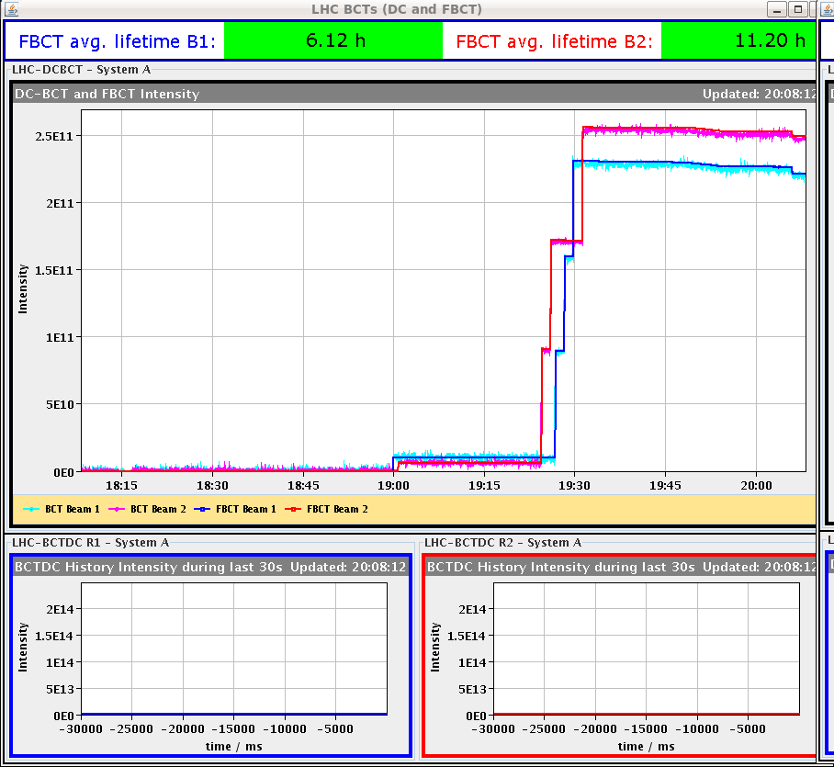
Monday Evening
17:30 Loss maps with beams in collision (using tune jump). Followed by off-momentum loss map dp/p +.
19:10 Refilling for loss maps.
20:10 Step loss at start of collisions due to orbit shift from tune change
Orbit feed-forward for next fill from offline analysis.

Slide 6
Monday evening / night
21:00 Another series of loss maps in collisions (betatron and off-momentum dp/p -).
22:10 Injecting for asynchronous beam dump test.
23:30 Asynchronous beam dump test.
Dump test OK (C. Bracco).
00:30 Injecting for VdM fill.
01:30 Again crowbar on RF module M2B1.
To be fixed during daytime asap – 3 hours.
03:50 Stable beams for VdM fill.
But I had forgotten to
adjust beta* limits – fixed.

Slide 7
Today
08:00 Beam dumped again by RF module M2B1 – RF arc detected.
ALICE VdM scans finished.
Today:
Access of ~3 hours for RF intervention.
VdM fill for ATLAS/CMS.
VdM fill LHCb.

