Slide 1
LHC Status Sat Morning 14-July
Bernhard Holzer, Jan Uythoven

Slide 2
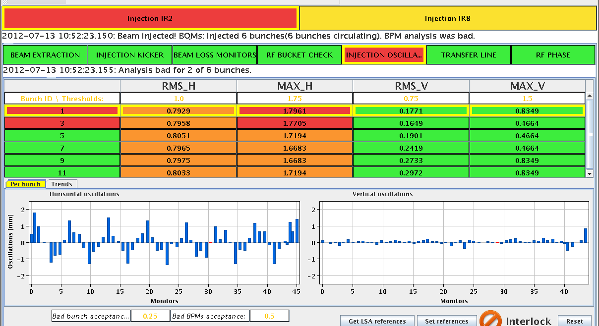
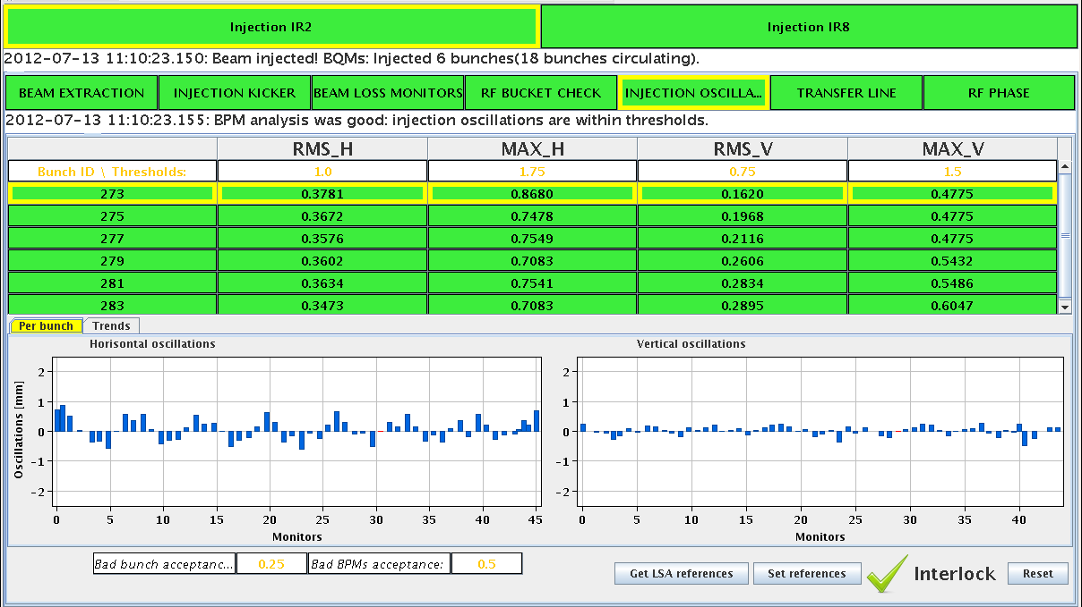
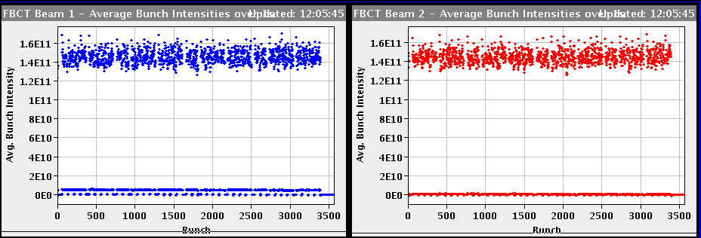
Fri Morning
... back to standard after 90m run
07:14h power converter fault IT 56 (RQTX1.R5 overcurrent)
09:22h probe beam & injection optimisation
11:21h injection physics beam

Slide 3
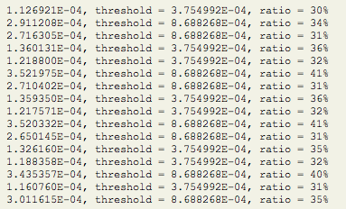
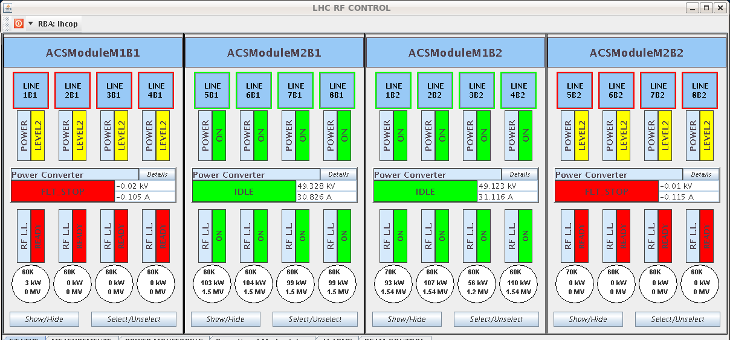
Fri Morning
12:12h Ramp & squeeze
12:58h beam dump during adjust:
Trip of IT.R5 again
and some minutes later: RF modules M1B1 and M2B2 tripped
(fault in control rack ... broken fuse)
→ access
β* = 2.2m

Slide 4
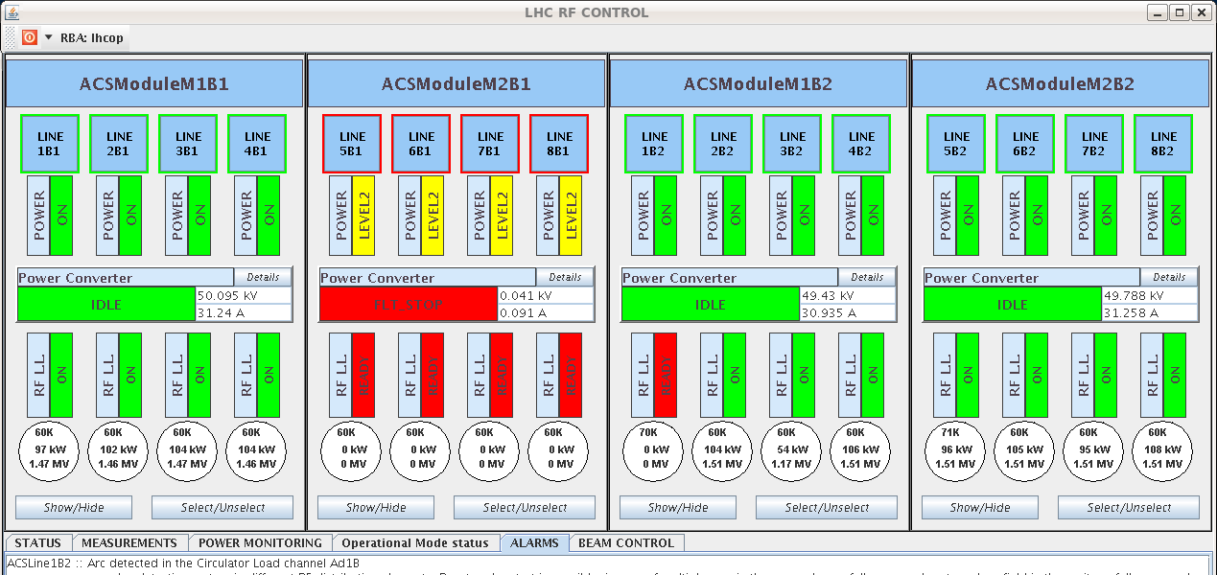
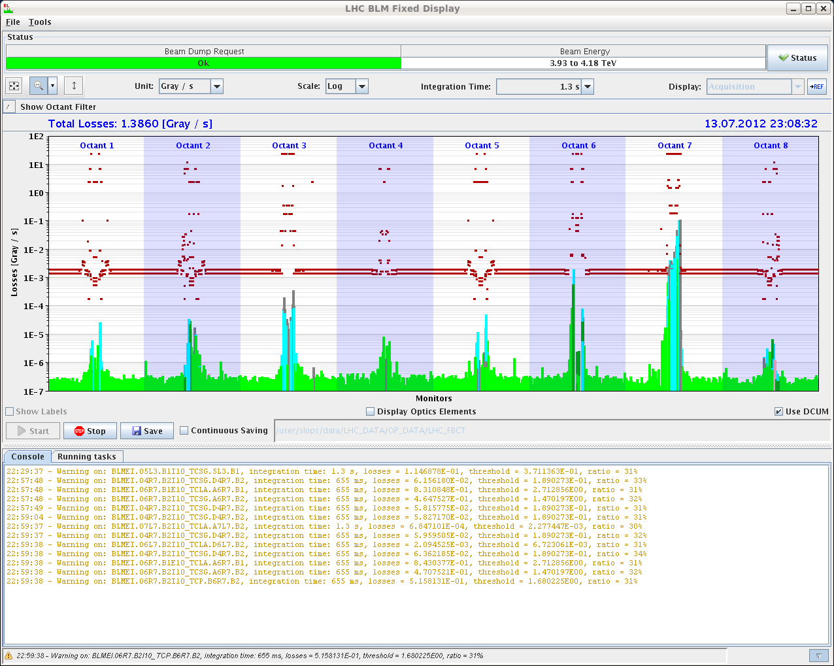
Fri Late
15:31h restart, pre-cycle
18:03h injection probes & waiting for SPS
19:05h injection for physics
20:00h ramp
... and beam dump: RF problem
spurious trigger on crowbar
21:27h new injection, ramp, squeeze, adjust

Slide 5
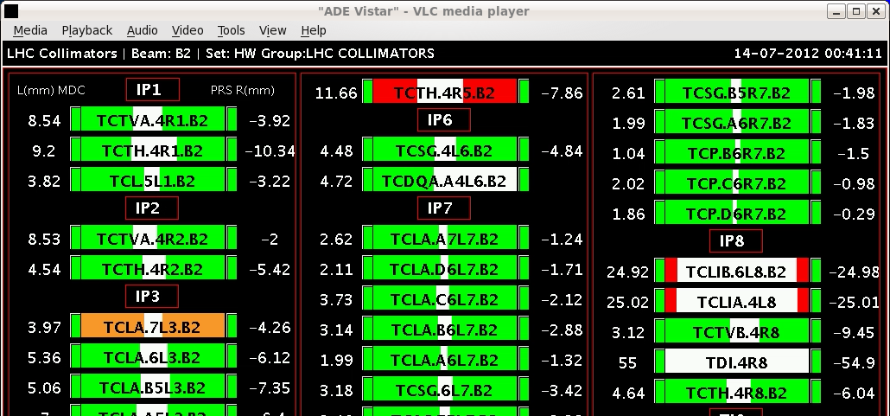
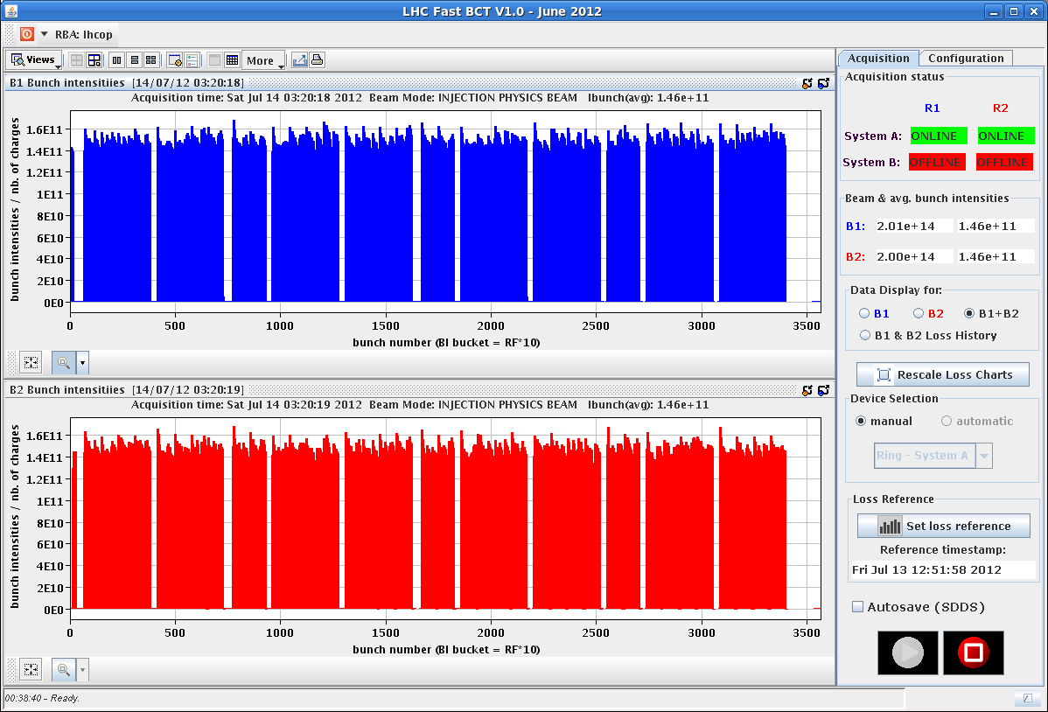
Fri Night
23:23h stable beams
00:38h beam dump: spurious rigger from collimators
interlock from collimator motor on TCTH.4R5.B2
02:54h precycle & new injection
Emittances
B1H = 1.98 B2H = 1.67
B1V = 1.73 B2V = 1.9

Slide 6
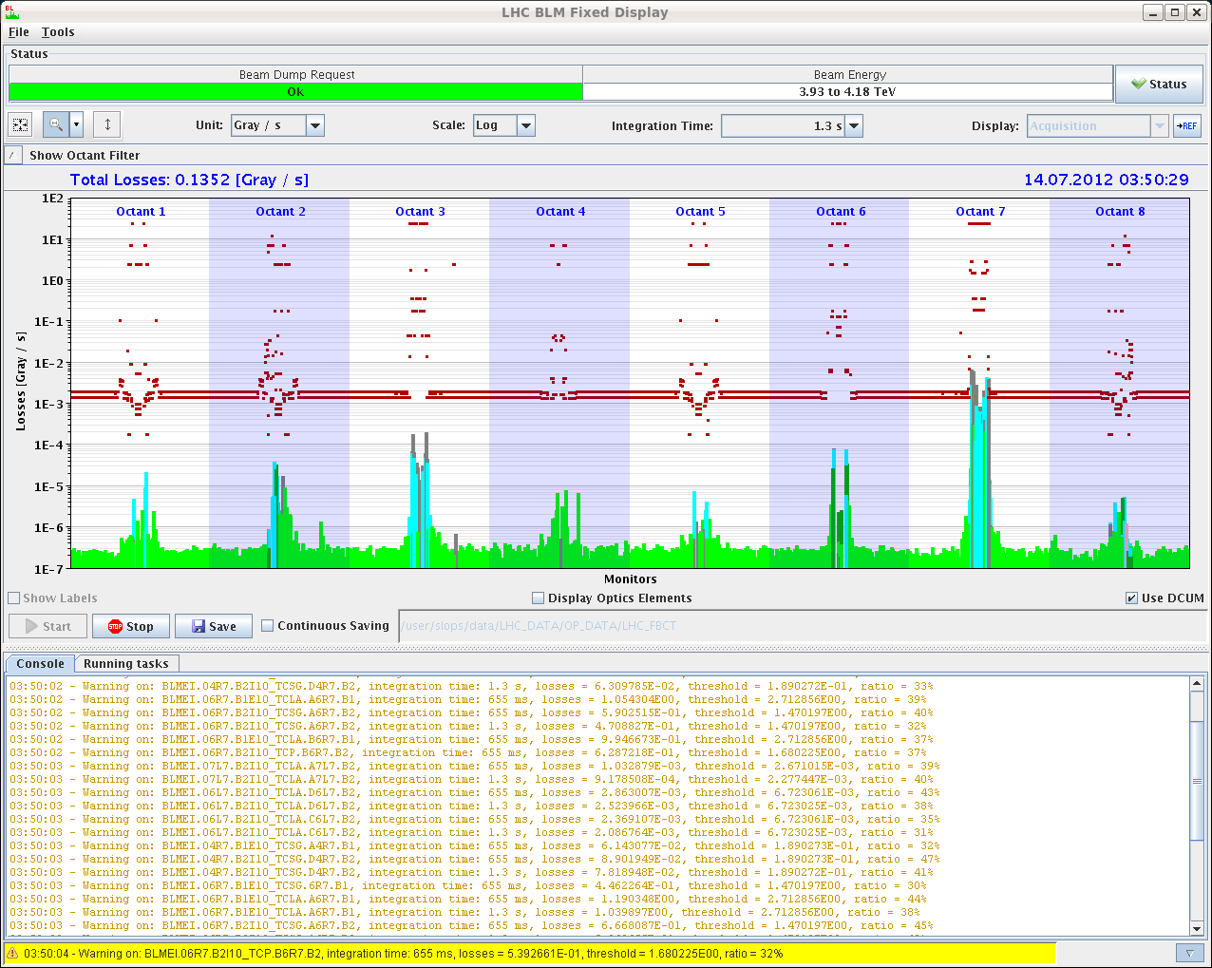
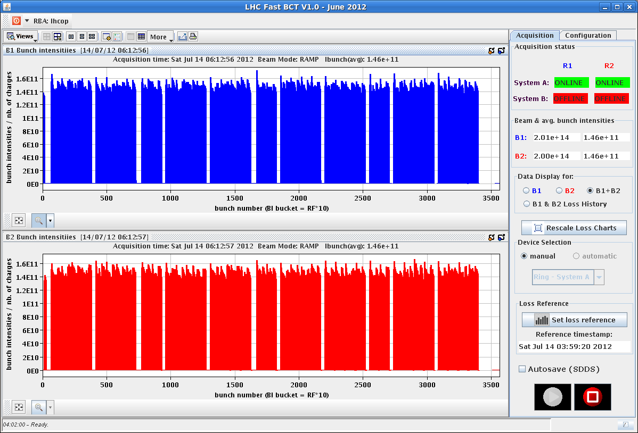
Fri Night
ramp & squeeze: ok
Losses up to 47% in IP7 around 2 m beta*
04:01h beam dump:
High losses on RS9 on TCTH.4R5.B2
going into collisions.
05:34h ... once again ... injection
06:23h ramp ... ok
carefully checking the Q trim currents

Slide 7
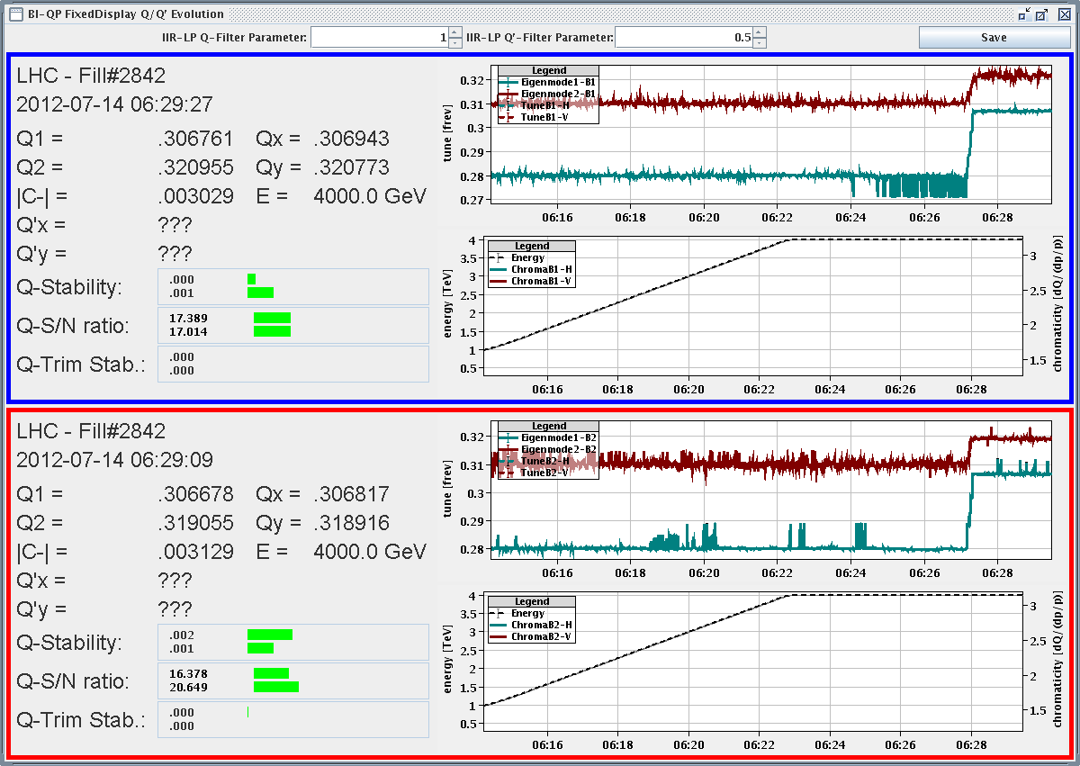
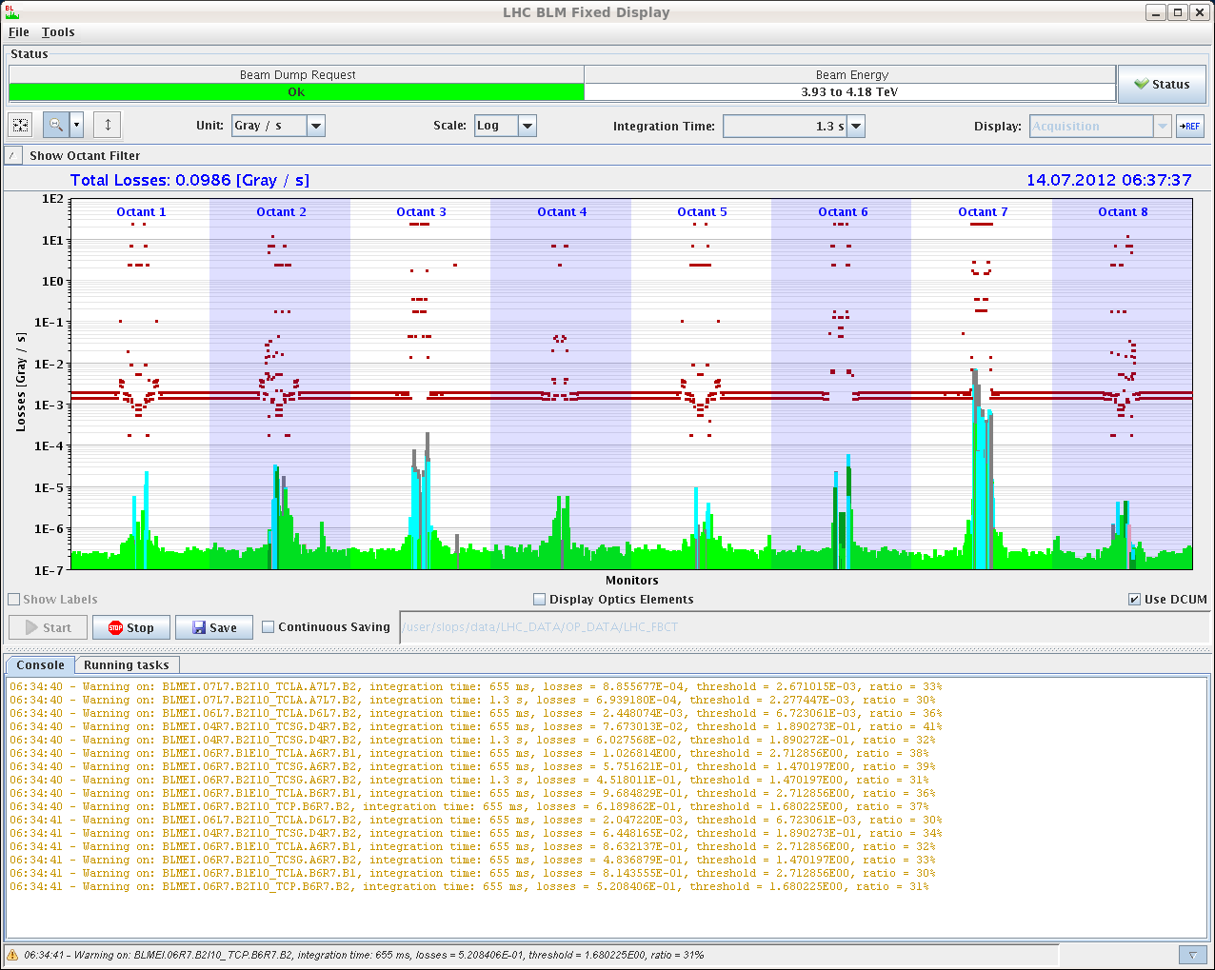
Fri Night
06:27h squeeze: “much cleaner tune signals than in the
previous fill”
again: some losses around β*=2m, 41 %
06:58h stable beams

Slide 8
Fri Night
Trip of IT.R5
RF problem
beam losses
SPS problem
collimators
... ????

