Slide 1
Thu 6/4
End of fill #2470. ~1 pb⁻¹ in 4 hours. Dumped by CMS BCM.
Problems with the following injection due to intermittent loss of communication with the FGC. Traced back to an issue with a client of the FGC acquisition (Luminosity scan application).
15:27 STABLE BEAMS #2471 (47 on 47 bunches). Initial luminosity: 8.7x10³¹cm⁻²s⁻¹
17:47 End of Fill #2471. 0.5 nb⁻¹ in ~2:15 hours (OP dump)
19:54 Stable beam #2472. (84 on 84 bunches): Initial luminosity: 2.9x10³²cm⁻²s⁻¹
00:18 End of fill #2472. 3.5 pb⁻¹ in 4:24 hours (OP dump)
01:00 – 01:50 no beam form LINAC2
01:50 – 07:30 Damper setting-up

Slide 4
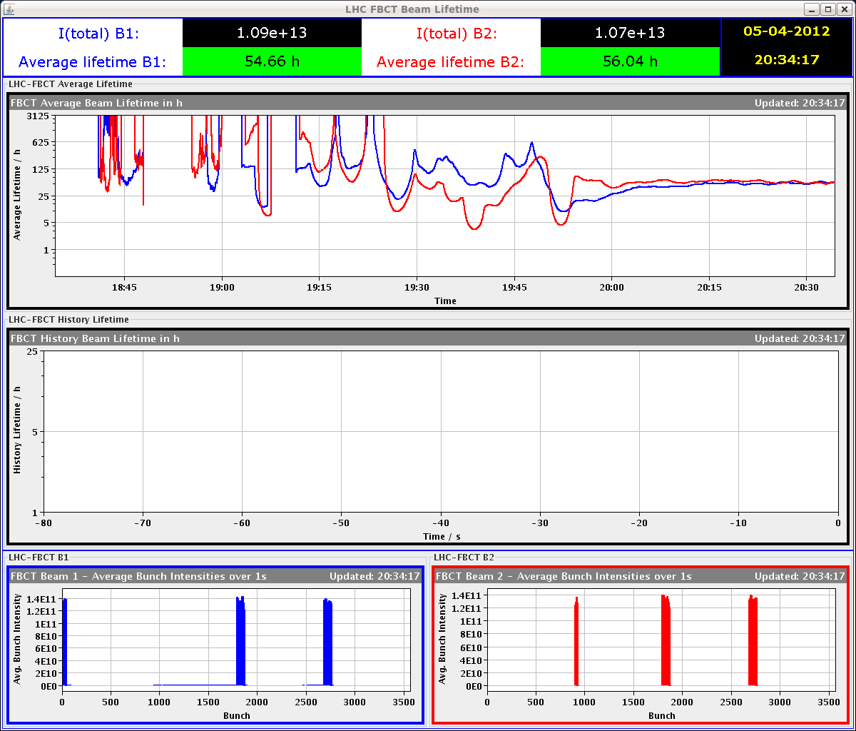
Beam Lifetime
Fill 2471 (47 bunches)
Fill 2472 (84 bunches)
Injection
Ramp
Squeeze
Collision
Injection
Ramp
Squeeze
Collision

Slide 5
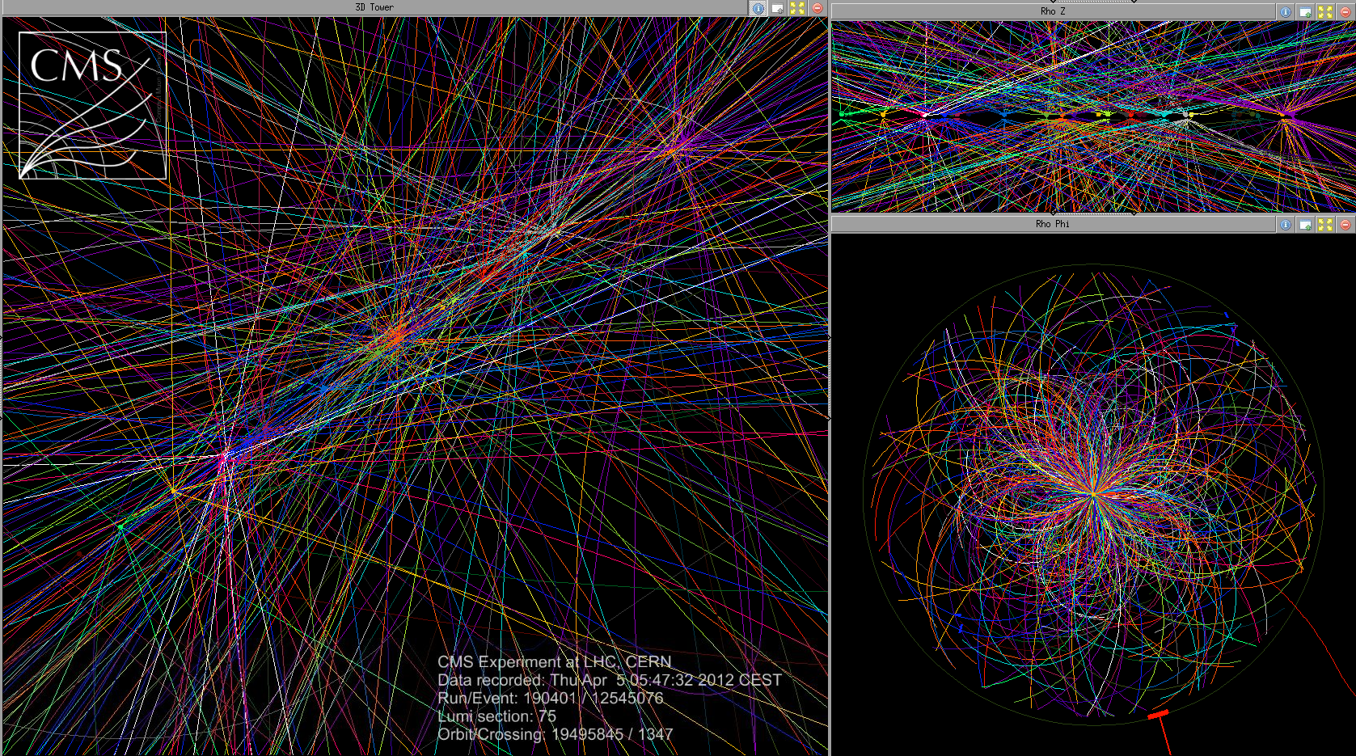
Fill 2470 - Pile-up (29 events)
Average pile-up at beginning of fill should be ~20

Slide 6
Vacuum
Some vacuum activity during injection and ramp (84 bunches)

Slide 7
Damper setting-up (D. Valuch, G. Hagmann)
ADT setting up for high intensity summary: - We started setting up only after 2am due to a linac problem. - we prepared optimized settings for 1.1, 1.3, 1.5, 1.7e11 ppb (average intensity per bunch) - ADT is left with 1.5e11 settings for the Easter (front-ends will saturate around 1.7-2e11) - if significant increase of per bunch intensity is expected the ADT experts should be contacted to load proper settings - new settings validated with single bunches, should be fine also for the trains
The transverse blow-up for loss maps is disabled by writing 'safe' settings. In case the application is needed please contact D. Valuch to re-enable it. The rbac protection was already prepared but the front-ends were not restarted yet. There is another update in the same package related to the post mortem buffer. After restarting the unit (HB1) the fixed display does not update anymore and status displayed in the ADT control application behaves strangely. It will be followed up.

Slide 8
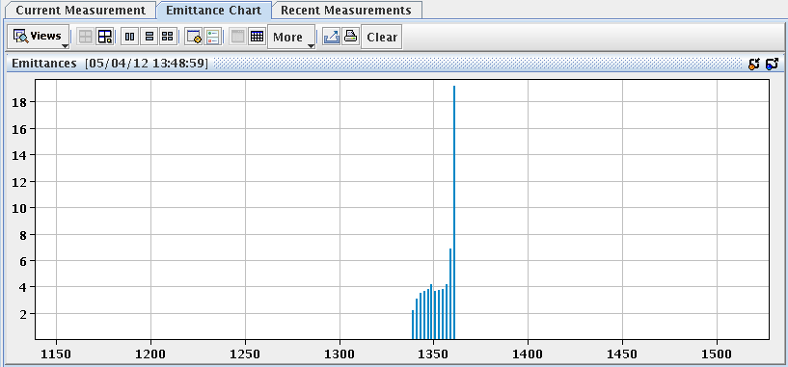
Issues
Application for luminosity optimization crashing and slowing down communication with FGC (acquisition of the PC currents) ➔ CO+OP follow-up. For the moment minimize the number of applications open
VdM scan application: cannot enter integration time ➔ CO+OP follow-up
Fidel correction for decay and snap-back: chromaticity drifting at flat-bottom ➔ Mike+Marek
Page 1 data: L_{int} ALICE= L_{int} ATLAS
Damper post-mortem (update required). Fixed display for injection oscillations (HB1)
During Fill 2471: while injecting B2, losses on B1; as soon as the event of injection of B2 came, the losses stopped. Large emittance on 1st batch of 12. ➔ Not understood

Slide 9
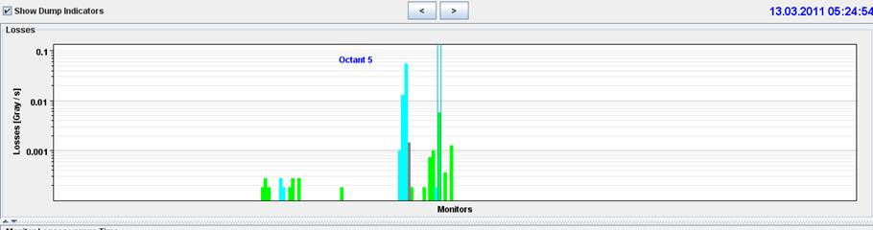
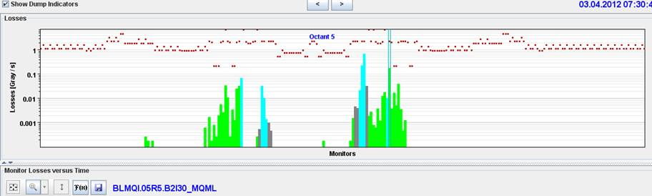
MPS tests – asynchronous dumps
Comparison 2011 to 2012 losses at IP5 – asynchronous dump in ‘collision’. Analysis done by collimation team ➔
We looked in the details of the losses and noticed that losses in Q4/Q5 occur also with squeezed and separated beams, when the TCLs are still out. They could be caused by losses from the incoming beam 2 (the beta functions at the Q4/Q5 are now higher than in 2011) or by debris from the TCT of the other beam (TCTs are now ~3 sigma tighter than in 2011). The latter seems less likely but we cannot easily distinguish between the two cases looking at losses with the 2 beams. We therefore propose to repeat the synch bump tests at the end of the squeeze with beams separated, with B2 only.

Slide 10
Plan
Asynchronous dump test ongoing
Morning: Stable beams 84 on 84: LHCb field OFF
Afternoon: Stable beams 268 on 268: levelling test (if OK from rMPP)
Night: Stable beams 268 on 268: levelling test

Slide 11
Intensity ramp-up
2-3 fills and 4-6 hours with 48b, 84b, 264b and 624b (cycle validation)
3 fills and 20 hours with 840b, 1092b, 1380b (intensity/lumi related problems)
MP checklists after 84b, 624b, 840b, 1092 bunches
Regular MP checklists every two weeks when operating with 1380b
Bunches | Max number of bunches injected | Alice
3 | 1 | Main-main
48 | 12 | Main-satellite
84 | 36 | Main-satellite
264 | 36 | Main-satellite
624 | 72 | Main-satellite
840 | 108 | Main-satellite
1092 | 108 | Main-satellite
1380 | 144 | Main-satellite

