Slide 1
Last 24h
RP alignment for TOTEM and ALFA
All H for TOTEM, all but one for ALFA aligned
Dumped by octupole trip during test with octupoles
RP control exhibited some issues to address in TS1
Completion of dump protection studies
Results in week report
BI studies
Week 13: R. Assmann, J. Wenninger

Slide 2
Last 24h

Slide 3
The Last Week
Full cycle for nominal bunch:
RF blowup issues in ramp
Orbit optimization and reference orbits for nominal bunches all through cycle
Improvement of lifetime with tight collimation settings
Final optics corrections for beta* = 0.6m
First collisions
Instabilities, tune tracking and octupoles
Setup of collimation, injection & dump protection
All completed. Collimation automatic setup worked (faster).
Qualification for stable beams.
Mostly completed. Few missing for final machine functions.
Other tests:
Dry runs for high beta* optics

Slide 4
Ramp: RF Blow Up Problems
It is clear that there is a problem with the new blow up, and it is not understood.
Since the present configuration is acceptable, it was decided not to touch the system for the weekend.
RF will decide on Monday morning whether we revert to the old blow-up in the ramp in the meantime
RF wants a ramp with observations in SR4 before taking decision
The new blowup will be re-tested in MD.

Slide 5
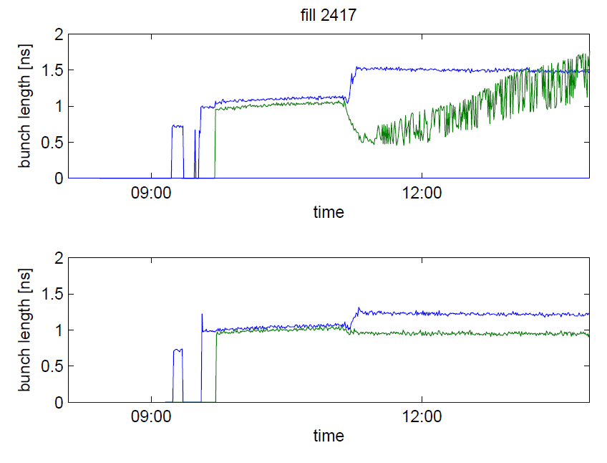
RF Stability Issue Manifests as…
correct bunch length average (around 1.1 ns), thanks to the feedback adjusting the excitation amplitude from a measurement of bunch length mean, but different lengths for the two bunches.
John, Themis, Andy and Philippe
We observed quadrupole oscillations (bunch lenght modulation) of growing amplitude, resulting in debunching and finally beam dump caused by excess loss on momentum collimator.
Plot Giulia P.

Slide 6
Three explanations were proposed
The opening of phase loop during blow-up
An increase in machine longitudinal impedance compared to 2011
A less stable bunch profile (more Gaussian)
The Phase loop influence was tested first. In Fill 2427 we had 4 equispaced bunches per ring, 9E10p, Phase loop ON (B1), OFF (B2). Both OK
Then we ramped 2 bunches per ring, higher intensity (1.1-1.2E11), spacing ½ turn B1 and ¼ turn B2. Phase loop ON for both rings. No instability but we observed diverging bunch length towards end of ramp (mean remains OK). Fill 2428

Slide 7
Collimator Gaps at 4 TeV

Slide 8
Lifetime with Tight Coll. + Normal Emittance
injection
ramp
flat top
Both beam 1 and beam 2 lifetimes are fine at flat top.
Fully acceptable reduction during ramp.
Lifetime reduction during ramp is unavoidable and not surprising at all:
Collimators go down in normalized “real” sigma (8.2σ → 6.2σ) and tails are cut. Note: Tails do not contribute to luminosity!

Slide 9
Orbit in Squeeze
Investigation of ‘spiky’ orbit excursion in the 2011 squeeze ➔improved handling of the separation and Xing bumps.
Smoothing using parabolic segments around matched optics.
Simulations predicted smaller and smoother orbit leakage from the IRs (bumps) into the arcs.
Observed orbit stability in the squeeze is already much better than in 2011. Feed-forward was applied to reduce workload of orbit FB.
So far no significant losses observed due to orbit control when operating with tight collimator settings.

Slide 10
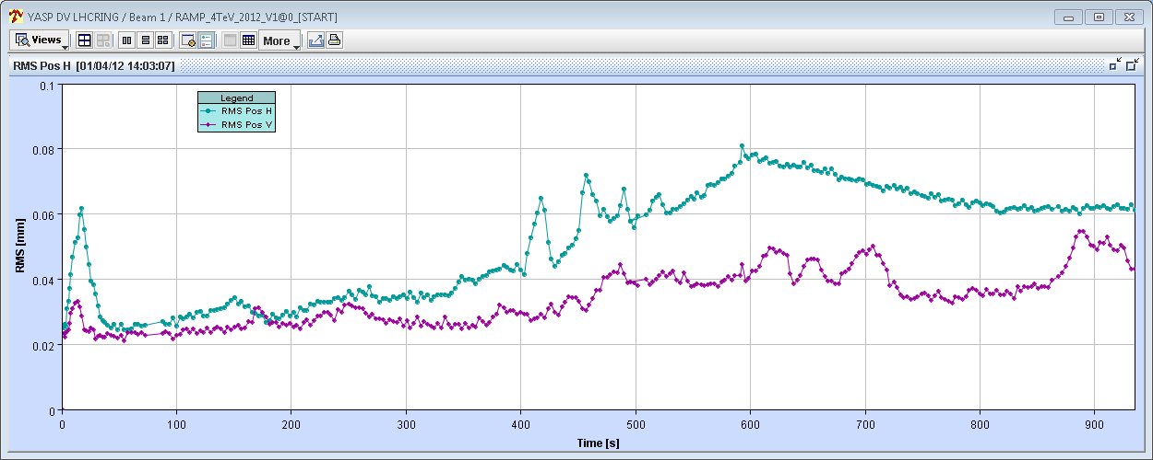
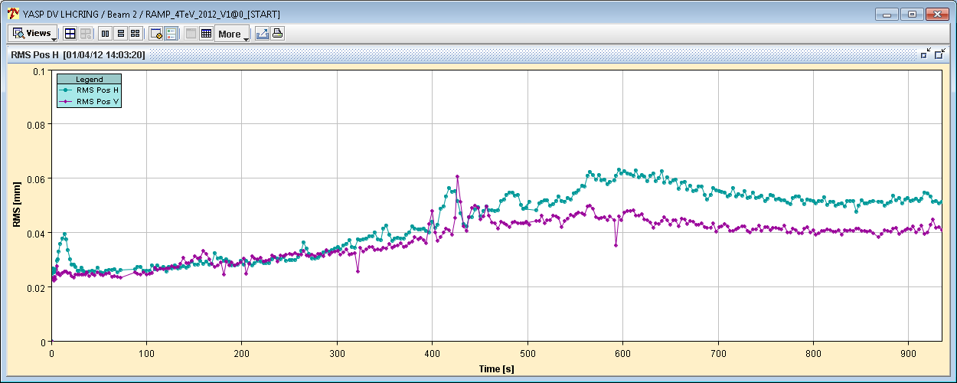
Global Orbit Leakage during Squeeze
Leakage much improved wrt 2011 (peaks of 150 μm).
Can improve further with correction around 1m (~600 s).
β* 1 m
B1
100 μm
100 μm
B2

Slide 11
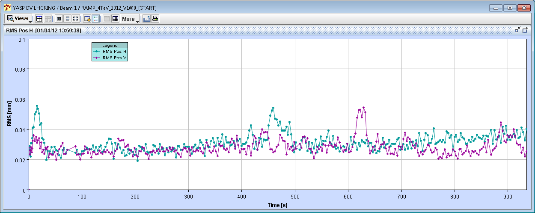
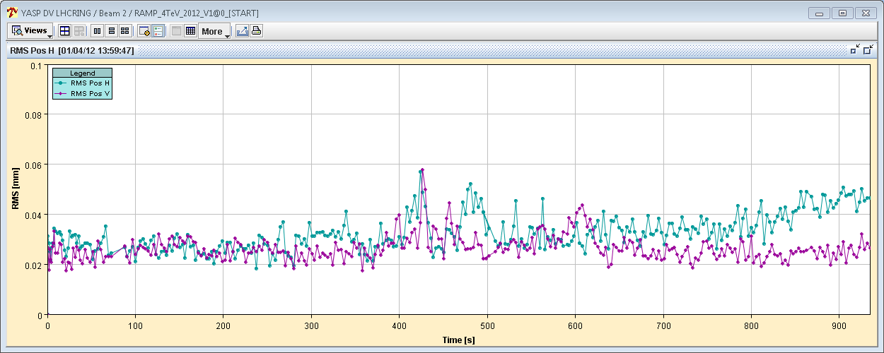
Local Orbit Leakage to IR7 during Squeeze
Orbit around IR7 (including ~10 BPMs either side) stable at the level of 50 μm rms or better.
B1
100 μm
B2

Slide 12
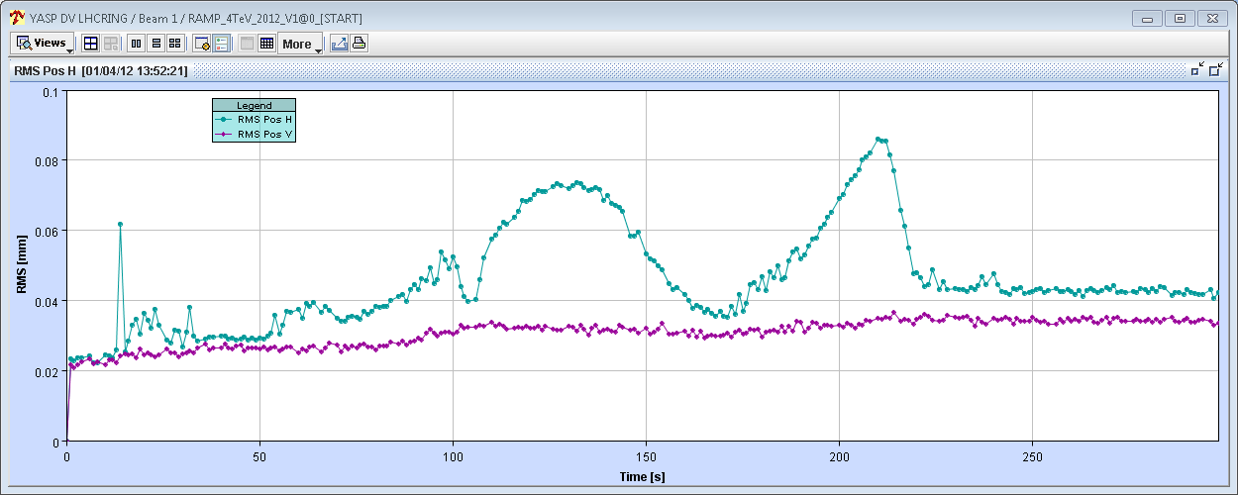
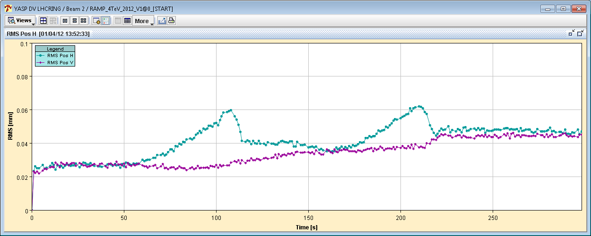
Global Orbit Leakage during Collision BP
Some leakage from complex separation and Xing bumps ramping (up / down).
More feed-forward needed (B1 H → LHCb Xing collapse).
If required could run with orbit FB – settings prepared.
B1
100 μm
LHCb H Xing to 0
B2
100 μm
LHCb H Xing to 0

Slide 13
Optics B2 – New Local Correction

Slide 14
Optics B2 – New Correction…

Slide 15
Fills Saturday until Sunday: Both in Collisions
Minimal losses, no lifetime issue, no instability, …
Sudden lifetime drops several minutes after the end of the squeeze

Slide 16
Lifetime Drop after End of Squeeze

Slide 17
Instabilities and Octupoles
We twice had after the squeeze significant losses for B2, after the tune peak on B2H jump to a 2nd peak. The resulting instability caused losses and only stabilized with reduced intensity and minor coupling trims.
It was observed that the 2nd bunch of B1 (bucket 17851) was blown up by in the transverse by at least a factor 3. We stabilized losses by adding a few units of chroma. We also optimised the coupling to try to improve the spectra.
Realized that octupoles were still at some intermediate settings: Octopoles updated to 400A at flat top.

Slide 18
First Collisions 2012
Going into collisions… very smooth.
Offline incorporation from first attempt worked very well.
Some collisions in ALICE without any corrections.
Lumi scans:
CMS and ATLAS first,
LHCb last, using standard X/Y optimization.
Correcting orbits, fixing coll. functions (for next time)…
Tried crossing/orthogonal plane luminosity optimization.
Knobs OK: beams move in same direction. Fix sign (B1 wrt B2).
Before collisions the RF colleagues corrected the BPTX offsets by 300 ps.

Slide 19
First Fill with Collisions

Slide 20
Lumi Scan Settings Cleaning.
Made a clone of the collision BP.
Verified the settings of clone and original were really identical (start and end).
Zeroed the LUMI-SCAN knob settings in the original BP.
Verified the orbit corrector settings of clone and original were still identical (start and end).
Rolled back the LUMI-SCAN settings to the state after the first fill on friday (30.03.2012). From the attached figure one can see that the present trims are almost exactly the double of the initial values on Friday.
Re-incorporated the LUMI-SCAN knob settings into the collision BP (see figure).

Slide 21
Collimator Set-up 4 TeV Flat Top
Collimator setup was completed in 7h45 hours and a single fill (first time).
First a coarse setup was performed, using the automatic setup algorithm, in parallel for all collimators per plane in B1 and B2.
Then the semi-automatic algorithm was used to fine-tune the parallel alignment and drive in the collimators again towards the beam. Once all collimators were close to the beam, they were aligned sequentially, first with the 12Hz data and then cross-checked with 1Hz data.
Betatron loss maps look very good (done with ADT).
Off-momentum loss map (+500 Hz, ‘natural’ failure direction) done.

Slide 22
B1H Loss Map

Slide 23
Collimation Setup Before & in Collision
TCT/TCL setup at end of squeeze and in collision all finished (22 coll.).
TCT-IR1/5 = 9 sigma
TCT-IR2/8 = 12 sigma
TCL = 10 sigma
Loss maps –ADT affect both beams – switch back to resonance crossing (less coupling).
Good hierarchy in IR7.

Slide 24
B2 H Loss Maps - Collisions

Slide 25
Off-Momentum 4 TeV

Slide 26
Injection Protection
Setup of TCDIs in TI 8 and TI2:
measured center
checked with injection of nominal and losses were OK
qualified for transmission and protection
Checked TCLIA.4R2
checked only lower jaw angle with 0 and +/-1.5 mrad
found symmetric results - --> no angle to be applied
TCLIB to be set at 8.3 instead of 6.8 sigma
Setup of TDIs:
angular alignment, found angles and center for both TDIs
same angles (within meas. accuracy) as last year
Checks
Abort gap protection checked: limit bunches 1-31181.
MKI failure simulation, beam grazing on TDI.
Settings defined for TCLI (6.8σ,8.3σ), TDI (6.8σ), TCDI (4.5σ).

Slide 27
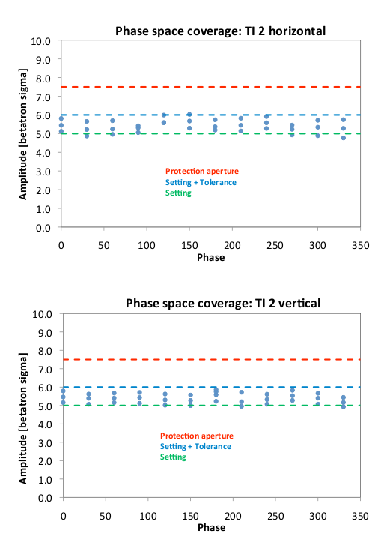
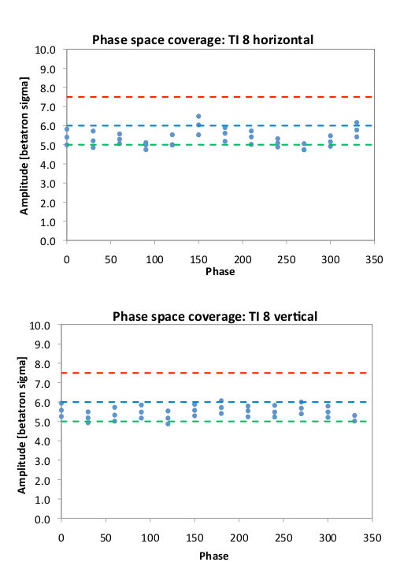

Slide 28
Dump Protection I
TCDQ angular alignment.
Not minimum found for B2 on angle. Decide to remain with ‘0’ angle.
B1 TCDQ angle -60 urad, compatible with -100 urad found previously. Apply -100 urad angle.
MKD test 14/15 kicker simulation – OK.
No increase in losses for ‘-1’ kicker.
Dump with extreme bunches (1- 34291) OK.
Trigger dump of each beam by switching off the dump septa (RMSD) PCs.
FMCMs trigger as expected.
Circulating beam aperture in P6 verified
reference measurements in case of asynch dump and MPS test
Two cases: absorbers in and out

Slide 29
Dump Protection II
TCDQ transmission
reference measurement for TCDQ damage in case of asynchronous dump
BPMS interlocks - MPS test
MSD FMCM interlock test at 450 GeV
Dump with RF frequency shift and orbit bump at TCDQ

Slide 30
Follow-Up Collimation at 450 GeV
Analysis of high losses in IR6 for B1H: Showed that TCSG.4R6.B1 set up too tight
Repeat of IR6 TCSG collimation setup at injection Results: center beam size ratio TCSG.4R6.B1 +0.150 99% TCSG.4L6.B2 -0.318 94% previous alignment from 2012.03.21 center beam size ratio TCSG.4R6.B1 +0.110 92% TCSG.4L6.B2 -0.185 94%

Slide 31
B1H Loss Map – IR6 → 20% Leakage

Slide 32
TCSG.4R6.B1 out → Less than1% Leakage

Slide 33
Without Beam: High Beta Un-squeeze
In windows without beam: Successful dry runs of the un-squeezes (no trips):
β* = 11 m → 90 m 1846 s
β* = 90 m → 500 m 604 s
β* = 500 m → 1km 298 s
Total un-squeeze time = 2748 s → 46 minutes.
Next step : test with probe beam.

Slide 34
This Week
Access for experiments before stable beams
RF work to fix problem with blow-up
Completion loss maps for final machine functions → OK from rMPP for stable beams
First stable beams
Check ADT excitation with colliding beams
Excitation of one beam couples (through beam-beam transfer function?) to the other beam
Different parameters for excitation
Use as MD tool
Set up for 50 ns

Slide 35
NEW longitudinal blow up
P. Baudrenghien, M. Jaussi, T. Mastoridis, J. Molendijk

Slide 36
Why change the blow-up?
In 2011 we have implemented longitudinal blow-up through the main phase loop. This loop updates the RF frequency at every turn and it therefore acts on all bunches at the same time. No batch per batch action is possible. That system is used in the SPS as well
With ions, it was observed in 2011 that the blow-up transforms a Gaussian bunch profile (at injection) into a non-Gaussian shape (at flat top). (For protons the shape is non-Gaussian at start ramp, due to manipulations in the SPS). A test with ions at flat top energy showed that the new blow-up preserves the Gaussian shape. It would thus hopefully reduce heating effect with protons
For batch-per-batch action at injection, the new implementation is needed as we need to modulate the excitation amplitude at the revolution frequency

Slide 37
Latest observations
The new long. blow up was commissioned on March 20th, achieving a promising doubling of the longitudinal emittance in 5 minutes at injection. It was then tested in the ramp with single pilot. Worked fine
450 GeV
Ramp

Slide 38
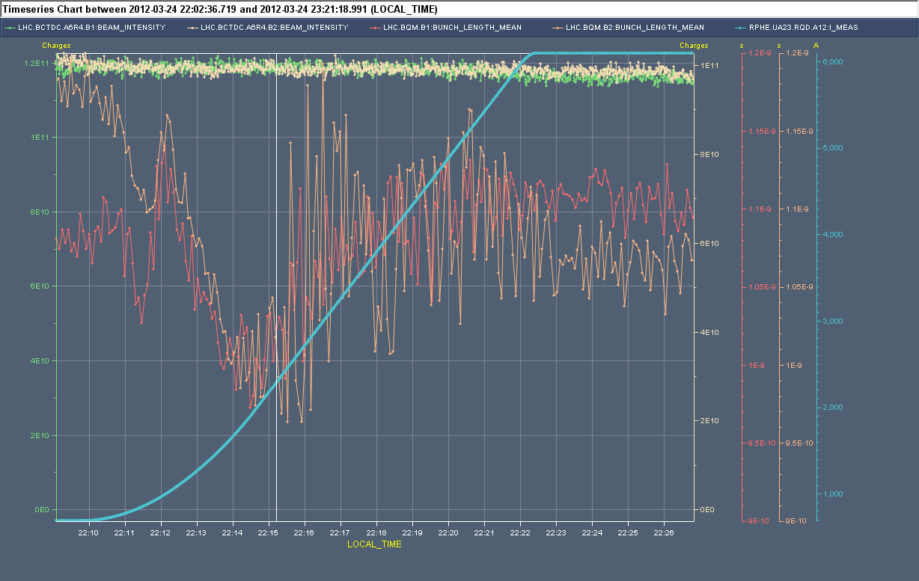
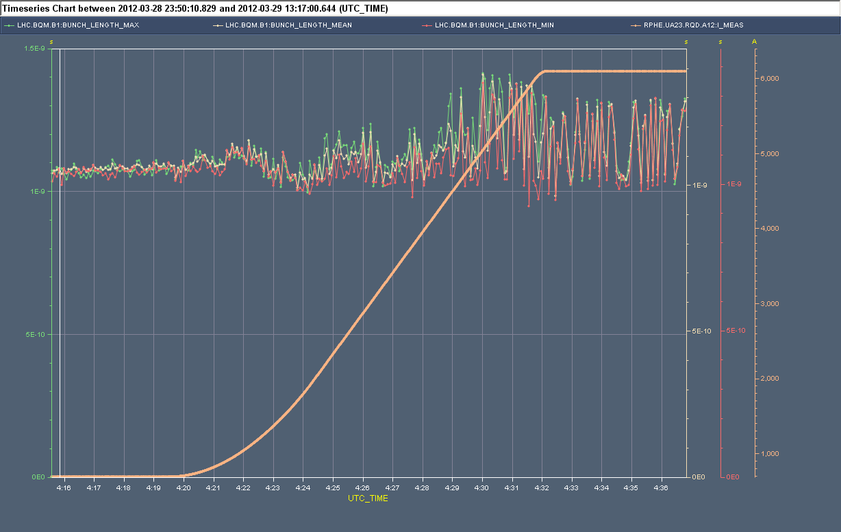
The first fill with single bunch nominal went fine as well, although the bunch length was a bit shaky in the last part of the ramp, but it calmed down on flat top Fill 2402
When we first ramped two nominal bunches, we observed instability at current/longitudinal emittance for which beam was stable last year. Fill 2218 showed marginal stability B1. Fill 2422, Beam 1, 1E11 p/bunch was clearly unstable
Bunch length shows quadrupole oscillations developing in the second part of the ramp and surviving on flat top

Slide 39
Three explanations were proposed
The opening of phase loop during blow-up
An increase in machine longitudinal impedance compared to 2011
A less stable bunch profile (more Gaussian)
The Phase loop influence was tested first. In Fill 2427 we had 4 equispaced bunches per ring, 9E10p, Phase loop ON (B1), OFF (B2). Both OK
Then we ramped 2 bunches per ring, higher intensity (1.1-1.2E11), spacing ½ turn B1 and ¼ turn B2. Phase loop ON for both rings. No instability but we observed diverging bunch length towards end of ramp (mean remains OK). Fill 2428

Slide 40
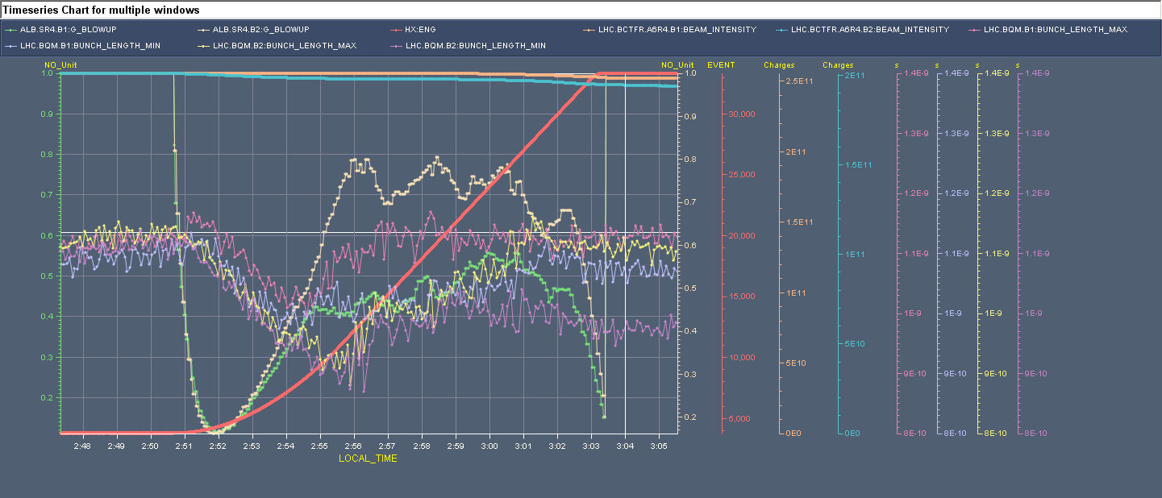
Fill 2429 ramped 2 bunches per ring, nominal. OK this time. No instability, no diverging bunch lengths. But blow up does not equalize bunch lengths as much as it did in 2011. We now observe a larger spread at 4 TeV than at 450 GeV.

Slide 41
Summary and plans
Without the beam phase loop, there is clear evidence of instabilities in the last part of the ramp
With the phase loop On, the instabilities disappear, but we still get a divergence in bunch length growth: We obtain a larger spread in bunch length at 4 TeV than at 450 GeV. Last year the blow up was equalizing bunch length
We will use the RF MD time to study the new blow-up at 450 GeV: resulting bunch profile (that influences stability threshold), origin of the length variations between bunches
We will decide on Monday morning whether we revert to the old blow-up in the ramp in the meantime
We want a ramp with observations in SR4 before taking decision

Slide 42
Additional material. More fills during the week-end…

Slide 43
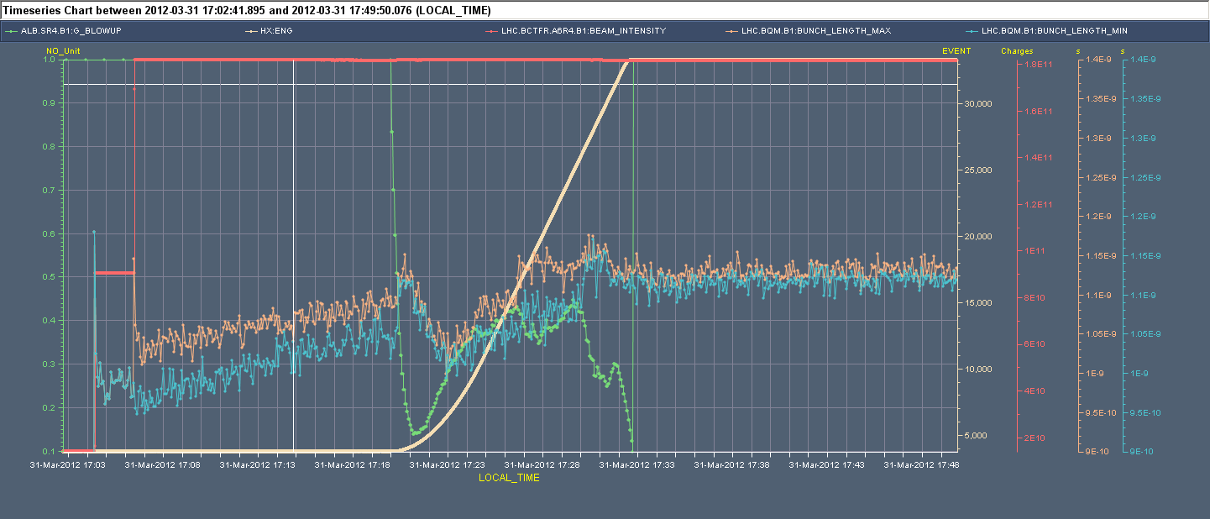
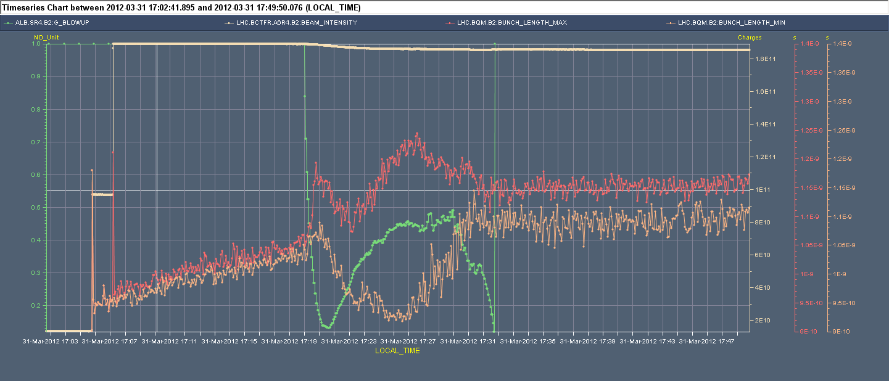
Fill 2439 ramped 2 bunches per ring, nominal. OK for B1, significant spread in bunch length B2

Slide 44
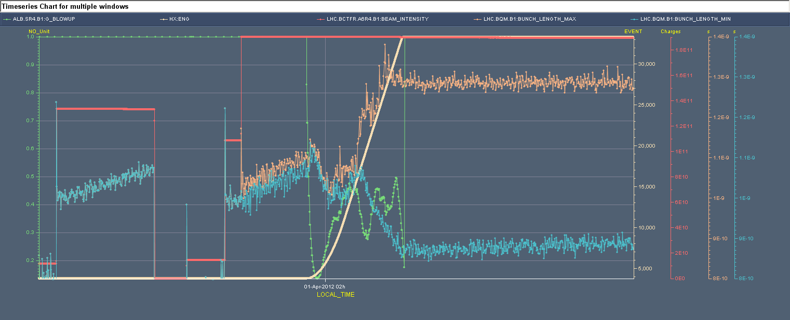
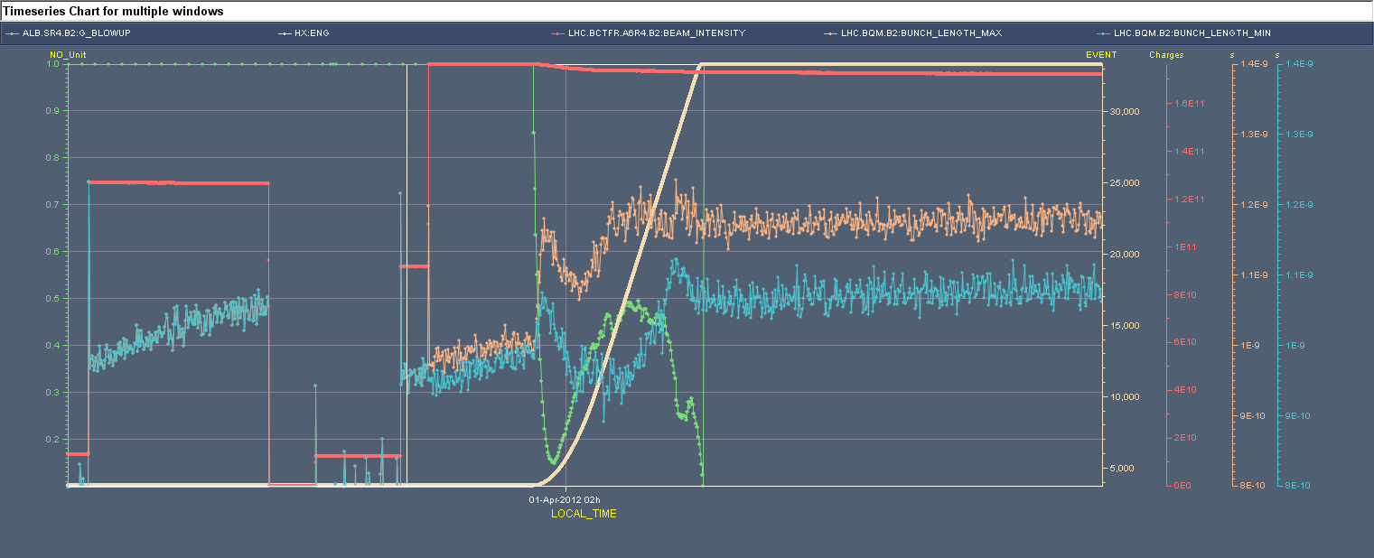
Fill 2440 ramped 2 bunches per ring, nominal. Large spread (400 ps) in bunch length for the two bunches B1 (1/2 turn apart). Less in B2

