Slide 1
Friday morning
→10:30 Optics measurements and corrections.
New local correction, new global correction B2.
Finish with MPS tests. Trigger dump of each beam by switching off the dump septa (RMSD) PCs.
FMCMs trigger as expected.
13:00 Test ramp for RF with 4 equidistant bunches / beam.
Ring 1 with Main Phase Loop ON.
Ring 2 with Main Phase Loop OFF.
Both beams are well behaved, Ib ~ 9E10.

Slide 2
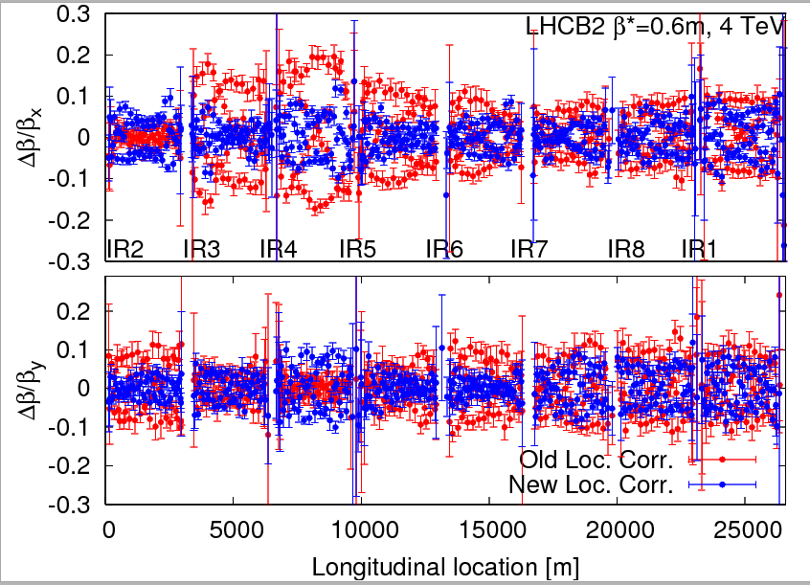
B2 – new local correction

Slide 3
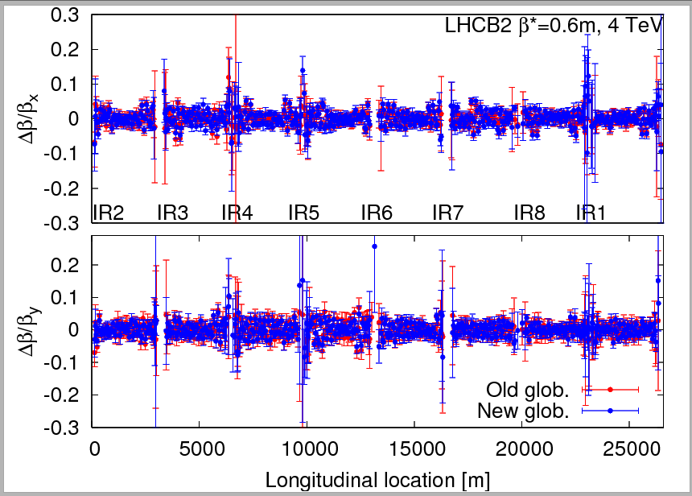
B2 – new correction…

Slide 4
Friday afternoon
14:45 Ramp of 2 nominal bunches (1.2E11) with collision pattern.
Phase loop ON.
Average bunch length correct, but significant differences between the 2 bunches !
Since the beam is usable we decide to carry on to squeeze and collisions.

Slide 5
RF blow up
It is clear that there is a problem with the new blow up, and it is not understood.
Since the present configuration is acceptable, it was decided not to touch the system for the weekend.
On Monday the RF will perform some measurements and then roll back to the 2011 style blow-up.
The new blowup will be re-tested in MD.

Slide 6
Friday afternoon
Squeeze OK, lifetimes ~25h, except for some scraping at IR2/8 TCTs (bump shape changes not yet in the functions, TCTs at 9 sigma).
TCT positions corrected at end of squeeze.
TCTs in IR2 and IR8 will be set to 12 sigma for standard OP.
While adjusting the collimators, B2 suddenly developed a low lifetime, apparently from the H plane.
Q & Q’ were OK.
Lifetime suddenly increased again – not understood.
Before collisions the RF colleagues corrected the BPTX offsets by 300 ps.

Slide 7
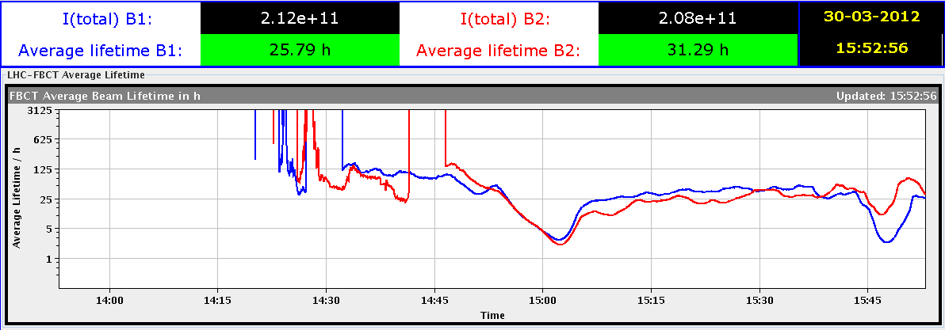
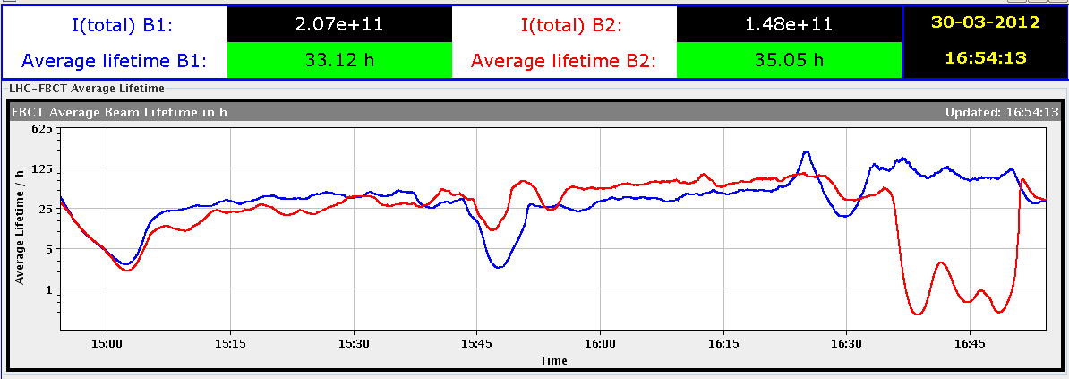
R&S
Ramp
Squeeze
TCTs
B2 ‘instability’

Slide 8
First collisions
17:40 Going into collisions… very smooth.
Some corrections were incorporated offline from the first attempt last week – worked very well.
Some collisions in ALICE without any corrections.
Lumi scans:
CMS and ATLAS first,
LHCb last, using standard X/Y optimization.
~18:30: all IPs optimized.
Correcting orbits, fixing collimator functions (for next time)…
Tried out the crossing/orthogonal plane luminosity optimization.
The knobs work… except that the beams move in the same direction. Sign to fix (B1 wrt B2).

Slide 9
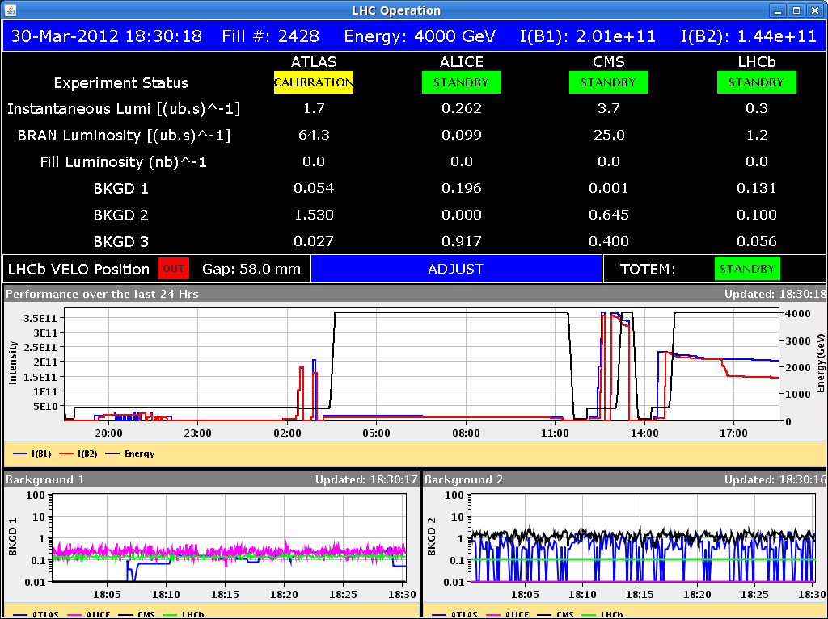
First fill with collisions

Slide 10
First collisions (cont’)
Since the situation is stable and quiet, we decide to carry on with TCT alignment in collision with the same beam.
20:20 Collimator alignment starting.
23:00 TCT/TCL setup in collision finished (22 coll.).
TCT-IR1/5 = 9 sigma
TCT-IR2/8 = 12 sigma
TCL = 10 sigma
Loss maps –ADT affect both beams – switch back to resonance crossing (less coupling).
Good hierarchy in IR7.
Some DIP problems… LHCb crate problem.
03:00 Loss map at 4 TeV un-squeezed, betatron (ADT) + off-momentum -500 Hz.

Slide 11
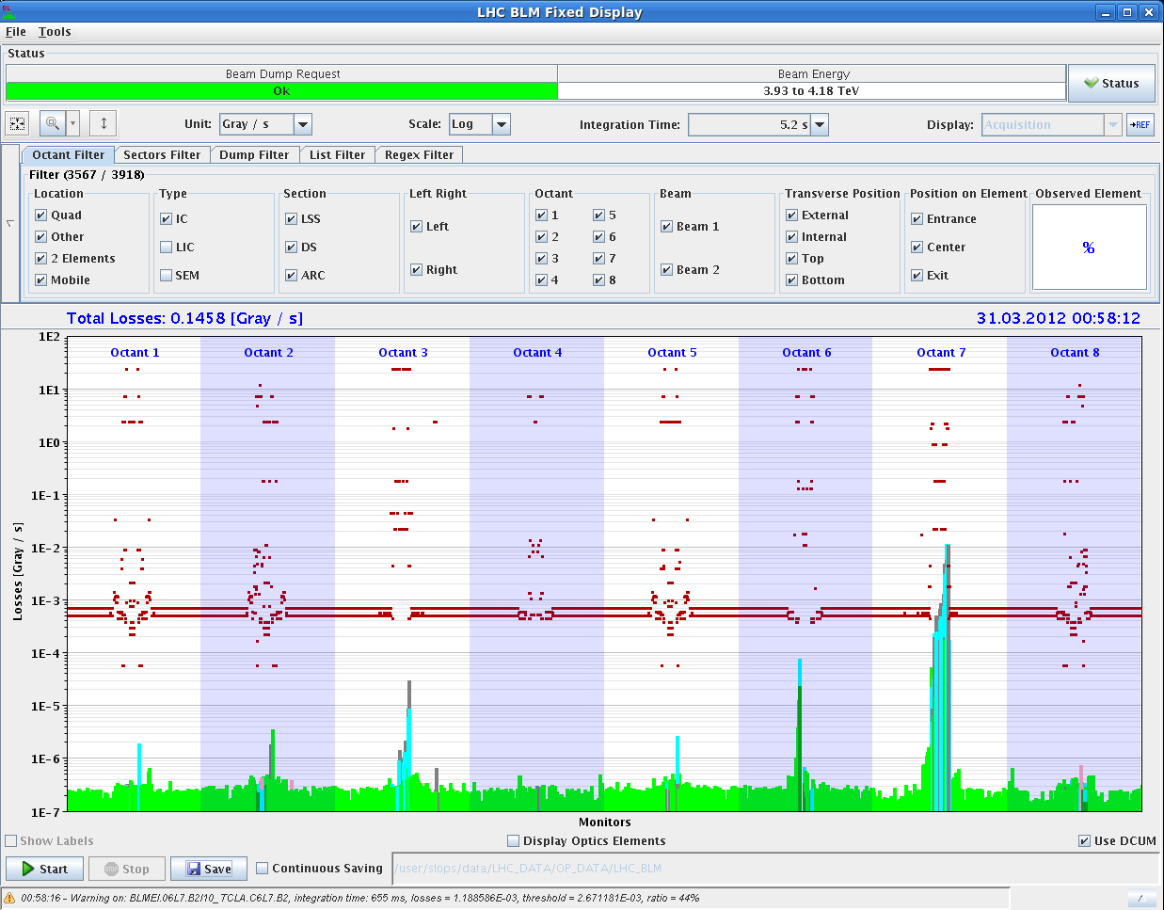
B2 H loss maps - collisions

Slide 12
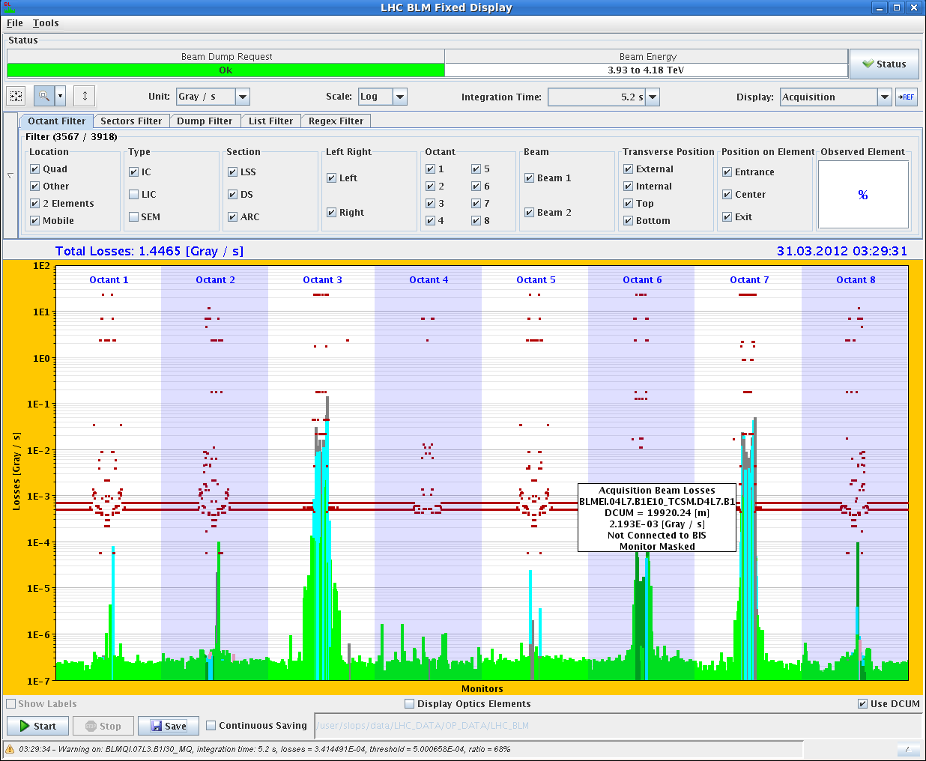
Off-momentum 4 TeV

Slide 13
Early morning
Test of collimator squeeze fcts. Mismatch on a TCT in IR2 TCT.4R2.B2 (again – saw it in the afternoon).
04:00 Tested un-squeeze (dry) to 500m and 1km beta* - both worked fine !
06:00 Asynch dump test at 4 TeV unsqueezed.
Presently loss-maps at 450 GeV with injection protection at nominal settings for injection.

Slide 14
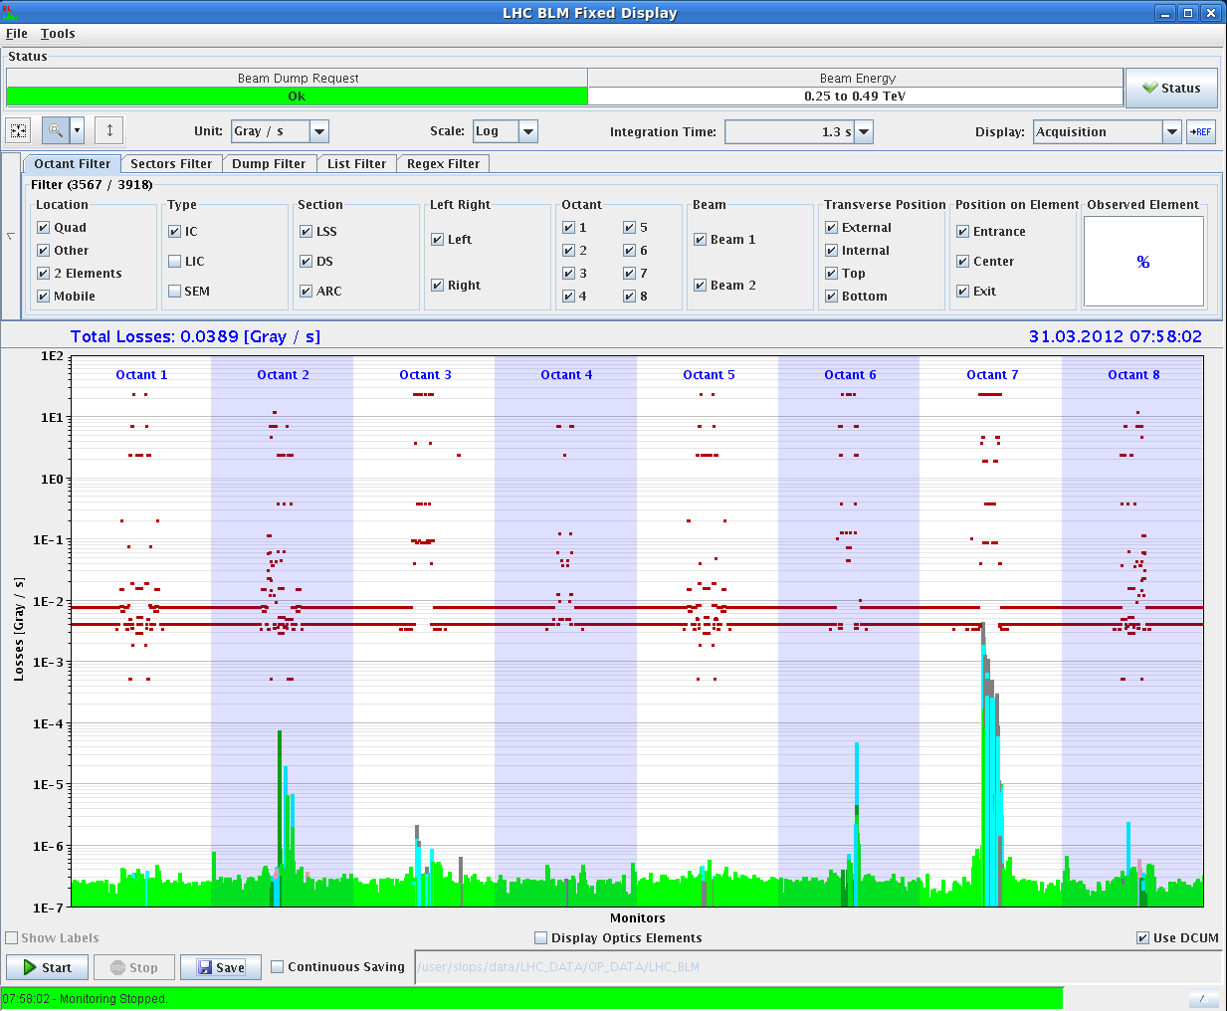
B2V loss map (with inj prot.)

Slide 15
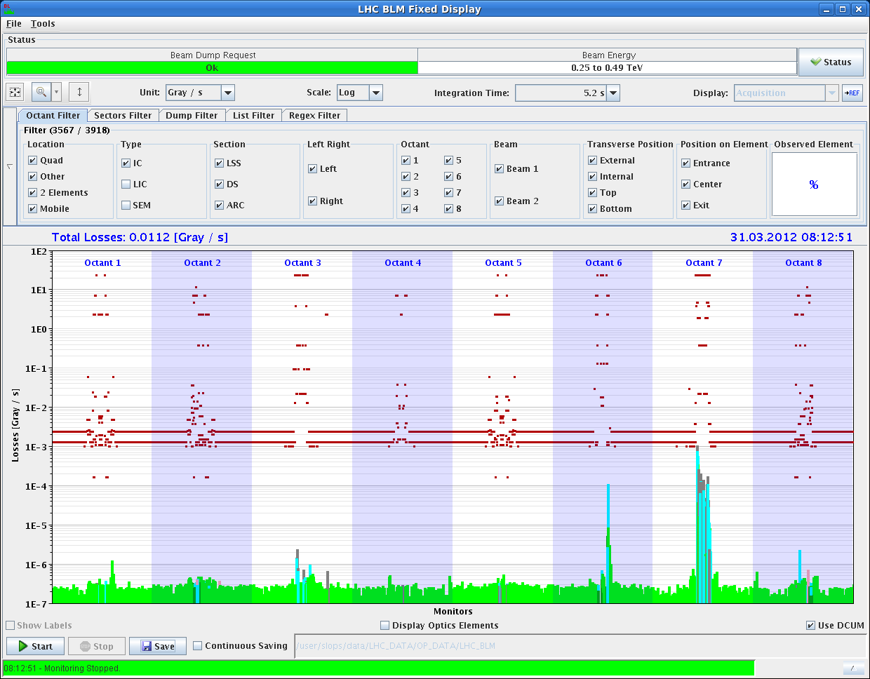
B1H loss map – IR6? (seen before)

Slide 16
Today
Repeat cycle with 2 nominal bunches, align TCTs in squeeze – TCT squeeze fct issue (TCT IR2).
ADT check in collisions – if it fits.
Evening : alignment of roman pots.
Night : loss maps & some MPS tests.
Sunday
12:00 Injection and dump work
20:00 BI setup with nominal bunches at 4 TeV

