Slide 1
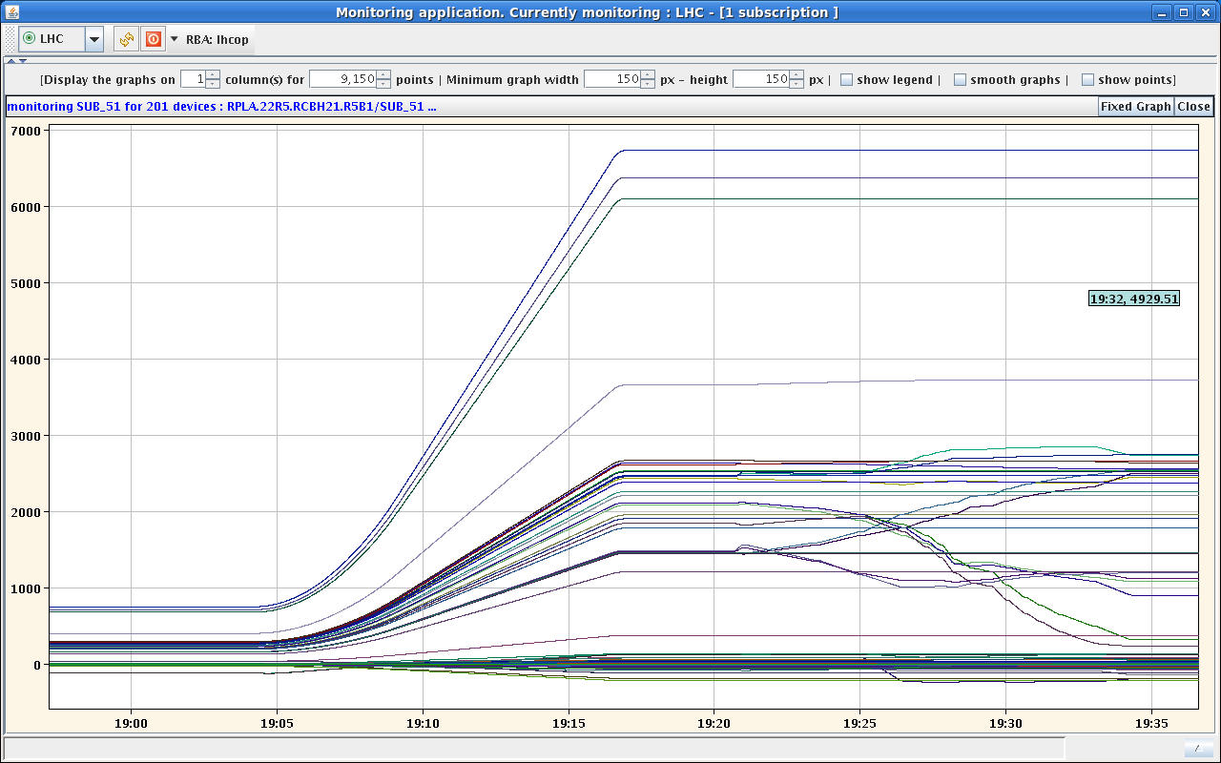
Last night
12:00 TDI Xray finished
13:00 TED check finished
14:00 Beam Loop closed
14:30 Not possible to perform the injection beam interlock test for MKI
SPS Beam LOOP open due to Vacuum intervention.
14:30 Continue LBDS tests in the LHC ring
18:30 Access Vacuum gauge problem on MKI8 finished.
19:00 Vacuum interlock tests finished.
19:17 Ramp squeeze and collision all circuits without problems.
20:00 Switch ON Exp’s compensator RBWMDV.L2 faulty
22:30 Collimators through the ramp and squeeze
While loading injection settings, sector 81 did not load as one circuit timed out: RCBV13.L1B1
RF cavity ACSMOduleM1B2 tripped. According to cryo it was a small quench

Slide 2
Last night
High-Beta squeeze still some problem when loading the function.
Totem settings ok for the nominal injection.

Slide 3
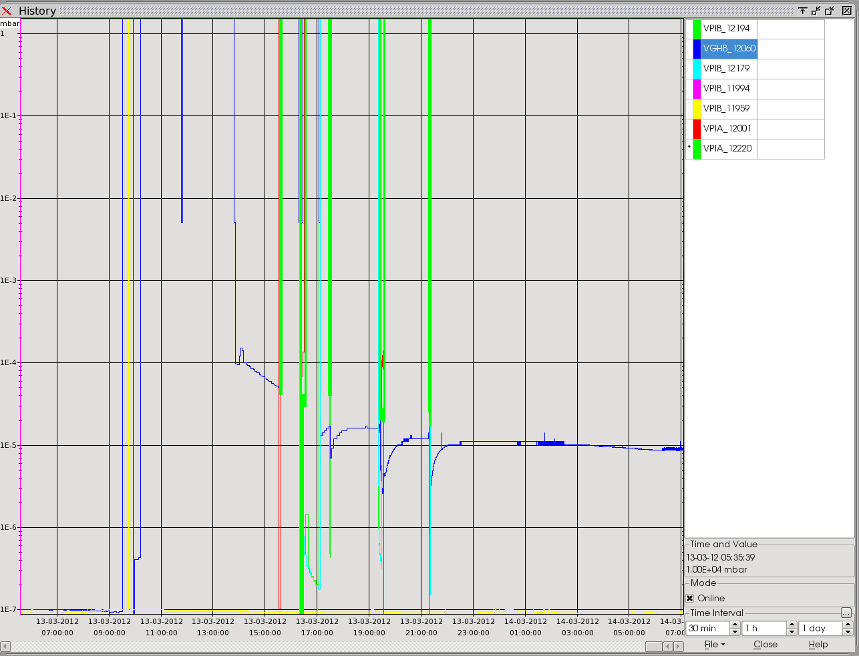
Open issues
SPS Vacuum leak in Ba1
Vacuum level 1E-5 Bar
RCBXH1.L1
ramp rate changed to 4.5 > 3.5 A/sec
Acceleration 0.25 > 0,2 A/sec^2
RQTD/F circuits unable to load ramp/squeeze function
RQF/RQD require higher commissioning current for high beta (50 A) LSA table updated
Now at from 6400 >> 6450 A
Exp’s compensator RBWMDV.L2 faulty
2 final tests for LBDS & Kicker to be operational

Slide 4
Lbds test
12:00 Synchronisation of injection and AGK tests (EC, WB)-
13:00 Injection BETS checks and Soft Start limits tests (MB, WB)

