Slide 1
Wednesday-Morning-Meeting
original plan ... old fashioned ... already after few hours
28 | MO | 23:00 | 8 | Beta beating & coupling correction and measurement through the squeeze
1 | TUE | 9:00 | 4 | Collimation continued
1 | TUE | 13:00 | 6 | Inj. & dump protection - 450 GeV
1 | TUE | 19:00 | 6 | Ramp and squeeze to 3.5 TeV: MP and test collisions
1 | TUE | 2:00 | 6 | Collimation validation at 450 GeV
2 | WED | 9:00 | 8 | Trial ramp to 3.5 TeV with 1 nominal bunch (RF blowup, orbit, emittance, damper, ...)
2 | WED | 15:00 | 4 | Transverse damper for multi-bunch
2 | WED | 19:00 | 5 | 1.38 TeV ramp with pilot bunch
3 | THU | 0:00 | 8 | Check of beta beat, orbit, coupling
3 | THU | 8:00 | 8 | Collimation setup 3.5 TeV before squeeze, 1 nominal bunch
3 | THU | 16:00 | 8 | Injection and dump setup (higher inetnsity, MP, …)
4 | FRI | 0:00 | 4 | TL measurements
4 | FRI | 4:00 | 4 | Ramp to 1.38 TeV, 1 nom bunch, test collisions
4 | FRI | 8:00 | 8 | Collimation setup 3.5 TeV before squeeze, 1 nominal bunch
4 | FRI | 16:00 | 8 | Injection and dump setup (higher inetnsity, MP, …)

Slide 2
Tuesday March 1st Morning
Collimation: finalize 450 GeV settings
skew collimators
done
“ We completed the beam-based alignment of the remaining skew collimators
in Beam 1 (7 collimators). The collimators were first moved in parallel
until they touched the beam, and then retracted by 400um. The collimators
were then aligned one by one as usual.”

Slide 3
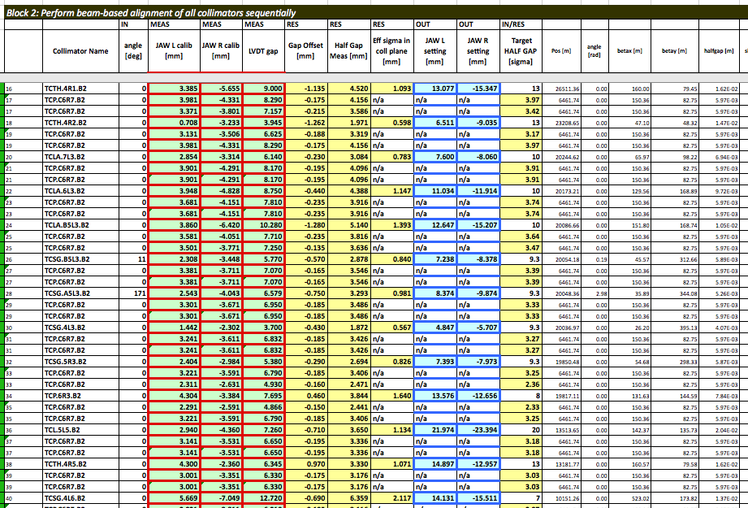
Tuesday March 1st Morning
Collimator set up 450 GeV finished

Slide 4
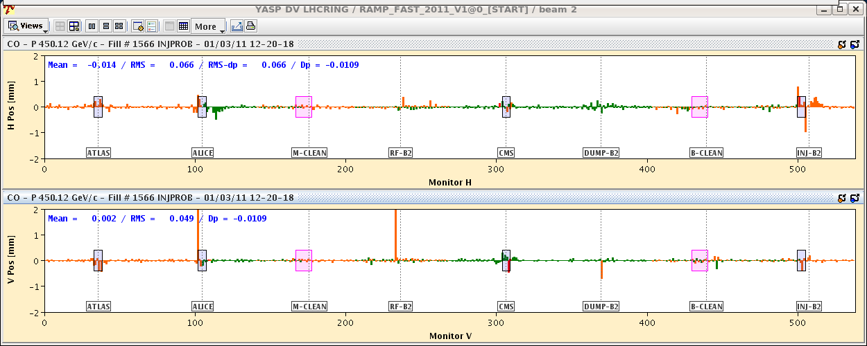
Tuesday March 1st Morning
serious
(small) problem: overload of feedback system causes flash lights at the BPM
measurements
Remedy: don’t reset or restart the server but call Ralph Steinhagen
... new version in preparation

Slide 5
Tuesday March 1st Afternoon
Injection and Dump Protection
***Summary of injection studies***
due to various interventions only for 4 more TCDIs the center was measured-
TI2 TCDIs are finished-
tomorrow remaining 5 collimators in TI8 to be measured-
new settings from today were not trimmed, to be done
... stopped by Cryo Problem

Slide 6
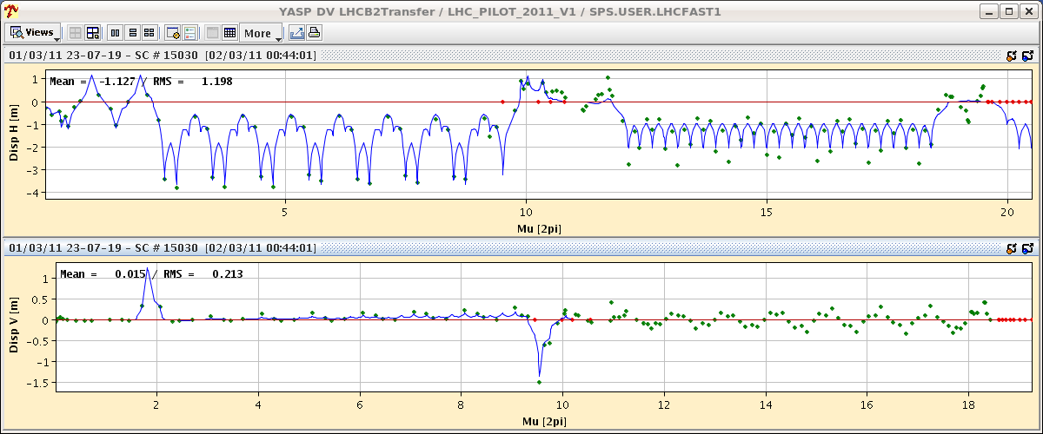
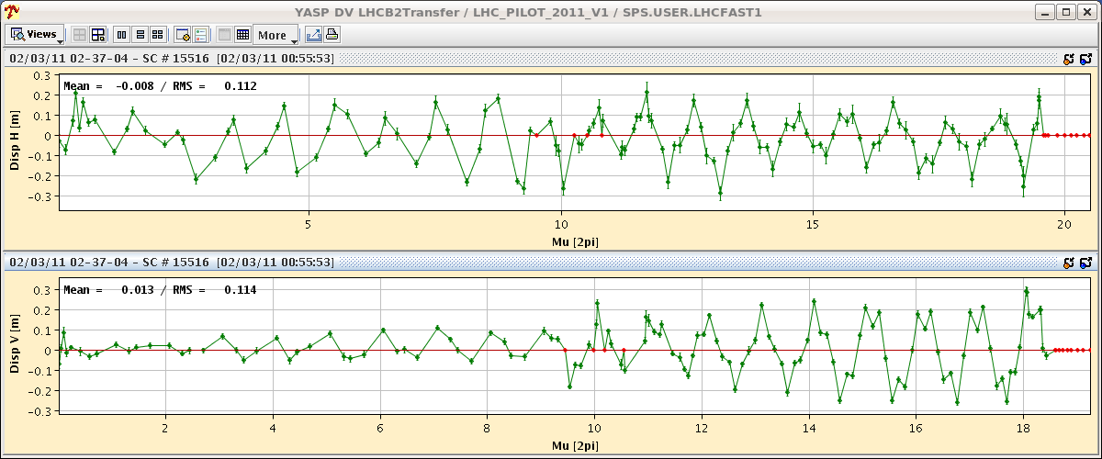
Tuesday March 1st Night
Transferline Optics: TI8 cont.
Nota bene:
Collimator Hierarchie ?

Slide 7
Tuesday March 2nd Night
Transfer line measurements during the night until 4:30 when cryo arc 81 was lost. One temperature sensor of RQF drop suddenly to 0
Access in UA87 ➔ Faulty contact ➔ may come back
Precycle of S67/S78/S81 started at 7h00
Summary of Transfer line study up to now We measured dispersion and Kick-response in TI8 across the injection point into S78 of LHC. Then we calculated a consistent correction with two quadrupoles at the end of the line, ignoring the collimation hierarchy in the TL for the moment. Although this correction improved both, dispersion and kick response, it is not clear, if a solution consistent with collimator phase-constraints can be found. The plan for the next steps would have been to measure the emittances for both planes in SPS and LHC, then remove the quad-trims and measure the emittances again for comparison. Unfortunately there we were interrupted by a cryo failure. A lot of data to be analyzed offline. No conclusions yet. Kajetan

Slide 8
Tuesday March 1st Afternoon
Hardware Problems: 13:42h Lost D2L5 problem at power converter
→ access
18:00h Problem with Cryo Electronics point 2
→ access
4:32 Cryo lost in ARC 81, one temperature sensor of RQF drop suddenly to 0

Slide 9
Plan for the Week:
1 | TUE | 9:00 | 4 | Collimation 450 GeV continued
1 | TUE | 13:00 | 6 | Inj. & dump protection - 450 GeV (a homeopatic dose)
1 | TUE | 21:00 | 3 | Machine Protection
1 | TUE | 24:00 | 4 | Optics Transferlines
2 | WED | 04:00 | 6 | Collimation verification / loss maps
2 | WED | 10:00 | 8 | Inj. & dump protection - 450 GeV (continued)
2 | WED | 18:00 | 4 | Transverse damper for multi-bunch (1 bunch required)
2 | WED | 22:00 | 4 | Ramp and squeeze to 3.5 TeV: MP and test collisions
3 | THU | 1:00 | 7 | beta beat correction (B2) & coupling at 3.5 TeV (B1 & B2)
3 | THU | 8:00 | 1 | BLM tests of new software
3 | THU | 9:00 | 8 | Collimation setup 3.5 TeV before squeeze, 1 nominal bunch
3 | THU | 17:00 | 7 | Injection and dump setup (higher intensity, MP, …)
4 | FRI | 0:00 | 4 | 1.38 TeV ramp with pilot bunch, Check of beta beat, orbit, coupling, (undulator check)
4 | FRI | 4:00 | 4 | Ramp to 1.38 TeV, 1 nom bunch, test collisions
4 | FRI | 8:00 | 8 | Collimation setup 3.5 TeV before squeeze, 1 nominal bunch
4 | FRI | 16:00 | 8 | Trial ramp to 3.5 TeV with 1 nominal bunch (RF blowup, orbit, emittance, damper, ...)

