Slide 1
Tuesday 22-02-11
Mystery unable to inject: timing, BIS, SIS…
8:15 to 12: 30 Injection/LBDS studies
Fine delay adjustment of injection kickers
Synchronization of MKI with AGK
TCDQ position interlock tests
Voltage lower limit tests
Tried to inject B1 in bucket 31241. Did not come in. Probably stopped by SIS, IQC or so as it was not tried to pulse the kickers. Injected at old limit = bucket 31141, but IQC complained that beam in wrong bucket. Conclusion: maximum bucket which can be injected to be tested with experts around.
95% of test of beam dump/injection without beam completed

Slide 2
Access system
Access to Beam dump OK. DSO tests are now considered to be completed successfully. The beam permit has been updated accordingly by BE-RSO
Tests on BIS loops, concerning injection and beam dump. Loops not linked. Cut B1 freq. A -> B1 beam permit loop open. PM detects both frequencies were cut -> second frequency cut par le CIBG. System can be re-armed without expert acknowledge as no errors found. On BIC expert supervision frequency signals crossed (CIBC supervision program). Cut B1 freq. B -> cut both frequencies B1. Cut B2 freq. A -> both freq. B2 cut. B2 BIS loop open. Cut B2 freq. B -> both freq. B2 cut. B2 BIS loop open.

Slide 3
Ramp 1 - 13:35
Most of B1 lost at the beginning of the ramp: lost QFB -> beam losses due to resonance -> then also OFB stopped. No point to continue the squeeze with one beam only. We dump and try a dry squeeze to check the new calibrations for beta*.

Slide 4
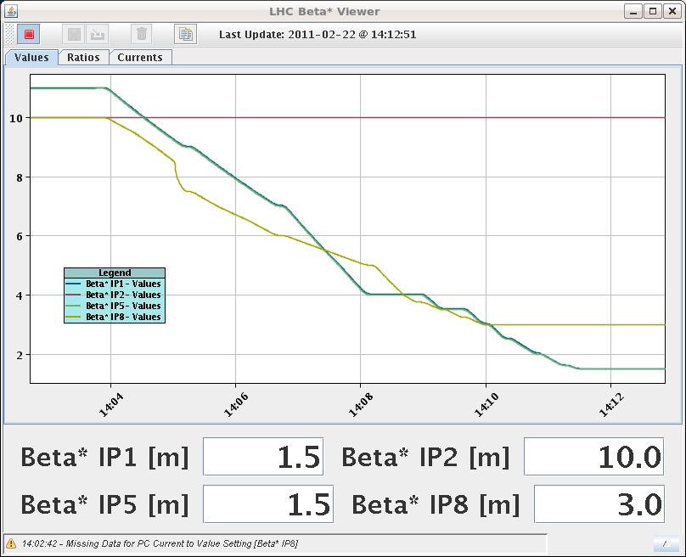
Dry squeeze
Calibration & Machine protection test for collimator beta* limits.

Slide 5
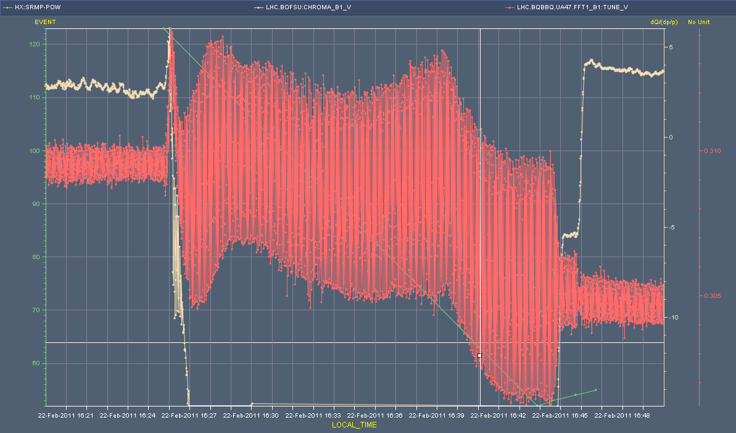
Ramp 2 – 16:32
Lost beam 2 - chromaticity
Beam 1 - vertical

Slide 6
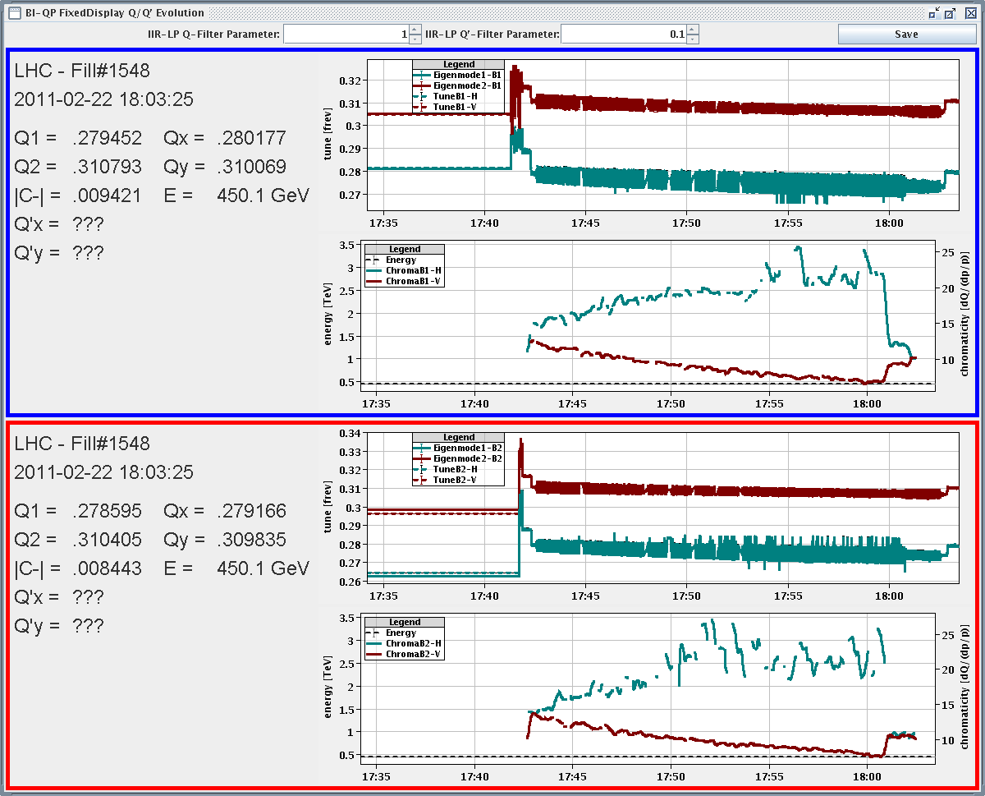
Injection

Slide 7
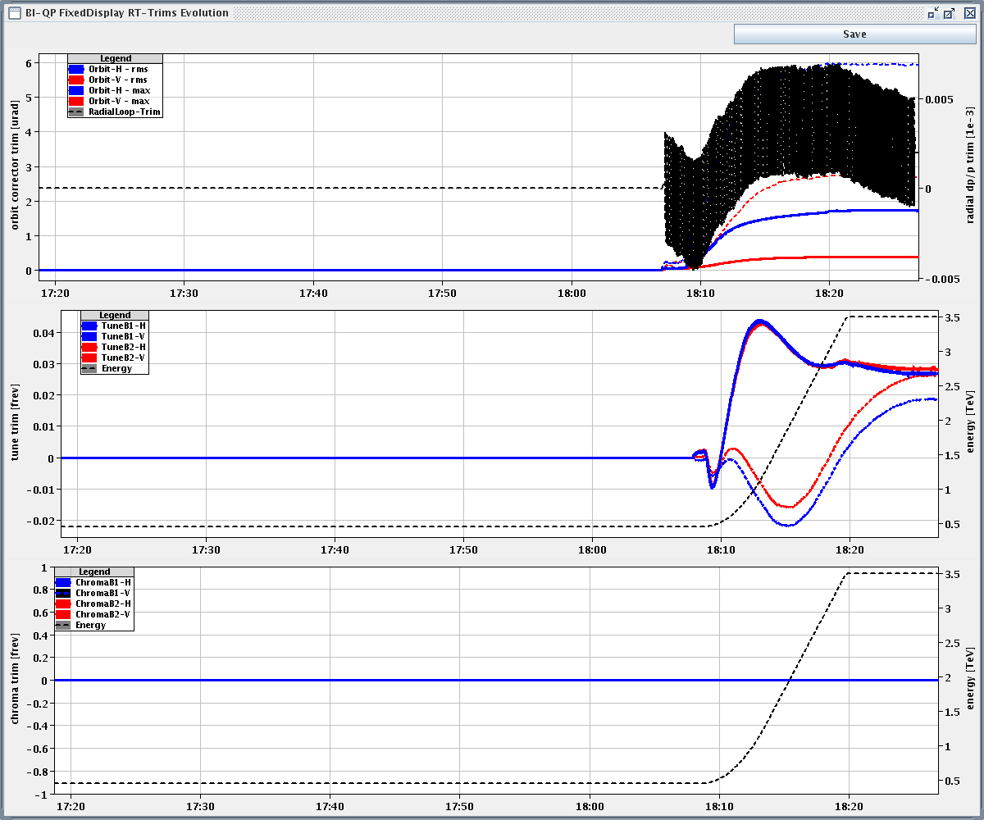
RAMP 3 – 18:00 Tune

Slide 8
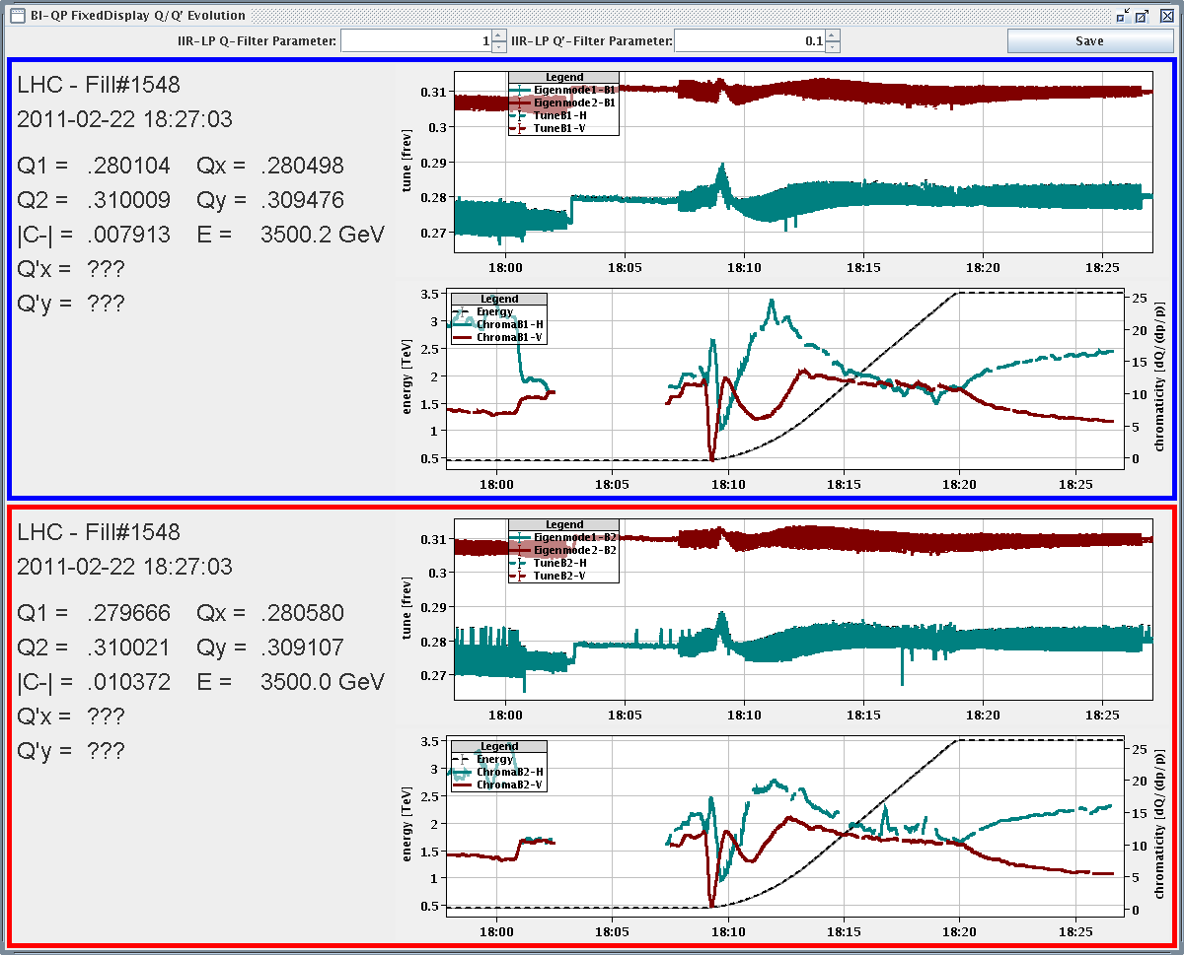
Chromaticity in ramp

Slide 9
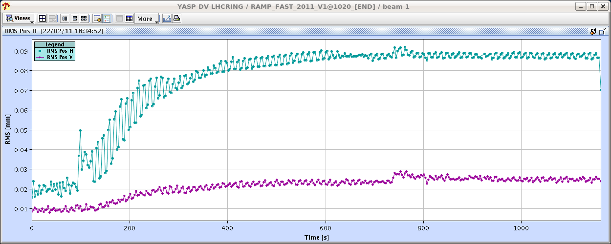
Orbit in ramp
Orbit RMS evolution during the ramp, vertical plane was kept better than 30 um during the ramp, horizontal better than 70 um, dominated by offsets around the IRs that cannot be corrected by the Orbit-FB

Slide 10
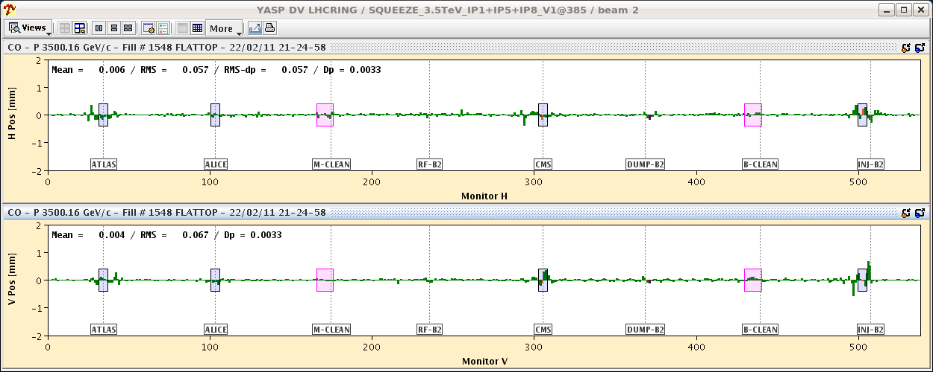
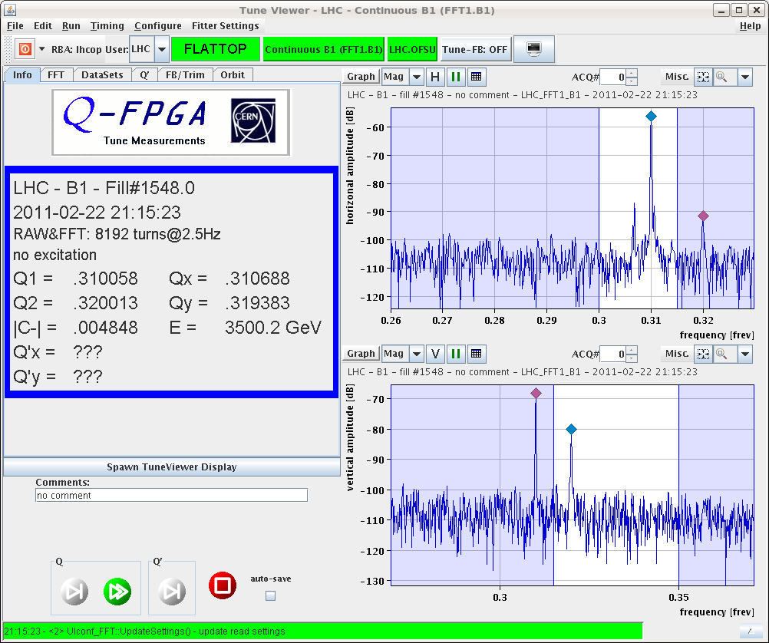
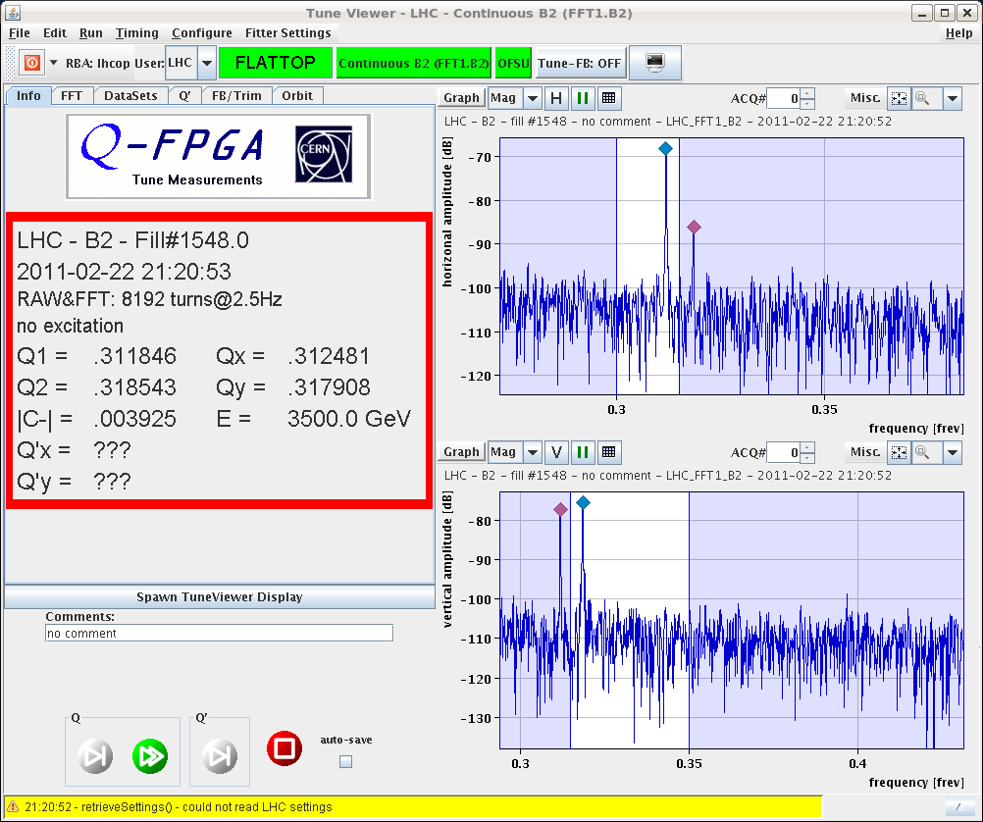
Squeeze (β*=3 m)
Orbit, coupling correction, beta beating measurements

Slide 11
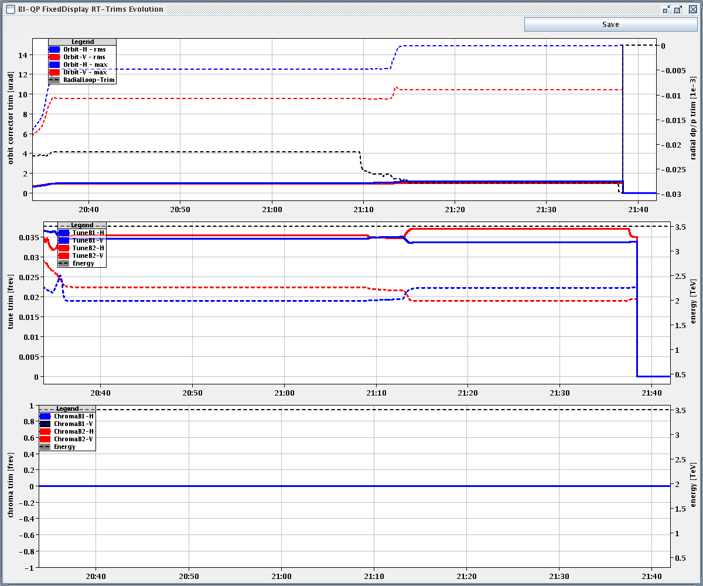
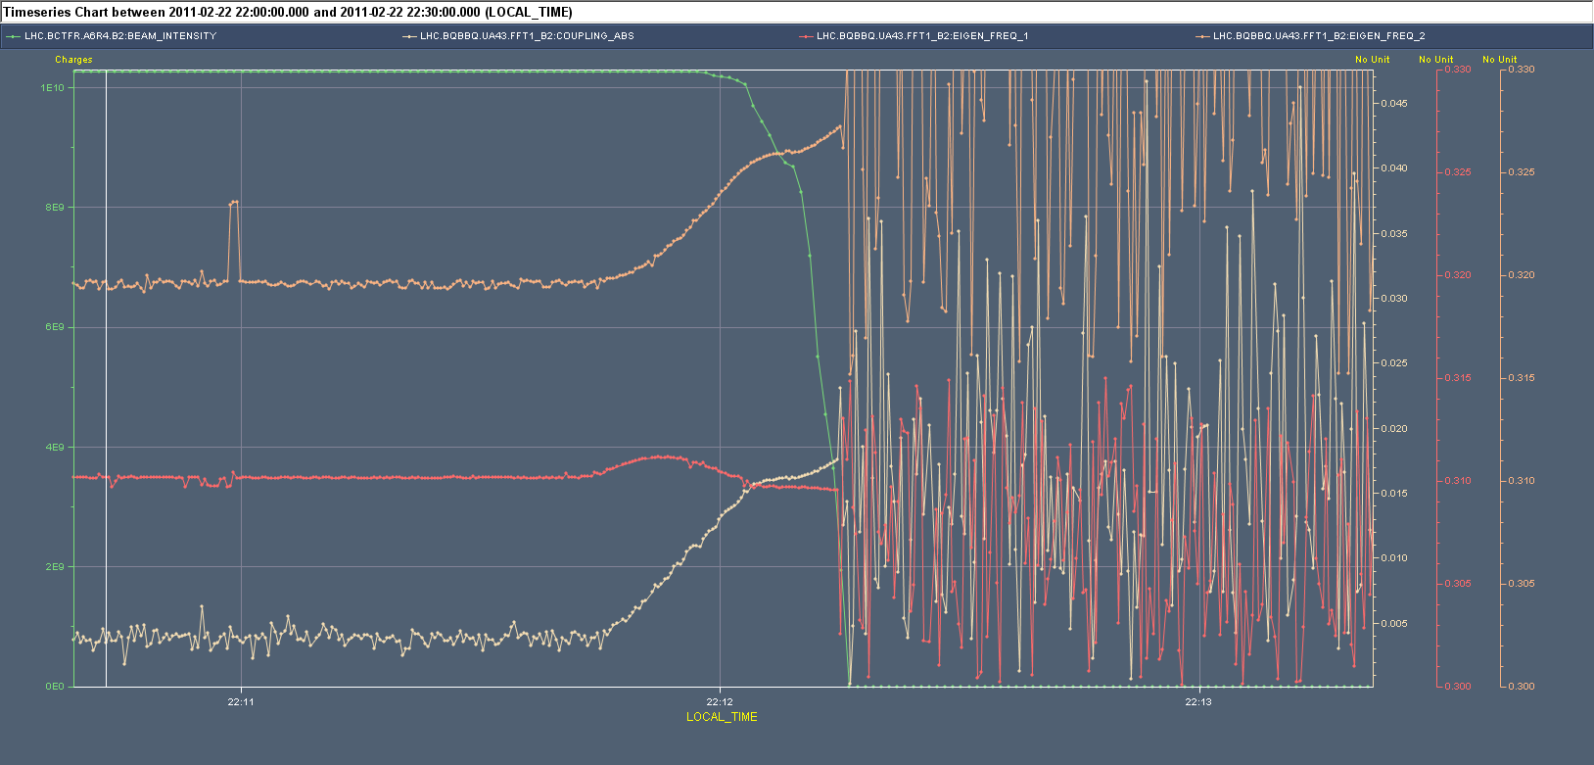
Squeeze
Squeeze (β*=3 m to 2 m): OFSU does not read any real time trim. Switch OFF the feedbacks.
Squeeze (β*=3 m to 1.5 m): Coupling increasing during the squeeze. B2 loss

Slide 12
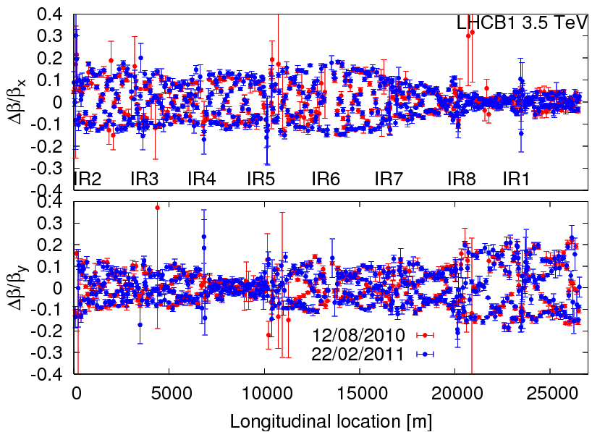
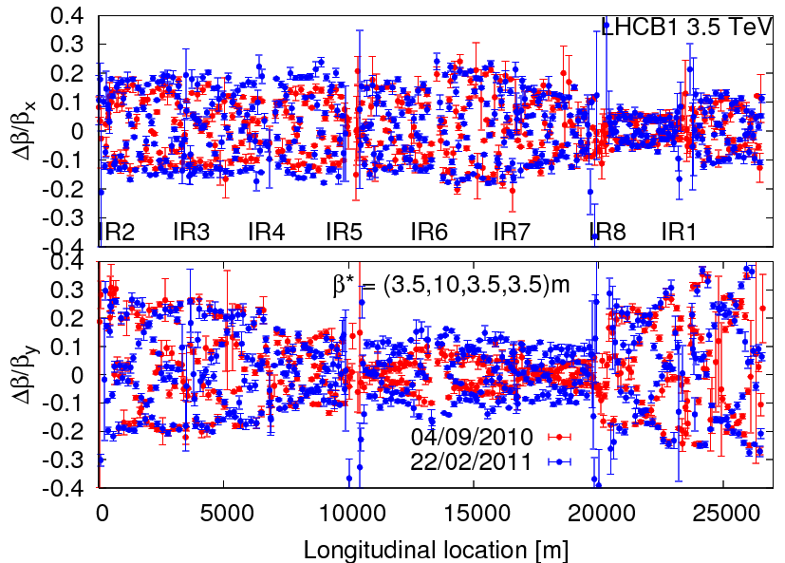
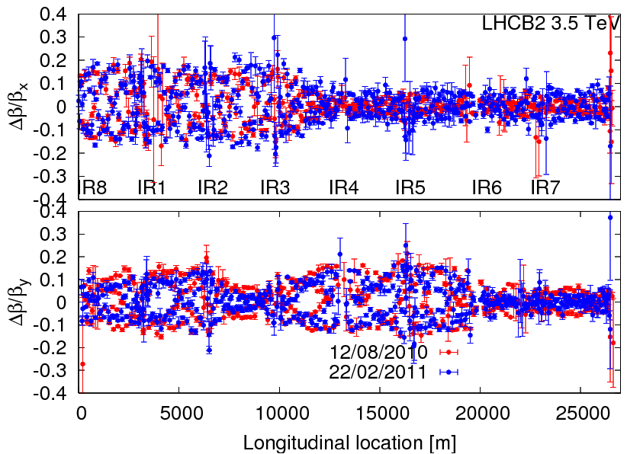
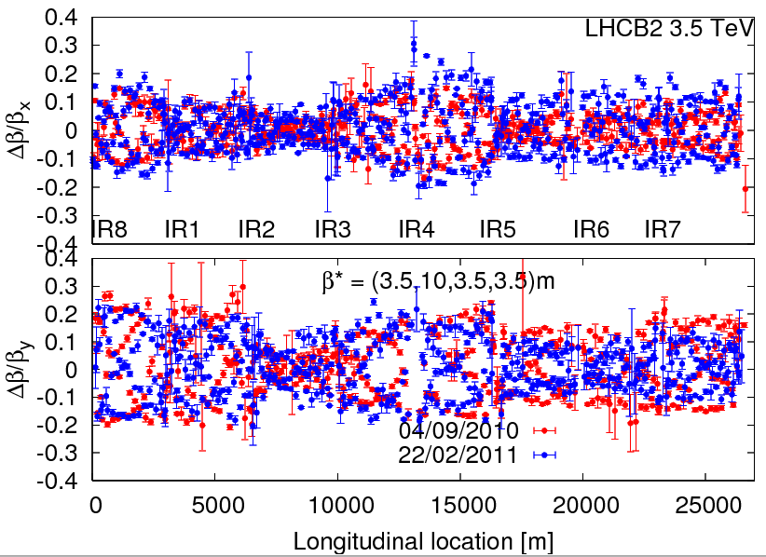
Squeeze (β*=11 m, 3.5 m)

Slide 13
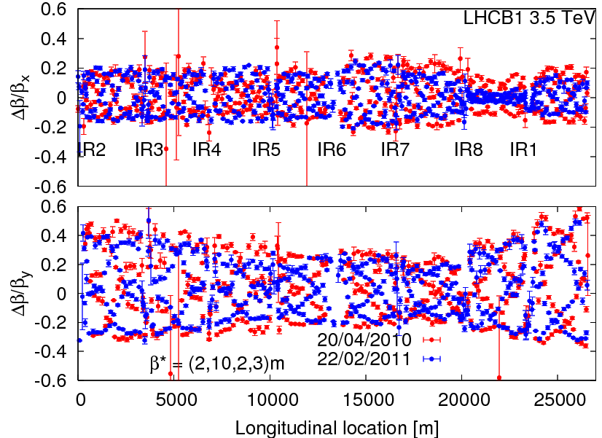
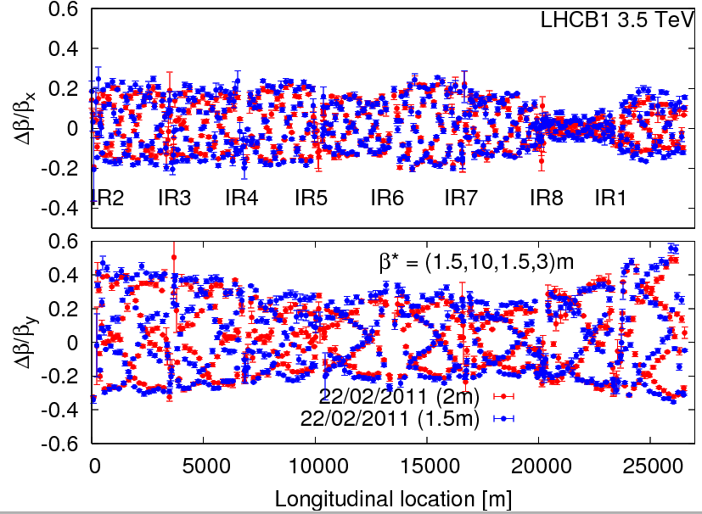
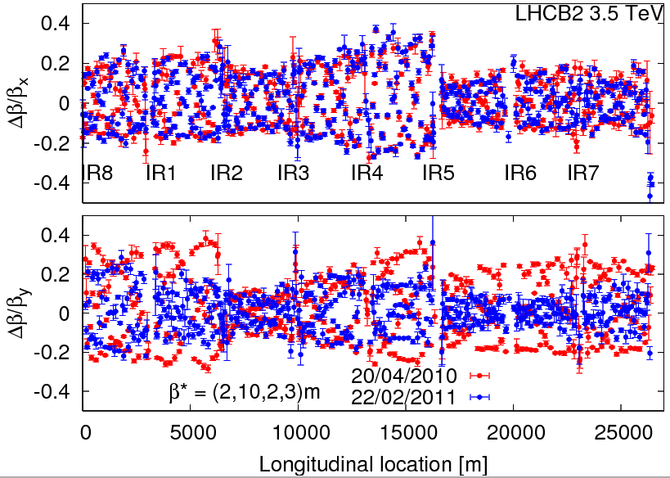
Squeeze (β*=2 m, 1.5 m)
Corrections to be calculated and implemented

Slide 14
Overnight
LBDS Test: Beam dump at 1.4 Tev
LBDS Test: Beam dump at 2.4 Tev
Chroma measurements at injection and start of ramp

Slide 15
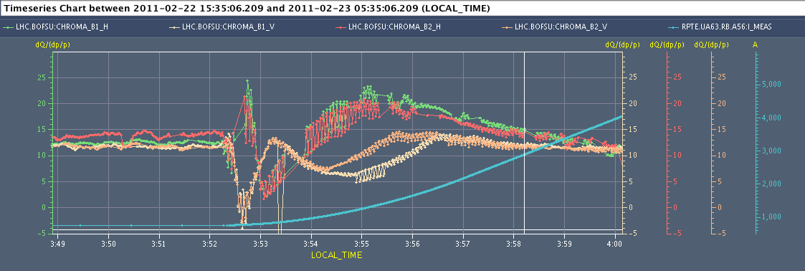
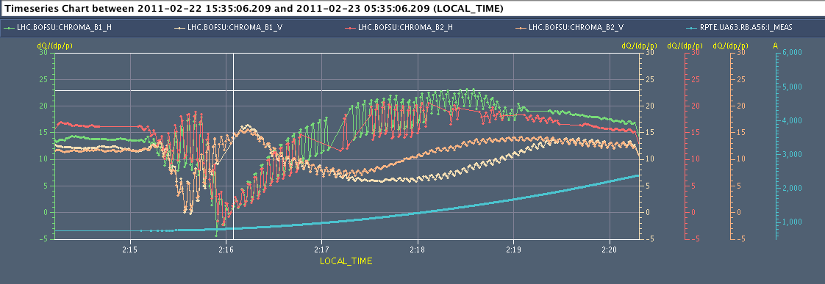
Time from RB@100A to Ramp start = 60min
Q’H
Q’V
Time from RB@100A to Ramp start = 129min
Q’H
Q’V

Slide 16
B2 Chroma Evolution at 450 GeV
B1 not injected as problem with vacuum signal input to LBDS (Vacuum_1_Digital) that caused the MKB_1 to trip.
Alick Macpherson

Slide 17
Incoming
Weds am | Cryo intervention in point 2
Weds pm | Injection nominal bunch
Weds pm & night | Reference orbit at 450 GeV + bump non-closure. Experimental dipoles.
Weds night | Transverse damper setup
Orbit feedback with variable separation and crossing angle through the ramp
Aperture at injection
Beta beating correction and measurement through the squeeze
Reference orbit at flat-top and during the squeeze with separation / crossing angle

Slide 18
Access
Cryo intervention Pt. 2 Wed 23/2: ramp down at 08:00
Access from 09:00 – 12:00
Requiring RP:
ZDC. R1 for ATLAS (2 hours)
RCBH30.R2B1 (UJ27) – EPC Piquet
DFBAH-LCM pressure controllers in Sector 45 (UJ47) - Cryo operator
RPLA.30L4.RCBV30.L4B1 (UJ43) – EPC piquet
Long. Prof Monitor – RA43/47 – F. Roncarolo
UJ56
RCBV11.R8B1, RCBH31.L1B2, RCBH34.L1B1 – 60 A power converter (UJ87) – L. Ceccone
RSS.A78B1, RPMBB.RR77 and RPMBA.RR77 –problem (UJ83 – towards pt. 7) – M. Bomont
RQT13.L7B1 tests (UJ67) – M. Bednarek
Wifi problem in RE72 (UJ67 – IT)

Slide 19
Access
Not requiring RP
UPS problem in US45
Network intervention UA43/47 and US45 (I. Gard)
Access in point 8 (UA83) RSFF2.A78B2 switch
Access in point 6 (UA63) RQTD.A56.B1 switch
Intervention not requiring access in the tunnel:
Power converter RD1.R5. Issue with the temperature of the building

