Slide 1
Saturday 26 November 2011

Slide 2
Fill 2325
7:15 near the end of the ramp: He pressure spike (kept conditions) on cavity 1B1.
ALICE squeeze: Switched off H tune FB around 2.5m for B1 and B2
08:00 Stable beam fill 2325.
12:39 BGI gas injection
13:11 dip in lifetime (beam intensity, luminosity) and bunch length; abort gap intensity going up to 5E9.
13:46 beam dump by QPS: trip of sector 45 (discharge request on RQF/RQD.A45)
Access RF: fix PLC problem of line 6.B1 (during fill 2325 Beam 1 was running without cavities 2B1 and 6B1 and RF total voltage beam 1 set to 6 MV at injection and 11.5 MV at flat top). Put total voltage to 7MV (as before last night) at injection and to 12 MV at flattop (was 12.25 before last night). (B2 at 12 MV as well).

Slide 3
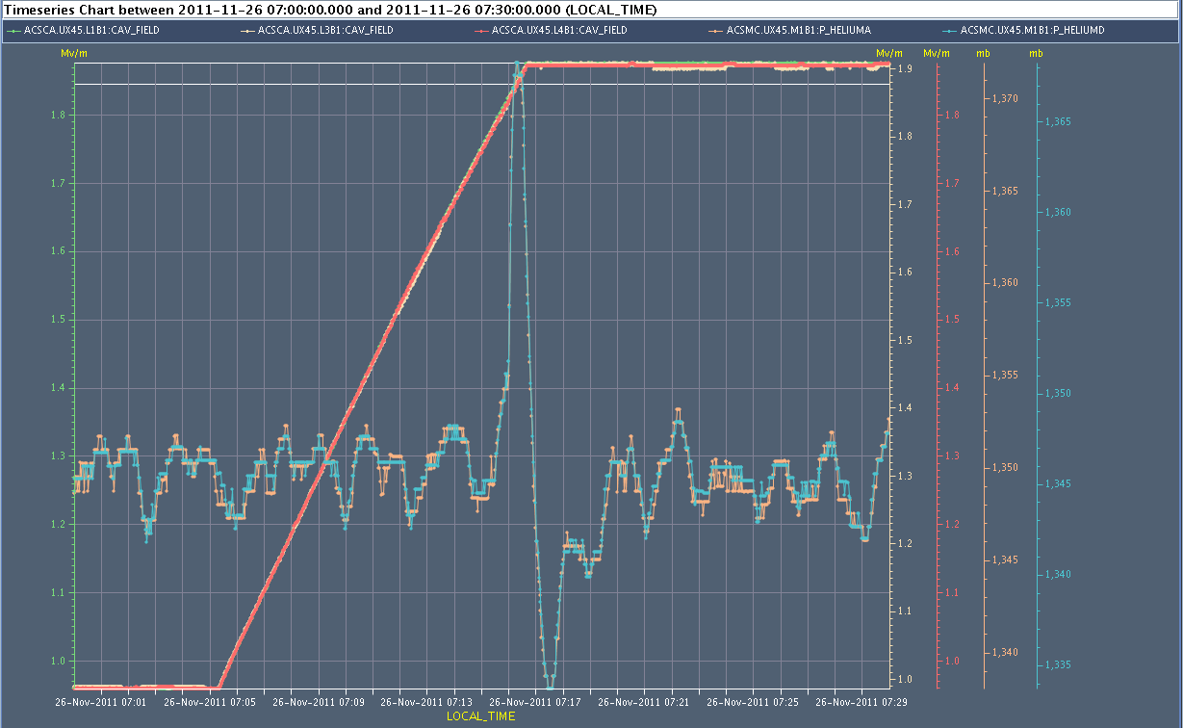
Fill 2325
helium pressure spike in M1B1, cavity voltages around 1.85 MV. Fortunately not big enough to trip

Slide 4
Fill 2325
13:11 dip in lifetime (beam intensity, luminosity) and bunch length; abort gap intensity going up to 5E9

Slide 5
Fill 2327
Fill 2326 dumped by operator as filling took too long (20’ SPS RF problem)
Fill 2327:
ALICE squeeze: Switched off H tune FB around 3.5m for B1 and B2.
19:58 Stable beam fill 2327
20:31 Beam dump: LBDS Self-trigger: MKB beam 1 faulty
Kicker piquet found the vacuum pump VRPA.683206.DB (in the dump line of B1) OFF with an over-current fault. Vacuum piquet reset the fault and switched it back on.
Kicker piquet: Bad vacuum (vacuum pump switching off) triggered the dump due to a bad vacuum pressure at the dilution kickers MKBH67.A and MKBH67.B

Slide 6
Fill 2328
0:03 Stable beam fill 2328
Peak Lumi ATLAS / ALICE / CMS: 5.3 / 4.3 / 4.5 10²⁶ cm-2s-1
6:11 Programmed dump
5.6 Atlas Int. lumi [ub-1]
0.9 Atlas Int. lumi [ub-1]
6.4 Atlas Int. lumi [ub-1]

Slide 7
Others
Cryo Pt8: Conditions have stabilized for the filter of cryo Pt8. We can carry on without stop of the cryo. Will hopefully be fine till end of run.

Slide 8
Outlook
Now: access for QPS reset MB cell 11 L1
ALICE polarity change probably Monday
VdM scan probably Tuesday
Quench MD (approx. 8 hours, at the latest on Monday 5.12.): induce losses (using ADT or resonance crossing) at IP7 collimation and possible magnet quench in DS (cell 11 left of IP7)

