Slide 1
Saturday 29th October
Friday during IP2 1 m squeeze test
19:53 beams dumped, electrical glitch. Cryogenics lost in sector 12.
11:00 Cryo recovered. Starting precycle
ATLAS needs an urgent access after pre-cycle.
12:08 Precycle finished, ATLAS access starting
13:37 Injecting probe beam
14:20 Ramp starting, with pilots for 1 m b* tests at IP2 for ion run Start with optics measurements
18:00 Start with collimator alignment IP2
19:00 Start aperture measurements
00:40 Loss maps, betatron H & V
Beam Dump XPOC/IPOC problem with cfi-ua63-mkdpm2 and cfi-ua67-mkdpm2 , some resets
02:40 Transverse damper checks: OK (ions set-up remains to be done)
04:00 Some injection steering
07:27 Stable beams with enhanced satellites, fill #2266

Slide 2
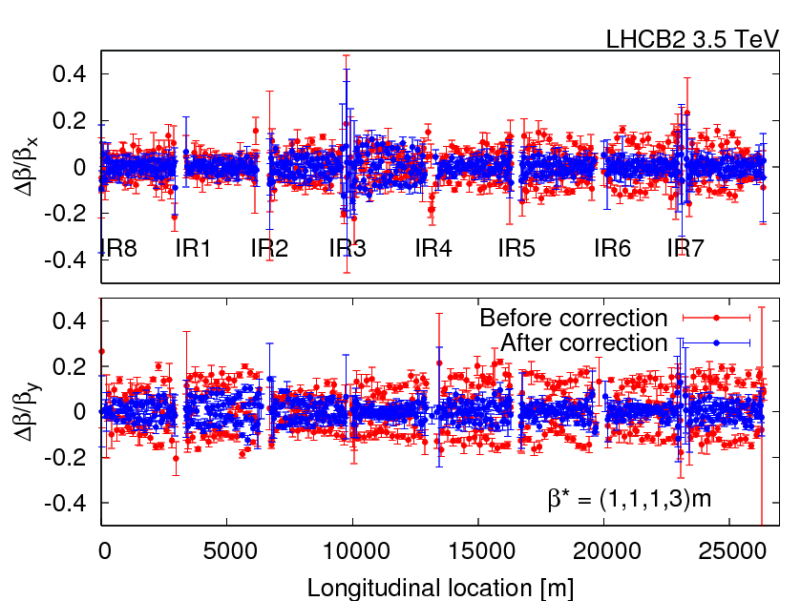
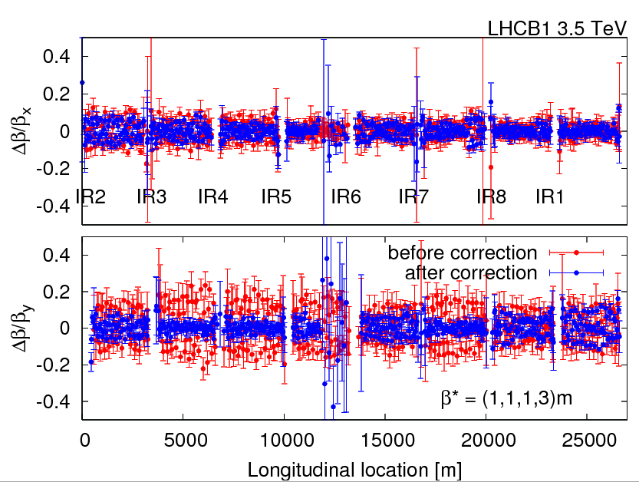
IP2 squeeze 1 m, in prep. of ion run
Checked coupling and other optics corrections applied yesterday that were incorporated
The coupling correction was increased from a knob value of 0.8 to 1.1. Resulting coupling about 0.0017, both beams
Beta-beat correction was calculated for beam 1 and beam 2. Only 20 correctors, for both beams, around IP2 are used. This resulted in a reduction of the beta-beat from 20% to a peak 10%.
betastar was measured with the K-modulation

Slide 3
Collimator setup for the 4 TCTs in IP2
Used the same beam as for the optics checks
The TCTH.4L2.B1, TCTVB.4L2, TCTH.4R2.B2 and TCTVB.4R2 collimators were setup at 1.0 m beta* in IP2.
Machine configuration:
Squeeze and separated beams;
Separation = 700 um (B1);
Crossing angle = -80urad (ALICE positive polarity).
The beam size ratios are OK (within 110%).
The setup took 1 hour.
Summary of beam-based centres: TCTH.4L2.B1/BBCentre -0.593 TCTH.4R2.B2/BBCentre -0.728 TCTVB.4L2/BBCentre 3.498 TCTVB.4R2/BBCentre 2.372

Slide 4
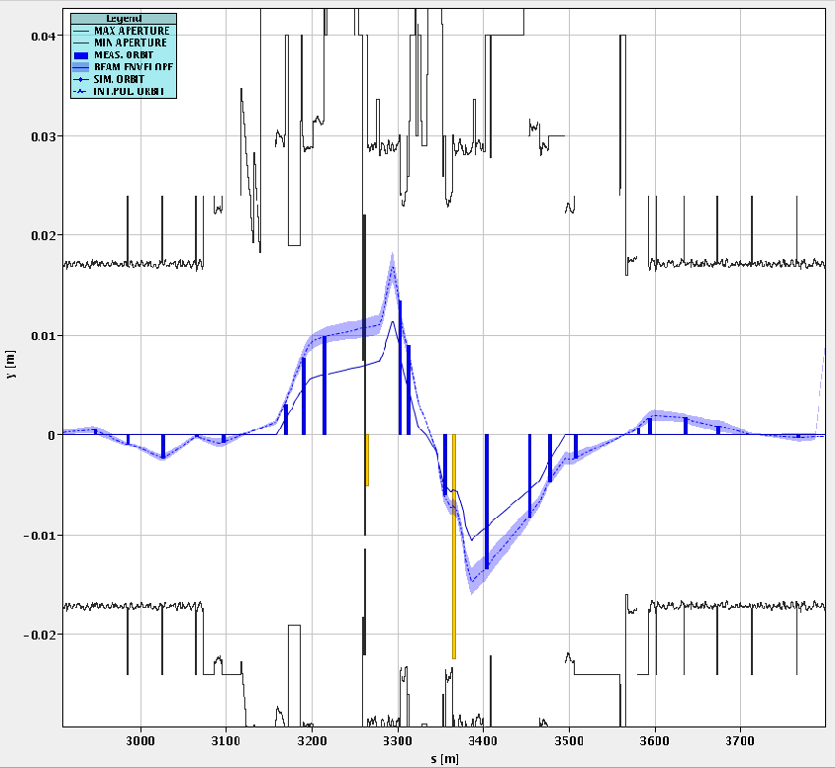
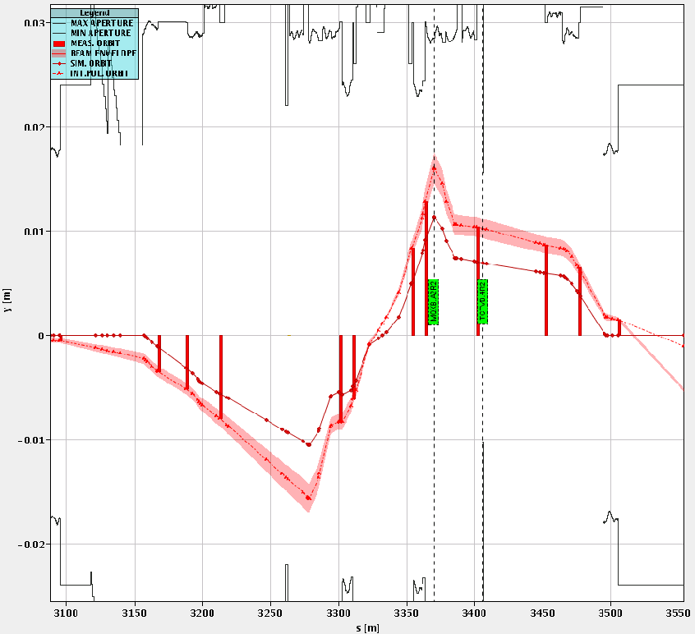
Measured beams at IP2 with apetures
B1
B2

Slide 5
Triplet Aperture Checks in IP2
We performed the local IR measurements with the technique used already in IP1 and IP5: Local crossing bumps are added to the reference orbit in the crossing and separation planes. An alignment of the TCTs of IR2 was performed to establish reference centres and accurate 12sigma gaps.
Starting configuration: -80urad crossing angle; squeezed beams (1m) and separated by 2 x 700 um.
For IP2, we immediately noticed that the strength of the standard lumi angle knobs was not sufficient to probe the aperture. So, we had to add on top of them additional crossing knobs generated with the correctors upstream (separated knobs for B1 and B2).
For the vertical planes, we found some puzzling results because we saw indication of aperture restrictions upstream of the TCTVB collimators. We did not manage to reach the aperture of the triplets.
The minimum aperture for the vertical case were found to be:
B1-V -> 15.5 to 16.0 sigmas
B2-V -> 16.0 to 16.5 sigmas
For the horizontal planes, the measurements were cleaner. We found:
B1-H -> 16.0 to 16.5 sigmas
B2-H -> 15.5 to 16.0 sigmas
Note that these results are given in terms of TCT aperture corresponding to the opening that "exposes" the triplet aperture. These results depend slightly on the shape of the bumps used to probe the aperture and therefore detailed offline analysis is required for precise quentitative estimates.
Parasitically, we also measured tune shifts versus orbit amplitude. The results will be analysed.

Slide 6
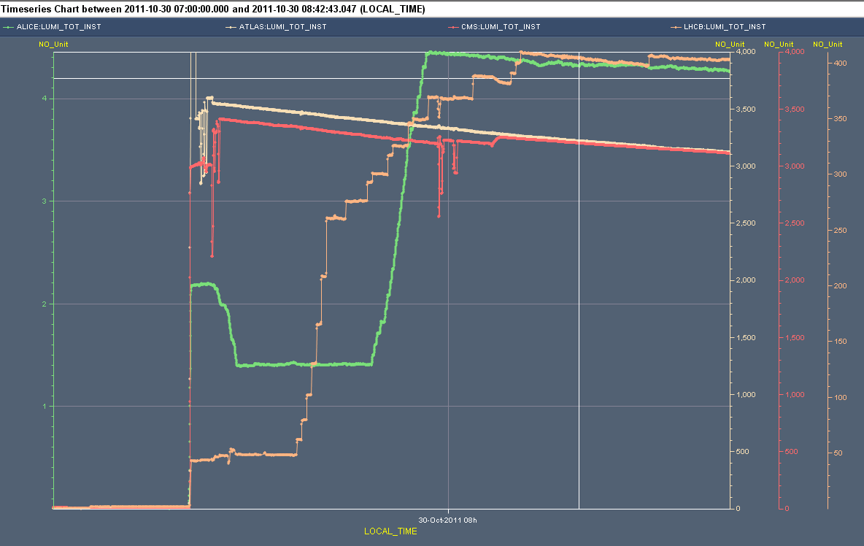
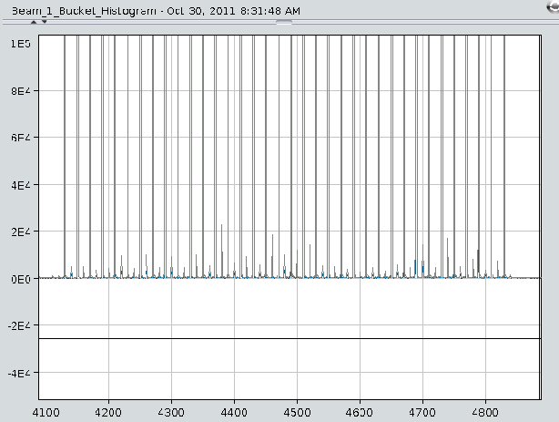
Fill #2266: Lumi’s and satellites
4000
400 LHCb
4 Alice
Reduced enhanced satellites of 1- 2 % of main bunches

Slide 7
The Plan for Sunday
Physics
End of fill studies (if possible):
Reduced ADT gain of 30 % for about 2 hours (check beam lifetime, emittance growth, luminosity lifetime)
ATLAS ~10 minutes of beam separation by
+/-3 sigma separation in the vertical plane
+/-1 sigma separation in the horizontal plane
Sunday 17:00, t.b.c., End of proton physics 2011
18:00 Sunday – 6:00 Saturday 5 November: MD block 4

Slide 8
MD Program
https://espace.cern.ch/lhc-md/default.aspx
Day | Time | MD | MP
Sun | 16:00 (?) | Ramp down, cycle
 | 18:00 | 450 GeV → 3.5 TeV: Dry run ATS optics | A
 | 21:00 | Ramp down, cycle
 | 23:00 | 450 GeV: Tune working points – half integer WP, more space for tune footprint, lower crossing angle, lower beta*, … | A
Mon | 07:00 | 450 GeV → 3.5 TeV: Proton-Lead – feasibility of new physics scenario | A/B
 | 23:00 | Ramp down, cycle

