Slide 1
Tuesday 25th October
08:22 Dump the 25 ns spaced 2100 x 1020 bunches
08:30 – 09:30 25 ns tests with different spacing between trains
Until 12:00: Access
Problems getting back
BLM sanity check repeated 4 times, HC.BLM.SR6.C - Connectivity: ERROR, not the first and not the last time…
14:00 Injecting pilots
15:15 Injecting high intensity bunches for pile-up tests
16:20 Stable beams & separation tests
19:40 Dump & test squeeze in IP2 without beam
We do the dry run for Alice squeeze at 1 meter beam process. The RQ5.L2B2 tripped during the squeeze, followed by the RQ5.L2B1.
21:20 Waiting for beam from the SPS, RF problem
22:00 RQT13.R5B1 tripped while sitting at injection without beam
Piquet said that in case it trips again it will need an access, but he hopes that it can survive the night. This converter had tripped already once last 17 October and one more time one month before that)

Slide 2
Tuesday night
22:30 injecting probes
23:30 SIS interlock for RQT13.R5B1/B2 due to a LT_Fip_Com_lost, Piquet QPS called
00:00 Loss of PIC when powercycling RQT13.R5B1&B2: again
02:30 Sandrine analysed the last trip of RQT13.R5B1 and she is not sure if in fact the problem is that the circuit quenches at injection. We finnaly agreed on resetting and trying to proceed
05:00 Lots of problems with BPM in IQC and YASP. BPMs missing in yasp again. Called Ralph S. for BPM front-end problems. Complete reboot of crate instead of restarting processes.
06:22 Stable beams, initial lumi around 3.5e33 cm-2s-1

Slide 3
PM of 25 ns MD
The injection of the beam was strongly hampered by the pressure rise on MKI8 and in particular by magnet D. Because of that the filling scheme had to be adapted to minimize the pressure rise and therefore the impact on the filling rate.
During a soft-start of kicker MKI8 a pressure spike has occurred and it required an extended conditioning
HV magnet break down due to the bad vacuum
Finally managed to inject 2100 (B1) against 1020 (B2) bunches with spacing of 925 ns between trains of 72 bunches.
Blow-up and losses are still observed along the bunch trains but there is a trend to improvement of the lifetime
Heat load data have been collected as well as vacuum data and they indicate an improvement when normalized to current but they must still be analyzed in detail
The last hour was dedicated to collect data in steady conditions.
From 08:30 to 09:30 we took some measurements with trains of variable spacing to try to quantify SEY and reflectivity at the end of the scrubbing
Gianluigi and vac team

Slide 4
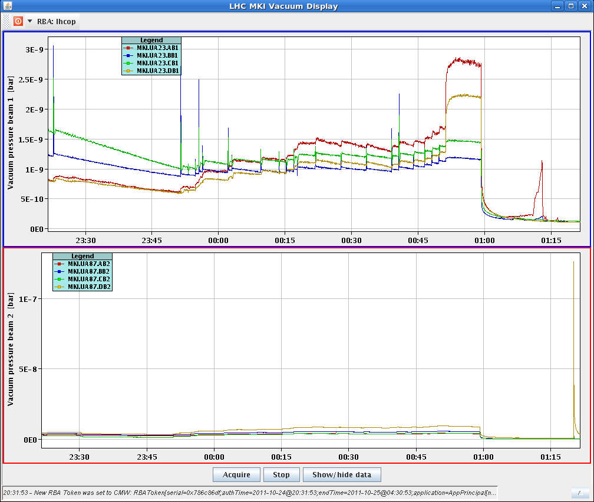
Injection kicker MKI HV break down
Happened during soft start after scrubbing period with bad vacuum
At voltage which was slightly above nominal
Vacuum spike of few 10-7

Slide 5
Injection kicker MKI HV break down
Electrical breakdown in MKI8-D kicker magnet during SoftStart (54.3kV, 1200ns). This followed an extended period of 25ns beam and vacuum of ~9e-9mbar in the MKI8 tanks as well as high pressure in the nearby beam pipes.
ALL electron cloud solenoids were turned off around the MKI8 kickers resulting in the high pressure.
Confusing about the ecloud coils during the MD
*** ECLOUD CIRCUIT VIESA.193.5R8.C MUST *NOT* BE TURNED-OFF, EVEN DURING SCRUBBING, AS THESE SOLENOIDS ARE ON THE INTERCONNECTS BETWEEN SOME OF THE MKI8 KICKER MAGNETS ***
*** ECLOUD CIRCUIT VIESA.3.6R8.C CAN BE TURNED-OFF FOR SCRUBBING. THESE SOLENOIDS ARE ON THE MKI SIDES OF Q4 & Q5, but are not extremely close to the MKIs ***
The electrical breakdown demonstrates the de-conditioning of the MKIs by high pressure (as per 17 April 2011). This also reinforces the importance of the SIS MKI vacuum interlock (normally set to 2e-9mbar, but relaxed to 2.5e-9mbar for the 25ns MD).
We should consider to always run an extended SoftStart (about 30 min instead of 10 min), following a period of time with high pressure in the MKI tanks, to re-condition the kicker magnets
Mike Barnes

Slide 6
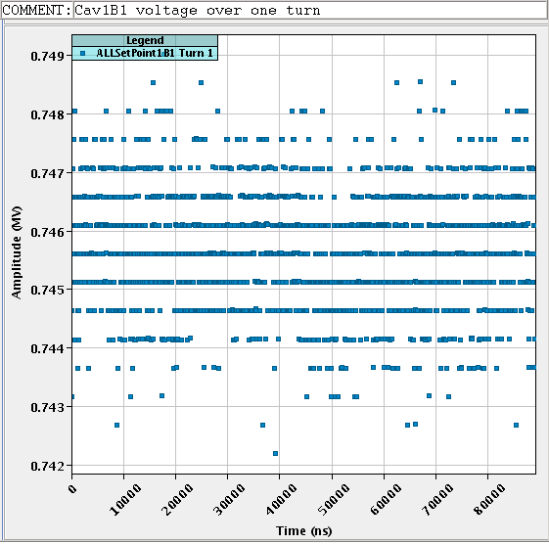
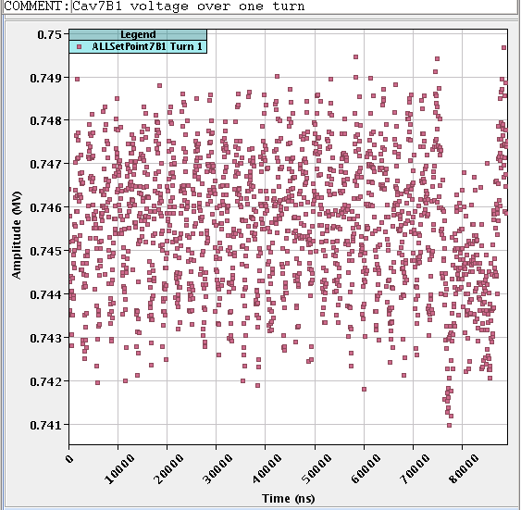
RF with 25 ns
Philippe & Co.
The 1-T feedback loops were commissioned on all cavities (except for 7B1) with the 25 ns MD beam last night.
This system compensates for the transient beam loading caused by the gaps in the beam current.
With 1E11 p/bunch at 25 ns spacing, the local beam intensity ( and therefore the resulting transient beam loading) is 30% higher than with 1.5E11 p/bunch at 50 ns spacing.
With 25 ns spacing the system showed a very significant (factor five) reduction of the cavity phase modulation (caused by beam current) that was reduced from 4 deg pk-pk to 0.8 deg pk-pk.
The demanded klystron peak power did not change significantly.

Slide 7
Access
Request from ALICE for 1 hour
Finally took about 2 hours
ALICE
Problem on the UJ14/16 PADs delayed the intervention of ZDC people.
List of accesses: - QPS for power-cyle on QRD/F controller in cell 11L4; - QPS restart of PC in UA83; - ButMons removal in UX65; - check of buffer zone by RP in PZ33; - RF, BI and EPC at point 4; - ALICE (twice); - ZDC experts.
RF
This morning we went in UX45 to solve the problem with 7B1 (cables disconnected!!!!). Its 1-T fdbk is now operational. We then spent an hour checking the behaviour in physics settings (Q=60k, 1.5 MV/cavity). The system is operational on all cavities and will be used for all beams from now on.

Slide 8
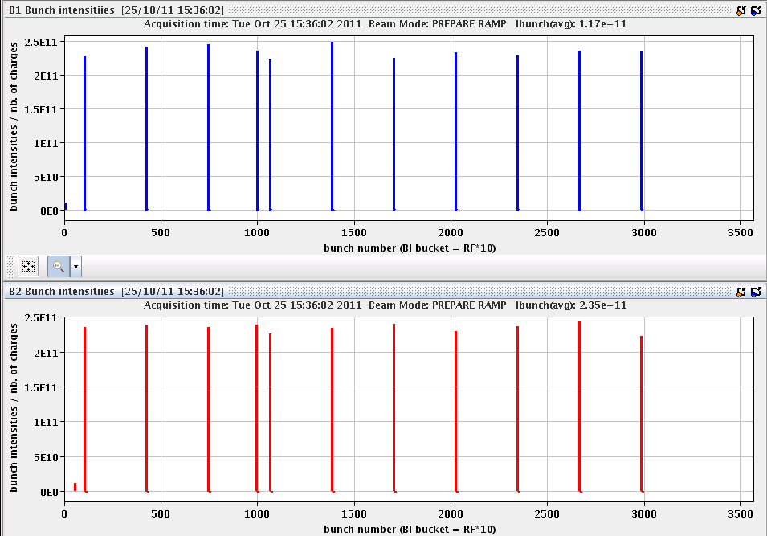
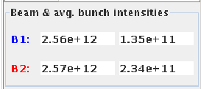
High pile-up physics run (not an MD)
2 x 11 bunches
average bunch intensities fooled by tails...

Slide 9
Pile-up run
Georges, Giulia, Michaela, Werner, Xavier
Injected 11 high intensity bunches (2.3-2.5e11ppb, ~2um at the SPS) to give IP1/5 10 high pile-up colliding pairs (+1 colliding pair for IP8 and IP2)
Minimized the time at injection by a semi-dedicated SPS supercycle (LHC4+CNGS only)
Observed emittance blow up at the LHC: ~3-3.5um in collisions from wire scanners
Achieved a peak pile-up of about 35
Observed once again the impact of number of HO collisions of loss pattern (lower losses for lower number of HO collisions)
Separation scans to reduce the pile-up in steps for both CMS and ATLAS (~20% reduction per step)
At the end, turned off ADT with head-on colliding beams to observe possible coherent modes
Additionally, acquired orbit data which will be looked at offline.

Slide 10
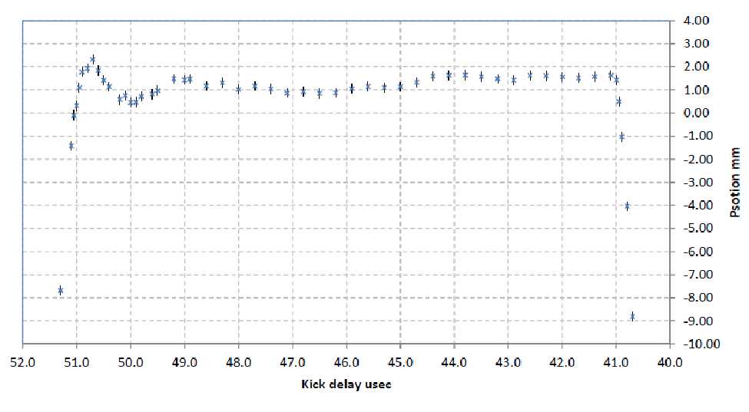
SPS extraction kicker MKE4 waveform scan
Brennan, Verena
Performed on SPS with TT40 TED in
Data from BTV.400343
Understand problems with steering of B2 and injection oscillation pattern
Clearly, steering with 12b in the first few hundred ns is not optimal
Resulting in beam not well centred when using 144 bunches = full kicker length
Watch that scale!

Slide 11
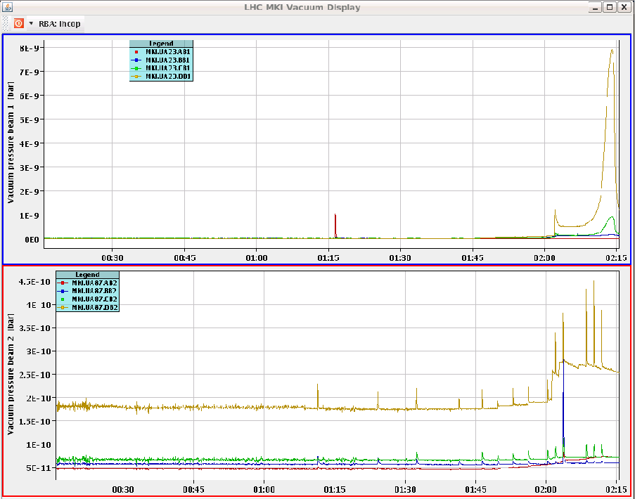
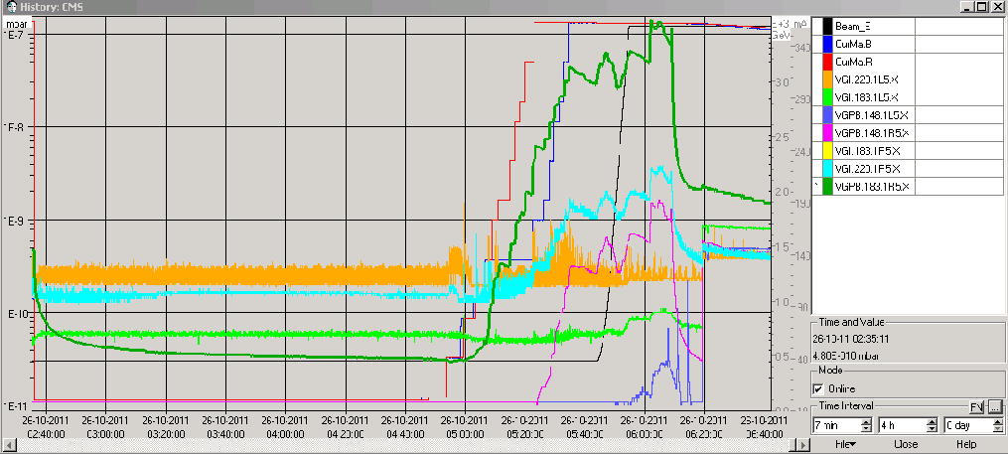
Physics fill #2254
Filling, MKI2 vacuum up to 8E-9
CMS vacuum up to about 10-7 again
Lumi around 3.5e33 cm-2s-1
OK when going into collisions

Slide 12
The Plan
Physics
Thursday PM: run with enhanced satellites
And likely some smaller intensities for the normal bunches
Friday: test of IP2 squeezed optics and aperture measurements, in preparation of the ion run.
Scheduled for 24 hours.
Sunday 18:00: start of MD period

Slide 13
Magnets and luminometers during MD
proposals and wishes

Slide 14
Magnets
ALICE: no special intentions/requirements from expt. Can keep the magnets ON or OFF.
what is needed for the ion setup/MD this and next week ?
ATLAS: The ATLAS magnets will stay ON during the MD. ATLAS will then ramp down the toroid on Mon 7nov in the morning and ramp up again on Friday 11nov. The solenoid will stay ON.
CMS: expt would like to ramp down the solenoid on Tue 1nov, for a filter regeneration. This will be completed sometime during the TS week and CMS will ramp up the solenoid when ready.
must wait for end of 25ns ? possible shift of MD ?
LHCb: prefer to put OFF and only turn ON if needed for an MD.
Indeed, needed for 25ns 20deg crossing in IP8 (Tue 1Nov ?).

Slide 15
Luminometers
Subject: luminometer requirements during LHC MD
Dear Massi,
Here follows the list of MDs which require luminosity measurements:
- Sunday 23-7: tune working points;
- Tuesday 13-21: LR beam-beam with 25 ns beams;
- Wednesday 9-19: ATS and tight collimators.
Can you please circulate it to the experiments?
Thank you very much,
Ralph, Frank and Giulia

