Slide 1
Summary of Week 41
Machine Coordinators: G. Arduini, J. Wenninger
Main aims:
Luminosity production
MDs

Slide 2
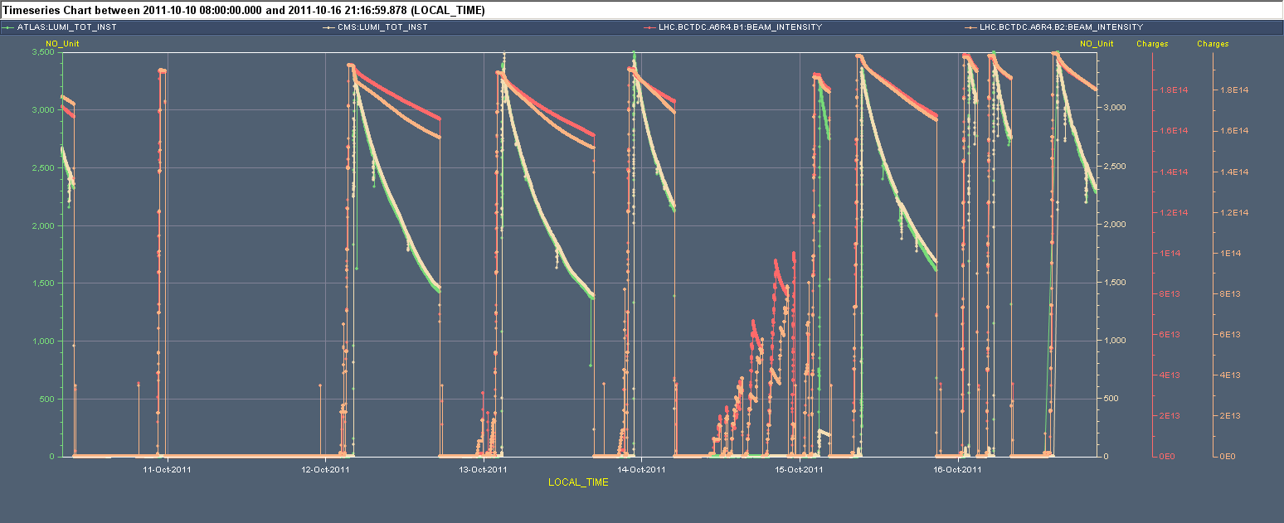
Week 41
25 ns MD
High pil-up
Cryo Pt. 6

Slide 3
Fill Overview (Mon 08:00 – Mon 08:00)
Summary of Week 30
G. Arduini, J. Wenninger
Main aims:
Adiabatic increase of peak luminosity by emittance reduction
Luminosity production
Fill | Peak L [10³³ cm⁻²s⁻¹] | Length [h] | Int. L [pb⁻¹] | Phase | Dump cause
2200 | 3.29 | 2 | ~15 | STABLE | IT L8 PC
2201 | 0.00 | 3.9 | 0.1 | STABLE | OP dump (High pile-up test)
2202 | - | - | - | ADJUST | CRYO PT. 6 (SEU?)
2204 | 3.34 | 13.1 | 99.8 | STABLE | Vacuum spike (BGI)
2208 | 3.39 | 13.6 | 102.4 | STABLE | OP dump
2210 | 3.48 | 6.2 | 58.7 | STABLE | RQ5.R5 QPS (SEU)
2215 | 3.26 | 1.5 | 15.7 | STABLE | CURRENT LEAD RB.A56 (SEU)
2216 | 3.34 | 11.4 | 92.8 | STABLE | RQT12.L5B2 (PC)
2217 | 3.46 | 1.2 | 13.1 | STABLE | RF (HOM – 4B2)
2218 | 3.49 | 2.6 | 28.7 | STABLE | RQT12.L5B2 (PC)
2219 | 3.5 | 15.5 | ~122 | STABLE
Total |  |  | ~550 (85)

Slide 4
Main achievements (c/o ATLAS)
Peak Stable Luminosity Delivered | 3.50x10³³ cm⁻²s⁻¹ | Fill 2219 | 11/10/16, 06:14
Maximum Luminosity Delivered in one fill | 122.44 pb⁻¹ | Fill 2219 | 11/10/16, 06:14
Maximum Luminosity Delivered in one day | 135.45 pb⁻¹ | Thursday 13 October, 2011
Maximum Luminosity Delivered in 7 days | 546.35 pb⁻¹ | Mon 10 October, 2011 - Sun 16 October, 2011
Maximum Peak Events per Bunch Crossing | 29.83 | Fill 2201 | 11/10/10, 07:59
Maximum Average Events per Bunch Crossing | 29.83 | Fill 2201 | 11/10/10, 07:59
Bunch population > 1.4x10¹¹ p

Slide 5
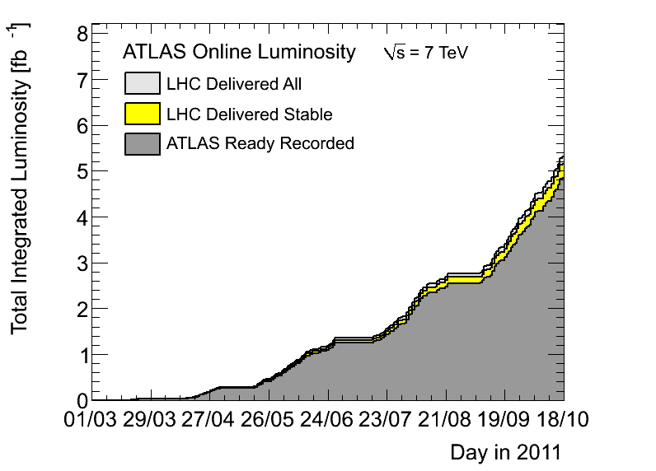
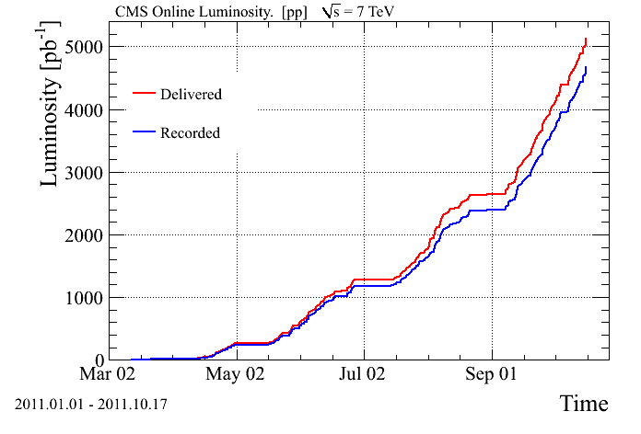
Integrated luminosity
> 5.1 fb⁻¹ in both high luminosity experiments!!

Slide 6
Statistics
70 h in stable beams ➔ 42 % (47 %)
6 h for high pile-up test
12 h for 25 ns MD
Major stops (33 h)
  Cryo Pt6 (Tue) 24 h
  Injectors (Mon,Wed) 7 h
  Power converters (Sun) 4 h
  TDI pt.2 – controls (Sun) 2 h

Slide 7
Sun/Mon
08:08 Beam dump due to power converter problem on RQT12.L5B2. End of fill #2218. 29 pb⁻¹ in 2.5 hours.
10:30-11:30 Access for power converter problem.
Vacuum spike observed during injection of first train of 144 bunches of beam 2 ➔ no losses observed
15:30 STABLE BEAMS #2219 3.5x10³³ cm⁻²s⁻¹ with 1.4x10¹¹ p/b
Several problems with DIP re-publishing to CMW ➔ fixed yesterday evening ➔ caused lumi spike in LHCb
Overnight LHCb reported issue with the filling pattern (being investigated)
07:00 OP dump End of fill #2219 ~122 pb⁻¹ in 15.5 h

Slide 8
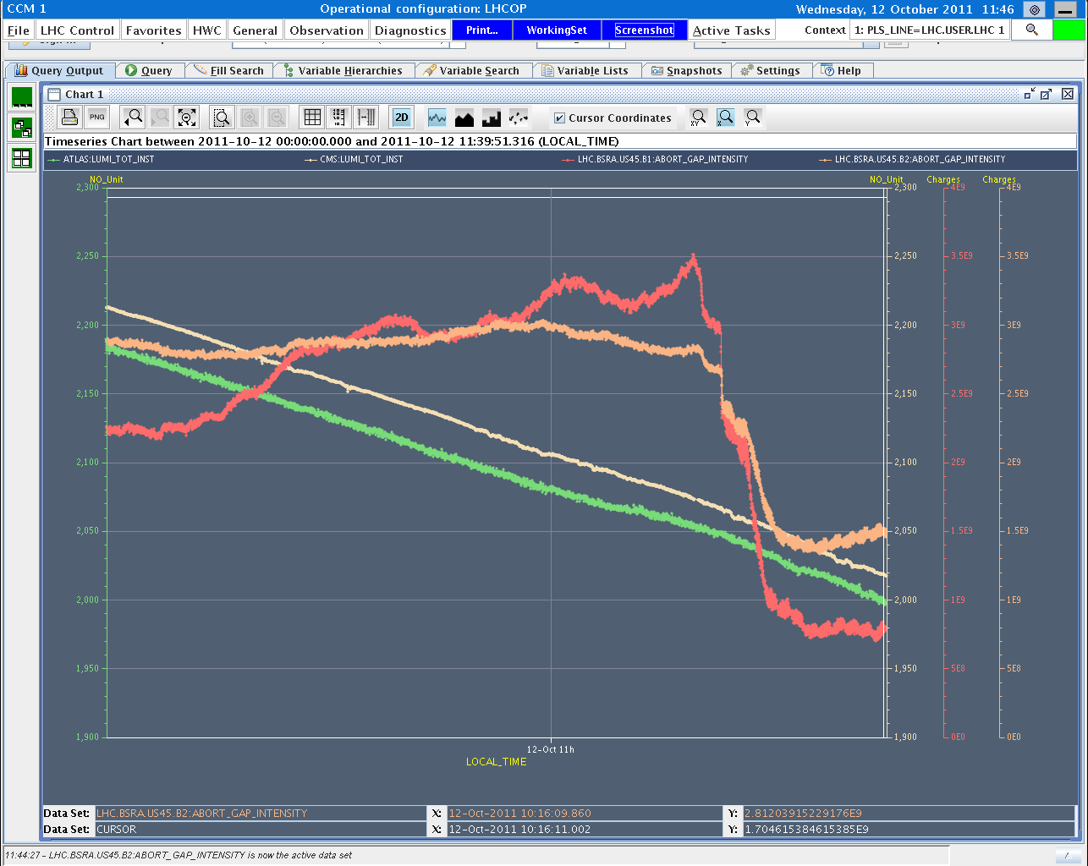
Abort gap cleaning tests
B1 AG pop
Lumi CMS
B2 AG pop
Lumi ATLAS
50%
100%
E. Gianfelice, J. Uythoven, D. Valuch

Slide 9
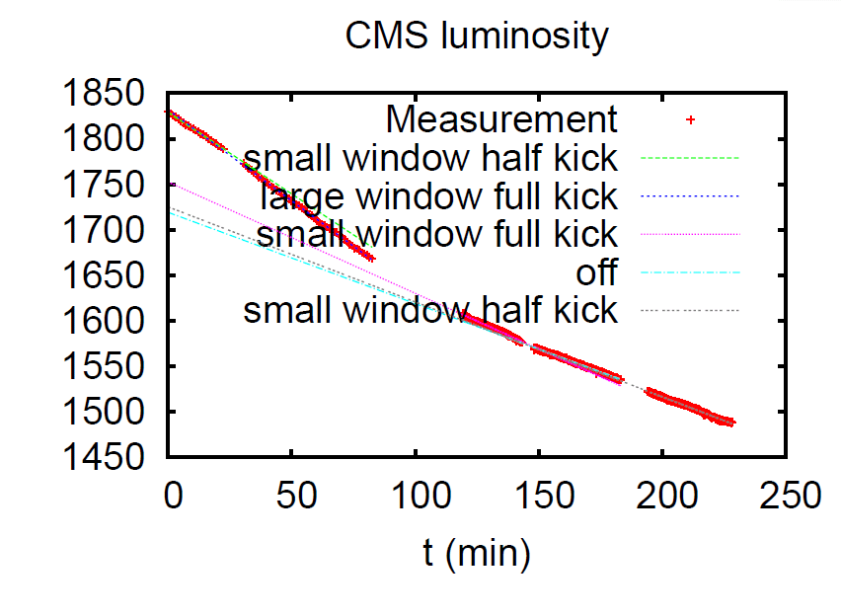
Abort gap cleaning tests
When cleaning switched on there is a small effect on the luminosity lifetime
Tested different strengths and 2 different excitation windows lengths
Proposed strategy: leave abort gap cleaning off and switch it on as soon as abort gap population reaches 1x10¹⁰ p and lower than 1x10¹¹ p. Announcer giving a warning when 1x10¹⁰ p level in the abort gap is reached
E. Gianfelice, J. Uythoven, D. Valuch

Slide 10
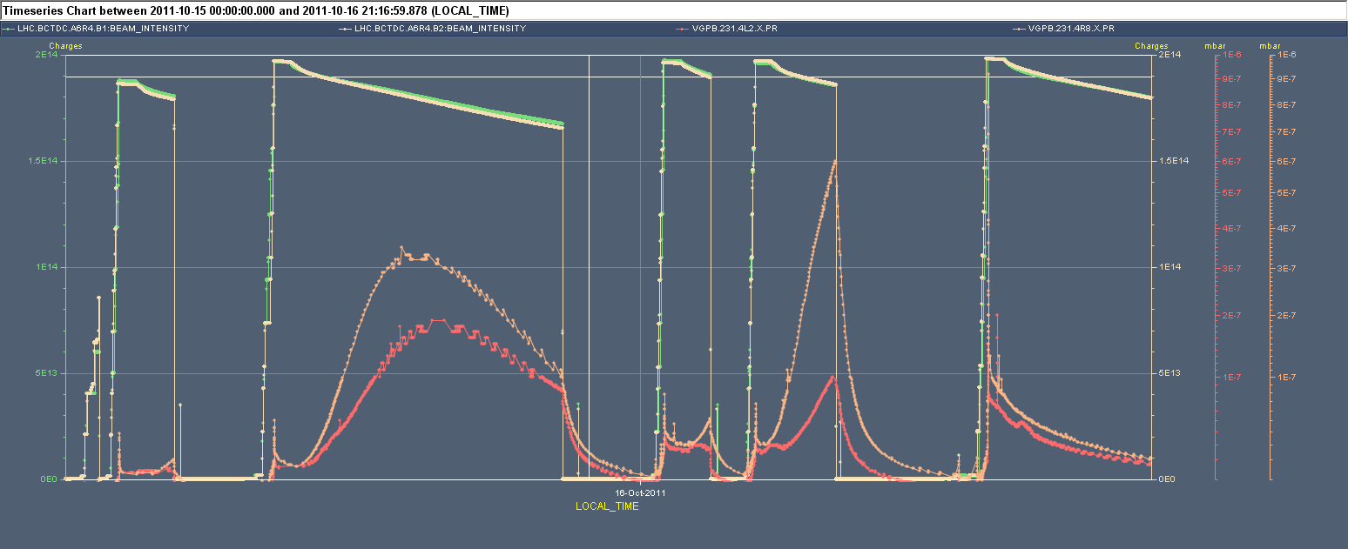
TDI vacuum
Important reduction of the vacuum activity during coasts after opening the TDI gap after injection to +/- 55 mm instead of +/- 20 mm (bunches were slightly longer for this fill)
+/-20 mm
+/-55 mm

Slide 11
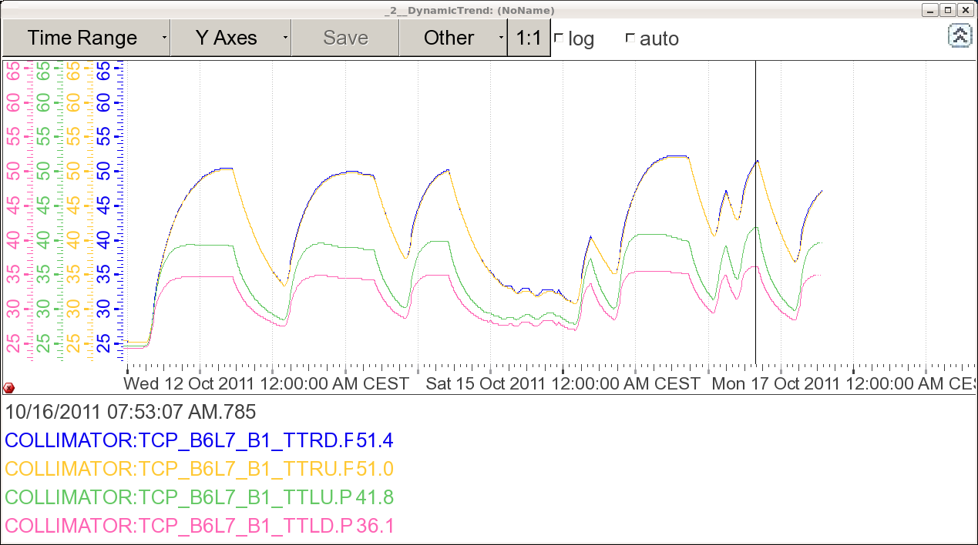
Other intensity effects
Monitored temperature interlocks on collimators ➔ marginal for TCP.B6L7 ➔ increased threshold from 55 to 70⁰C after OK from Ralph and vacuum.

Slide 12
High pile-up MD
1 high intensity bunch per beam (+ probe).
  At injection 2.4E11, 2 μm.
Significant transverse blow-up while sitting at injection and in the ramp.
  To be analysed…
15:30 Stable beams fill #2201, 5x10³⁰ cm⁻²s⁻¹.
  Average pile-up of ~ 32 events.
  Emittances ~2.8 to 3.6 μm at start of the fill.
  Emittances ~3.4 to 4.7 μm towards end of fill.

Slide 13
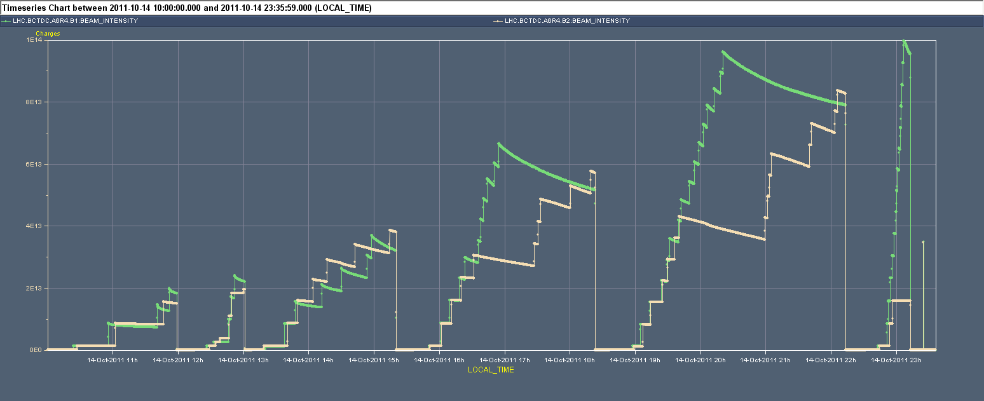
25 ns MD
3.625 μs
1020 + 156 b
3.625 μs
1092 + 1020 b
Reference meas. variable spacing
6.325 μs
732 + 660 b
Setting-up
Limited by pressure rise on MKI8. Now limited to 2.5x10⁻⁹ mbar. No injection interlock level during the scrubbing run and pressures of up 10⁻⁸ mbar reached.

Slide 14
Heat load
3.625 μs
1092 + 1020 b
Reference meas. variable spacing
6.325 μs
732 + 660 b
L. Tavian

Slide 15
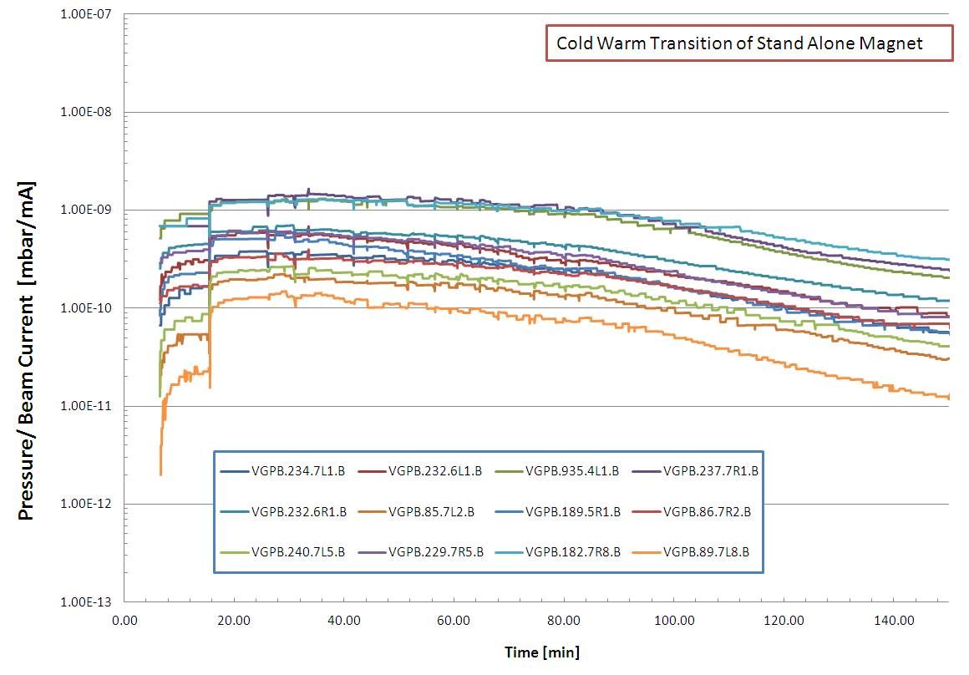
Vacuum
Reduction of approx. Factor 4 in all the Cold Warm Transition of Stand Alone Magnets after 2 hours
G. Bregliozzi
After that period possible to inject 1.4x10¹¹ p/b with no important vacuum instability so far ➔ would be good to have another period of ~24 h this week to test potential effects on high intensity 50 ns operation

Slide 16
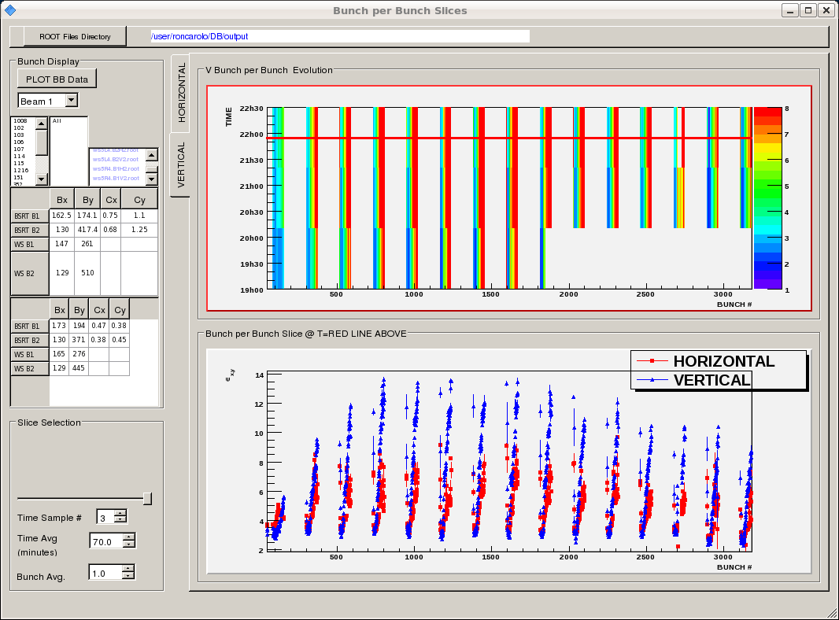
Emittances along trains

Slide 17
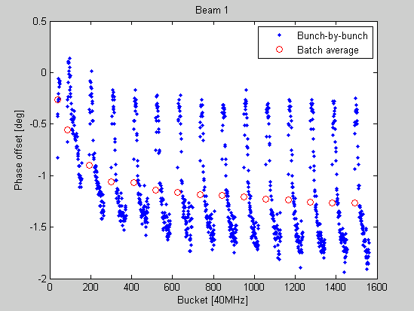
RF stable phase shift along batches
E. Shaposhnikova, JF Esteban Muller

Slide 18
Pending issues
Injection of high intensity beam (>1.4x10¹¹ p/b) requires stopping the North Area extraction during LHC filling to avoid ZS (electrostatic septum) sparks.
ALICE background
A fault on the powerPC of the PAD in UJ16 prevents anyone going into UJ16 until after the access piquet makes an intervention. This intervention is not yet scheduled, and will wait until needed

Slide 19
Upcoming
Access for QPS reset in Sector 78
Physics
90 m Beta*
Pending: loss maps
Week 42 Coordinators: B. Holzer, M. Lamont

