Slide 1
Friday
Filling for 1380b after the problem with Q8.L5.
SEU candidate.
12:30 Fill #2091 L = 2.65E33 cm-2s-1.
Bunch intensities ~1.2E11.
14:30 Dump by cav1 B1 trip. 20 pb-1.
Access for RF.
RF Cavity controler tripped due to the loss of the 80MHz clock.
When the cavity was restarted by OP following the instructions, it quenched.
Piquet replaced 80MHz clock cable.
19:30 Filling again.
21:00 Fill #2092 L = 2.98E33 cm-2s-1.
Bunch intensities ~1.27E11.

Slide 2
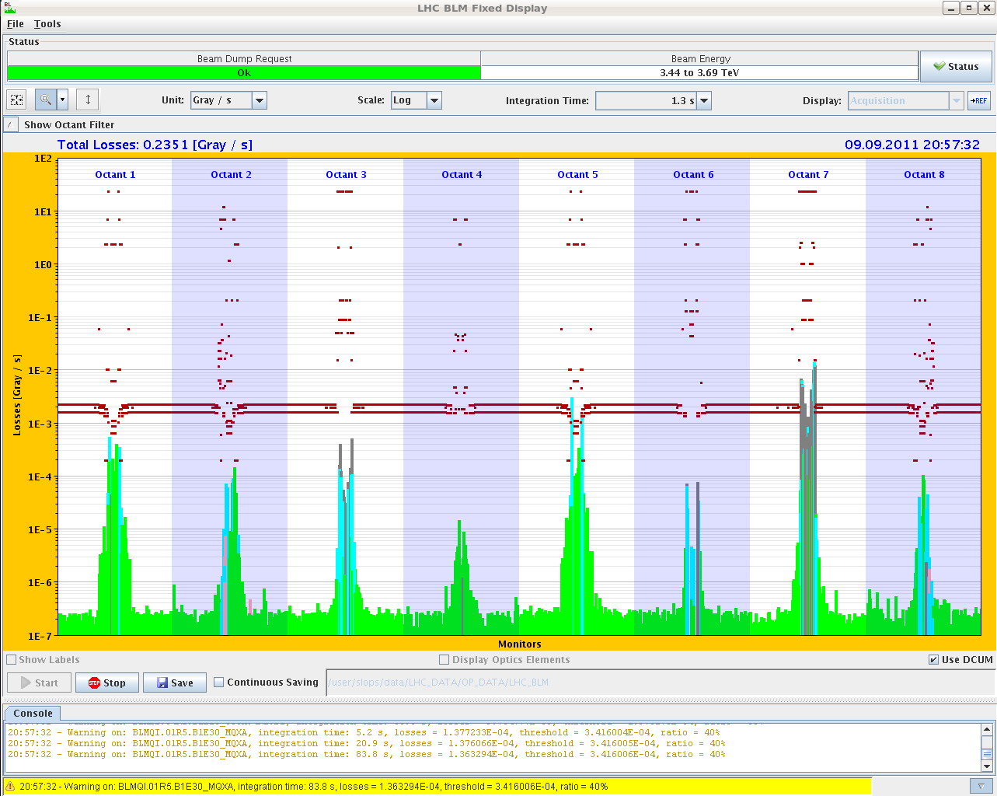
Losses fill 2092

Slide 3
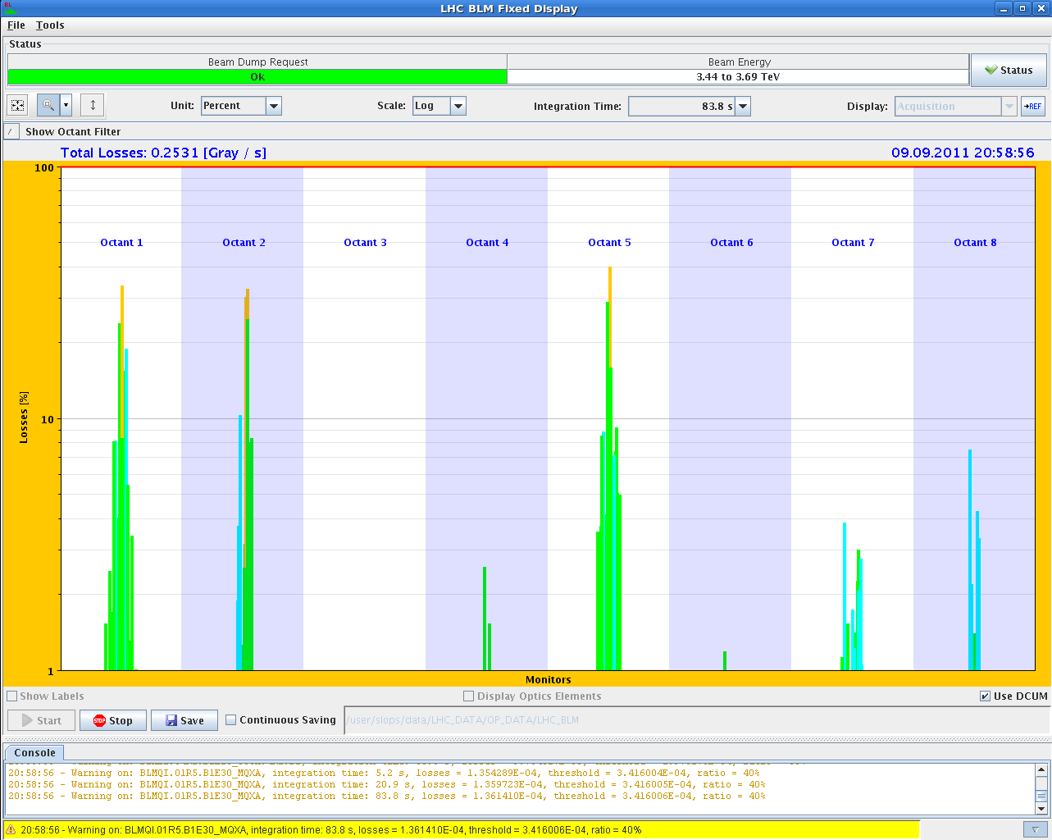
Steady losses 2092 – normalized to threshold
RS12 = 84 s

Slide 4
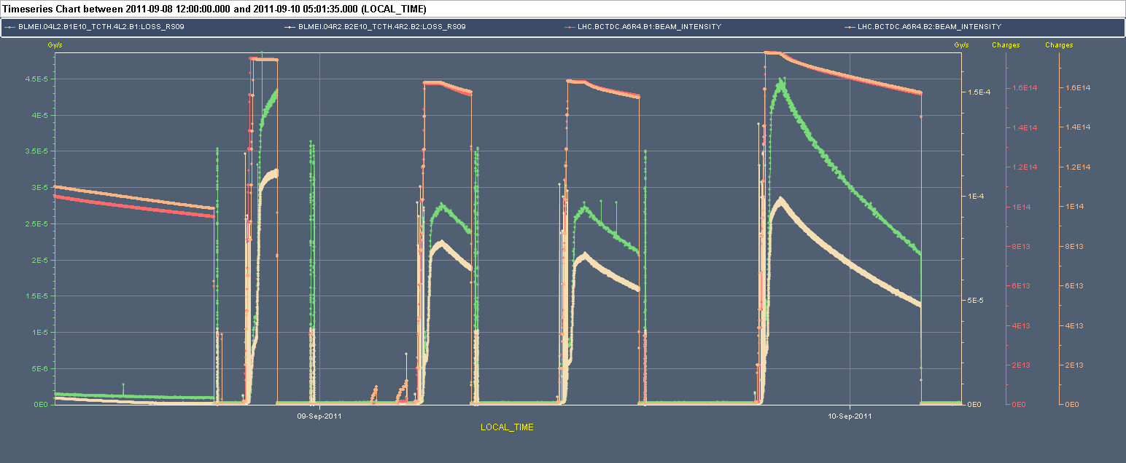
IP2 losses /vac – decreasing, but still very high.

Slide 5
03:15 Dump 2092, 52 pb-1.
Electrical circuit breaker fault on old QPS RQF.12. Could be restored by MPE piquet.
Injection delayed. Some BLM data missing in XPOC.

Slide 6
Fill list
Fill (nb) | L (10³³ cm-2s-1) | Length (h) | Int. L (pb-1) | Dump cause
2083 (264) | 0.57 | 6 | 10 | OP dump
2085 (480) | 0.94 | 6 | 15 | OP dump
2086 (912) | 1.97 | 10.2 | 50 | OP dump
2090 | 2.75 | 1 | 10 | QPS Q8.L5. SEU candidate
2091 | 2.65 | 2.5 | 20 | RF trip B1
2092 | 2.98 | 6 | 52 | El. circuit breaker on QPS RQF.12

Slide 7
Issues, todo’s
TDI position after injection to be moved out further.
CMS vacuum on B2 side.
Procedure with vac, try to move beams?
BLM SW update

