Slide 1
LHC MD block#3
Ralph Assmann, Giulia Papotti, Frank Zimmermann
on behalf of the marvellous MD teams
29 August 2011

Slide 2
MD highlights
β*=1 m
- optics as good as for 1.5 m w/o any addt’l correction!
- TCT’s aligned; center variation? ; loss maps & asyn. dump
- high intensity, lifetime spike in squeeze, instability with beams separated, low lifetime in collision, losses locally confined
longer bunches at 3.5 TeV
minimum separation for long-range beam-beam
triplet aperture
- (much) larger than expected!
blow up of “single” bunches with transverse damper!
- tool to get collimator loss maps in 5 minutes for the future
injection 25-ns beam with 48 bunches
- fast beam loss due to vertical instability (e-cloud?)

Slide 3
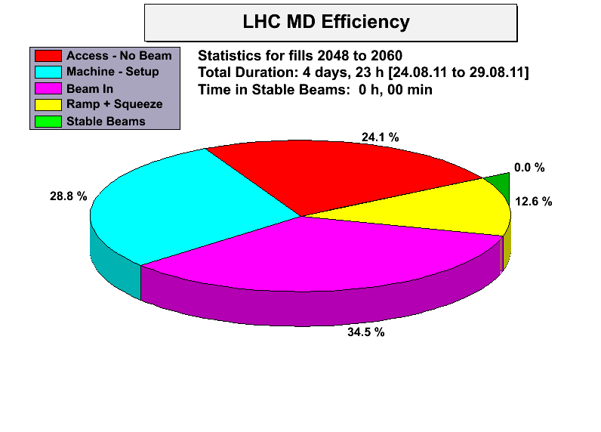
A. MacPherson

Slide 4
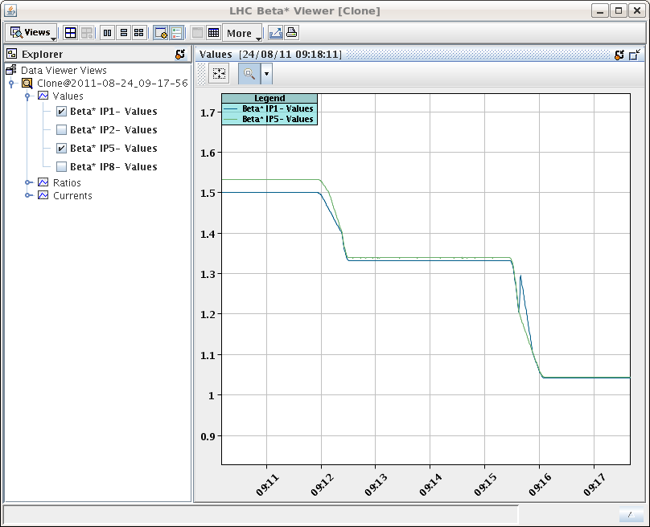
β*=1 m
“squeeze to 1m beta star without problems.”
S. Redaelli et al
calibration for beta* curves not yet final

Slide 5
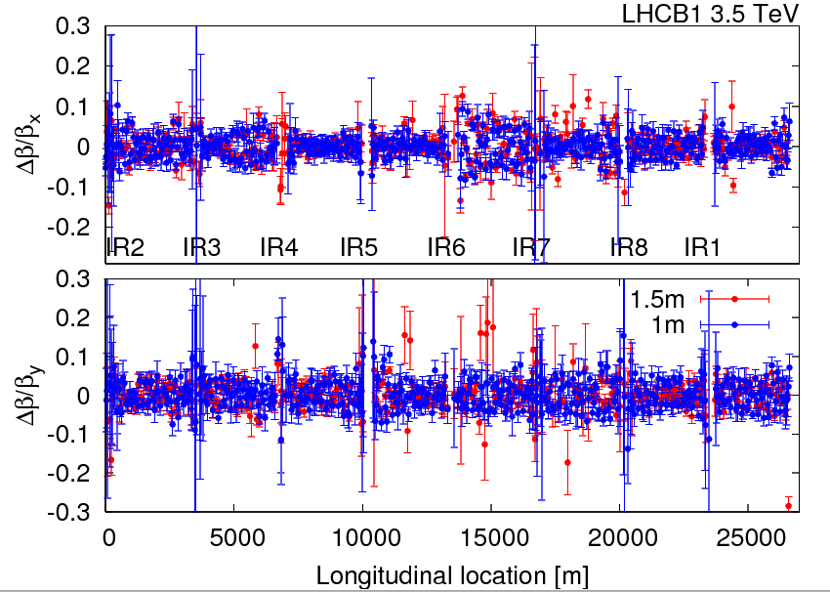
R. Tomas, R. Miyamoto. G. Vanbavinckhove
beam-1 beta beating at β*=1 m similar to β*=1.5 m
peak beta-beat of around 10%-15%

Slide 6
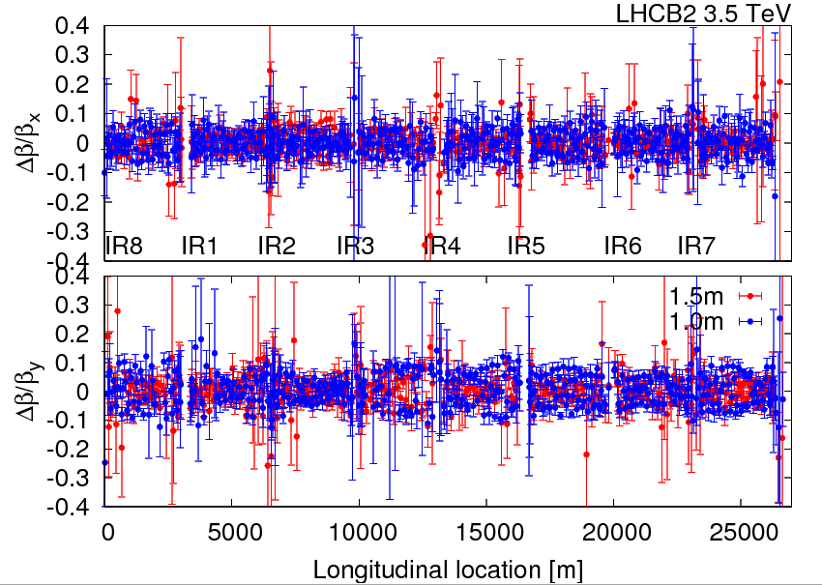
R. Tomas, R. Miyamoto. G. Vanbavinckhove
beam-2 beta beating at β*=1 m similar to β*=1.5 m
peak beta-beat of around 10%-15%

Slide 7
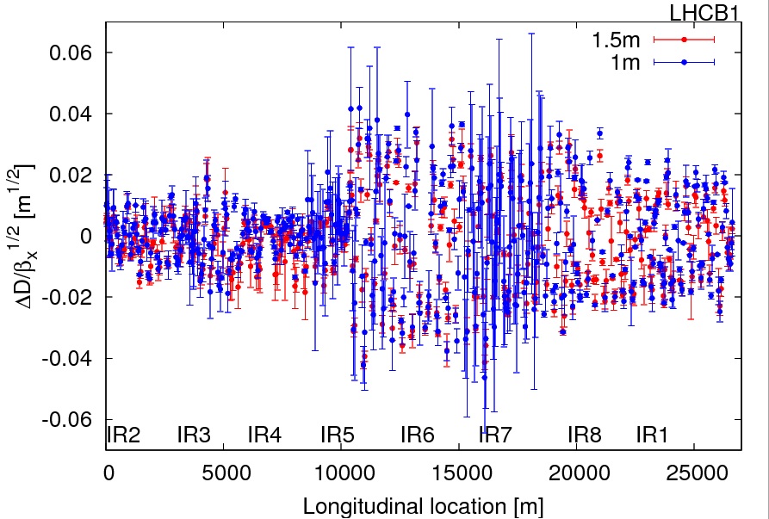
R. Tomas, R. Miyamoto. G. Vanbavinckhove
beam-1 normalized dispersion for β*= 1.5 m & 1 m comparable;
peak normalized dispersion beat of 0.04 m^(1/2); jump at IP5

Slide 8
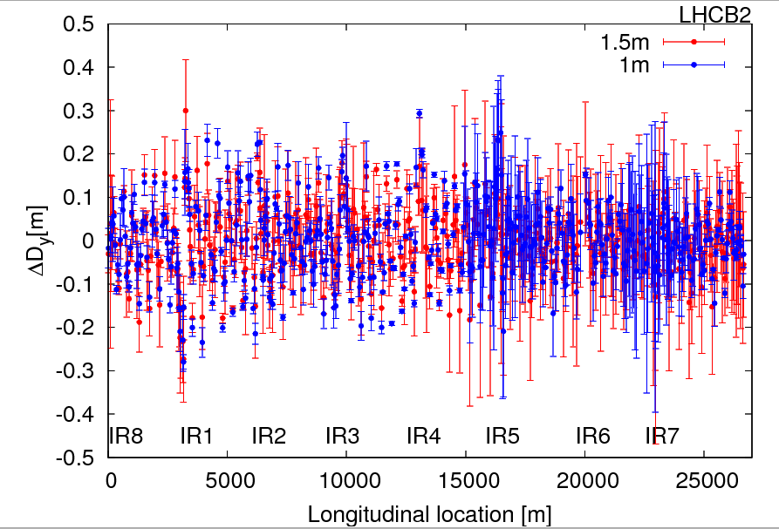
R. Tomas, R. Miyamoto. G. Vanbavinckhove
beam-2 vertical dispersion for β*= 1.5 m & 1 m comparable;
peak vertical dispersion beat of 20 cm; slightly larger at 1.5 m

Slide 9
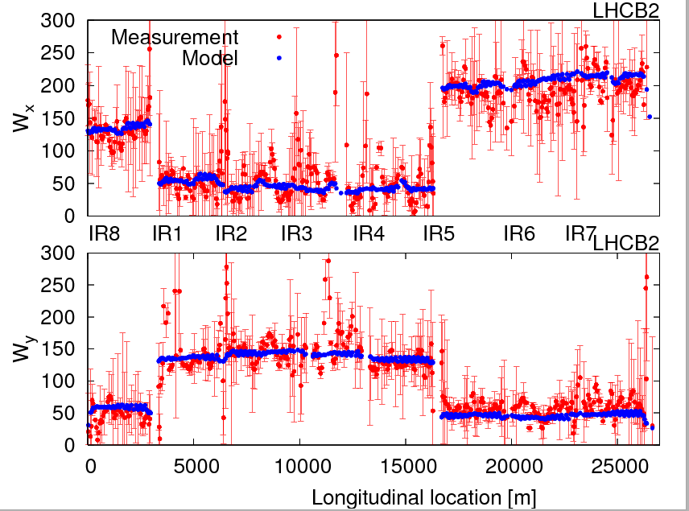
R. Tomas, R. Miyamoto. G. Vanbavinckhove
beam-2 chromatic beta-beat for β*=1 m (Montague function W): measurement and model agree

Slide 10
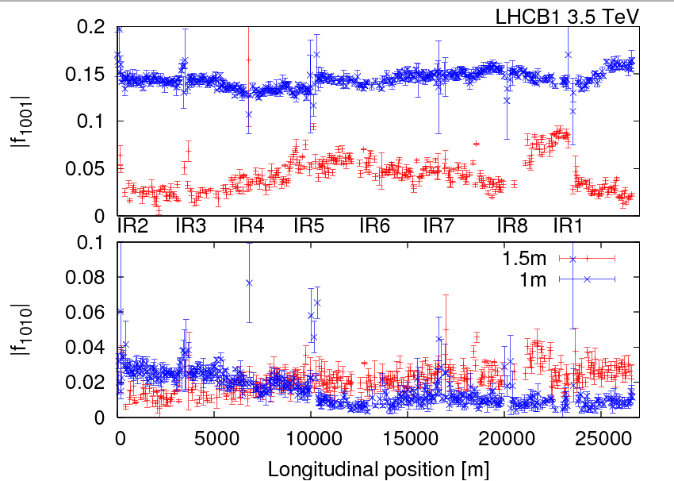
R. Tomas, R. Miyamoto. G. Vanbavinckhove
Beam-1 local coupling for β*= 1 m &1.5 m: No clear jumps are observed (to be confirmed with segment-by-segment technique) → local coupling knobs are performing well

Slide 11
R. Tomas, R. Miyamoto. G. Vanbavinckhove, et al
β*=1 m
Optics corrections: No extra corrections; the corrections implemented at 1.5 m were kept constant (local and global corrections for beta-beat and coupling) until 1 m. β* from K-modulation: Preliminary analysis indicated some important waist shift (?!), but after error propagation results are OK, e.g.
IP1 beta* err[m]
B1H 1.20 0.20
B1V 1.05 0.13
B2H 1.14 0.10
B2V 1.17 0.18

Slide 12
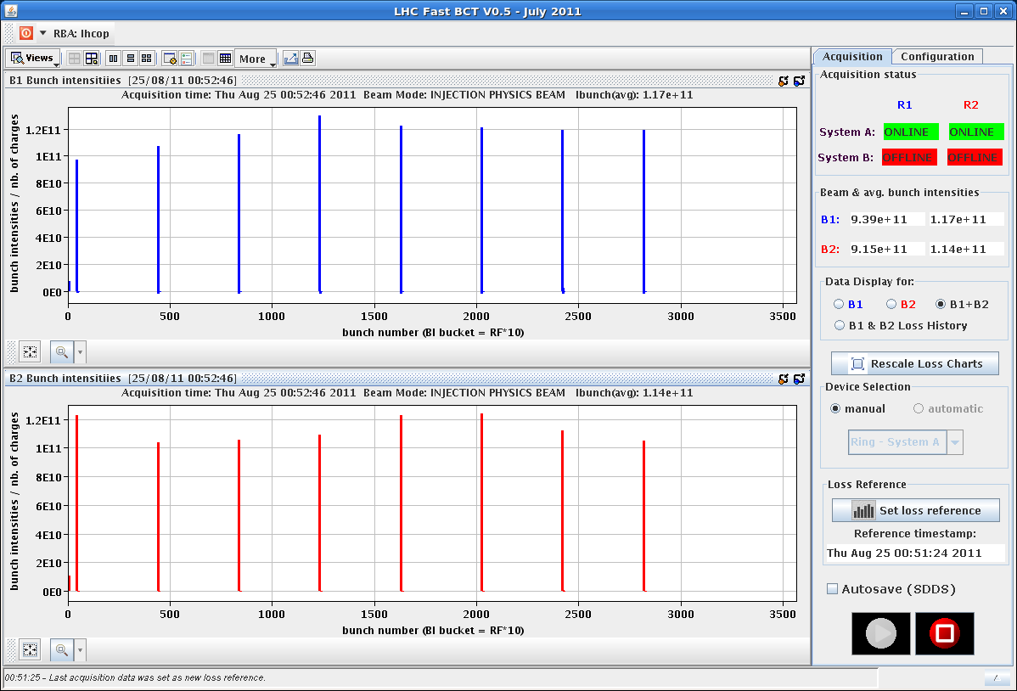
P. Baudrenghien,
E. Shaposhnikova
T. Mastoridis,
L. Ponce, et al
“long bunch length”
filling pattern

Slide 13
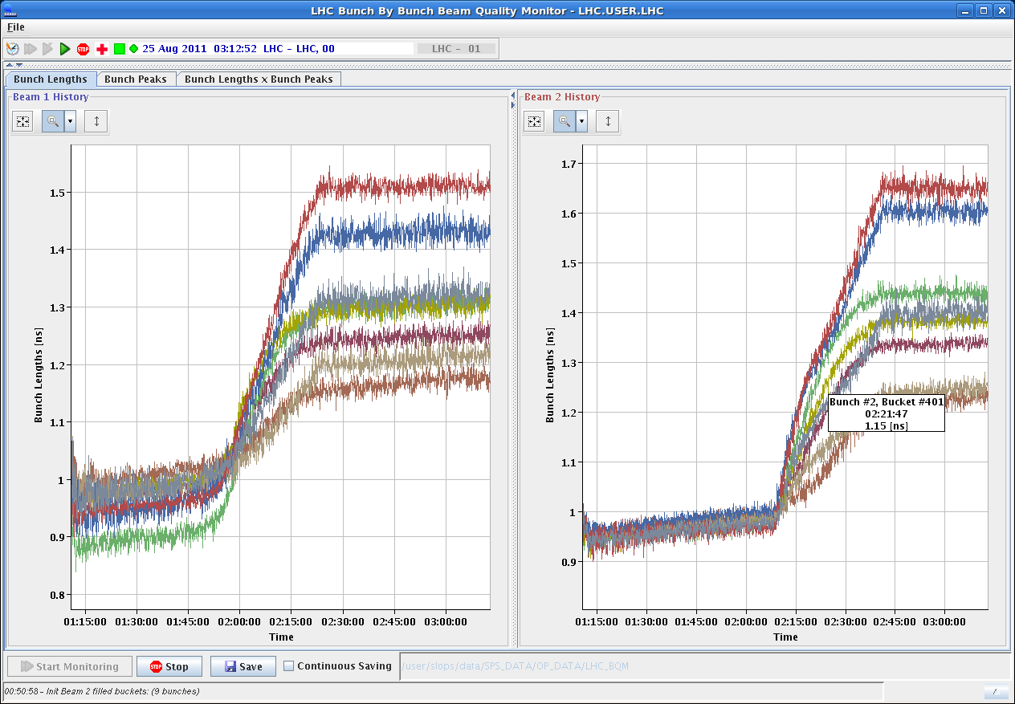
P. Baudrenghien,
E. Shaposhnikova
T. Mastoridis, et al
“long bunch length”
after Frev-amplitude modulated excitation
at flat top - max. bunch length >1.5 ns
individual bunch lengths since start of flat top
vary from 1.15 to 1.65 ns

Slide 14
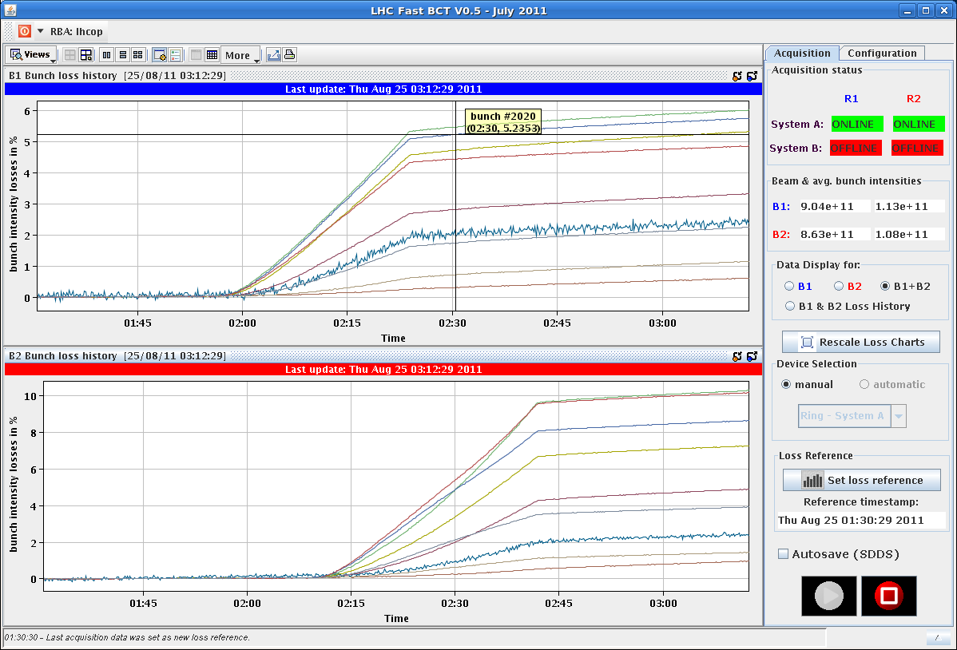
P. Baudrenghien,
E. Shaposhnikova
T. Mastoridis, et al
“long bunch length”
integrated losses since start of flat top
bunches of different length have
different losses

Slide 15
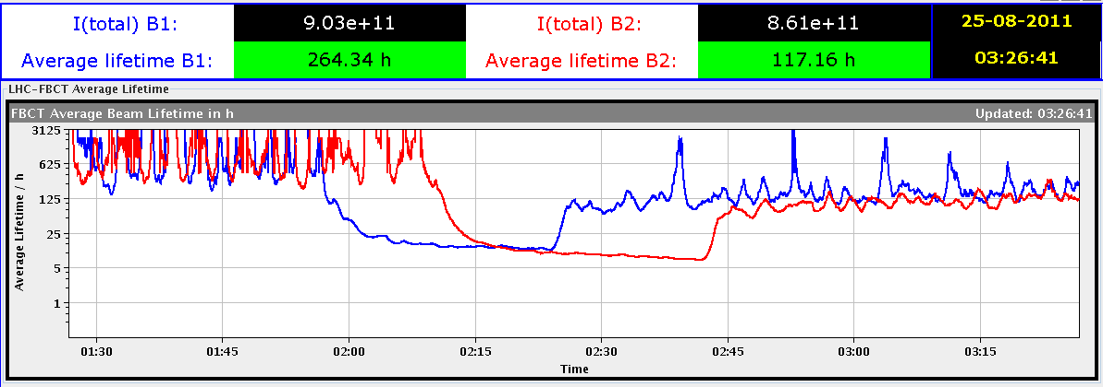
P. Baudrenghien,
E. Shaposhnikova
T. Mastoridis, et al
“long bunch length”
recovery of beam lifetimes after stop of excitation

Slide 16
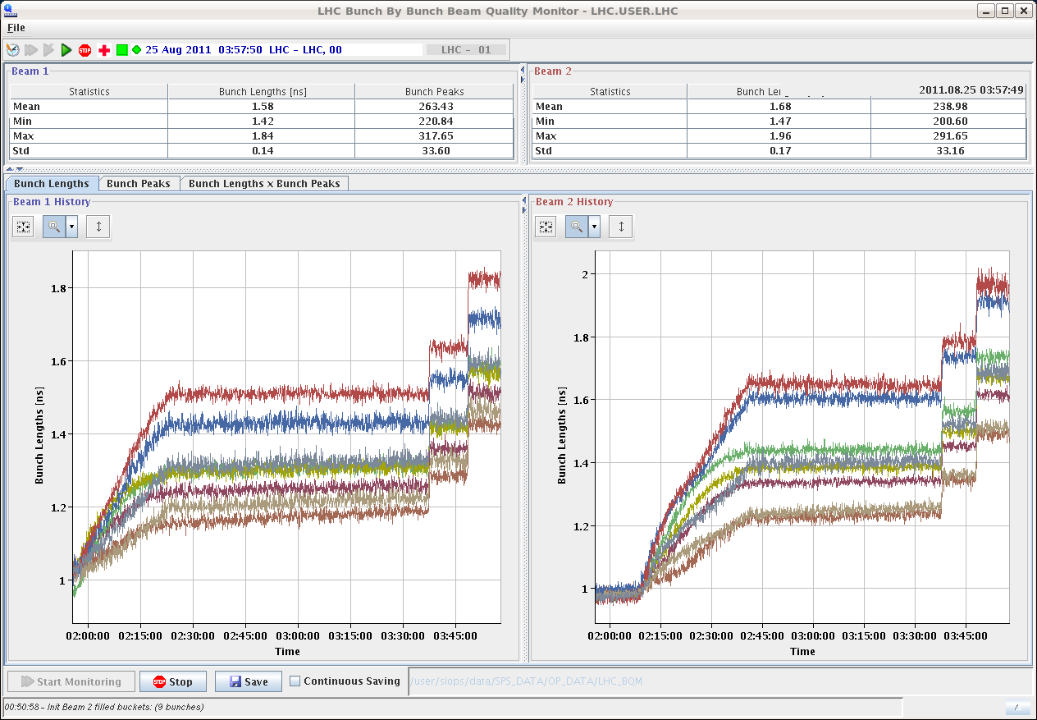
P. Baudrenghien,
E. Shaposhnikova
T. Mastoridis, et al
“long bunch length”
bunch length after two steps of
RF voltage reduction 12 MV→9MV→6 MV
maximum final bunch length ~1.95 ns

Slide 17
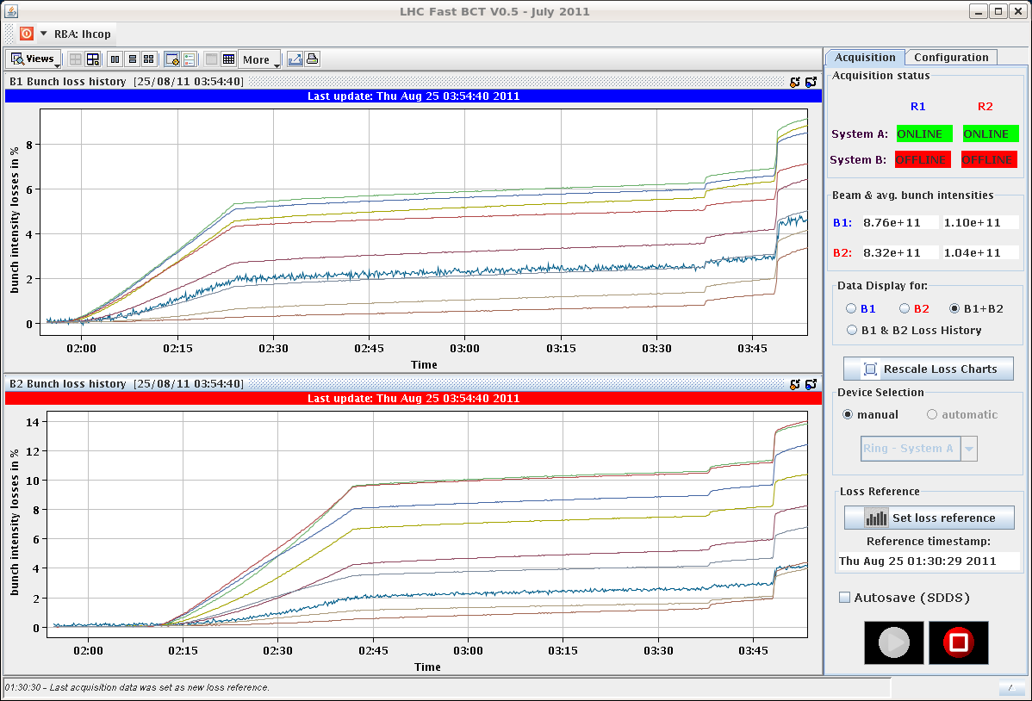
P. Baudrenghien,
E. Shaposhnikova
T. Mastoridis, et al
“long bunch length”
integrated losses after two steps of
RF voltage reduction

Slide 18
Beam Instrumentation MD
overhead due to changes of beam types
BI MD summary
BLM direct dump BLM system calibrated
BCT data taken while scraping high intensity bunches
BPMs: test of orbit filters and strip-lines crosstalk.
BSRT: very little data taken (bump B1V 450 GeV), 90% of the programme not completed

Slide 19
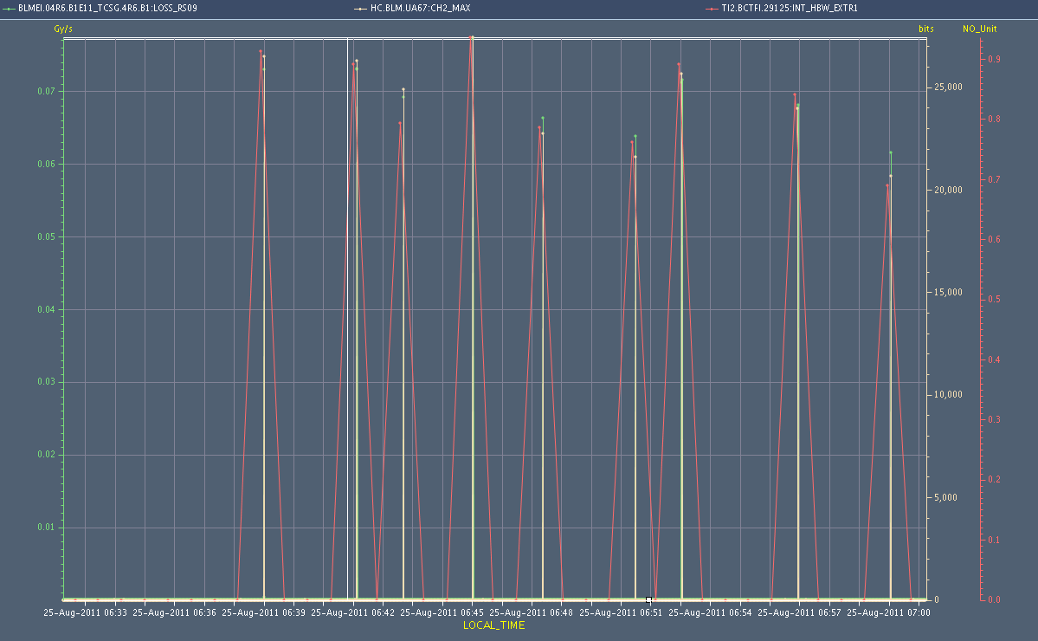
BI Direct Dump BLM Calibration by
shots onto closed TCSG in IP6
beam intensity
& BLM readings
for different shots
E. Nebot, et al

Slide 20
Beam Scraping for BCT Calibration

Slide 21
Long-Range Beam-Beam (W. Herr et al)
Only 1 hour in beam-beam study at flat top:
~ 2h problems with transverse damper: cable left connected.
Trip of IR8 triplet
One fill lost during squeeze due to tune feedback
Special collision scheme:
12 (not colliding) + 36 + 36 bunches per beam
Collision scheme is highly asymmetric between beam 1 and beam 2 (on purpose)
Proved very efficient to get data within short time
Reducing crossing angle (IR1 and IR5 together) while following with tertiary collimators.

Slide 22
LR-BB: Losses per Bunch
Crossing angle
100% = 120 μrad
30%
35%
HD 1-2-5
Strong LR
40%
50%
HD 8
Tiny LR
Note: B2 collision scheme practically equivalent to last LR BB MD: 2 head-on
HD 1-5
Strong LR
HD 2-8
Small LR

Slide 23
LR-BB: Losses per Bunch
30%
35%
HD 1-2-5
Strong LR
40%
50%
30% of beam lost in 1 hour → strong LR effects with reduced crossing angles
HD 8
Tiny LR
HD 1-5
Strong LR
HD 2-8
Small LR

Slide 24
LR-BB: Losses per Bunch
30%
35%
HD 1-2-5
Strong LR
40%
50%
HD 8
Tiny LR
Lower losses beam2 (factor 2) could show that LR losses are enhanced by number of head-ons
To be analyzed...
HD 1-5
Strong LR
HD 2-8
Small LR

Slide 25
LR-BB: Losses per Bunch
30% (36 μrad)
HD 1-2-5
Strong LR
IR2 separated → one HD less
Better for bunches with lower than maximum LR interactions
HD 8
Tiny LR

Slide 26
How Could Head-On Drive LR BB Losses?
To be analyzed in detail...
Possible mechanism (Werner Herr):
Lower beam-beam separation creates lower dynamic aperture.
Beam tails then cut by dyamic aperture.
Losses constrained if tails are not repopulated.
Head-on collisions might provide a mechanism to feed beam into region of reduced dynamic aperture.
At the moment just a speculation...
If true, can be reduced by tune WP optimization.

Slide 27
Preliminary Conclusions for Physics
Based on results, expect 8σ BB separation with 50ns to work (setup for 1m β*):
Keep emittance small and equal.
Probably reduced margins in tune space, requiring reoptimization of tune.
Analysis for 25ns to be done, but will be interesting for beam-beam

Slide 28
transverse blow-up using transverse damper
Blow-up using band limited and white noise was prepared for beam 2.
Initial tests on pilot bunches (max two pilots) spaced 2 μs adjusted delays, gating etc. Demonstrated selectivity (one bunch left untouched, one blown-up) largest emittance observed was about 18-20 μm, then too small intensity for clean wire-scanner measurement, but profile seemed to not increase beyond this; to be checked with collimator settings, but at first sight seems compatible with 5.7 sigma

Slide 29
Blowup with Transverse Damper test on two pilot bunches (W. Hoefle, D. Valuch et al)

Slide 30
transverse blow-up using transverse damper - 2
Used filling scheme with 2 batches of 6 bunches spaced at the nominal distance of 925 ns; adjust excitation to middle of gap, then demonstrated that we can move controlled into first batch of 6 bunches; both planes checked plus loss maps done (moderate speed). It was demonstrated that it is possible to perform controlled loss maps with high intensity beam above safe limit.
Moved to single bunch; compared traditional loss map and damper loss map on single bunch. Achieved similar losses as with traditional loss maps, amplitude nicely controllable. Loss maps by the two methods show in the details some features that differ, to be analysed by collimation team.

Slide 31
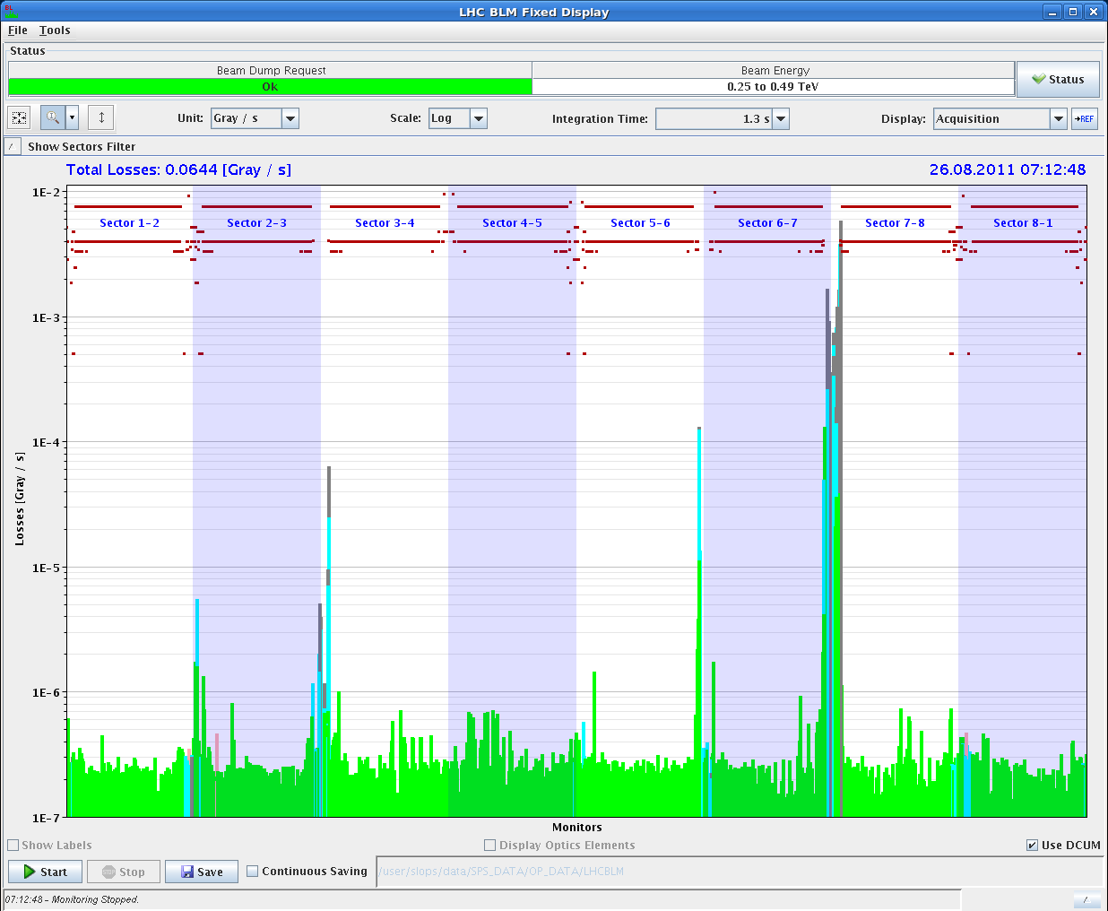
Loss Map with Transverse Damper

Slide 32
MD IR Aperture (S. Redaelli et al)
measurements at 3.5 TeV (squeezed beams to 1.5m)
started after about 1h due to a problem with a collimator in IP7 for B1. This time was given to the previous MDers, who were working on the other beam.
Real measurements at top energy, with squeezed and separated beams, could start at about 9h30.
The measurements were aimed at measuring with the beam the retraction between TCTs and triplets in IP1 and IP5, both in crossing and separation planes. We increased appropriate crossing bumps in both planes of each IP to explore the aperture in the expected limiting locations. We started from nominal separation (+/-0.7mm) and crossing (+/-120urad).

Slide 33
MD IR Aperture
The aperture was approached with bumps, keeping the TCT at settings that exposed the triplet by 0.5 sigmas at most. The first scan took about 2 hours. Then we got more confident in the procedure and could finish measurements in the separation and crossing planes of both IP1 and IP5.
We found a good aperture in both planes and IPs. So good that we want to take more time to see if we overlooked something. Had to open the TCT aperture to the following values before seeing primary losses at the triplet: IR1 - V -> 18.3 - 18.8 sigmas IR1 - H -> 19.8 - 20.3 sigmas IR5 - V -> >= 20.3 sigmas (corrector limit reached) IR5 - H -> 19.8 - 20.3 sigmas

Slide 34
MD IR Aperture
If preliminary estimates are confirmed possibility to squeeze further than 1 m at 3.5 TeV or to run at 1.0 m without going to tight settings or w/o reducing the crossing.
As we had 30 min left, we squeeze to 1 m keeping the 120 urad crossing in IP1/5 and keeping the presently operational settings for collimators (relaxed).
At beta*=1m, the TCTs in IP1 and IP5 were set to 11.8 sigmas for the new optics, keeping the same centre as at 1.5 m (negligible difference of orbit with respect to 1.5 m). We made loss maps in the vertical planes for both beams to preliminary address the triplet protection with these settings.
Note that in parallel, we did measurements of the tune and coupling induced by the non linear errors in the triplet magnets. Tune and coupling shifts were indeed observed. More detailed analysis is required.

Slide 35
25-ns beam
little time : thunderstorms & electrical perturbation
injected 12 bunches for both beams; injection & losses OK
damper setup for 25ns for B1 with pilots; not completed
B2 injection of 48b batch with 25 ns tried twice,
beam dumped immediately after injection each time:
1st time ADT on, beam dumped after ~1000 turns on IR6 BPM
2nd time ADT off, beam dumped after ~500 turns on P7 beam losses
PM BLM data: fast (~150 turn) increase in BLM signals,TCPV in P7
orbit BPM PM data: nothing seen at first look
no vacuum activity aside small pressure rise in MKIP8 with 2x12b & 1x24b 25 ns circulating
possibly fast e-cloud instability
plan for future MD: higher Q' (20 in both planes), injecting 36b 25 ns trains, switching ADT PU gating for display to last injected bunch, fully setting up ADT

Slide 36
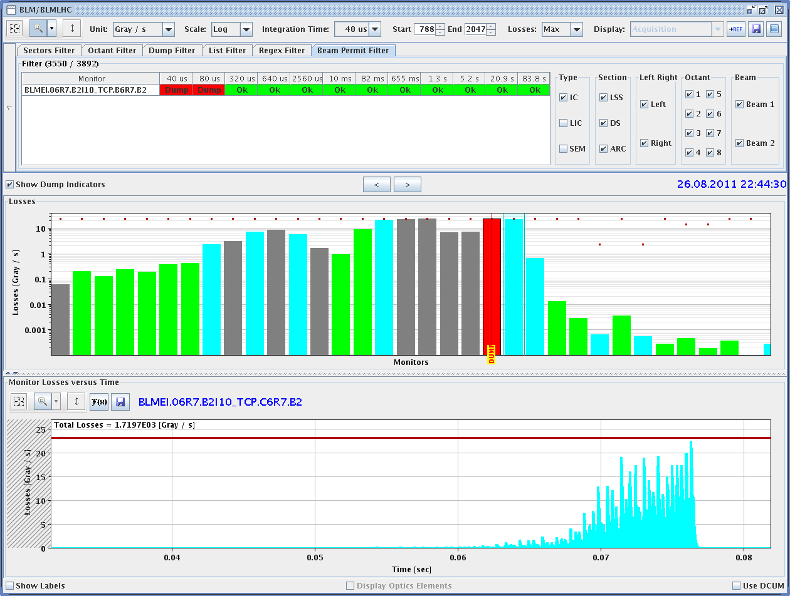
25-ns beam: fast vertical beam loss

Slide 37
β*=1 m
summary by
J. Wenninger & R. Assmann
& S. Redaelli

Slide 38
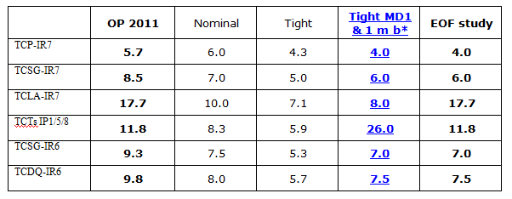
Machine changes for beta* 1m
J . Wenninger,
R. Assmann et al
Collimators to tight settings.
Xing angles in IR1/5 from ±120 to ±100 μrad.
Long-range beam-beam separation from 12σ to 8σ (ε=2.5 μm).
>> with those changes we maintain the same orbit, beta-beat, etc margins than for 1.5 m

Slide 39
1 m beta* - MD period, Wednesday
Fill no. 1: Squeeze with probes, optics measured.
Xing angles kept constant at 120 μrad for this first test.
Optics OK, < 10% beating. No correction required.
β* measurement consistent with 1 m within error of ±0.2 m.

Slide 40
1 m beta* - MD period, Sunday
Fill no. 2: Squeeze & collide 2 nominal bunches.
Collimators IR6/IR7 with tight settings.
Xing angle reduced from 120 to 100 μrad (1.5 to 1 m).
Collide.
TCT alignment at end of squeeze (1m, sep.) & in collision.
Loss maps and asynchronous dump – OK.
Fill no. 3: Squeeze & collide 2 nominal bunches.
Repeat fill no. 2 in one step.
Final collimator functions (also with new TCT settings).
Almost everything sequenced already !
Another loss maps and asynchronous dump.
Issues:
Lifetime dips of B2 to below 5 hours, cured by Q’ +3 units.
Found a different orbit in collision, had to re-optimize the IPs. Why?

Slide 41
1 m beta* - MD period – getting interesting…
Fill no. 4: 12 + 3x36 bunches
Chromaticity H +2 at end of ramp (from experience of fill 3).
Squeeze to 1.5 m rocky, losses seem mostly correlated to orbit excursions – tbc.
Squeeze to 1 m smooth, but then strong instability (seemed mostly vertical) – increase of octupoles restores lifetime.
Colliding, orbit reproducible (wrt fill 3), almost no optimization required in IR1/5.
Lifetime in collision rather low-ish (see figure).
Tried to move Q and Q’, but then…
Beam dump on motor failure on B1 TCP vertical IR7 at 04:45.
End of the exercise…

Slide 42
Lifetimes 84 b
Lifetimes during fill 3:
Colliding
Losses when collimator gaps become very tight towards end of the ramp,
seen in all 3 fills
Squeeze to 1.5 m
(orbit ?)
Instability at 1 m,
cured by octupoles.

Slide 43
Losses in squeeze to 1.5 m – 84b / beam
Note that losses are well confined in collimation regions

Slide 44
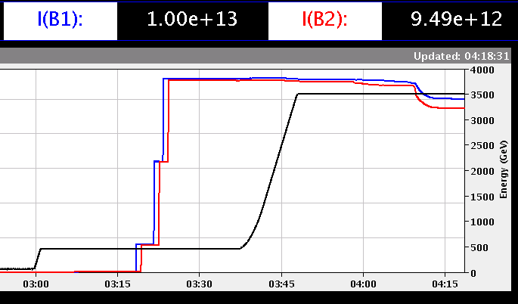
Squeeze
to 1.5 m
Instability at 1 m,
cured by octupoles.

Slide 45
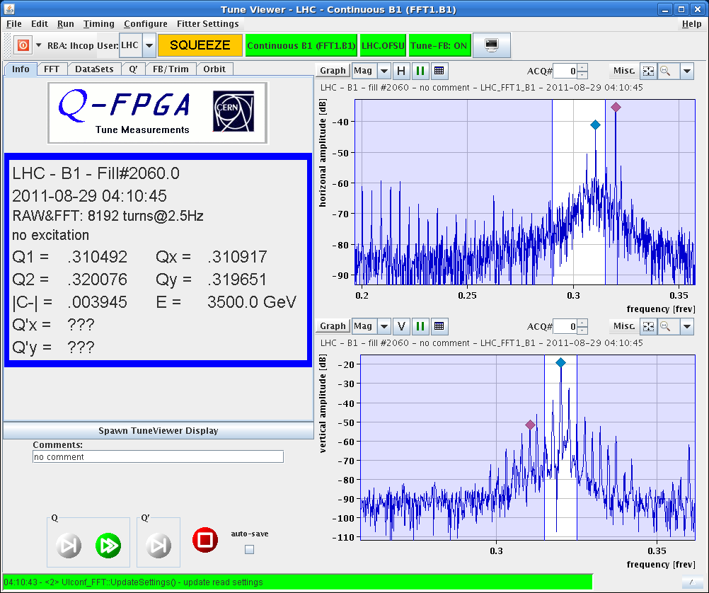
The Xmax tree is back – instability at 1 m
Remember such pictures with our first nominal bunches in 2010?

Slide 46
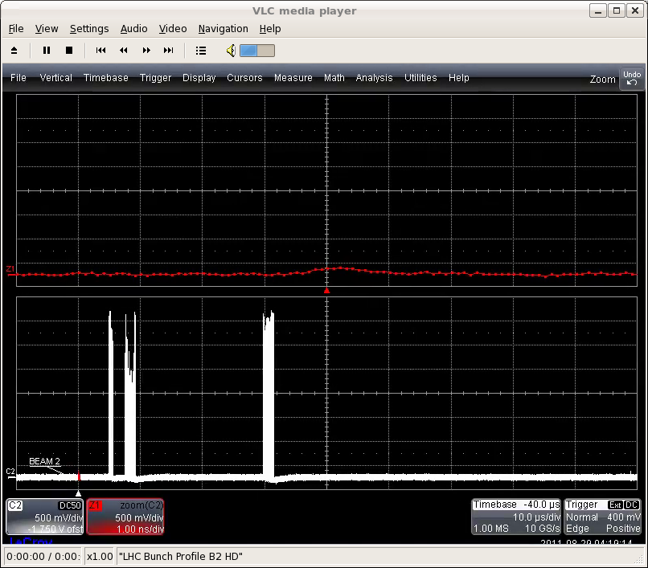
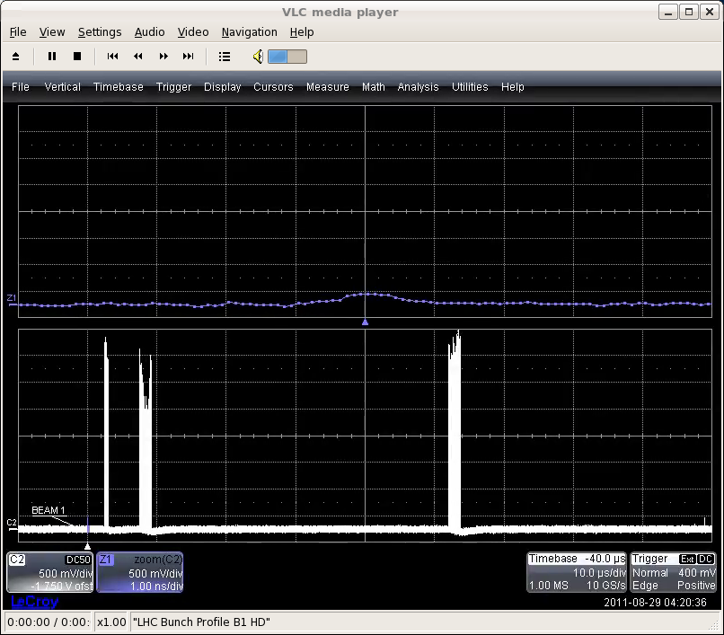
Bunch losses from instability at 1 m, separated.
First 36b train suffered.

Slide 47
Summary β*=1 m (1)
First experience with very tight collimator settings !
Technically the 1m setup is almost ready (PC & collimator settings, orbit references, sequences).
Mainly some loss maps missing.
The fill with 12 + 2x36b highlighted some points that must be investigated:
Beam stability, in particular at 1 m with separated beams, ‘cured’ by octupoles.
Losses (spikes) in the squeeze that could be due to the residual orbit excursions not corrected by the orbit FB – life with very tight collimator settings !
Lifetime in collision – note however that the beams may have been blown-up by the instability in our fill → LR beam-beam even stronger.

Slide 48
Summary β*=1 m (2)
A few fills will be required to follow up on the issues that have been found before 1 m can be used for physics – all seem solvable:
Octupoles, Q’, damper.
Higher gain for orbit FB?
Lifetime in collisions with smaller beams (no instability).
J. Wennninger, R. Assmann, S. Redaelli.
This work was carried out with the invaluable help of the optics team, the collimation team, L. Ponce, M. Lamont, the EiCs & operators on shift and many more.

Slide 49
MD Planning Wed – Thu (24. – 25.8.)
Day | Time | MD | MP
Wed | 04:00 | Ramp down, cycle
 | 06:00 | 450 GeV → 3.5 TeV: Head-on beam-beam + 1h data taking (stable beams) – for highest pile-up | B
 | 13:00 | Ramp down, cycle
 | 15:00 | 450 GeV → 3.5 TeV: Optics setup for β*=1m (1) – Pilots through squeeze, measure and correct Q, Q’, C, orbit, measure beating and local coupling | A
 | 19:00 | Ramp down, cycle
 | 21:00 | 450 GeV → 3.5 TeV: Long bunch length – RF setup at injection, test ramp for losses in IR3, voltage change at flat top | B
Thu | 03:00 | Ramp down, cycle
 | 05:00 | 450 GeV → 3.5 TeV: Beam Instrumentation | B
 | 13:00 | Ramp down, cycle.
 | 15:00 | 450 GeV → 3.5 TeV: LR beam-beam – 2 batches, effect of number of LR interactions, effect of emittance | C
postponed to after TS
only 3 hm but success
BSRT 90% still to be done
only 1 hm but success

Slide 50
Draft MD Planning Fri – Sat (26. – 27.8.)
Day | Time | MD | MP
 | 23:00 | Ramp down, cycle.
Fri | 01:00 | 450 GeV: Transverse damper – beam blowup at injection | B/C
 | 07:00 | 450 GeV → 3.5 TeV: Aperture – scraping pilot beam tails in triplets, maybe test global aperture measurement with transverse damper | B
 | 15:00 | Ramp down, cycle.
 | 17:00 | 450 GeV: 25 ns studies – injection of up to 144b/288b, damper | B
Sat | 00:00 | 450 GeV: 25 ns studies – vacuum, ecloud, RF | B
 | 07:00 | 450 GeV → 3.5 TeV: Optics setup for β*=1m (2)– apply proposed beating and local coupling corrections; at 1m: measure beating and coupling, verify corrections, test collision beam process; check LR beam-beam with new β* & reduced crossing angle | A
 | 15:00 | Ramp down, cycle.
 | 17:00 | 450 GeV → 3.5 TeV: Collimator setup for β*=1m– tight collimation settings, set up TCT’s in IR, loss maps. Asynchronous dump, if time left. | B
cancelled/postponed

Slide 51
Draft MD Planning Sun – Mon (28. – 29.8.)
Day | Time | MD | MP
Sun | 01:00 | Ramp down, cycle. | B
 | 03:00 | 450 GeV → 3.5 TeV: p-p rephasing – debunching during ring rephasing with nominal emittances
 | 09:00 | Ramp down, cycle.
 | 11:00 | 450 GeV: UFO studies – generation mechanism at MKI’s, statistics, MKQA tests (p-Pb interlock test in the shadow) | C
 | 19:00 | 450 GeV: Quench margin at injection – observation with special QPS instrumentation, losses from TCLIB collimator | C
 | 22:00 | 450 GeV → 3.5 TeV: Quench test at 3.5 TeV – test losses in other dispersion-suppressors – dropped if extra time needed for β*=1m | C
Mon | 06:00 | Technical Stop
cancelled/postponed
cancelled/postponed
cancelled/postponed
cancelled/postponed
Needs from experiments:
-Luminometers on during beam-beam MDs and in the second slot of β*=1 m

Slide 52
not done
large pile up
25-ns beam injection & studies
p-p rephasing
MKI UFOs
quench margin at injection
quench test at 3.5 TeV
beam instrumentation (BSRT calibration)
collision with large Piwinski angle
…

