Slide 1
Tue 23/8 – Wed 24/8
09:00 Start 90 m optics run
Preparation and verification of the collimation functions
Re-generation of functions for Transverse damper, RF longitudinal blow-up etc.
10:30 Injecting.
Problems in the orbit acquisition due to the defined filling scheme with bunches of different intensity (2 bunches with 8x10¹⁰ p/bunch, 4 bunches with 3x10¹⁰ p/bunch).
BPM triggering also on lower intensity bunches even reducing their intensity below 2x10¹⁰ p/bunch.
Poor orbit readings leading to beam dump (LSS6 BPMs)

Slide 2
Tue 23/8 – Wed 24/8
14:00 New filling scheme with 5 bunches of 6x10¹⁰ p/bunch

Slide 3
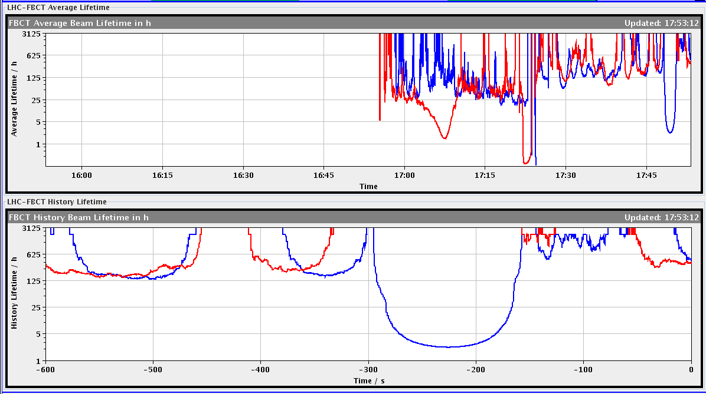
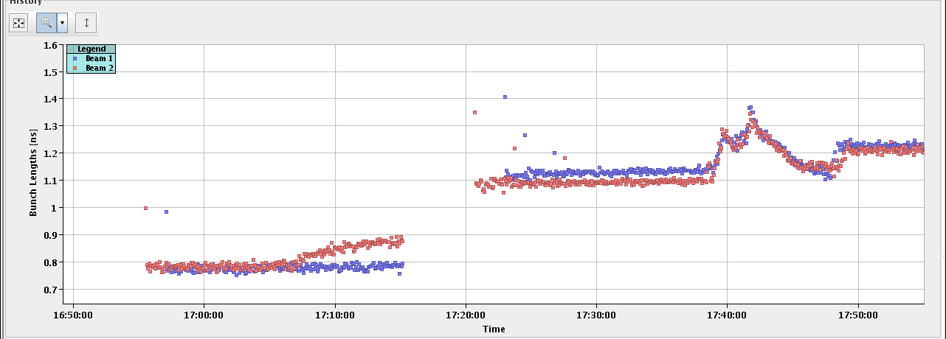
Tue 23/8 – Wed 24/8
15:00 Lost beam during the ramp due to a problem on an RF frequency distribution module requiring a reboot on request of RF expert
17:00 refill after fixing problem with RF module (replaced). Ramp OK a part of a dip in Beam 1 lifetime. Longitudinal blow-up OK

Slide 4
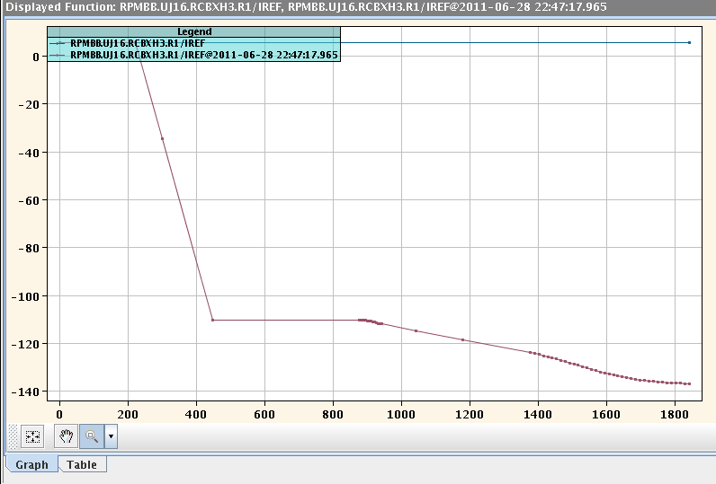
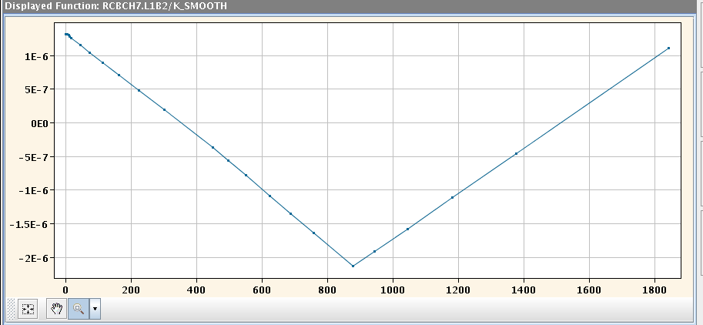
Tue 23/8 – Wed 24/8
18:30 Beam dump during the squeeze due to a trip of two triplet orbit correctors (RCBXH1.R1, RCBXH3.R1). Traced back to a problem in LSA function trim leading to functions with no rounding. Not observed on the physics hyper-cycle ➔ still being analyzed with CO experts.

Slide 5
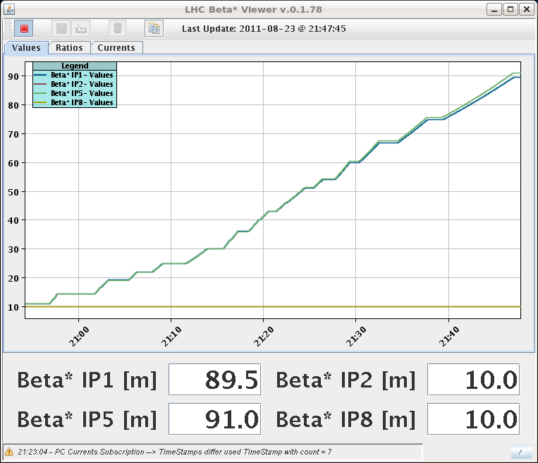
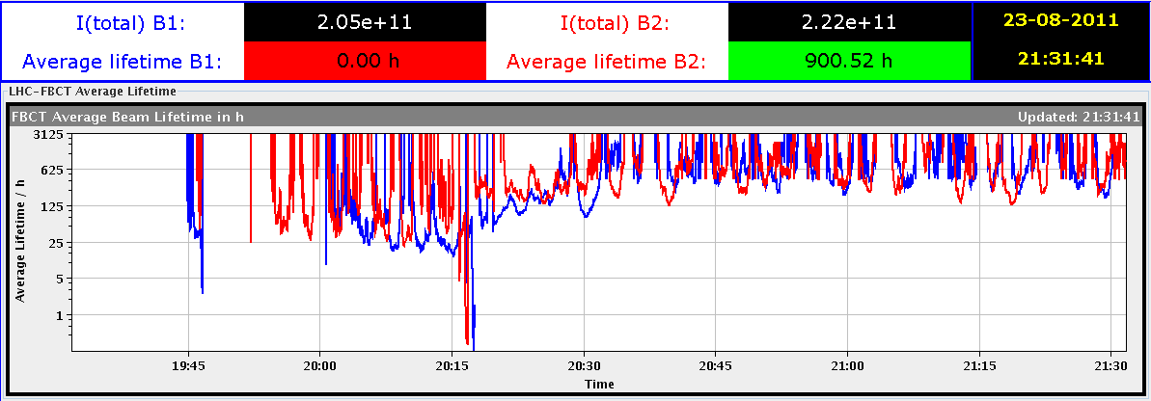
Tue 23/8 – Wed 24/8
Functions smoothed out by rolling back to older functions
21:47 finally squeezed to 90 m. Lifetime OK this time

Slide 6
Tue 23/8 – Wed 24/8
In agreement with MD coordinator and Physics coordinator decided to give an additional slot of 9 h taking it from MD time (beam-beam MD) to be recovered after technical stop to allow completing the TCT/roman pot alignment and data taking
23:47 Beams colliding at all IPs and start TCT alignment. Some difficulties in optimizing collisions due to missing luminosity data (had to reboot DIP servers)

Slide 7
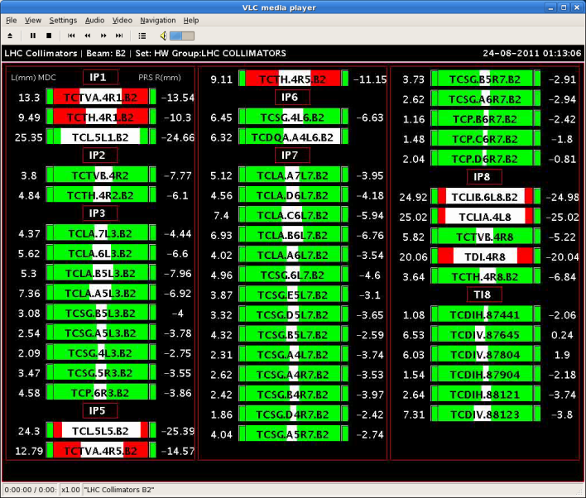
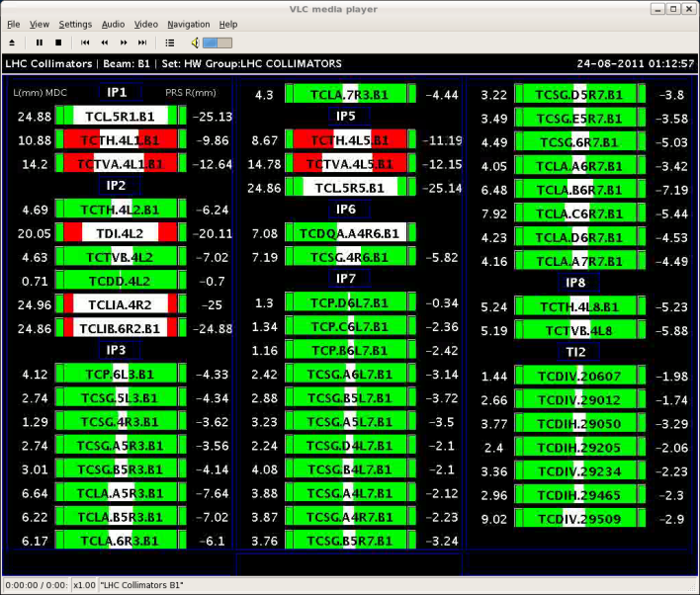
Tue 23/8 – Wed 24/8
01:06 All TCTs aligned.
04:53 All TOTEM Vertical roman pots aligned but problem with high voltage for data taking.
Problems with ALFA roman pots movement (no communication with PXI). After verification with rMPP (Rüdiger) decision not to reboot PXI with circulating beam

Slide 8
Tue 23/8 – Wed 24/8
05:16 Power glitch. Trip of compensators in point 2 and 8
Start preparation of β* 1 m MD.

Slide 9
MD Planning Wed – Thu (24. – 25.8.)
Day | Time | MD | MP
Wed | 04:00 | Ramp down, cycle
 | 06:00 | 450 GeV → 3.5 TeV: Head-on beam-beam + 1h data taking (stable beams) – for highest pile-up | B
 | 13:00 | Ramp down, cycle
 | 15:00 | 450 GeV → 3.5 TeV: Optics setup for β*=1m (1) – Pilots through squeeze, measure and correct Q, Q’, C, orbit, measure beating and local coupling | A
 | 19:00 | Ramp down, cycle
 | 21:00 | 450 GeV → 3.5 TeV: Long bunch length – RF setup at injection, test ramp for losses in IR3, voltage change at flat top | B
Thu | 03:00 | Ramp down, cycle
 | 05:00 | 450 GeV → 3.5 TeV: Beam Instrumentation | B
 | 13:00 | Ramp down, cycle.
 | 15:00 | 450 GeV → 3.5 TeV: LR beam-beam – 2 batches, effect of number of LR interactions, effect of emittance | C
Postponed to after TS

Slide 10
Draft MD Planning Fri – Sat (26. – 27.8.)
Day | Time | MD | MP
 | 23:00 | Ramp down, cycle.
Fri | 01:00 | 450 GeV: Transverse damper – beam blowup at injection | B/C
 | 07:00 | 450 GeV → 3.5 TeV: Aperture – scraping pilot beam tails in triplets, maybe test global aperture measurement with transverse damper | B
 | 15:00 | Ramp down, cycle.
 | 17:00 | 450 GeV: 25 ns studies – injection of up to 144b/288b, damper | B
Sat | 00:00 | 450 GeV: 25 ns studies – vacuum, ecloud, RF | B
 | 07:00 | 450 GeV → 3.5 TeV: Optics setup for β*=1m (2)– apply proposed beating and local coupling corrections; at 1m: measure beating and coupling, verify corrections, test collision beam process | A
 | 15:00 | Ramp down, cycle.
 | 17:00 | 450 GeV → 3.5 TeV: Collimator setup for β*=1m– tight collimation settings, set up TCT’s in IR, loss maps. Asynchronous dump, if time left. | B

Slide 11
Draft MD Planning Sun – Mon (28. – 29.8.)
Day | Time | MD | MP
Sun | 01:00 | Ramp down, cycle. | B
 | 03:00 | 450 GeV → 3.5 TeV: p-p rephasing – debunching during ring rephasing with nominal emittances
 | 09:00 | Ramp down, cycle.
 | 11:00 | 450 GeV: UFO studies – generation mechanism at MKI’s, statistics, MKQA tests (p-Pb interlock test in the shadow) | C
 | 19:00 | 450 GeV: Quench margin at injection – observation with special QPS instrumentation, losses from TCLIB collimator | C
 | 22:00 | 450 GeV → 3.5 TeV: Quench test at 3.5 TeV – test losses in other dispersion-suppressors – dropped if extra time needed for β*=1m | C
Mon | 06:00 | Technical Stop
Needs from experiments:
-Luminometers on during beam-beam MDs and in the second slot of β*=1 m

