Slide 1
Status with Beam, LMC 24.8.2011
Coordinators week 33:
Bernhard Holzer and Jan Uythoven
Coordinators week 34:
Gianluigi Arduini and Ralph Assmann
MD coordinators:
Frank Zimmermann and Ralph Assmann

Slide 2
Summary Last 8 Days
Operation for physics:
7 standard physics fills, 226 pb⁻¹
LHCb polarity
ALFA
90m run (attempt)
Tests:
Tight collimation settings with high intensity
Test coupling functions for β* of 1m
New damper software for controlled emittance blow-up
Problems:
3 days lost due to general power cut

Slide 3
Fills Last 8 Days
Fill date length max Lumi int lumi Dump
.... recovering from cry problem: restart Tuesday
16.8. 3:06h 1.9 19.3 RF Cly fil current
2029 17.8. 4:10h 2.1 26.4 UFO Atlas
2030 17.8. 1:41h 2.2 11.7 RQX.L5 curr meas.
2031 17.8. 0:51h 2.1 6.1 EDF
18.8. 5:13h 2.4 35.5 EDF
.... General power cut with subsequent recovery
2037 21.8. 8:00h 2.0 44.0 tight collimation test
2040 22.8. 18:00h 2.1 83.0 planned dump

Slide 4
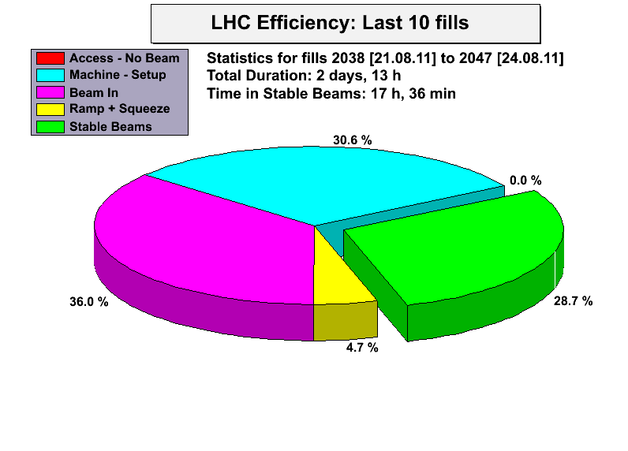
Efficiency since Saturday

Slide 5
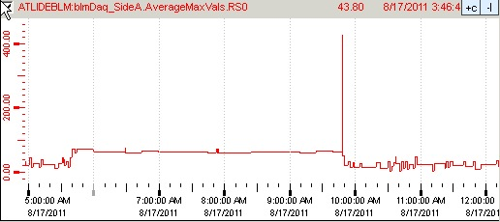
Wed, 17.Aug
On 17.8. at approximately 9:48 am the ATLAS BLM aborted the beam (fill 2029).
Both BLM sides showed a significant peak in activity in Average Max Values RS0 (40µs running sum).
Also ATLAS BCM saw large signal (totally independent detector).
Both signals are compatible with an UFO close to ATLAS (beam 1)
A-side: 2x abort threshold (thr=230)
BLM A-side 40µs running sum during the whole fill 2029
BCM high gain channel
bin-width = 5µs
Right: BCM signal from the post mortem buffer.
Big signal also seen in ATLAS BCM.
Also there the beam abort condition was reached, but ATLAS BCM is masked in the abort logic.
BCM low gain channel
bin-width = 5µs

Slide 6
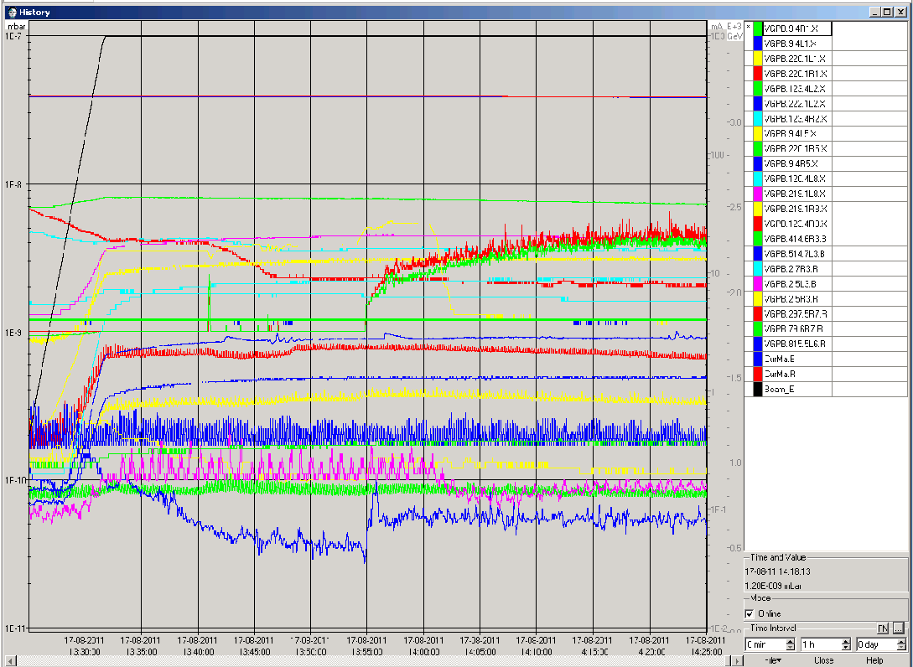
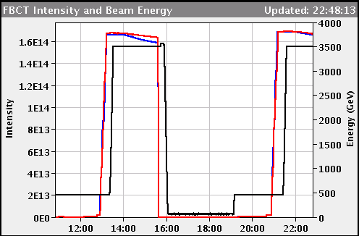
Wed, 17.Aug LHCb polarity change
LHCb polarity changed to negative
Vacuum ok
Background ok
Only slightly reduced B1 life time, but also seen on other fills before

Slide 7
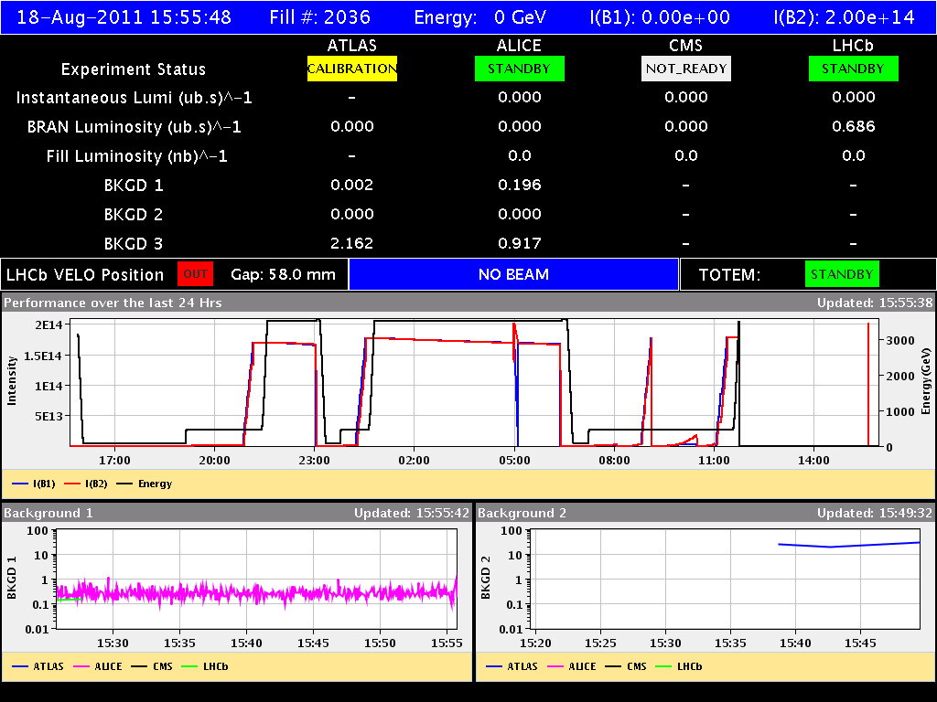
Thu 18-Aug: Electrical Glitches to Power-Cut
inj optimisation
power glitch
power glitch
power cut
rf hom alarm
(sis) 9:07
6:23, 8:04, 8:07

Slide 8
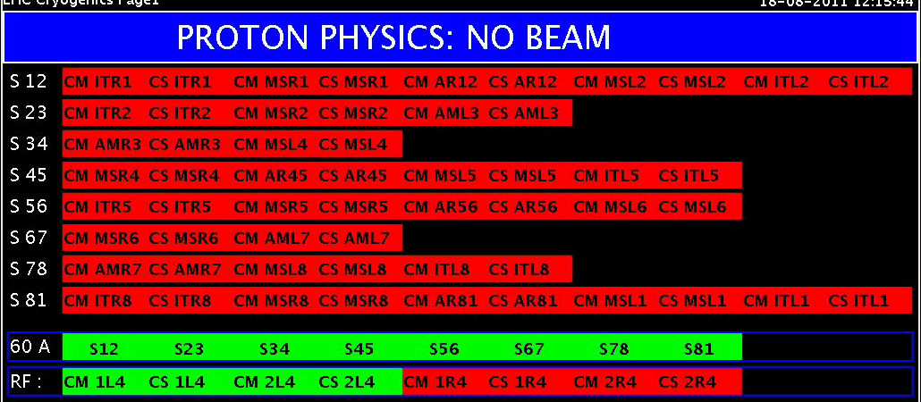
Thu Morning: General Power Cut
11:45h during the ramp:
General power cut,
ATLAS, ALICE and LHCb tripped.
Injection kickers tripped. All RF tripped. Undulators tripped.
Collimators seem to be in a bad state. Dump kickers faulty.
All 8 sectors tripped. All vacuum valves in.
➔ But all hardware interrupted safely!
Cryo: 4 sectors stopped. 23, 34, 78, 81

Slide 9
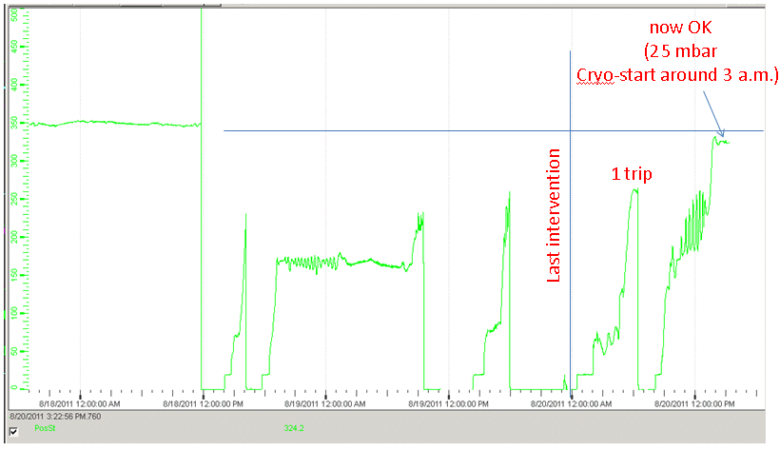
Saturday 20th August
Cryo Recovery
Yesterday’s main event:
Cold compressor speed S45
several attempts to restart
Thu, 18-Aug
power cut
Sat, 20-Aug
success
L.Tavian

Slide 10
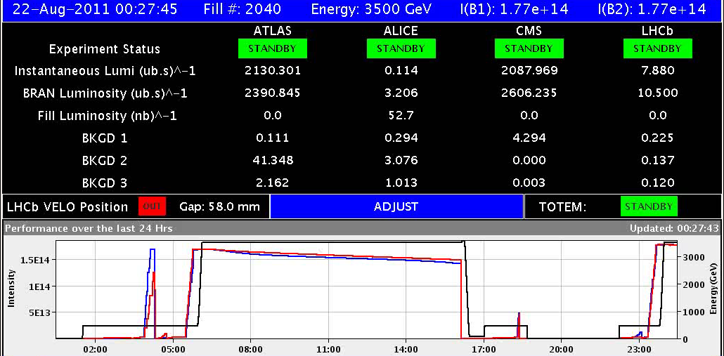
Sunday 21 August
11:00h ALFA moves roman pots to physics position: fine
15:07h Collimators put to tight settings: fine
TCP-H at 4
sigmas (both
jaws).
… dump due to “forgotten” interlock on relative TCSG – TCDQ position
00:27h lumi

Slide 11
Results from Test for Tight Collimation
“Tight” collimation settings:
Developed and tested in 1st MD block, however, only for low intensity.
E.g. primary collimators: 5.7 σ → 4 σ
Much better cleaning efficiency
More margin can be used for lower β*: 1.5 m → 1.0 m
Increased impedance: Test required for high intensity!

Slide 12
Results from Test for Tight Collimation
Test done in physics conditions, going to adjust mode.
Beam 1 only.
Only robust (carbon) collimators moved in: they have a high electrical resisitivity and make the impedance.
Summary (S. Redaelli, see plots on next slides):
Small halo population 4 to 5.6 sigmas: ~2e12p i.e.
1.3% of total after 8h of stable beams.
No effects seen on tunes while moving collimators IN.
Lifetime reduction only seen while cutting the halo, then recovered in steady conditions.
No unexpected hierarchy violation while moving in TCSGs.
Nice improvement of cleaning at the Q8 when TCSGs went in.

Slide 13
Intensity During Fill

Slide 14
Improvement in Cleaning Efficiency to IR8

Slide 15
Beam Lifetime

Slide 16
Mon 22/8 – Tue 23/8
00:07 stable beams #2040. Initial luminosities: 2.1x10³³ cm⁻²s⁻¹
18:00 Programmed dump. End of physics #2040. ~83 pb⁻¹ in ~18 hours

Slide 17
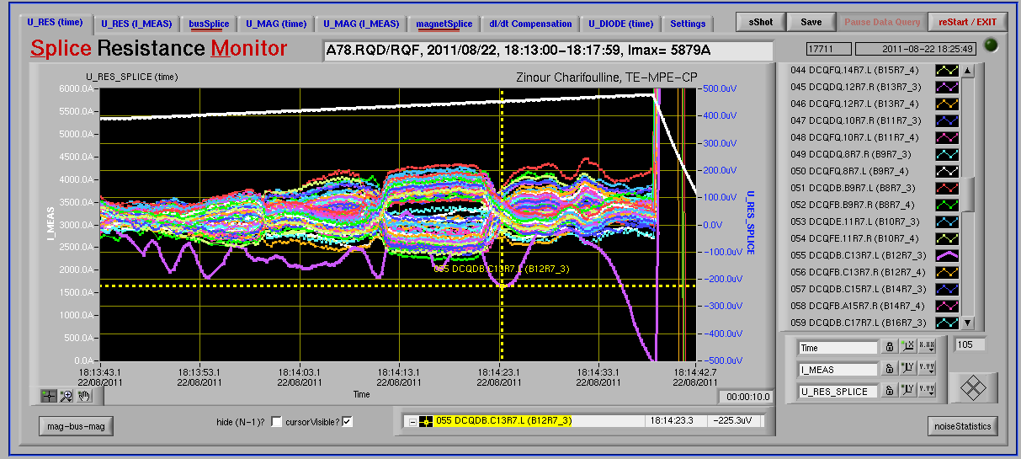
Mon 22/8 – Tue 23/8
Test of the coupling functions for the squeeze to 1 m.
Trip of Sector 78 (QD) at the start of the ramp-down (nQPS BS board B12R7_3 – RQD – Board A) - Z. Charifoulline. Noisy already during the last two ramps, so it has to be replaced during coming technical stop. For the time being we can try to survive with threshold 600μV.

Slide 18
Mon 22/8 – Tue 23/8: Test ADT Software
Summary on the ADT problem (D. Valuch)
missing 25ns in the total one turn delay. This explains the instability followed by a dump.
It has an origin in the new firmware deployed yesterday (version 322110720). All previous firmware versions were compiled by Synplify, while the new one by Synplify Premier.
Problem could be solved in 3 out of 4 crates
As it is not possible to have different version of drivers/fesa class on the different ADT front ends we had to revert back to the previous firmware, previous driver and previous DSPU FESA and previous AbortGapCleaning class on all units (kindly done by M. Jaussi in a middle of the night)
The problem is probably related to a specific clock phase or conditions in the crate Vertical Beam 1
On top of that, driver amplifier #7A (Vertical plane, beam 1) trips on a DC power, RF and Power module fault. Access at point 4 and quickly checked the amplifier in UX45. There is no apparent problem. Switch unit OFF till the ADT power piquet will have a look.

Slide 19
Tue 23/8 – Wed 24/8: 90m Run TOTEM/ALFA
09:00 Start 90 m optics run
Preparation and verification of the collimation functions
Re-generation of functions for Transverse damper, RF longitudinal blow-up etc.
10:30 Injecting.
Problems in the orbit acquisition due to the defined filling scheme with bunches of different intensity (2 bunches with 8x10¹⁰ p/bunch, 4 bunches with 3x10¹⁰ p/bunch).
BPM triggering also on lower intensity bunches even reducing their intensity below 2x10¹⁰ p/bunch.
Poor orbit readings leading to beam dump (LSS6 BPMs)

Slide 20
Tue 23/8 – Wed 24/8
14:00 New filling scheme with 5 bunches of 6x10¹⁰ p/bunch

Slide 21
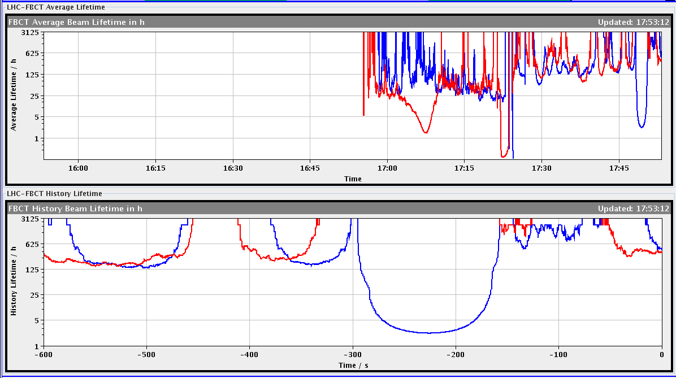
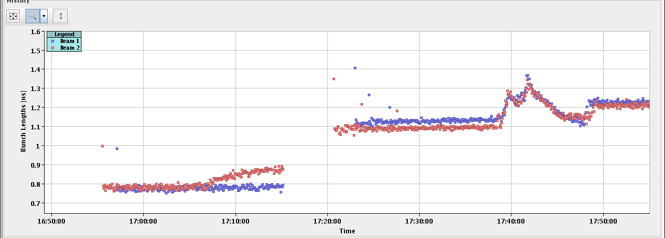
Tue 23/8 – Wed 24/8
15:00 Lost beam during the ramp due to a problem on an RF frequency distribution module requiring a reboot on request of RF expert
17:00 refill after fixing problem with RF module (replaced). Ramp OK a part of a dip in Beam 1 lifetime. Longitudinal blow-up OK

Slide 22
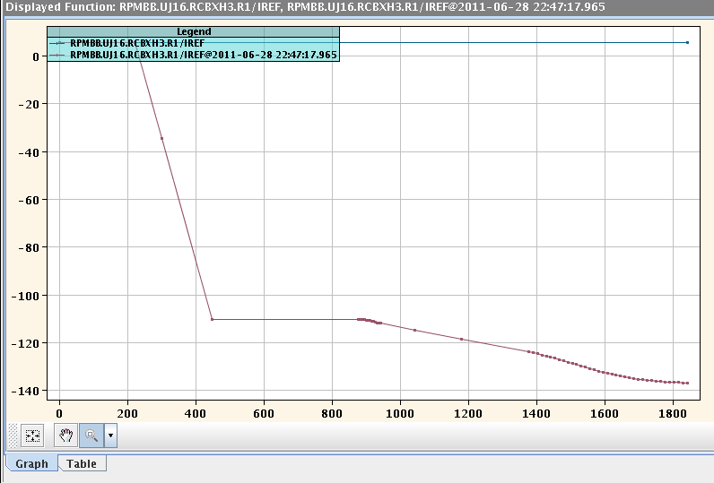
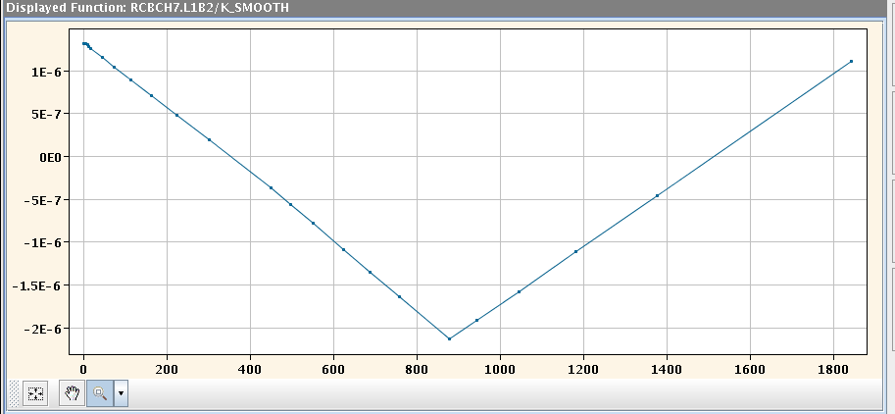
Tue 23/8 – Wed 24/8
18:30 Beam dump during the squeeze due to a trip of two triplet orbit correctors (RCBXH1.R1, RCBXH3.R1). Traced back to a problem in LSA function trim leading to functions with no rounding. Not observed on the physics hyper-cycle ➔ software problem understood by CO experts.

Slide 23
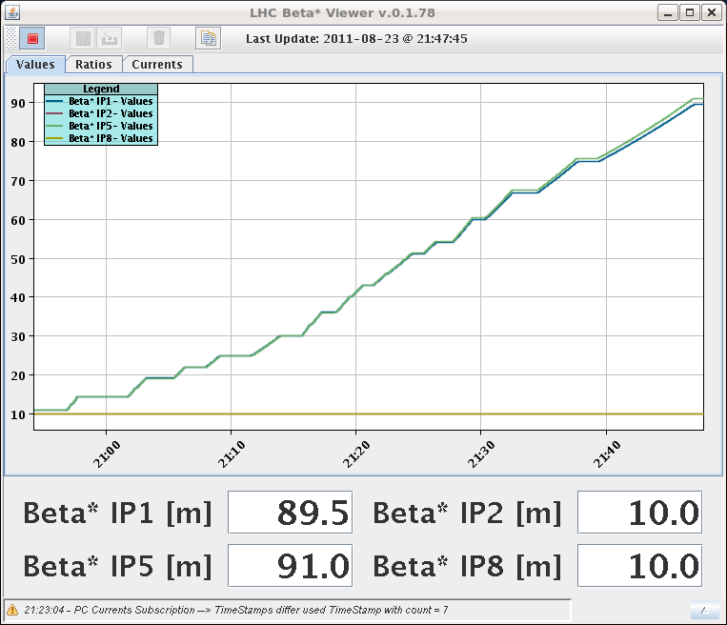
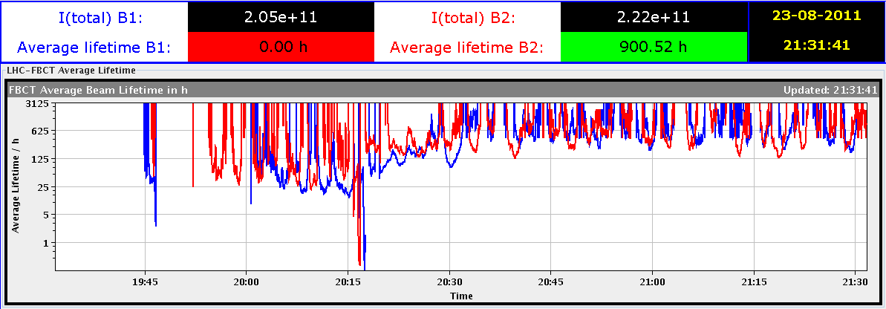
Tue 23/8 – Wed 24/8
Functions smoothed out by rolling back to older functions
21:47 finally squeezed to 90 m. Lifetime OK this time

Slide 24
Tue 23/8 – Wed 24/8
In agreement with MD coordinator and Physics coordinator decided to give an additional slot of 9 h taking it from MD time (beam-beam MD) to be recovered after technical stop to allow completing the TCT/roman pot alignment and data taking
23:47 Beams colliding at all IPs and start TCT alignment. Some difficulties in optimizing collisions due to missing luminosity data (had to reboot DIP servers)

Slide 25
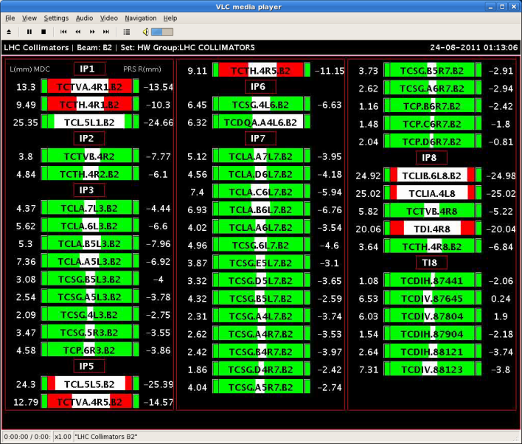
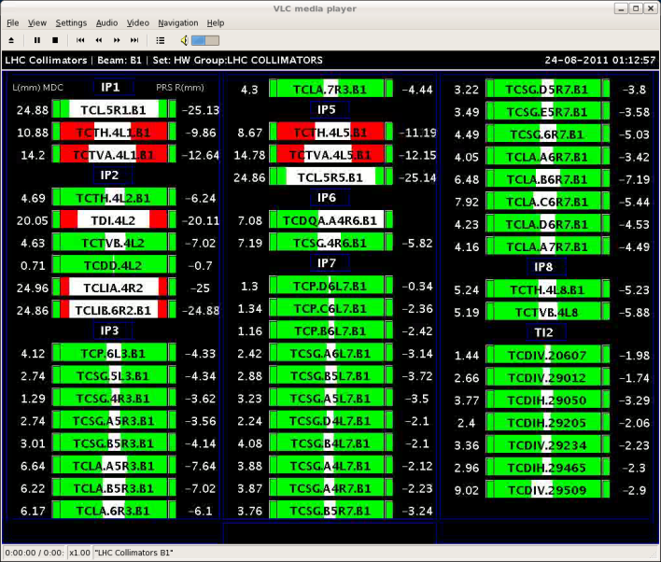
Tue 23/8 – Wed 24/8
01:06 All TCTs aligned.
04:53 All TOTEM Vertical roman pots aligned but problem with high voltage for data taking.
Problems with ALFA roman pots movement (no communication with PXI). After verification with rMPP (Rüdiger) decision not to reboot PXI with circulating beam

Slide 26
Tue 23/8 – Wed 24/8
05:16 Power glitch. Trip of compensators in point 2 and 8
Start preparation of β* 1 m MD.
No TOTEM/ALFA data taking in the end, but lot‘s of set-up work done which will be used next time.
Set-up conditions were good for TOTEM data taking.
ALFA PXI problem and TOTEM HV problem to be followed up.

Slide 27
Wed 24/8 → MD#3
MD session #3 started.
Optics work for β* = 1m ongoing:
No problem to get to 1m.
Optics measured but very good → no correction.
Test squeeze to 0.5m (not usable for physics).
Once optics, orbit and sequence set up:
Collimation set-up in IR1 and IR5 (Sat).
LR beam-beam test for 8σ separation (Sat).

Slide 28
MD Planning Wed – Thu (24. – 25.8.)
Day | Time | MD | MP
Wed | 04:00 | Ramp down, cycle
 | 06:00 | 450 GeV → 3.5 TeV: Head-on beam-beam + 1h data taking (stable beams) – for highest pile-up | B
 | 13:00 | Ramp down, cycle
 | 15:00 | 450 GeV → 3.5 TeV: Optics setup for β*=1m (1) – Pilots through squeeze, measure and correct Q, Q’, C, orbit, measure beating and local coupling | A
 | 19:00 | Ramp down, cycle
 | 21:00 | 450 GeV → 3.5 TeV: Long bunch length – RF setup at injection, test ramp for losses in IR3, voltage change at flat top | B
Thu | 03:00 | Ramp down, cycle
 | 05:00 | 450 GeV → 3.5 TeV: Beam Instrumentation | B
 | 13:00 | Ramp down, cycle.
 | 15:00 | 450 GeV → 3.5 TeV: LR beam-beam – 2 batches, effect of number of LR interactions, effect of emittance | C
Postponed to after TS

Slide 29
Draft MD Planning Fri – Sat (26. – 27.8.)
Day | Time | MD | MP
 | 23:00 | Ramp down, cycle.
Fri | 01:00 | 450 GeV: Transverse damper – beam blowup at injection | B/C
 | 07:00 | 450 GeV → 3.5 TeV: Aperture – scraping pilot beam tails in triplets, maybe test global aperture measurement with transverse damper | B
 | 15:00 | Ramp down, cycle.
 | 17:00 | 450 GeV: 25 ns studies – injection of up to 144b/288b, damper | B
Sat | 00:00 | 450 GeV: 25 ns studies – vacuum, ecloud, RF | B
 | 07:00 | 450 GeV → 3.5 TeV: Optics setup for β*=1m (2)– apply proposed beating and local coupling corrections; at 1m: measure beating and coupling, verify corrections, test collision beam process | A
 | 15:00 | Ramp down, cycle.
 | 17:00 | 450 GeV → 3.5 TeV: Collimator setup for β*=1m– tight collimation settings, set up TCT’s in IR, loss maps. Asynchronous dump, if time left. | B

Slide 30
Draft MD Planning Sun – Mon (28. – 29.8.)
Day | Time | MD | MP
Sun | 01:00 | Ramp down, cycle. | B
 | 03:00 | 450 GeV → 3.5 TeV: p-p rephasing – debunching during ring rephasing with nominal emittances
 | 09:00 | Ramp down, cycle.
 | 11:00 | 450 GeV: UFO studies – generation mechanism at MKI’s, statistics, MKQA tests (p-Pb interlock test in the shadow) | C
 | 19:00 | 450 GeV: Quench margin at injection – observation with special QPS instrumentation, losses from TCLIB collimator | C
 | 22:00 | 450 GeV → 3.5 TeV: Quench test at 3.5 TeV – test losses in other dispersion-suppressors – dropped if extra time needed for β*=1m | C
Mon | 06:00 | Technical Stop
Needs from experiments:
-Luminometers on during beam-beam MDs and in the second slot of β*=1 m

