Slide 1
Status of Cryogenics at point 4 following the power cut
L. Tavian
20 August 2011

Slide 2
The issue
Problem with one cold compressor (CC2) on the pumping unit of P4, S4-5.
Trips of the compressor during the pump-down
Overload on magnetic bearing (still to be investigated and confirmed)
The cause of this trip is not yet identified (electronics, powering, cabling, mechanics…)

Slide 3
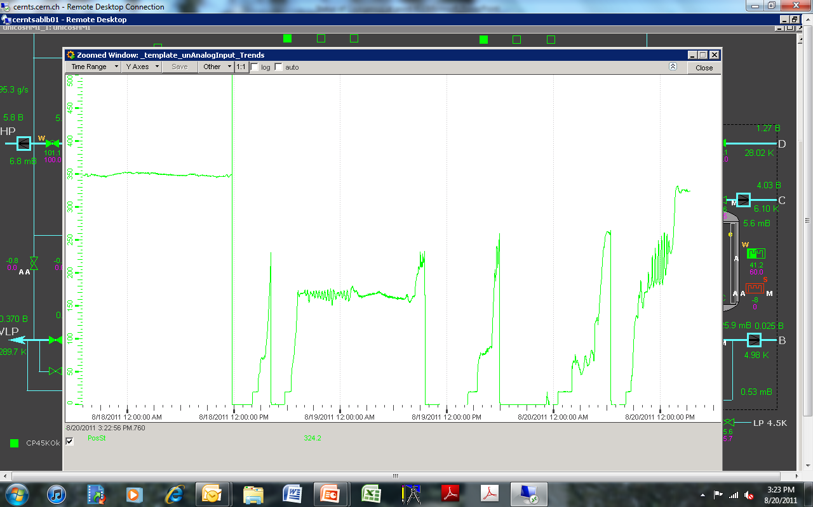
CC2 speed trend (Hz)
Electrical power cut
Nominal speed
4 trips during pump-down

Slide 4
Normal action plan
Reset
Remotely if process trip (PVSS action)
Locally if “assisted landing”
Locally with recalibration if “hard landing”
Replace
Active magnetic bearing drive
Frequency drive and other electronics
Transformer with check of the cabling to the motor
CC cartridge

Slide 5
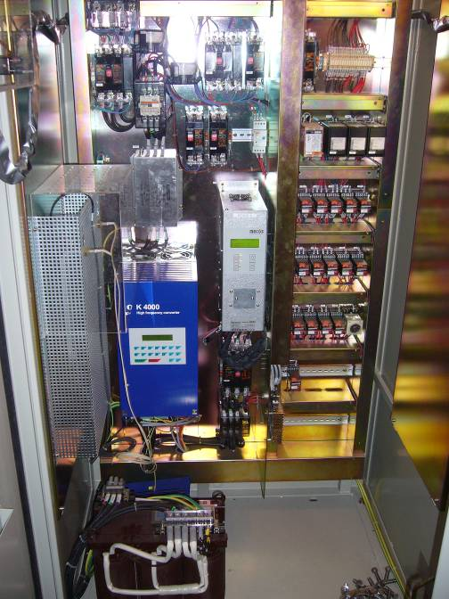
Electrical cabinet of a cold compressor
Magnetic bearing drive
Frequency drive
Warner K4000
Transformer 400 V - 150 V

Slide 6
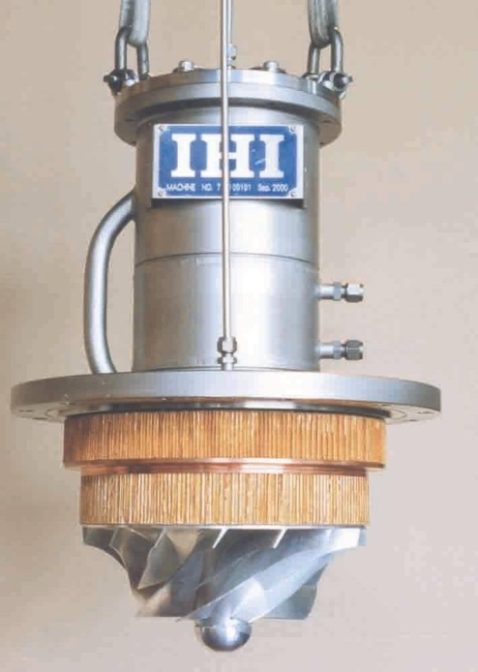
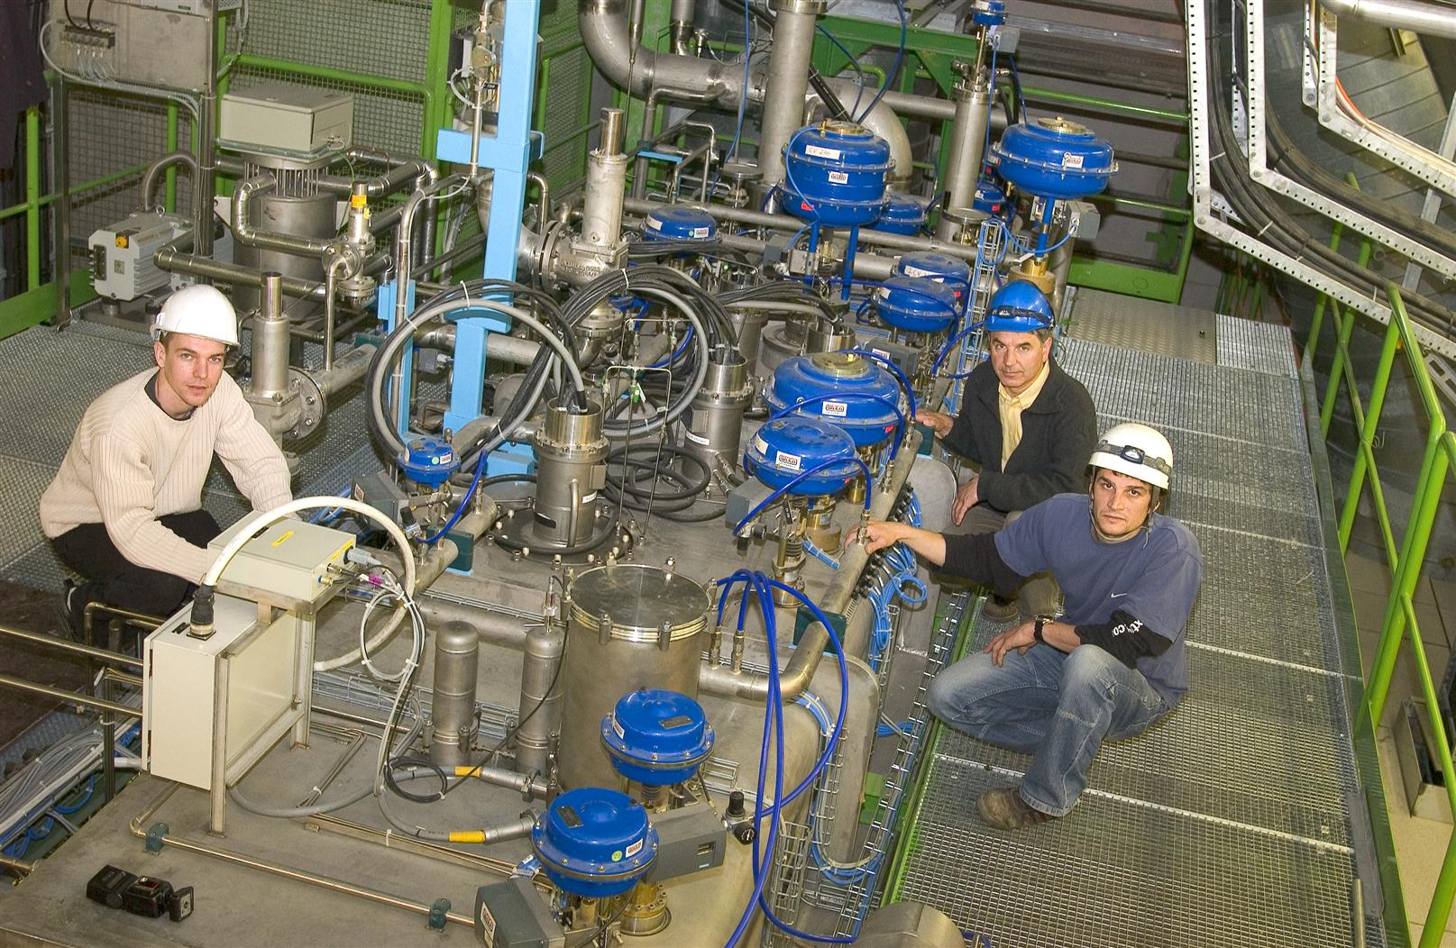
Cold compressor cartridge

Slide 7
Normal action plan
Reset
Remotely if process trip
Locally if “assisted landing”
Locally with recalibration if “hard landing”
Replace
Active magnetic drive
Frequency drive and other electronics
Transformer with check of the cabling to the motor
CC cartridge
NOK then OK

Slide 8
Present situation
now OK
(25 mbar
Cryo-start around 3 a.m.)
1 trip
Last intervention

Slide 9
Future plan
If the present run not successful → continue the normal action plan (Plan A):
Exchange the transformer (spare already in UX45) (~1 h interv.)
Exchange the CC cartridge:
Warm-up of the cold box on Sunday nigth
Exchange of cartridge on Monday morning (5-8 h)
Cool-down of the cold box on Monday (8 - 10 h)
Validation test (2-3 h) Tuesday morning
Pump-down to cryo-start (24 h)
Remark: As the cause of the problem is not clearly identified the success of these interventions is not known

Slide 10
Other alternative (Plan B)
Limit the maximum speed of this compressor below the trip threshold (260 Hz ?).
Need of the CERN expert on Linde CC PLC → not before Tuesday (8h intervention)
Try to assess which pressure can be reached by pushing the other stages.
Difficult to assess as the cold compressors are limited by their control algorithms (black box).
Personal remark: limited confidence in reaching stable cryo-maintain condition with this alternative

Slide 11
Other alternative (Plan C)
Use redundancy with S3-4 cryoplant
Because of RF load at P4, not possible to implement the P8 and P6 configuration (one cryoplant on 2 sectors)
Because of RF at P4, not possible to implement the P2-P18 configuration (thermal shields on the S4-5 cryoplant and the rest (CM, BS, DFB, RF…) on the S3-4 cryoplant (low-load ex-LEP plant).
Implement another redundant scheme:
Supply of the 1.9 K cooling loop via the S4-5 cryoplant
Return of the pumping flow via the S3-4 cryoplant
Consequences:
The S4-5 cryoplant will have and additional liquefaction duty of about 50 g/s (seems to be compatible with its capacity margin)
The S3-4 cryoplant will have an extra cold return flow (~50 g/s) at 20 K and will work as “economizer cycle” → turbine attenuation.
Personal remark: The better alternative plan with nominal conditions until the next TS

Slide 12
Summary
Continue the present pump-down → CS by 3 a.m.
If trip again: change of the transformer
If trip again: start plan C on Sunday morning
CS expected ~40 h after restart (but it is a new operation mode with possible surprises)
Wait the next TS for cartridge exchange and/or further investigations.

