Slide 1
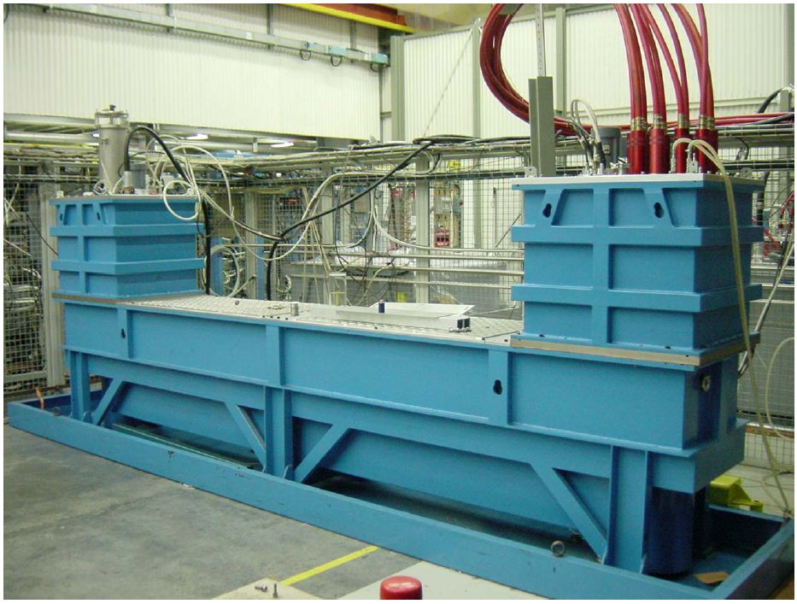
MKI2 thyratron erratics (untriggered) turn-ons of 30 July 2011 M.J. Barnes
Acknowledgements:
Alain Antoine, Nicolas Magnin, Volker Mertens & Rodolphe Rosol
Notes:
4 PFNs per Point 2 & Point 8
1 RCPS charges 2 PFNs, hence 2 RCPS at each of Pt2 & Pt8
DS
MS
PFN

Slide 2
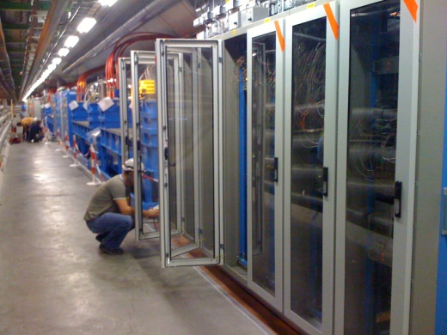
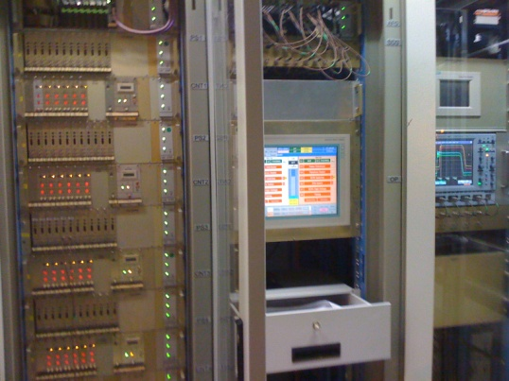
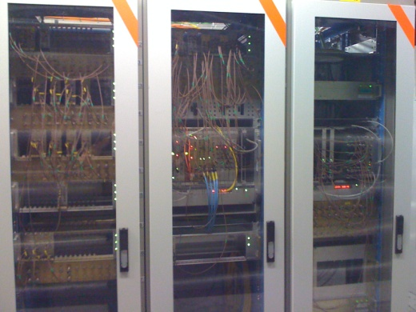
RECAP OF MKI2 EVENTS UP TO 29/7/2011
At 16:30:43hrs, on 28/7/2011 , an erratic turn-on of MKI2 MS3 at full PFN voltage;
Interlocks detected erratic and correctly triggers MS and DS of system. Hence all 4 kicker magnets pulsed for up to 4.5µs, emptying PFNs of energy.
Circulating beam was not in IP2 and therefore not disturbed.
Batch was extracted from SPS but saw no kick at MKI and went straight into the TDI.
Note: this MS was put in place during last TS and has since made 5 erratics (only last 2 effected beam).
At 18:03:09hrs , on 28/7/2011 , an erratic turn-on of MKI2 MS3 occurred during resonant charging – sending current to one of the four kicker magnets (Not usual to have an erratic at such low voltage);
Interlocks did NOT detect erratic of MS3 (at 33kV): hence no immediate action was taken to turn-on other thyratrons. PFNs correctly discharged via the DS after 4ms (no further magnet current);
The failure occurred early in the charging process, and the extraction from the SPS was inhibited;
Circulating beam was swept over the aperture and protection elements (~17% of normal kick) for ~9µs.
Intervention on morning of 29/7/2011:
All 6 erratic detection cards, for MS3 replaced.
Cards used to retrigger MSs replaced; Some 50 ohm LEMO terminations, on the retriggering chain, replaced.
MS3 exchanged for spare
Local operation, SoftStarts and Inject and Dump did not result in any further erratics.

Slide 3
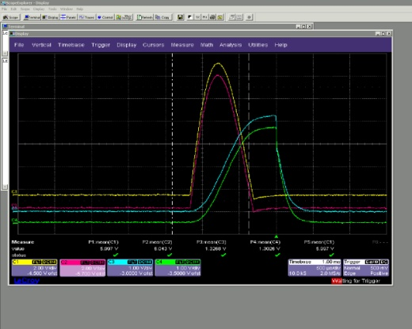
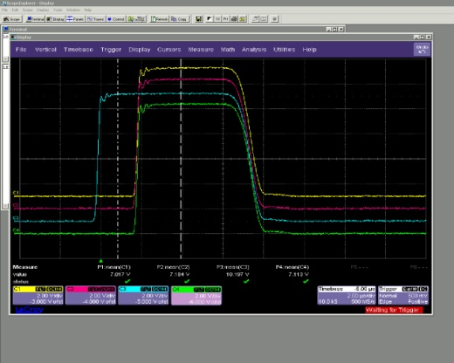
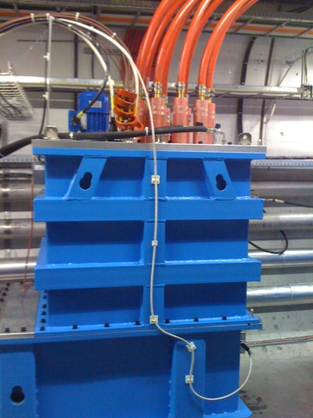
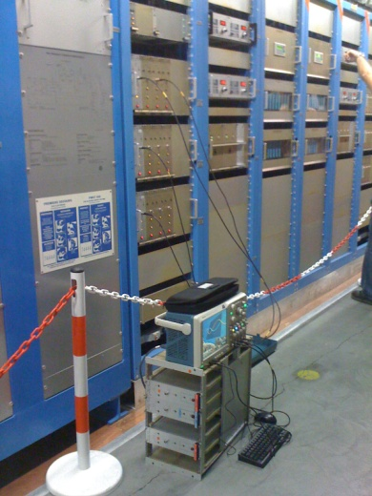
Erratics of 30/7/2011
MS3 erratic during SoftStart @ ~04:30hrs, at 51.6kV (2kV above nominal). Erratic was correctly detected, resulting in the turn-on of all 4 MS.
MS3 erratic, during SoftStart @ ~15:06hrs, at 50.4kV (0.8kV above nominal). Erratic was correctly detected, resulting in the turn-on of all 4 MS.
Intervention on afternoon of 30/7/2011:
Magnetic cores added to trigger inputs of MS3
Trigger units for MS3 replaced.
Power supply and crate for MS3 heater/reservoir replaced.
Diagnostics added
Local operation, SoftStarts and Inject and Dump did not result in any further erratics.

Slide 4
Plans
If there is another erratic on MKI2 MS3 I should be called and will go down to UA23 to analyze the waveforms on two scopes we left there.
Carry out some checks on trigger cables for MS3.
If the measurements show a faulty triggering from a trigger unit we will follow that up. If not, it suggests a problem with the MS3 (since trigger units and heater power supply are now replaced) -- in which case the spare MS from point 8 or the lab test cage will need to be transported to point 2 and exchanged for MS3.
(NOTE: the present MS3 switch, point 2, did have an erratic on July 4th (early morning) immediately before the TS - so maybe it has a weakness too.)

