Slide 1
Wednesday 01.06.
07:45 injection for physics
09:17 Ramp. Dump: collimator temperature
10:16 Injection pilot. Increase bunch length 1.2ns to 1.25ns.
10:20 SPS intervention as planned. No beam for injection.
11:36 Injection setup 144b.
A few injectors issues on the way. Injection of 1092b with 144b batches. Beam dump test. All fine (vacuum, …).
17:04 Injection for physics with 108b batches.
18:50 Ramp.
19:31 Stable beams. Fill #1835. Lumi ~1.2e33.
20:37 Beam dump.
Collimation crate IR5R down (SEU?). Lost cryo maintain S78 (SEU?). S78 tripped. Access for collimation crate.
22:44 Cycling

Slide 2
Tuesday to Wednesday
Injection preparation for 144b
Collimator temperature
QPS noise → quench
Cryo S56
Cryo S34
UFO IR2
RF arc

Slide 3
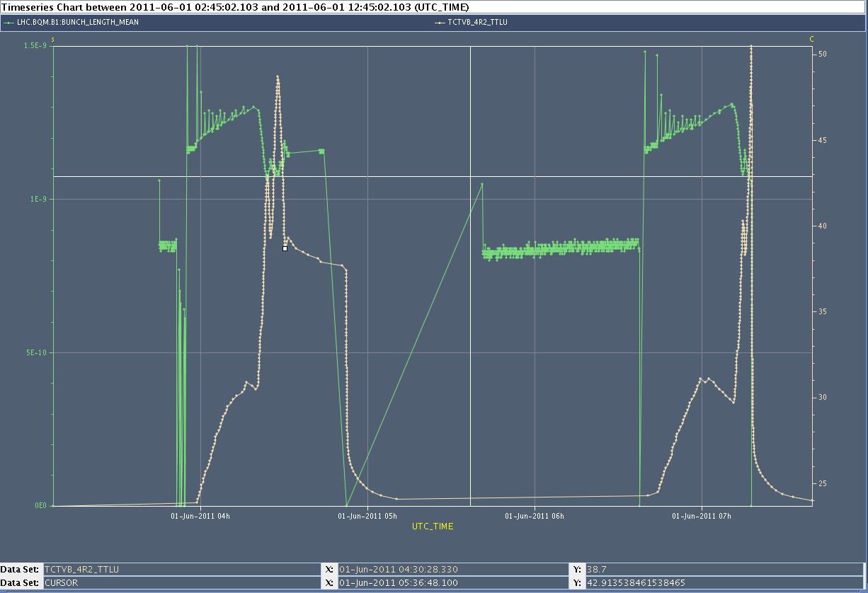
Collimator Heating by EM fields
Bunch Length
25 deg.
0.5 ns
Collimator
temperature

Slide 4
Thursday 02.06.
00:31 Injection
01:29 Ramp
02:03 Stable beams. Fill #1836. Lumi ~1.2e33.

Slide 5
Back into Stable Beams
Collimator rack
S78 trip

Slide 6
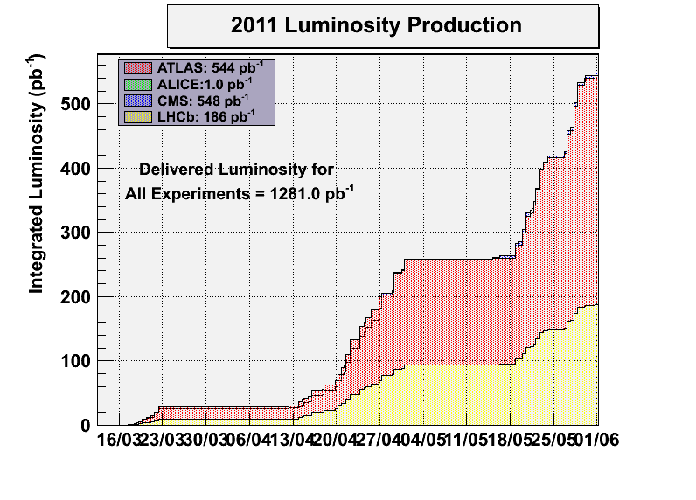
Luminosity Production

Slide 7
Ahead
Physics fills over long weekend (1092 x 1092 bunches, 108b injections).
Average bunch intensity: ~ 1.2e11 p
End of fills (if any):
Try to reduce DS losses with TCL collimators (open now)
RF cavity switch off test

