Slide 1
Monday
Fill 1803 into stable beams at 9:30.
Luminosity ~ 8.5E32 cm-2s-1 – some trains blown up (first 4) during injection.
Solenoids ramped down in steps between 18:00 and 19:00. Feedback from exps?
Dump at 19:45.
Access for ALICE.
Start refill 22:20.
ADT ‘bumps’ now properly integrated into OFB reference and functions – decaying in the ramp.
Delay due to bunch length issues in the SPS.
Dump and refill a blown-up beam, re-correct Q’ (after more than 2 hours at injection). It was worth it ….
Quite a few high loss (40%) injections B1.

Slide 2
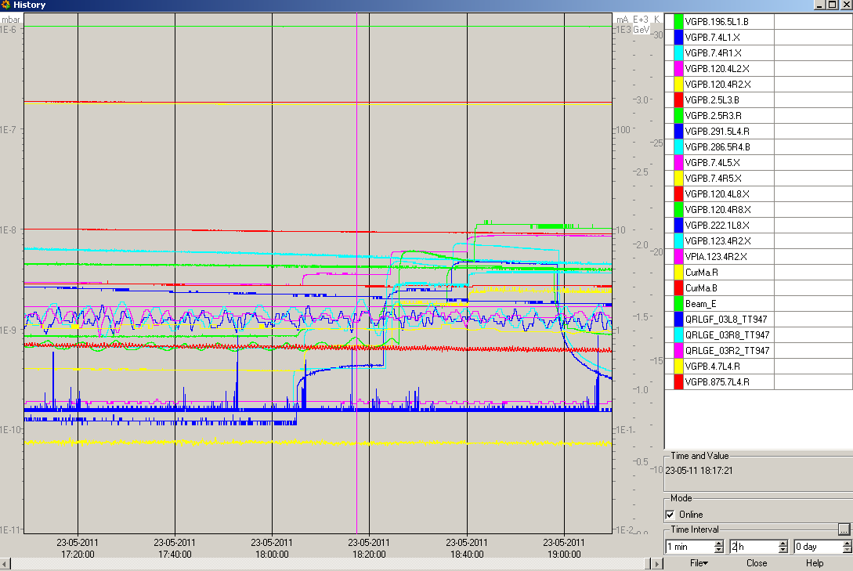
Solenoids

Slide 3
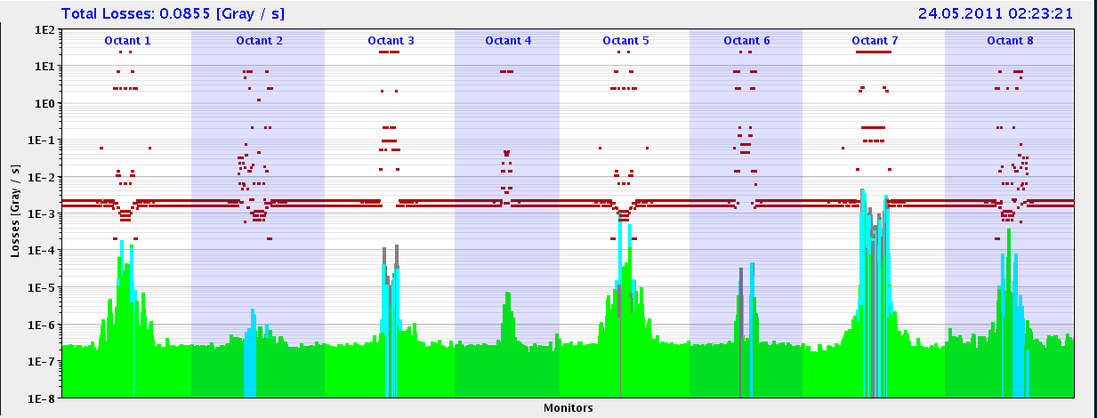
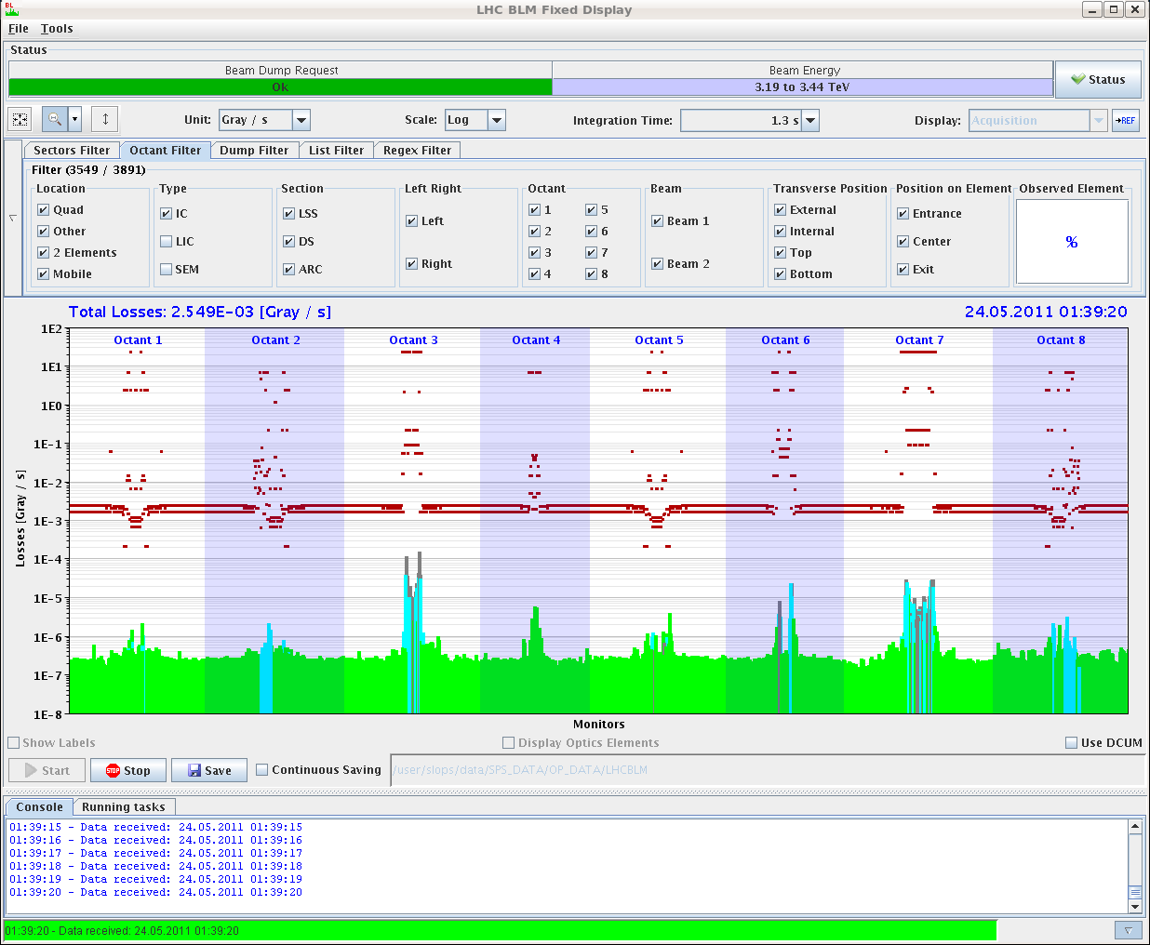
Monday
End of ramp : again high losses in IR6 (as compared to IR7)
Disappears in collisions.
Collisions
Ramp

Slide 4
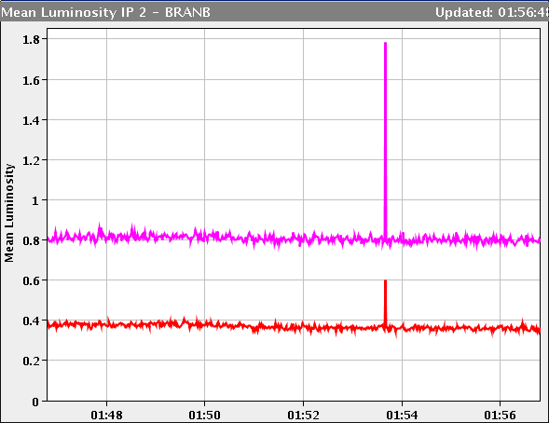
UFO
UFO @ 40% in MKI 2 seen on IR2 BRAN

Slide 5
Fill 1804 hitting 1E33 cm-2 s-1.
LHCb: first separate V, then optimize H before collisions.
CMS scan repeated after LHCb/ALICE leveled – chage of ~ 1.8 um V, negligible in H.

Slide 6
Today
Keep this fill a while… at least 14:00.
TCL collimator check at EoF.
Loss maps at injection with injection protection in.
Refill 912 bunches – same conditions.

