Slide 1
Sat 21/5
12:00 End of STABLE BEAMS 1798: 18.8 pb-1 in 9 h
12:00-14:00: RF tests – study of transient during klystron switch off
14:00-18:00: ramp down and access for ATLAS and QPS controller reset.
OK from rMPP to go ahead with 912 bunches
20:34 STABLE BEAMS #1799 - 912 bunches/train - Initial luminosity 8.5x10³² cm⁻²s^{-1.} More than 10¹⁴ p/beam in collision
07:00 Beam dump: end of STABLE BEAMS #1799: 25 pb⁻¹. Record integrated luminosity in 24 hours: 33.33 pb⁻¹

Slide 2
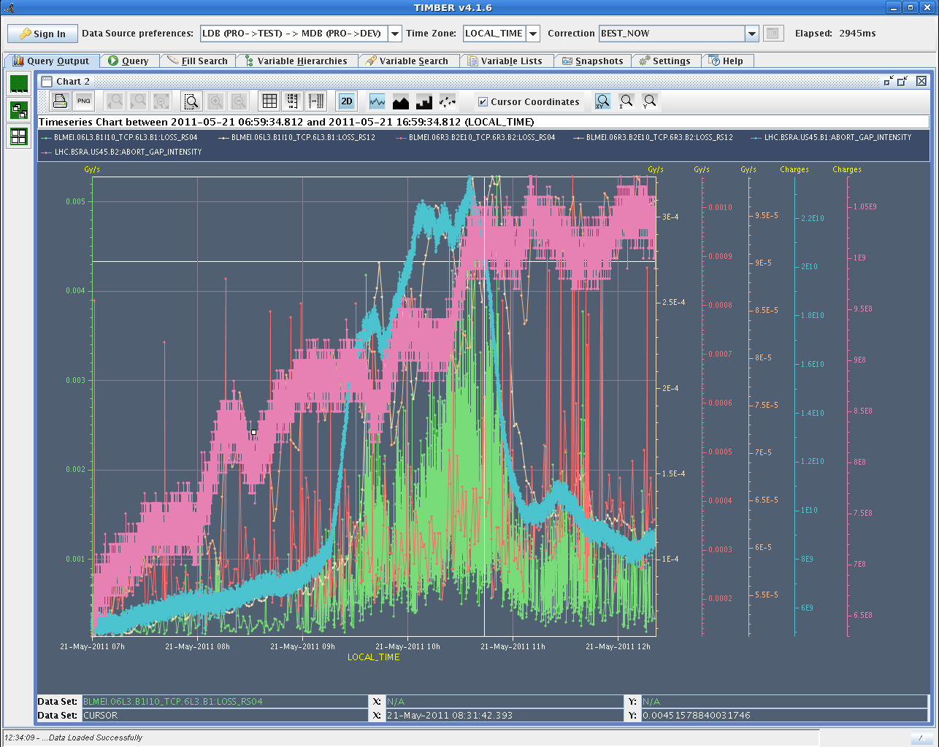
Abort gap population during fill 1798
for B1, there has been a 2h long period (9:00-11:00) during which some unexplained debunching took place.
No correlation with RF activity or others. We will monitor next fills.
Calibration for B1 and B2 abort gap population data to be verified

Slide 3
Transients at RF OFF on 1 klystron (P. Badrenghien)
RFOFF on one cavity per beam, with 768b (8.3E13) at 3.5 TeV, after a long physics period (Fill 1798). Bunch length ~ 1.25 ns before RF OFF. Cavity Q=60k. Beam induced voltage is measured at 0.6-0.65 MV in the cavity (1B1 and 1B2) The CW power extracted from the beam thru interaction with the idling cavity is measured at 65-70 kW. However, at the exact time of RF OFF, we observe a short (10 microsec long) peak in RF power measured around 700 kW on 1B1. This peak was expected. Transient acquisition on 1B2 is not usable. Extrapolating to 912b we would expect 0.8 MV and 100 kW CW for an idling cavity. That is no problem. The few microsec long power spike will almost reach 1 MW. The theory is that the spike does not last long enough to cause damage... That will be re-evaluated by the LHC RF team on Monday.

Slide 4
912 bunches

Slide 5
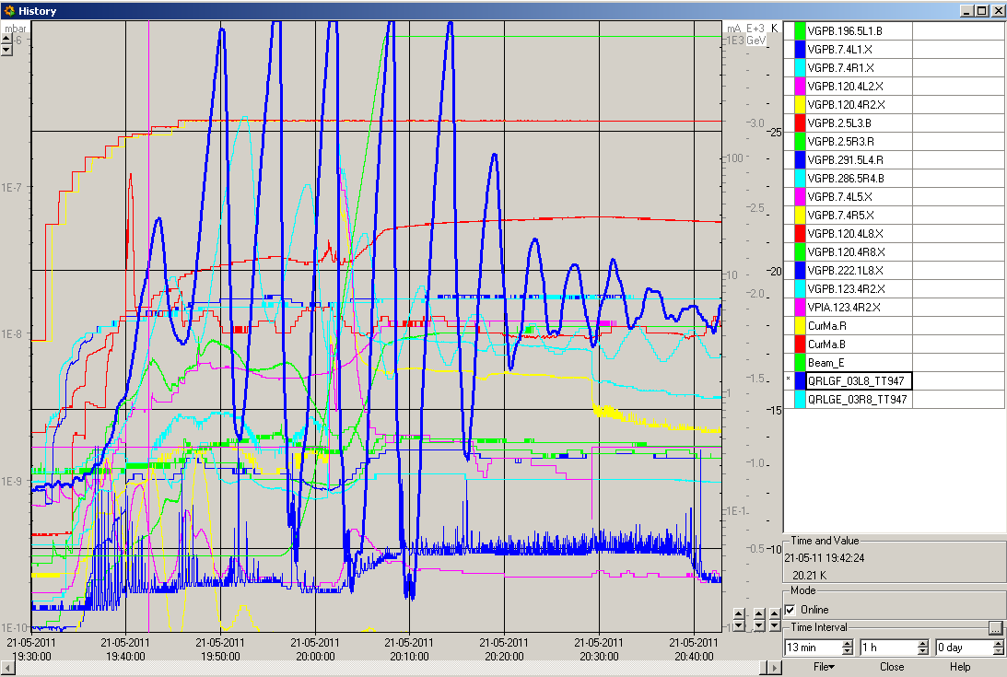
Vacuum and cryo evolution
Cryo team struggling to keep the temperature of the BS L8 under control.

Slide 6
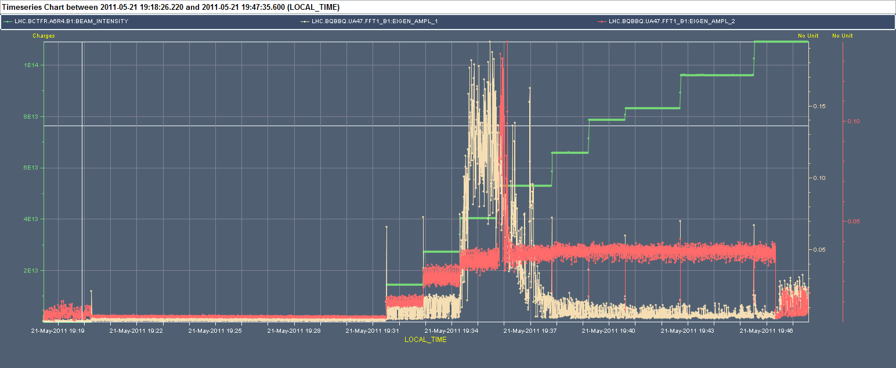
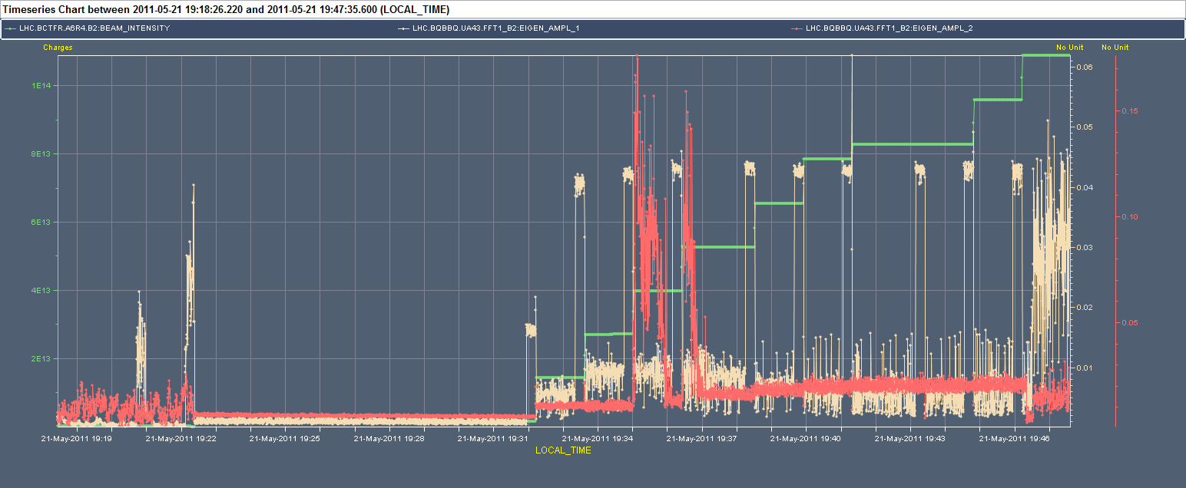
Filling with trains of 912 bunches

Slide 7
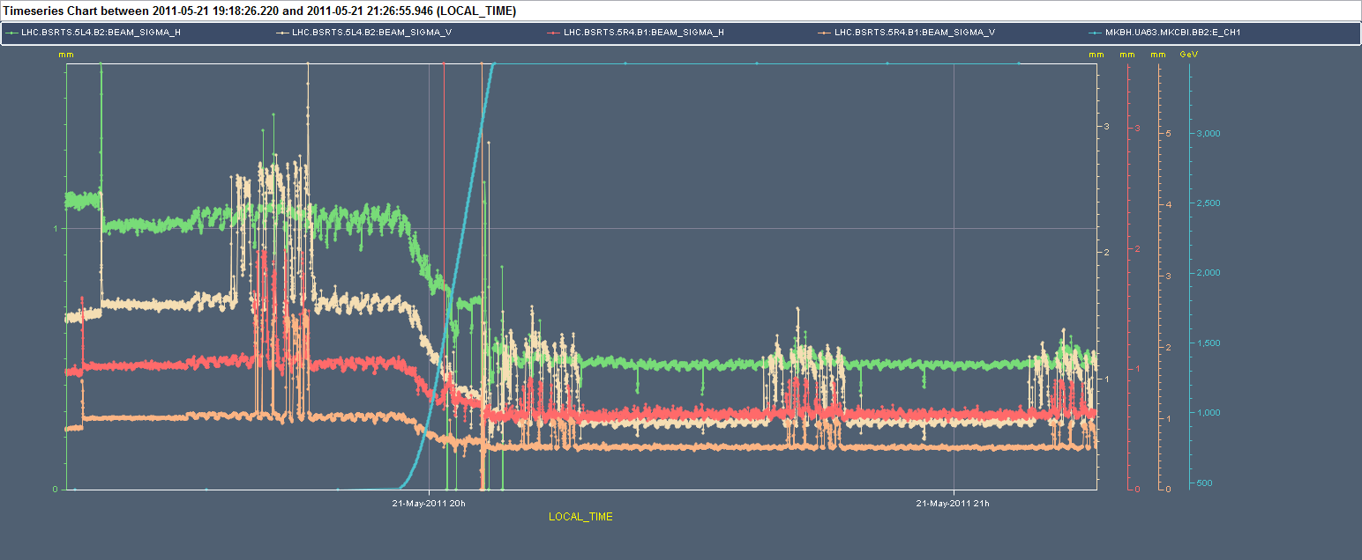
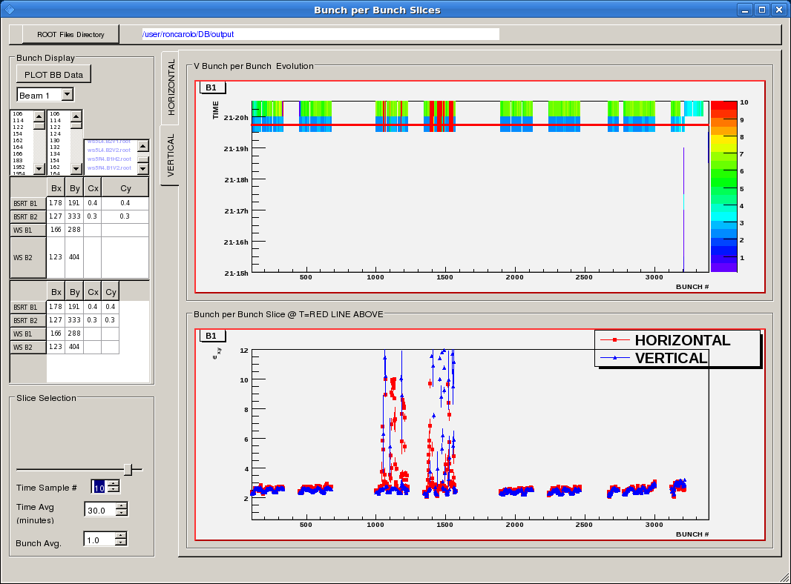
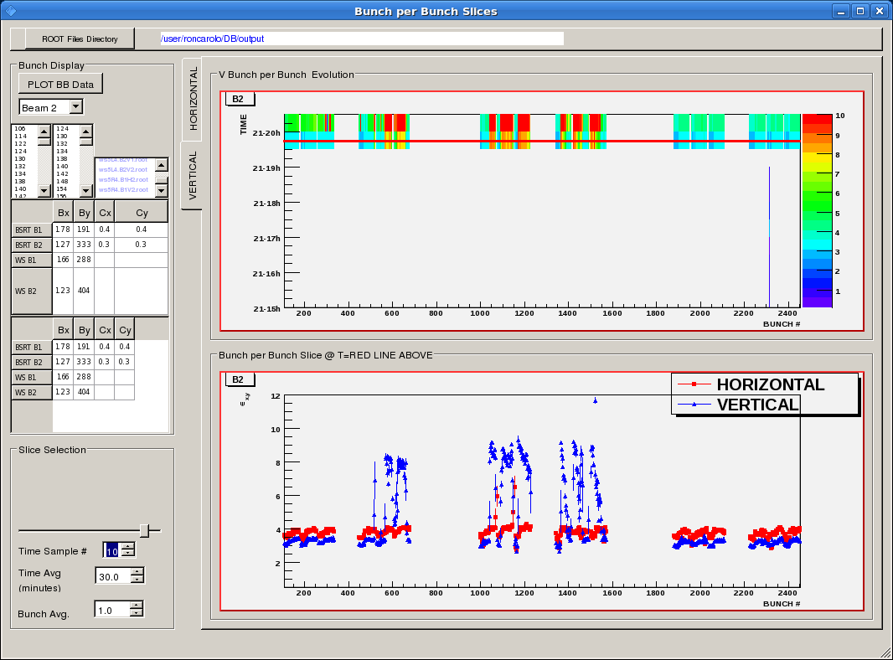
Filling with 912 bunches

Slide 8
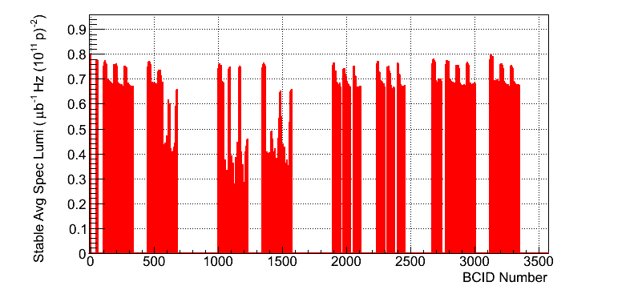
Not a record fill…

Slide 9
Plan
Physics with 912 bunches...try harder

