Slide 1
Collimators Control P1

Slide 2
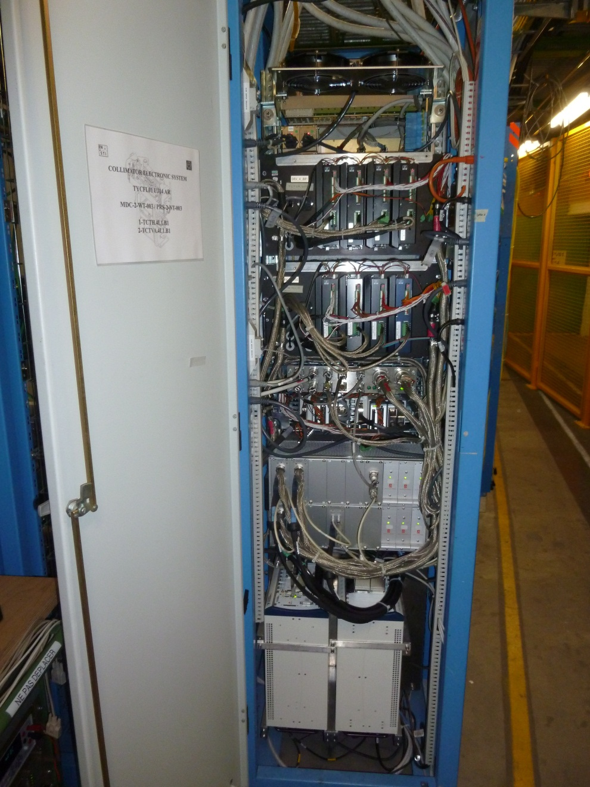
Collimators controls P1
Rack for 2 collimators
MDC drives the motors. Does not generate interlocks.
PRS monitors the position sensors and generate interlocks
MDC
PRS

Slide 3
Collimators controls P1
1st event:
5 Oct. 2010
MDC lost communication during SB or after programmed dump.
MDC remotely reset then failed and replaced.
No interlock, no beam dump
After 14 hours of SB at 200 vs 200 bunches.
Not identified as SEU
2nd event
27 Apr. 2011
MDC lost during SB at 480 vs 480 bunches.
no interlock, no beam dump
Remotely reset.
Exchanged for precaution
Identified as SEE

Slide 4
Collimators controls P1
3rd event:
1 May 2011
PRS rebooted during SB with 768 bunches.
Interlock, beam dump
Clear signature of SEU.
Radiation levels in UJ14 last week as high as from start of LHC to week before.
A few 10^6 HEH (> 20 MeV).

Slide 5
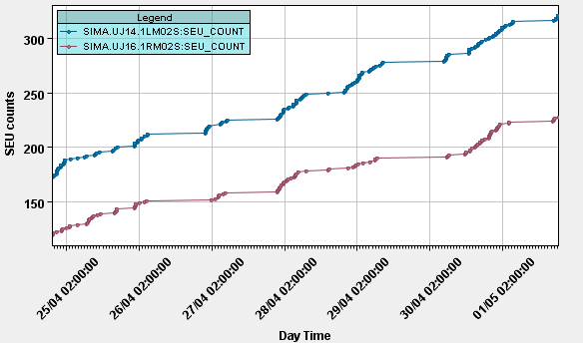
Collimator’s controls P1
In UJ16 the situation is almost symmetric, for some reason the radiation levels are 1.4 times lower!

Slide 6
Collimators controls P1
Next days of SB will confirm (or hopefully not) whether it is really a SEU.
If confirmed, no quick solution at hand
Ralph proposes to close the TCL and see if it helps…
R2E integration of P1 completed, if necessary move of collimator’s rack may be anticipated
To be discussed if SEU and low cross section (few 10^-6 HEH) confirmed.

