Slide 1
Monday 11.04
07h34: beam (1020b) lost after 10 Hz RF trim. Fill 1694.
07h56: XPOC to be reset by expert.
08h18: Masked QPS_STATE SIS interlocks for RB.A12 and RB.A45.
09h43: BPM calibration. BPM good and bad status flips.
11h00: M. Andersen: “Did a quick fix of OFSU by changing Fesa threads priorities to allow the Orbit reading thread more CPU time. Back to the drawing board to determine if more substantial redesign is needed to make the system more robust.”
11h25: LHC.USER.RAMP added to Hypercycle (RAMP_FAST_2011_V1 BP) for test ramp with 12+1 bunches + probe.
11h42: XPOC problem.
12h21: XPOC cleared.

Slide 2
Beam Loss at 7h34 (1020b)
Analysis loss with 1020 bunches. Fill 1694.
Beam lost during +10Hz frequency trim of RF frequency.
Dumped by BLM interlocks (loss limits violated).
Fast loss developed over ~70ms
Highest losses at TCP.B6R7.B2 (skew primary, probably due to losses on upstream H and V primary collimators), reaching 23 Gy/s in 40 us scale and 0.6 Gy/s in 1.3s.
Integrated losses in 1.3s bins went from 5e-4 Gy/s to 6e-1 Gy/s in one second.
Peak losses in 40us bin went from smaller 0.2 Gy/s to 23 Gy/s
Factor ~1000 increase in losses within 70 ms.
Interlocks from various BLM's, including TCP.B6R7.B2
Nice exponential take-off for losses initially. Then saturating.
Started from ~48.5h beam lifetime. Loss reduced lifetime to around 3 minutes.
Power loss went from 46 W to about 46 kW.

Slide 3
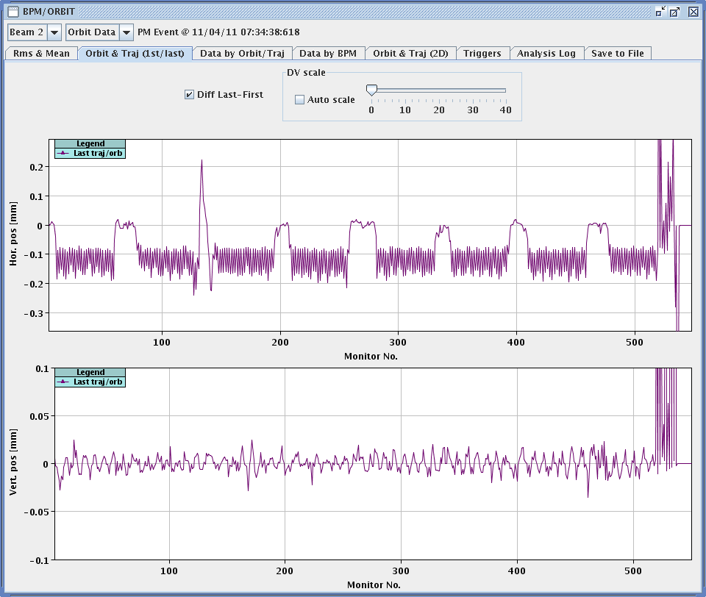
Δf_{RF} = 10 Hz → Radial orbit change

Slide 4
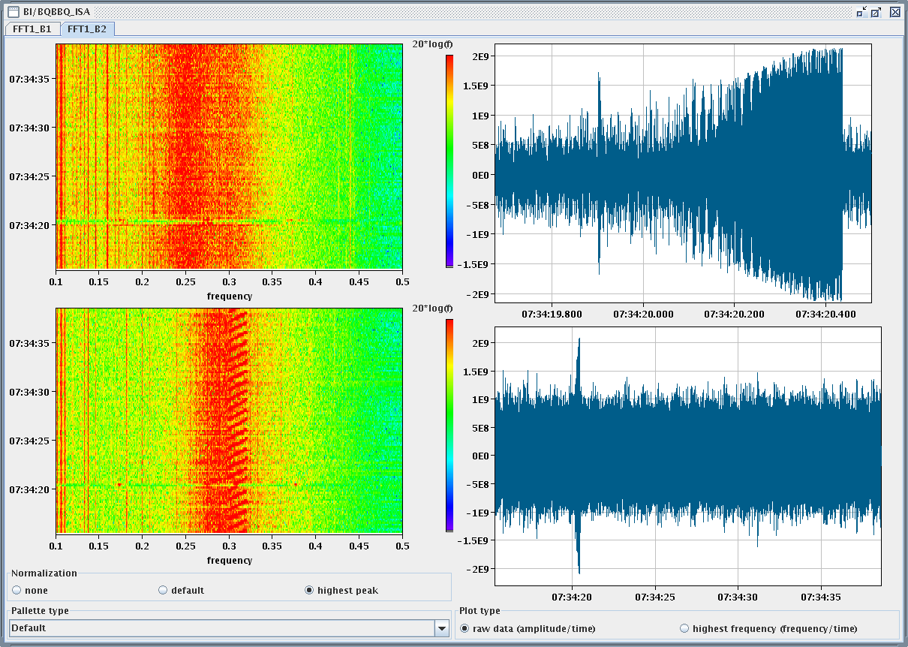
Δf_{RF} = 10 Hz → Beam instability
Losses
BBQ beam2

Slide 5
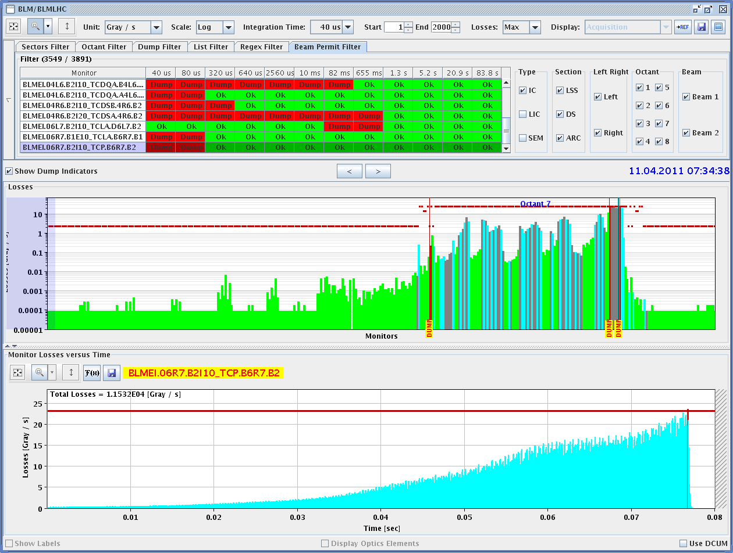
Losses in IR7: up to 23 Gy/s (saturation)

Slide 6
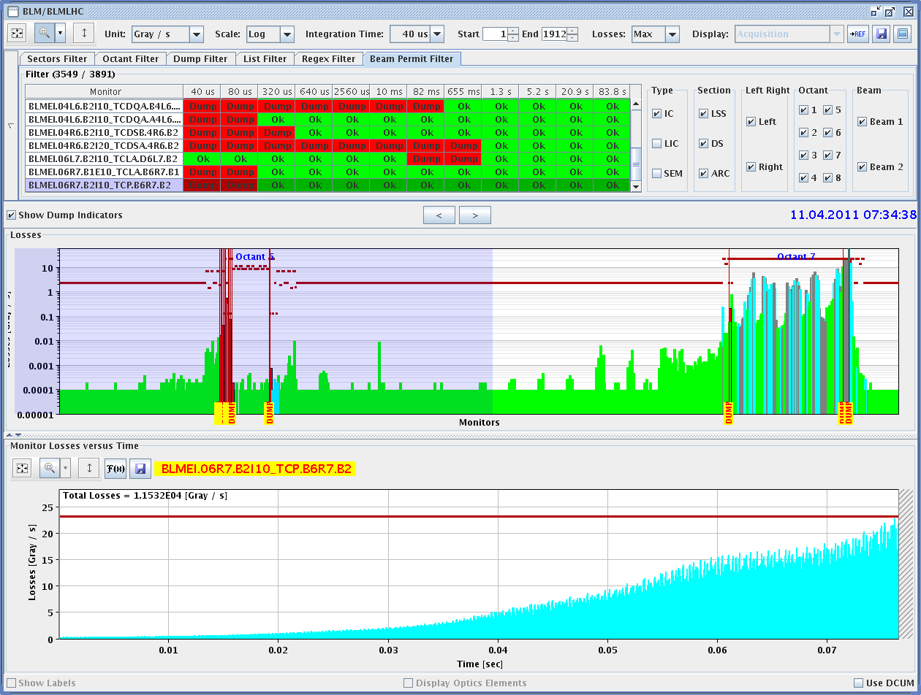
From IR7 to IR6

Slide 7
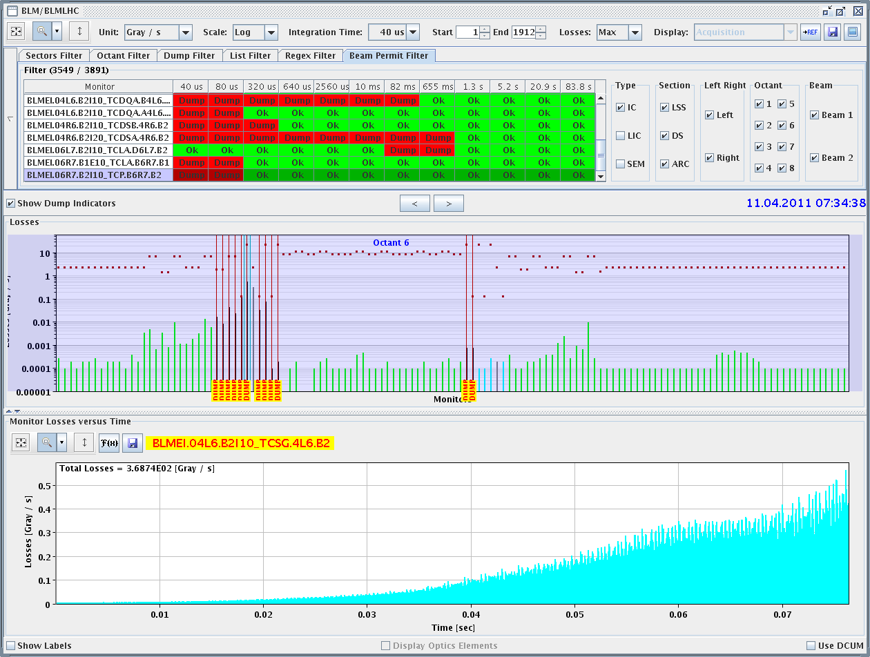
Losses in IR6: up to 0.5 Gy/s

Slide 8
Monday 11.04
12h21: Start injection.
Reduced ADT vertical gain of B1 & B2 by 50% (old value: 0.04 new value: 0.02). Reduced ADT gain for B1-V by another 50% to 0.01 (adapted 1st point of ADT - ramp functions as well).
13h58: Start ramp.
V.Baglin: All pressure interlock thresholds have been reset to their standard values (1e-7) for this test ramp.
14h17: Flat top.
Ramp was fine.
Orbits at flat top recorded for bunch train (12b) and single nominal bunch. To be used for 3.5 TeV reference orbit.
Squeeze and collision not possible due to required update of TCTH.4L2 function.
15h26: Beams dumped.

Slide 9
Monday 11.04
15h43: RCBH21.R4B2 tripped during ramp down. Reset.
16h35: Sector 81 tripped.
Bridge B cooling. Access.
Give access for discharging quench heaters in S12 and S45. One QPS team only: do S12 first.
CMS access in shadow.
19h39: Access in tunnel point 4 for QPS.
One of the electron stoppers does not move in, preventing QPS intervention. Calling experts. Cannot get in and out access anymore.
20h57: Fire detection is faulty in point 3. Piquet is intervening.
22h22: In shadow of access – TCT collimator functions for squeeze and physics beam processes updated. The nominal sequences are fully operational.

Slide 10
Status TCT collimator functions (SR)
The functions for the TCTH.4L2.B1:
Have been updated to take into account the new beam-based centred established after the re-alignment in the tunnel that took place during the technical stop.
The functions for the centres of the TCT collimators in IP8:
Have been updated. The collimator centres now stop at t=385s, i.e. when the b* reaches the 3.m. This removes an erros by about 1 sigma in the colliamtor centre.
See details in the LHC COLL logbook.
The nominal sequences are fully operational.

Slide 11
Monday 11.04
22h29: Access team intervention completed. Relais was broken.
00h56: Access finished in pt 4, quench heaters are charged in cell 32R4.
01h19: Access finishing in pt 3.
02h40: Injection. 2+1b. Qualification of ramp cycle and new collimator functions:
03h16: Ramp.
03h37: Squeeze.
03h58: Adjust
04h46: Collisions optimized (except ALICE). Loss maps.

Slide 12
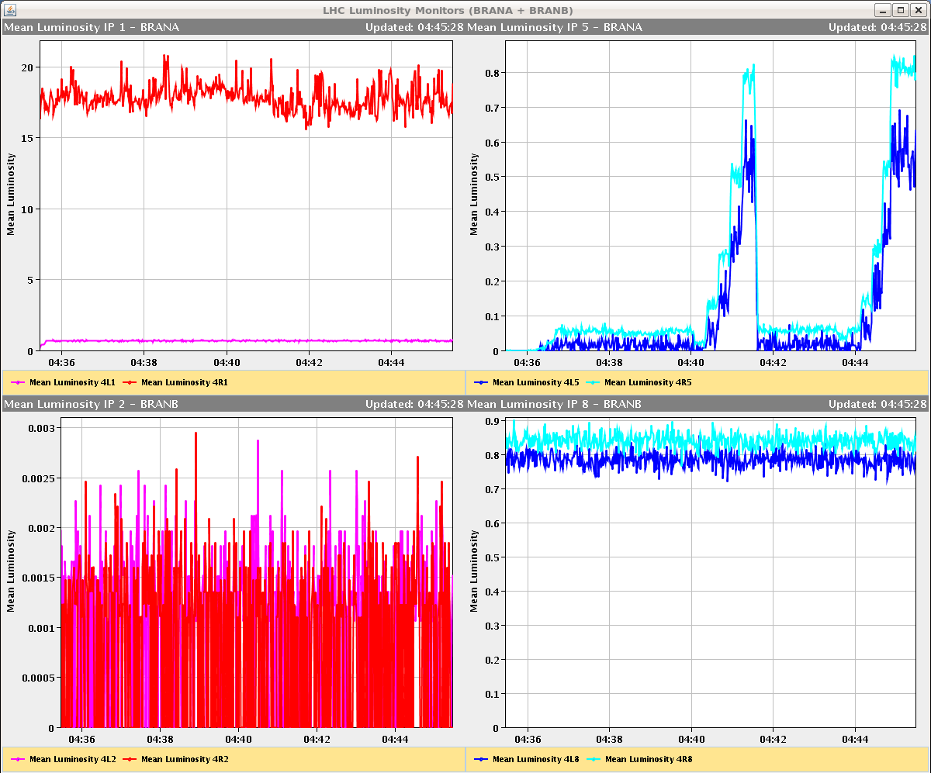
After collision optimization…
BRAN IR5

Slide 13
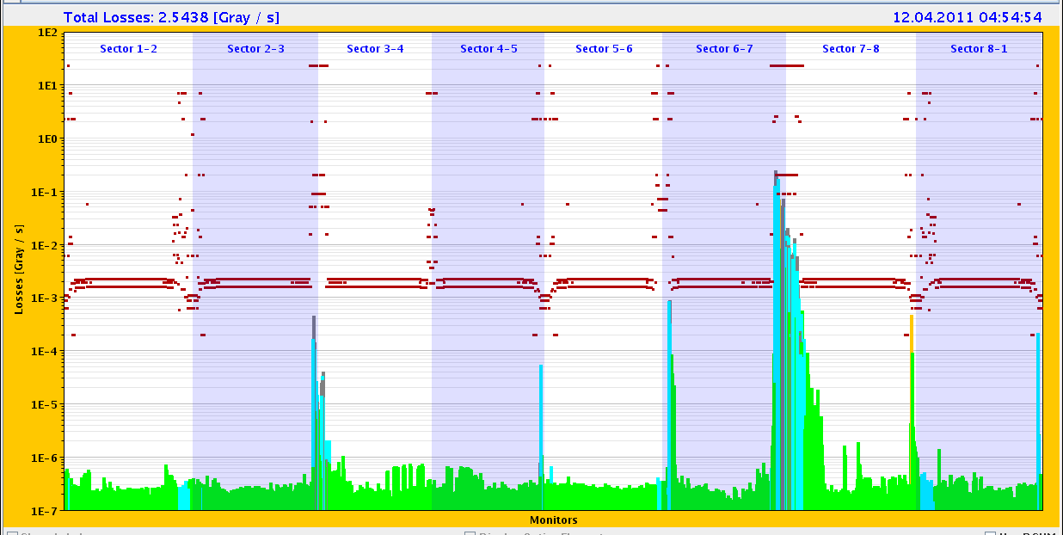
Loss Map B1H
This is where we had trouble at injection. Also at 3.5 TeV: TCT in IR8 highest (only orange TCT – BLM warning level). To be analyzed…

Slide 14
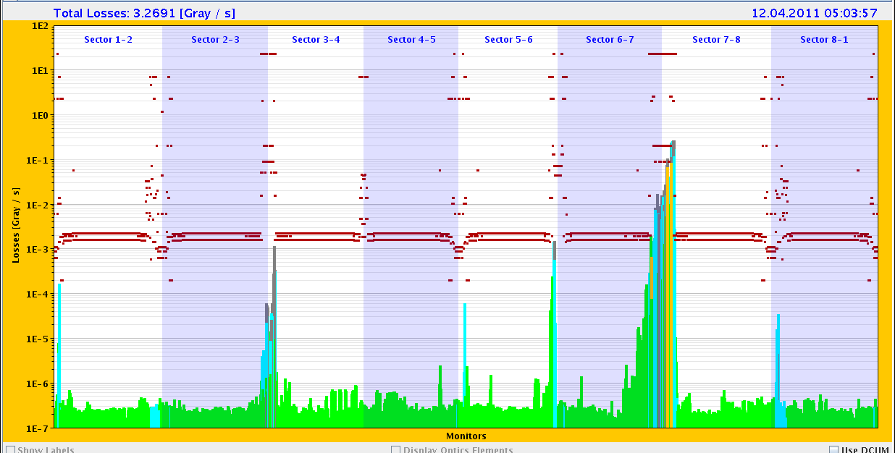
Loss Map B2H

Slide 15
Incoming
Tue AM | Scrubbing dependence on orbit and delta p at 450 GeV
Tue PM | Set up and qualify flat machine at 450 GeV
Tue PM | Scrubbing dependence on crossing and separation
Tue PM | RF HOM check for 1000 bunches
Tue to be scheduled | Injection check: losses

