Slide 1
Saturday 26th March
9:15 Problem with RB78 temporarily solved. It's running on one Thyristor bridge only and without the active filter
LHCb polarity change
IR6 interlock BPMs reconfiguration and tests
Check IR6 BPMs with 8b per beam:
No interlock for windows completely closed, for both beams, as expected
Checking BPM IR6 intlk with 16b
B1 dumped when moving from 0.75 to 0.25 mm as expected - beam position was +0.5 mm
B2 dumped when moving from 1.21 to 0.71 mm as expected - beam position was +0.8 mm

Slide 2
Saturday afternoon
Checking BPM interlock with full pattern and new count/turn settings
Worked OK for B1 and B2
B1 dumped between +0.13 and -0.37 mm (position was 0.08 mm)
B2 dumped between +1.0 and +0.5 mm (position was +0.55 mm)
OK to fill with new pattern
16:15 Next 1.38 TeV attempt
Beams dumped (SIS on TCDQ/beam position)
Joerg identified the cause in a BPM which started to develop an offset today. He opened the thresholds to recover the margin
18:20 Stable beams
bigger emittances (around 3 microns from SPS)
different filling scheme avoiding offset collisions

Slide 3
Updated IR6 interlock BPMs
Brennan Goddard
bunchCntWin1 changed from 70 to 75;
turnCntWin1 changed from 100 to 5;
Left the other values unchanged
bunchCntWin2 250; turnCntWin2 10
All position values unchanged.
As a result, the interlock will now only become active when 15 or more bunches are out of tolerance in IR6.
The interlock thus becomes active at injection only when 15 or more bunches are circulating
*** IMPORTANT: NO RAMP OF FEWER THAN 80 BUNCHES ALLOWED UNTIL THE INTERLOCK IS MODIFIED BACK TO THE INITIAL VALUES *

Slide 4
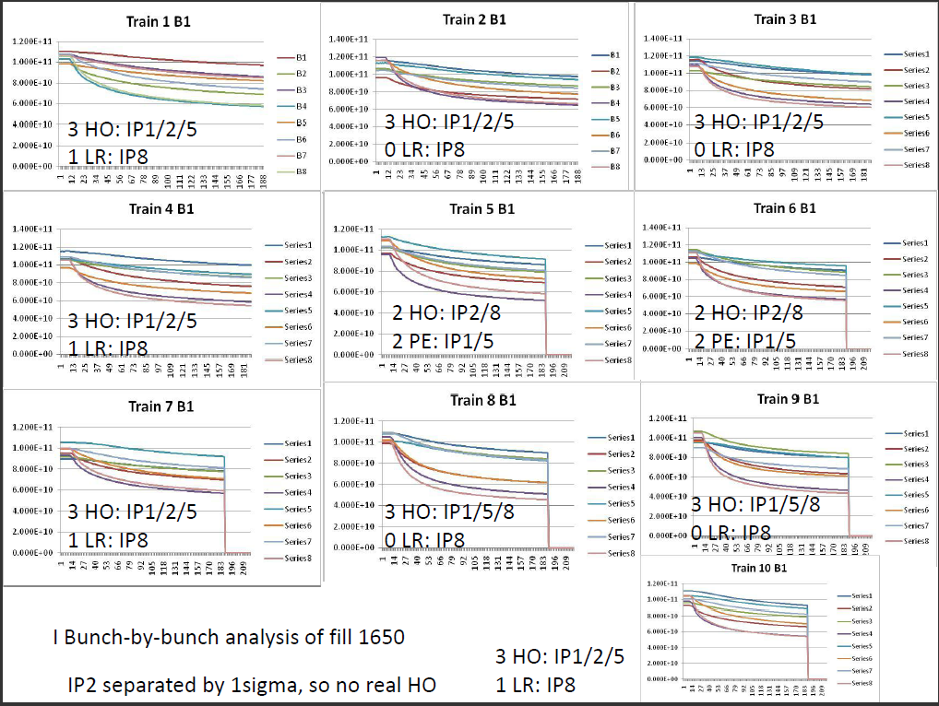
1650
Reyes

Slide 5
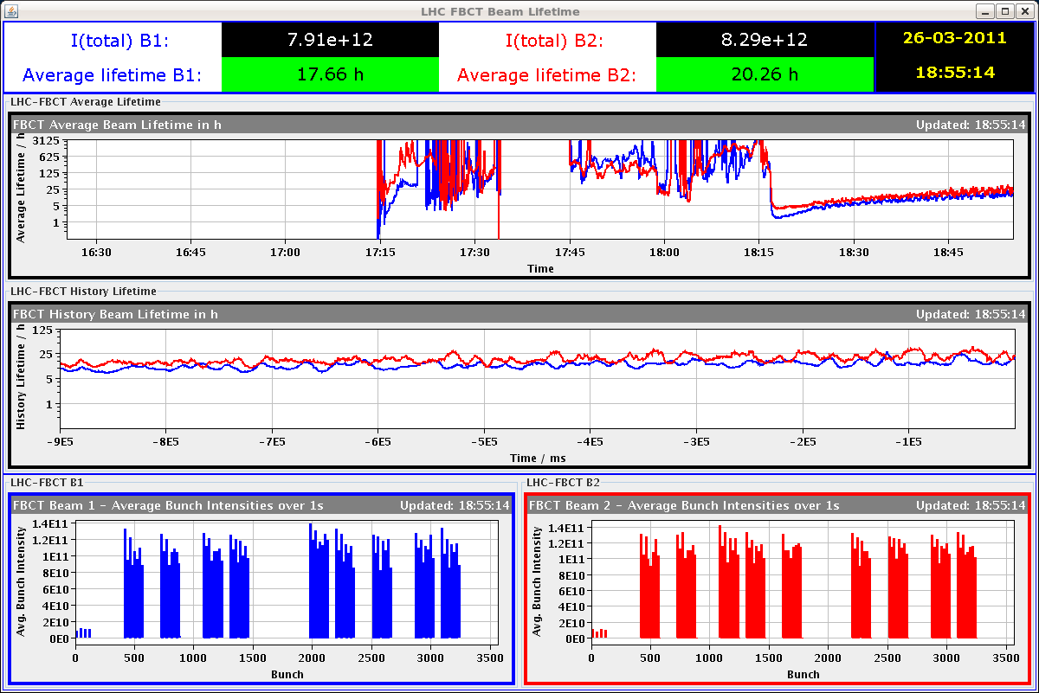
1653 – start fill

Slide 6
Incoming
Sat PM | 1.38 TeV
Sat night | 1.38 TeV stable beams
Sunday AM | VdM scans
Sun PM | Transfer lines tests - Injection loss calibration before the shielding (needs to be done before TS) | 2 h
Sun PM/night | 1.38 TeV
Mon 06:00 | Dump beams for TS

Slide 7
Noted – Per Hagen
Will the “soon to come” fill 1664 be celebrated? with or without crossing angle…

