Slide 1
Summary of week 10
Last official week of beam commissioning:
M. Lamont and J. Wenninger
for the commissioning teams,
Special thanks to collimation, optics and inject & dump teams.
Machine availability reaching well over 80%

Slide 2
Stable beams @ D-1
First stable beams at 18:05 on 13th March 2011
Filling scheme: 1 probe + 3 nominal bunches (2-2.5 um)
L ~ 1.2E30 cm-2s-1 for ATLAS/CMS

Slide 3
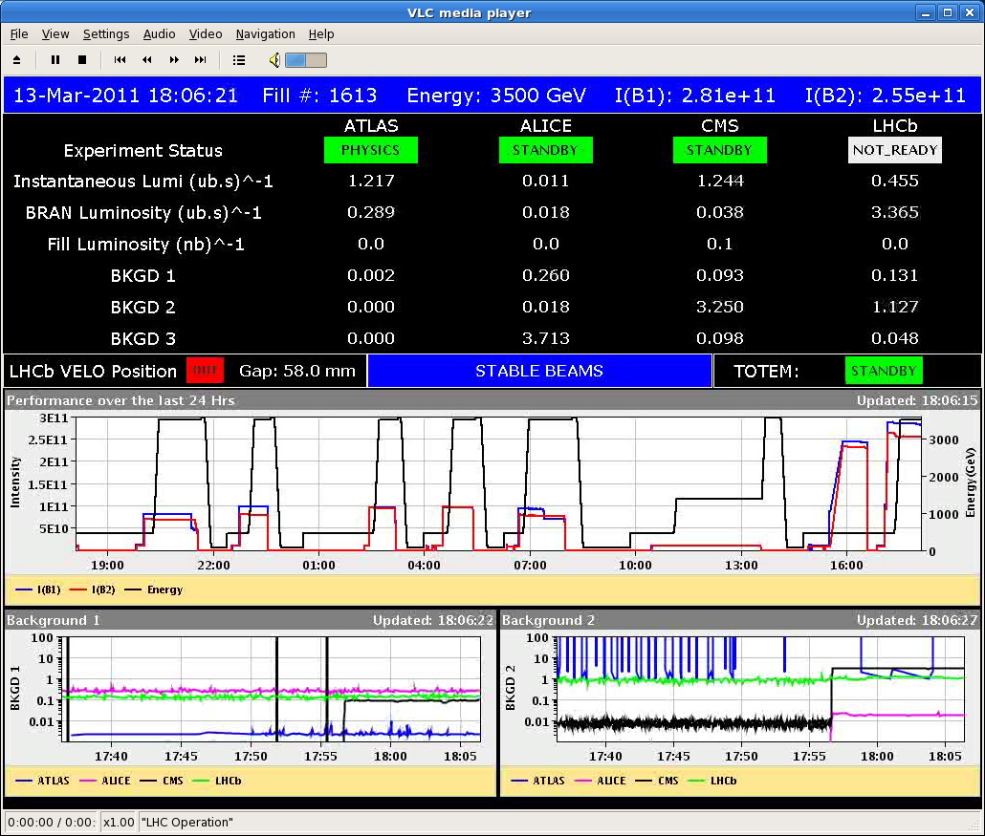
What an end for week 10 !
Protection validation ‘factory’, 1.38 TeV ramp & collisions, and finally stable beams at 3.5 TeV.
1.38 TeV

Slide 4
No 2
First fill dumped after 7 hours at 01:00.
Repeat H betatron loss map and asynch. dump test for B1.
Refill – during the ramp shift crews realized that one bunch was in the wrong bucket.
Dump and restart.
Second fill 1615 in at 05:10. Bunch intensities slightly higher.
Initial L ~ 1.5E30 cm-2s-1 for ATLAS/CMS.
Lost at 07:20 – electrical network – EDF non-transparent tests..

Slide 5
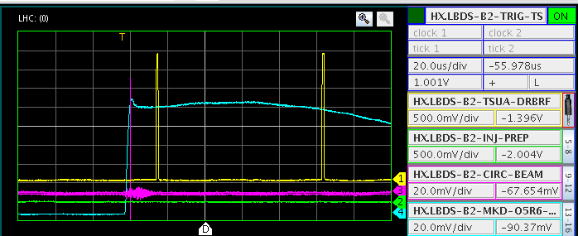
Injection
Inject and dump mode setup.
Injection protection.
TDI setup and protection validation.
Completion of the TI8/2 collimator protection validation.

Slide 6
Injection
Multi-bunch injection.
‘Pushed’ up to 8 bunches (75 ns) without problems.
Injection of 24 and more bunches was ‘sacrificed’ in order to go ahead with collimation (for stable beams).
MKI energy tracking.
Checked interlocks on energy for MKI.
‘Abort gap keeper’ limits have been verified:
Presently the last bucket for injection is 31181.
Access needed to extend to 31241.

Slide 7
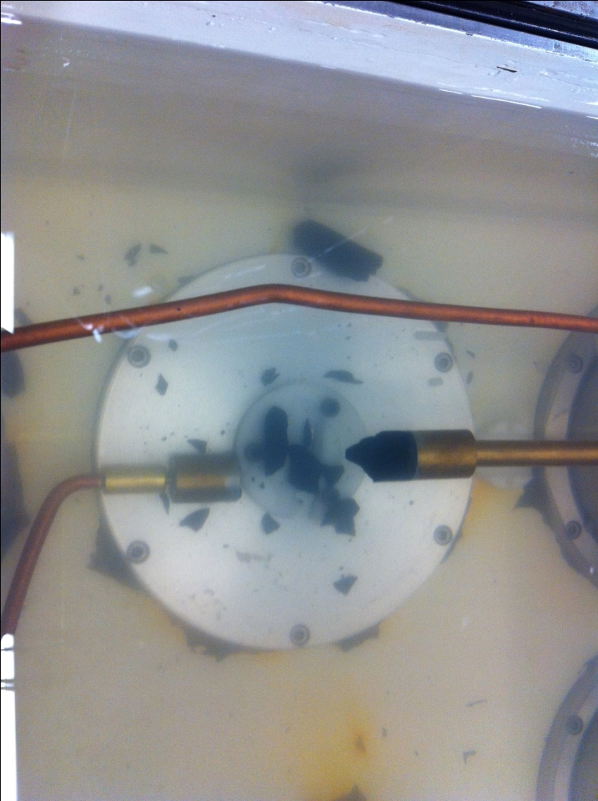
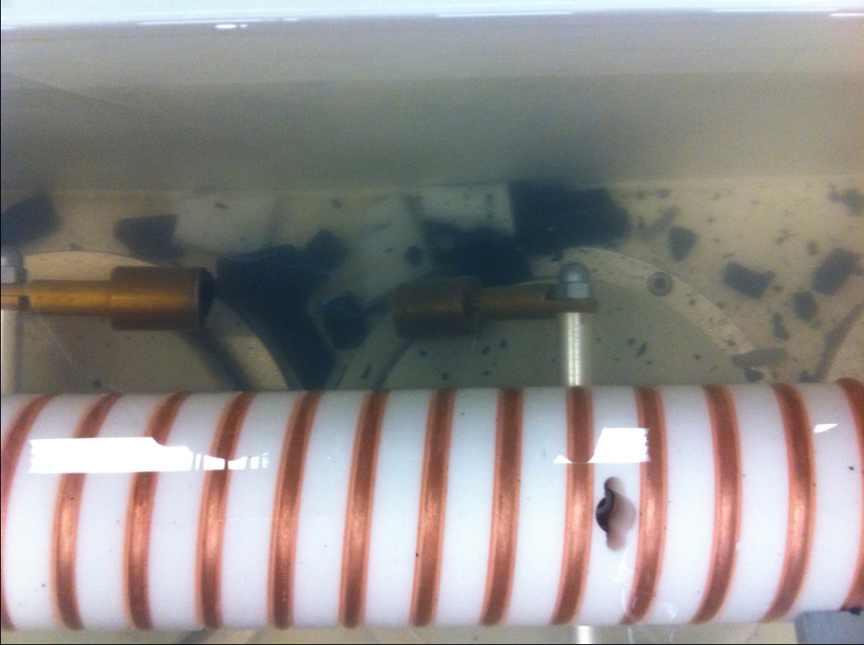
Injection - SPS
For almost the entire week the SPS injection kicker was missing a good fraction of its strength (1 out of 4 generators effectively missing !).
Injection steering proved difficult.
But emittances were good !
Was only discovered Saturday night !!
Repair TODAY !

Slide 8
Dump
BIS-LBDS teams have worked on the BIS-LBDS interface (optical receivers) on Wednesday since some issues had been observed during arming of the LBDS even after TSU firmware downgrade to 2010 version.
Beam position interlocks in IR6.
Interlock limits adjusted to new orbit (most changes in the range of a fraction of mm).
Protection functionality tested.
Extracted beam apertures (dump lines) were verified.
Results are good and consistent with 2010.
Dump with 14 out of 15 kickers was checked to be OK.
Simulated with an orbit bump !

Slide 9
BLM firmware update
BLM firmware was updated after vertical slice testing to fix an issue with the ‘capture’ buffer that was affecting the IQC (Inj. Qual. Check).
Final validation of the firmware:
BLM dump trigger initiated by sending a probe bunch on a closed collimator.
Event chain and delays (100-120 microsec from injection to dump) were verified.

Slide 10
General MPS tests with beam
Reaction time of FMCM installed on warm magnet circuit for fast detection of failures have been validated with beam.
RQ5.LR3, RD34.LR7 at 3.5 TeV squeezed.
Dump septa MSD checked at injection.
RF frequency interlock validated (+- 100 Hz).
Last SIS (Software Interlock System) interlocks checked.
All interlocks now armed.
Orbit surveillance throughout the cycle.

Slide 11
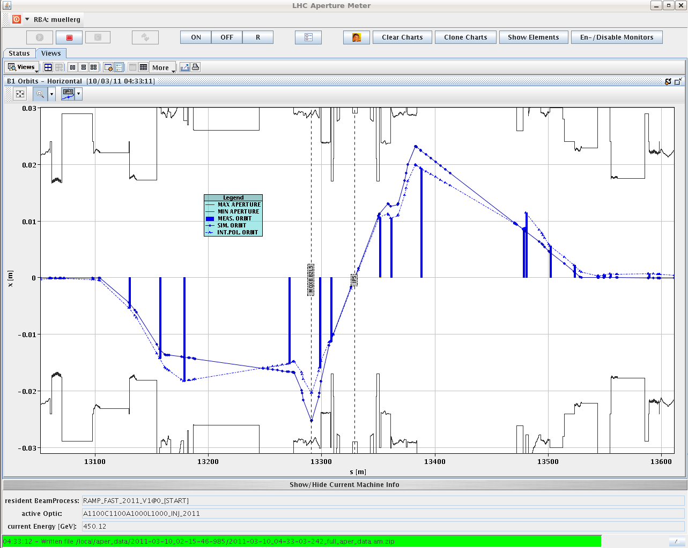
Aperture
The local triplet aperture was verified with local bumps, the beam edge is defined by a TCP – preliminary results
IR1 V B1: 16 sigmas 16 in prev. meas.
IR1 V B2: 14 sigmas 15 in prev. meas.
IR5 H B1: 13.5 sigmas 15 in prev. meas.
IR5 H B2: 13 sigmas 17 in prev. meas.

Slide 12
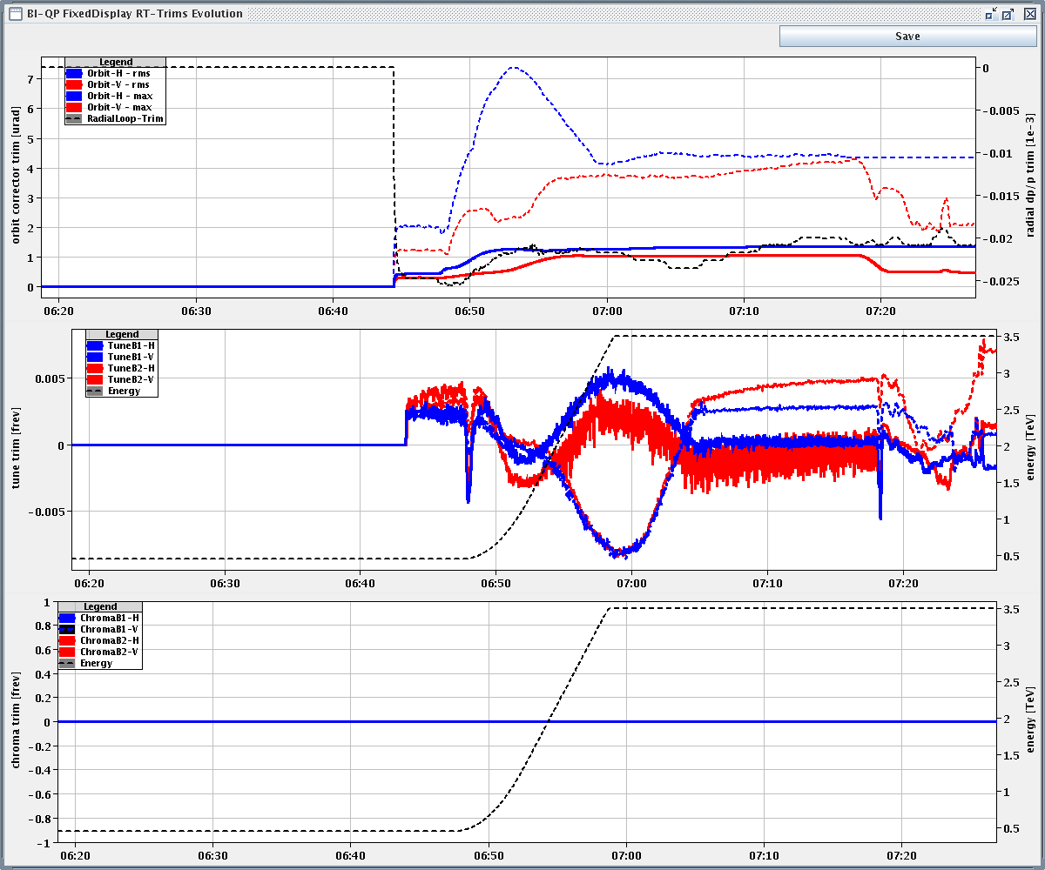
Ramp & squeeze
Ramp & squeeze cleaned and consolidated.
Orbit corrector functions entirely cleaned on Thursday.
Ramp
Squeeze
RT trims
Orbit
Tune

Slide 13
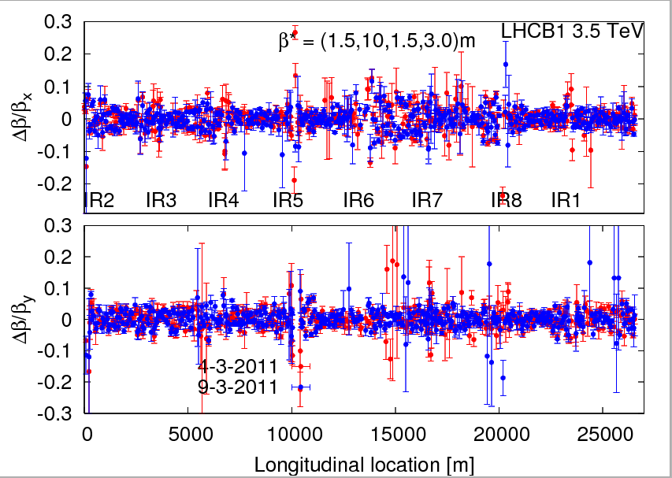
Optics at 3.5 TeV squeezed
Following the last global optics correction (in w9) the beta-beating in collisions is at the level of ~5%.

Slide 14
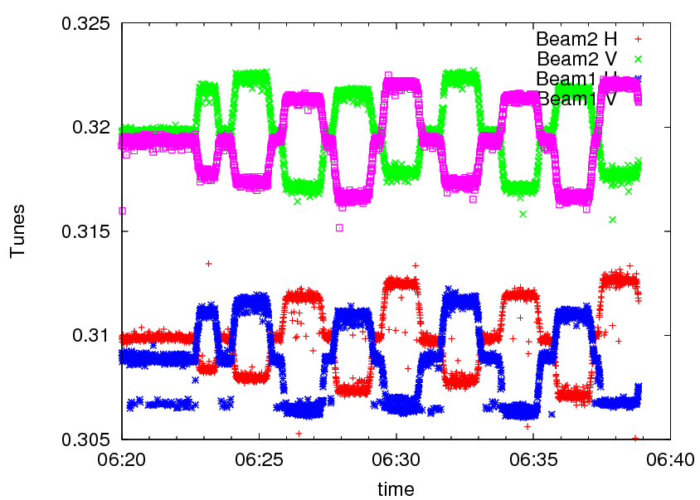
Optics at 3.5 TeV squeezed
β* measurements at IR1 and IR5 with AC-dipole and K-modulation.
β* is extracted from the amplitude of the tune modulation when changing the gradient of triplet quadrupoles.

Slide 15
Latest β*
‘Final’ β* values from K-modulation:
Errors around 4-10%.
Imbalance is 2.5 +- 8% in favor of CMS.
Beam/plane | IR5 | IR1
B1H | 1.50 | 1.53
B2H | 1.48 | 1.57
B1V | 1.52 | 1.50
B2V | 1.52 | 1.57

Slide 16
Collimation setup at 3.5 TeV
Full collimation setup at 3.5 TeV before the squeeze.
IR3, IR7, IR6 and TCTs.
Typically 20-25 minutes / collimator thanks to improved SW tools.
TCT setup at end of squeeze and for colliding beams.
Setup time of 1.5 hours achieved.
Collimation setup completed Friday late afternoon.
Collimators driven by functions (also for interlocks) for:
Ramp,
Squeeze,
Collide.

Slide 17
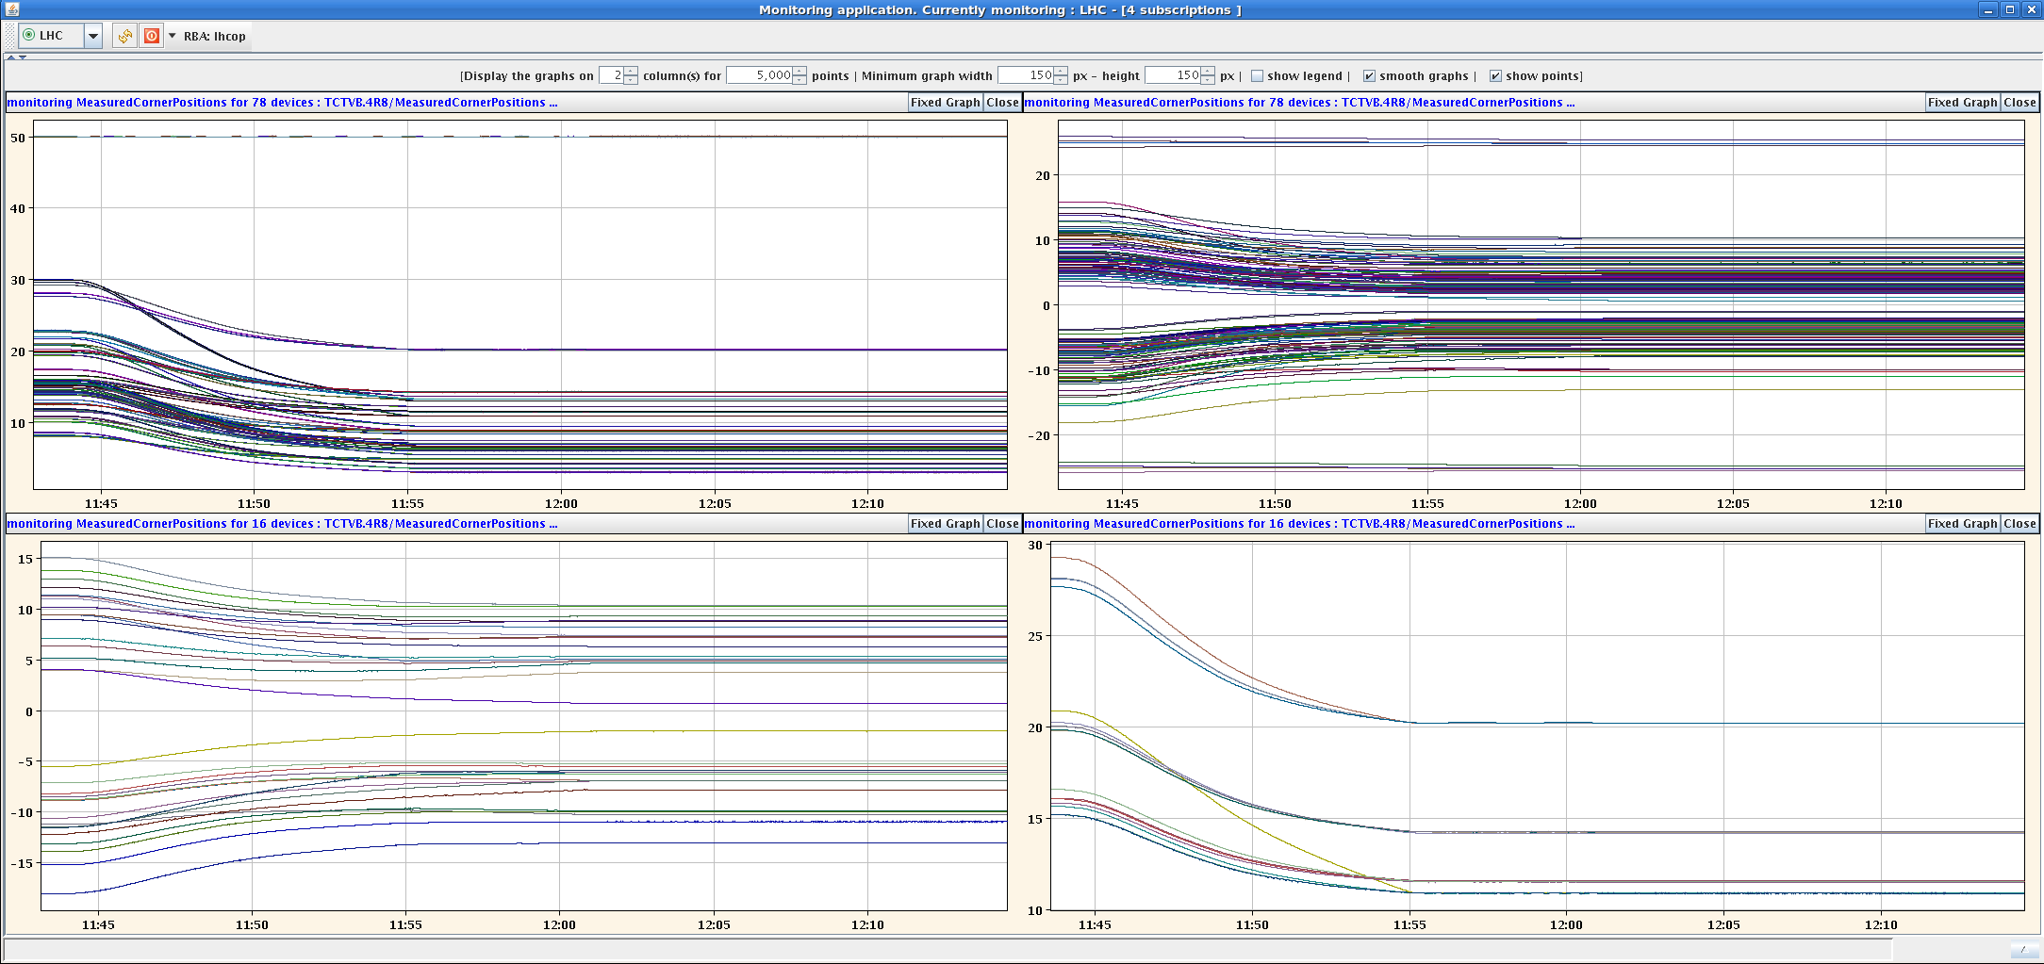
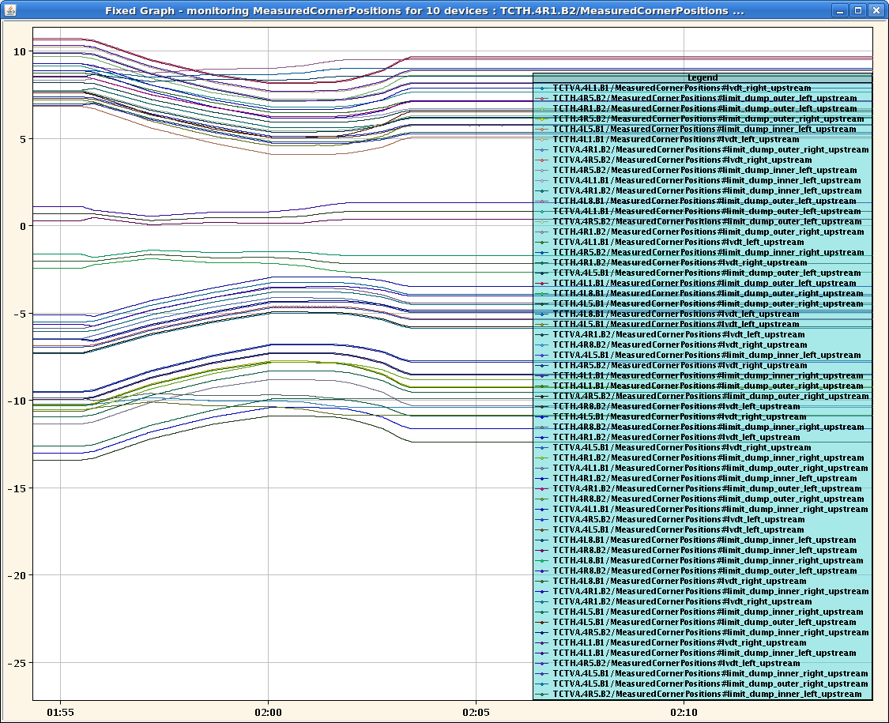
Collimators in ramp & squeeze
Ramp functions of the collimation system
TCTs in squeeze

Slide 18
Validation
Extensive validation campaign between Friday evening and Sunday morning.
List of validation steps for that were made for collimation and dump protection:
Condition | Betatron H | Betatron V | Dp/p + | Dp/p - | Dump
Injection | X | X | X | X | X
Flat top | X | X | X | X | X
Squeezed | X | X | X | X | X
Collisions | X | X | X | X | X

Slide 19
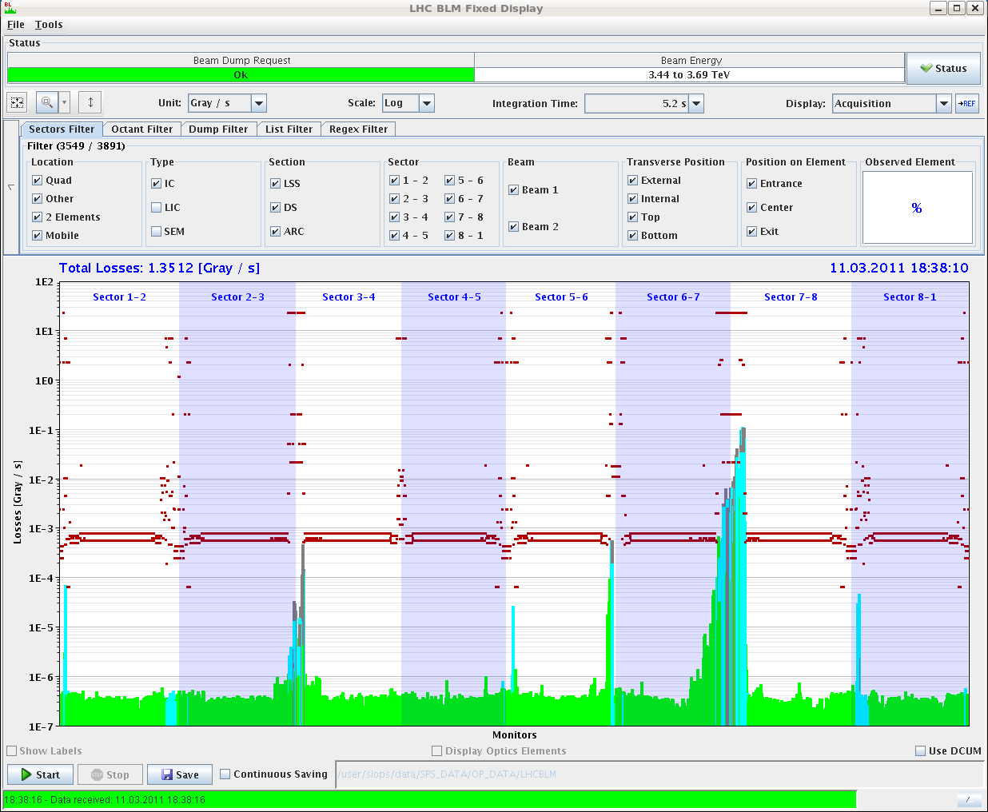
Loss maps
Example of a betatron loss map @ 1.5 m beta*

Slide 20
Validation results - collimation
Preliminary of qualification tests (R. Assmann):
Highest losses always at primary collimators.
Leakage to cold magnets at 1e-4 level.
Leakage to TCT's at 1.5m beta* as expected (1e-3 level).
Leakage to TCTV's in IR1 and IR8 is at 1e-2 level for off-momentum loss maps. H collimators in IR3 produce a vertical halo that is intercepted at the vertical tertiary collimators. OK.
No leakage of losses to the triplets observed.
Interlock thresholds have been set.
Summary: collimator and protection hierarchy is qualified for 1.5m beta*. The triplets are protected and the TCT's are safe themselves.

Slide 21
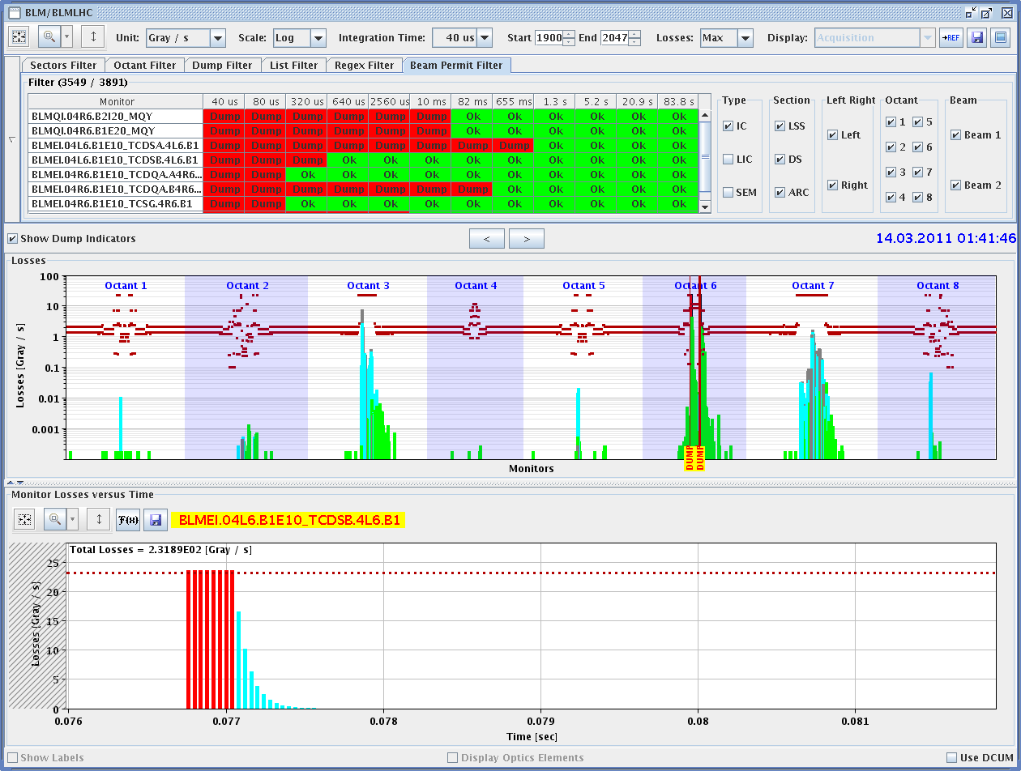
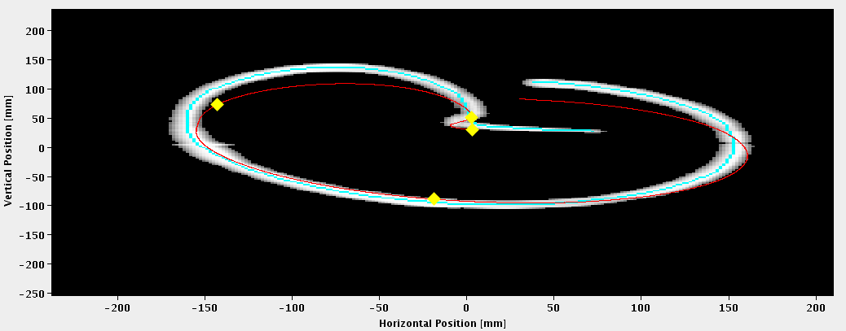
Validation results – beam dump
Preliminary analysis of qualification tests (B. Goddard):
Leakage to TCTs with 1.5m beta* is the level of few e-4, as expected. No unusual losses seen on cold elements or elsewhere.
All tests passed - ready for stable beams.

Slide 22
Protection – to be done
Repeat betatron loss map in H with colliding beams (better quality).
Done for B1.
Repeat asynchronous dump test with colliding beams with more intensity.
Done for B1.
Activate β* dependent interlocks (collimators).
Update the collimator interlock threshold with new LVDT-settings offsets.

Slide 23
1.38 TeV
Test ramp and collisions for 1.38 TeV run (Sunday).
Ramp: 320 secs (-> 1.38 TeV) + 280 secs (waiting for decay).
Keep orbit constant (crossing and separation) in ramp.
Ramp crossing angles to 0 when bringing beams into collisions.
Some collisions observed… a bit more work needed.

Slide 24
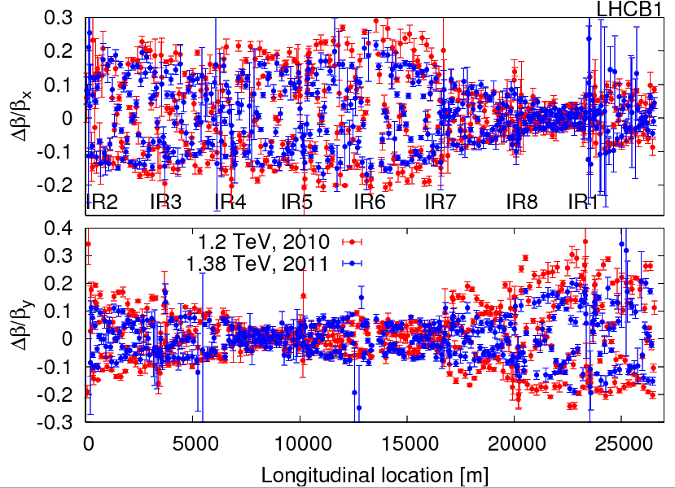
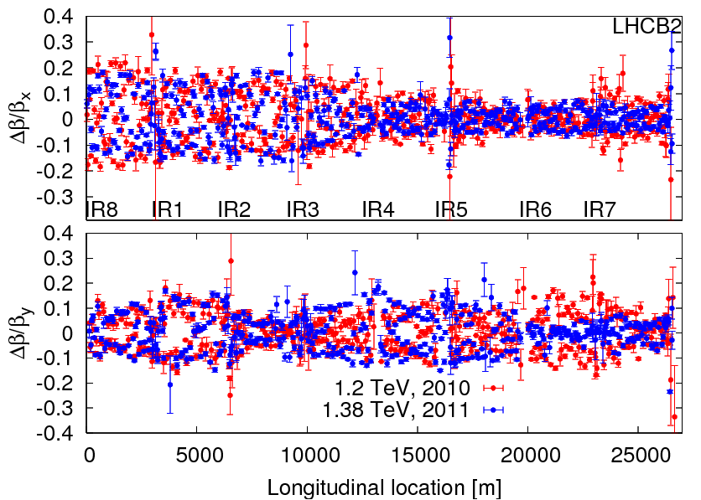
1.38 TeV optics
Beta-beat rather similar to 1.2 TeV case.
Peak beating around 20%

Slide 25
Next
Final MPS checks + approval.
Then progressive intensity increase over the next 2 weeks.
32, 64, 104, 152, 200 bunches.
Injection of multiple bunches (> 8 !).
For physics and for the scrubbing run.
Abort gap and injection cleaning.
And more details to tune…

Slide 26
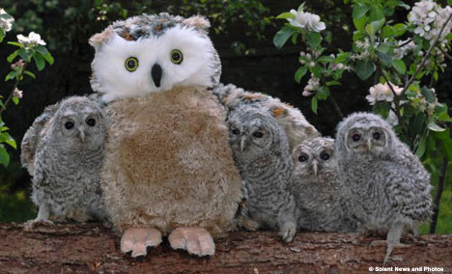
Thank you everybody !
Thank you to all who contributed to this remarkable startup !
Special applause for our optics team !
Rarely seen during daytime!
R. Thomas & friends

