Slide 1
Thursday 10 March
Injection of 8b of 75 ns – no problems.
Consistent (identical) trajectories between SPS cycles.
Dump protection.
TCSG – TCDQ cross-calibration with orbit bumps. New positions and offsets of TCDQ defined wrt TCSG in IR6.
IR6 extracted beam aperture (to be finished): [deg] [sig] 0 10 30 12 60 22 90 11.5 180 12 210 14.5 240 17

Slide 2
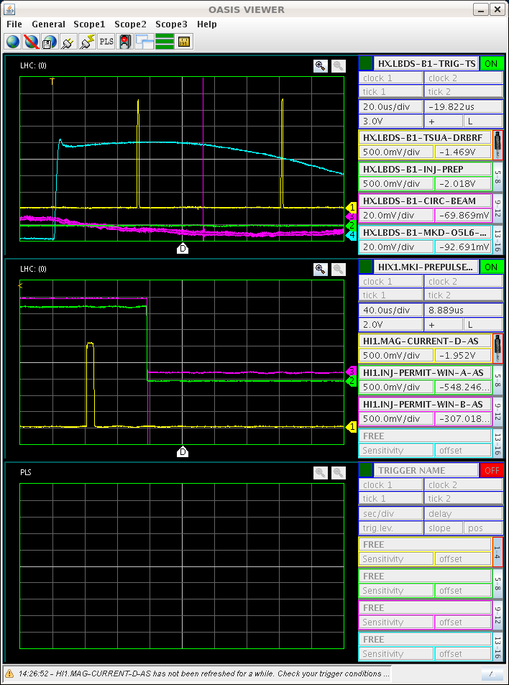
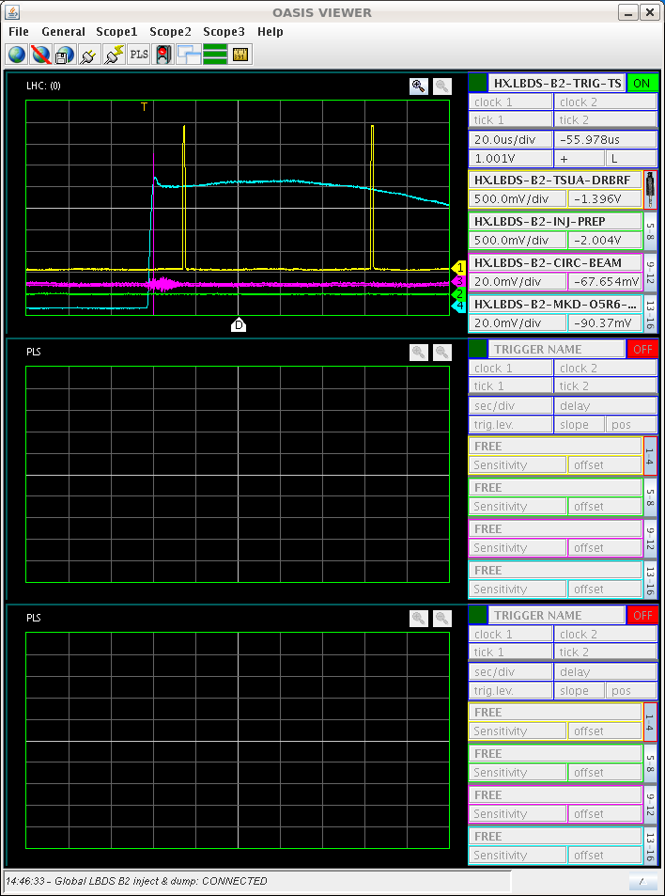
Thursday 10 March
Inject-dump delay checks.
Synchronization issue found (and understood/fixed – clock delay) on B1.
B1
B2

Slide 3
Thursday PM – ramp & squeeze
Ramp and squeeze attempt with nominal bunch for collimation setup at end of squeeze – lost beam.
Orbit corrector settings ‘reset’ – as possible source of OFB difficulties in stabilizing the orbit.
Lost at beta* = 3.5 m due to negative Q’.
Ramp and squeeze attempt with nominal bunch – no 2.
Step by step.
Prepared damper functions. Damper on when going into collisions.
Check Q’ – ok all along after correcting the functions.
Orbit – residual excursions better, systematic incorporation of RT trims, some global corrections mostly at the end.

Slide 4
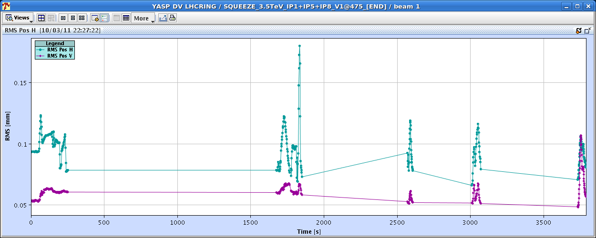
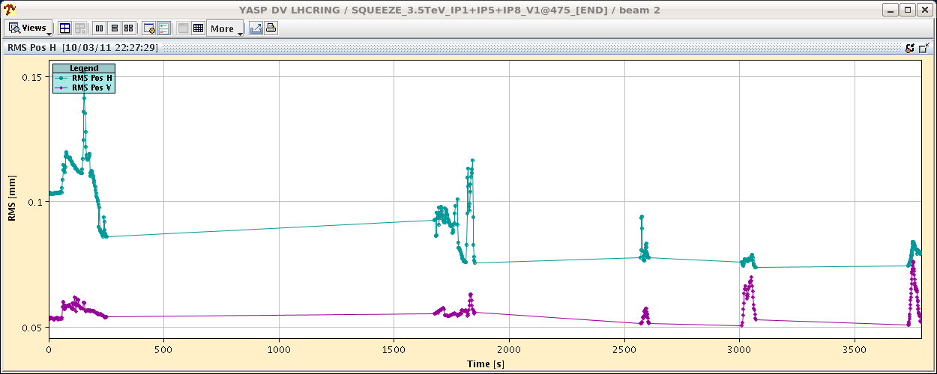
Thursday PM – orbit in squeeze
Spikes were larger in previous ramps, in particular at the end of the squeeze (factor ~2-3 better).

Slide 5
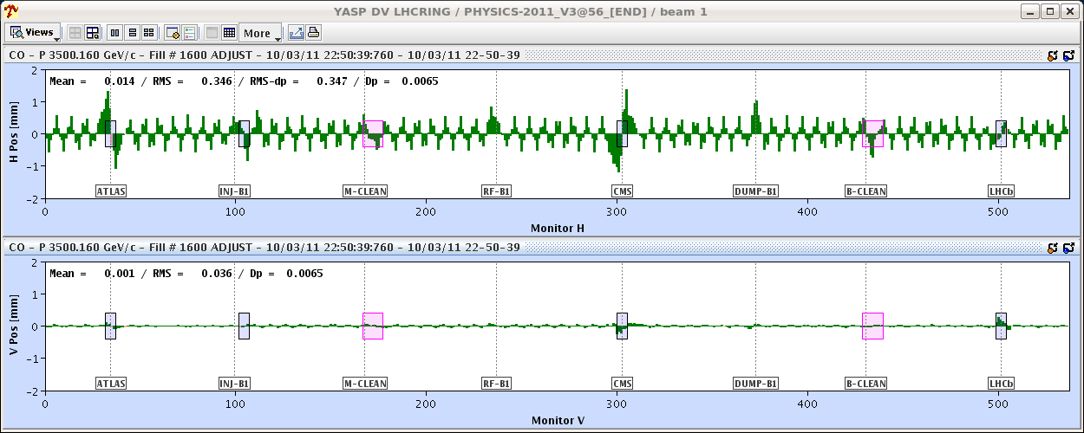
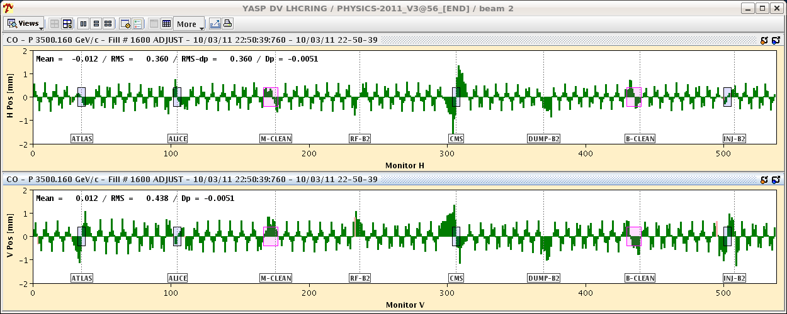
Going into collisions
Large orbit excursions when going into collisions, bem dumped on beam loss. B1V unaffected – a smell of controls problem…

Slide 6
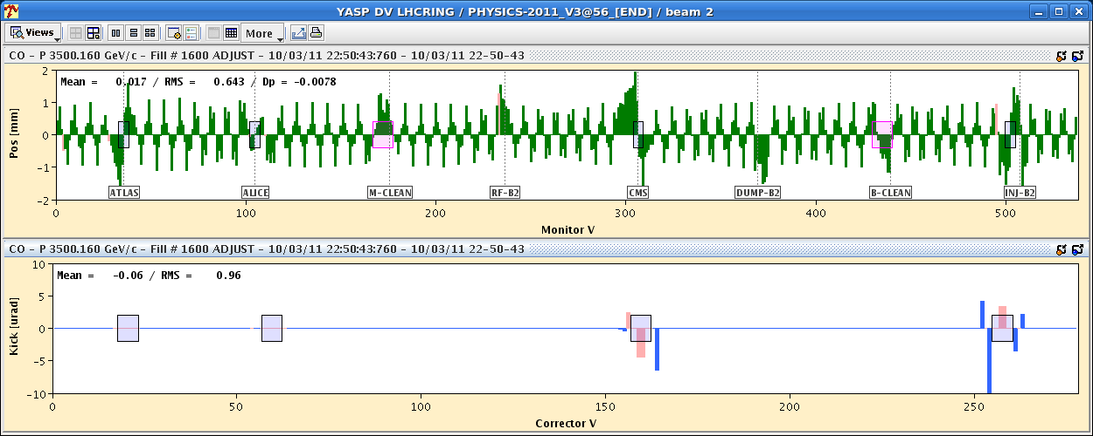
Going into collisions
Problem was tracked to a wrong back-incorporation of orbit correction from the previous night affecting 3 strong correctors involved in separation knob. Not clear why this happened…
There is a kick missing here !

Slide 7
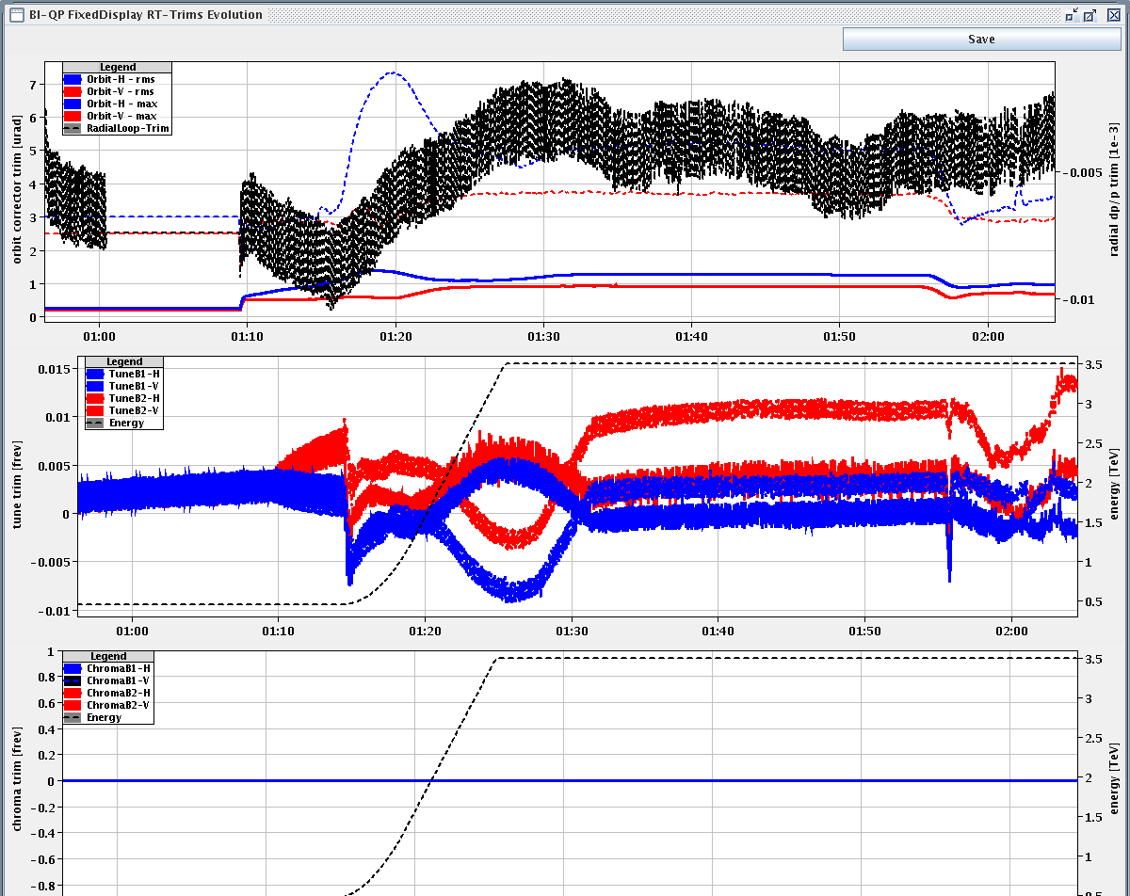
More R&S
Following the issues with the collisions, decide to insert another last ramp-squeeze-collide with 2 probes.
Very smooth and moderate RT corrections.
Collimator squeeze functions (preliminary !)

Slide 8
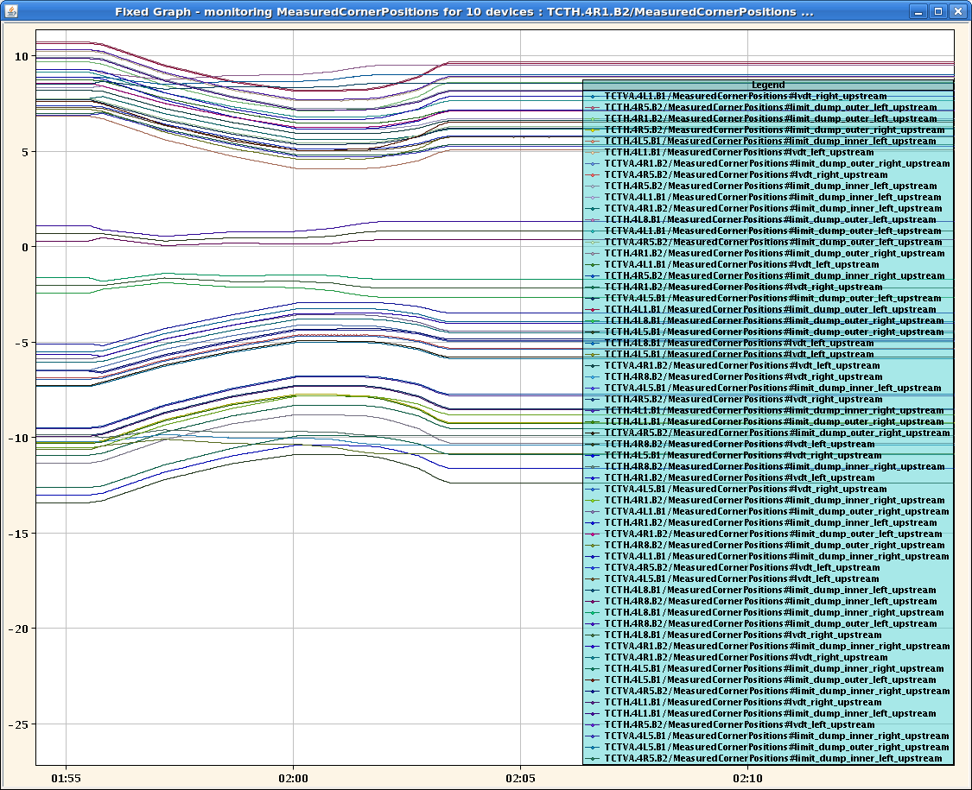
Squeezed TCTs
Problems to find collisions with probes.
Collisions seen in IP8 only…
XPOC detected TSU problem after dump – to be checked.

Slide 9
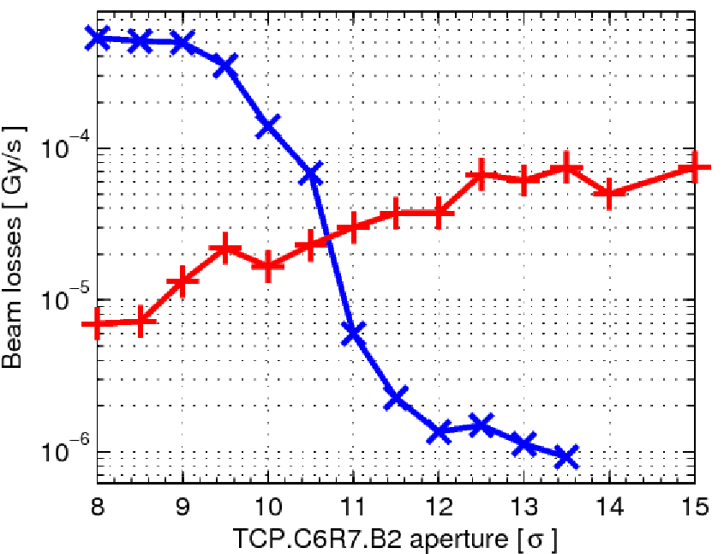
Aperture measurements at 450 GeV
Measured loss level ratio TCP-aperture MQ9.L7.B2

Slide 10
News from beta*
‘Final’ values from K-modulation:
Errors around 4-10%.
Imbalance is 2.5 +- 8%.
Optics team feels uncomfortable to correct such a small effect given the uncertainty.
Beam/plane | IR5 | IR1
B1H | 1.50 | 1.53
B2H | 1.48 | 1.57
B1V | 1.52 | 1.50
B2V | 1.52 | 1.57

Slide 11
Today
Until late afternoon:
Collimator setup at end of squeeze.
Collide.
Collimator setup in collisions.
Then injection-dump.
Night: loss maps and other validations.

