Slide 1
Tuesday 23/11/10
8:00 Physics fill #1511 dumped
Delivered lumis: Atlas/Alice/CMS: 424/396/394 mb-1
Ramp down take orbit reference
10:00 Change ALICE polarity
ALICE solenoid and dipole were in NEGATIVE polarity, go to POSITIVE polarity
Change compensators, correct orbit
Changed the crossing angle value from -140urad to 140 urad
12:00 Ramp 2 x 4 bunches
RF diffusion tests at flat top
16:15 Squeeze, find collisions
17:45 Adjust TCTs around ALICE, trimmed into beam process
Loss maps
21:00 Injecting for physics fill #1513
Some problems…
23:30 Injecting again for physics fill #1514

Slide 2
RF diffusion tests
Philippe Baudrenghien et al.
Objective 1: Which Phase Noise Power Spectral Density (PSD) creates which diffusion effect.
This is important in the coming years as systems intended to further reduce the cavity impedance for high intensity will also inject phase noise on the synchrotron sidebands.
Objective 2 is more theoretical.
Using the beam model, we can compute diffusion coefficients. Experimental data help confirm the studies (US-LARP collaboration)
Conclusion:
Phase Noise PSD was measured. From these data, we will quantify diffusion effects with Phase noise spectrum in rad^2/Hz. This is important for the design/installation of future systems. The profile data must be analyzed and compared to the evolution expected from the computed diffusion coefficients (US-LARP collaboration).
13:52 Double excitation again (level 16). FIRST VISIBLE effects on bunch length

Slide 3
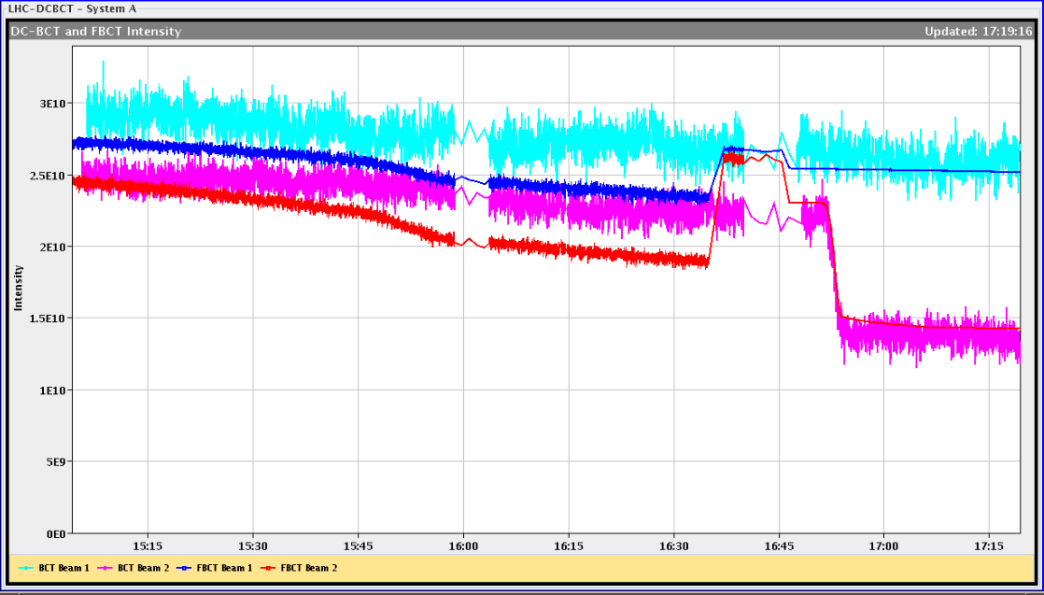
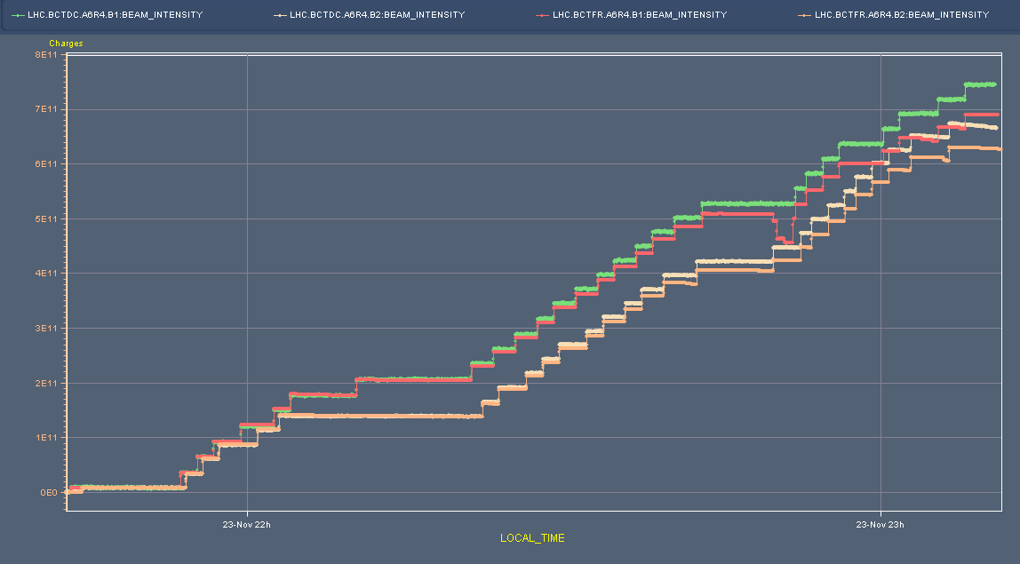
BCTFR Sum improved in the afternoon
JJ Gras, M.Ludwig
Used for Page 1 and a lot more
Now sum over bunches taken from high bandwidth signal.
Should give correct values as of 16:45 in the afternoon
But XPOC BCT values (used for BLM thresholds) unchanged…
“We have to check the calibration. We plan to do that during next fill injection process”
Fill of the evening: looks better but not perfect… Error around 10 %

Slide 4
TCTs set-up for IR2
Daniel Wollmann et al.
TCTVB.4R2: old center: 4.89; new center: -3.51 TCTVB.4L2: old center: 5.655; new center: -3.175 TCTH.4R2.B2: old center: -0.47; new center: -0.545 TCTH.4L2.B1: old center: 0.01; new center: -0.01
Incorporated this into the beam processes (thanks Mike)
Tested the functions
Performed one half set of loss maps: B1v, B2v, B1+B2 negative off-momentum. Results (preliminary): - no surprising loss spikes (taking ions into account) - highest leakage into dispersion suppressor 3e-2 (B1v) - highest leakage into other cold magnets 5e-3 (B2v) - highest leakage into IR6 5e-3 (off momentum losses) - highest leakage into TCTs 5e-3 (IR1, off momentum losses)

Slide 5
‘Physics fill’
20:30 ions back in SPS after water leak in LSS1
20:30 LHC beams dumped after loss maps
21:15 Injecting for physics, but some problems
Offset orbit in IP7 of about 0.5 mm -> BPMs need calibration
Large injection oscillations B2, bad trajectory in transfer line
Problems with filling pattern update in BQM B1
No BCT data transfer line
Large beam size and bad lifetime B2
23:30 Decide to dump the beam and sort out the problems
Recalibrate BPMs
Injection oscillations are getting close to the limit in the horizontal plane. Also, TI 8 does not look good horizontally
There seems to be an issue with the BCTs in TI 2 (or TT60)
Emittances, with all bunches injected: B1H 3.0, B1V 2.2, B2H 3.2, B2V 3.6

Slide 6
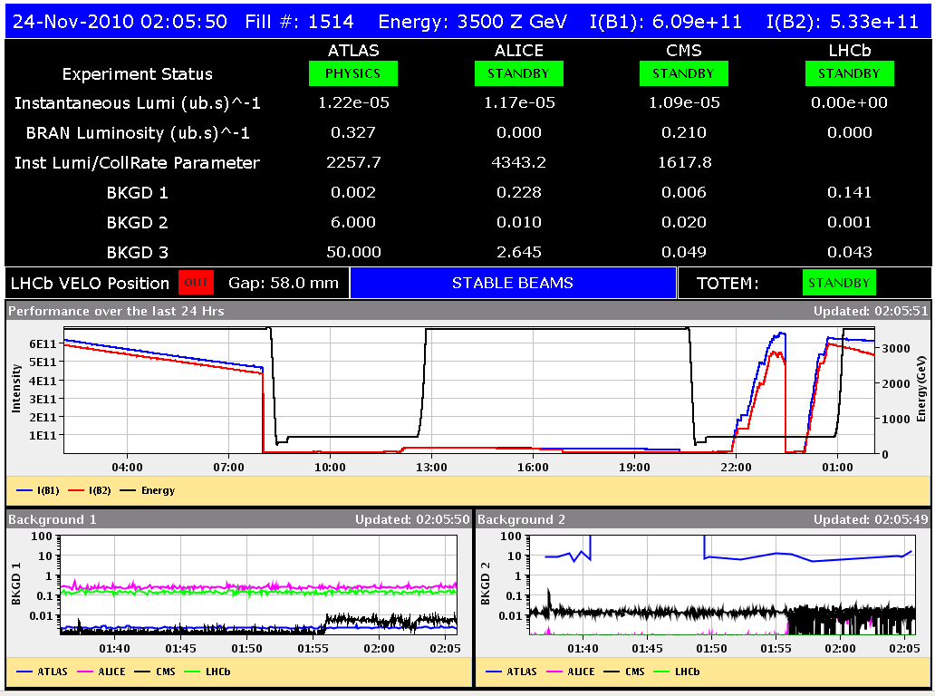
Fill, still in this morning
2:00 Stable beams
Initial lumi’s not great

Slide 7
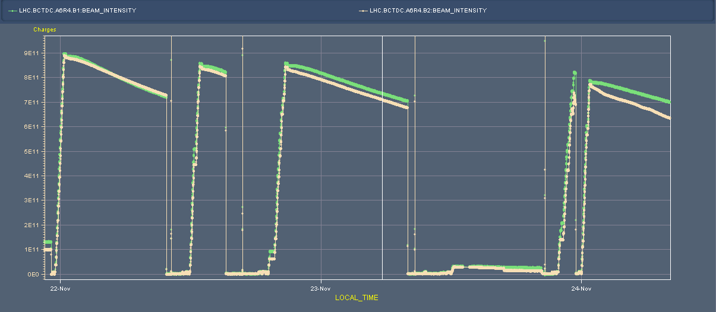
Injected current going down

Slide 8
Program
Dump(ed) this fill now
Physics 121 x 121
Outstanding items
Van der Meer scan in the coming days. To be decided when, may be depending on BCTs
BGI calibration, 0.5 hour (Mariusz)

