Slide 1
Preliminary
Results of MD wk46
V. Baglin, G. Bregliozzi, P. Chiggiato,
J-M. Jimenez, G. Lanza
CERN TE-VSC, Geneva
On behalf of TE-VSC

Slide 2
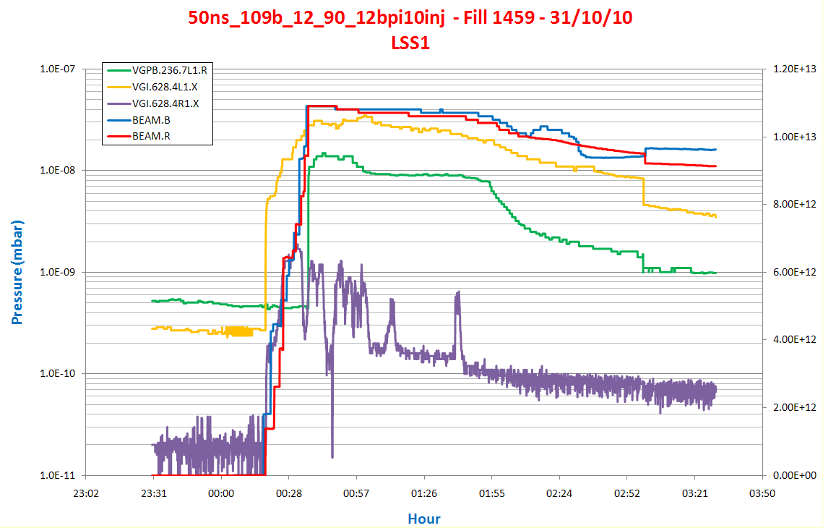
Fill 1459 – 31th October
50ns_109b_12_90_12bpi10inj - Trains well separated i.e. no discussion between trains
Pressure up to 2e-8 mbar

Slide 3
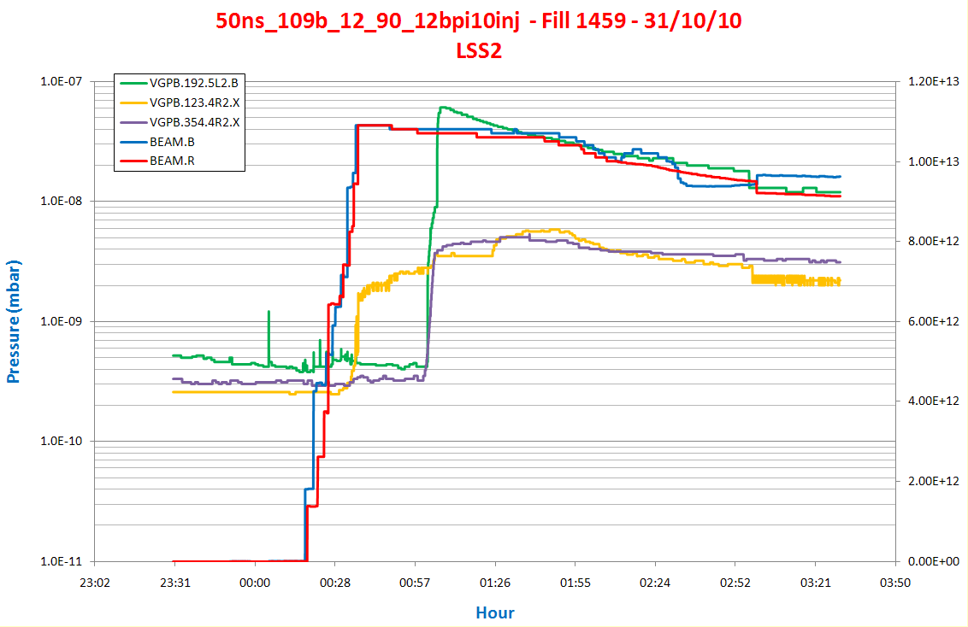
Fill 1459 – 31th October
50ns_109b_12_90_12bpi10inj - Trains well separated i.e. no discussion between trains
Pressure increases due to ecloud in the 1e-9 mbar region
SR at ~ 2 TeV

Slide 4
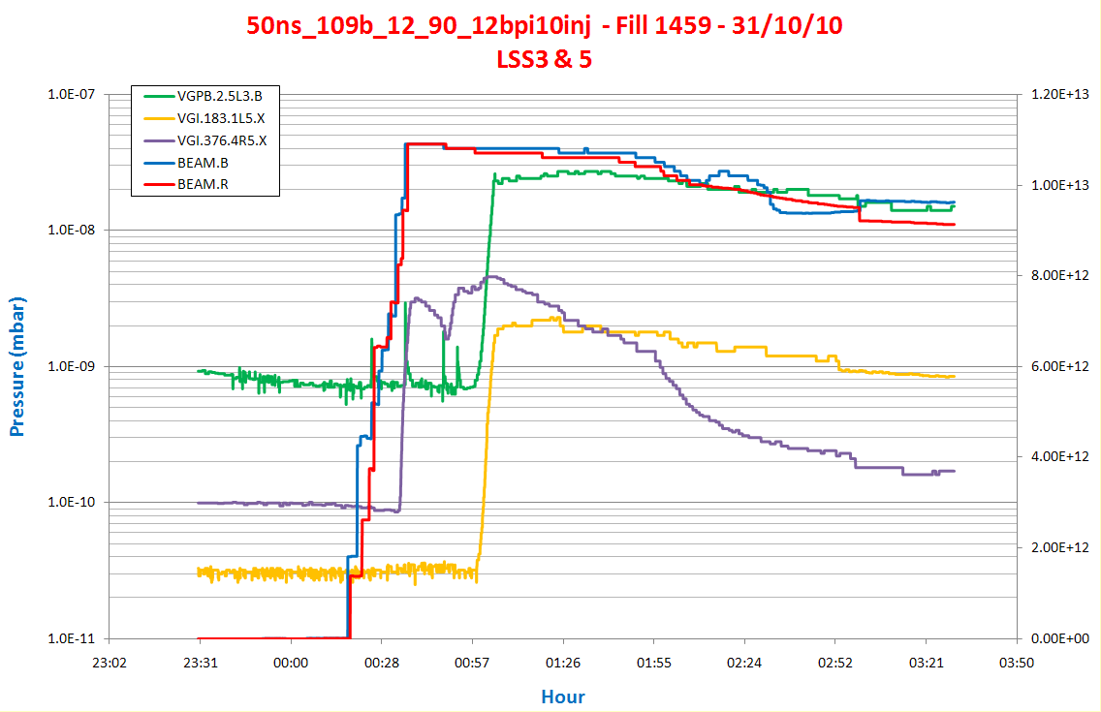
Fill 1459 – 31th October
50ns_109b_12_90_12bpi10inj - Trains well separated i.e. no discussion between trains
Pressure 4e-9 mbar
SR at ~ 2 TeV

Slide 5
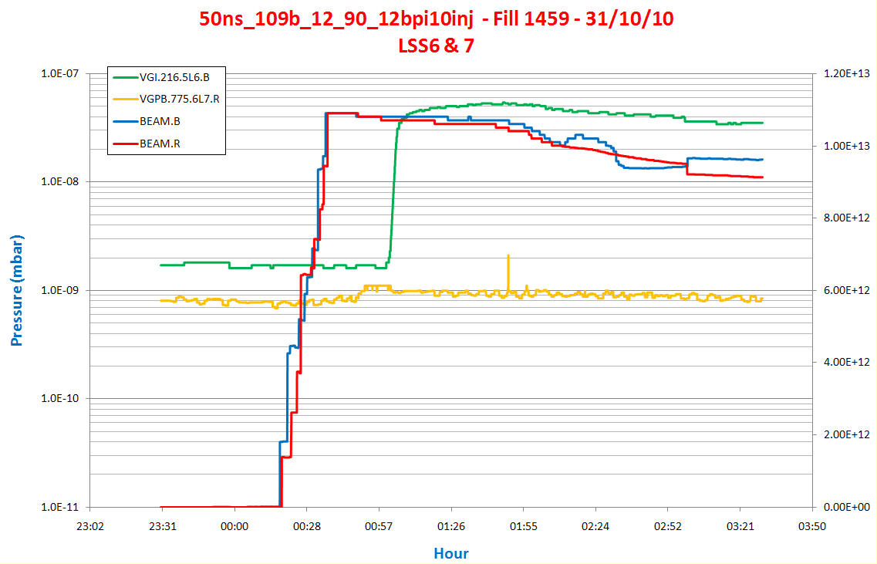
Fill 1459 – 31th October
50ns_109b_12_90_12bpi10inj - Trains well separated i.e. no discussion between trains
SR at ~ 2 TeV

Slide 6
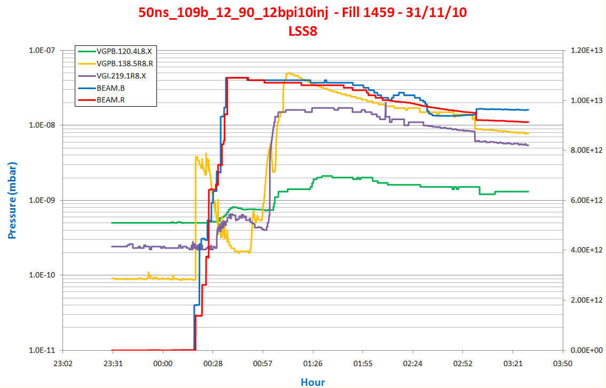
Fill 1459 – 31th October
50ns_109b_12_90_12bpi10inj - Trains well separated i.e. no discussion between trains
Electron cloud stimulated pressure increases in the kicker intermodule up to 4e-9 mbar
SR at ~ 2 TeV

Slide 7
After scrubbing and MDs of Wk44 and Wk46

Slide 8
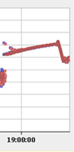
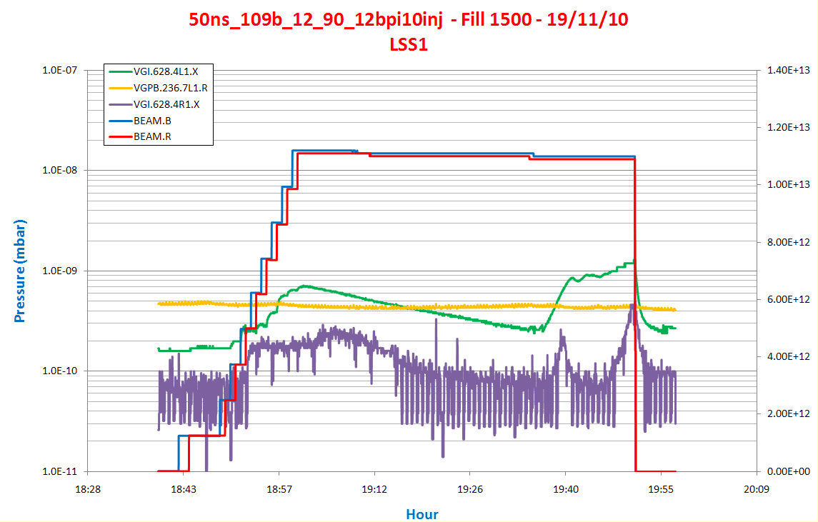
Fill 1500 – 19th November
Pressure increases at VGI in A4L1
But remains lower than 7E-10 mbar
SR at ~ 2 TeV
Bunch length
increases
Bunch length
decreases during ramp
Up to 1 TeV

Slide 9
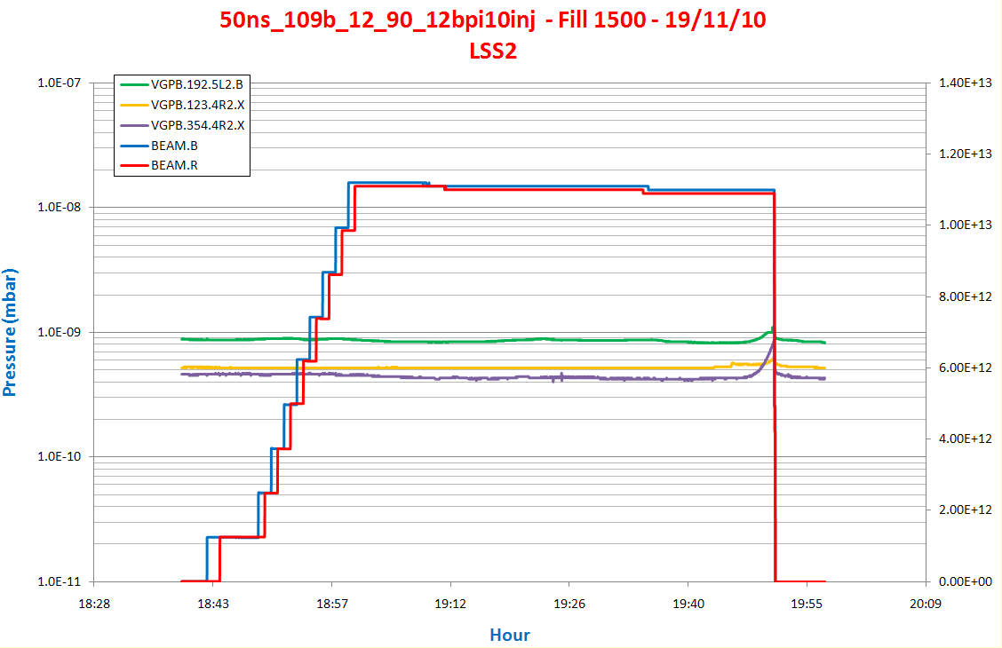
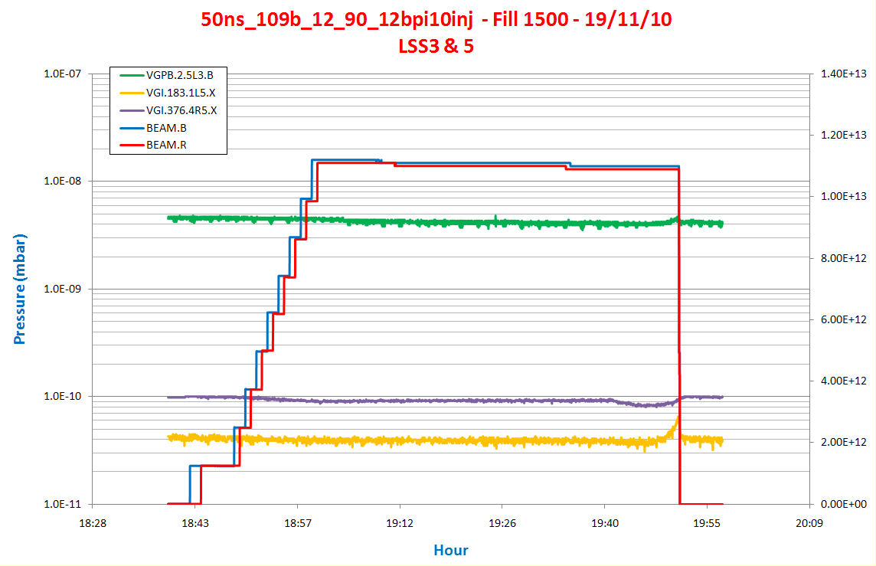
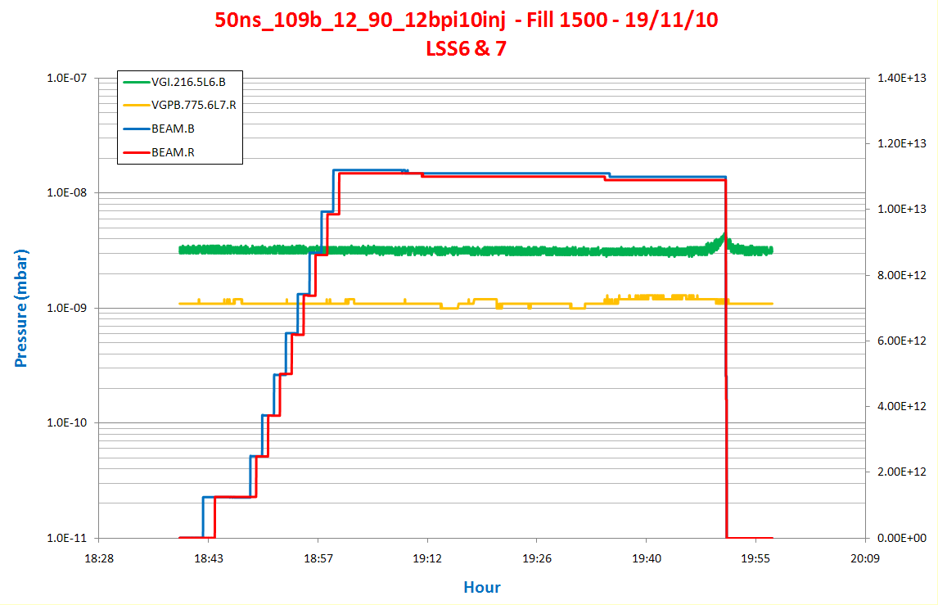
Fill 1500 – 19th November
Only SR desorption
in LSS2
in LSS3&5
In LSS6&7

Slide 10
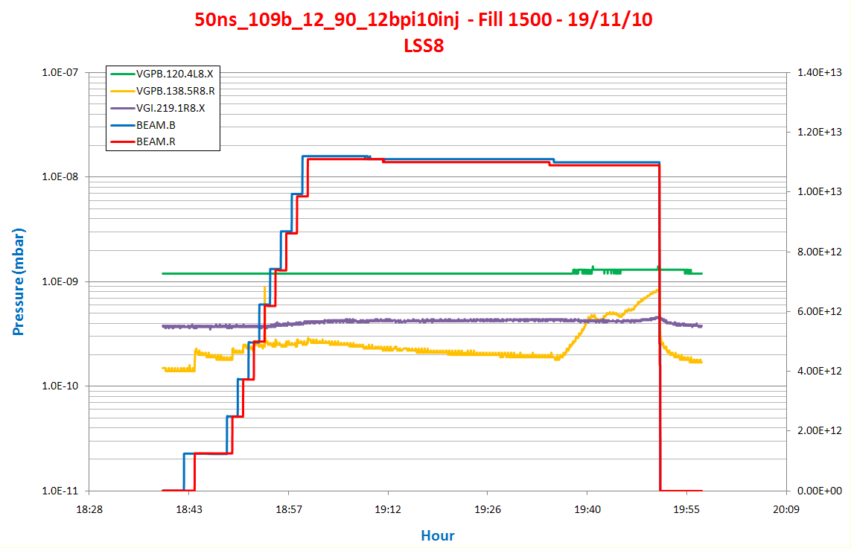
Fill 1500 – 19th November
Some activity in MKIR8 intermodule stimulated by ramp and SR
Start ramp, pressure increase starting from ~ 550 GeV (19:36)
But flattens at 800– 1000 GeV (19:40)
SR at ~ 2 TeV
Bunch length
decreases during ramp
Up to 1 TeV
Bunch length
increases

Slide 11
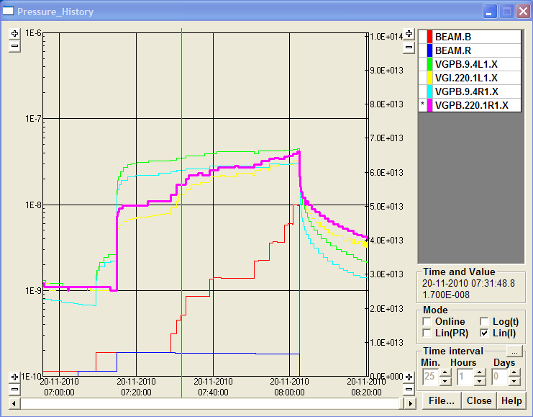
Fill 1502
B1=444 Bunches – B2= 60 Bunches – 50ns
ATLAS
4E-8 mbar

Slide 12
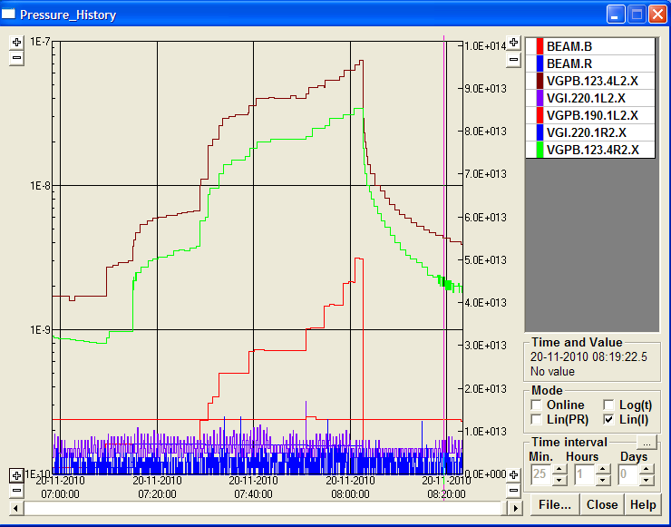
Fill 1502
B1=444 Bunches – B2= 60 Bunches – 50ns
ALICE
8E-8 mbar

Slide 13
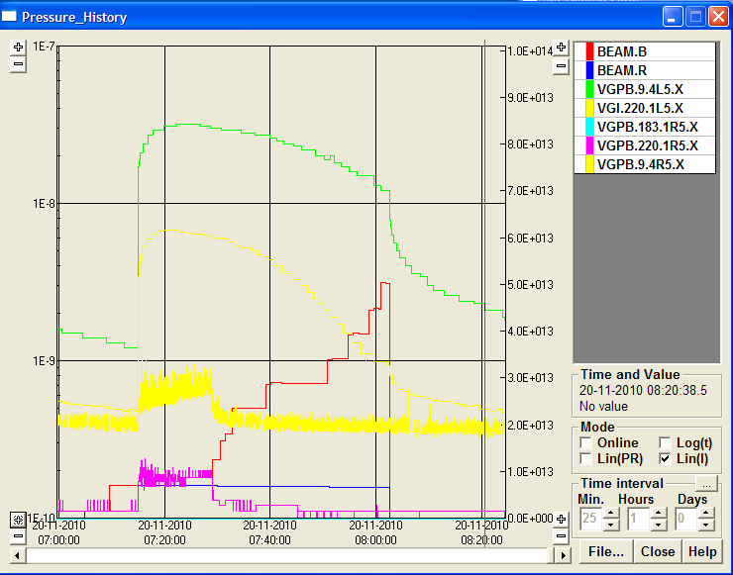
Fill 1502
B1=444 Bunches – B2= 60 Bunches – 50ns
CMS
3E-8 mbar

Slide 14
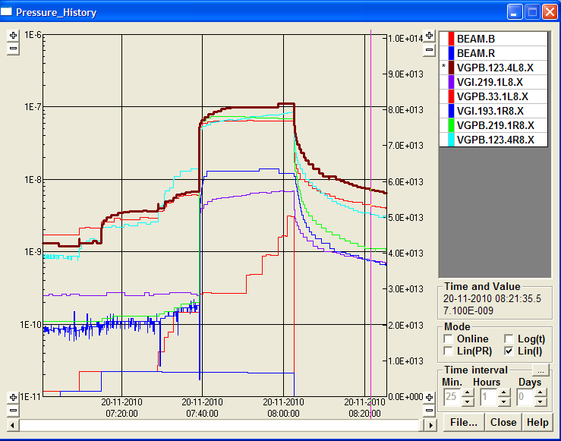
Fill 1502
B1=444 Bunches – B2= 60 Bunches – 50ns
LHCb
1E-7 mbar

Slide 15
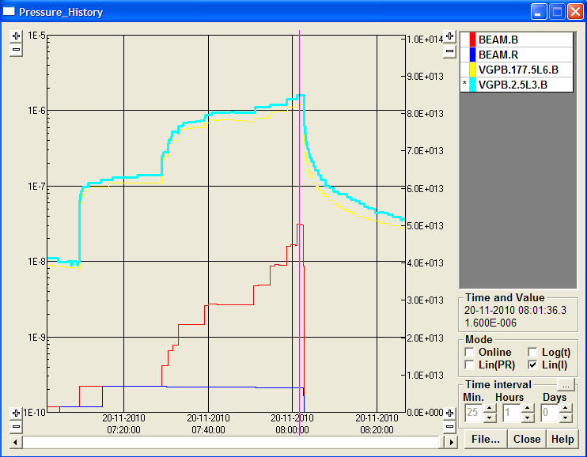
Fill 1502
B1=444 Bunches – B2= 60 Bunches – 50ns
Highest Pressure on LSS3 and LSS6
1E-6 mbar

