Slide 1
Fill 1410 revisited
Peak luminosity | 1.4e32
Beam current | 2.68/2.65 e13
Average bunch current | 1.04e11
Emittance (reconstructed from lumi) | 1.8 micron
Approx beam size at IP | 41 micron
Approx beam-beam tune shift | 0.021
Time in collisions | 61 seconds
Integrated luminosity | 8.5 nb⁻¹
Stored beam energy | 14.9 MJ

Slide 2
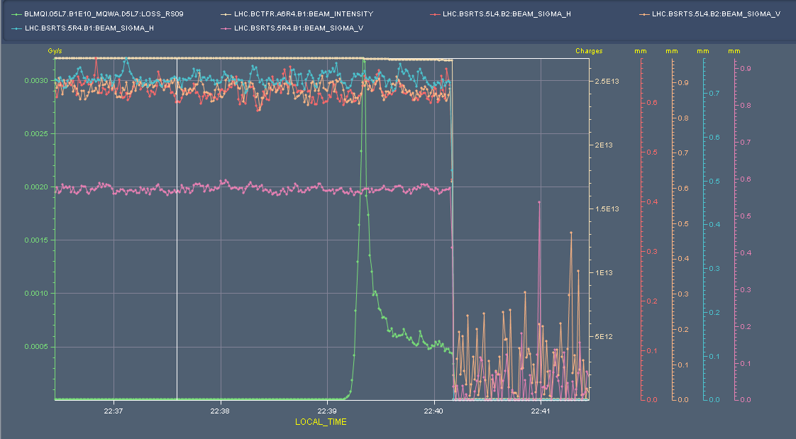
Beam size
Beam loss spike
No apparent transverse blow-up
Beam size

Slide 3
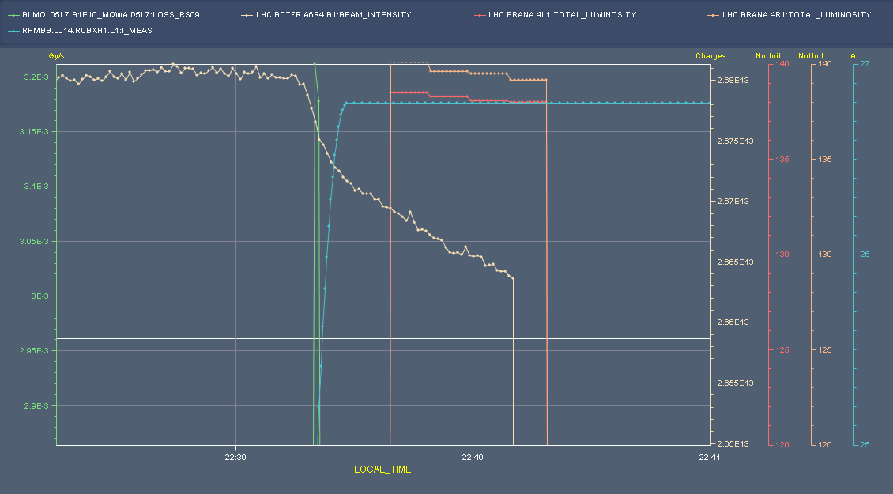
Going into collision
Beam loss spike
Separation bump
Luminosity (BRAN)
Beam current

Slide 4
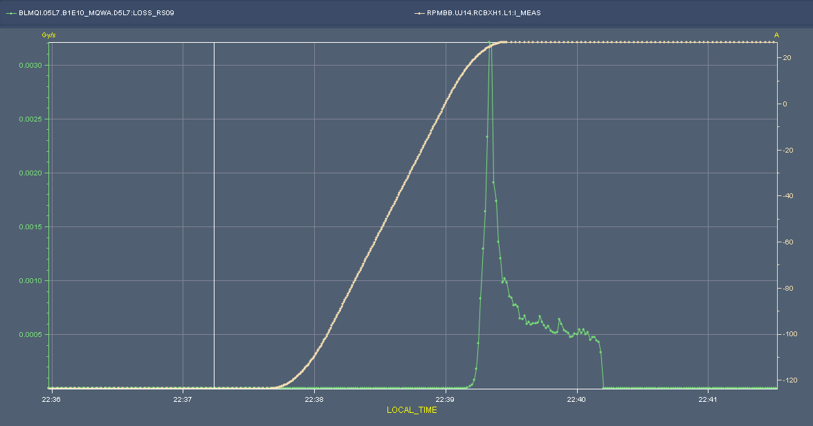
Into collision
Separation bump
Beam loss
The LHC beams will cross each other and experience perturbations as a result of the beam-beam effect at the interaction points, which can result in emittance growth and halo creation. The beam-beam force is approximately linear for small offsets and highly non-linear for larger offsets with peaks in growth close to 0.3 and 1.5 σ separation
S. M. White, H. Burkhardt, S. Fartoukh, T. Pieloni
Still cleaning
beam dump
On set of losses at: 6.4 sigma
Peak losses at: 1.4 sigma

Slide 5
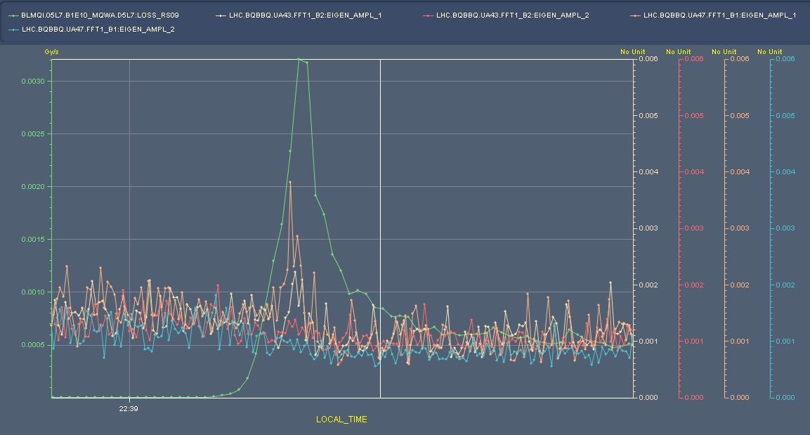
Tune amplitudes

Slide 6
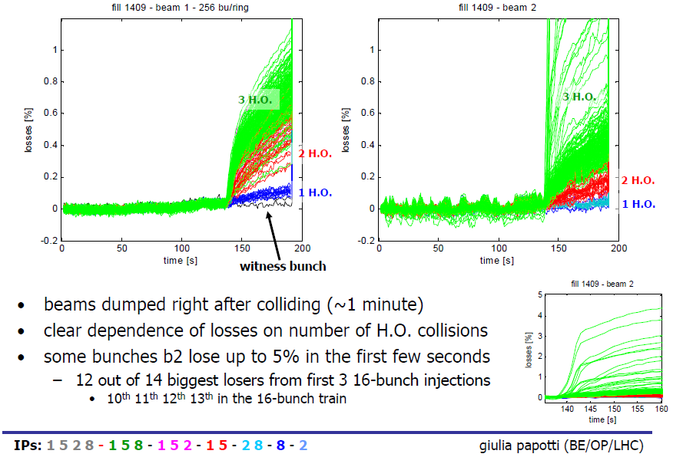
Bunch by bunch

Slide 7
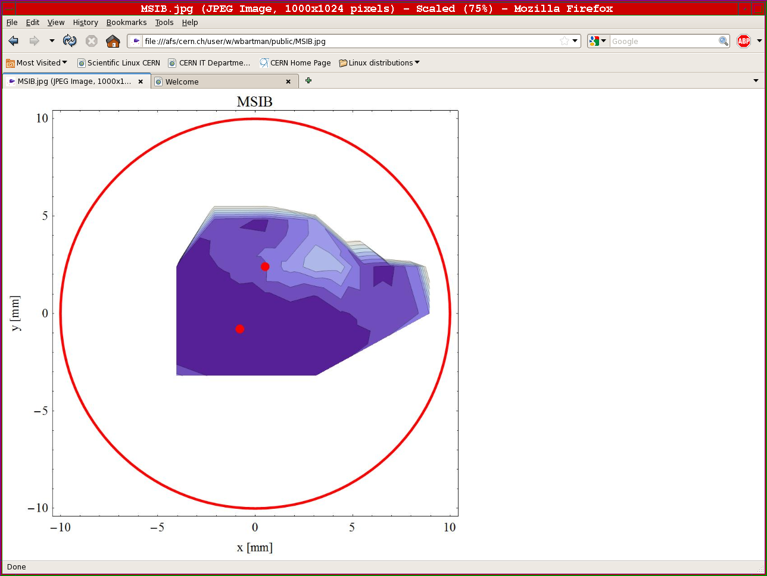
Wednesday 13th October
06:30 Start preparation for van der Meer scans
somewhat tardily
10:15 Following 9:30 meeting - stop vdM scans and move to:
aperture scans of problematic region in injection septa L2
TL steering and associated correction in LHC
Over to the I-team…

Slide 8
Wednesday evening
23:25 Clean injection of 24 bunches into ring 1
00:20 BLM intervention IP7
Thanks and apologies - Christos Zamantzas & Mariusz Sapinski
intervention to exchange the processing module that had triggered a dump request on 12/10/2010 19:03.
The trigger come from a failure in the optical link transmission and the unavailability of data to process in a 40 us cycle.
Looking the history of statuses of this card shows a slow and constant degradation and we expect it to have another failure in the short future (few hours to days).
Thresholds changed on warm elements – MQWs up a factor of 10

Slide 9
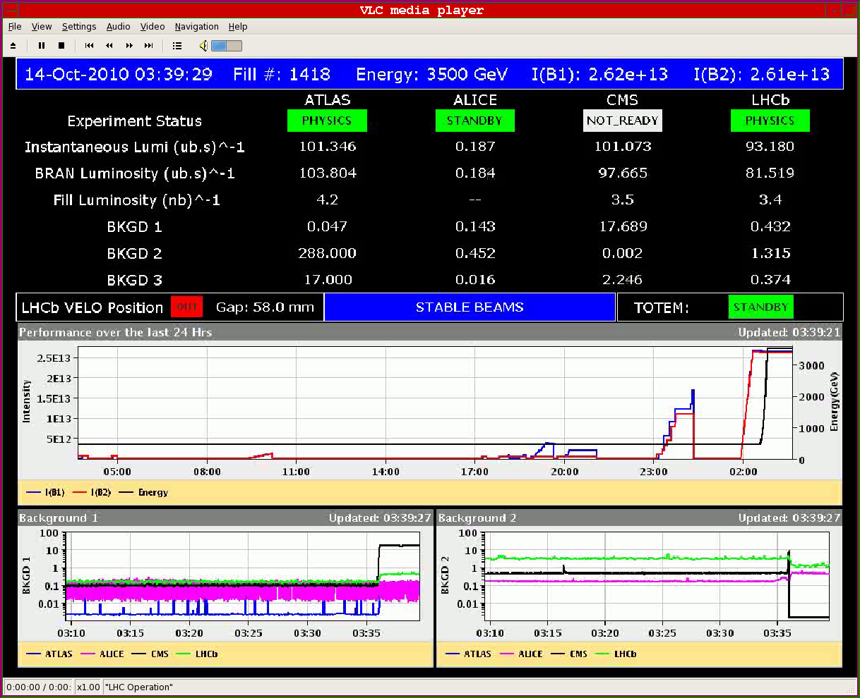
Thursday morning
Filled for physics and brought the beams into collisions: 10e32 peak lumi reached in both IP 1 and 5 with 248 bunches/ring.

Slide 10
Fill 1418
Peak luminosity | ~1.03e32
Beam current | 2.62/2.61 e13
Average bunch current | 1.04e11
Emittance (reconstructed from lumi) | 2.4 micron
Approx beam-beam tune shift | 0.016
Stored beam energy | 14.9 MJ

Slide 11
Options
If MSI solution not stable:
Fill time thorough to weekend
Vacuum: open up:
install mobile pumping unit, inject Neon
open and fix
pump, bake, pump
3 -4 days
Move technical stop to Mon-Tues-Wed-Thurs next week

Slide 12
Backup MD

Slide 13
OP
Periodic loss maps
Betatron loss map done week 40.
Orbit shift versus TCT check:
collide 1 bunch and check the TCT center change as compared to predicted orbit change.
All in one ramp, squeeze, collide - 1 shift
Plus test of 'dynamic' references for the OFB (varying Xing.separation bump): injection, then test of ramp + first part of squeeze
IR aperture at 3.5 TeV
50 ns – pilot runs
After 3-4 fills with ~400 bunches
Push beam-beam tune shift with 150 ns
one test already performed with #1410

Slide 14
BI studies – list to be updated
Check the linearity of the fast BCT’s in the new configuration for nominal bunches
Tune the High BW/Low Gain fast BCT calibration for the coming ion run
Measure the High BW/Low Gain fast BCT sensitivity limit and linearity for low intensity bunches (ion run)
Re-check BPM sensitivity limit
Calibrate the abort gap over the whole ramp
Check the abort gap acquisition gate timing resolution and stability
Commission BGI in preparation to ions
Check BSRT/BGI/BWS cross-calibration including corresponding emittance logging
Test and compare bunch/bunch profile measurement via BWS and/or BSRT
PLL studies during ramp continued
JJG: for all this, we would need the 2 rings for a few hours at 450 GeV then a ramp and again a few hours at 3.5 TeV. This would be really difficult to fit in a 4 hour slot. 8 would be perfect but we could try with 6.

Slide 15
Other
Abort Gap Cleaning – on at injection for physics
continue testing
Injection studies 32 Bunches when required (344 bunches)
Injection studies with 50 ns
Setting-up of the SPS with tighter batch spacing (225 ns)
Quench test at 3.5 TeV – pilot beam
Bernd & co

Slide 16
Experiments
50 pb⁻¹
12 fills@3 pb-1 ~ 12 good days
Alice – fill without dipole
Totem – dedicated fill
LHCb – switch polarity
vdM continued – count 1 – 2 shifts

