Slide 1
Thursday 9.9
07.00 Aperture studies (foreseen until ~ midday, nothing done)
Problems with single bunch B2 from SPS (extraction kicker not enabled)
Setting up started
Then problem with cryogenics in S78 (at 10.30)
Temperature sensor on RQTL9.R7B1 – “not easy to fix” during JG
Proposed to overcool the lead, mask the fault temperature sensor and rely on the voltage measurements from the QPS
Pre-cycle for RQTL9.R7B1 finished OK
QPS experts looked at the voltage data and gave us the OK to proceed with operation in these conditions
Then problem of QPS on RB.A12 (at 14.30)
could work at injection
needed access later (done at 22.00)
Decided to postpone B1 capture/energy matching until later

Slide 2
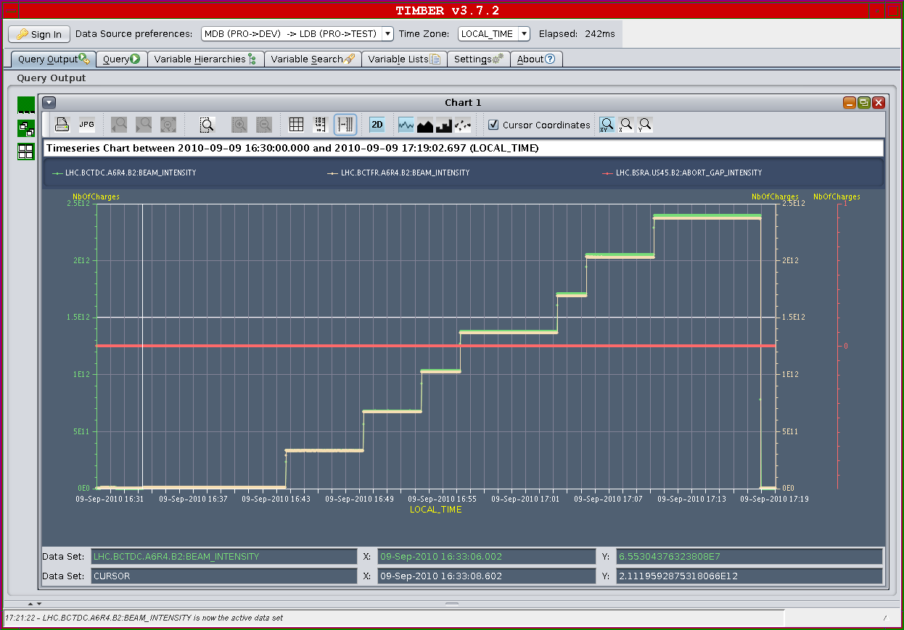
Thursday 9.9
13.00 Continuation commissioning of injection of bunch trains
Started again onto TEDs while machine not available
B1 12b in 3x 4b trains to end of TI2 - losses and trajectory look OK
B2 12b in 3x 4b trains....trajectory still slightly different and losses reflect this
Injected into LHC around 15.30
Centering transfer line collimators B2
Centering transfer line collimators B1
uncaptured beam losses seen
minor hinderance
No evidence of uncaptured beam B2
Finished around 20.30
Then tried running full coll sequence
A few surprises ! (understood but …)
Earlier collimator function work

Slide 3
***SUMMARY of INJECTION STUDIES***
Took 12 nominal bunches to the downstream TEDs in both TI2 and TI8, in 3x 4b trains.
Looks fine from trajectory; losses also reasonable. Steering of TI8 to optimise injection oscillations.
Used one corrector at the end of the line for a nice correction - defined a new golden reference orbit for TI8. Measured center of remaining 6 TCDIs
Found changes of up to 0.5 sigma, looks like with good trajectory correction we can hope for this kind of stability. The following collimators were centered today (all downstream of the TEDs): adjustment [um] TCDIH.29465 +200 TCDIH.88121 -250 TCDIV.29234 -150 TCDIV.29509 0 TCDIV.88123 -240 TCDIV.87804 -255 Trimmed all new settings in and adjusted thresholds, drove all the settings and thresholds through the sequencer Tried to make one full filling sequence with the new settings - ran out of time. Ready to start the protection validation tests tomorrow.

Slide 4
Thursday 9.9
Golden orbit tidied up offline by Jorg
22.00 Access for QPS in point 2
Test ramp of collimator functions
LHC ready around 00.30 but then problem in SPS
02.00 Beam injected
Ramp with collimators (with movement interlocks masked) (!)
Xing angles to 100/110/100/100
Squeeze
04.00 Beam lost at 3.5m - power convertor RCBYVS4.L1B1 tripped
Access from 06.00 for power convertor in S81
07.00 Access finished. Restarting

Slide 5
Friday 10.9
M Continuation commissioning of injection of bunch trains
A First look at beam-beam (if we get trains of 12 in)
N IR aperture
To fit in before we ramp nominal bunch (Saturday ?)
Capture / energy matching
RF longitudinal blowup. V reduction at injection.

