Slide 1
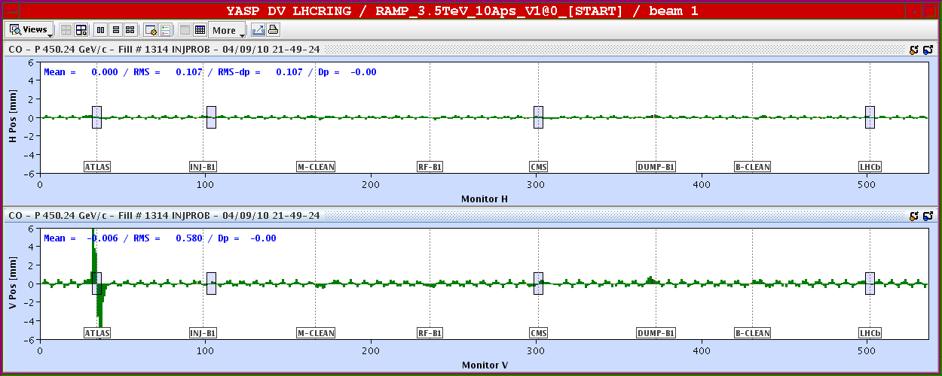
04/09/2010
Cryogenics in Sector 34 recovered at 19:00
19:00 – 21:30 Pre-cycle and preparation for injection
Only managed to inject B1 before PS MPS cooling problem
Switch ON crossing angle for IR1. Non closure calculated.
22:00 Dump due to RF trip of 4 cavities. Expert could not give us an explanation on the origin.

Slide 2
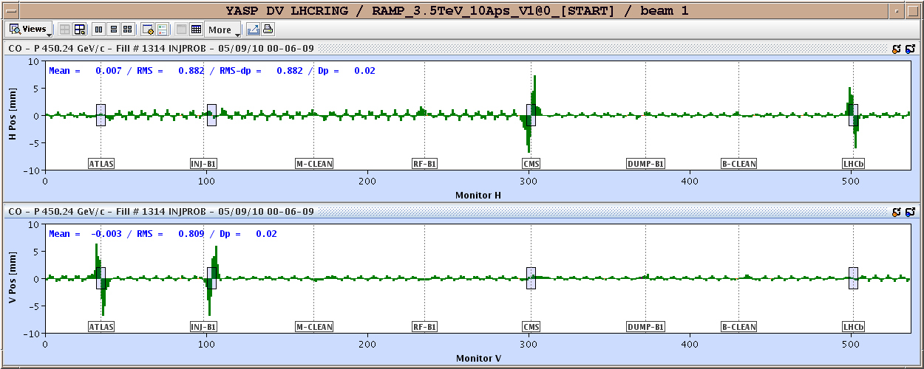
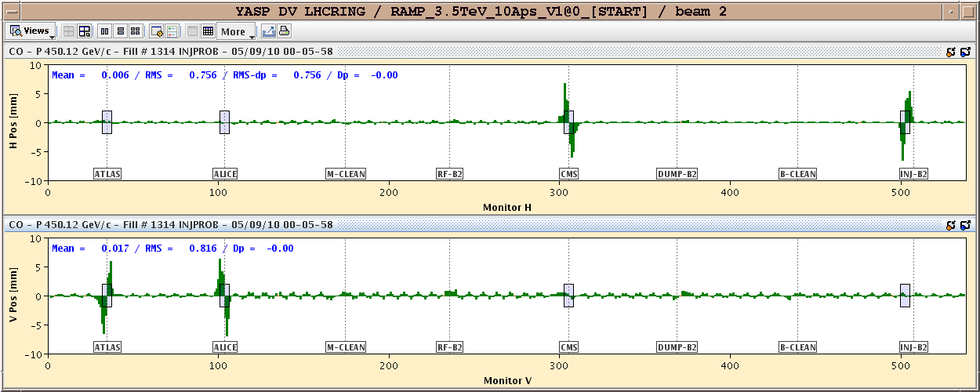
04/09/2010
Finally PS and RF back at 23:20. All crossing angles ON with nominal single bunch
Non-closures (rms): - B1 H/V : 0.44/0.27 mm - B2 H/V : 0.14/0.31 mm
Calculated corrections for each point separately ➔ knobs to be created

Slide 3
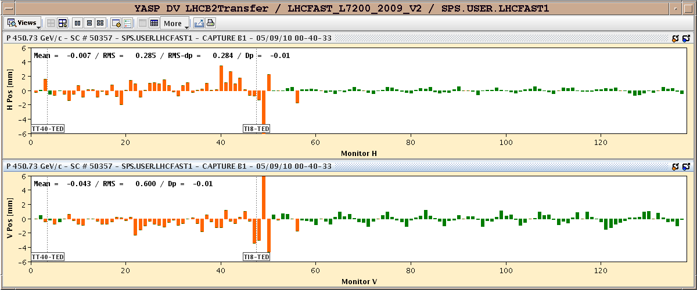
04/09/2010
Injection of beam 2 with crossing angle ON up to nominal single bunch.

Slide 4
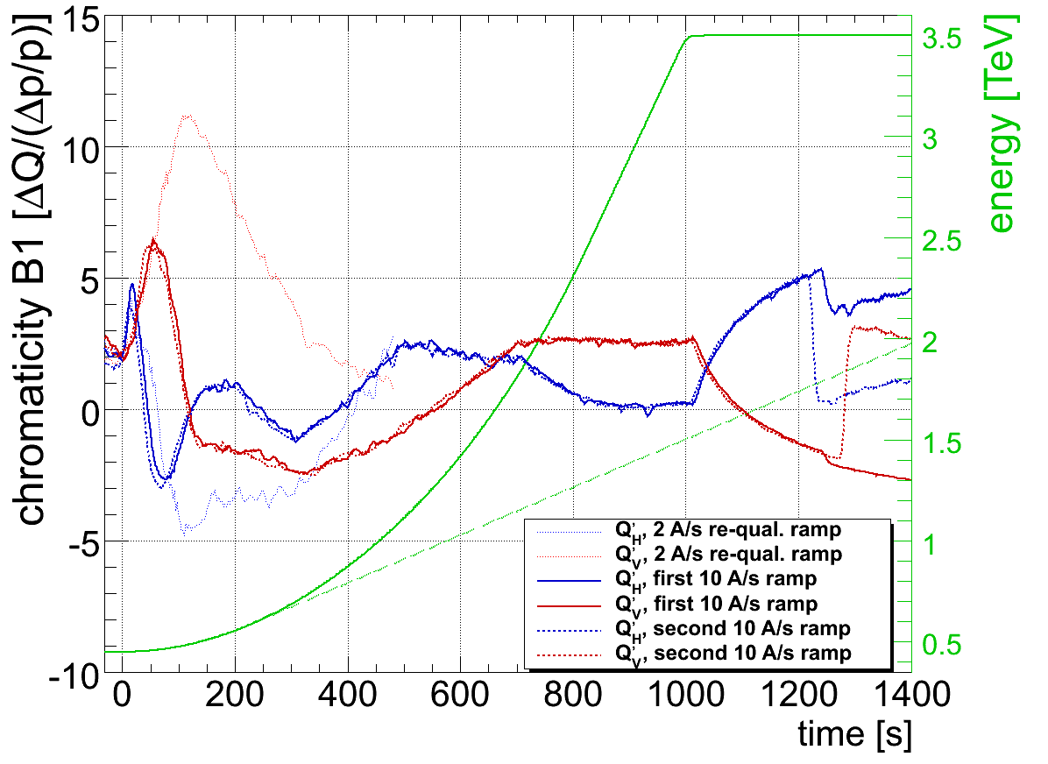
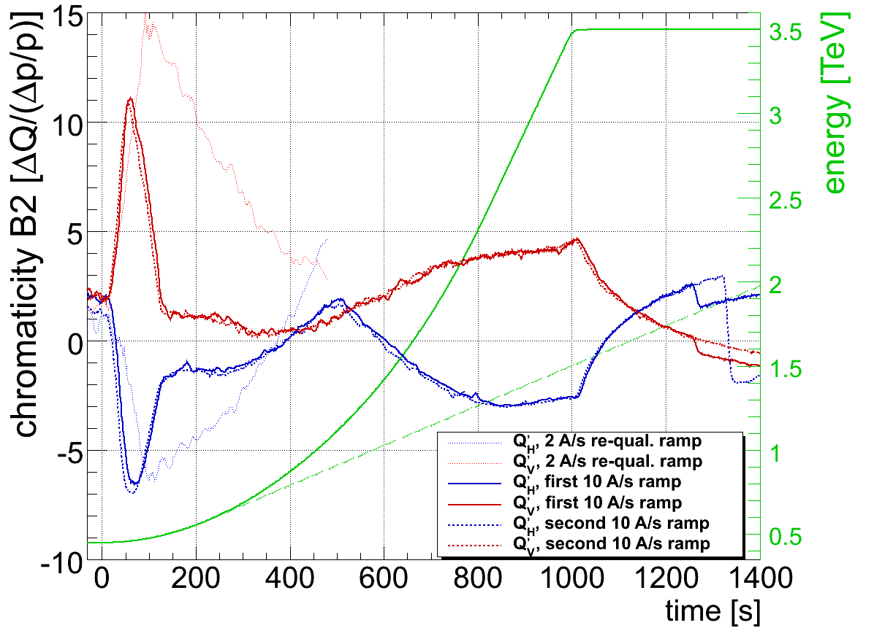
05/09/2010
03:00 start ramp (10 A/s – crossing angles OFF) with pilot bunch for beta beating measurement and correction at 3.5 m
Chromaticity during the ramp ➔ to be corrected before next ramp
R. Steinhagen

Slide 5
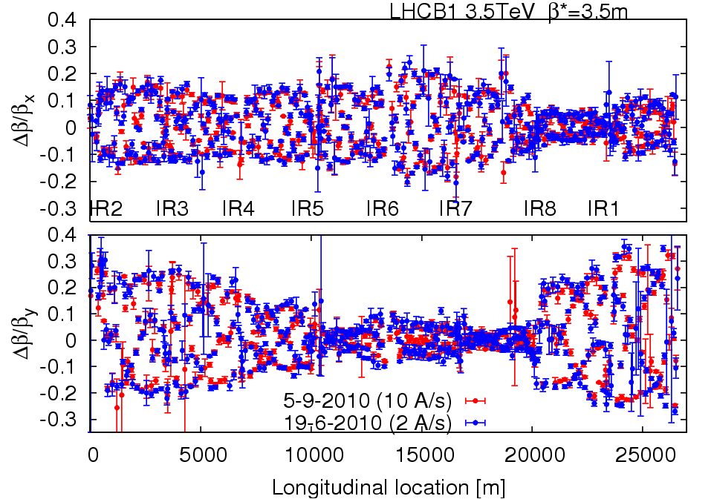
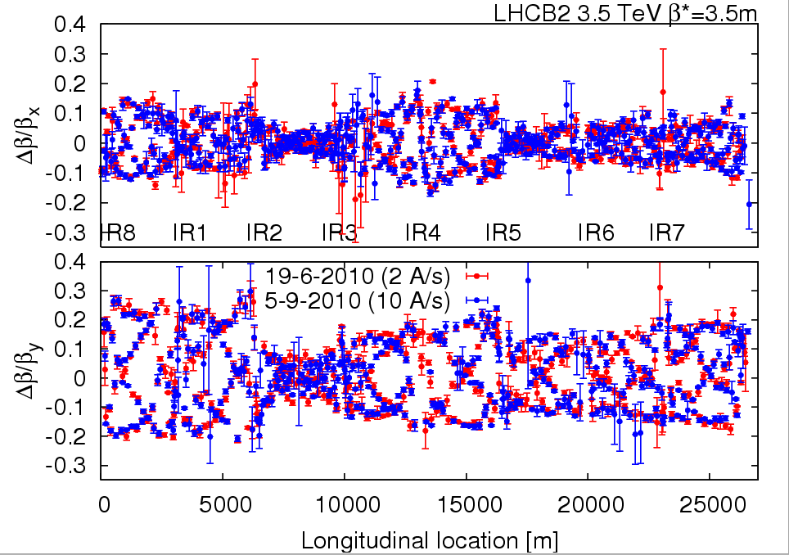
05/09/2010
Beta-beating measurements: reproducible
R. Tomas et al.

Slide 6
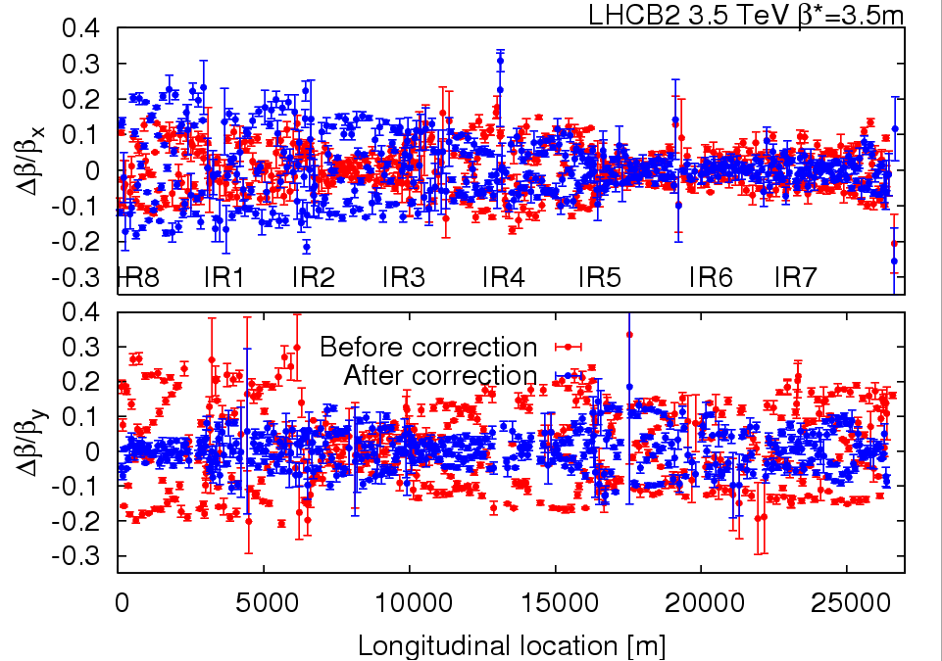
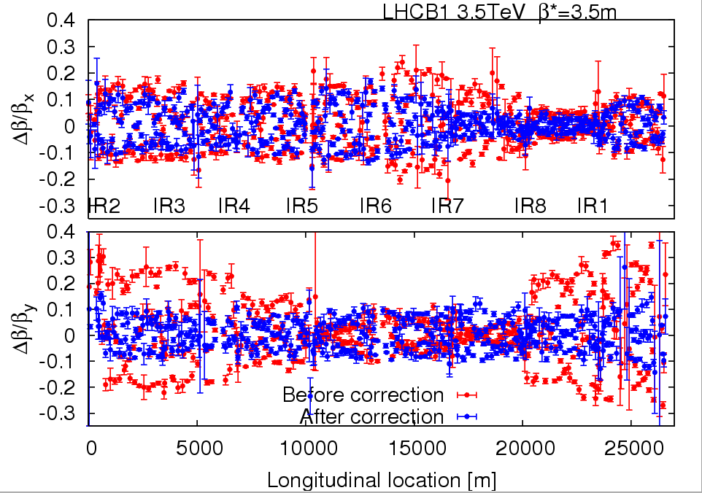
05/09/2010
Correction of beta*: below 20%. Clear improvement in the V-plane
R. Tomas et al.

Slide 7
05/09/2010
Beam1: NAME BETX BETY IP1 3.87±0.04 3.82±0.58 IP2 3.53±0.25 3.45±0.06 IP5 3.67±0.13 3.35±0.13 IP8 3.30±0.05 3.62±0.11 Beam2: NAME BETX BETY IP1 3.41±0.70 3.84±0.19 IP2 3.85±0.43 3.57±0.15 IP5 3.70±0.10 3.79±0.06 IP8 3.67±0.06 3.36±0.05
K-modulation being finished
R. Tomas et al.

Slide 8
Plan
 | Day | Start | Time (h) | Activity | Comments | Beam type
5 | Sun | M | 5 | Transverse feedback setting up: noise reduction (450 GeV - single nominal bunch) |  | INDIV
5 | Sun | A | 1 | Closed oorbit at 450 GeV with crossing angle ON | Non-closuire correction based on measurement done on 4/9/2010 | PROBE, INDIV
5 | Sun | A | 8 | Injection / injection protection: crossing angles ON | TDI/TCLI setup in LHC and protection validation (pilot bunch) | PROBE, INDIV
5 | Sun | N | 6 | ramp at 10 A/s with single bunch/beam 1e10 + squeeze and crossing angles ON during the ramp - measurement of non closure during the squeeze | Feedforward from previous measurements should be implemented Chromaticity measurement during the ramp - collimators open. Crossing angles on during the ramp | PROBE
6 | Mon | M | 8 | Injection / injection protection - crossing angles ON | Steering of trajectory in TLs and adjustment of TCDIs | PROBE, LHC3
6 | Mon | A | 8 | Collimation set-up at 450 GeV/c |  | INDIV
6 | Mon | N | 8 | Transverse feedback setting up: noise reduction (450 GeV - single nominal bunch) - crossing angle ON |  | INDIV

Slide 9
Crossing angles
Polarities for ALICE solenoid/spectrometer: + +
Polarity for LHCb spectrometer: -
External crossing angles:
IR1: -170 μrad at inj./ramp and -100 μrad in squeeze/collision
IR2: ±170 μrad at inj./ramp and ±110 μrad squeeze+collision
IR5: +170 μrad at inj./ramp and +100 μrad in squeeze/collision
IR8: -170 μrad at inj./ramp and -100 μrad in squeeze/collision
IP2 with parallel separation (3 to 4 sigmas).

Slide 10
Pending requests
Access in point 2 for scope removal (K. Dahlerup-Petersen) – 3 hours (including re-qualification of the QPS after intervention)
Sector 78 energy extraction test (K. Dahlerup-Petersen) – 2 hours

