Slide 1
Summary Saturday 28.8.
07h00: Machine closed and start of pre-cycle.
08h30: Injection of beam but staying at 450 GeV.
10h30: Decision to allow ramp to 3.5 TeV with modified UPS configuration. Regular physics operation only for the rest of the weekend. Broken UPS unit to be repaired on Monday during technical stop.
10h54: Start of ramp.
11h41: Flat top.
11h50: BLM triggered beam dump during chromaticity measurement. Losses with long integration time in warm quadrupole. Ramp down and pre-cycle.
13h19: Injection.
14h20: SPS scraper broken. Needs SPS access for repair. LHC beams partially filled, kept at 450 GeV.

Slide 2
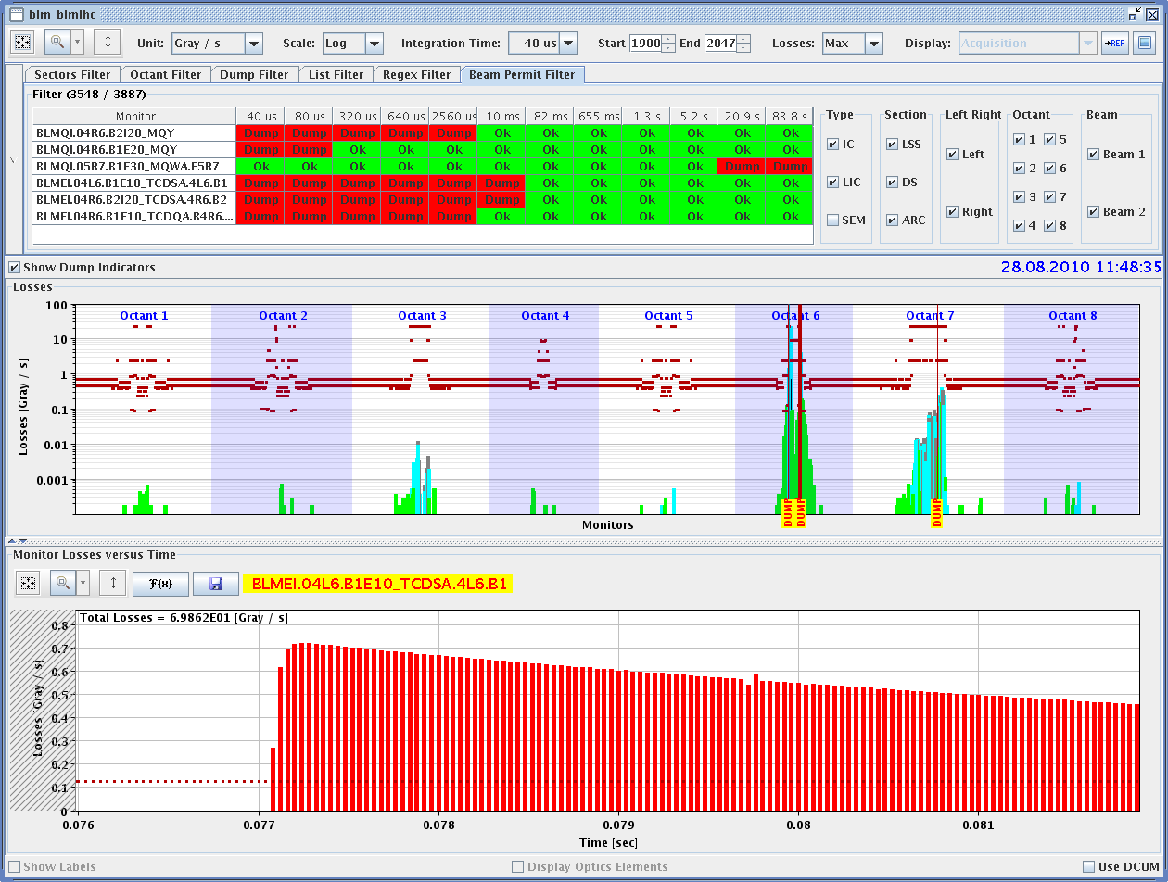
Dump During Chroma Measurement

Slide 3
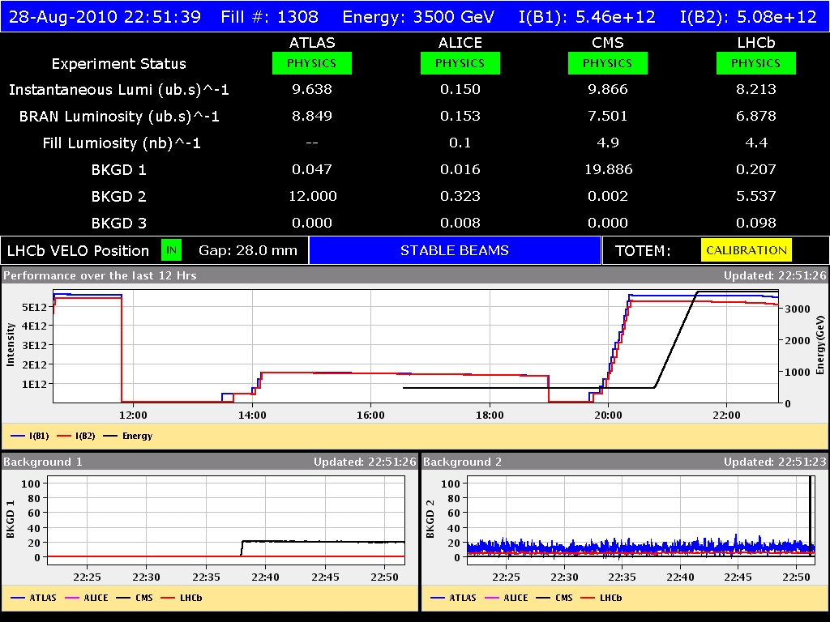
Current History

Slide 4
Summary Saturday 28.8.
14h20: SPS scraper broken. Needs SPS access for repair. LHC beams partially filled, kept at 450 GeV.
19h25: SPS problem solved. Reinjecting LHC beams.
20h45: Start of ramp.
22h42: Stable beams fill #1308.
Sun 09h00: Still running.
Above 3,000 nb-1 delivered (already after last physics fill) and recorded by experiment (by now)!

Slide 5
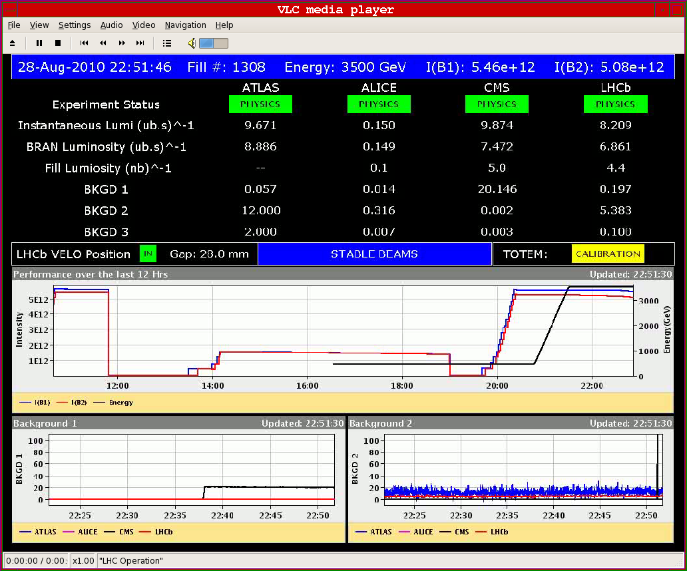
Back to Stable Beams

Slide 6
Program ahead
Sat 09h00: Decision on UPS. If continuing with 1 unit then following program.
Sunday: Physics 50b x 50b. Change LHC-b polarity after fill #1308 (end of present physics fill).
Sun 18h00: Dump fill #1308 without any end-of-fill studies. Or keep if very close to 500 nb-1.
Mon 05h30: end of beam before technical stop

