Slide 1
LHC commissioning Week 27
Aims for the week
Deliver luminosity for physics
Luminosity of 10³⁰ cm⁻² s⁻¹
Stabilise performance in physics
Transfer line and injection system setting up for >10¹² p/beam
Advance the understanding of sudden beam losses in stable beams
Blow up emittance injected in LHC to ~nominal
Run with different collision schemes

Slide 2
Beam losses in stable beams
Since higher intensity and crossing angle → sudden losses observed during stable beams
Most of time after luminosity scans
Hump presence? Sometime but not always? Is it the cause or the symptom?
Observation of strong coherent oscillations which is certainly linked to beam-beam effect - Werner Herr
→ why beam-beam ?
- with single beam : not observed
- with low intensity : not observed
→ beam-beam effects are probably not the origin of the problem, but the killer when it happens : Remember the SPS p-pbar where any source of modulation or noise on the beams led to heavy losses.

Slide 3
Collision schemes considered
Single_10b_4_2_4 → Probe the effect of long range encounters
4 colliding pairs in IP1, IP5 and IP8, 2 colliding pairs in IP2
0 parasitic encounters
Max. 2 head-on collisions/bunch (not 3 as before)
Observed again sudden beam losses → eliminate this candidate - Long range encounters are not the source of the problem
Single_10b_4_2_4 without crossing angle in IP 1 and 5 → Probe crossing angle effect
Crossing angle not needed
Single_10b_4_2_4_rotated → Probe the effect of bucket number
As above but rotated to have 1*1 in IR8 instead of IR1 and 5

Slide 4
Single_10b_4_2_4
Monday
23:00 – 03:00 : Stable beams
Single_10b_4_2_4
~7.4e11 /beam
B1H 2.9 - B1V 3.2 - B2H 3.2 B2V 5.6
No spurious beam losses observed, but note above parameters
Tuesday (3 attempts)
Dumped at 450 GeV: RBAC error in the middle of sequence
Dumped at 3.3 TeV : Interlock on LVDT of TCLAB5.L3.B2. Piquet intervened (software re-set)
Dumped at 500 GeV, same problem, piquet intervened, (hardware re-set)

Slide 5
Single_10b_4_2_4
Wednesday (2 attempts)
Beams lost just before squeeze, reason not clear (hump activities)
Beams lost just before collide, RQT13.L8B1 trip, access needed (module in PS)
Thursday
05:00 – 10:00 : Stable beams
Single_10b_4_2_4
~7.4e11 /beam, but losses (of beam 1) in collision
Tried to take off crossing angle on end of fill, but beams lost while correcting the orbit
Saturday
Single_10b_4_2_4_rotated
Cannot inject 10th bunch of beam 2 - Processing of the request of bucket numbers > 29626 → common frequency generator is stopped. Problem will be solved today. Philippe Baudrenghien

Slide 6
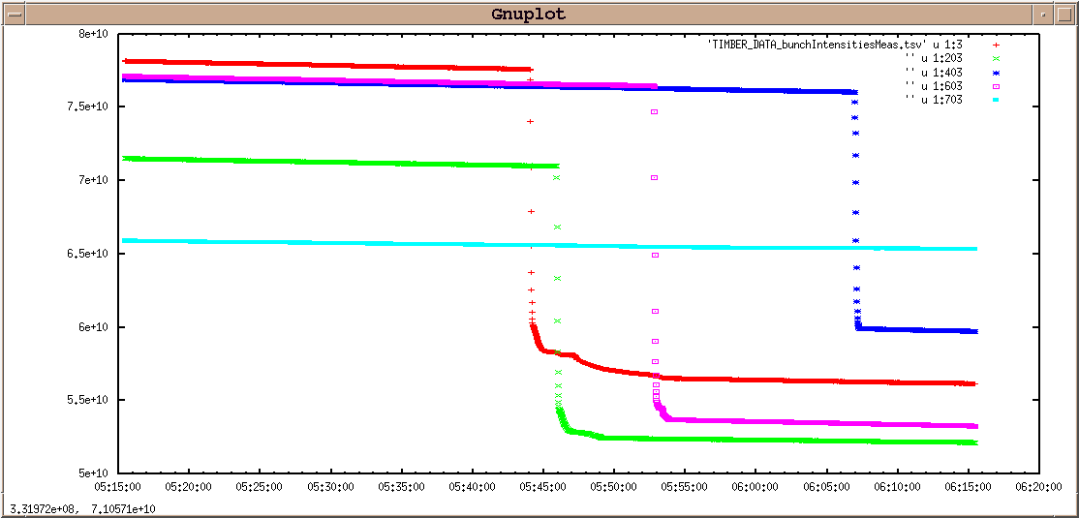
Beam observations
Example of the fill in the night of Thursday 7 to Friday 8 July (single10b_4_2_4)
Only the 4 bunches of B1 colliding in IP 1 and 5 (only) are suffering from these sudden losses. Not the others of beam 1
Beam 2 is unaffected.

Slide 7
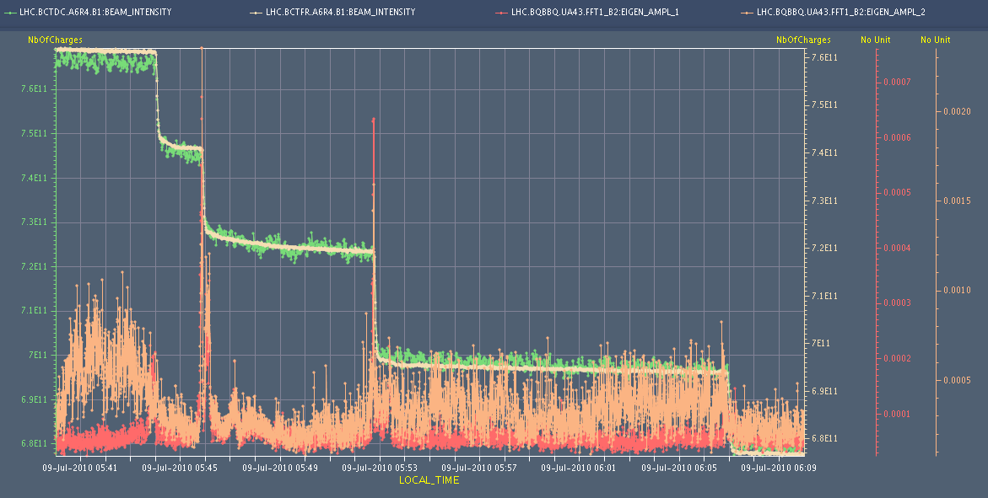
Beam observations
'Hump' in particular in the vertical plane seems to be the likely cause of this night's B1 losses

Slide 8
Physics (attempts)
Saturday (2 attempts)
Switch to Single_9b_6_6_6
Right before collapsing the separation bumps, got hit by an electrical glitch on the network which was caught by the FMCM and dumped the beams
During the squeeze, lost the beam on orbit excursion interlock (the orbit feedback was off).

Slide 9
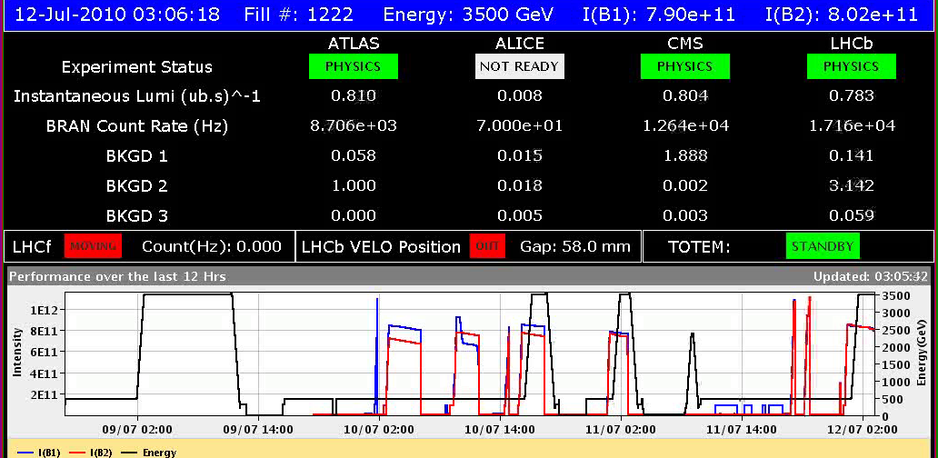
Physics (attempts)
Sunday
Single_9b_6_6_6
B1H = 3.0 - B1V = 3.0 - B2H = 3.2 - B2V = 3.4 - ~9e10/bunch
Collisions since 3:00 - No losses seen so far. Tune spectra quiet

Slide 10
Physics (attempts)
Sunday
No emittance blow up

Slide 11
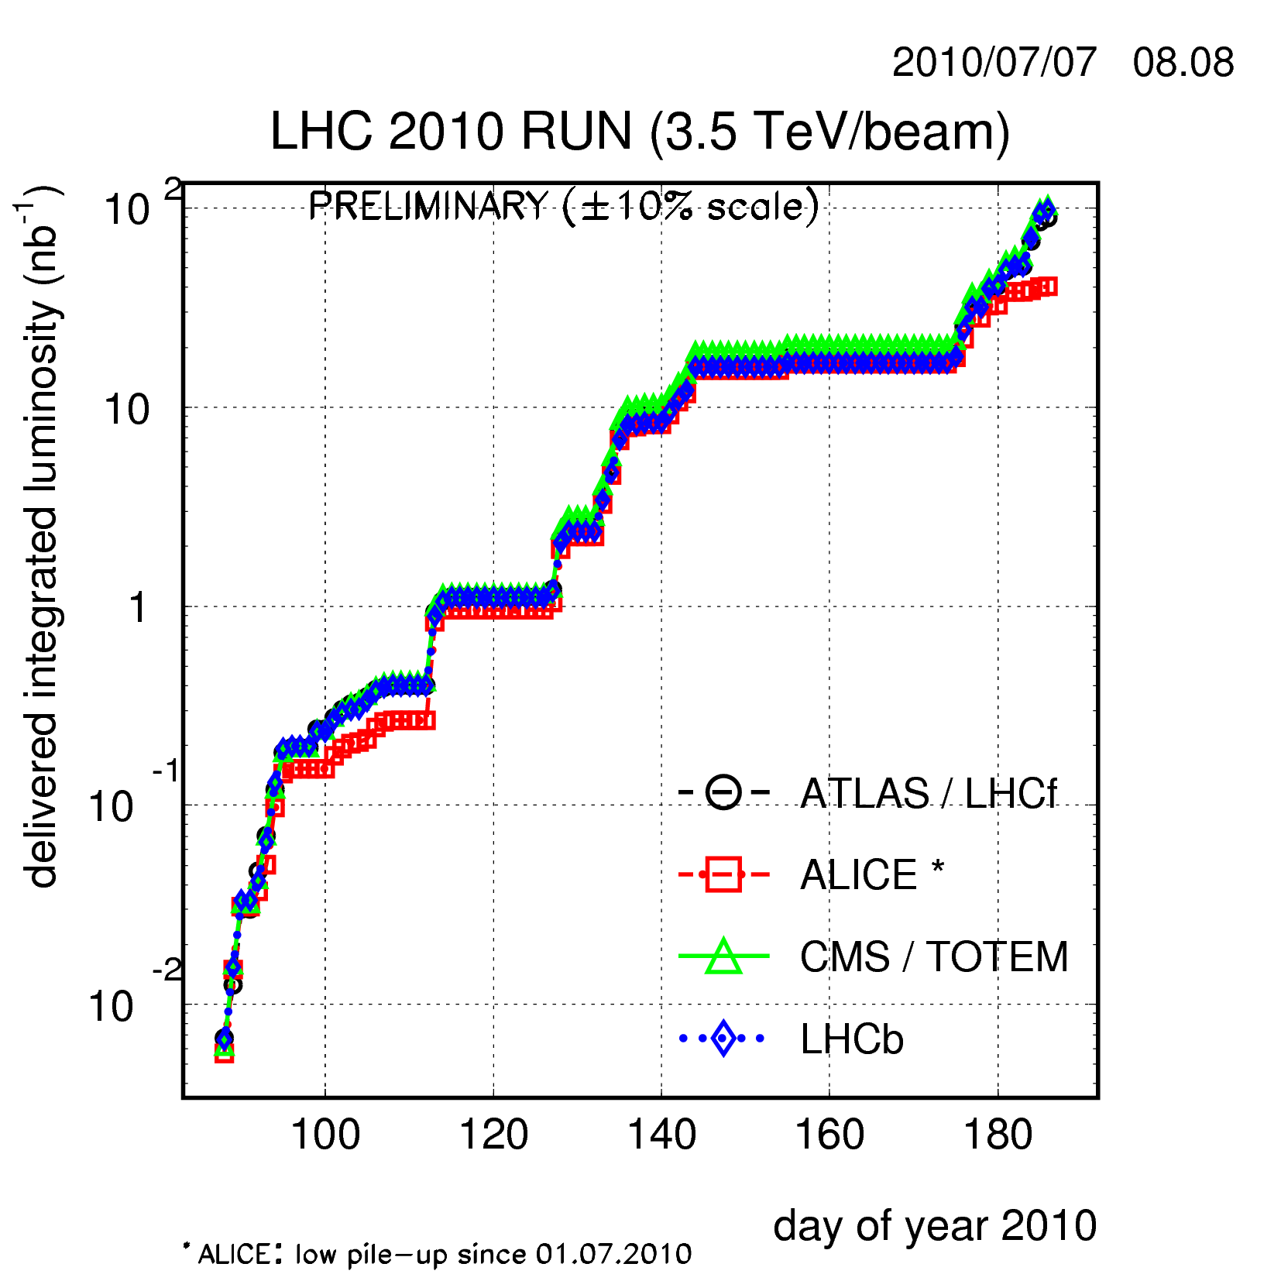
Delivered luminosity (Wednesday)

Slide 12
Preparation towards > 1e12 p /beam 450 GeV
Multi-bunch controlled longitudinal blow-up – Thomas Bohl, Joachim Tueckmantel, Urs Wehrle.
4 single bunches were injected into the SPS, 2.4 s apart, bunch spacing was 2 us, I_bunch ~1e11 at injection
Optimisation of the controlled long. emittance blow-up. At 450 GeV, with 7.0 MV → bunch lengths: 1.3 - 1.85 ns ←→longitudinal emittances : 0.40 - 0.75 eVs.
For better optimisation: TWC 800 MHz is required (this will be a new operational requirement) →More beam time needed
SPS transverse blow-up with transverse damper - Wolfgang Hofle
Octupoles are used in combination with an excitation by the damper around the tune frequency (small frequency modulation) → Tuned the system for providing emittances of ~3 um in H and V for both beams

Slide 13
Preparation towards > 1e12 p /beam 450 GeV
Transverse emittance measurements across the SPS-TLs-LHC chain - Brennan Goddard – Chiara Bracco – Wolfgang Hofle -Federico Roncarolo, Jean-Jacques Gras, Anna Guerrero, Rhodri Jones, Enrico Bravin, OP crews
With transverse blow-up:
SPS H and V: ~3.3 um TI 2 horizontal: ~3.6 um - TI 2 Vertical: ~3.3 um TI8 horizontal : ~3.6 um - TI8 Vertical : ~3.5 um LHC H & V B1: ~ 3.3 um for each newly injected bunch
LHC H & V B2: ~ 3.3 um for each newly injected bunch
Bunch 1 measured after each injection of a new bunch → blowup of the individual bunches on the flat bottom at about 1 um/h - B2 V most affected
BTV screens in the dump lines : added to the screen matching application -– Fabio Follin
→ provide useful emittance measurements

Slide 14
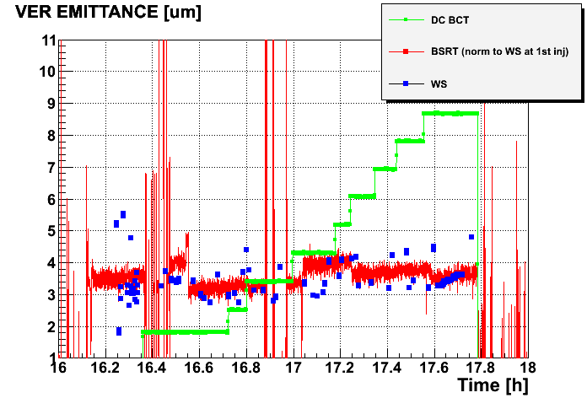
LHC beam emittance measurements
BEAM 2
scan on bunch 1
scan on last injected bunch
Courtesy Federico Roncarolo
scan on bunch 1

Slide 15
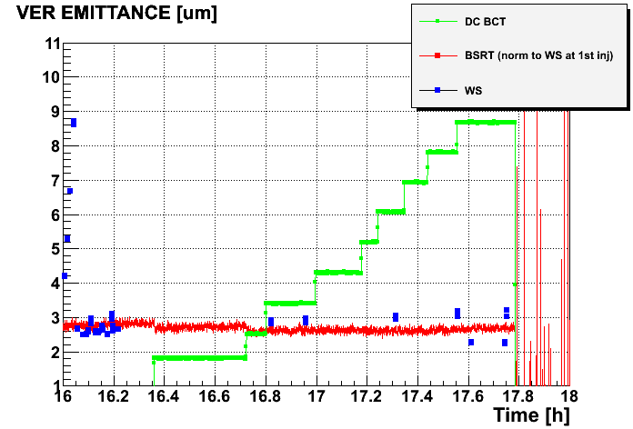
LHC beam emittance measurements
BEAM 1
Courtesy Federico Roncarolo
scan on bunch 1

Slide 16
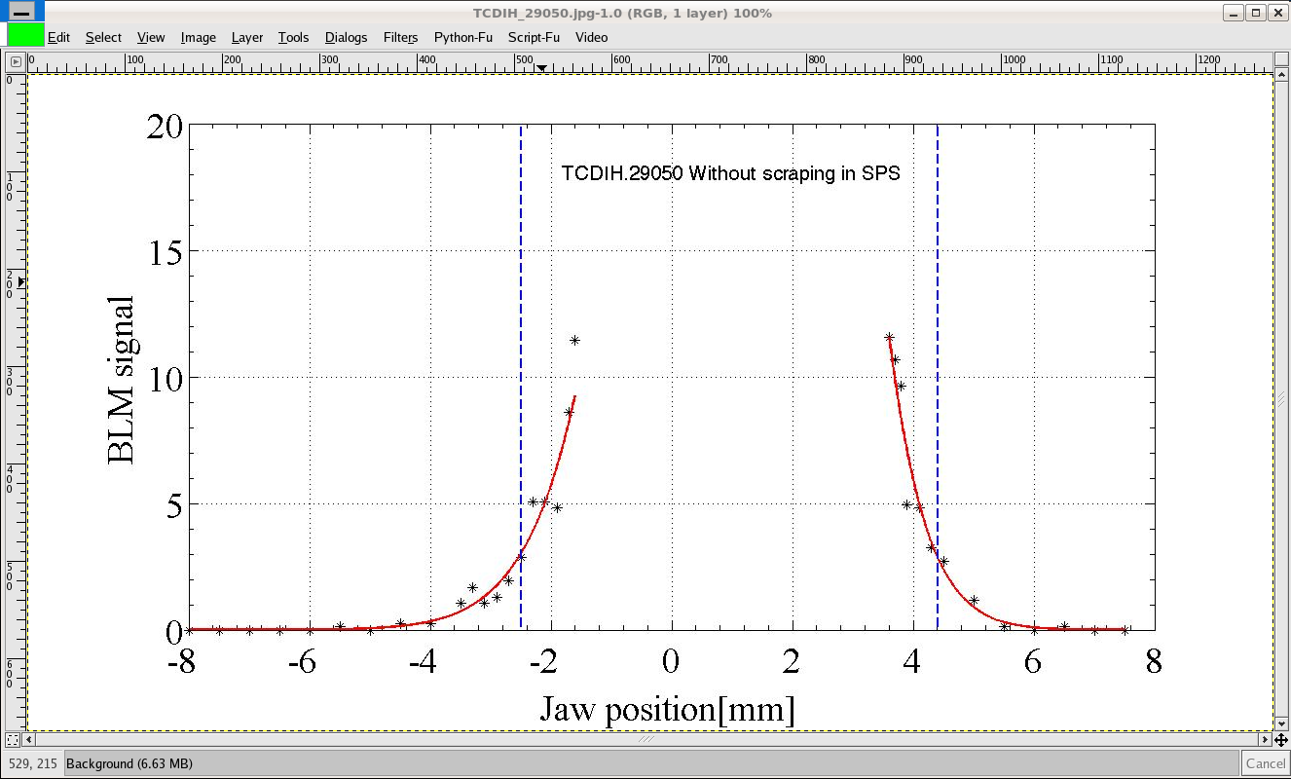
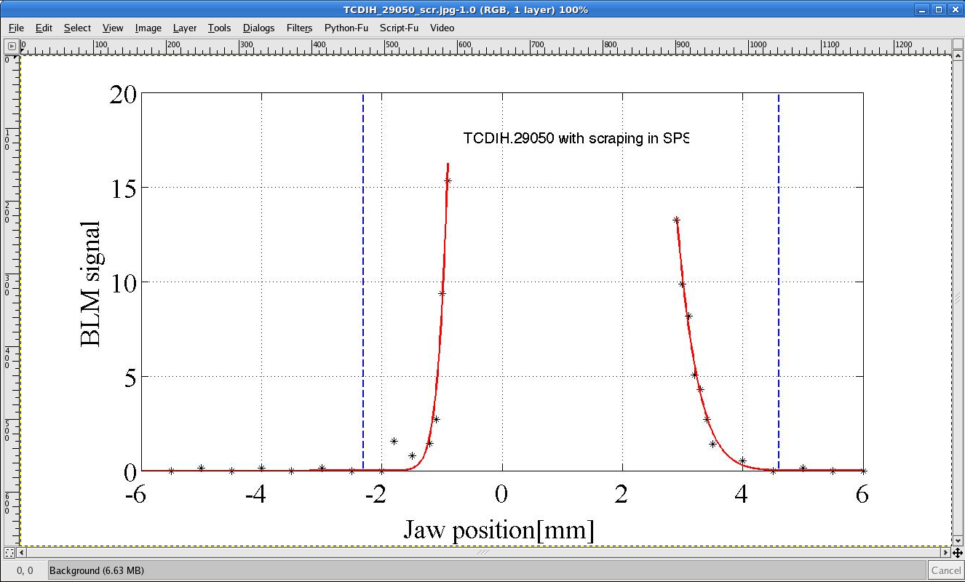
Preparation towards > 1e12 p /beam 450 GeV
LHC injection protection devices – Brennan Goddard
TDI settings verification as a function of TCP setting. Data to be fully analysed for B1- For B2 TDI scan repeated with the offsets found in previous measurements: results coherent with earlier findings.
Tail scans in TI 2 – Chiara Bracco
Tail scan performed for two collimators upstream of the TED with nominal bunch, with and without SPS beam scraping.
Showing tails in H, with about 2% of the beam outside 4.5 sigma, coming from blowups in the SPS (losing at TCDI with large Dx)

Slide 17
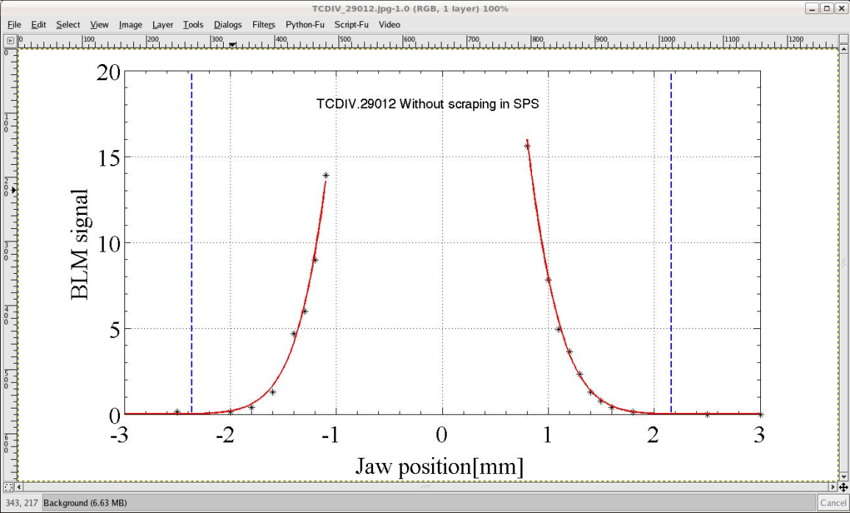
Tails in TLs
V profile is cleaner, even without scraping in SPS
→ likely to need scraping operational in the H plane if this cannot be improved

Slide 18
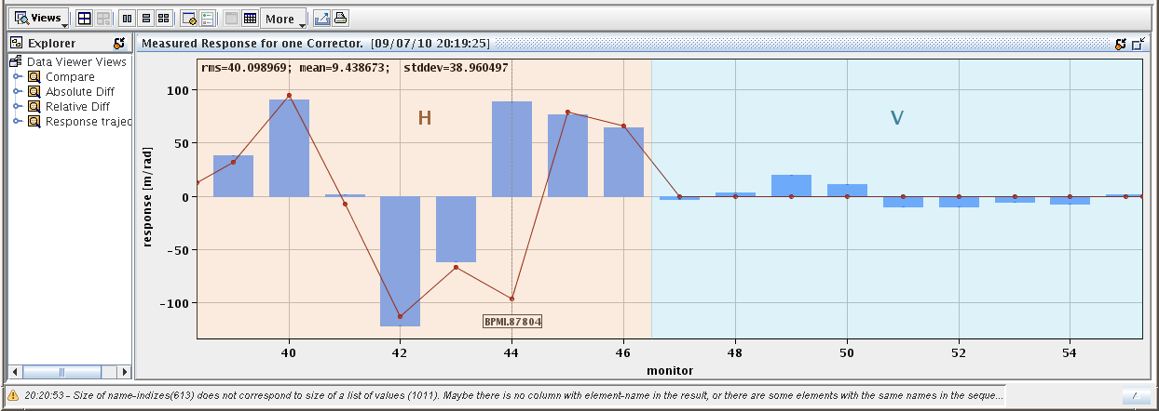
Preparation towards > 1e12 p /beam 450 GeV
Trajectory consolidation in TI 2 and TI 8 - Brennan, Chiara, Malika, Volker, Kajetan
Performed TI 2 bare corrections → allowed removing most of the correctors which have been added over the weeks wrt to May orbit reference
Corrected the injection oscillations into the LHC, minimising kicker strengths and overall trajectory
Same done for TI 8 trajectory
→ suspicion on the sign of BPMI87804 (both planes), confirmed by kick response measurements in both planes (red model – blue measurements). BPMIH.87904 is also suspicious (plane inverted?)
TI 2 and TI 8:
Stored new trajectory
in the reference catalogue

Slide 19
Preparation towards > 1e12 p /beam 450 GeV
Re-centering of the TL collimators in TI 2 and TI 8
7 collimator setting-up in TI 2 [6 in TI 8] around the new trajectory.
Scanned and re-centred all devices using the nominal +/- 4.5 sigma gaps. New settings deployed and trimmed into the beam process; position thresholds to do.
Losses seen at first over-injection - x5 over threshold on TCTVB only (all other losses OK). Subsequent injections of nominal bunches below BLM threshold.
Injected 12 (13) nominal bunches, final 8 with BLMs unmasked, to total intensity of 1.1e12 (setup beam flag -> FALSE)
Dump of 12 (13) nominal bunches clean
Injection oscillations for B1 / B2 with the new steering look OK - avoid correcting from now on. Oscillations are dumped nicely with the transverse damper

Slide 20
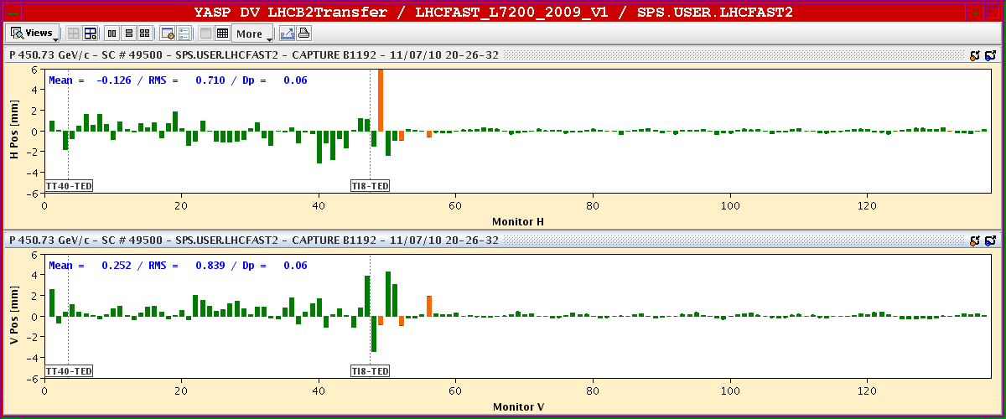
Preparation towards > 1e12 p /beam 450 GeV
Used the horizontal scraping in the SPS and injected 13 single bunches per beam – much cleaner than without.

Slide 21
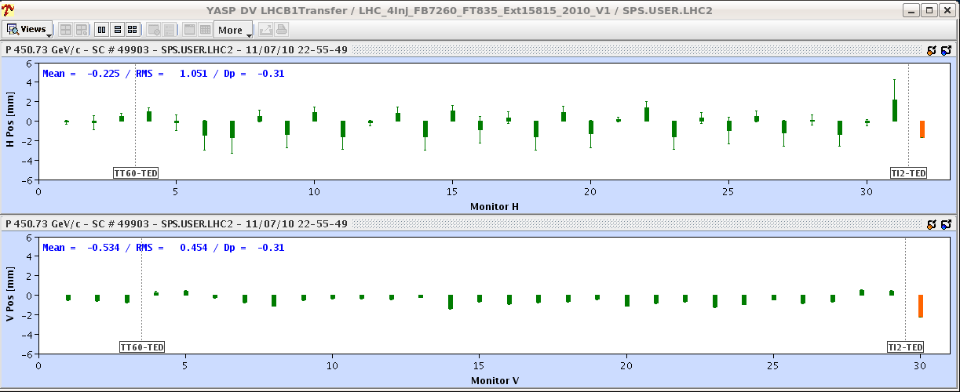
Preparation towards > 1e12 p /beam 450 GeV
Multi bunch injection from the SPS into LHC
Still much work to be done in the SPS (orbit, transverse, settings…) before injection into the LHC
Sent 1 train of 4 bunches in TI 2 - will wait for SPS tidy up before continuing.
OK for injection for 12 nominal bunches per beam.

Slide 22
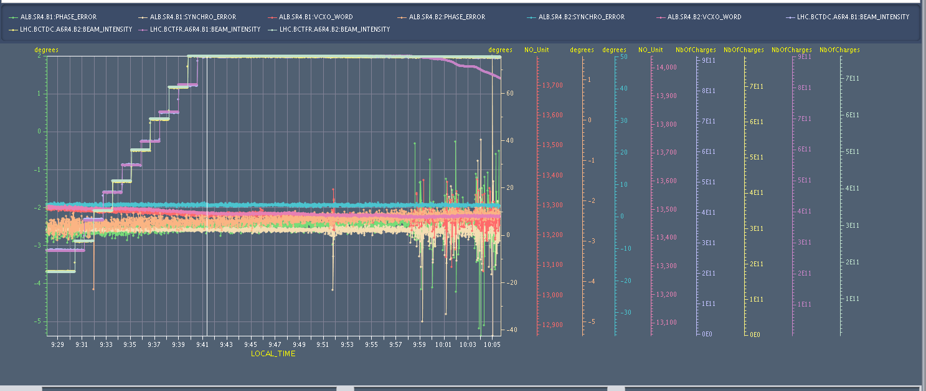
RF observations and investigation
B1 RF noise problems: Philippe Baudrenghien and Frederic Dubouchet
While investigating RF bucker number, observed big de-bunching on beam 1 with signature similar to last Sunday!
→ RF noise
One of this clock (380 MHz) produced by a Phase Lock Loop which was not locking anymore on beam 1
→ generating bursts of noise in the loop
→ was re-tuned - Effect not caused by temperature but probably humidity. To be monitored periodically.

Slide 23
BI consolidation
Wire scanner B2: Ana Guerrero
Pending issues fixed (Wire not home, and no signal)
BPMS + BPMSW gains: Rhodri Jones, Lars Jensen, Kajetan Fuchsberger – much improved, still some work to do
Changing monitor factors for BLM - Annika Nordt – Bernd Dehning – done for 6 monitors (seeing losses during wire scans)
High/Low sensitivity switching – Rhodri Jones, Lars Jensen, Kajetan Fuchsberger.Test of the time needed in view of automatic switching at injection

Slide 24
Next steps – Joerg and Mike this week
Fill in : QPS ok lost in S12. The old bus bar protection does not work anymore (nQPS more sensitive and still O.K.). It also contains the current lead protection. An intervention is necessary in UA23 (1/2h) but it can wait until end of the morning –Sandrine Le Naour
Establish absolute reference orbit with stable beam configuration – Joerg Wenninger
FMCM : re-visit / tests whether the threshold can be relaxed? Markus Zerlauth
Switch on ADT in collisions - Wolfgang Hofle – Daniel Valuch - Maarten Schokker
Continue to monitor and analyse beam losses during collisions using a consistent set of parameters - Werner Herr
Continue preparation for multi-bunch injection – OP-ABT

Slide 25
Next steps – Joerg and Mike this week
EOF:
Octupoles to zero
WS (vs. BLM threshold, also during the ramp) – Bernd Dehning
Loss maps – Ralph Assmann
Beam time requests:
Hump measurements – Gianluigi Arduini – 450 GeV, 1.5h
Optics measurements – Rogelio Tomas, 450 GeV (8h) and 3.5 TeV (8h)
Beam-beam studies – Werner Herr (few shifts)
High/Low gain sensitivity switch (mostly parasitically) –Rhodri
ADT: 450 GeV, 8 hrs, to check the noise improvement after going to the high intensity settings, complete the set-up of one missing pick-up – Wolfgang Hofle and team

Slide 26
Pending Requests
Access requests:
Wire scanner B2: electronics board to change – Anna Guerrero
TCLA.B5L3.B2 collimator (during next TS) – Alessandro Masi
Check Clock Gen. in Faraday Cage (SR4) – Philippe Baudrenghien
In investigation:
RSS.A34B1 S34 : No PM by detector due to the low current level in the circuit --> no trigger. PM however from switch confirming self opening (both flags change state). 1st event of this kind in LHC to be studied by EE experts once back from holidays. But tripped again 2 other times

