Slide 1
Thursday 15.4.
06:00: Physics fill from the night shift
08:30: End stable beam mode
09:30: Start squeeze in IR 1 & IR5:
  β* = 5m reached at 9:40; followed by orbit, Q, coupling and Q’ adjustments.
  β* = 2m reached at 10:07; followed by orbit, Q, coupling and Q’ adjustments.
  (tunes inverted)
11:30: Start squeeze in IR8:
  β* = 5m reached at 11:55; followed by orbit, Q, coupling and Q’ adjustments.
  Collimators moved to 12.8 σ position for β* = 2m squeeze.
  β* = 3.5m reached at 12:20; followed by optics adjustments.
  β* = 3.0m reached at 12:33; followed by optics adjustments & β-beat measurements.
  β* = 2m reached at 12:55; followed by optics adjustments & β-beat measurements.
  Large vertical beam size for Beam2 due to ‘hump’ ➔ losses during AC dipole

Slide 2
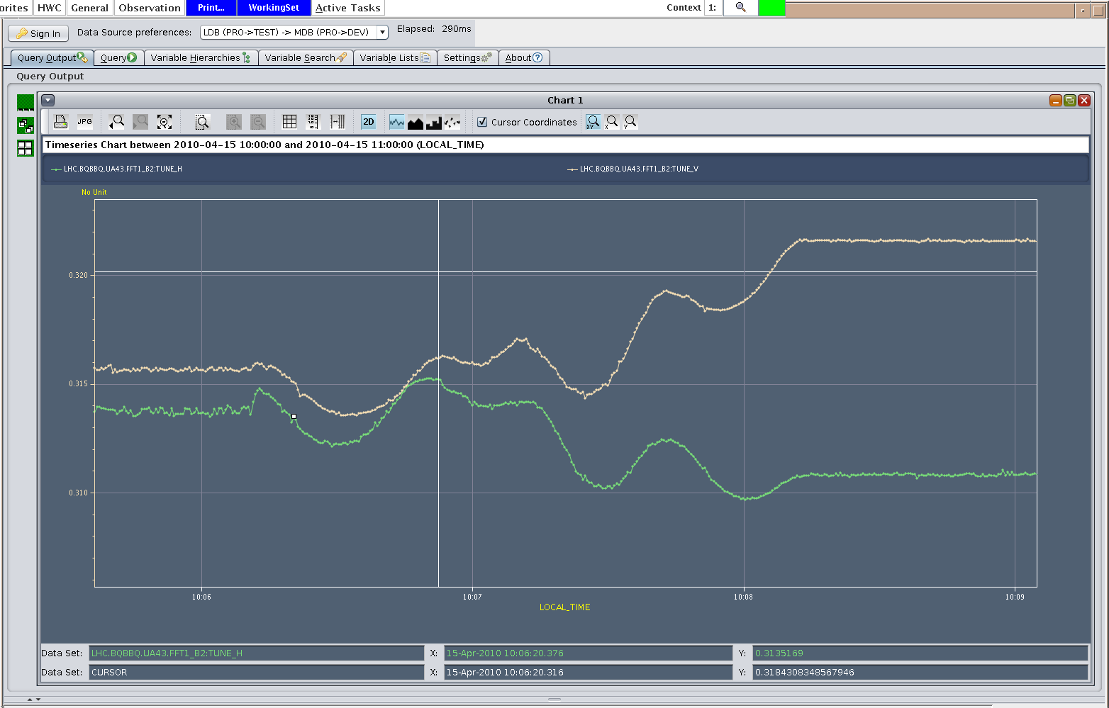
Thursday 15.4.
Tunes during IR1 and IR5 squeeze:

Slide 3
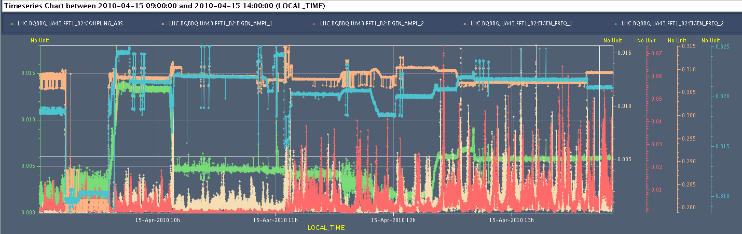
Thursday 15.4.
Tune coupling, Eigenmode frequencies and amplitudes during morning squeeze:

Slide 4
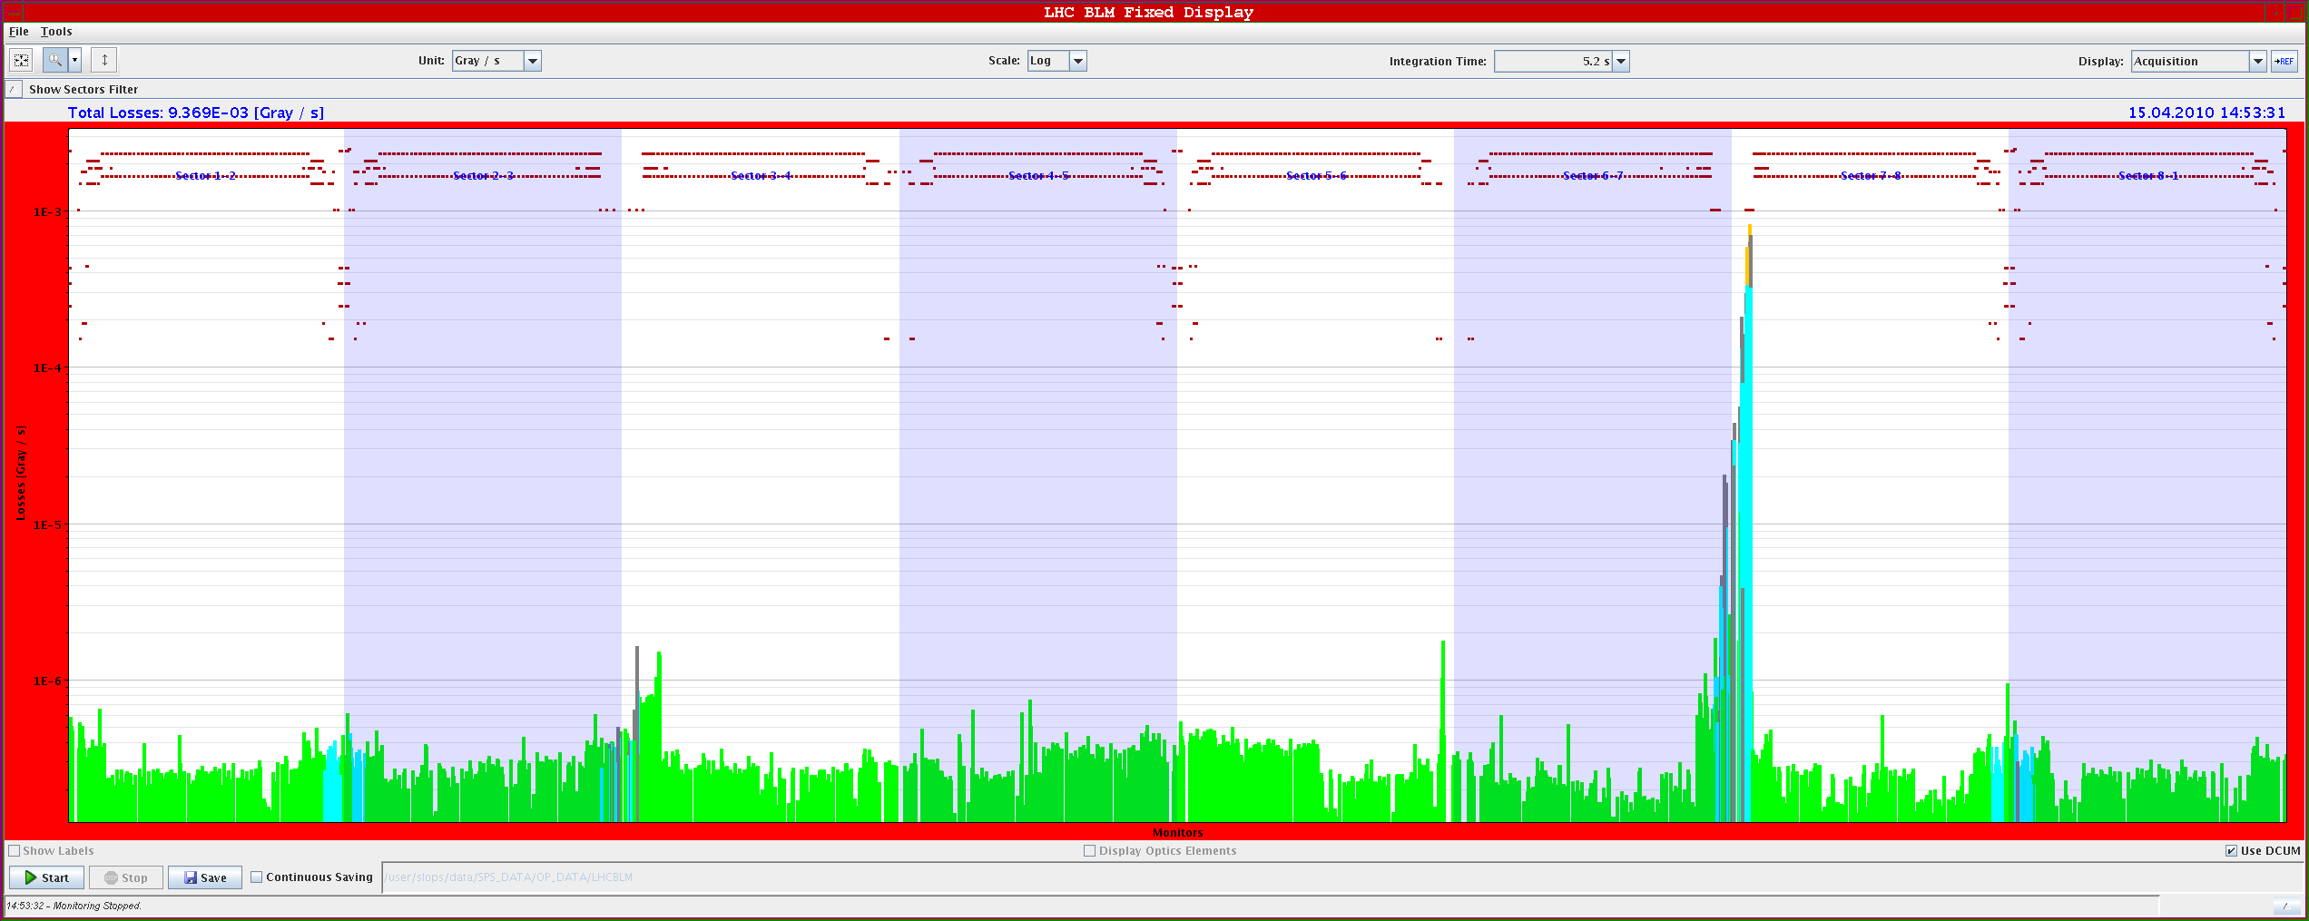
Thursday 15.4.
Losses during AC dipole measurements:

Slide 5
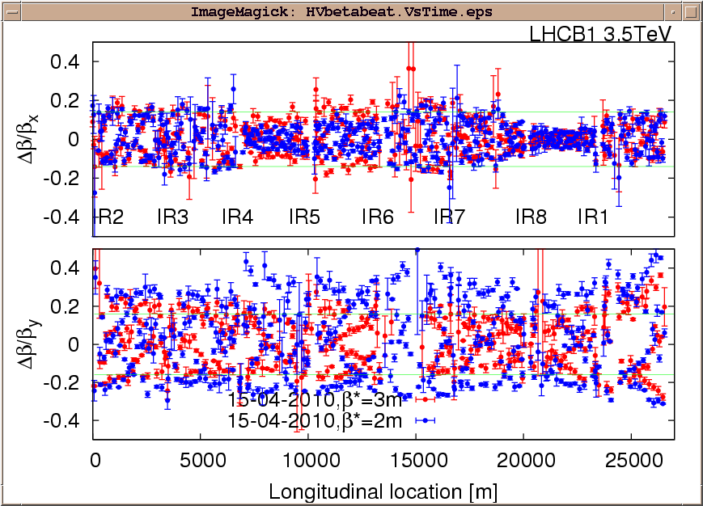
Thursday 15.4.
β-beat Beam1 during IR8 squeeze:

Slide 6
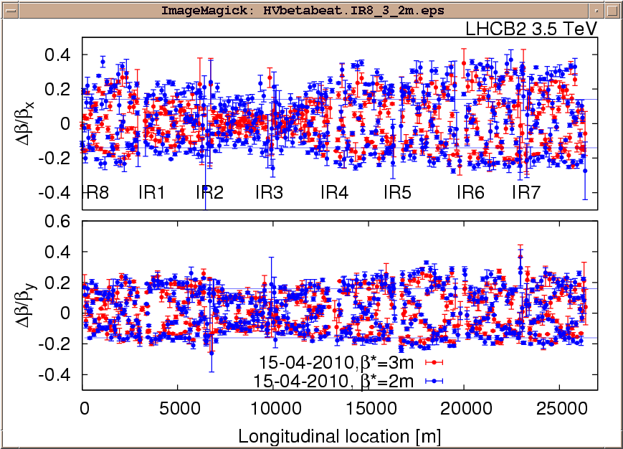
Thursday 15.4.
β-beat Beam2 during IR8 squeeze:

Slide 7
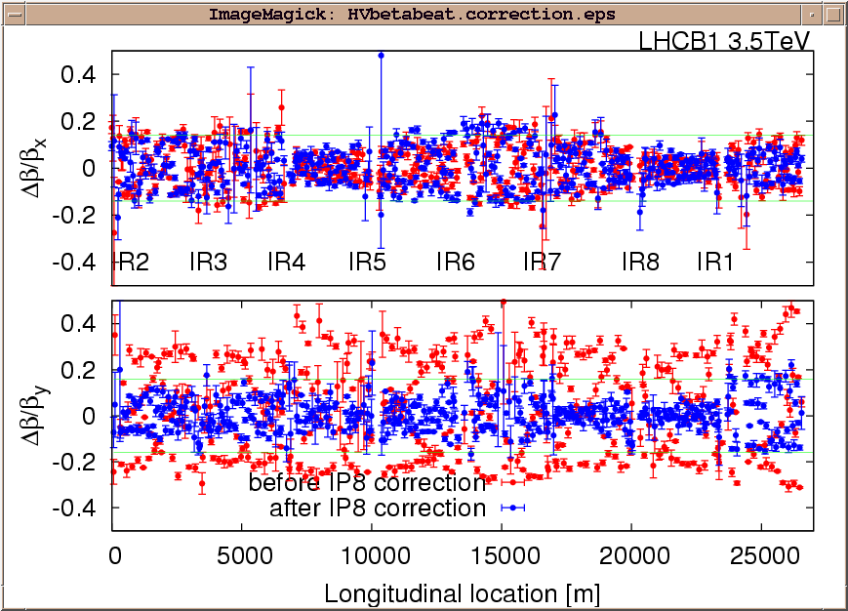
Thursday 15.4.
β-beat Beam1 with Q5 correction via knob implementation:

Slide 8
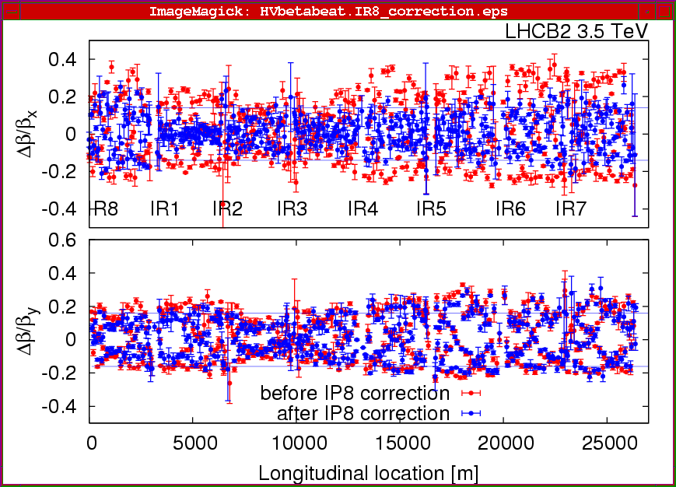
Thursday 15.4.
β-beat Beam2 with Q5 correction via knob implementation:

Slide 9
Thursday 15.4.
15:00: β-beat measurements in IR8 indicate again 40% beating:
  Incorporate corrections from yesterday even though not necessarily ultimate solution in order to reduce β-beat before squeeze in IR2.
16:30: Starting squeeze in IR2:
  Have to stop at β* = 9m due to current limitation for RQTL11 on the power converter side. End squeeze studies for the day.
18:00: Beams dumped by switching RQ5.LR7 off and provoking an emergency dump.
20:00: Starting injections for LBDS studies
21:15: Static VAR compensator Pt8 off.
  Kept off – will be looked at on Friday morning.

Slide 10
Thursday 15.4.
Higher intensity
  Switching between PROBE and INDIV in the SPS is now working smoothly: adjusted some settings for the SPS rephasing.
  Optimization of some TI2 TCDI collimators – minimize losses.
  Over-injection working well in IR2 (only one dump from pilot send to TDI).
  Over-injected 1.1E11, collimators at nominal 4.5 sigma settings.
  Emittance at 1E11: 2.5 um H, 2,3 um V.
  The losses in the injection region do not scale with intensity: above 5E10, the losses go down (in absolute!).
  Saw beam de-bunching for 0.6E11 ➔ not yet understood.
  Beam dump due to losses on a TCLA in P7--> we had to mask it.
  Large losses on B1 cleaning collimators…

Slide 11
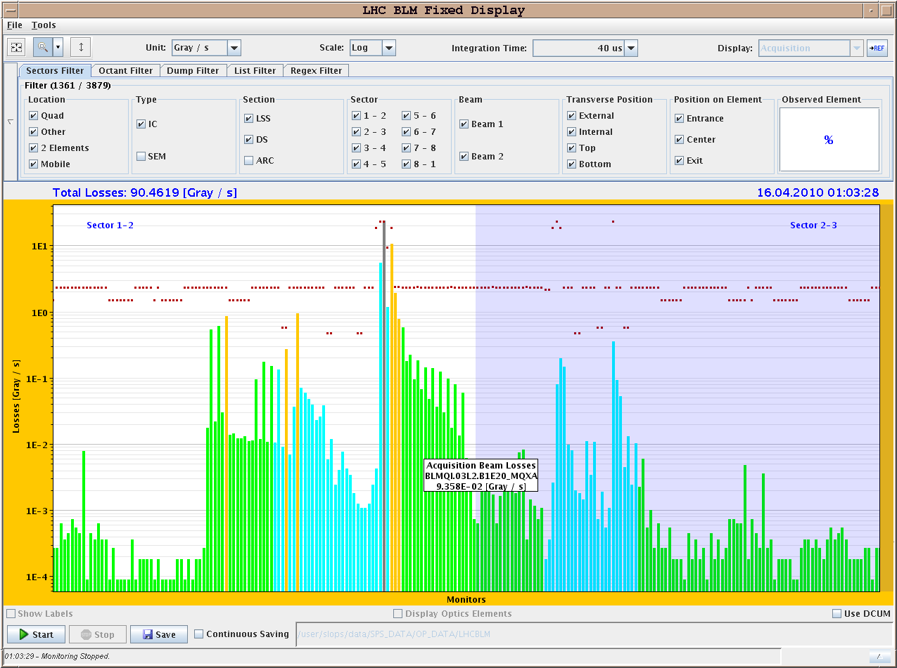
LHC ring losses with over-injection
Example of over-injection of 1E11 – 40 us integration
Losses from over-injection
Losses from TL
collimators (X-talk)
TDI

Slide 12
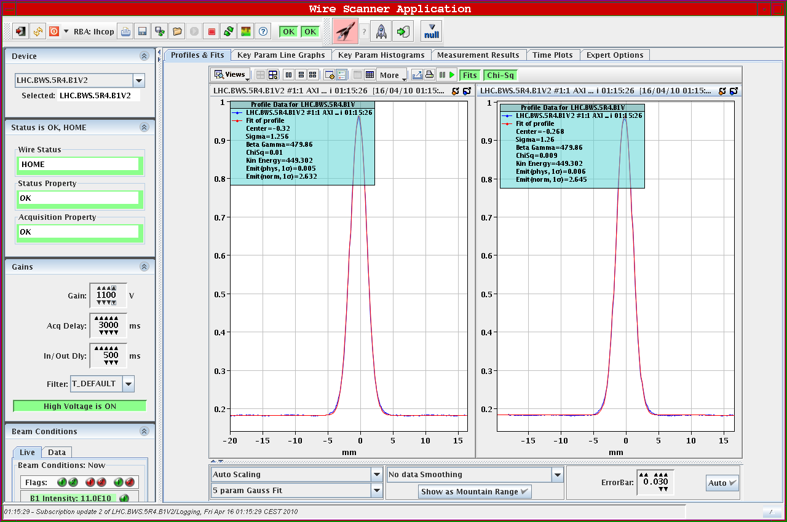
Thursday 15.4.
Beam1 Emittances for 1 10¹¹: ε_{h}= 2.8 μm, ε_{v} = 2.6 μm

Slide 13
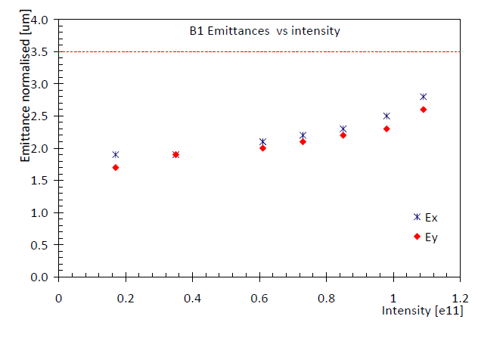
Thursday 15.4.
Emittances versus bunch intensity:

Slide 14
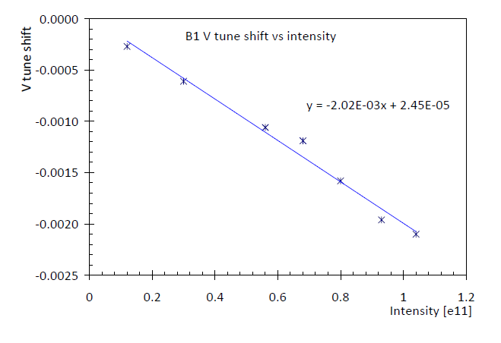
Thursday 15.4.
Tune shift versus bunch intensity:

Slide 15
15.4.
06:00: Physics fill for the night
Plan for the morning:
  Continue preparation of ‘stable beam’ operation with squeezed optics.
Afternoon:
  access: Quench heater problem in S67, Cryo temperature sensor for RQTL9.67; PO for missing orbit correctors; CMS, ALICE, and TOTEM; LBDS. All access should be finished within 3h; Compensator Pt8 (switch ON).
  Continuation of LBDS studies or second ramp with squeeze.
Night:
  Physics fill.
Weekend:
  Continuation with preparations for higher beam intensities.
  Physics fills over night.

