Slide 1
Planning at 5 o’clock meeting Friday
FR | M | 8 |  | Access
FR | A | 8 |  | Recover
FR | N | 8 |  | Kick-response campaign
SA | M | 8 |  | Initial commissioning of beam dumping system, beam 1 and 2 | B1/B2
SA | A | 8 |  | Key beam parameters revisited - beam 1 & 2, beam size etc. measure & correct tune, chromacity, coupling both beams | B1/B2, pilot
SA | N | 8 |  | Optics measurements (beta beating meas and correct)
SU | M | 8 |  | Protection devices and collimator setting-up - b2/b1 | B1/B2, pilot
SU | A | 4 |  | MPS tests: FMCM, time delays | B1/B2
SU | A | 4 |  | Trial ramps | B1, pilot
SU | N |  |  | Kick-response campaign
MO | M | 8 |  | Solenoids/coupling compensation | pilot, b1
MO | A | 8 |  | MPS: BLM thresholds - check plus thresholds and checks on beam dump BLMs | B1/B2 pilots
MO | N | 8 |  | Aperture measurements | pilot, B2
TU | M | 8 |  | Two Beam Operation setting-up - 450 GeV - bumps | 2x2, 5e9
TU | A | 8 |  | MPS: aperture in insertion regions, Calibration/check of triplet BLMs, experiment dump tests with BCM | pilot
TU | N | 8 |  | Aperture measurements | Solenoids & dipoles ON
WE | M | 8 |  | MPS: provoke magnet 'trip' and check adequate protection by collimators | pilot
WE | A | 8 |  | 450 GeV collision setting-up - experiments | 2x2, 2e10
WE | N | 8 |  | 450 GeV collisions | 2x2, 2e10

Slide 2
Friday
Recovering from cryo PLC problem S34 (02.00)
Limited access in the shadow for essential things
TCDQ issue understood (IN<->OUT)
Cryo S34 back at 18.00
Still problems to get all QPS OK
S45 access needed
Pre-cycling sectors when possible
Finally all (needed) circuits OK at 23.00
Struggled with the injection interlock system
Beam in around 01.30
Overnight
Re-established conditions for beams 1 and 2
Kick response beam 2 (sectors 12 23 34 45 done)
Beam dumps due to beam loss when starting sector 56
PS off from 04-07

Slide 3
Saturday
Beam dump studies started around 08.00
Synchronisation checked with beam by scanning RF bucket through sweeps for B1 and B2: beam 2 system looks spot on, beam 1 kick is too late by about 1μs - need to adjust to exact value with access to UA when opportune - in the meantime should use RF bucket 500 to make sure beam is extracted (bucket 1 ends up on TCDS and will provoke interlock).
Protection devices and aperture scans
Aperture scanned for B1 extraction channel
Apertures look similar to those obtained for B2 on Monday
Physical apertures seem OK on both planes
Verification of the protection in case of asynchronous dump

Slide 4
Saturday
Orbit
Reference orbit B1 and B2 using common correctors
Tune, coupling and chromaticity measurement and correction
C_ down to ~0.005 (Beam 1)/0.0025 (Beam 2) after correction
Chromaticity
Measured values from +- 100, 50,0 trims off ref Beam 1 ➔ Q’_{H}=+5 - Q’_{V}=+7 Beam 2 ➔ Q’_{H}=+9 - Q’_{H}=+8
Undulator RU.L4 ON at 50 A:
no effect on orbit/tune (Beam 2) ➔ but not sufficient to see synch light ➔ HW commissioning to be continued

Slide 5
Saturday
BI commissioning summary
phased in horizontal and vertical MKQA tune kicker for B1 and B2
measured and corrected PLL beam transfer function for B1 and B2 system (B2 requires some polarity/mapping checks)
tested continuous radial modulation via the orbit feedback controller and verified switch on/off procedures, frequency and amplitudes behaviour
performed initial PLL lock studies with B1, initial results look very promising, further assessment w.r.t. nominal PLL performance (bandwidth/sensitivity to resolve dp/p changes in the order of 1e-5) is needed
performed semi-automatic chromaticity measurements and preliminary tune modulation/de-modulation studies in view of continuous Q' tracking -> some FESA/SW issues have been identified that need to be addressed
Not yet ready for tune/chromaticity feedback

Slide 6
Saturday/Sunday
Summary of beta-beating studies:
The beta-beating in beam2 was very different to the beta-beating measured before the ramp (most likely due to the lack of precycling then).
For Beam1 the initial beta beating agrees with the measured after the ramp (Friday 00:00 am), proving no changes in time with proper pre-cycling.
The first local error was found and successfully corrected in IP2 (MQXB2.R2 + 7e-5 and MQXB2.L2 -5e-5). A reduction of the peak vertical beta-beating in beam 1 of 10% was observed. No change was observed in the peak b-beat in beam 2 and the horizontal of beam1.
We removed all the trims and re-measured the initial conditions without observing any change (no hysteresis effects).
Another study in IP7 was started but due to lack of time and frequent beam absence was not conclusive.

Slide 7
Sunday
Summary collimation setup: BEAM1: => All IR3, IR7 to nominal settings (primary aperture about 5.7 sigma) ==> multi-stage collimation is set up ==> Dump protection IR6 set up ==> TCT's in IR1 cross-checked: rough setting confirmed ==> Other TCT's not touched: at +-15 mm around +-15-25 sigma BEAM2: ==> All IR3, IR7 to nominal settings (primary aperture about 5.7 sigma) ==> mutli-stage collimation is set up ==> Dump protection IR6 set up ==> TCT's not touched: at +-15 mm around +-15-25 sigma Additional tests: ==> Check on interlock threshold for tungsten collimators (see logbook entry) ==> Movement and beam loss response check for vertical Roman Pots, beam1

Slide 8
Sunday
MPS checks
FMCM reaction checks etc
Ramp tests
Second LHC ramp with beam 1 to 1.04 TeV
Tunes feed forward for next time
Machine did not come back (no pre-cycle)
Tunes off for beam 1
Tunes trimmed (beam 1) and incorporated into ramp
Third ramp with both beams to 1.18 TeV !!
Problem with patrol box in ATLAS 2-4
Injected again around 6
Beam 2 OK
Beam 1 tunes wrong

Slide 9
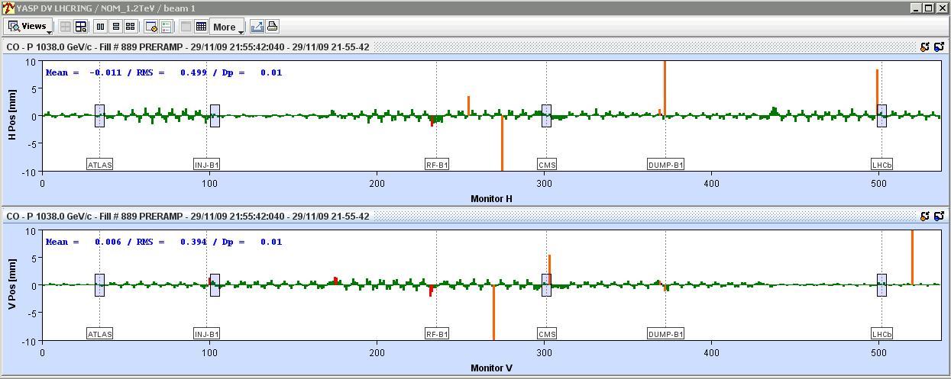
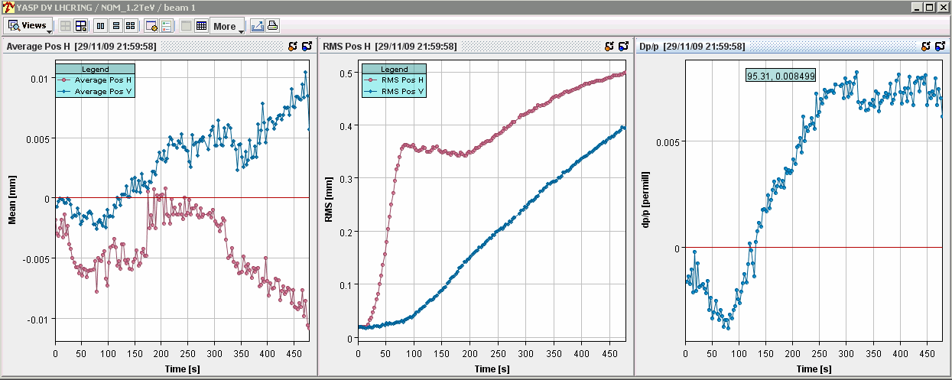
Ramp 2 orbits

Slide 10
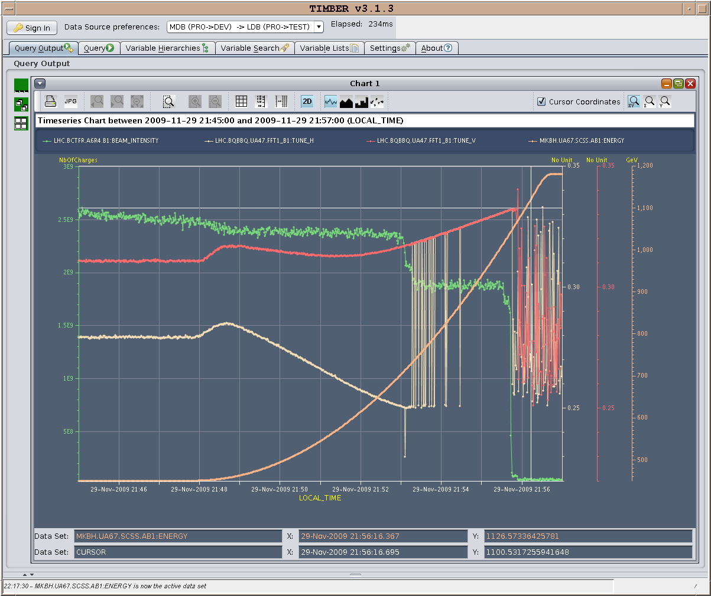
Ramp 2 tunes

Slide 11
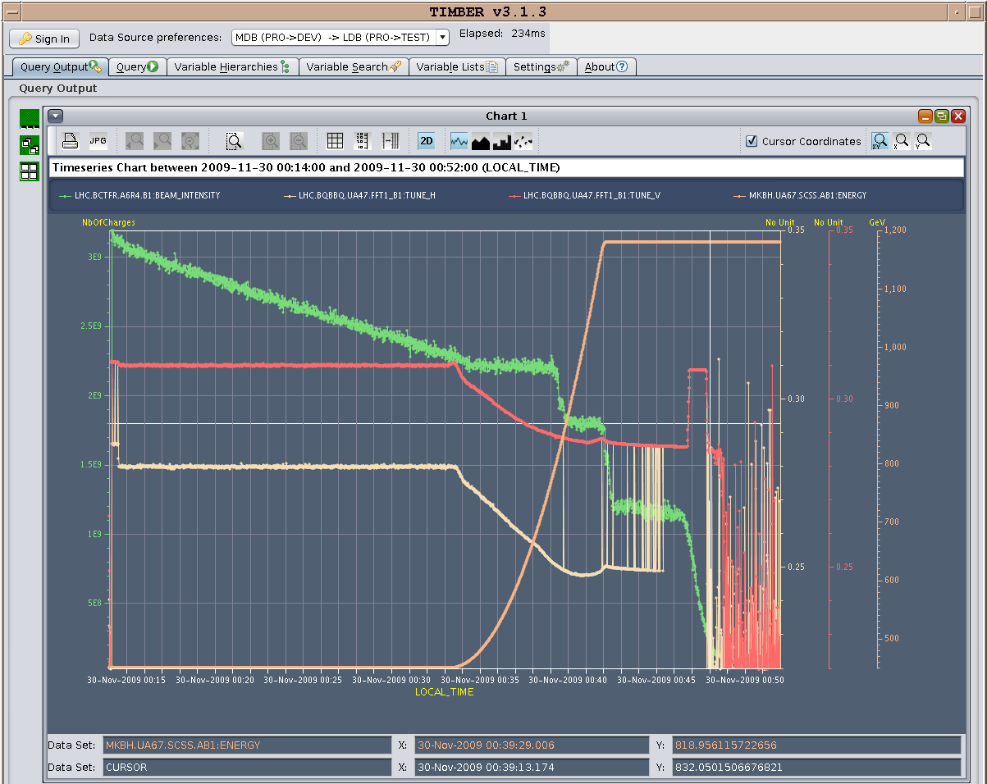
Ramp 3 tunes B1

Slide 12
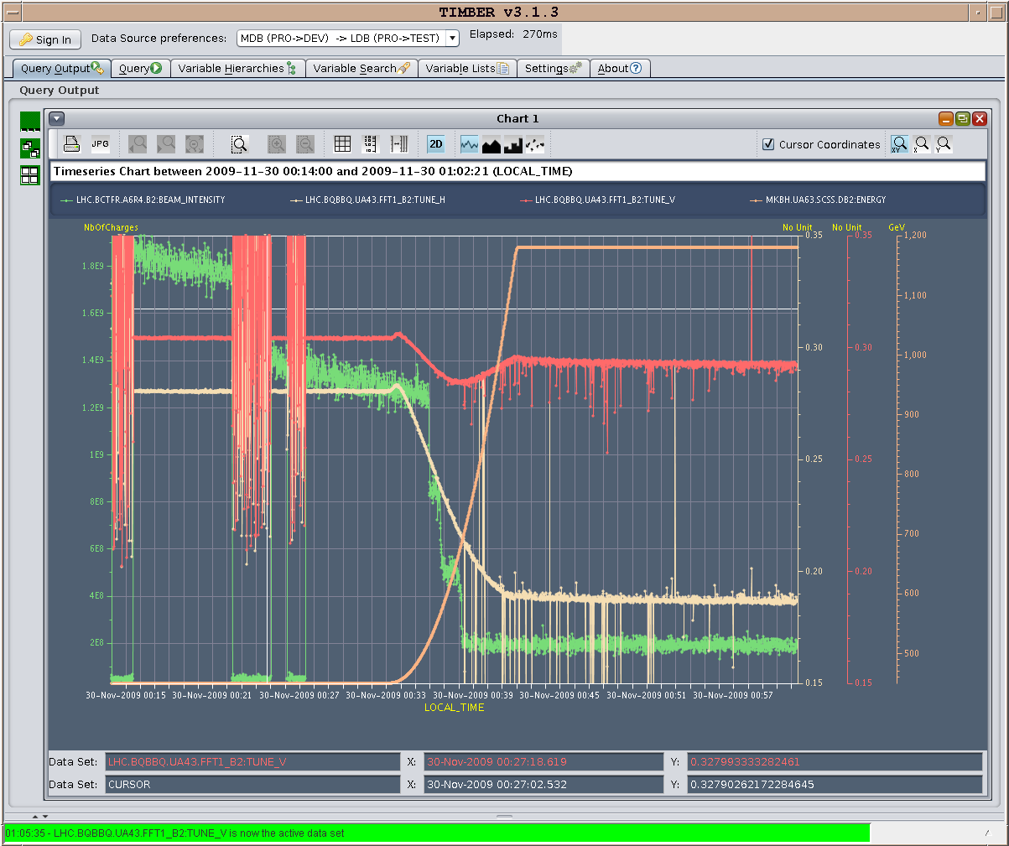
Ramp 3 tunes B2

