Slide 1
LHC machine status
LHCC 3rd June 2015
Mike Lamont for the LHC team

Slide 2
In parallel with sector by sector cool-down

Slide 3
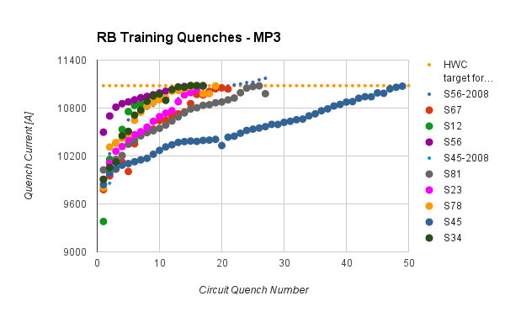
Dipole training 1/2
154 dipoles per sector, powered in series
Ramp the current until single magnet quenches - “training quench”
Usually quench 3 – 4 other dipoles at the same time
Cryogenics recovery time: 6 – 8 hours

Slide 4
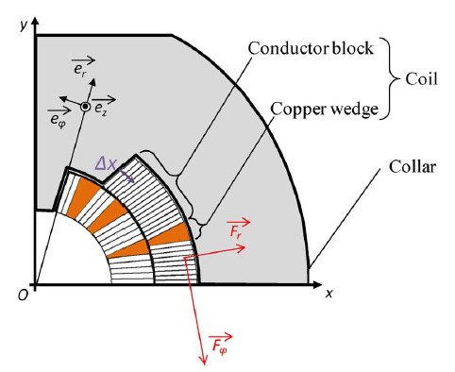
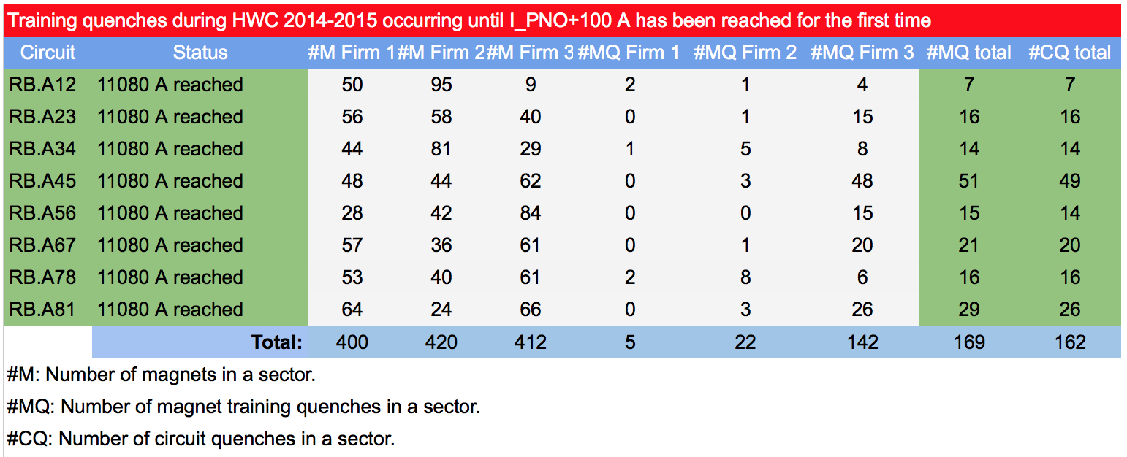
Dipole training 2/2
Training: frictional energy released during conductor motion
Campaign summary
All magnets have been trained to well over 7 TeV in SM18 before installation
Extensive re-training in situ was not expected

Slide 5
LHC - 2015
Target energy: 6.5 TeV
looking good
Bunch spacing: 25 ns
strongly favored by experiments (pile-up limit around 50)
Beta* in ATLAS and CMS: 80 to 40 cm
Energy
25 ns
Lower quench margins
Lower tolerance to beam loss
Hardware closer to maximum (beam dumps, power converters etc.)
Electron-cloud
UFOs
More long range collisions
Larger crossing angle, higher beta*
Higher total beam current
Higher intensity per injection

Slide 6
LHC bunch structure - 2015
25 ns bunch spacing
~2800 bunches
Nominal bunch intensity 1.15 x 10¹¹ protons per bunch
1 PS batch
(72 bunches)
1 SPS batch
(288 bunches)
Abort gap
26.7 km 2800 bunches
New limits of ~2 PS batches per injection from the injection protection absorbers – will reduce the maximum number of bunches to around 2500

Slide 7
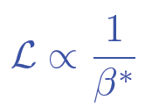
2015: beta* in IPs 1 and 5
Many things have changed. Start carefully and push performance later.
Start-up: β*= 80 cm – (very) relaxed
2012 collimator settings
11 sigma long range separation
Aperture, orbit stability… checks ongoing
Ultimate in 2015: β*= 40 cm
Possible reduction later in the year

Slide 8
2015 commissioning strategy
Low intensity commissioning of full cycle – 8 weeks
Pilot physics – low number of bunches
Special physics run: LHCf and luminosity calibration
Scrubbing for 50 ns
Intensity ramp-up with 50 ns
Characterize vacuum, heat load, electron cloud, losses, instabilities, UFOs, impedance
Scrubbing for 25 ns
Ramp-up 25 ns operation with relaxed beta*
Possibly commission lower beta*
25 ns operation

Slide 9
2015 Q2
FIRST BEAM 5th APRIL
FIRST STABLE BEAM 3rd JUNE
SCRUBBING FOR 50 ns
PILOT PHYSICS
8 weeks beam commissioning
Pilot physics – up to at least 40 bunches per beam
5 days special physics at beta* = 19 m (VdM, LHCf, TOTEM & ALFA)
Start technical stop – 15th June

Slide 10
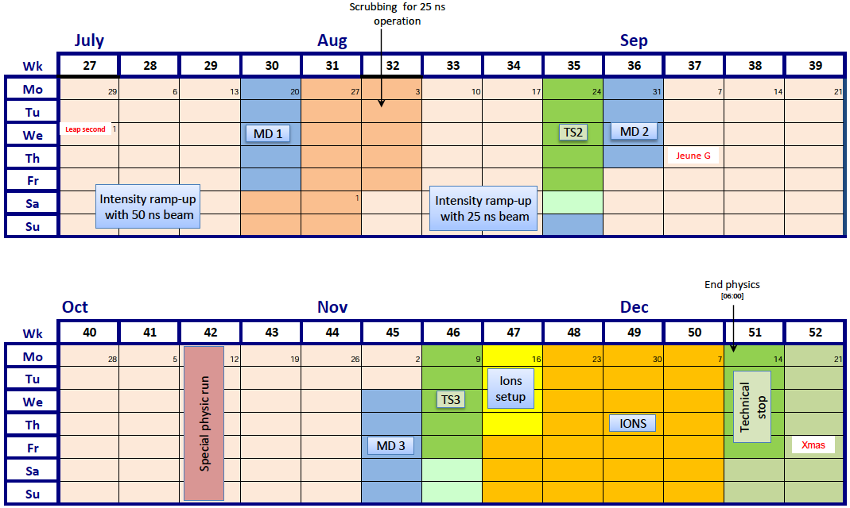
Q3/Q4 2015
SCRUBBING FOR 25 ns

Slide 11
2015 – latest schedule
Phase | Days
Initial Commissioning | 57
Scrubbing | 23
Special physics run 1 (LHCf/VdM) | 5
Proton physics 50 ns | 9 + 21
Proton physics 25 ns | 70
Special physics run 2 (TOTEM/VdM) | 7
Machine development (MD) | 15
Technical stops | 15
Technical stop recovery | 3
Ion setup/Ion run | 4 + 24
Total | 253 (36 weeks)

Slide 12
Schedule - comments
Picked up some 4 weeks delay from:
Powering tests/quench training overrun
Earth fault resolution
Proton-proton physics down to 70 days
Decrease in beta* to be reviewed after gaining some experience (although considerable progress made during commissioning)
Ion program unaffected
Proton-proton reference data will be difficult to squeeze in

Slide 13
Commissioning
Injection - probe
Ramp - probe
System commissioning with beam
Collimation
Beam dump
Feedbacks
Beam instrumentation
Machine protection
RF
Transverse damper
Injection
Machine characterization
Optics measurement and correction
Magnetic machine
Operations
High intensity injection
Ramp to 6.5 TeV
Squeeze
Flat-top - probe
Squeeze - probe
Injection - nominal
Ramp - nominal
Flat-top - nominal
Squeeze - nominal
Complete
Ongoing
Collide & validation

Slide 14
Milestones
Circulating beam | Sunday 5th April
Ramp to 6.5 TeV | Friday 10th April
First 13 TeV collisions | Wednesday 20th May
First Stable beams | Wednesday 3rd June
Working throughout with:
probes (5e9 protons per bunch) or
1 or 2 nominals (1.2e11 protons per bunch)
THIS IS NOT BAD!

Slide 16
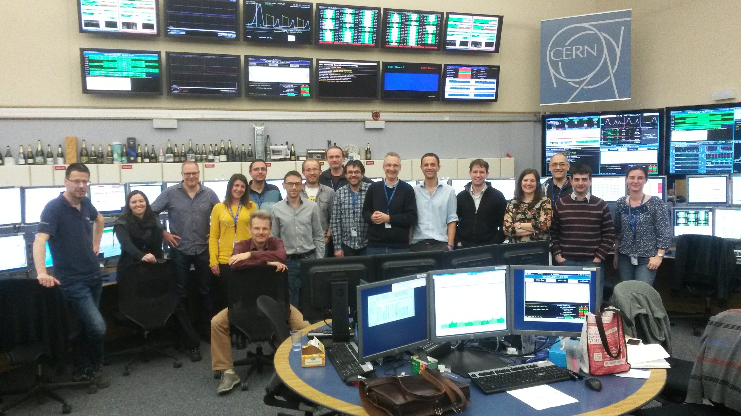
6.5 TeV for the first time
01:03 10th April

Slide 17
21st May
2 nominal bunches per beam
De-squeezed to 19 m

Slide 18
First Stable Beams
This morning
07:00 Injection delayed
Issue with interlocked BPM
SPS beam dump kicker fault
08:25 Start ramp
08:38 Beams dump at 4.1 TeV
Software interlock related to interlock BPM fix!
09:46 Start ramp
10:15 Start squeeze
10:40 Stable beams

Slide 20
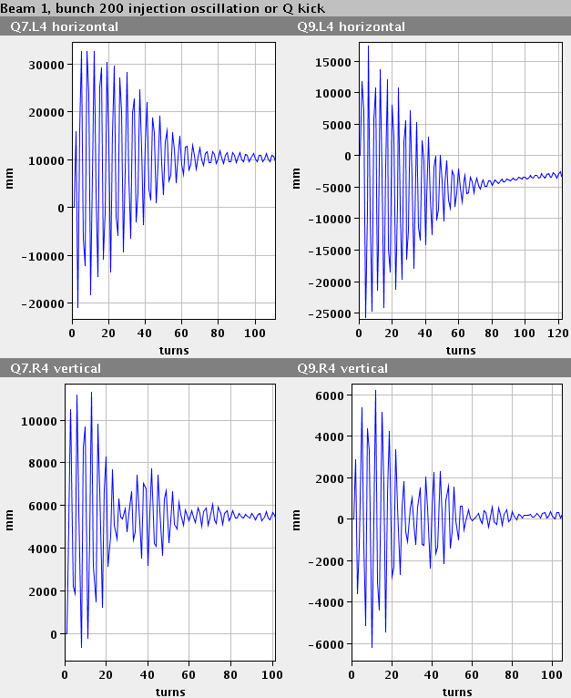
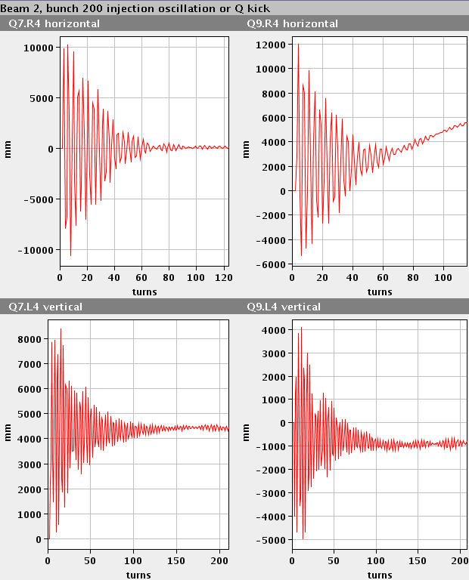
Of note 1/2
A lot of lessons learnt from Run 1
Excellent and improved system performance:
Beam Instrumentation
Transverse feedback
RF
Collimation
Injection and beam dump systems
Vacuum
Machine protection
Improved software & analysis tools
Experience!

Slide 21
Of note 2/2
Magnetically reproducible as ever
Optically good, corrected to excellent
Aperture
measurements at top energy, 80cm, before and after collision indicate that the aperture is ok and compatible with the present collimation hierarchy. This is a very good result.
Behaving well at 6.5 TeV
One additional training quench so far
Operationally well under control
Injection, ramp, squeeze, de-squeeze
Still have to face the intensity ramp-up
UFOs, e-cloud, vacuum, beam induced heating, instabilities

Slide 22
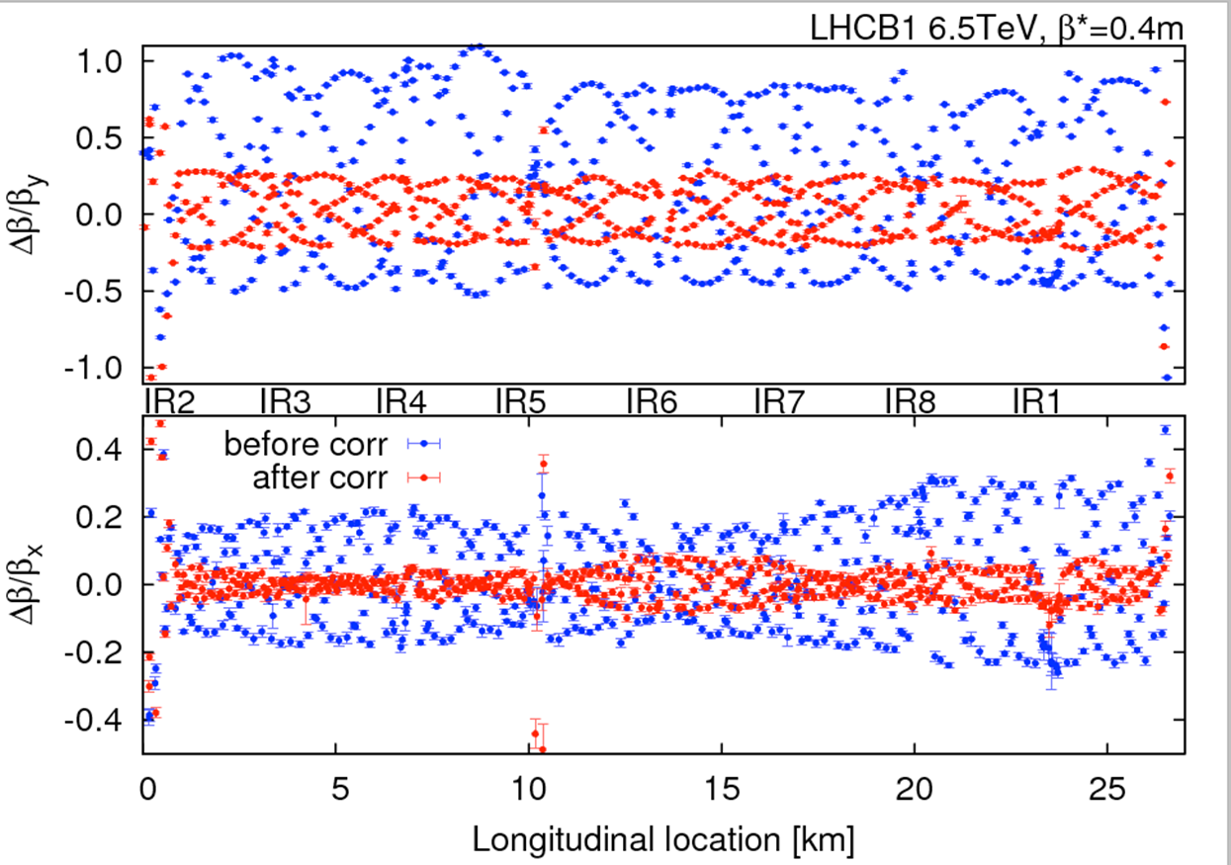
Optics - 40 cm
OMC team

Slide 24
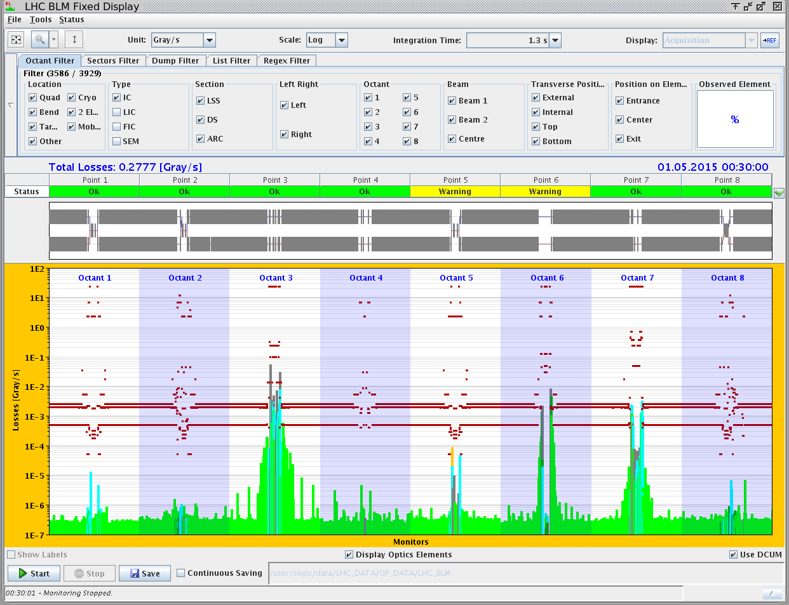
Off momentum loss map 6.5 TeV
Novel features of collimation system – BPM equipped tertiary collimators, automatic beam based set-up

Slide 25
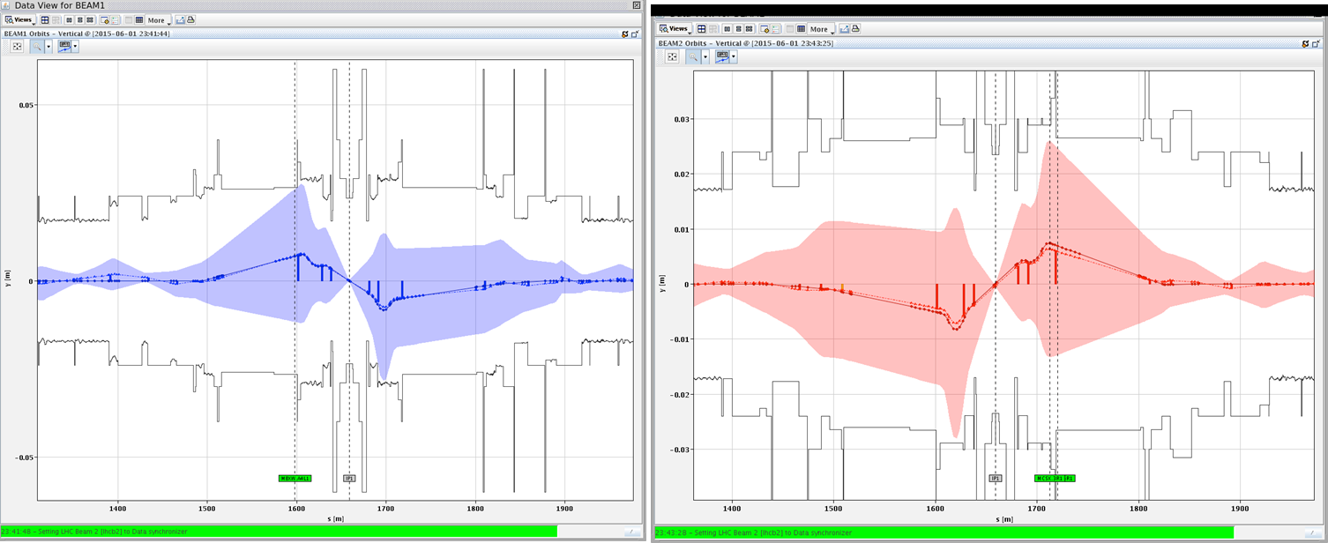
Aperture

Slide 26
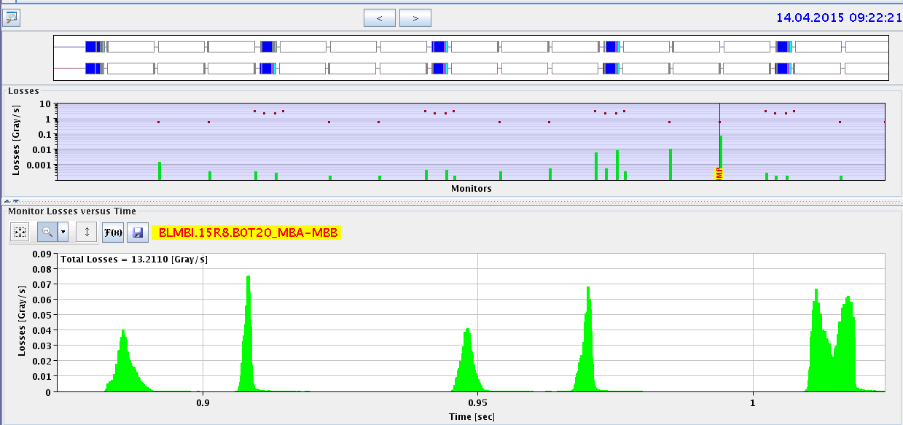
MUFOs in 15R8
quench
B2
B1
X
Q14
Q15
highest
loss
Multiple loss events after a short time at 6.5 TeV compatible with particles falling into the beam
loss patterns point to a specific position in the middle of a dipole magnet
Quenched twice, numerous BLM triggered dumps…

Slide 27
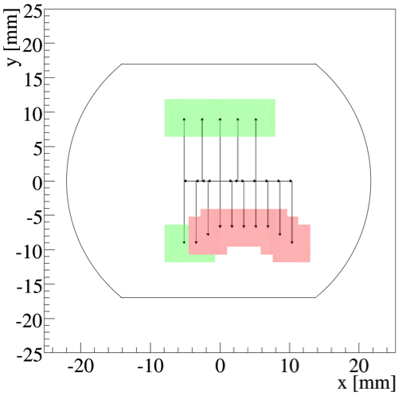
Aperture restriction in 15R8
ULO (Unidentified Lying Object)
Aperture restriction measured at injection and 6.5 TeV
Presently running with orbit bumps
-3 mm in H, +1 in V, to optimize available aperture
aperture probably not limiting for operation
Behaviour with higher intensities and bunch trains still unknown
MUFOs went away but last week
D. Mirarchi

Slide 28
This following a 15R8 aperture scan. A worry.

Slide 29
2015: ATLAS and CMS performance
Conservative beta* to start
Nominal bunch population
Reasonable emittance into collisions
Assume same machine availability as 2012
 | Nc | Beta* | ppb | EmitN | Lumi [cm⁻²s⁻¹] | Days (approx) | Int lumi | Pileup
50 ns | 1300 | 80 | 1.2e11 | 2.5 | 4.8e33 | 21 | ~1 fb⁻¹ | 25
2015.1 | 2448 | 80 | 1.2e11 | 3.1 | 7.1e33 | 35 | ~4 fb⁻¹ | 21
2015.2 | 2448 | 40 | 1.2e11 | 3.1 | 1.2e34 | 30 | ~5 fb⁻¹ | 35
Official GPD luminosity target for the year was 10 fb⁻¹
Now on the challenging side – let’s say 5 to 10 fb⁻¹

Slide 30
Special physics runs
First run 5 day run scheduled for next week
LHCf and luminosity calibration with VdM scans. TOTEM and ALFA to piggy-back.
De-squeeze to 19-19-19-24 m commissioned (and test collision delivered)
Roman Pot set-up and validation still to do
Pilot physics and ~10 pb⁻¹ to be delivered before but in good shape
Second 7 day run for later in year
VdM and 90 m run for TOTEM and ALFA
Procedures and tools for set-up in good shape – should allow effective exploitation of scheduled time

Slide 31
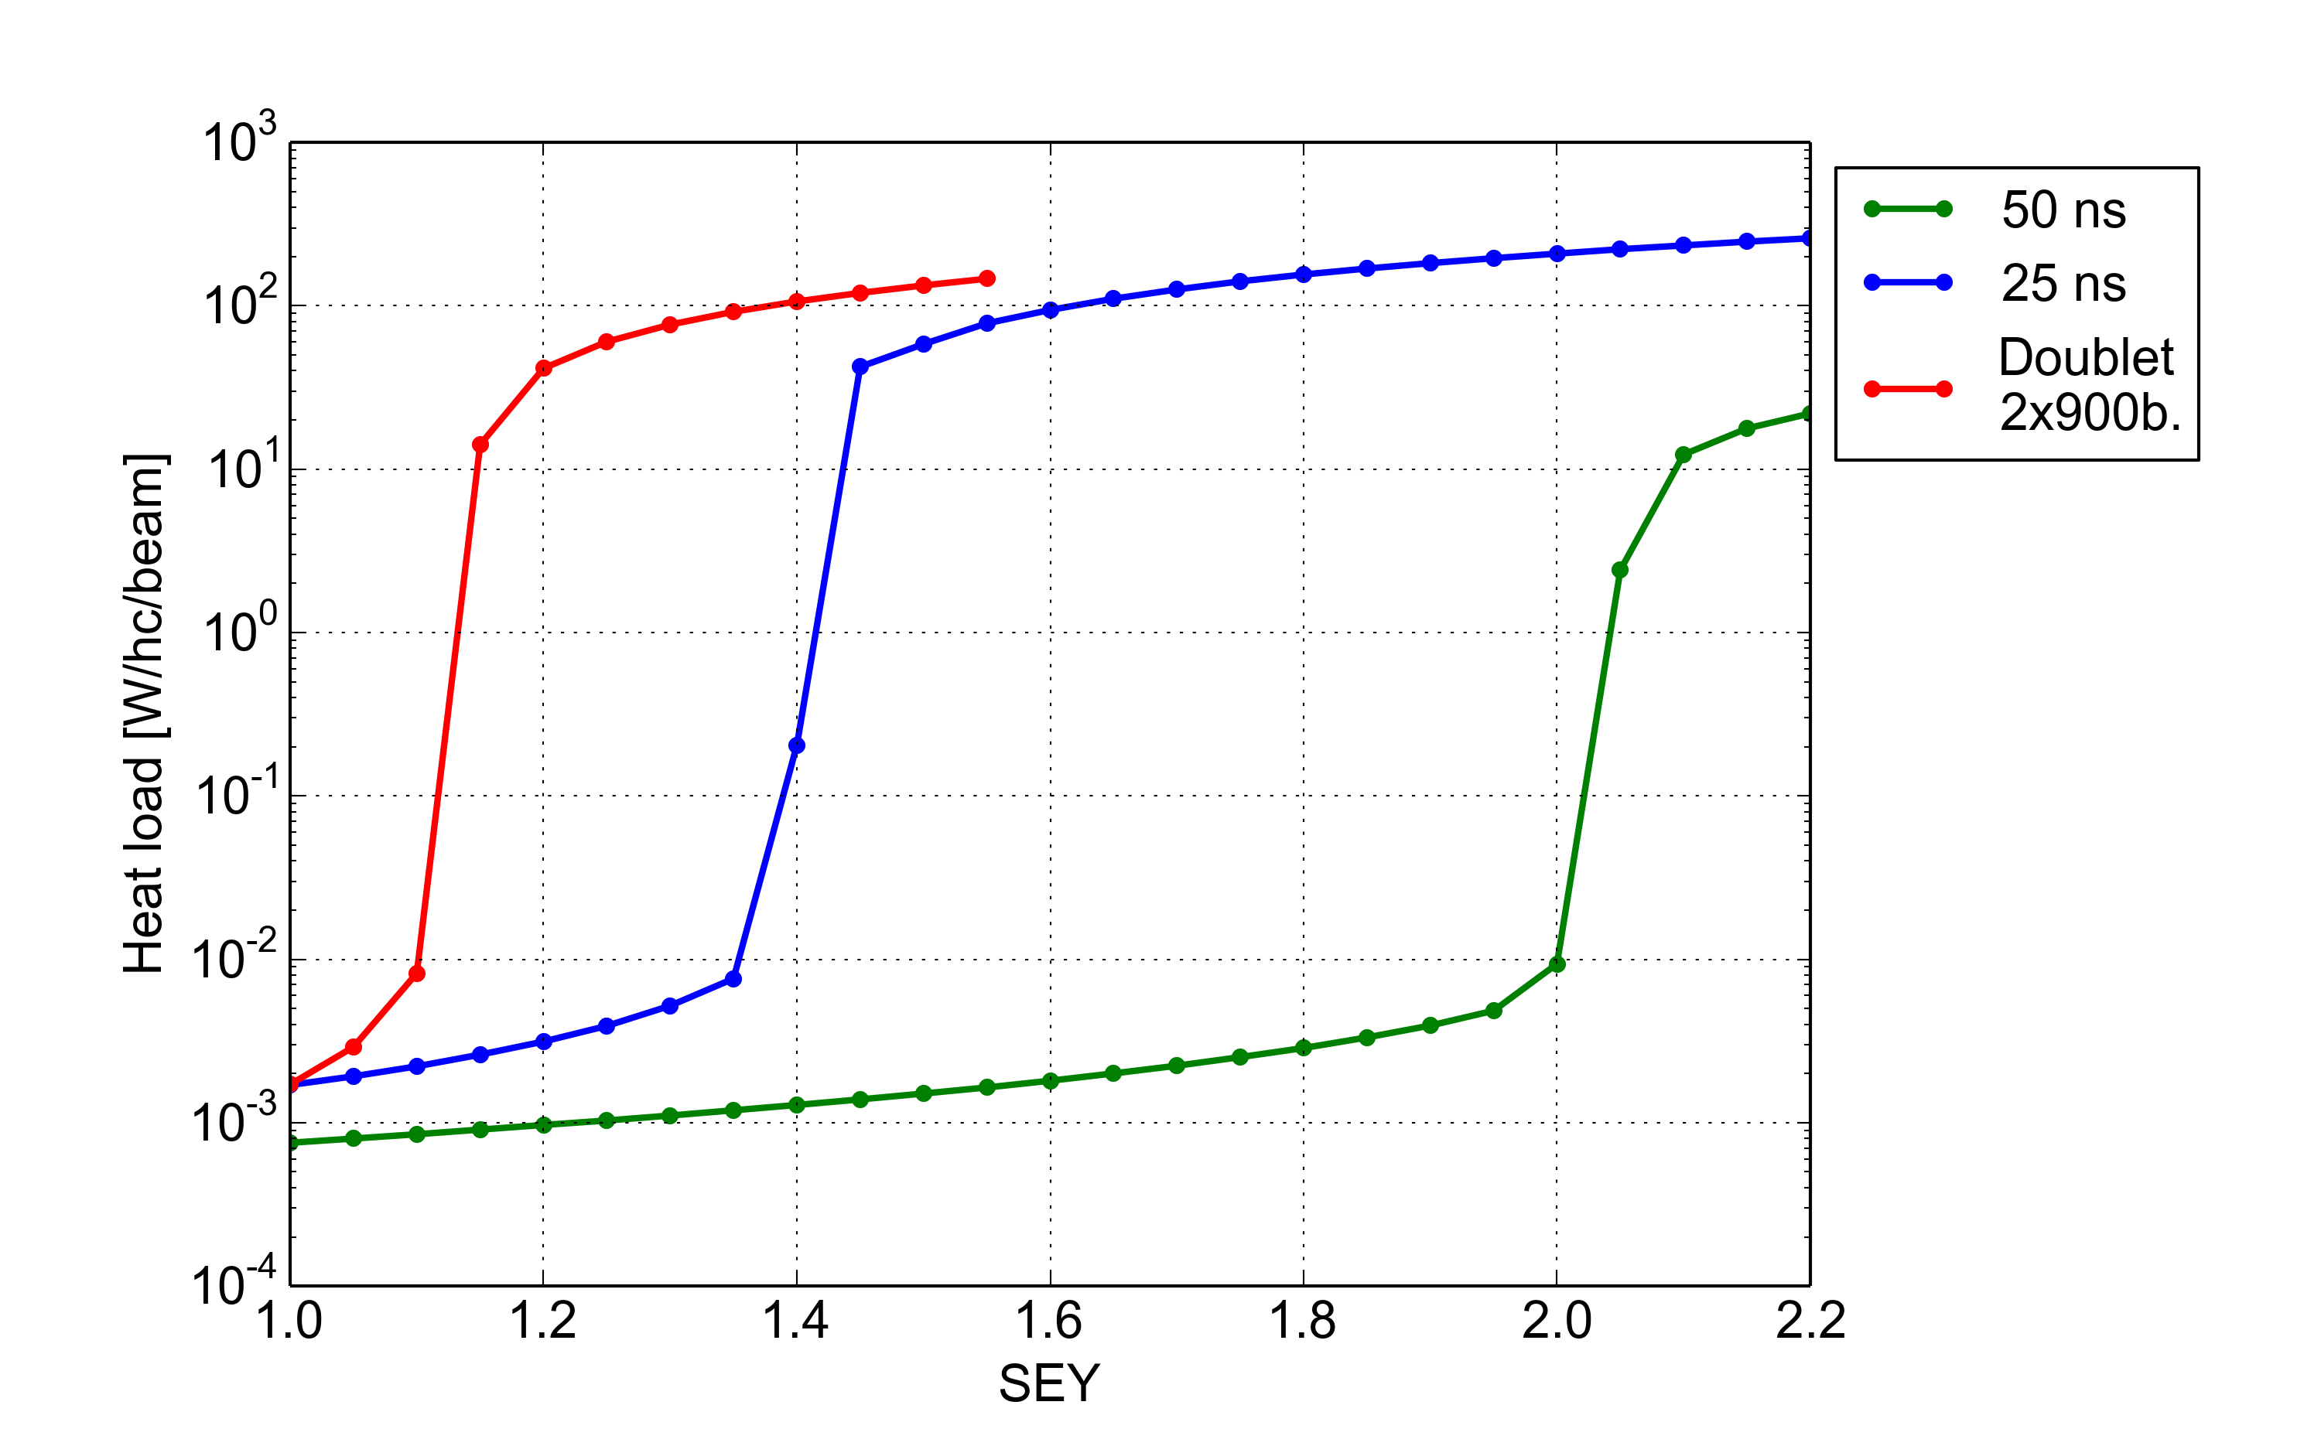
“Doublet” scrubbing beam: PyECLOUD simulation results
Buildup simulations show a substantial enhancement of the e-cloud with the “doublet” bunch pattern
Cryogenics limit
50 ns beam
~1400 bunches
1.7 x 10¹¹ p/b
50 ns
Scrubbing
25 ns Scrubbing
Doublet Scrubbing
25 ns beam
~2800 bunches
1.15 x 10¹¹ p/b
No e-cloud in the dipoles ☺
Doublet beam
~900 doublets
0.7 x 10¹¹ p/b
PyECLOUD simulations for the LHC arc dipoles
Giovanni Iadarola and Giovanni Rumolo

Slide 32
Conclusions
Looking good at 6.5 TeV
Great job done in LS1 and during powering tests
Impressive progress so far, lot of lessons learnt in Run 1 and fed-forward
Fundamentals look sound, no show stoppers for the moment
Some irritants – resolution cost time
Next challenge - higher intensity and e-cloud
2015 will be a short year for proton physics but lay foundations for production for the rest of Run 2

