Slide 1
News from the LHC machine
ATLAS Week: The First 13 TeV Data!
15th June 2015
Mike Lamont for the LHC team

Slide 2
LHC - 2015
Target energy: 6.5 TeV
looking good after a major effort
Bunch spacing: 25 ns
strongly favored by experiments – pile-up
Beta* in ATLAS and CMS: 80 to 40 cm
Energy
25 ns
Lower quench margins
Lower tolerance to beam loss
Hardware closer to maximum (beam dumps, power converters etc.)
Electron-cloud
UFOs
More long range collisions
Larger crossing angle, higher beta*
Higher total beam current
Higher intensity per injection

Slide 3
Nominal LHC bunch structure
25 ns bunch spacing
~2800 bunches
Nominal bunch intensity 1.15 x 10¹¹ protons per bunch
1 PS batch
(72 bunches)
1 SPS batch
(288 bunches)
Abort gap
26.7 km 2800 bunches

Slide 4
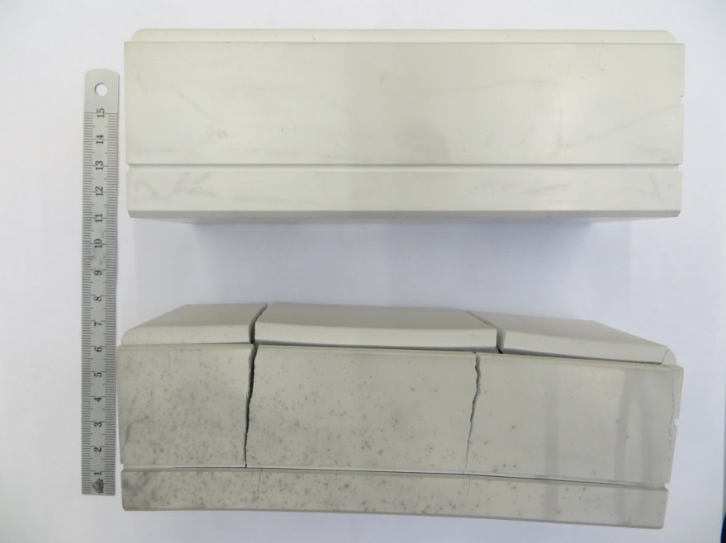
TDI limitations
TDI: movable vertical absorbers – 4.2 m in length – down stream of injection kickers
TDI
SEPTA
KICKERS
Main blocks: h-BN
However during bake-out tests…

Slide 5
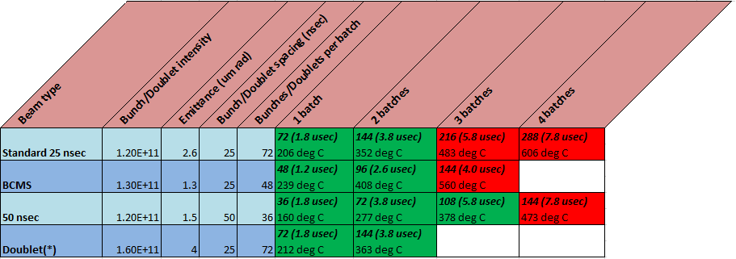
TDI Limits
TDI hBN block cannot withstand temperatures higher than 450 ◦C (B₂O₃ reactant melting temperature) ➔ limit the maximum number of bunches which can hit the TDI (maximum allowed temperature = 400 ◦C )
J. Uythoven A. Lechner
New limits of ~2 PS batches per injection from the injection protection absorbers will reduce the maximum number of bunches to around 2400

Slide 6
TDI limited injection schemes
25 ns nominal
25ns_2388b_2376_2061_2124_144bpi19inj
BCMS
25ns_2076b_2064_1690_1768_96bpi23injB
50 ns
50ns_1230b_1188_51_1083_108bpi13inj
Proposed intensity ramp-up
50ns: 3-12-48-144-288-480-768-1092-1230
25 ns: 3-12-48-72-144-288-432-588-1164-1740-2388

Slide 7
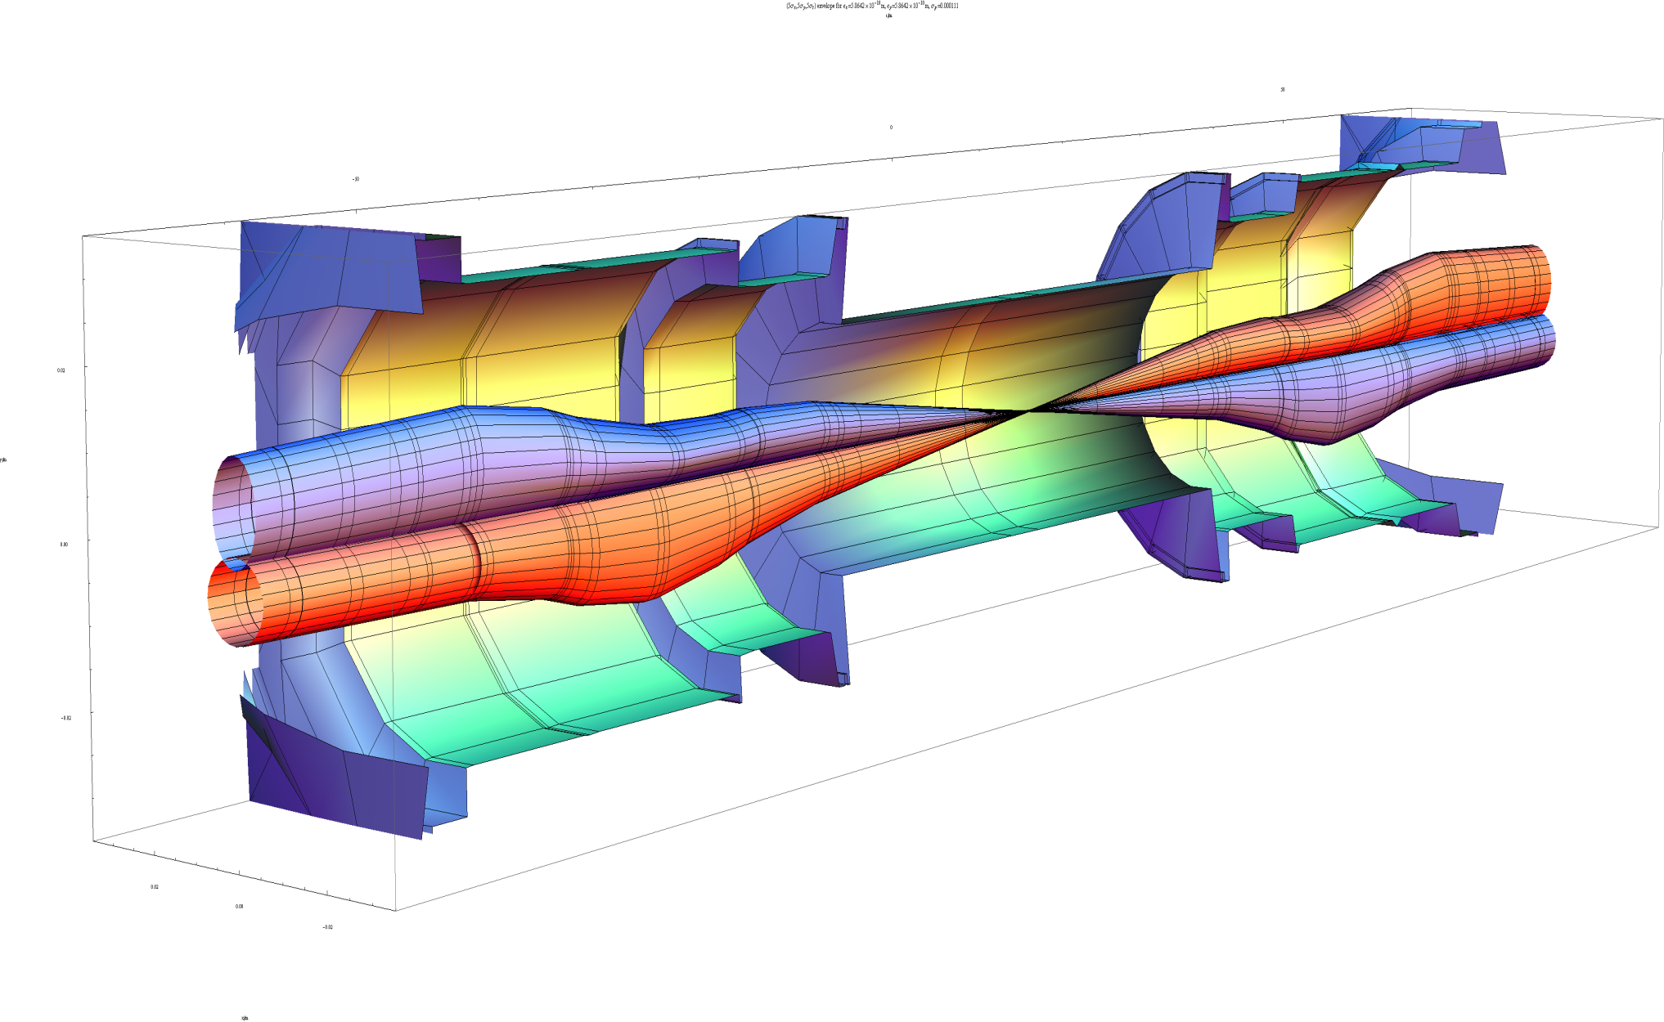
Squeeze in ATLAS
 | β_{triplet} | Sigma triplet | β* | Sigma*
Nominal | ~4.5 km | 1.5 mm | 55 cm | 17 um
HL-LHC | ~20 km | 2.6 mm | 15 cm | 7 um
β* = 55 cm
β* = 15 cm
7 microns
Image courtesy John Jowett

Slide 8
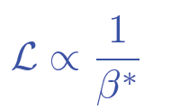
2015: beta* in IPs 1 and 5
Many things have changed. Start carefully and push performance later.
Start-up: β*= 80 cm – (very) relaxed
2012 collimator settings
11 sigma long range separation
Aperture, orbit stability… looking good
Ultimate in 2015: β*= 40 cm
Possible reduction later in the year

Slide 9
2015 commissioning strategy
Low intensity commissioning of full cycle – 8 weeks
Pilot physics – low number of bunches
Special physics run: LHCf (and luminosity calibration)
Scrubbing for 50 ns
Intensity ramp-up with 50 ns
Characterize vacuum, heat load, electron cloud, losses, instabilities, UFOs, impedance
Scrubbing for 25 ns
Ramp-up 25 ns operation with relaxed beta*
Possibly commission lower beta*
25 ns operation with lower beta*

Slide 10
2015 Q2
FIRST STABLE BEAM 3rd JUNE
SCRUBBING FOR 50 ns
FIRST BEAM 5th APRIL
PILOT PHYSICS
8 weeks beam commissioning
Pilot physics – up to ~40 bunches per beam
5 days special physics at beta* = 19 m LHCf, (VdM, TOTEM & ALFA - postponed)
Start technical stop – 15th June

Slide 11
Commissioning
Injection - probe
System commissioning with beam
Collimation
Beam dump
Feedbacks
Beam instrumentation
Machine protection
RF
Transverse damper
Injection
Machine characterization
Optics measurement and correction
Magnetic machine
Aperture
Operations
Inject, ramp, squeeze, collide
Ramp - probe
Flat-top - probe
Squeeze - probe
Injection - nominal
Ramp - nominal
Flat-top - nominal
Squeeze - nominal
Huge thanks due to the teams involved
Collide & validation

Slide 12
Milestones
Circulating beam | Sunday 5th April
Ramp to 6.5 TeV | Friday 10th April
First 13 TeV collisions | Wednesday 20th May
First Stable beams | Wednesday 3rd June
Working throughout with:
probes (5e9 protons per bunch) or
1 or 2 nominals (1.2e11 protons per bunch)
NOT BAD

Slide 13
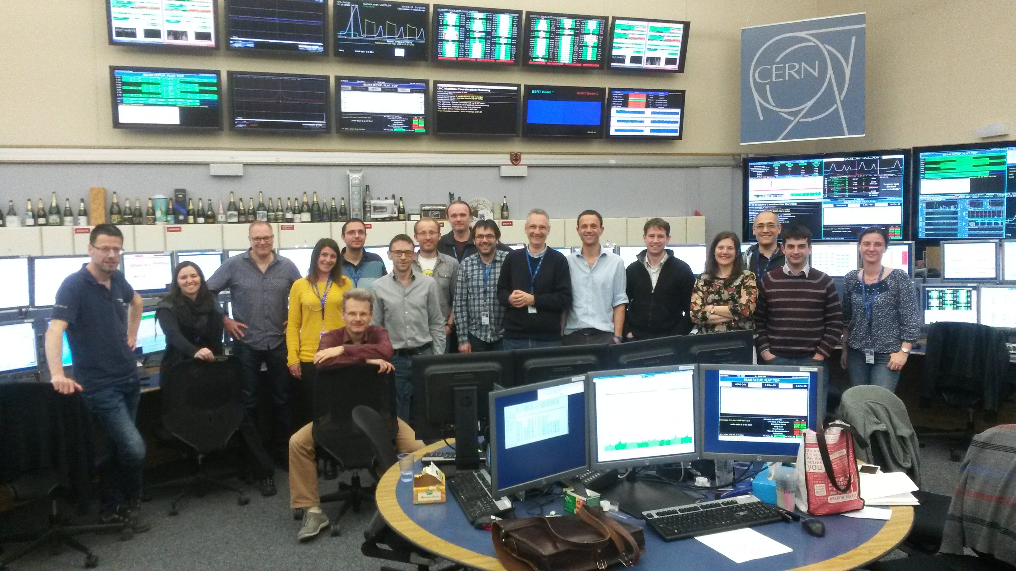
6.5 TeV for the first time
01:03 10th April

Slide 14
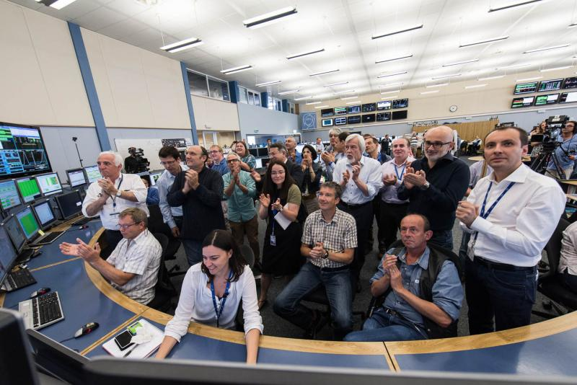
10:40 3rd June

Slide 15
LHCf
Target: 10 nb⁻¹
fill | Stable beams | nb⁻¹ | bun
3846 | 1h55m | 0.1 | 39 pilots
3847 | 2h16m | 0.28 | 39 pilots
3848 | 2h42m | 0.91 | 12 nominal
3850 | 2h49m | 1.95 | 39 nominal
3851 | 11h13m | 6.81 | 39 nominal
3855 | 14h15m | 6.49 | 39 nominal

Slide 16
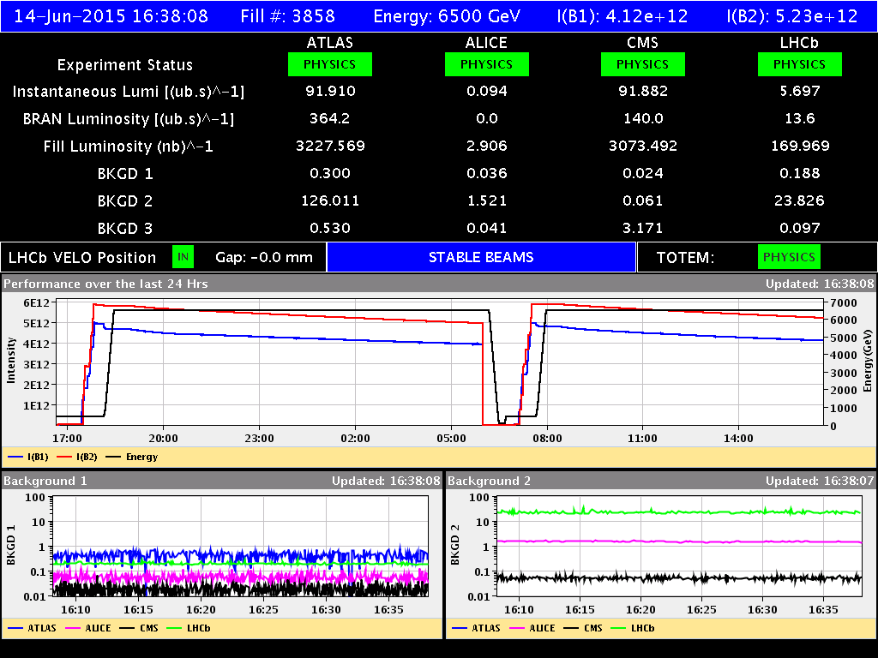
Last weekend: fills 3857 & 3858
Number of bunches | 50
Number of colliding bunches (ATLAS/CMS) | 38
Peak luminosity | 1.45 x 10³² cm⁻²s⁻¹
Integrated luminosity | 3.8 + 3.5 pb⁻¹
Peak <Events>/BX | ~27

Slide 17
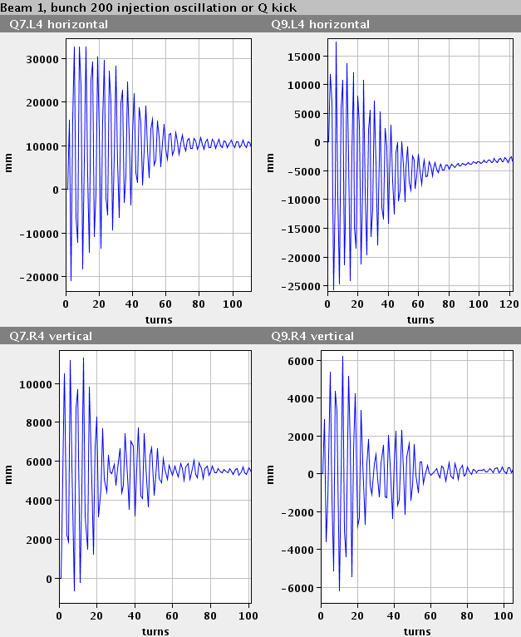
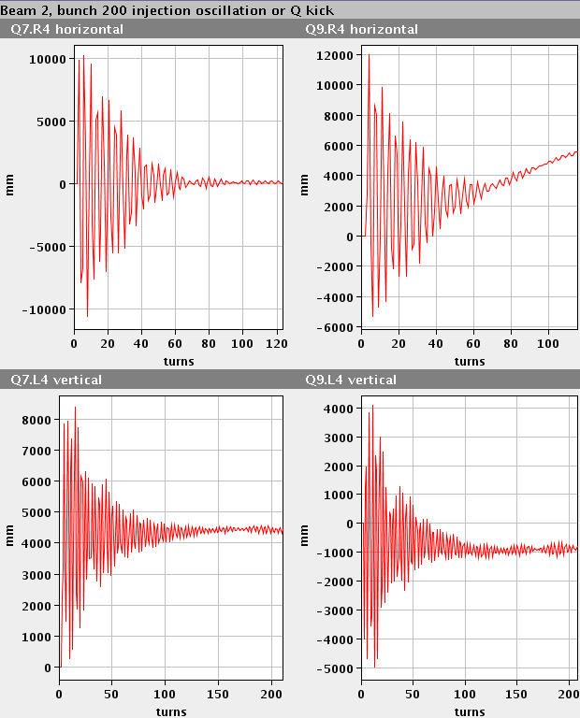
Of note 1/2
A lot of lessons learnt from Run 1
Excellent and improved system performance:
Beam Instrumentation
Transverse feedback
RF
Collimation
Injection and beam dump systems
Vacuum
Machine protection
Improved software & analysis tools
Experience!

Slide 18
Of note 2/2
Magnetically reproducible as ever
Optically good, corrected to excellent
Aperture
measurements at top energy, 80cm, before and after collision indicate that the aperture is ok and compatible with the present collimation hierarchy. This is a very good result.
Behaving well at 6.5 TeV
Two additional training quenches so far
Operationally well under control
Injection, ramp, squeeze, de-squeeze
Still have to face the intensity ramp-up
UFOs, e-cloud, vacuum, beam induced heating, instabilities

Slide 19
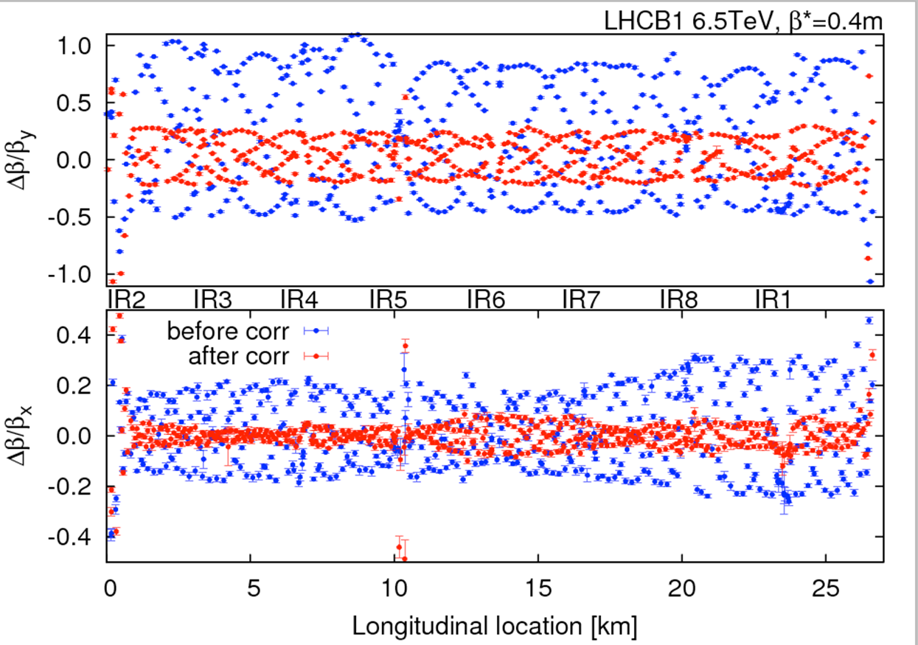
Optics - 40 cm
OMC team

Slide 21
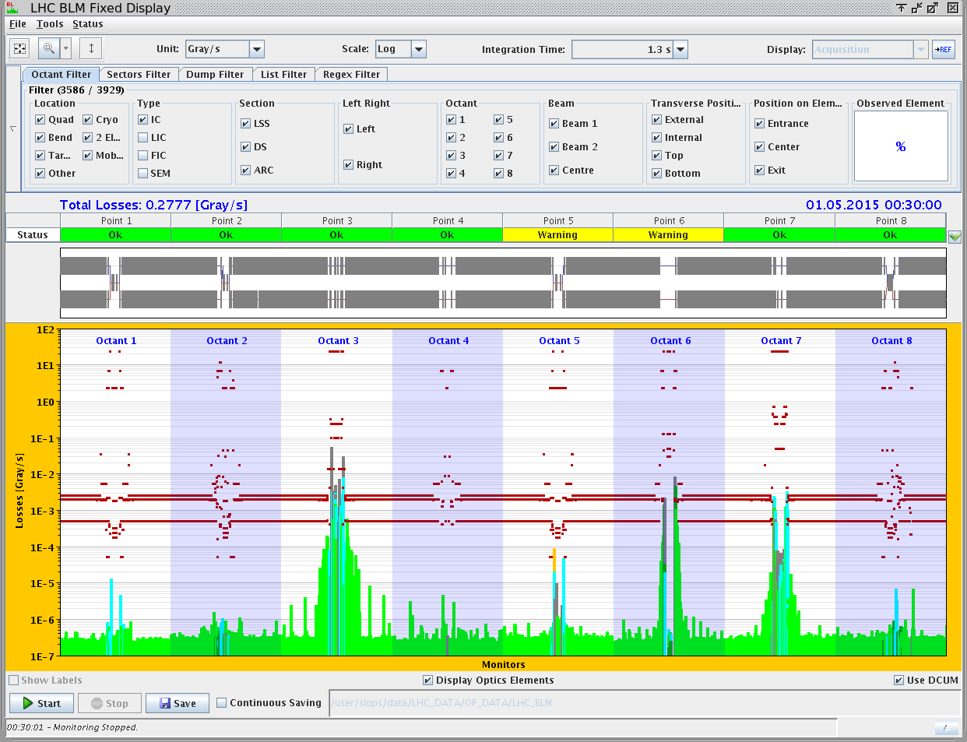
Off momentum loss map 6.5 TeV
Novel features of collimation system – BPM equipped tertiary collimators, automatic beam based set-up

Slide 22
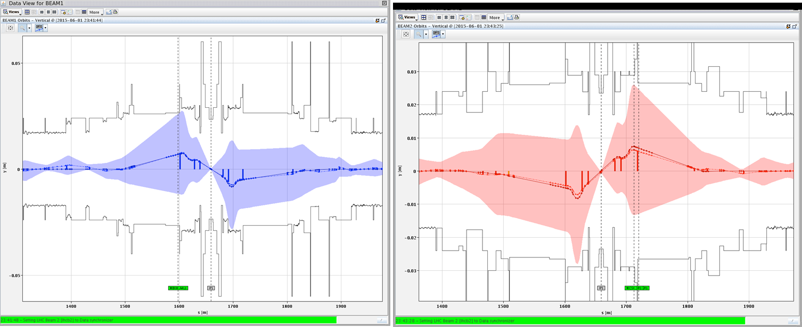
Aperture

Slide 23
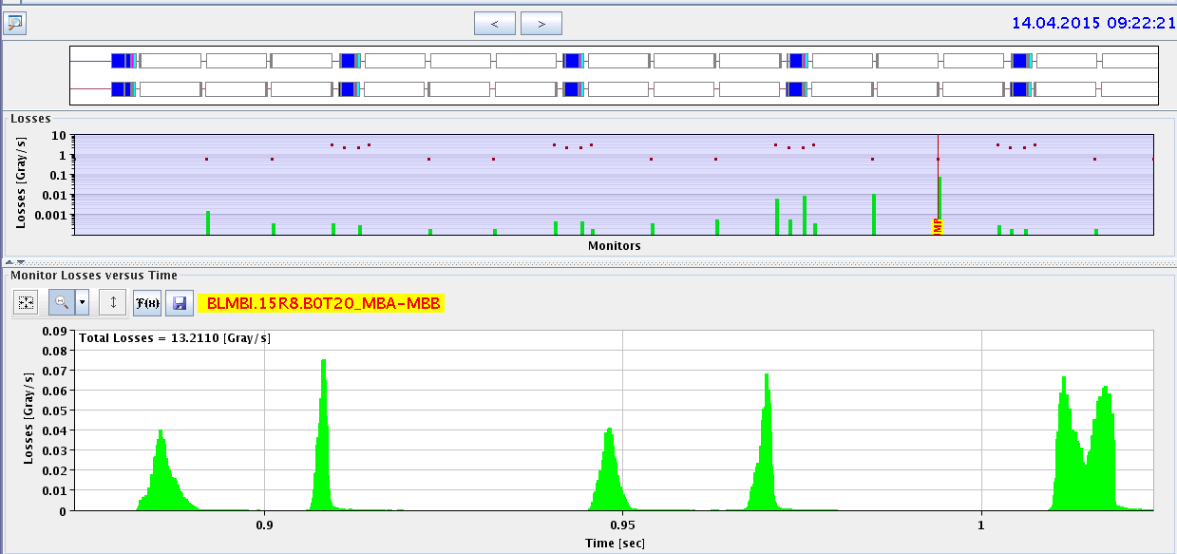
MUFOs in 15R8
quench
B2
B1
X
Q14
Q15
highest
loss
Multiple loss events after a short time at 6.5 TeV compatible with particles falling into the beam
loss patterns point to a specific position in the middle of a dipole magnet
Quenched twice, numerous BLM triggered dumps…

Slide 24
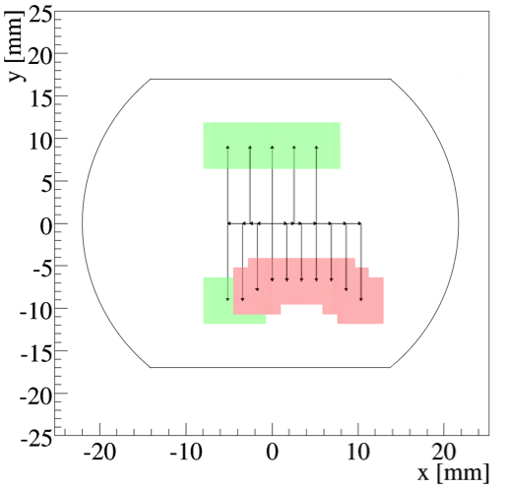
Aperture restriction in 15R8
ULO (Unidentified Lying Object)
Aperture restriction measured at injection and 6.5 TeV
Presently running with orbit bumps
-3 mm in H, +1 in V, to optimize available aperture
aperture probably not limiting for operation
Behaviour with higher intensities and bunch trains still unknown
MUFOs went away but 2 weeks ago…
D. Mirarchi

Slide 25
This following a 15R8 aperture scan – no more scans!
Concern is that e-cloud could kick things off again

Slide 26
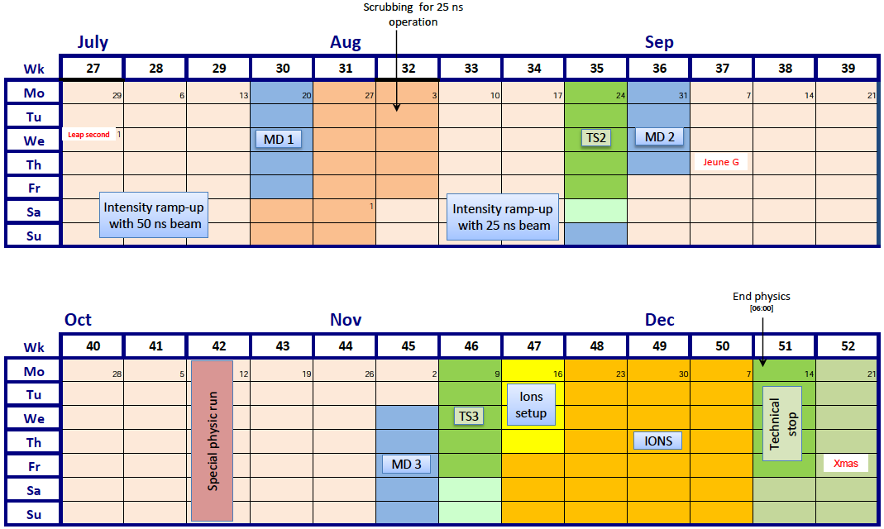
Q3/Q4 2015
SCRUBBING FOR 25 ns

Slide 27
2015 – latest schedule
Phase | Days
Initial Commissioning | 57
Scrubbing | 23
Special physics run 1 (LHCf/VdM) | 5
Proton physics 50 ns | 7 + 21
Proton physics 25 ns | 70
Special physics run 2 (TOTEM/VdM) | 7
Machine development (MD) | 15
Technical stops | 15
Technical stop recovery | 3
Ion setup/Ion run | 4 + 24
Total | 253 (36 weeks)

Slide 28
Schedule - comments
Picked up some 4 weeks delay from:
Powering tests/quench training overrun
Earth fault resolution
Proton-proton physics down to 70 days
Decrease in beta* to be reviewed after gaining some experience (although considerable progress made during commissioning)
Ion program unaffected
Proton-proton reference data to be scheduled
Still some commissioning/machine protection stuff to mop up coming out of technical stop and before 50 ns ramp-up

Slide 29
2015: ATLAS and CMS performance
Beta* = 80 cm, possible reduction later in year (count 4 days + ramp-up)
Nominal bunch population for 50 and 25 ns
Reasonable emittance into collisions
Assume slightly worse machine availability than in 2012
TDI limit: max colliding bunches 2376
Hubner factor = 0.15
 | Nc | Beta* | ppb | EmitN | Lumi [cm⁻²s⁻¹] | Days (approx) | Int lumi | Pileup
50 ns | 1300 | 80 | 1.2e11 | 2.5 | 4.8e33 | 21 | < 1 fb⁻¹ | 25
2015.1 | 2376 | 80 | 1.2e11 | 3.1 | 7.0e33 | 35 | ~5 fb⁻¹ | 21
2015.2 | 2376 | 40 | 1.2e11 | 3.1 | 1.2e34 | 30 | ~4 fb⁻¹ | 35
Official GPD luminosity target for the year was 10 fb⁻¹
Now on the challenging side – let’s say 5 to 10 fb⁻¹

Slide 30
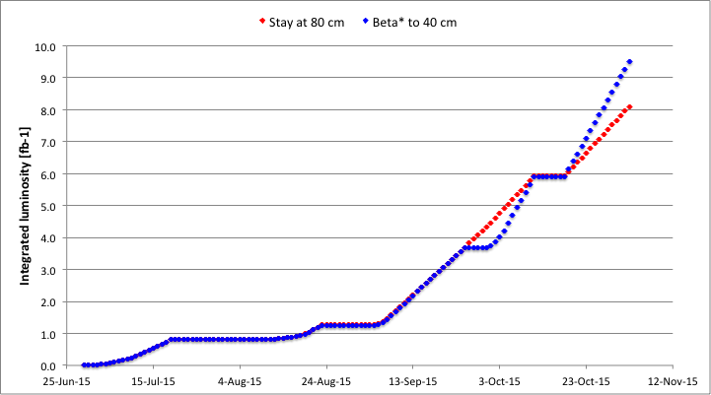
Day by day projection
Special
runs
MD & 25 ns scrubbing
TS2
Possible beta* reduction plus fast ramp-up
50 ns
Including intensity ramp-ups and steadily increasing physics efficiency

Slide 31
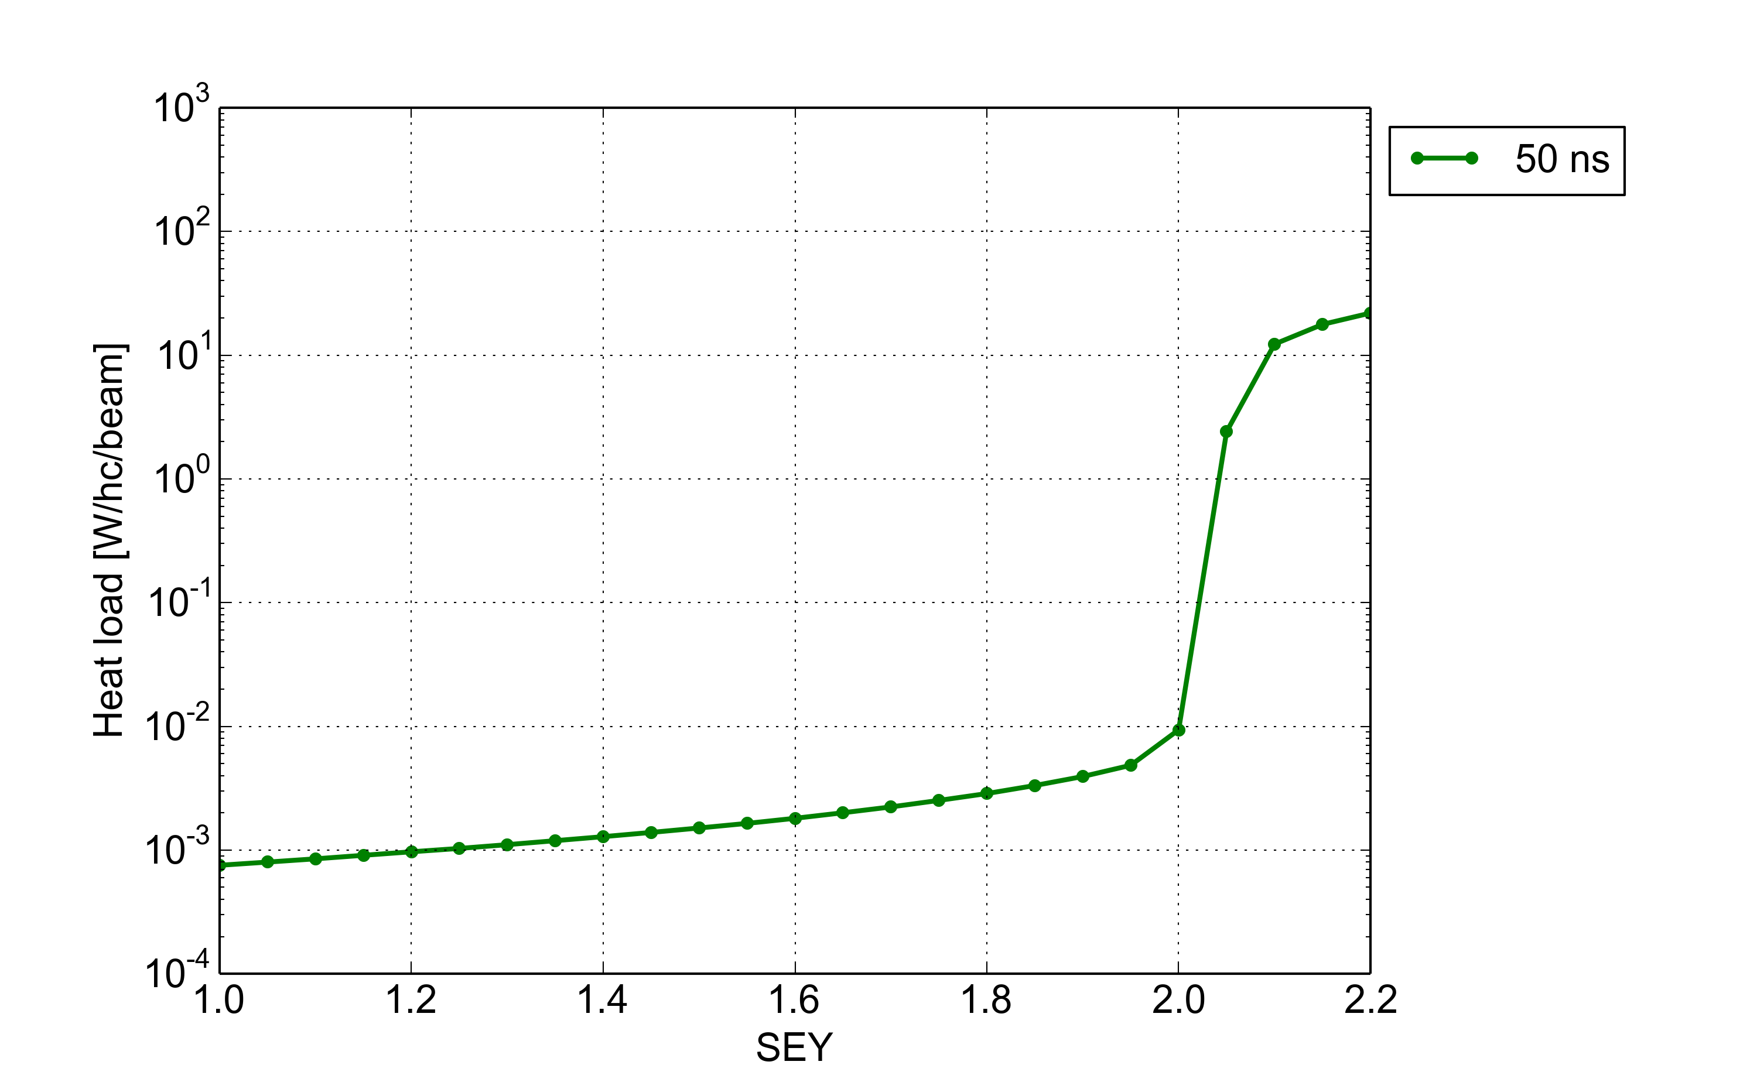
Scrubbing: Goal and strategy
Goal: accumulate e⁻ dose on the beam chambers to mitigate e-cloud effects with 50 ns and 25 ns beams
Strategy: gradually increase the e⁻ flux (50 ns → 25 ns → doublets) while keeping under control vacuum, heat loads and beam degradation
50 ns beam
~1400 bunches
1.7 x 10¹¹ p/b
50 ns
Scrubbing
Giovanni Iadarola and Giovanni Rumolo

Slide 32
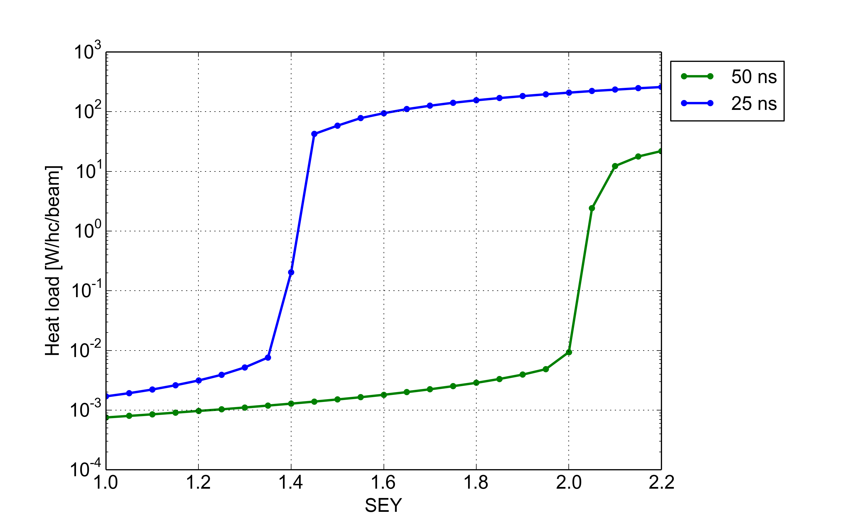
Scrubbing: Goal and strategy
Goal: accumulate e⁻ dose on the beam chambers to mitigate e-cloud effects with 50 ns and 25 ns beams
Strategy: gradually increase the e⁻ flux (50 ns → 25 ns → doublets) while keeping under control vacuum, heat loads and beam degradation
50 ns beam
~1400 bunches
1.7 x 10¹¹ p/b
25 ns Scrubbing
50 ns
Scrubbing
25 ns beam
~2800 bunches
1.15 x 10¹¹ p/b
Sufficient mitigation
for 50 ns physics
Giovanni Iadarola and Giovanni Rumolo

Slide 33
Scrubbing: Goal and strategy
Goal: accumulate e⁻ dose on the beam chambers to mitigate e-cloud effects with 50 ns and 25 ns beams
Strategy: gradually increase the e⁻ flux (50 ns → 25 ns → doublets) while keeping under control vacuum, heat loads and beam degradation
50 ns beam
~1400 bunches
1.7 x 10¹¹ p/b
50 ns
Scrubbing
25 ns Scrubbing
25 ns beam
~2800 bunches
1.15 x 10¹¹ p/b
Sufficient mitigation
for 50 ns physics
Giovanni Iadarola and Giovanni Rumolo

Slide 34
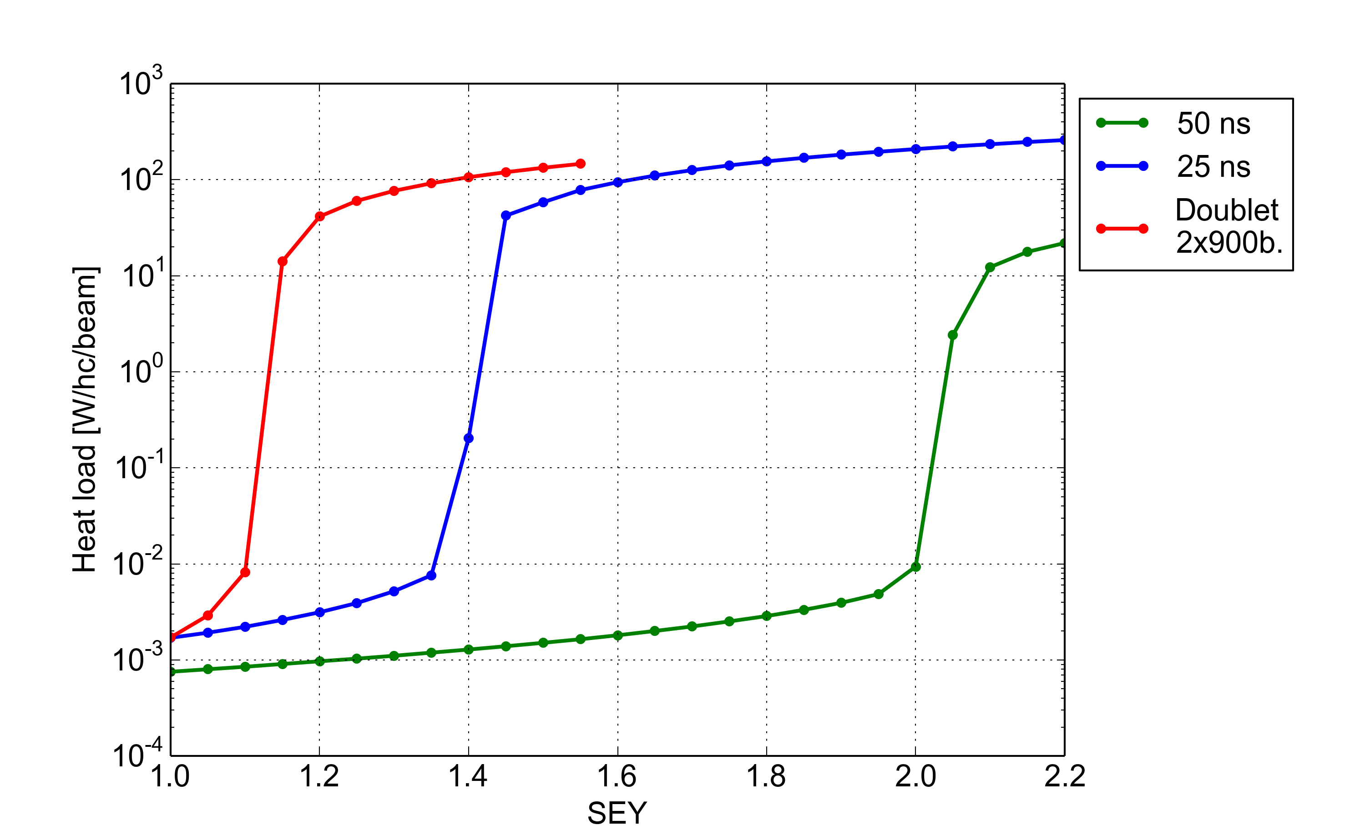
Scrubbing: Goal and strategy
Goal: accumulate e⁻ dose on the beam chambers to mitigate e-cloud effects with 50 ns and 25 ns beams
Strategy: gradually increase the e⁻ flux (50 ns → 25 ns → doublets) while keeping under control vacuum, heat loads and beam degradation
50 ns beam
~1400 bunches
1.7 x 10¹¹ p/b
50 ns
Scrubbing
25 ns Scrubbing
Doublet Scrubbing
25 ns beam
~2800 bunches
1.15 x 10¹¹ p/b
No e-cloud in the dipoles ☺
Doublet beam
~900 doublets
0.7 x 10¹¹ p/b
Giovanni Iadarola and Giovanni Rumolo

Slide 36
Conclusions
Looking good at 6.5 TeV
Great job done in LS1 and during powering tests
Impressive progress so far, lot of lessons learnt in Run 1 and fed-forward
Fundamentals look sound, no show stoppers for the moment
Some irritants – resolution cost time
Next challenge - higher intensity and e-cloud
2015 will be a short year for proton physics but lay the foundations for production in the rest of Run 2

