Slide 1

The LHC machine:
Run 2 and beyond
Mike Lamont for the LHC team

Slide 2
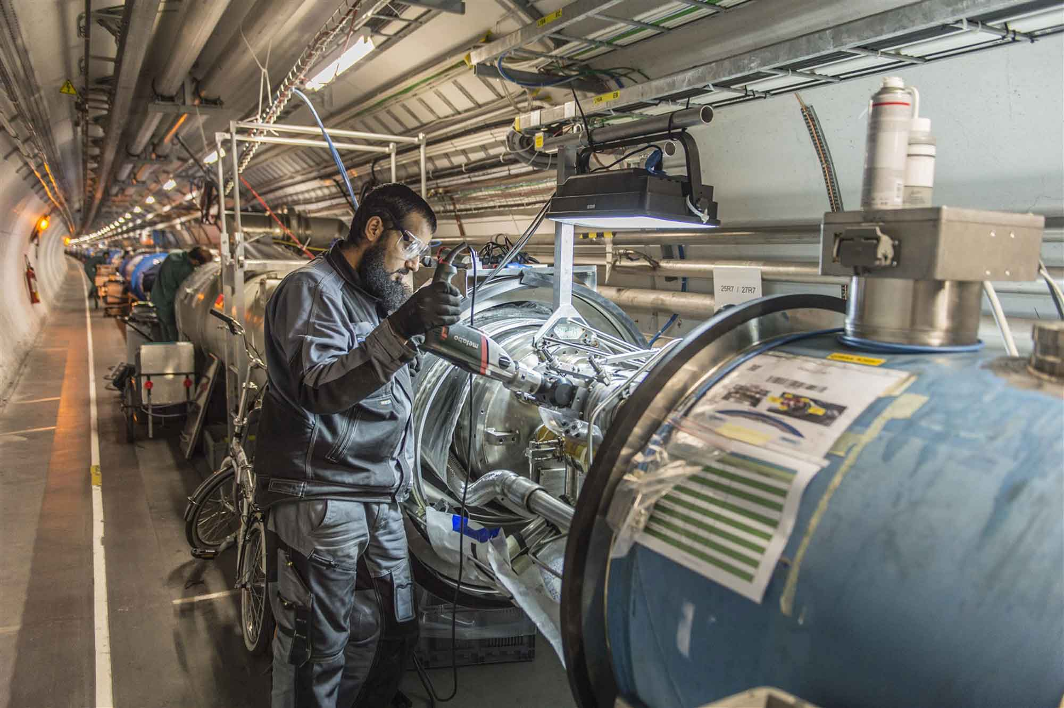
LS1 - descent into the underworld again

Slide 3
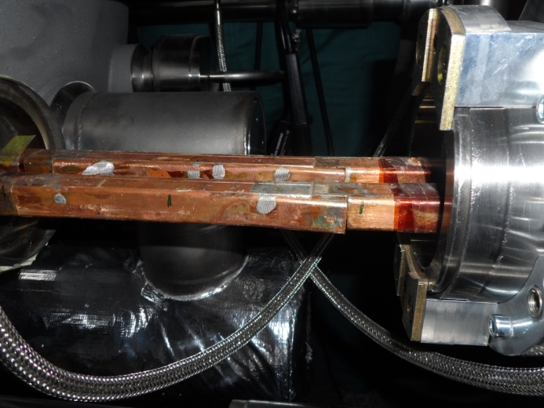
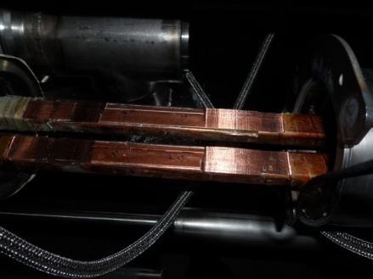
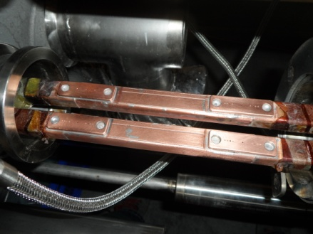
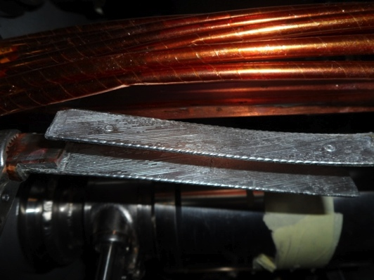
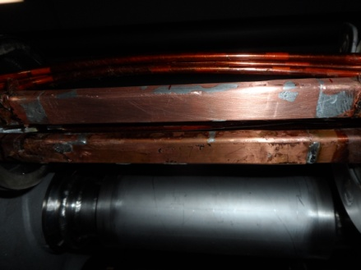
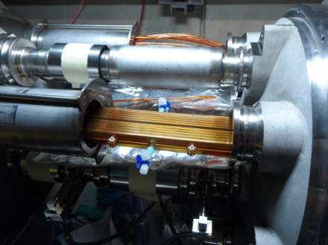
« Old Splice » « Machined Splice » « Consolidated Splice »
« Cables » « New Splice »
Total interconnects in the LHC:
  1,695 (10,170 high current splices)
Number of splices redone: ~3,000 (~ 30%)
Number of shunts applied: > 27,000
« Insulation box »
And a lot more besides…

Slide 4
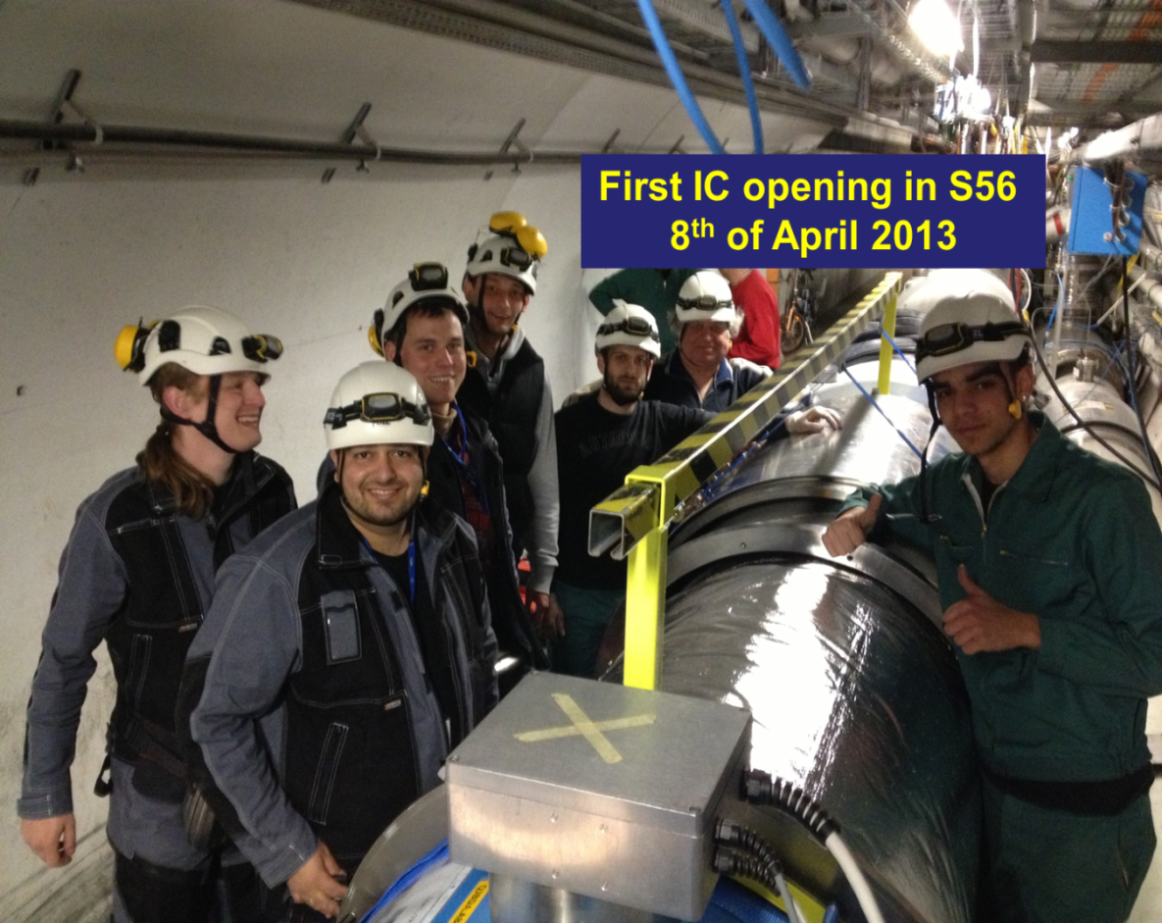
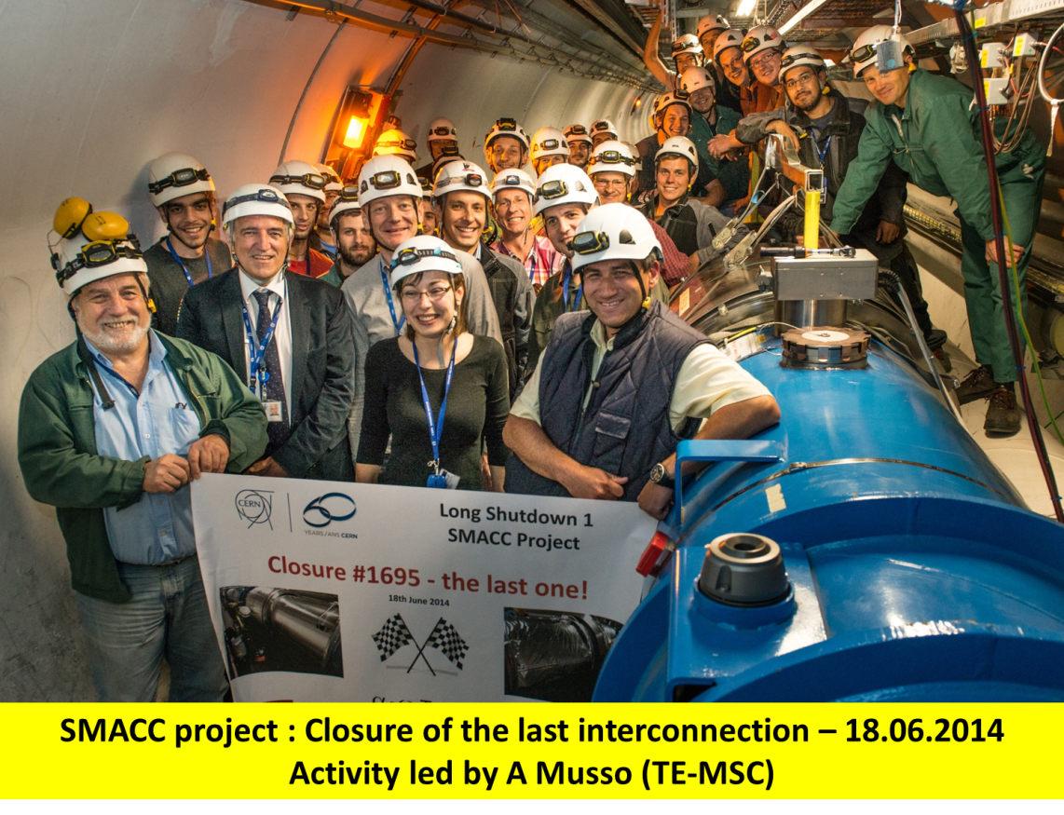
Superconducting Magnets and Circuits Consolidation (SMACC)
Monumental effort
Over 350 persons involved
Including preparation: ~1,000,000 working hours
No serious accidents!
Jean-Philippe Tock
Collaborations with NTUA (Athens), WUT (Wroclaw) and support of DUBNA

Slide 5
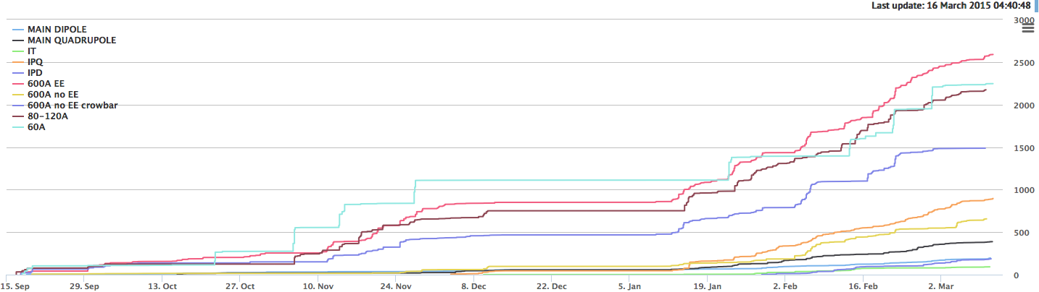
Powering tests
Following sector by sector cool-down
All ~1700 magnet circuits taken to nominal current level one by one
  Rigorous checks of quench protection, energy extraction, interlocks, power converter, ELQA
  Some circuits are more critical than others…
3000
cumulative number of powering tests
6 months

Slide 6
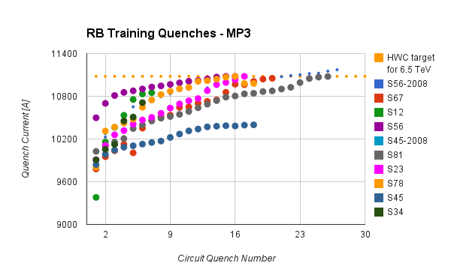
Dipole training 1/2
154 dipoles per sector, powered in series
Ramp the current until single magnet quenches - “training quench”
Repeat as necessary

Slide 7
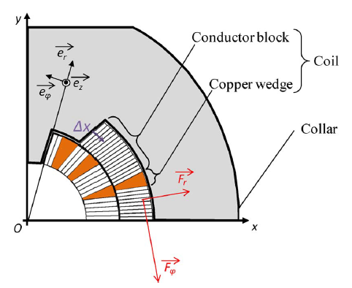
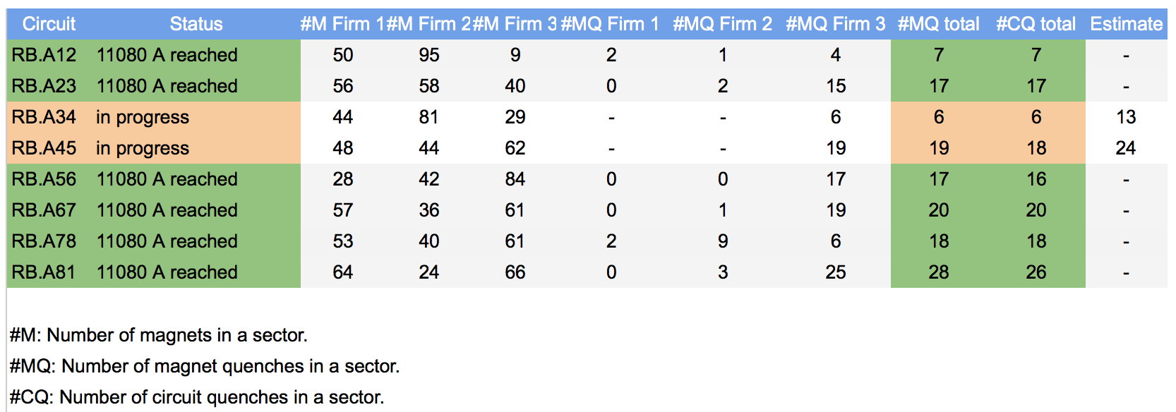
Dipole training 2/2
Training: frictional energy released during conductor motion
From this morning…
All magnets have been trained to well over 7 TeV in SM18 before installation
Extensive re-training was not expected

Slide 8
LHC - 2015
Target energy: 6.5 TeV
  to be confirmed at end of powering tests!!!
Bunch spacing: 25 ns
  strongly favored by experiments (pile-up limit around 50)
Beta* in ATLAS and CMS: 80 to 40 cm
Energy
25 ns
  Lower quench margins
  Lower tolerance to beam loss
  Lower intensity set-up beams
  Hardware closer to maximum (beam dumps, power converters etc.)
  Electron-cloud
  UFOs
  More long range collisions
  Larger crossing angle, higher beta*
  Higher total beam current
  Higher intensity per injection

Slide 9
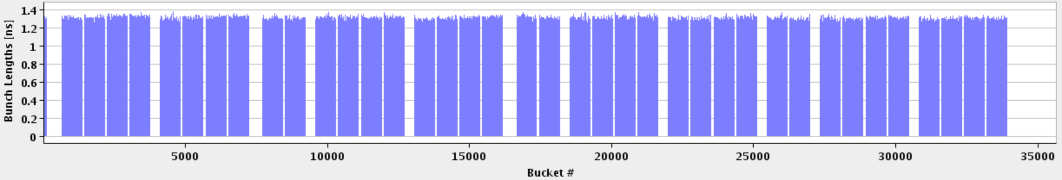
LHC bunch structure - 2015
25 ns bunch spacing
~2800 bunches
Nominal bunch intensity 1.15 x 10¹¹ protons per bunch
1 PS batch
(72 bunches)
1 SPS batch
(288 bunches)
Abort gap
26.7 km 2800 bunches

Slide 10
25 ns & electron cloud
SEY
200 eV
10 eV
2 keV
Beam screen
5 eV
25 ns
Typical e– densities10¹⁰–10¹² m^{–3}
Possible consequences:
  instabilities, emittance growth, desorption – bad vacuum
  excessive energy deposition in the cold sectors
Electron bombardment of a surface has been proven to reduce drastically the secondary electron yield (SEY) of a material. This technique, known as scrubbing, provides a mean to suppress electron cloud build-up.
Electron cloud significantly worse with 25 ns

Slide 11
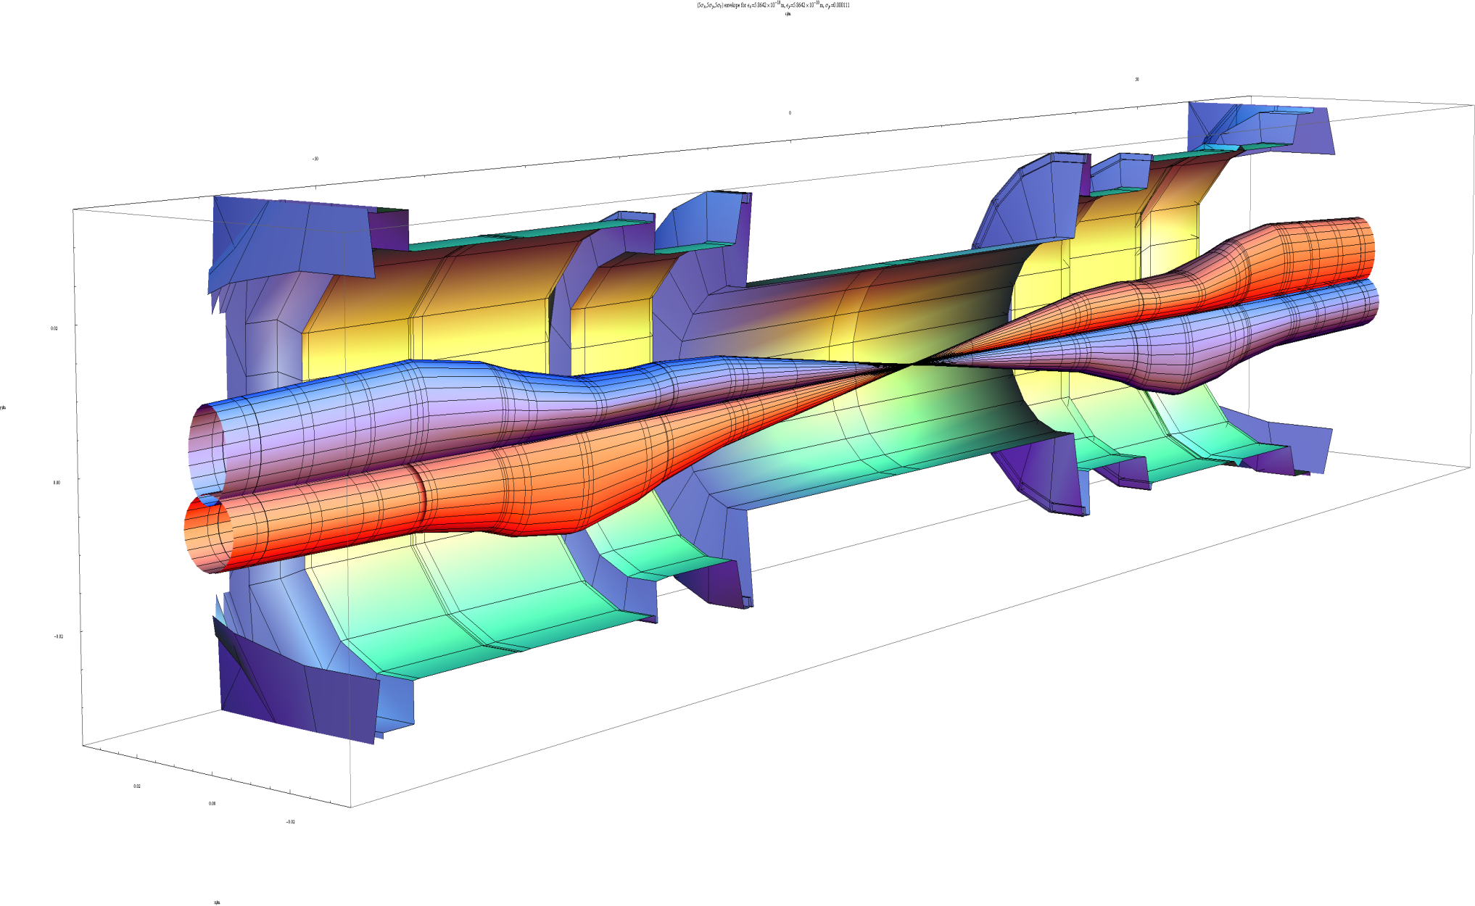
Squeeze in ATLAS
 | β_{triplet} | Sigma triplet | β* | Sigma*
Nominal | ~4.5 km | 1.5 mm | 55 cm | 17 um
HL-LHC | ~20 km | 2.6 mm | 15 cm | 7 um
β* = 55 cm
β* = 15 cm
7 microns
Image courtesy John Jowett

Slide 12
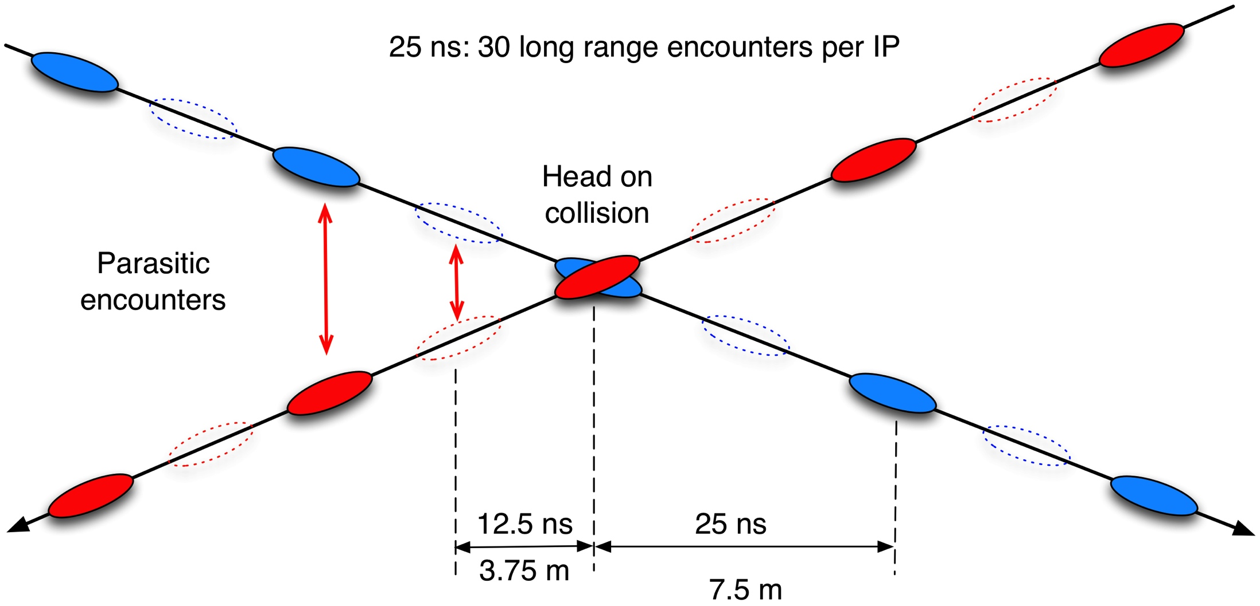
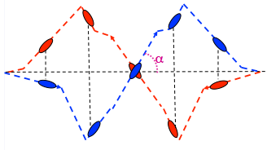
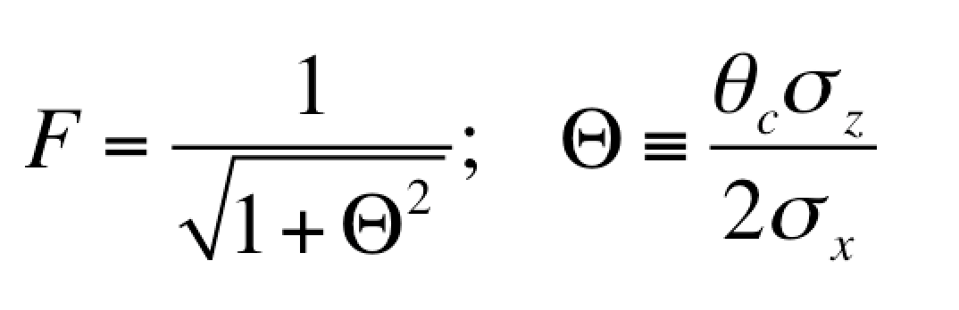
Crossing angle
work with a crossing angle to avoid parasitic collisions.
Separation: 10 -12 σ
geometric luminosity
reduction factor:

Slide 13
2015: beta* in IPs 1 and 5
Many things have changed. Start carefully and push performance later.
Start-up: β*= 80 cm – (very) relaxed
  2012 collimator settings
  11 sigma long range separation
  Aperture, orbit stability… to be checked
Ultimate in 2015: β*= 40 cm
  To be deployed later in the year

Slide 14
2015 commissioning strategy
Low intensity commissioning of full cycle – 8 weeks
First stable beams – low number of bunches
Special physics: LHCf and Luminosity calibration
Scrubbing for 50 ns
Intensity ramp-up with 50 ns
  Characterize vacuum, heat load, electron cloud, losses, instabilities, UFOs, impedance
Scrubbing for 25 ns
Ramp-up 25 ns operation with relaxed beta*
Commission lower beta*
25 ns operation

Slide 15
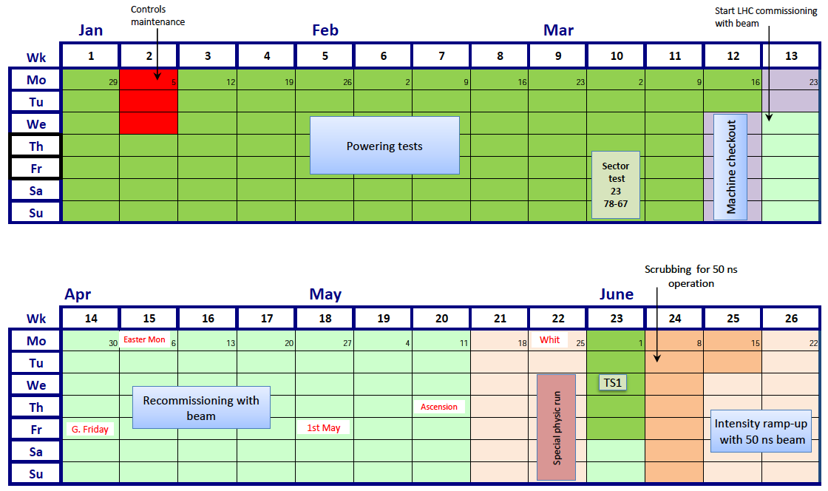
2015 Q1/Q2
FIRST BEAM
25th MARCH
(at the earliest!)
SCRUBBING
FOR 50 ns

Slide 16
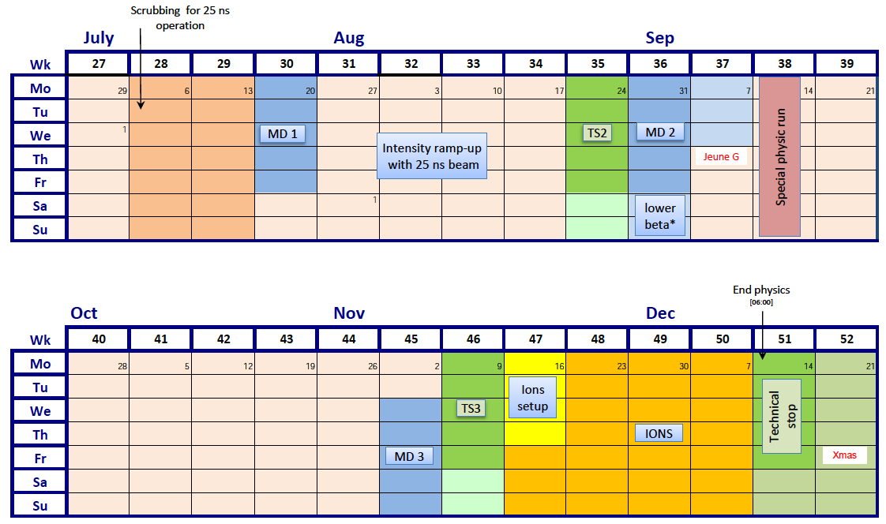
Q3/Q4 2015
SCRUBBING
FOR 25 ns

Slide 17
ATLAS and CMS performance
Conservative beta* to start
Conservative bunch population
Reasonable emittance into collisions
Assume same machine availability as 2012
 | Nc | Beta* | ppb | EmitN | Lumi [cm⁻²s⁻¹] | Days (approx) | Int lumi | Pileup
50 ns | 1300 | 80 | 1.2e11 | 2.5 | 4.8e33 | 21 | ~1 fb⁻¹ | 25
2015.1 | 2592 | 80 | 1.1e11 | 2.5 | 7.6e33 | 30 | 3 fb⁻¹ | 21
2015.2 | 2592 | 40 | 1.1e11 | 2.5 | 1.2e34 | 48 | 8 fb⁻¹ | 34
Official GPD luminosity target for the year: 10 fb⁻¹

Slide 18
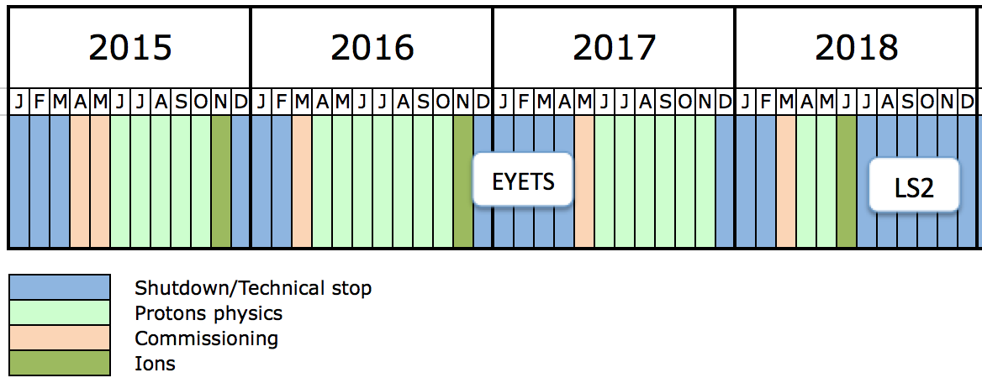
Run 2
 | Peak lumi E34 cm⁻²s⁻¹ | Days proton physics | Approx. int lumi [fb⁻¹]
2015 | 1.3 | 100 | 10
2016 | 1.5 | 160 | 35
2017 | 1.7 | 160 | 45
2018 | 1.7 | 40 | 10

Slide 19
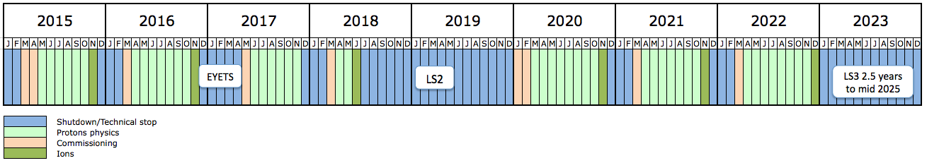
10 year plan
Long years – 13 weeks Christmas stop
Interspersed with long shutdown every 3 to 4 years
Ions very much part of the plan
Run 2: 13 to 14 TeV c.m. with peak luminosity of ~1.7x10³⁴ cm⁻² s⁻¹
Run 3: 14 TeV c.m. with peak luminosity of ~2x10³⁴ cm⁻² s⁻¹
EYETS 19 weeks
Extended year end technical stop (CMS)
LS2: 18 months
Connection of LINAC4
LHC Injectors Upgrade
LS3: 30 months
High Luminosity LHC

Slide 20
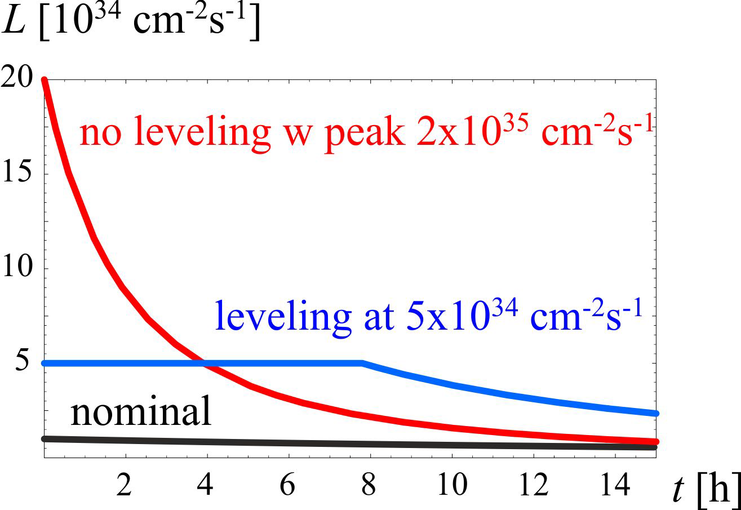
HL-LHC - goals
Prepare machine for operation beyond 2025 and up to 2035
Devise beam parameters and operation scenarios for:
  total integrated luminosity of 3000 fb⁻¹ in around 10-12 years
  an integrated luminosity of 250 fb⁻¹ per year
  mu ≤ 140 (peak luminosity of 5x10³⁴ cm⁻²s⁻¹)

Slide 21
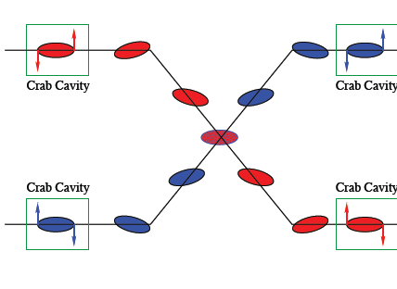
How?
Beam from injectors
  High bunch population, low emittance, 25 ns beam
Lower beta* (~15 cm)
  New inner triplet magnets - wide aperture Nb₃Sn
  Large aperture NbTi separator magnets
  Novel optics solutions
Crossing angle compensation
  Crab cavities
Dealing with the regime
  Collision debris, high radiation
  High machine availability
  Beam stability, losses etc.

Slide 22
HL-LHC: key 25 ns parameters
Protons per bunch | 2.2 x 10¹¹
Number of bunches | 2750
Normalized emittance | 2.5 micron
Beta* | 15 cm
Crossing angle | 590 microrad
Geometric reduction factor | 0.305
Virtual luminosity | 2.4 x 10³⁵ cm⁻²s⁻¹
Levelled luminosity | 5 x 10³⁴ cm⁻²s⁻¹
Levelled <pile-up> | 140

Slide 23
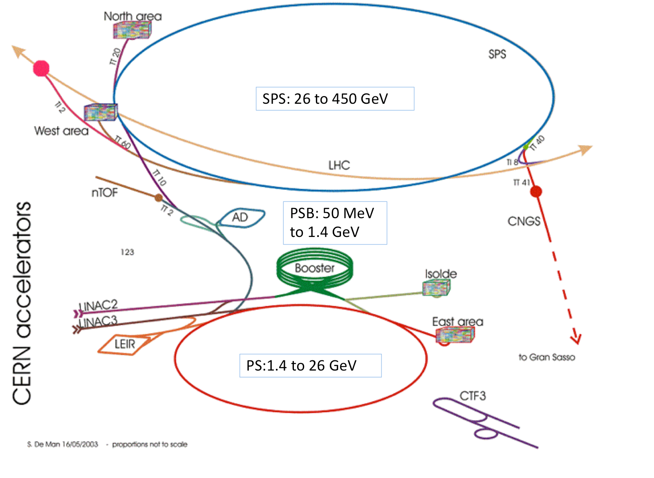
1. Beams from injectors
BOOSTER: 160 MeV to 2.0 GeV
LINAC4: H- at 160 MeV
PS: 2 GeV to 26 GeV
LHC Injector Upgrade (LIU): A cascade of improvements across the whole injector chain to reach the HL-LHC target

Slide 24
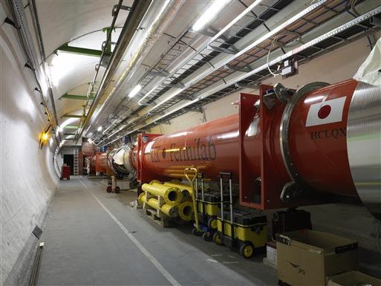

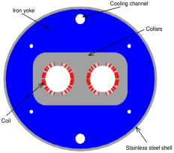

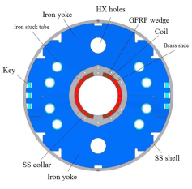
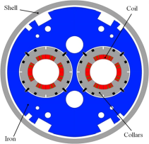
The critical zones around IP1 and IP5
ATLAS
CMS
3. For collimation we also need to change the DS in the continuous cryostat: 11T Nb₃Sn dipole
2. We also need to modify a large part of the matching section
e.g. Crab Cavities &
D1, D2, Q4 & corrector
New triplet Nb₃Sn
required due to:
-Radiation damage
-Need for more aperture
More than 1.2 km of LHC
Plus technical infrastructure
(e.g. Cryo and Powering)…
2. Lower beta*; 3. crossing angle compensation

Slide 25
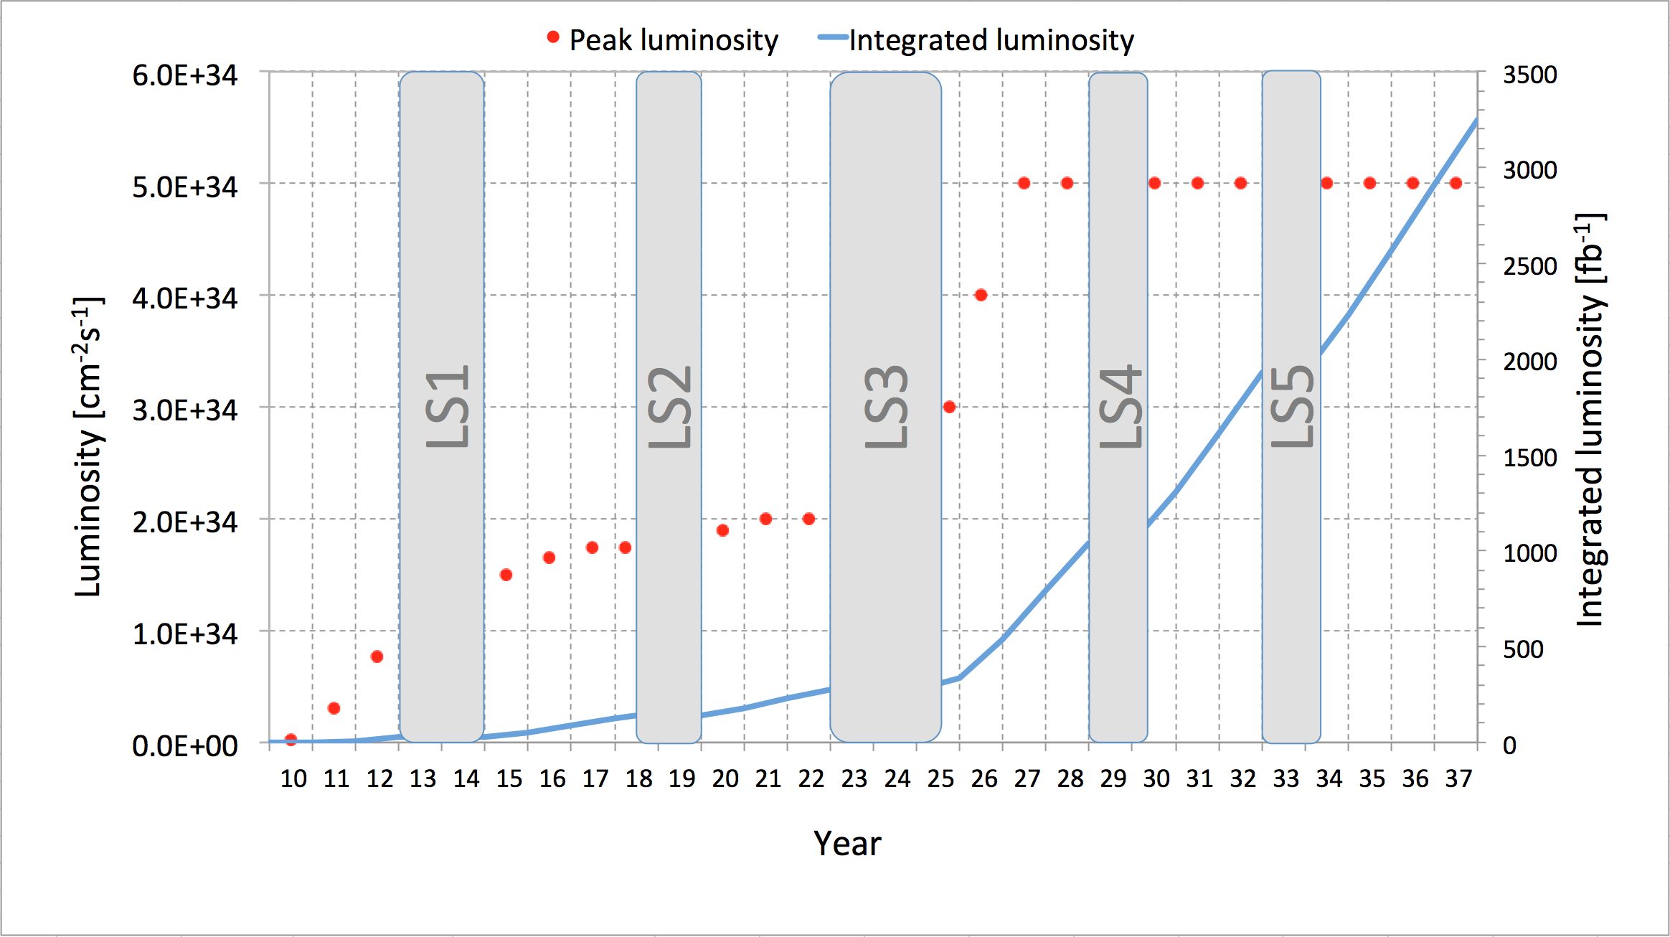
HL-LHC & LIU
Projects firmly established and key parts of CERN’s mid-term planning

Slide 26
Conclusions
2015 goal is 25 ns at 6.5 TeV
  Scrubbing++ required – even then electron cloud could remain an issue
Lot of stuff to sort out again but there’s a lot of Run 1 experience
Non-aggressive parameter choice/strategy to start with, aiming to re-establish stable operation with 25 ns before pushing performance
LIU/LHC firmly established with planning out to 2035.

