Slide 1
The LHC in Run 2: status and plans
Mike Lamont for the LHC team

Slide 2
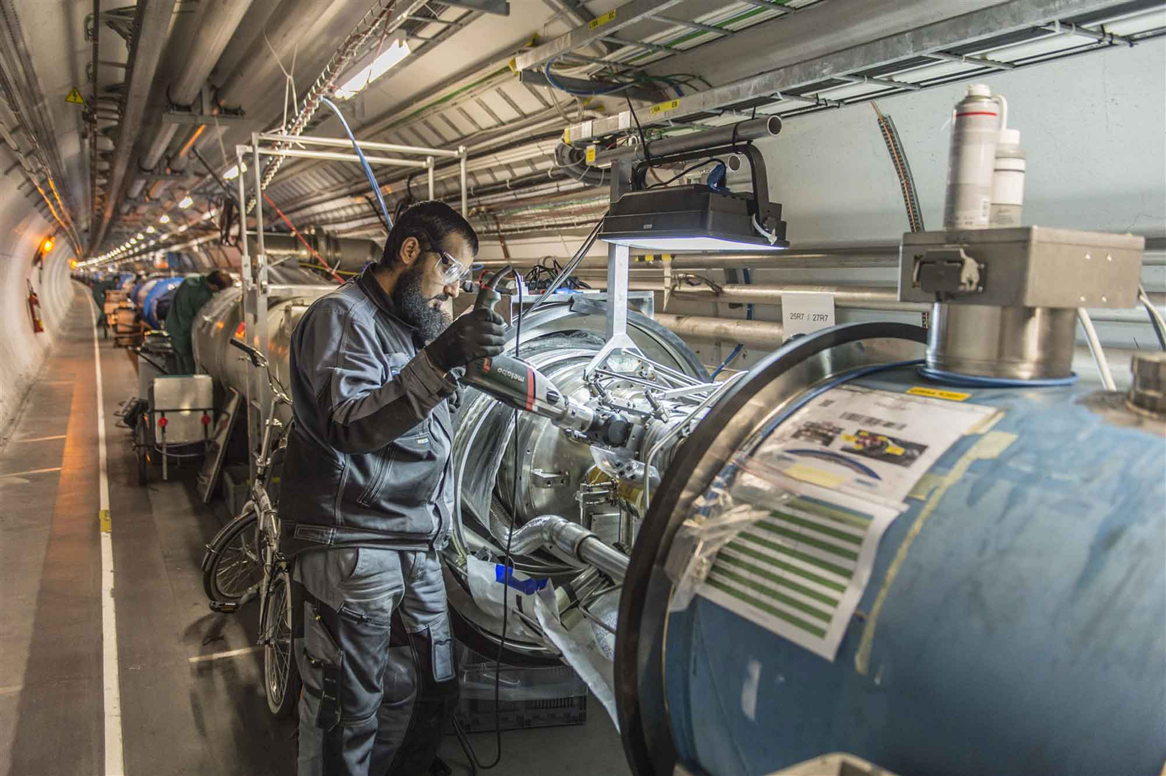
LS1 - descent into the underworld again

Slide 3
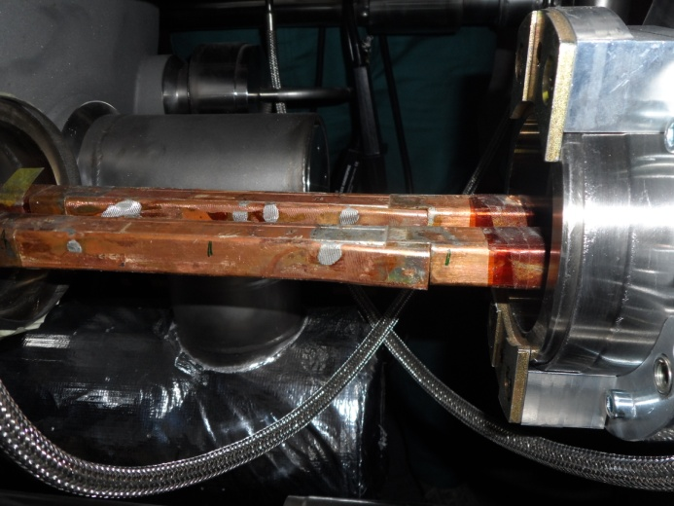
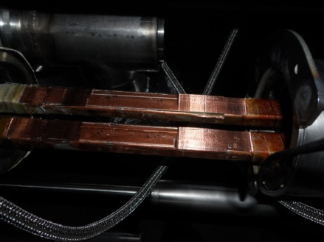
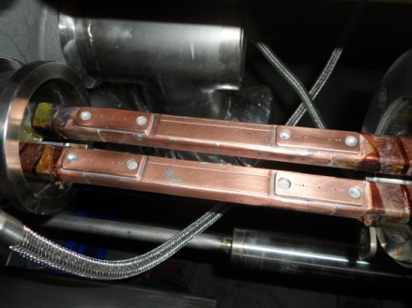
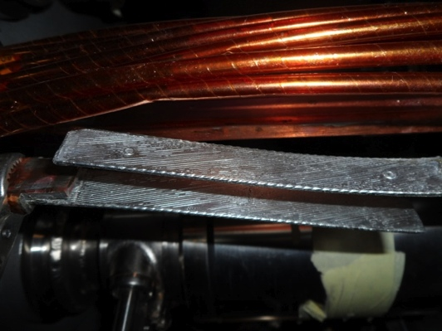
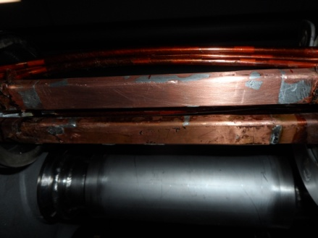
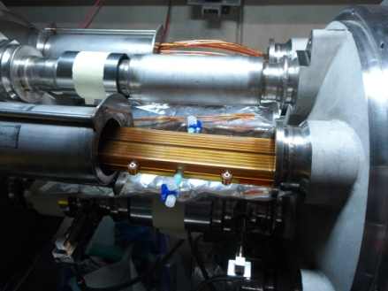
« Old Splice » « Machined Splice » « Consolidated Splice »
« Cables » « New Splice »
Total interconnects in the LHC:
1,695 (10,170 high current splices)
Number of splices redone: ~3,000 (~ 30%)
Number of shunts applied: > 27,000
« Insulation box »
And a lot more besides…

Slide 4
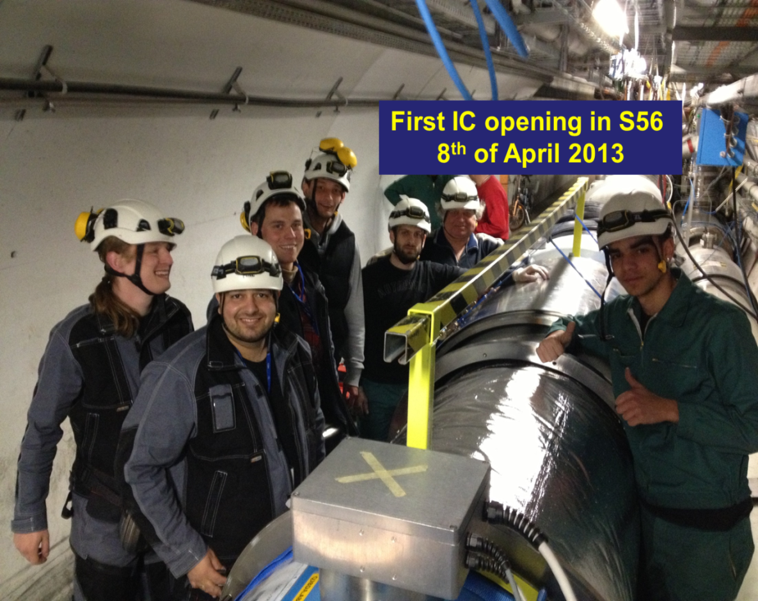
Superconducting Magnets and Circuits Consolidation (SMACC)
Monumental effort
Over 350 persons involved
Including preparation: ~1,000,000 working hours
No serious accidents!
Jean-Philippe Tock
Collaborations with NTUA (Athens), WUT (Wroclaw) and support of DUBNA

Slide 5
Following sector by sector cool-down

Slide 6
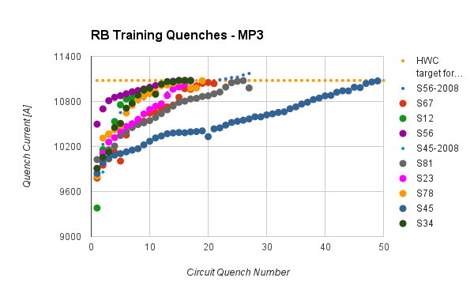
Dipole training 1/2
154 dipoles per sector, powered in series
Ramp the current until single magnet quenches - “training quench”
Usually quench 3 – 4 other dipoles at the same time
Cryogenics recovery time: 6 – 8 hours

Slide 7
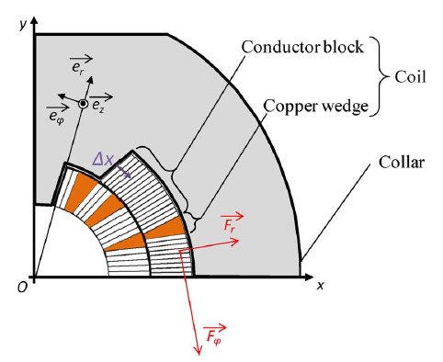
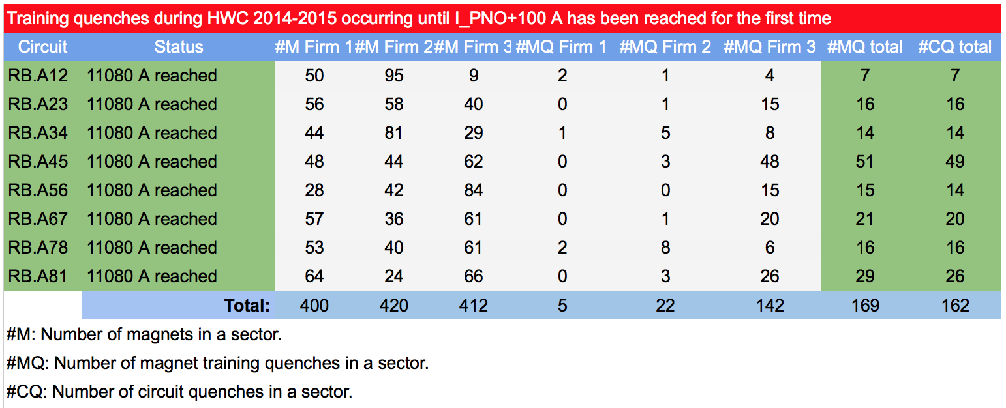
Dipole training 2/2
Training: frictional energy released during conductor motion
Campaign summary
All magnets have been trained to well over 7 TeV in SM18 before installation
Extensive re-training in situ was not expected

Slide 8
7 TeV?
Assume all 412 firm 3 dipoles need re-training
Some will required more than 1 re-training quench
Firm 2 (~5% to 6.5 TeV) and firm 1 (~ 1% to 6.5 TeV) will also play a part
Detailed analysis ongoing
Clearly hundreds more t-quenches required
Could type test 1 sector in 2015 YETS…
The essential feeling at the moment is: let’s get the machine running at 6.5 TeV first

Slide 9
LHC - 2015
Target energy: 6.5 TeV
looking good
Bunch spacing: 25 ns
strongly favored by experiments (pile-up limit around 50)
Beta* in ATLAS and CMS: 80 to 40 cm
Energy
25 ns
Lower quench margins
Lower tolerance to beam loss
Hardware closer to maximum (beam dumps, power converters etc.)
Electron-cloud
UFOs
More long range collisions
Larger crossing angle, higher beta*
Higher total beam current
Higher intensity per injection

Slide 10
LHC bunch structure - 2015
25 ns bunch spacing
~2800 bunches
Nominal bunch intensity 1.15 x 10¹¹ protons per bunch
1 PS batch
(72 bunches)
1 SPS batch
(288 bunches)
Abort gap
26.7 km 2800 bunches
New limits of ~2 PS batches per injection from the injection protection absorbers – will reduce the maximum number of bunches to around 2500

Slide 11
25 ns & electron cloud
SEY
200 eV
10 eV
2 keV
Beam screen
5 eV
25 ns
Typical e– densities10¹⁰–10¹² m^{–3}
Possible consequences:
instabilities, emittance growth, desorption – bad vacuum
excessive energy deposition in the cold sectors
Electron bombardment of a surface has been proven to reduce drastically the secondary electron yield (SEY) of a material. This technique, known as scrubbing, provides a mean to suppress electron cloud build-up.
Electron cloud significantly worse with 25 ns

Slide 12
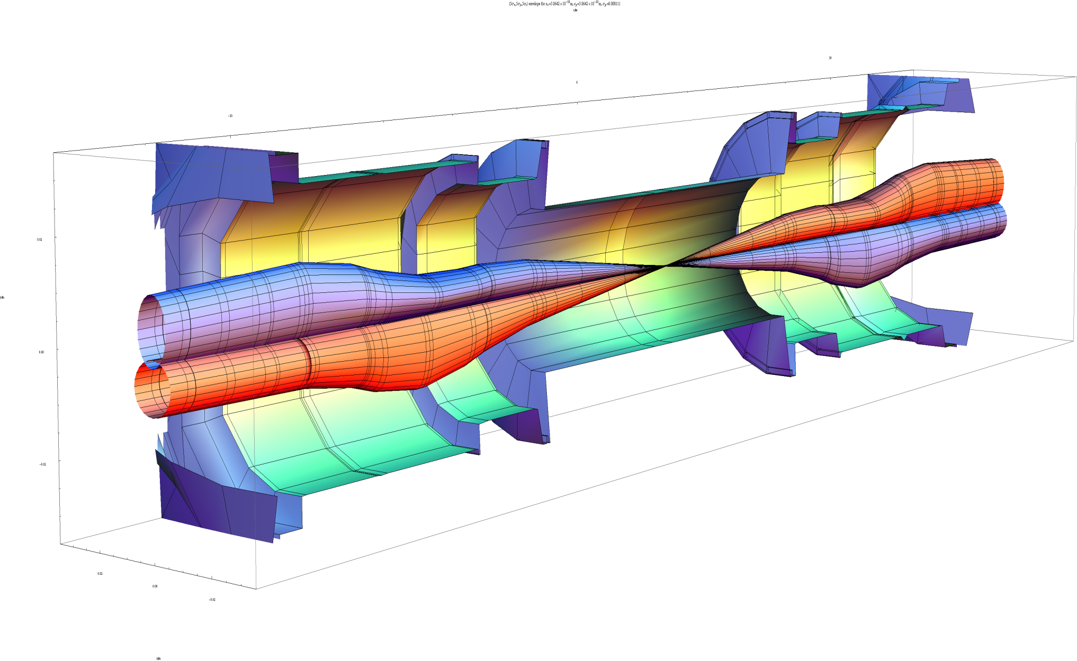
Squeeze in ATLAS
 | β_{triplet} | Sigma triplet | β* | Sigma*
Nominal | ~4.5 km | 1.5 mm | 55 cm | 17 um
HL-LHC | ~20 km | 2.6 mm | 15 cm | 7 um
β* = 55 cm
β* = 15 cm
7 microns
Image courtesy John Jowett

Slide 13
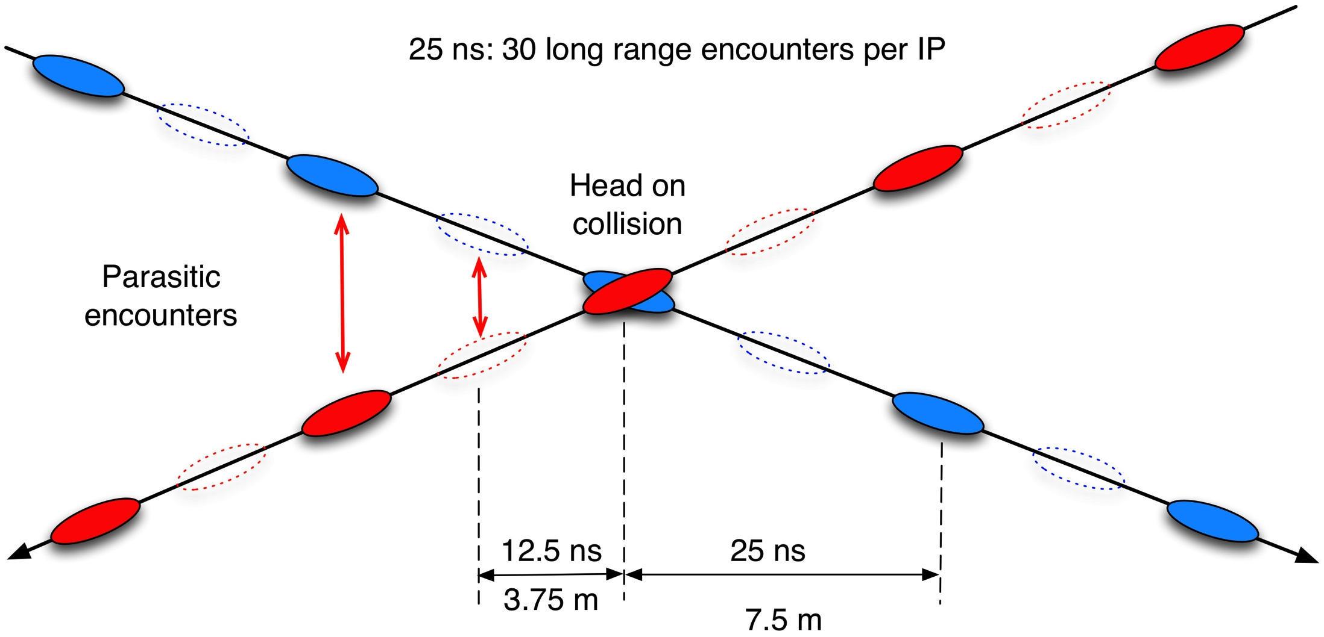
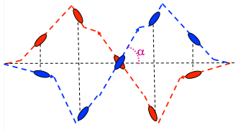
Crossing angle
work with a crossing angle to avoid parasitic collisions.
Separation: 10 -12 σ
geometric luminosity
reduction factor:

Slide 14
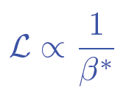
2015: beta* in IPs 1 and 5
Many things have changed. Start carefully and push performance later.
Start-up: β*= 80 cm – (very) relaxed
2012 collimator settings
11 sigma long range separation
Aperture, orbit stability… checks ongoing
Ultimate in 2015: β*= 40 cm
Possible reduction later in the year

Slide 15
2015 commissioning strategy
Low intensity commissioning of full cycle – 8 weeks
Pilot physics – low number of bunches
Special physics run: LHCf and luminosity calibration
Scrubbing for 50 ns
Intensity ramp-up with 50 ns
Characterize vacuum, heat load, electron cloud, losses, instabilities, UFOs, impedance
Scrubbing for 25 ns
Ramp-up 25 ns operation with relaxed beta*
Possibly commission lower beta*
25 ns operation

Slide 16
2015 Q2
FIRST BEAM 5th APRIL
FIRST STABLE BEAM 3rd JUNE
SCRUBBING FOR 50 ns
PILOT PHYSICS
8 weeks beam commissioning
Pilot physics – up to at least 40 bunches per beam
5 days special physics at beta* = 19 m (VdM, LHCf, TOTEM & ALFA)
Start technical stop – 15th June

Slide 17
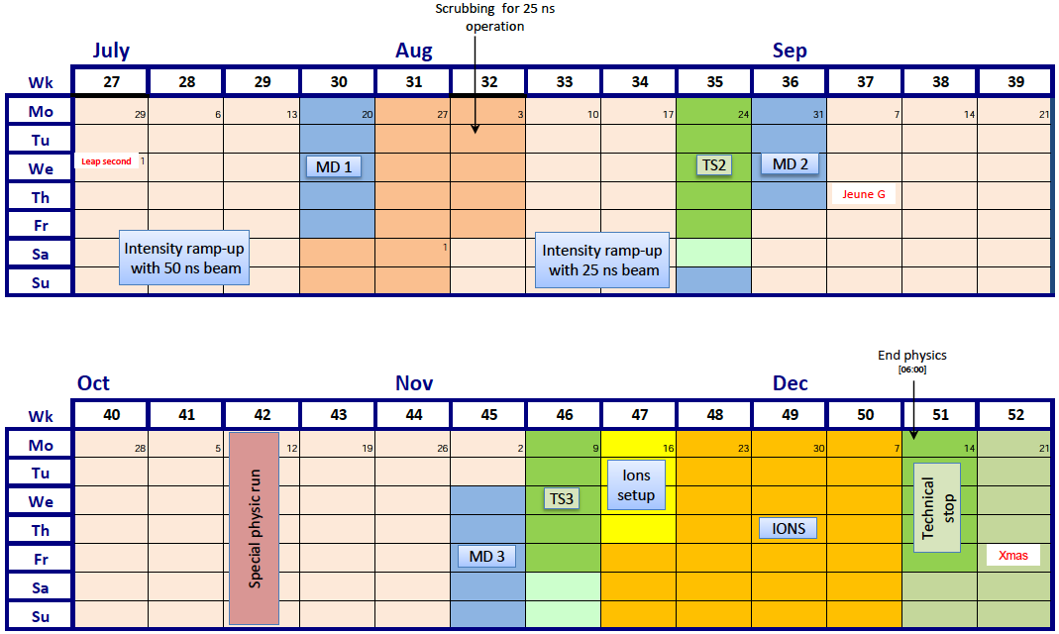
Q3/Q4 2015
SCRUBBING FOR 25 ns

Slide 18
2015 – latest schedule
Phase | Days
Initial Commissioning | 57
Scrubbing | 23
Special physics run 1 (LHCf/VdM) | 5
Proton physics 50 ns | 9 + 21
Proton physics 25 ns | 70
Special physics run 2 (TOTEM/VdM) | 7
Machine development (MD) | 15
Technical stops | 15
Technical stop recovery | 3
Ion setup/Ion run | 4 + 24
Total | 253 (36 weeks)

Slide 19
Schedule - comments
Picked up some 4 weeks delay from:
Powering tests/quench training overrun
Earth fault resolution
Proton-proton physics down to 70 days
Decrease in beta*to be reviewed after gaining some experience (although considerable progress made during commissioning)
Ion program unaffected
Proton-proton reference data will be difficult to squeeze in

Slide 20
Commissioning
Injection - probe
Ramp - probe
System commissioning with beam
Collimation
Beam dump
Feedbacks
Beam instrumentation
Machine protection
RF
Transverse damper
Injection
Machine characterization
Optics measurement and correction
Magnetic machine
Operations
High intensity injection
Ramp to 6.5 TeV
Squeeze
Flat-top - probe
Squeeze - probe
Injection - nominal
Ramp - nominal
Flat-top - nominal
Squeeze - nominal
Complete
Ongoing
Collide & validation

Slide 21
Milestones
Circulating beam | Sunday 5th April
Ramp to 6.5 TeV | Friday 10th April
First 13 TeV collisions | Wednesday 20th May
First Stable beams | Wednesday 3rd June
Working throughout with:
probes (5e9 protons per bunch) or
1 or 2 nominals (1.2e11 protons per bunch)
THIS IS NOT BAD!

Slide 23
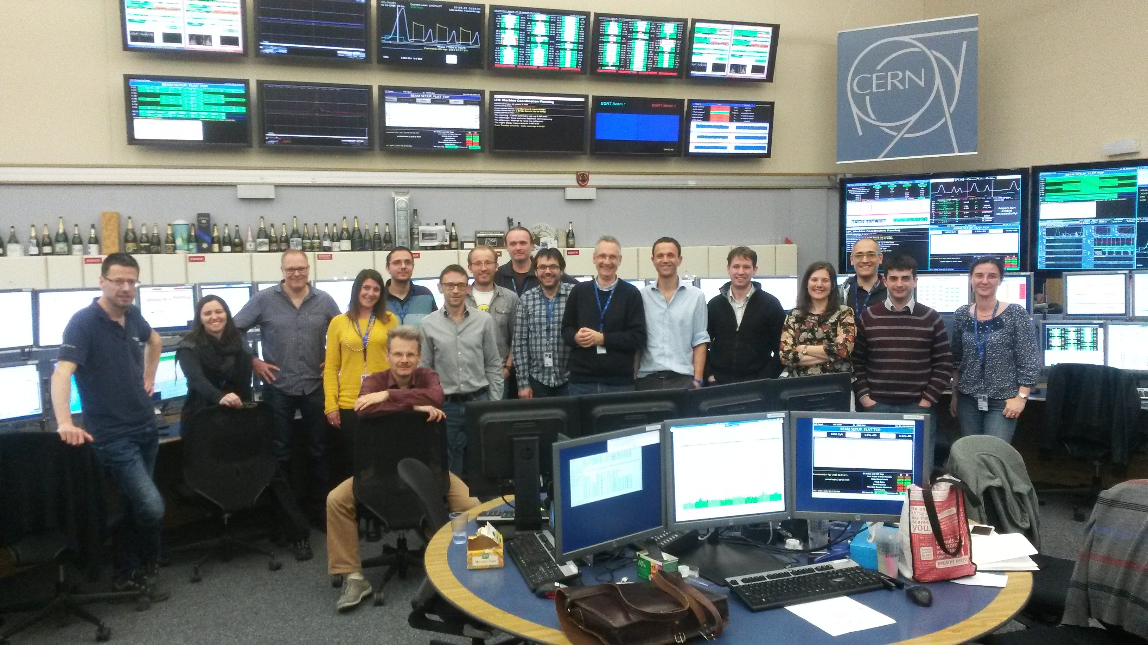
6.5 TeV for the first time
01:03 10th April

Slide 24
2 nominal bunches per beam
De-squeezed to 19 m

Slide 25
Of note 1/2
It’s not a new machine – a lot of lessons learnt from Run 1
Excellent and improved system performance
Beam Instrumentation
Transverse feedback
RF
Collimation
Injection and beam dump systems
Vacuum
Machine protection
Improved software & analysis tools
Experience!

Slide 26
Of note 2/2
Magnetically reproducible as ever
Optically good, corrected to excellent
Behaving well at 6.5 TeV
One additional training quench so far
Operationally well under control
Injection, ramp, squeeze, de-squeeze
Still have to face the intensity ramp-up
UFOs, e-cloud, vacuum, beam induced heating, instabilities

Slide 27
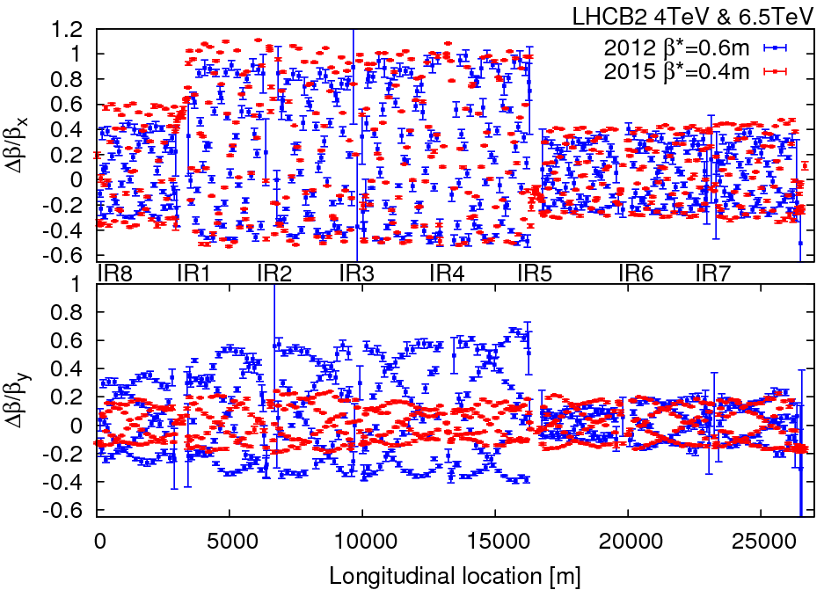
Optics - 40 cm
Rogelio and OMC team

Slide 28
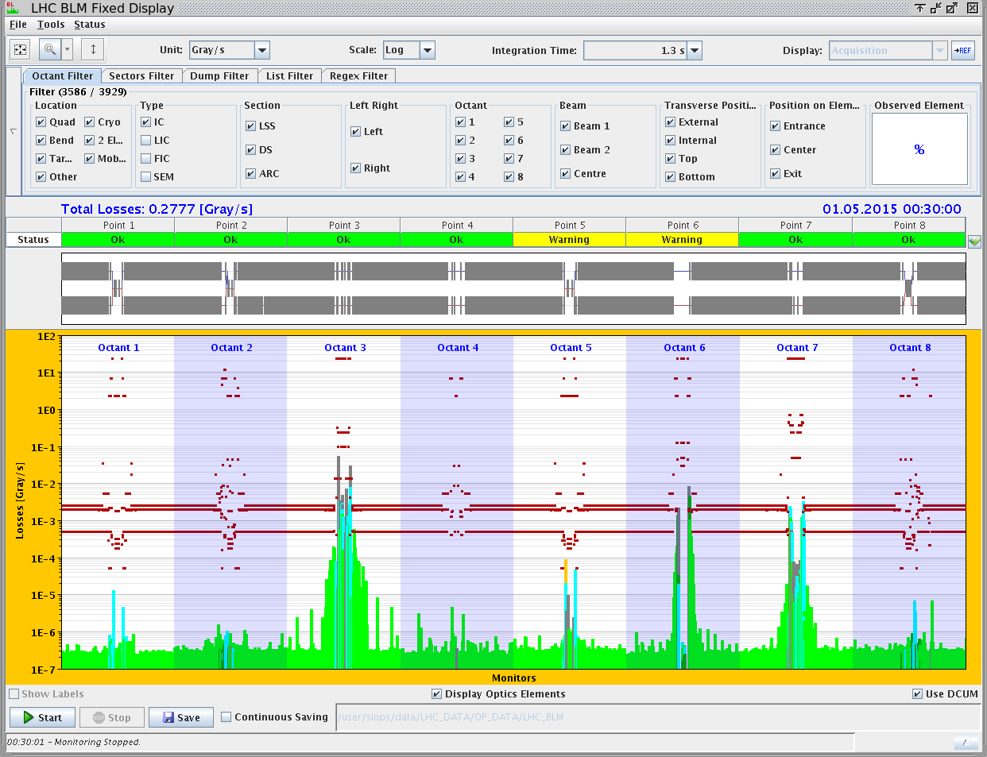
Off momentum loss map 6.5 GeV
Novel features of collimation system – BPM equipped tertiary collimators, automatic beam based set-up

Slide 29
Of course we’ve had a few issues…

Slide 30
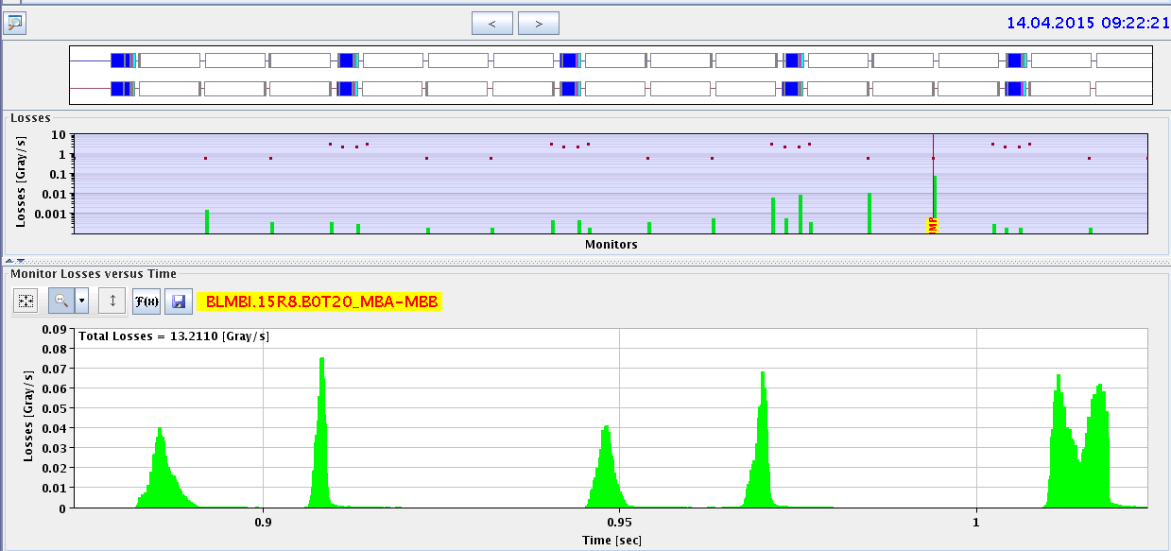
MUFOs in 15R8
quench
X
Q14
Q15
highest
loss
Multiple loss events after a short time at 6.5 TeV compatible with particles falling into the beam
loss patterns point to a specific position in the middle of a dipole magnet
Quenched twice, numerous BLM triggered dumps…

Slide 31
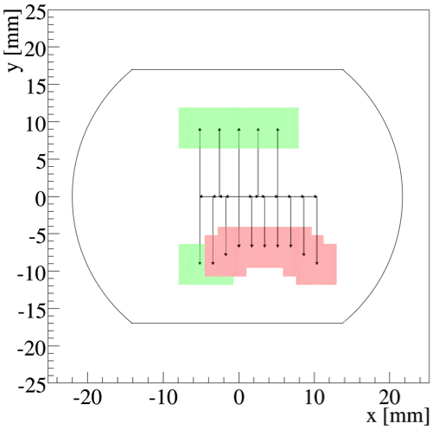
Aperture restriction in 15R8
ULO (Unidentified Lying Object)
Aperture restriction measured at injection and 6.5 TeV
Presently running with orbit bumps
-3 mm in H, +1 in V, to optimize available aperture
aperture probably not limiting for operation
Behaviour with higher intensities and bunch trains still unknown
MUFOs went away but last week
D. Mirarchi

Slide 32
Somewhat worrying

Slide 33
2015: ATLAS and CMS performance
Conservative beta* to start
Nominal bunch population
Reasonable emittance into collisions
Assume same machine availability as 2012
 | Nc | Beta* | ppb | EmitN | Lumi [cm⁻²s⁻¹] | Days (approx) | Int lumi | Pileup
50 ns | 1300 | 80 | 1.2e11 | 2.5 | 4.8e33 | 21 | ~1 fb⁻¹ | 25
2015.1 | 2448 | 80 | 1.2e11 | 3.1 | 7.1e33 | 35 | ~4 fb⁻¹ | 21
2015.2 | 2448 | 40 | 1.2e11 | 3.1 | 1.2e34 | 30 | ~5 fb⁻¹ | 35
Official GPD luminosity target for the year was 10 fb⁻¹
Now on the challenging side – let’s say 5 to 10 fb⁻¹

Slide 34
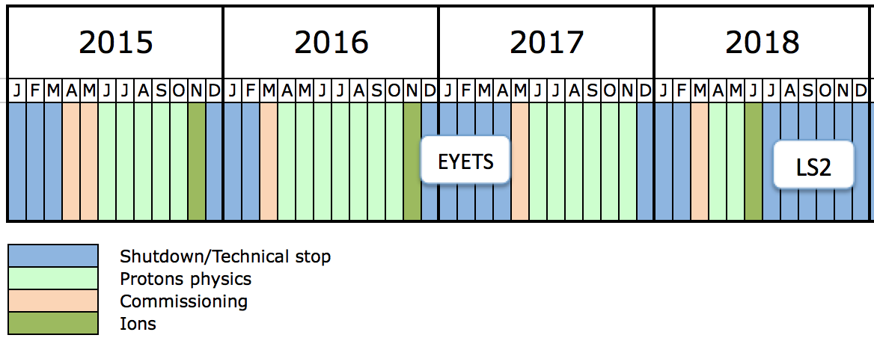
Run 2
EYETS – Extended Year End Technical Stop – 19 weeks – CMS pixel upgrade
Mid-year 2018 stop will be pushed towards year end (not yet official)

Slide 35
Run 2 performance
Aim to start 2016 in production mode
6.5 TeV, machine scrubbed for 25 ns operation
Beta* = 40 cm in ATLAS and CMS
New injection protection absorbers – full injection
Peak lumi limited to 1.7e34 by inner triplets
 | Peak lumi E34 cm⁻²s⁻¹ | Days proton physics | Approx. int lumi [fb⁻¹]
2015 | 1.2 | 70 | 5 - 10
2016 | 1.5 | 160 | 35
2017 | 1.7 | 160 | 45
2018 | 1.7 | 40 | 10

Slide 36
Conclusions
Looking good at 6.5 TeV
Impressive progress so far
Fabulous job done in LS1 and during powering tests
Lot of lessons learnt in Run 1
Next challenge - higher intensity and e-cloud
Fundamentals look sound, no show stoppers for the moment
Some irritants – resolution cost time
2015 will be a short year for proton physics but lay foundations for production for the rest of Run 2
It takes a remarkable effort by a large number of teams to prepare and exploit the LHC.

