Slide 1

The future of the LHC and beyond
Mike Lamont (B.Sc. Physics, Manchester 1978-1981)
for the LHC team

Slide 2
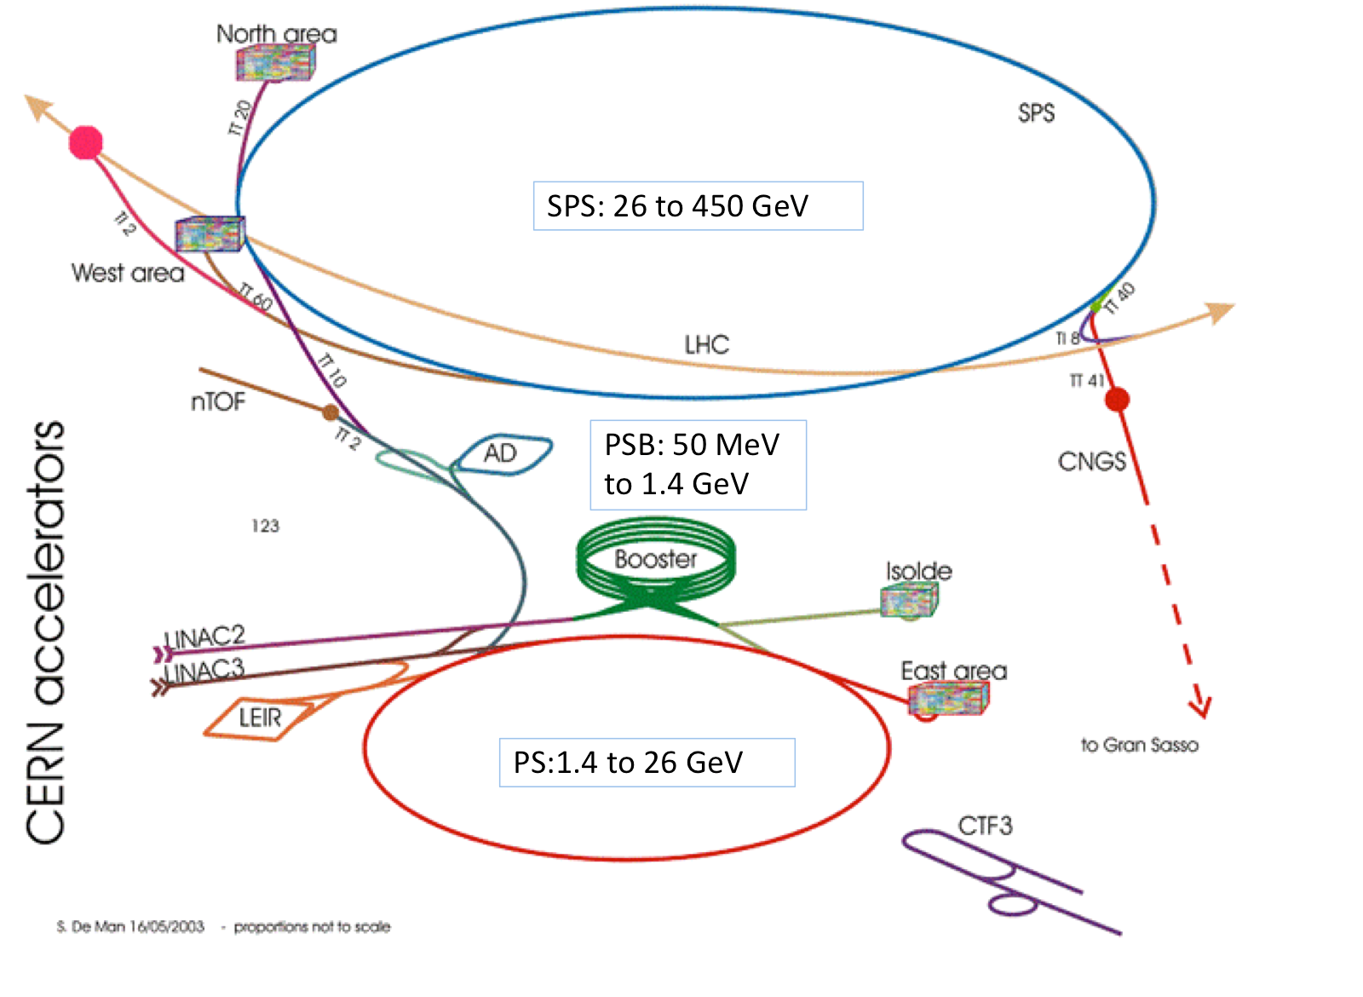

Slide 3
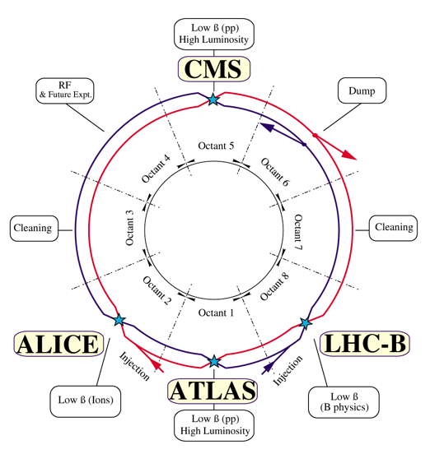
LHC – principles
High energy
High luminosity
High availability
High energy
High bunch intensity
Many bunches
Small beam size
LEP tunnel defines the bending radius
Superconducting magnet technology
1.9 K cryogenics
Bending radius & achievable field strength -> 7 TeV/c
Two beam pipes - 2 in 1 magnet design
Separated function - strong focusing
Luminosity insertions
Injectors

Slide 4
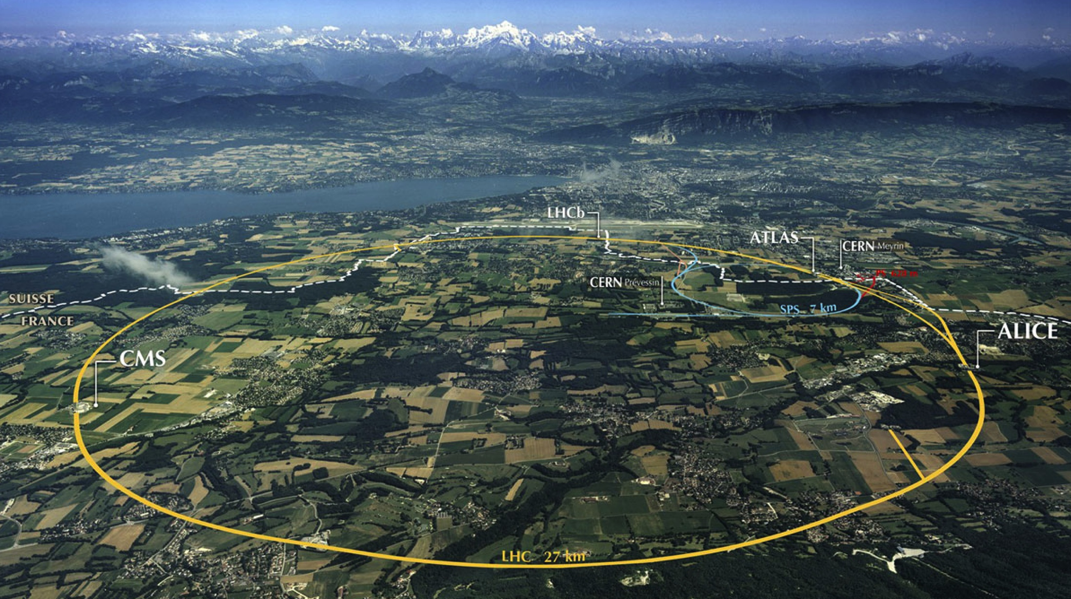
LHC: big, cold, high energy
Collimation
Injection B2
Beam dumps
Injection B1
Collimation
RF
1720 Power converters
> 9000 magnetic elements
7568 Quench detection systems
1088 Beam position monitors
~4000 Beam loss monitors
150 tonnes Helium, ~90 tonnes at 1.9 K
140 MJ stored beam energy in 2012
450 MJ magnetic energy per sector at 4 TeV

Slide 5
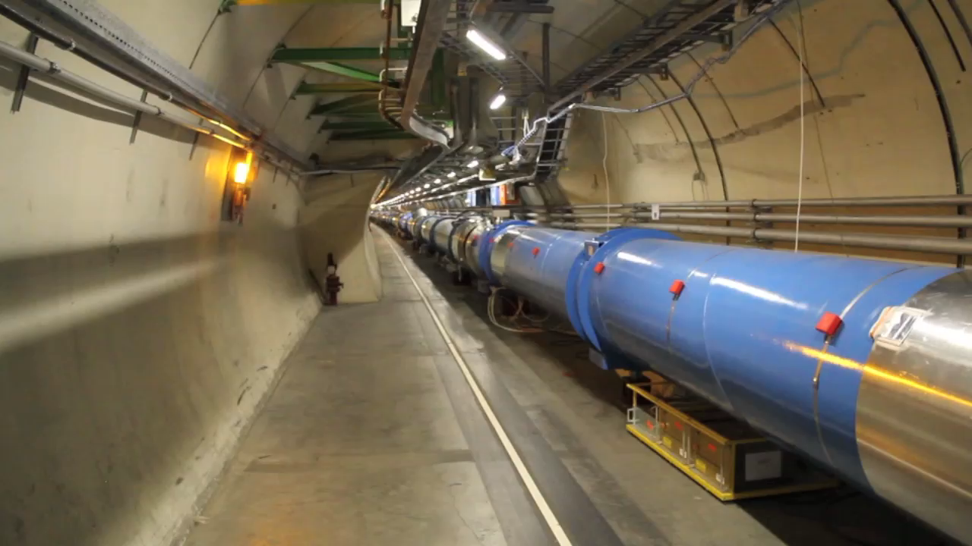
For real
Video 1’22’’

Slide 6
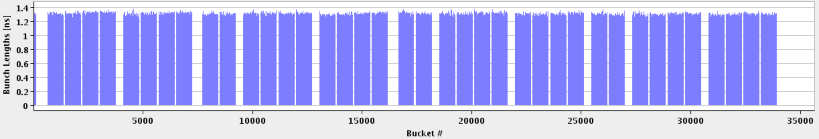
LHC bunch structure - 2012
50 ns bunch spacing
Maximum bunch intensity 1.7 x 10¹¹ protons per bunch
1 PS batch
(36 bunches)
1 SPS batch
(144 bunches)
Abort gap
26.7 km 1380 bunches

Slide 7
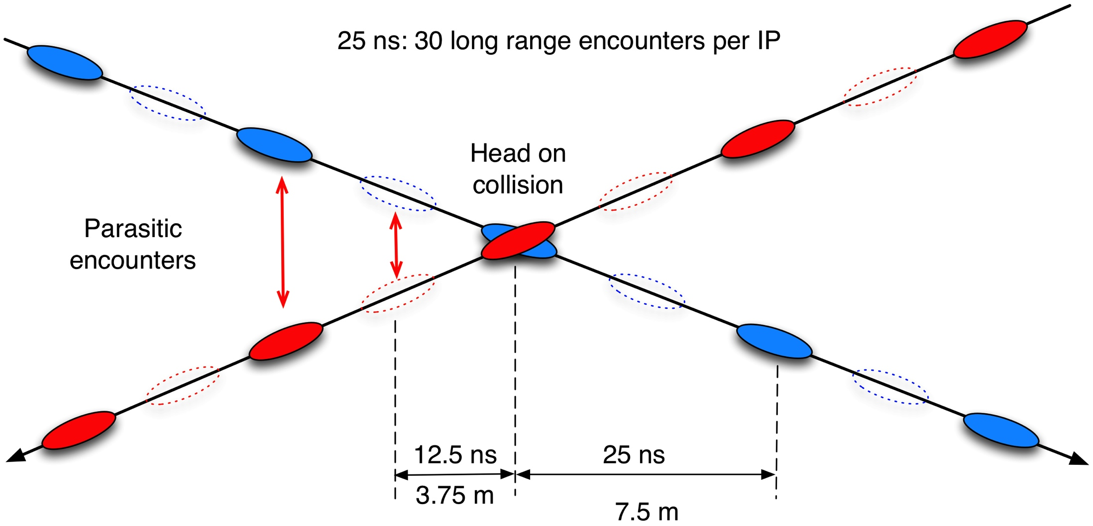
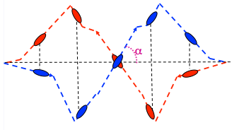
Crossing angle
work with a crossing angle to avoid parasitic collisions.

Slide 8
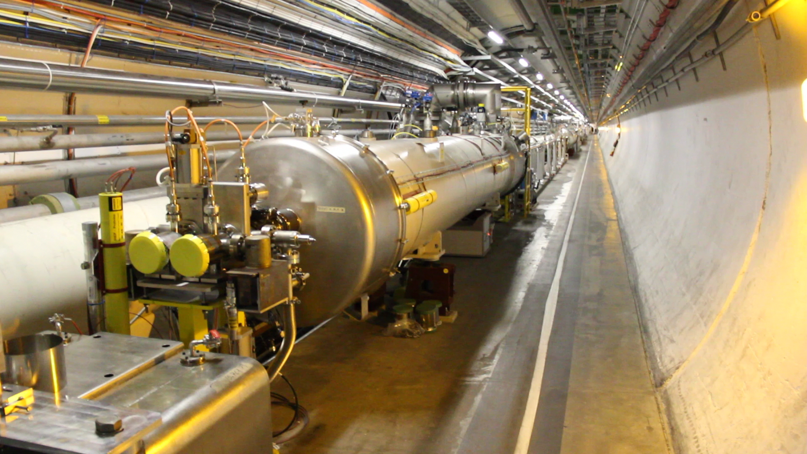
In the long straight section
Video 1’57’’

Slide 9
Alternate gradient focusing
x
s
Oscillatory term
Amplitude term
A and ₀ are constants, which depend on the initial conditions.
(s) = the amplitude modulation due to the changing focusing strength.
(s) = the phase advance, which also depends on focusing strength.
The amplitude and phase advance are both modulated by the beam envelope function, β.

Slide 10
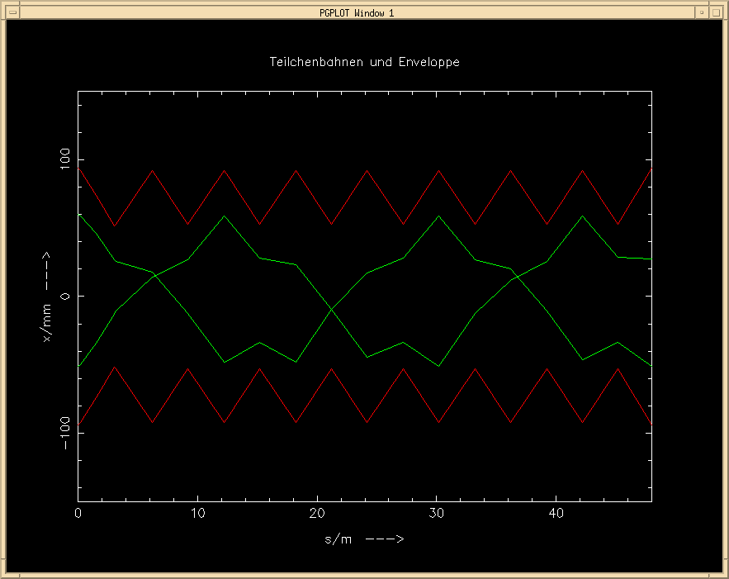
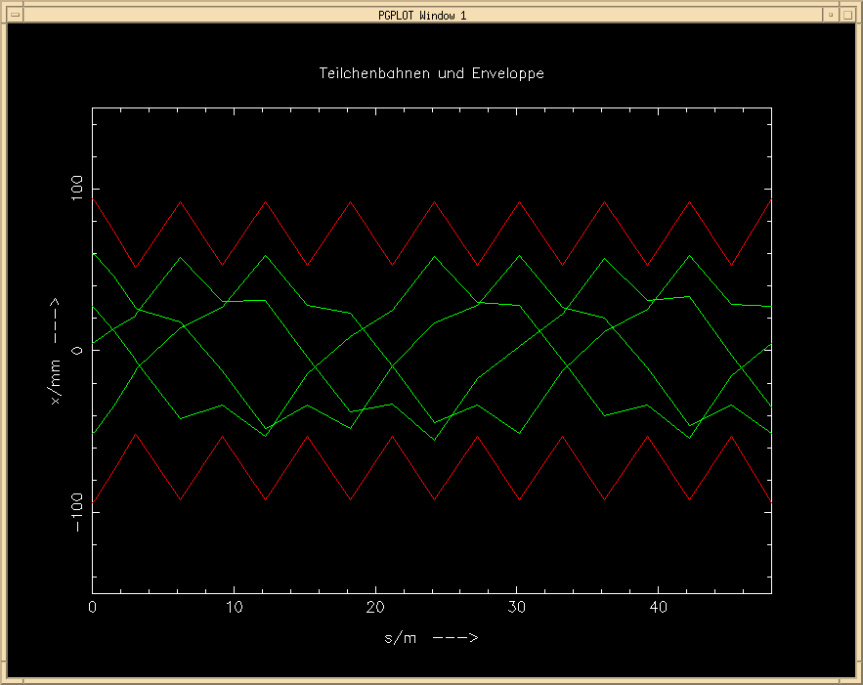
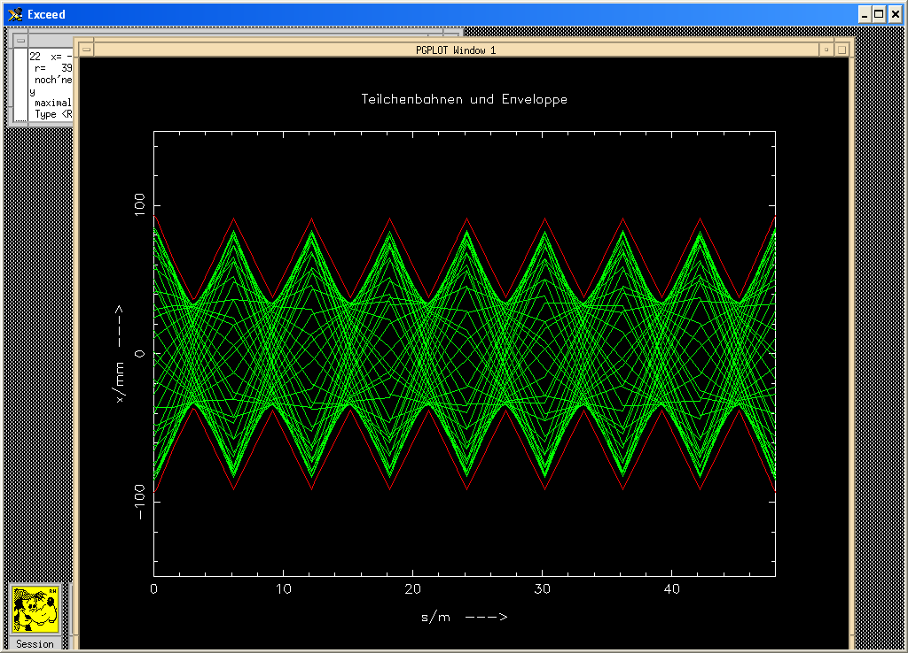
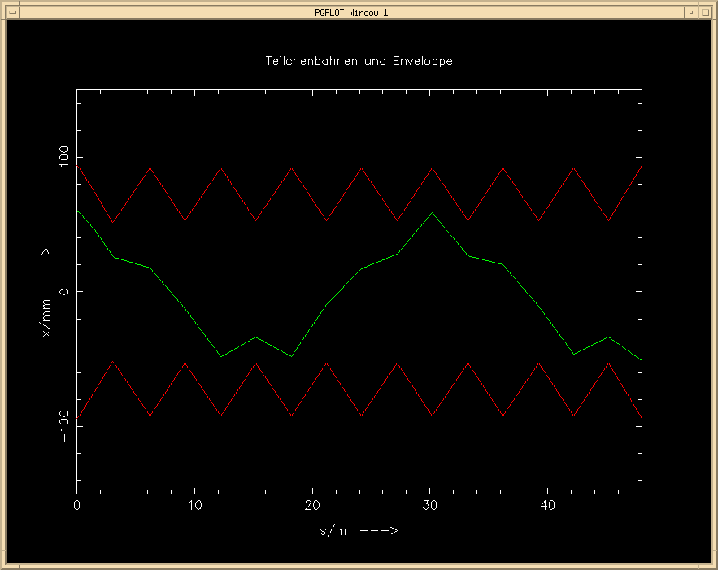
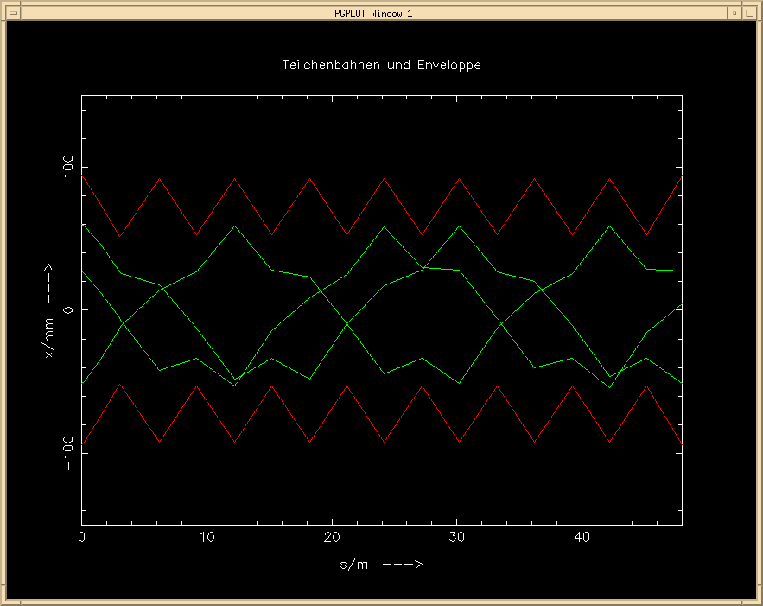
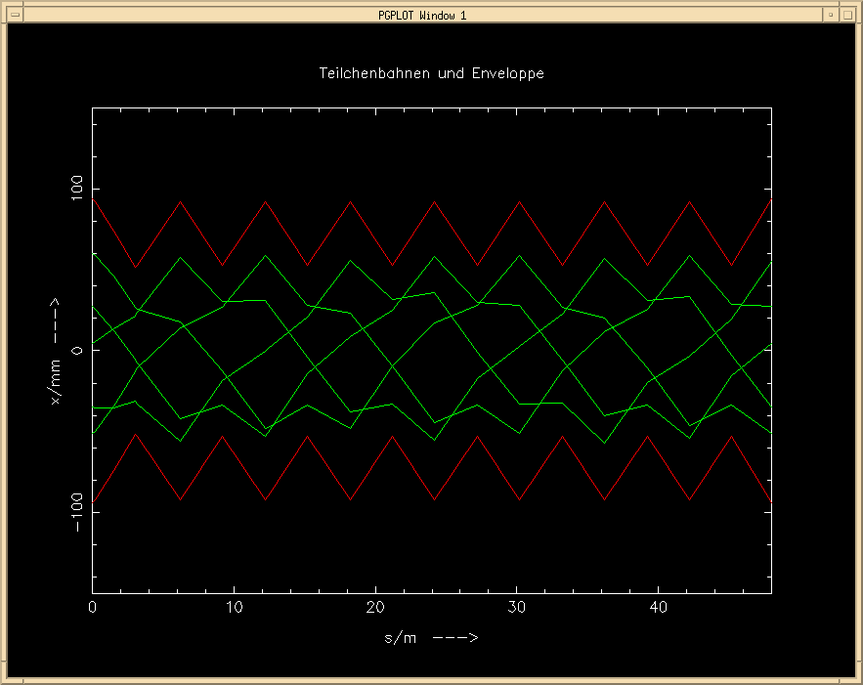
Question: what will happen, if the particle performs a second turn ?
... or a third one or ... 10¹⁰ turns
x
0
s
Bernhard Holzer

Slide 11
Phase space
x’
x
s
Sit at a focusing quadrupole (for example) and plot the phase space coordinates of a single particle, it will describe an ellipse:
x’ [μrad]
t4
t3
t5
x [mm]
t6
t2
t1

Slide 12
Phase space
As we move around the ring the ellipse changes orientation BUT the area remains the same
x’
x’
x’
x
x
x

Slide 13
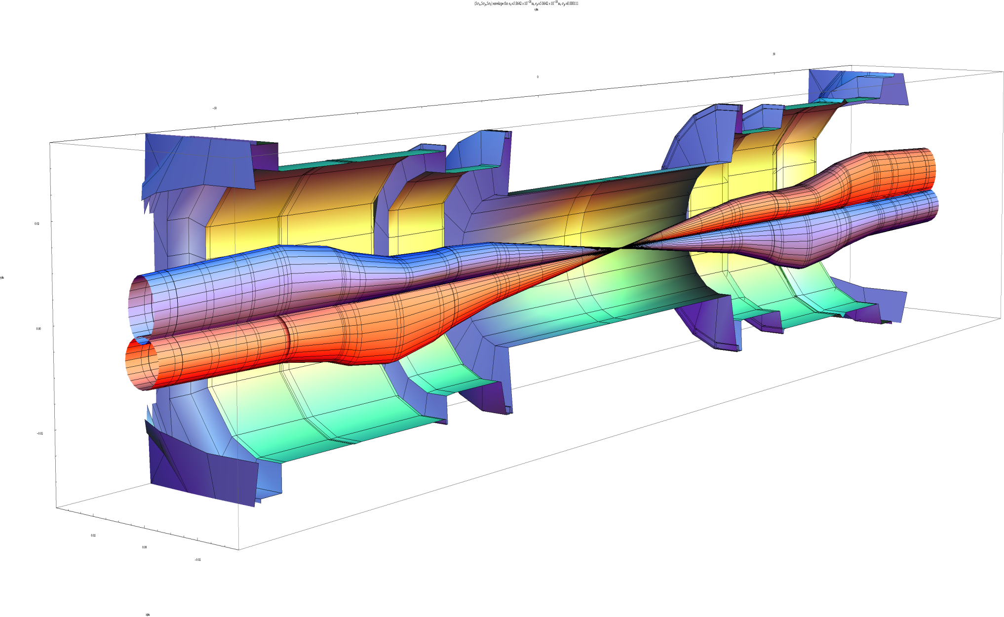
Squeeze in ATLAS
x´
x
β_{max} ~4.5 km
β* = 60 cm
NB: round beams at IP
Image courtesy John Jowett

Slide 14
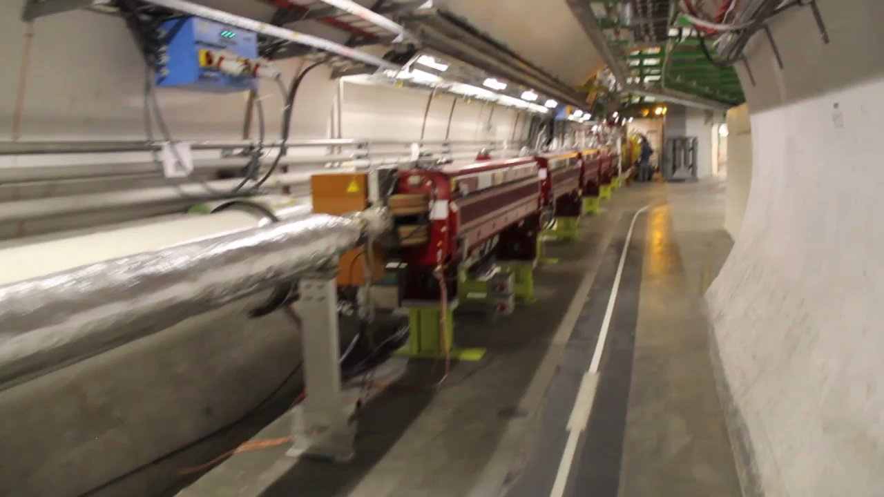
Triplet
Video 58’’

Slide 15
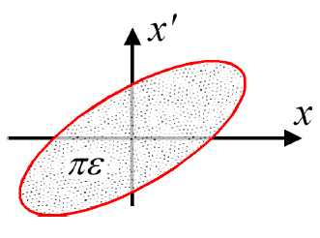
Luminosity
N | Number of particles per bunch
k_{b} | Number of bunches
f | Revolution frequency
σ* | Beam size at interaction point
F | Reduction factor due to crossing angle
ε | Emittance
ε_{n} | Normalized emittance
β* | Beta function at interaction point
Round beams, beam 1 = beam 2

Slide 16
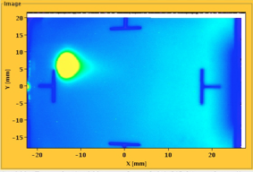
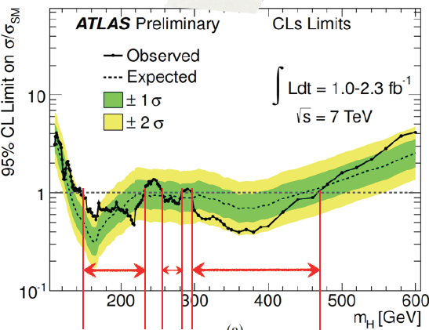
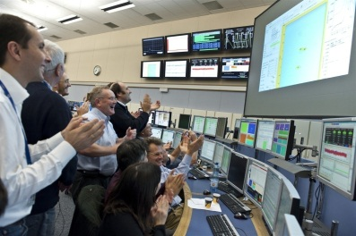
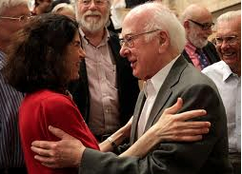

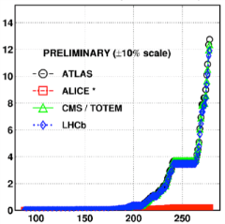

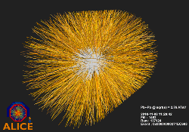
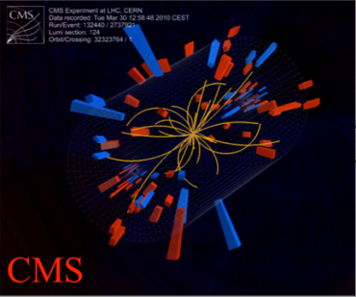
August 2008
First injection test
November 29, 2009
Beam back
August, 2011
2.3e33, 2.6 fb⁻¹
1380 bunches
September 10, 2008
First beams around
June 28 2011
1380 bunches
October 14 2010
1e32
248 bunches
4 July, 2012
1380
6 June, 2012
6.8e33
2008
2009
2010
2011
2012
November 2010
Ions
March 30, 2010
First collisions at 3.5 TeV
September 19, 2008
Disaster
Accidental release of 600 MJ stored in one sector of LHC dipole magnets
18 June, 2012
6.6 fb⁻¹
to ATLAS & CMS
LHC Timeline

Slide 17
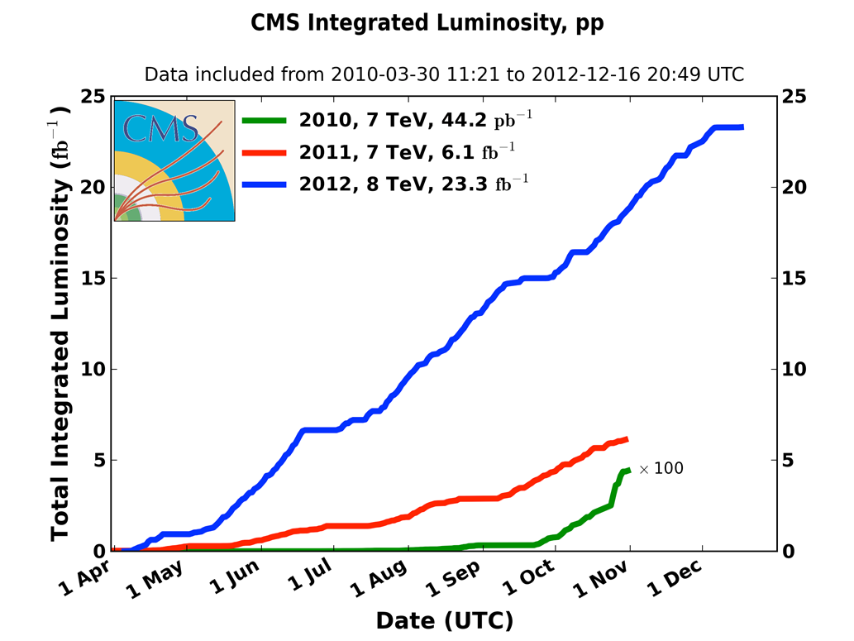
Integrated luminosity 2010-2012
2010: 0.04 fb⁻¹
  7 TeV CoM
  Commissioning
2011: 6.1 fb⁻¹
  7 TeV CoM
  Exploring the limits
2012: 23.3 fb⁻¹
  8 TeV CoM
  Production
 | 2010 | 2011 | 2012
Max. luminosity delivered in 7 days [fb⁻¹] | 0.025 | 0.58 | 1.35

Slide 18
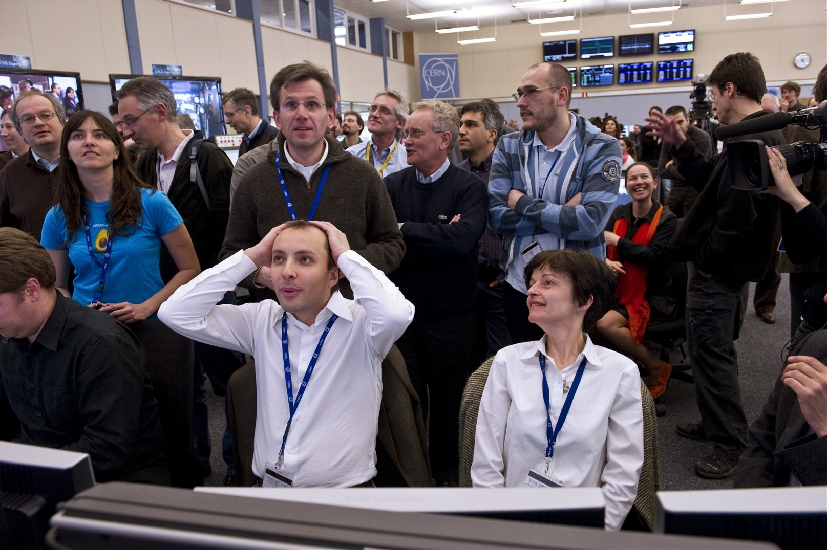
First 7 TeV collisions – that was close
You lucky, lucky buggers!!!

Slide 19
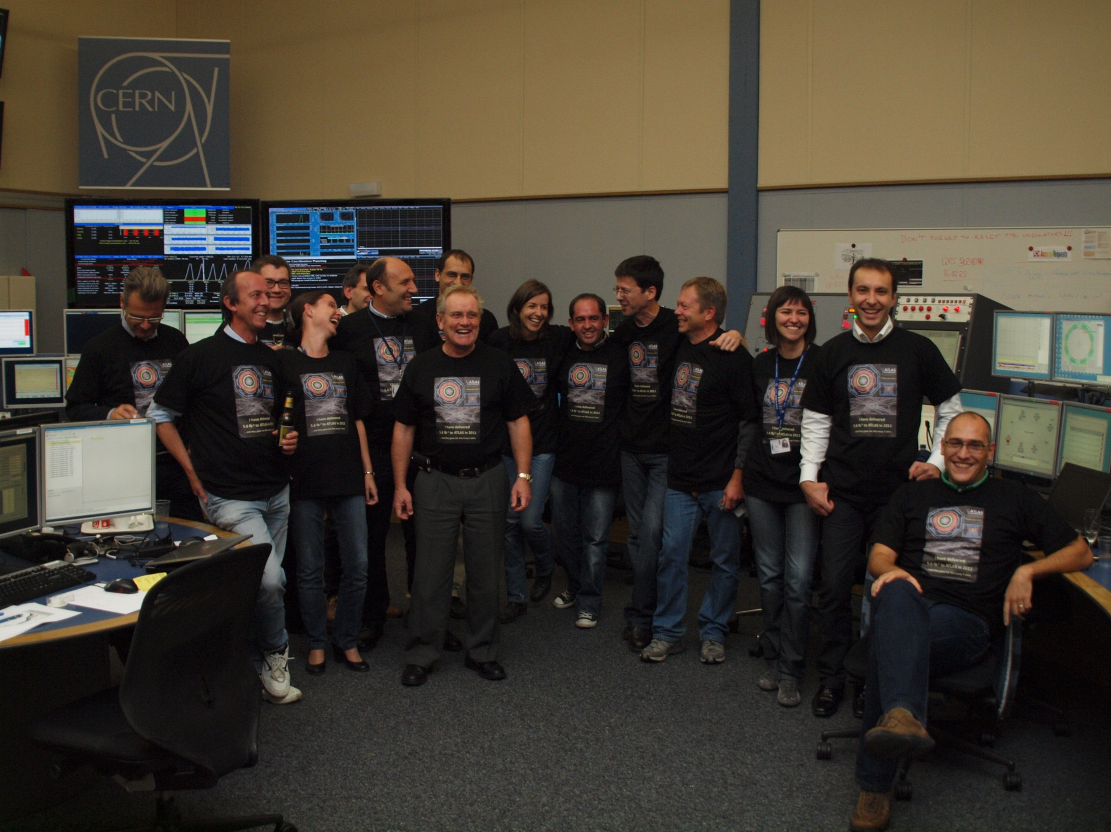
We delivered 5.6 fb⁻¹ to Atlas in 2011 and all we got was a blooming tee shirt

Slide 20
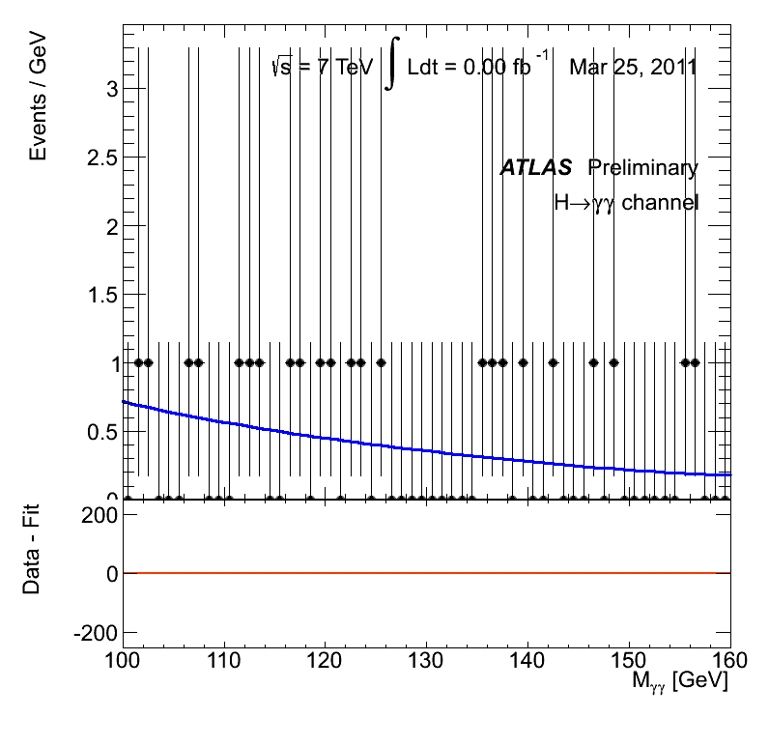

Slide 21
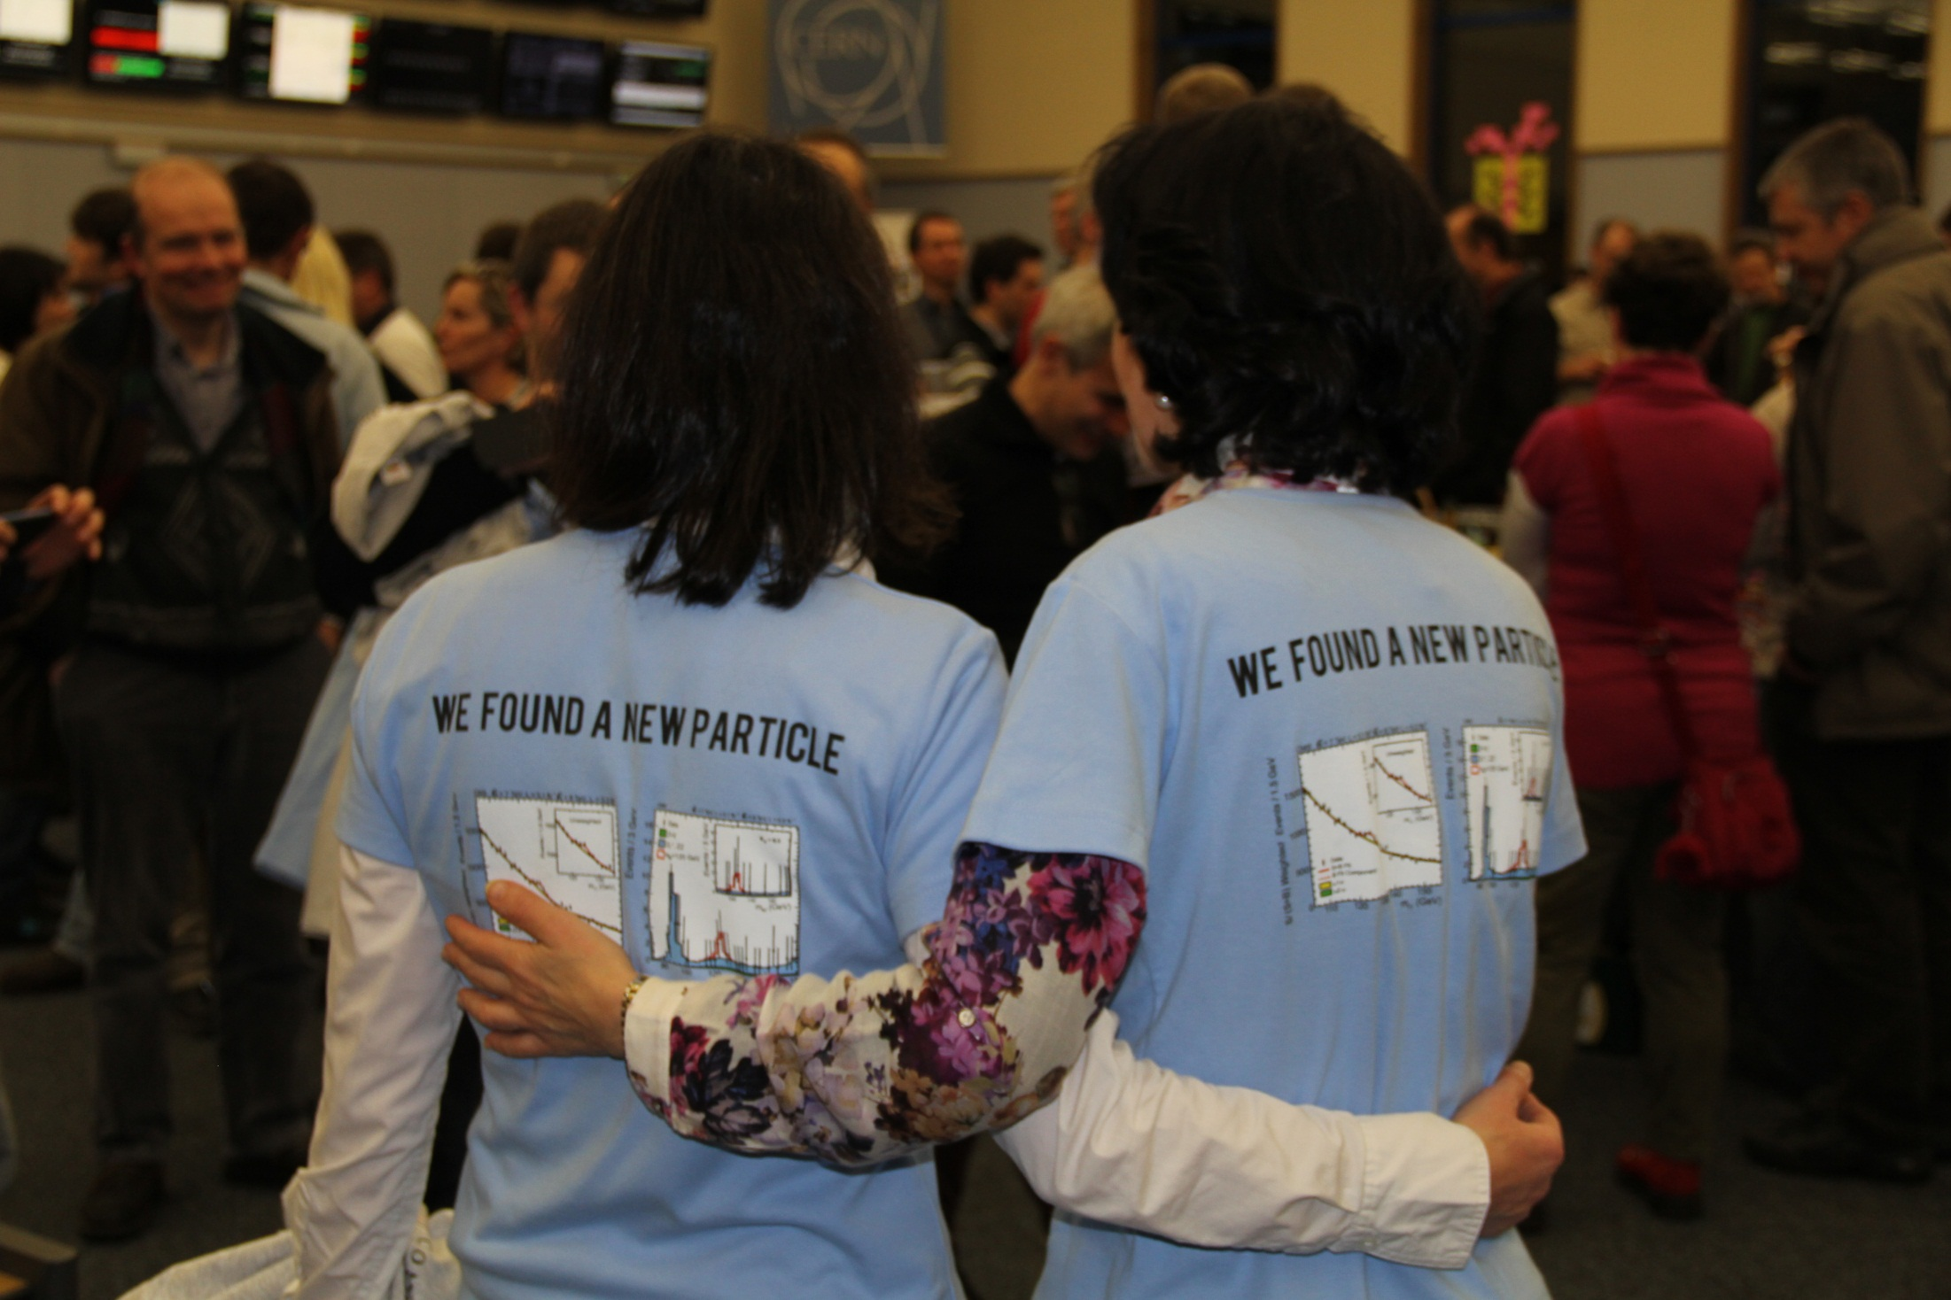

Slide 22
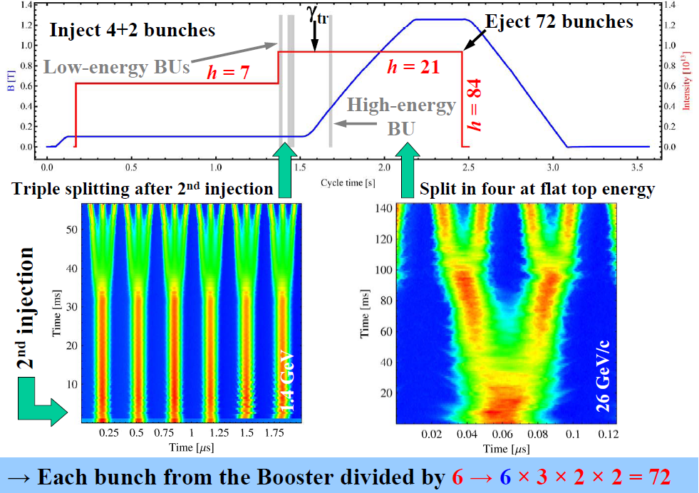
Performance from injectors 2012
Bunch spacing [ns] | Protons per bunch [ppb] | Norm. emittance H&V [μm] Exit SPS
50 | 1.7 x 10¹¹ | 1.8
25 | 1.2 x 10¹¹ | 2.7
25 (design report) | 1.15 x 10¹¹ | 3.75
Chose to stay with 50 ns:
I_{b}²
lower total intensity
less of an electron cloud challenge
High pileup as a result

Slide 23
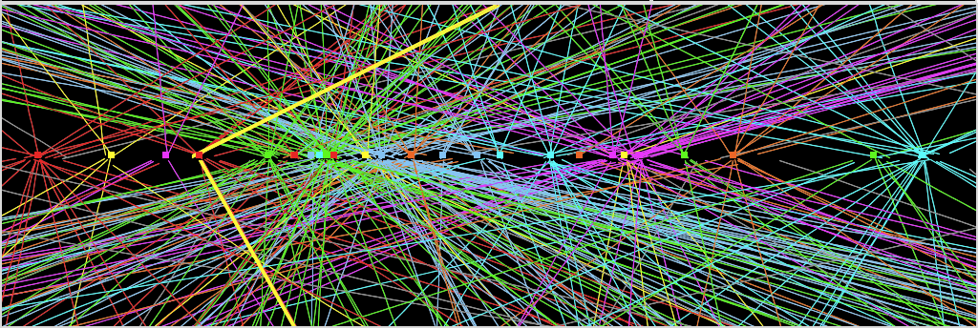
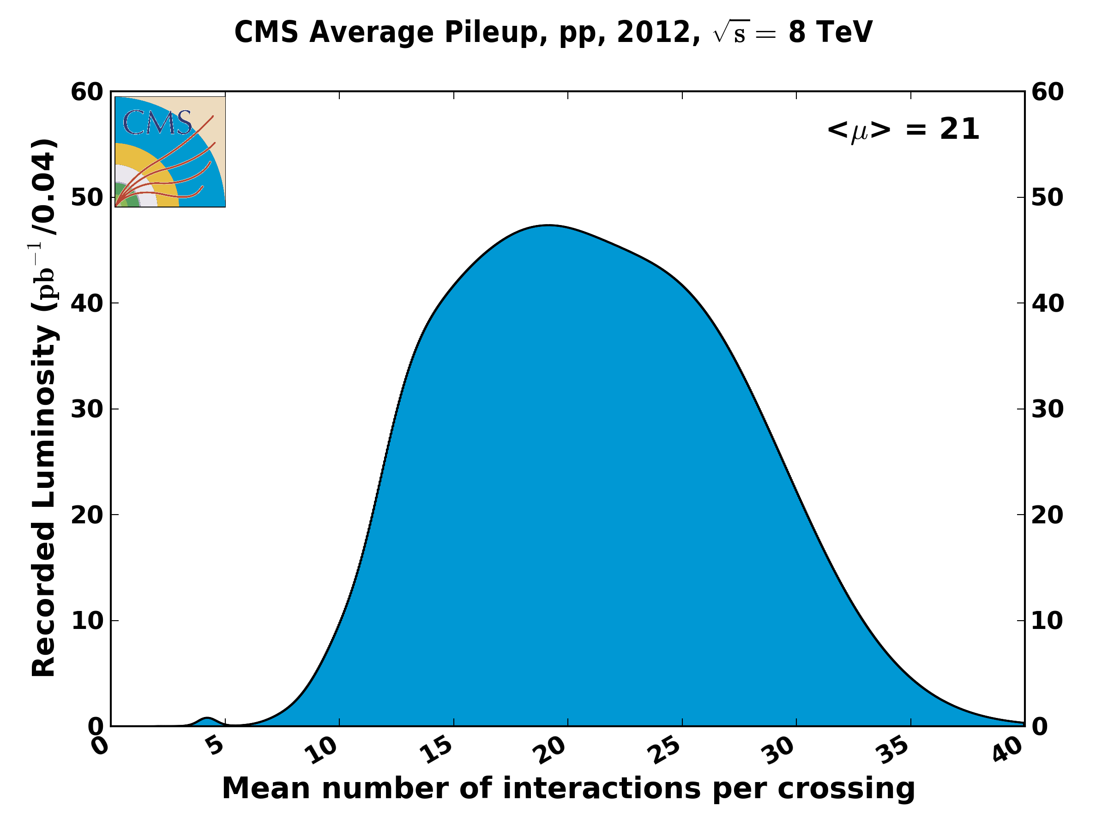
Z→ μμ event from 2012 data with 25 reconstructed vertices
Huge efforts over last months to prepare for high lumi and pile-up expected in 2012:
optimized trigger and offline algorithms (tracking, calo noise treatment, physics objects)
→ mitigate impact of pile-up on CPU, rates, efficiency, identification, resolution
in spite of x2 larger CPU/event and event size → we do not request additional computing
resources (optimized computing model, increased fraction of fast simulation, etc.)
Z→ μμ
23

Slide 24
Peak performance through the years
 | 2010 | 2011 | 2012 | Nominal
Energy [TeV] | 3.5 | 3.5 | 4 | 7
Bunch spacing [ns] | 150 | 50 | 50 | 25
No. of bunches | 368 | 1380 | 1380 | 2808
beta* [m] ATLAS and CMS | 3.5 | 1.0 | 0.6 | 0.55
Max bunch intensity [protons/bunch] | 1.2 x 10¹¹ | 1.45 x 10¹¹ | 1.7 x 10¹¹ | 1.15 x 10¹¹
Normalized emittance [mm.mrad] | ~2.0 | ~2.4 | ~2.5 | 3.75
Peak luminosity [cm⁻²s⁻¹] | 2.1 x 10³² | 3.7 x 10³³ | 7.7 x 10³³ | 1.0 x 10³⁴

Slide 25
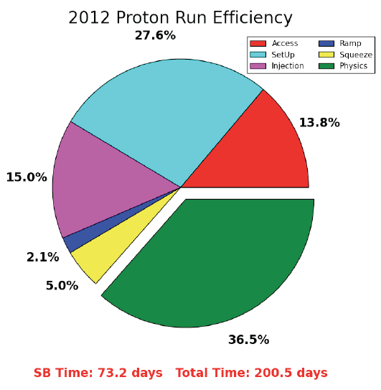
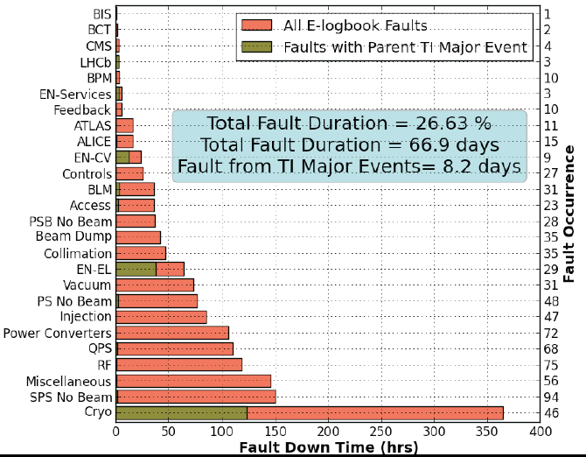
Availability
There are a lot of things that can go wrong – it’s always a battle
Pretty good availability considering the complexity and principles of operation
Stable beams
Cryogenics availability in 2012: 93.7%

Slide 26
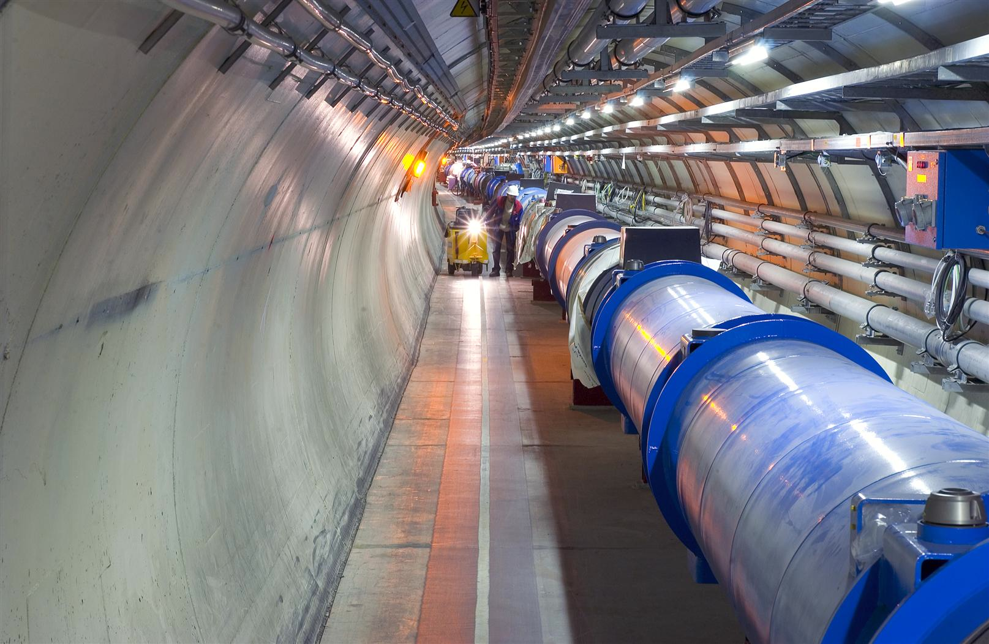
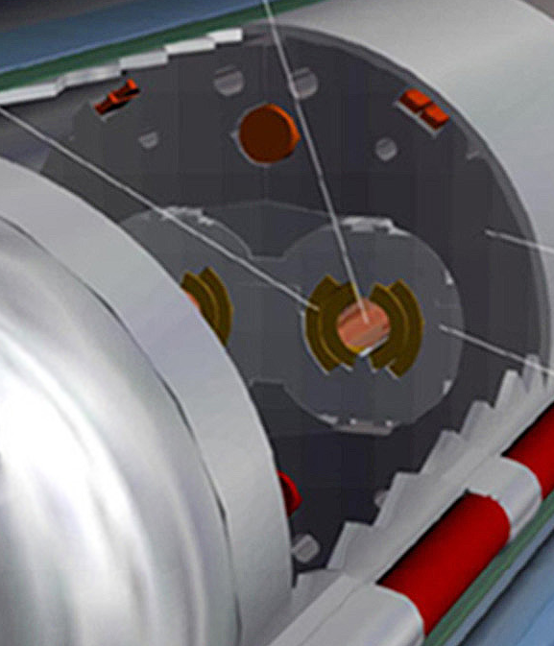
Machine protection
Beam
140 MJ
Not a single accidental beam induced quench at 4 TeV
… YET
11 magnet quench at 450 GeV – injection kicker flash-over
56 mm
SC Coil:
quench limit
15-100 mJ/cm³
Operations unpinned by superb performance of machine protection
Rigorous machine protection follow-up, qualification, and monitoring
R. Assmann

Slide 27
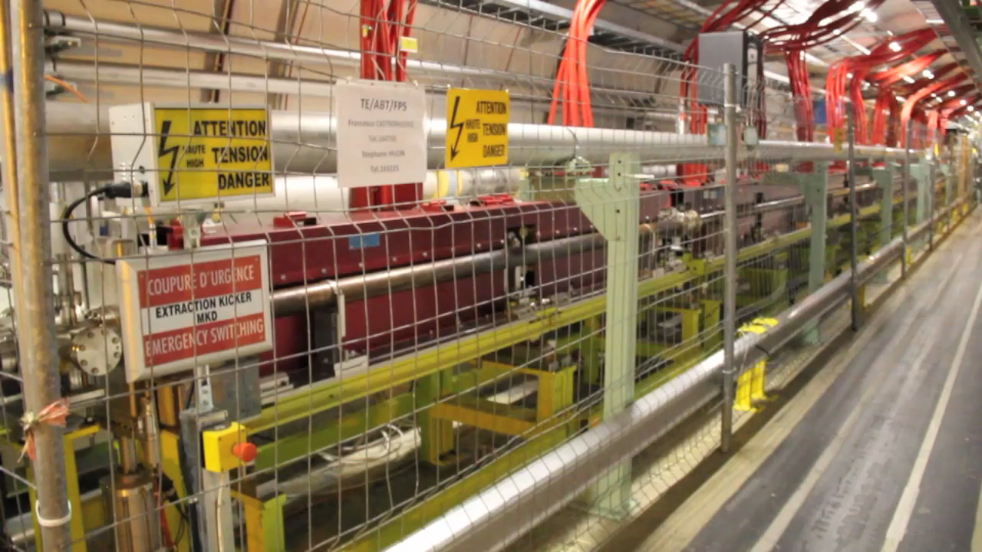
Beam dump system – point 6
Video 2’10”

Slide 28
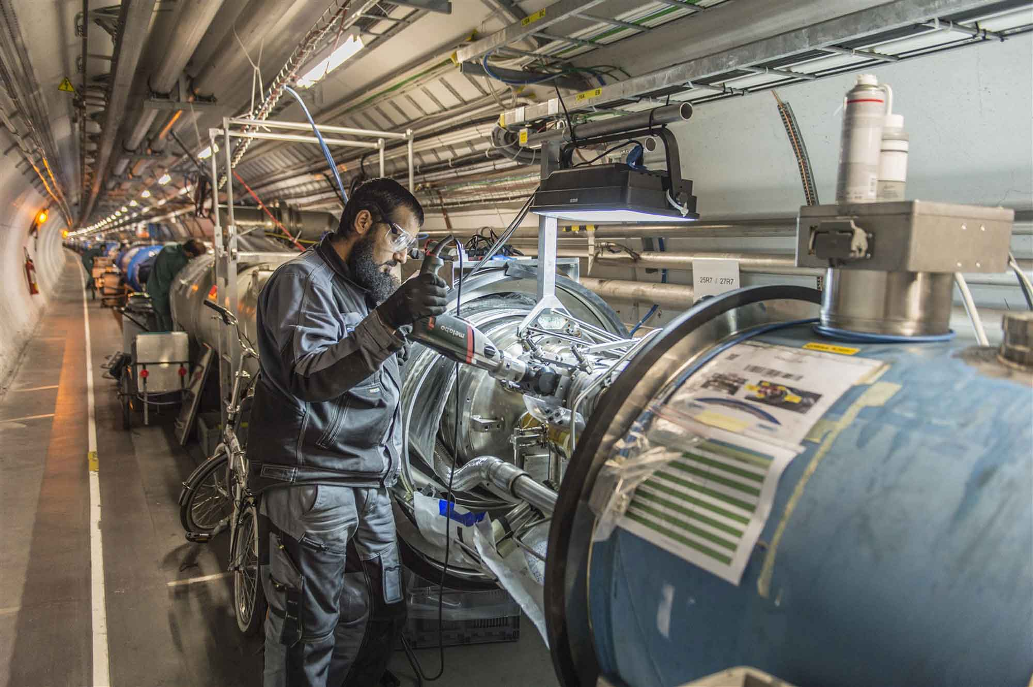
Long Shutdown 1

Slide 29
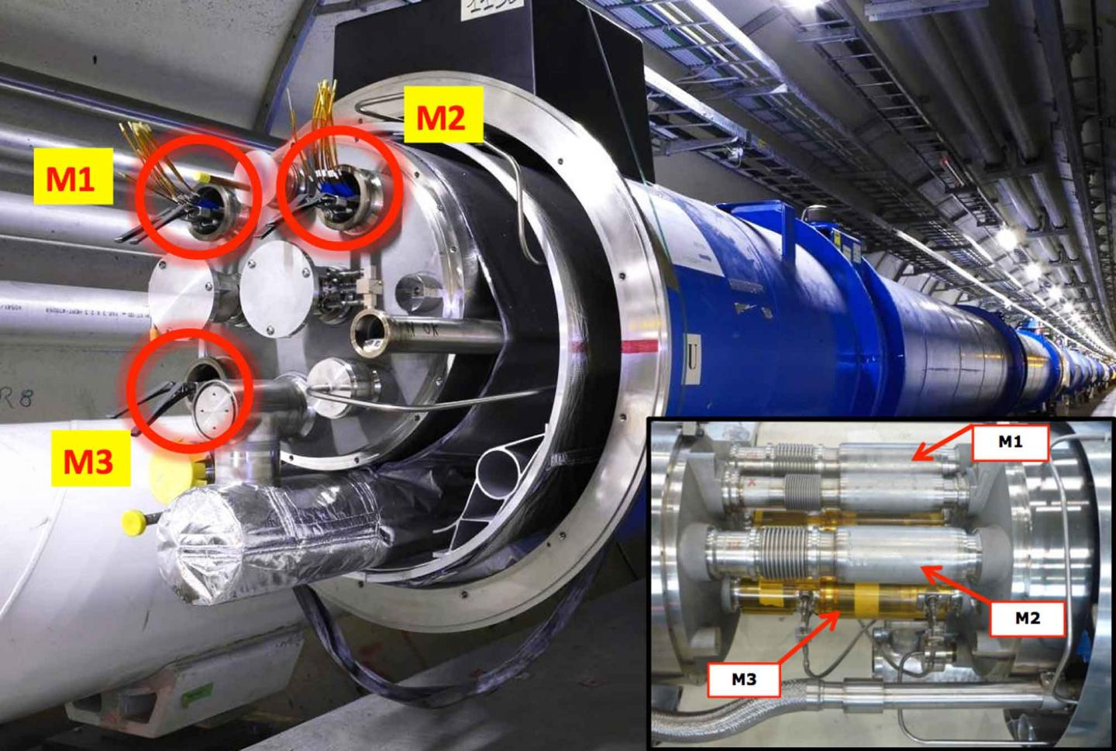

Slide 30
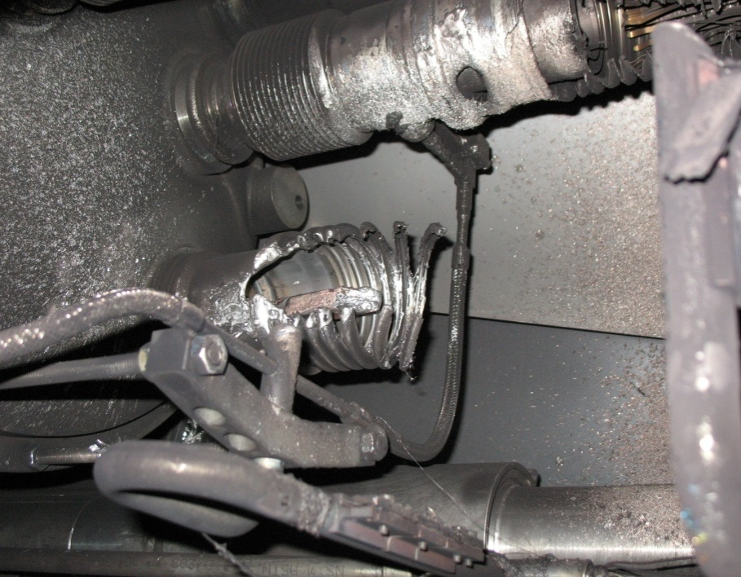
2008 - what happened?
Theory: A resistive joint of about 220 nΩ with bad electrical and thermal contacts with the stabilizer
No electrical contact between wedge and U-profile with the bus on at least 1 side of the joint
No bonding at joint with the U-profile and the wedge
Loss of clamping pressure on the joint, and between joint and stabilizer
Degradation of transverse contact between superconducting cable and stabilizer
Interruption of longitudinal electrical continuity in stabilizer
Problem: this is where the evidence used to be
A. Verweij

Slide 31
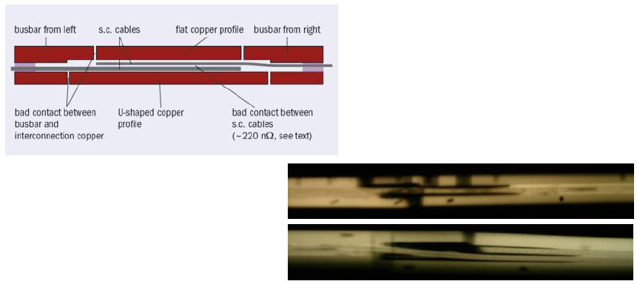
The Splices
gamma-rays of splices showing voids and bad contacts

Slide 32
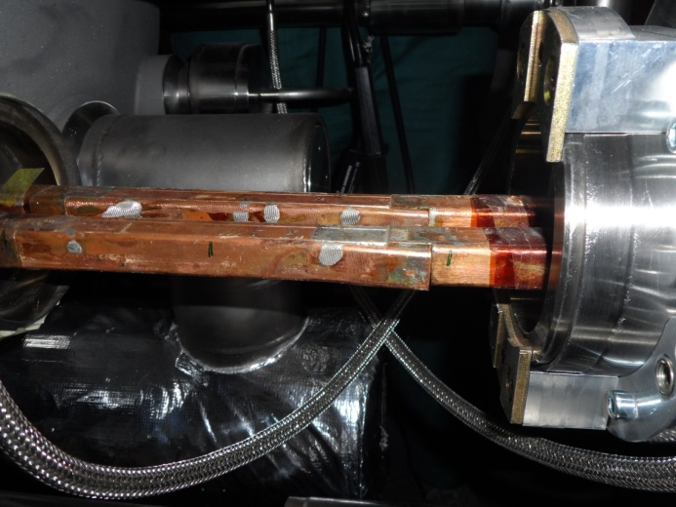
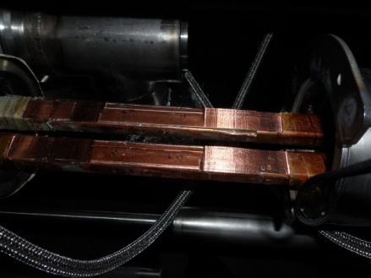
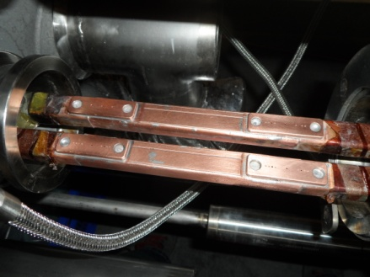
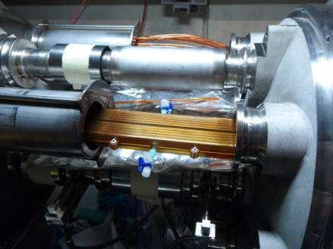
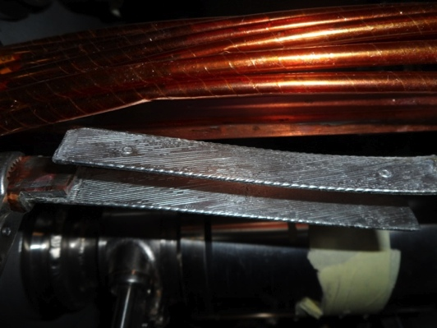
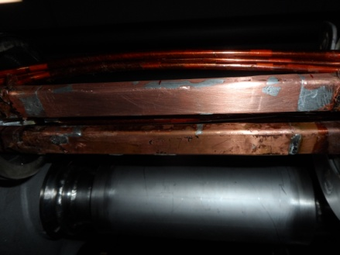
Splice Consolidation Process
Old splices
10170 splices
Machined splices
Consolidated splices including shunts
> 27000 shunts
30% of the splices
Initially estimated at 15%
~ 3000
Unsoldering of splice and superconducting cables
Reconstruction and soldering of splice and superconducting cables
Consolidated and insulated splices

Slide 33
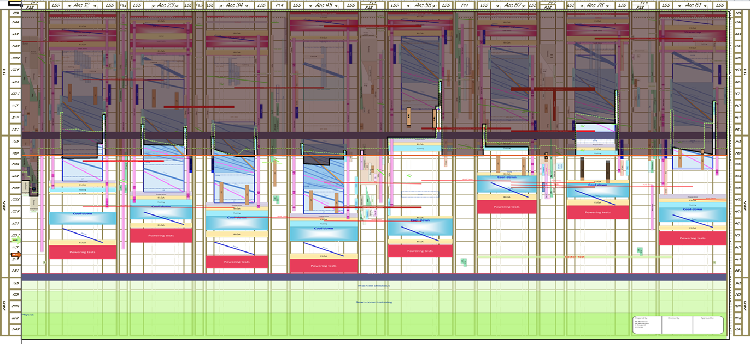
LS1 Overall Schedule
Warm-up & Preliminary tests
2013
Completed
Consolidation & Maintenance Activities
Start of Cool-down
2014
Powering tests & HW commissioning
2015
Machine check-out & Beam commissioning

Slide 34
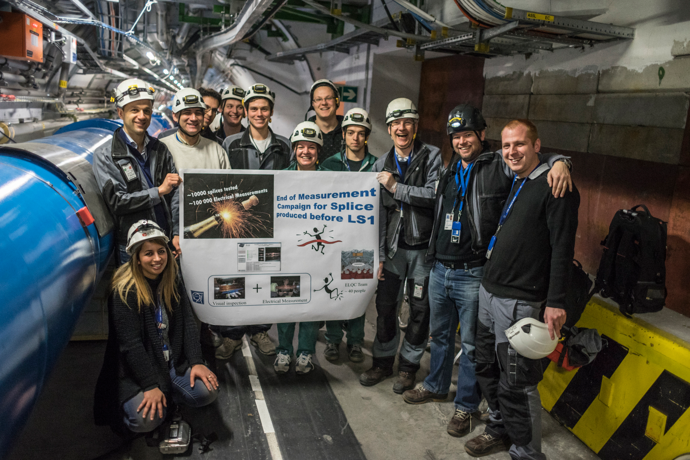

Slide 35
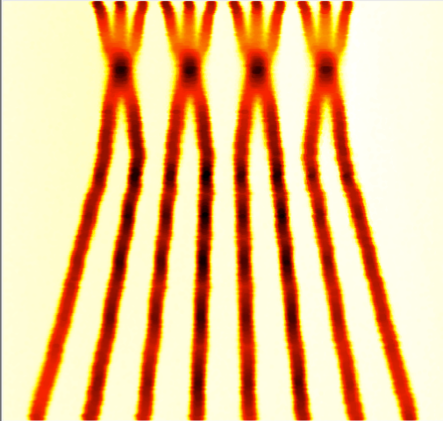
Post LS1
Energy: 6.5 TeV
Beta*: 40 – 50 cm
Bunch spacing: 25 ns
  because of pile-up considerations
Injectors potentially able to offer nominal intensity with even lower emittance
BCMS = Batch Compression and Merging and Splitting
 | Number of bunches | Ib LHC [1e11] | Emit LHC [um] | Peak Lumi [cm-²s⁻¹] | ~Pile-up | Int. Lumi per year [fb⁻¹]
25 ns BCMS | 2590 | 1.15 | 1.9 | 1.7e34 | 49 | ~45

Slide 36

Next 10 years
Run 2
Run 3
6.5 to 7 TeV
Peak luminosity 1.7x10³⁴cm⁻²s⁻¹
7 TeV
Peak luminosity 2.0x10³⁴cm⁻²s⁻¹
LIU (Injectors)
ALICE
LHCb
HL-LHC
(Machine & expts)

Slide 37

Luminosity evolution
~300 fb⁻¹
Usual caveats apply

Slide 38


Slide 39

HL-LHC
3000 fb⁻¹ delivered in the order of 10 years
High “virtual” luminosity with levelling anticipated
Challenging demands on the injector complex
  major upgrades foreseen (Linac 4, Booster 2GeV, PS and SPS)
5 x 10³⁴ cm⁻²s⁻¹ levelled luminosity
3 fb⁻¹ per day
~250 fb⁻¹ /year

Slide 40


HL-LHC: main thrusts
Wide aperture Nb₃Sn quadrupoles – new inner triplet
  Optics and layout: beta* = 15 cm
11 T Nb₃Sn dipoles
  Used to make room for collimation in cold region
Large Aperture NbTi separator magnets
Crab cavities
  Reduce the effect of the crossing angle
LARP: HQ02

Slide 41


HL-LHC
Project firmly established under leadership of Lucio Rossi and Oliver Bruning
International collaboration with solid R&D program in place
Q4

Slide 42
HL-LHC: key 25 ns parameters
Protons per bunch | 2.2 x 10¹¹
Normalized emittance | 2.5 micron
Beta* | 15 cm
Crossing angle | 590 microrad
Geometric reduction factor | 0.305
Virtual luminosity | 24 x 10³⁴ cm⁻²s⁻¹
Levelled luminosity | 5 x 10³⁴ cm⁻²s⁻¹
Levelled <pile-up> | 140

Slide 43

2010 - 2035
HL-LHC upgrade – machine and experiments

Slide 44
Fabiola’s Conclusions
The discovery of a (the ?) Higgs boson is a giant leap in our understanding
of fundamental physics and the structure and evolution of the universe
After almost 100 years of superb theoretical and experimental work (in particular
from accelerator-based particle physics), the Standard Model has been completed.
However: we also know that the SM is not the ultimate theory of particle physics,
because of the many outstanding questions, including:
Why is the Higgs boson so light (“naturalness” problem) ?
What is the the nature of the dark part (96% !) of the universe ?
What is the origin of the matter-antimatter asymmetry ?
Why is gravity so weak ?
There are compelling reasons to believe that answers to some of the above questions lie
at the TeV scale, whose exploration JUST started …
The STRONG physics case for the HL-LHC with 3000 fb⁻¹ comes from the imperative
necessity of exploring this scale as much as we can with the highest-E facility we
have today (note: no other planned machine, except a 100 TeV pp collider, has a similar
direct discovery potential). Likely, and perhaps more importantly, the HL-LHC will
also tell us what are the right questions to ask and how to continue.
More powerful accelerators will be needed in the future to advance our knowledge
of fundamental physics, requiring new ideas, ingenuity, new developments in
order to provide higher energy at affordable costs.

Slide 45


Large Hadron Electron Collider: LHeC
Foresees 60 GeV electrons on 7 TeV protons
Conceptual design report published in June 2012
Two e⁻ options: linac-ring (LR) and ring-ring (RR)
Linac-ring option: re-circulating linac with energy recovery
Oliver Bruning, Max Klein et al

Slide 46


High Energy LHC: HE-LHC
Re-equip existing LHC tunnel with high field magnets
Conceptual layout of 20 T dipole magnet
(Nb₃Sn and HTS)
Intense R&D required
Circumference | 26.7 km
Maximum dipole field | 20 T
Injection energy from SC-SPS | 1.3 TeV
Maximum c.o.m. energy | 33 TeV
Peak luminosity | 5 x 10³⁴ cm⁻²s⁻¹

Slide 47

80 to 100 km Very High Energy LHC VHE-LHC
LHC
Pre-Feasibility Study for an 80-km tunnel at CERN
John Osborne and Caroline Waaijer, CERN, ARUP & GADZ
Jura
1
8
2
Geneva
7
3
Saleve
6
100 km
4
5

Slide 48
VHE-LHC (FCC hh)
Circumference | 80 or 100 km
Maximum dipole field | 20 or 16 T
Injection energy | > 3.0 TeV
Maximum c.o.m. energy | 100 TeV
Peak luminosity | 5 x 10³⁴ cm⁻²s⁻¹
Stored beam energy | ~5500 MJ
Among the many challenges:
Synchrotron radiation heat load 33 W/m
Collimation!
IR quadrupoles
Arc quadrupoles (naïve scaling gives 1593 T/m at 50 TeV beam energy)

Slide 49
Injection into VHE-LHC
LHC
Jura
1
VHE-LHC-LER
8
SPS+
2
Geneva
7
3
Saleve
6
4
5

Slide 50



Possible VHE-LHC with LER
“Pipetron” using transmission line magnets (W. Foster, H. Piekarz)
Possible variant
Relatively cheap
Limited cryogenic power – HTS
Lucio Rossi
LER also suitable for e⁺/e⁻ …

Slide 51


TLEP (FCC ee)
Circular electron-positron collider in new 80 – 100 km tunnel
  Storage ring has separate beam pipes for e⁺ and e⁻ for multi-bunch operation up to 350 GeV c.m.
  top-up injection with an ancillary accelerator
  Very high luminosity at Z pole and above WW threshold with operation up to tt threshold
Using the tunnel before installation of the VHE-LHC

Slide 52
TLEP: parameters
Beam lifetime dominated by Bhabha scattering and bremstrahlung
 | TLEP Z | TLEP W | TLEP H | TLEP t
E c.m. [GeV] | 91 | 160 | 240 | 350
#bunches/beam | 7500 | 3200 | 167 | 160
Peak luminosity [x 10³⁴ cm⁻²s⁻¹] | 59 | 16 | 5 | 1.3
Beam lifetime to Bhabha [min.] | 99 | 38 | 24 | 21
Beam lifetime to bremstrahlung [min.] | > 1025 | >106 | 38 | 14
 | TLHeC |  | VHE-TLHeC (FCC-he)
species | e± | p | e± | p
beam energy [GeV] | 60/120 | 7000 | 60/120 | 50000
Frank Zimmermann et al

Slide 53


Slide 54
Conclusions
Reasonably good performance from commissioning through Run 1
  Foundations firmly laid for Run 2
Run 2 and Run 3 will see exploitation at 6.5 to 7 TeV with 25 ns
  Target 300 fb⁻¹ by end Run 3
HL-LHC firmly established
  Target 3000 fb⁻¹ in ~10 years
Study team (Future Circular Colliders) has just kick off to look at more distant circular options

