Slide 1

Status of the LHC
Mike Lamont for the LHC team

Slide 2
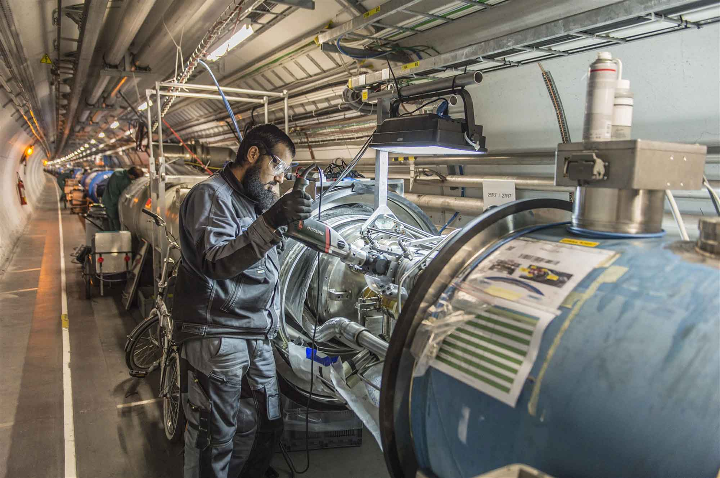
LS1 - descent into the underworld again

Slide 3
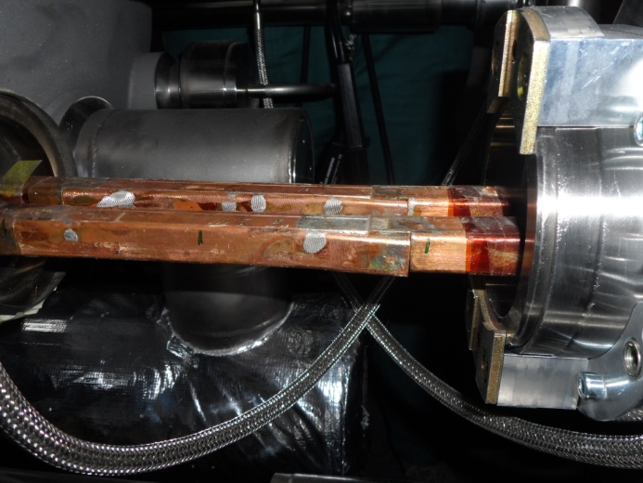
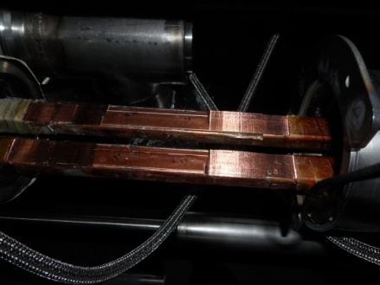
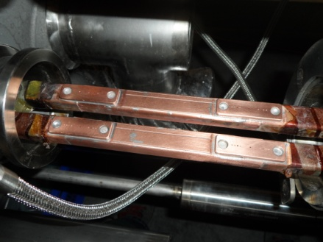
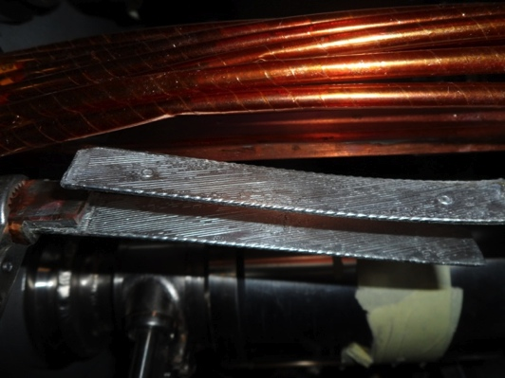
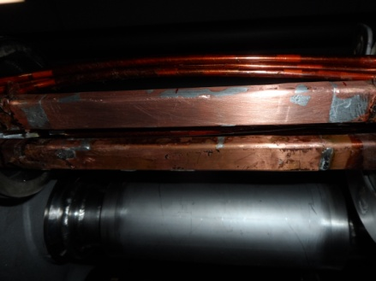
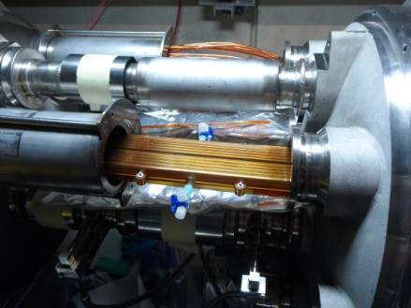
« Old Splice » « Machined Splice » « Consolidated Splice »
« Cables » « New Splice »
Total interconnects in the LHC:
  1,695 (10,170 high current splices)
Number of splices redone: ~3,000 (~ 30%)
Number of shunts applied: > 27,000
« Insulation box »
And a lot more besides…

Slide 4
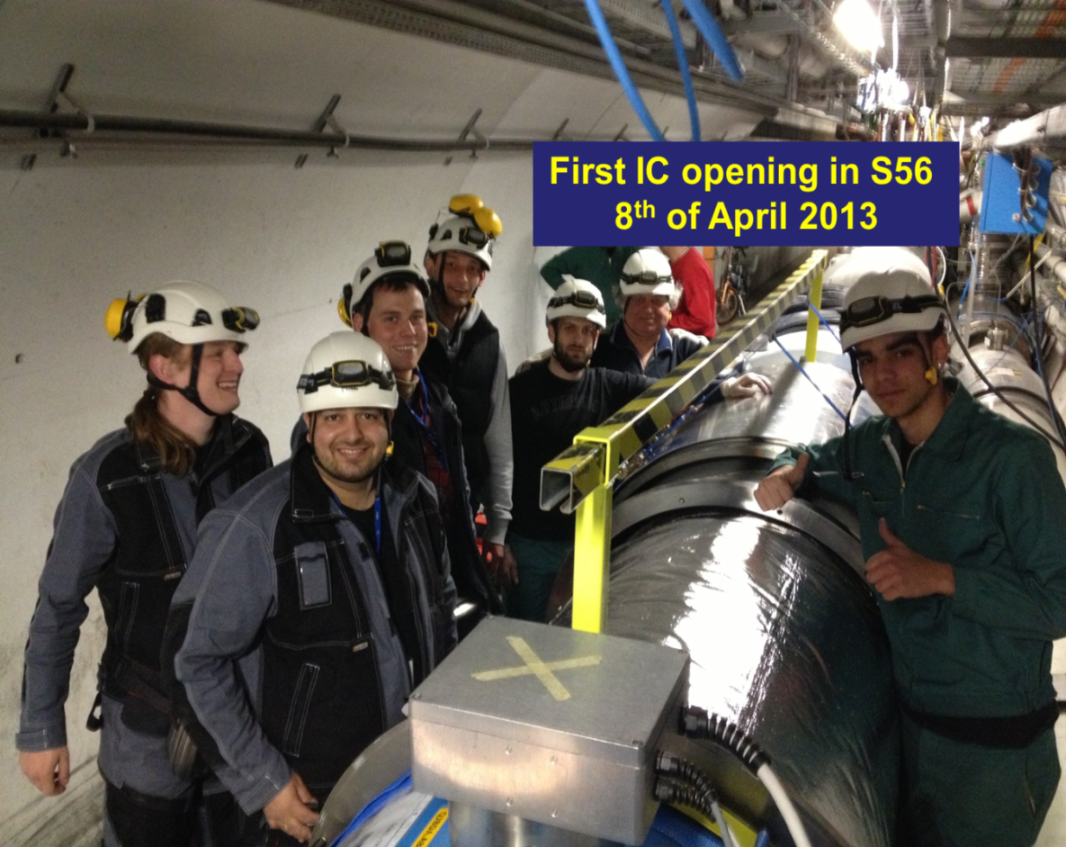
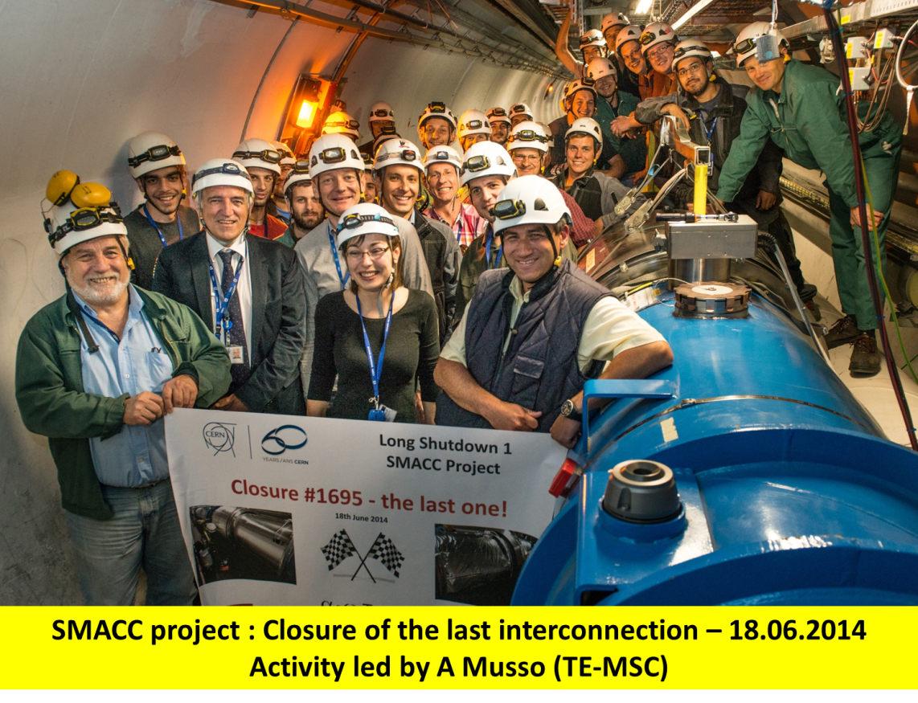
Superconducting Magnets and Circuits Consolidation (SMACC)
Monumental effort
Over 350 persons involved
Including preparation: ~1,000,000 working hours
No serious accidents!
Jean-Philippe Tock
Collaborations with NTUA (Athens), WUT (Wroclaw) and support of DUBNA

Slide 5
Version 4.1
c/o Marzia Bernardini & Katy Foraz
Access system tests: 8/9 Nov.
DSO tests: 15/16 Nov.
Transfer line tests: 22/23 Nov.

Slide 6
CSCM (Copper Stabilizer Continuity Measurement)
Fully qualify magnet bypass = copper stabilizer of the bus-bar + diode + diode leads
Bypass contains about 3500 connections/joints per sector!
Connect the two 6 kA/200 V power converters in series
Stabilize the sector 20 K so the magnets and bus are not superconducting.
Apply a current of a few 100 A to open the bypass diodes
Apply a current pulse of 6.5 TeV equivalent and watch carefully

Slide 7
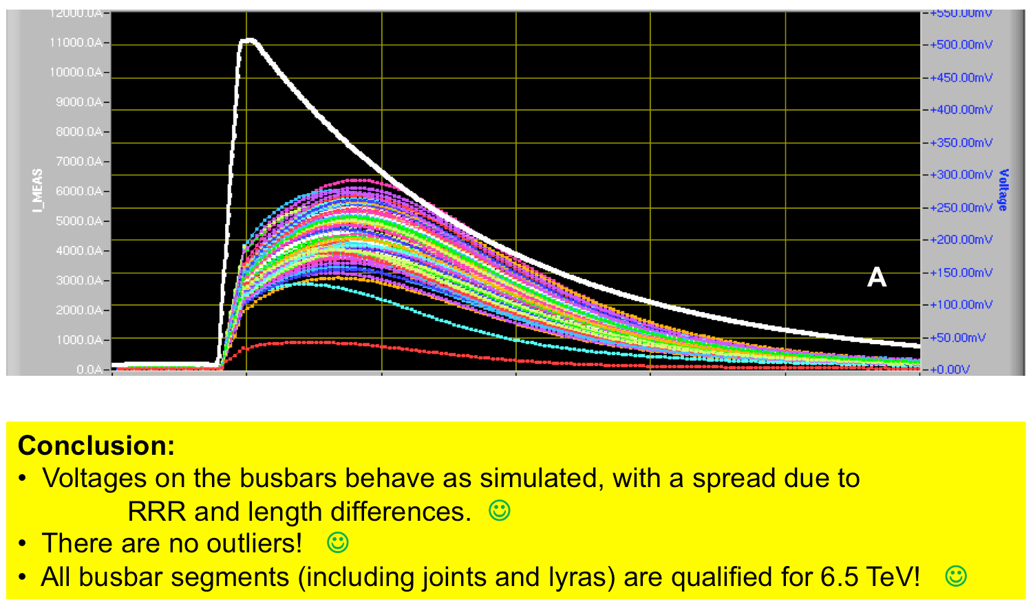
Signals from 11.1 kA run

Slide 8
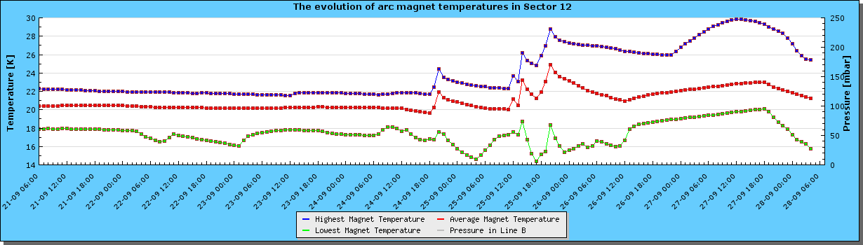
Cool-down - status
Sector 12 | 20 K | CSCM ongoing
Sector 23 | 70 K
Sector 34 | 290 K
Sector 45 | 290 K
Sector 56 | 18 K
Sector 67 | 1.9 K | CSCM OK – powering
Sector 78 | 90 K
Sector 81 | 50 K | CSCM OK
Sector 12 yesterday

Slide 9
Powering tests
All magnet circuits taken to nominal current level one by one
  Rigorous checks of quench protection, energy extraction, interlocks, power converter…
Phase 1: one sector closed, low current levels, limited access
Phase 2: three sectors closed, nominal 6.5 TeV currents (11 kA in dipoles)
  This is when we will start to experience quenches

Slide 10
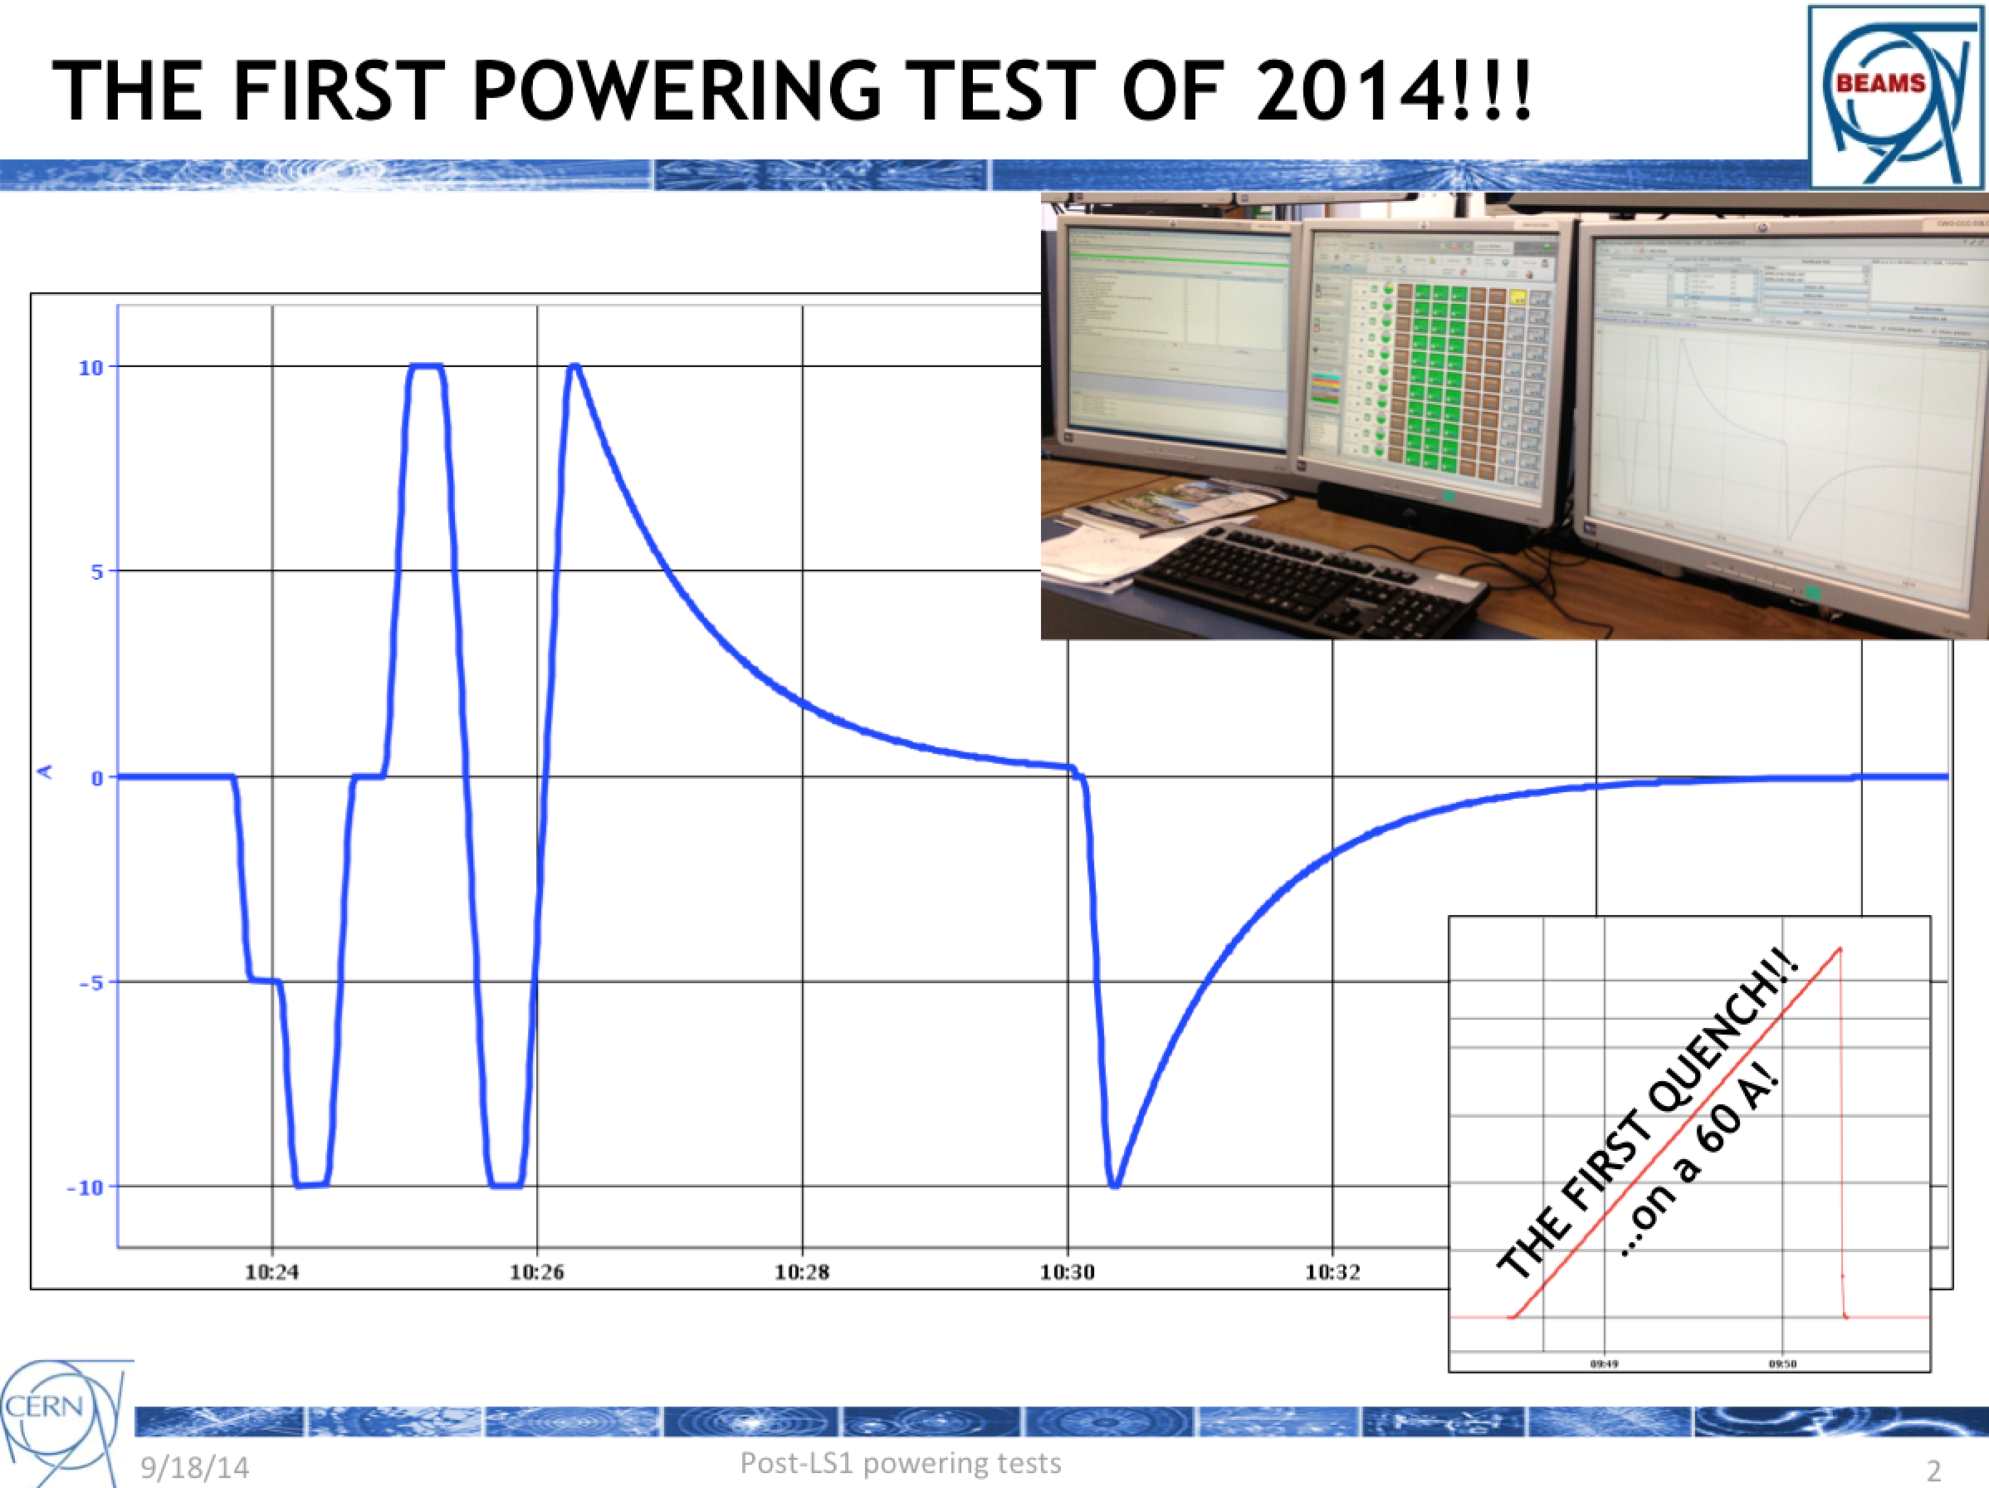
18th September
Matteo Solfaroli

Slide 11
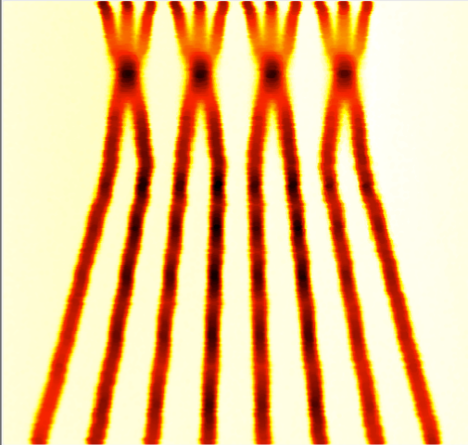

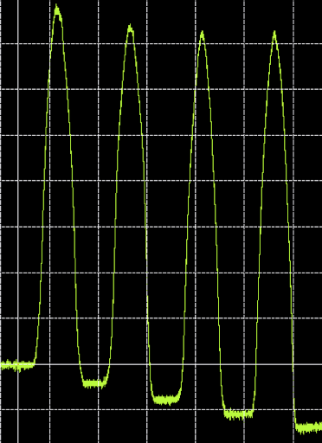
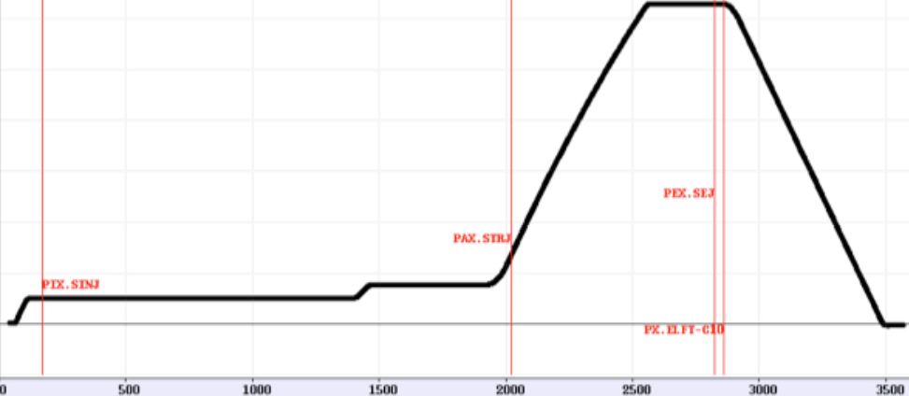
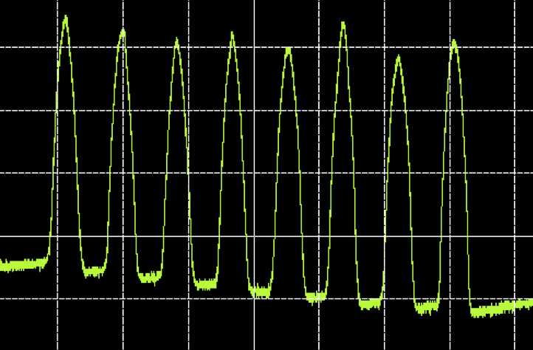
Beam from the injectors 2015
Batch Compression, Merging and Splitting in PS
25 ns bunch spacing
48 bunches
50 ns bunch spacing
24 bunches
4 bunches
Another 4 bunches

Slide 12
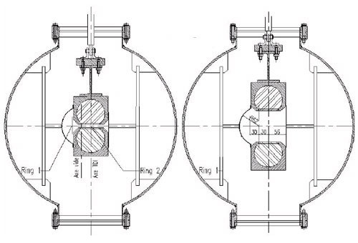
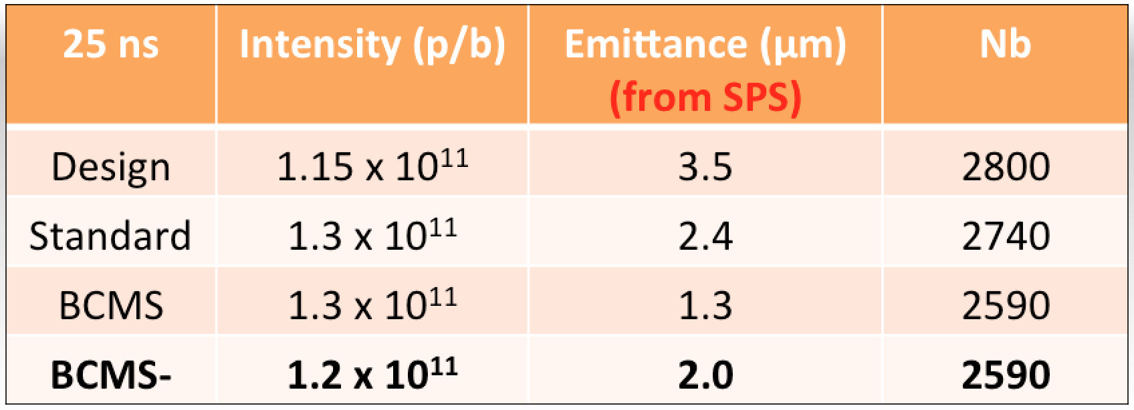
BCMS - High brightness
(but… worry about protection devices and stability)
TDI
Target Dump Injection
down stream of injection point

Slide 13
LHC - 2015
Target energy: 6.5 TeV (maximum)
  to be confirmed at end of powering tests
Bunch spacing: 25 ns
  strongly favored by experiments (pile-up…)
Beta* in ATLAS and CMS: 80 to 40 cm
Beta* in LHCb: 3 m
Beta* in ALICE: 10 m

Slide 14
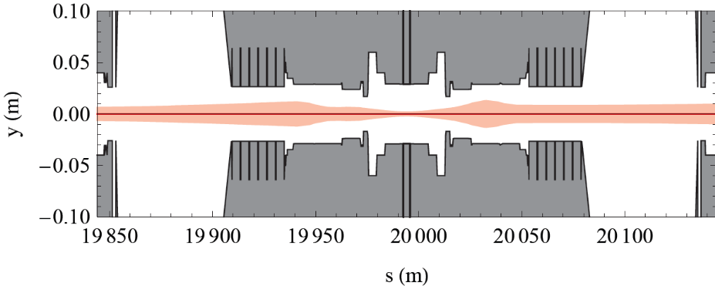
Aperture limit on β*
Collimation hierarchy determines minimum protected aperture
As β* is squeezed to achieve a smaller beam size at IP, and higher lumi, beam size increases in triplet => Aperture margin decreases => Limitation on β* in 1&5

Slide 15
Beta* in IPs 1 and 5
Run 2: Many things have changed. Start carefully and push performance later.
Start-up: β*= 80 cm – (very) conservative
  assuming 2012 collimator settings, aperture, orbit stability… to be checked
  11 sigma long range separation
  standard 25 ns beam sizes
Ultimate in 2015: β*= 40 cm

Slide 16
2015 – challenges 1/3
Operationally not a new machine, carry forward considerable experience – however will face familiar and new challenges
Energy
Issue | Possible effects
Higher stored beam energy | Even bigger disaster if things go wrong
Lower tolerance to beam loss, lower quench margins | Premature beam dumps Tighter parameter control required
More energy dumped in triplets and collimator regions | Beam loss, heat load
Lower intensity set-up beams | Commissioning efficiency
Systems closer to maximum (RF, converters, beam dump…) | Premature dumps, asynchronous dumps

Slide 17
2015 – challenges 2/3
25 ns
Issue | Possible effects
Injection of 25 ns beams | Bigger beam size, higher intensity per injection
Electron cloud | Instabilities, emittance growth, desorption, heat-load
UFOs+ | Premature dumps
Long range beam-beam | Poor lifetime, larger crossing angle
Scrubbing will be one of the main drivers of commissioning 2015

Slide 18
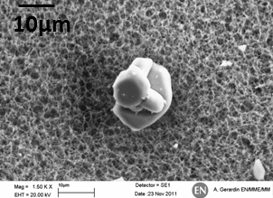
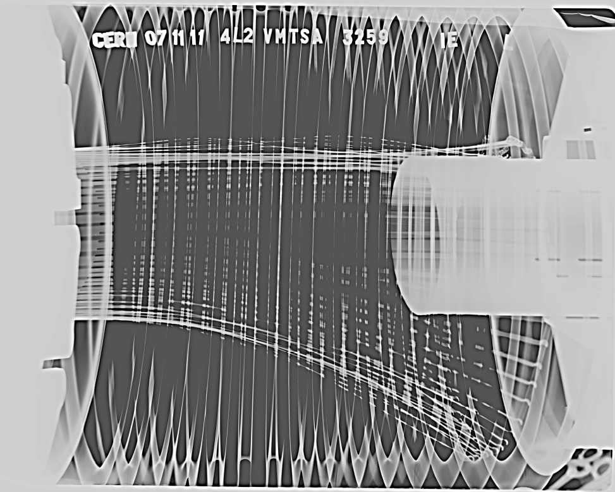
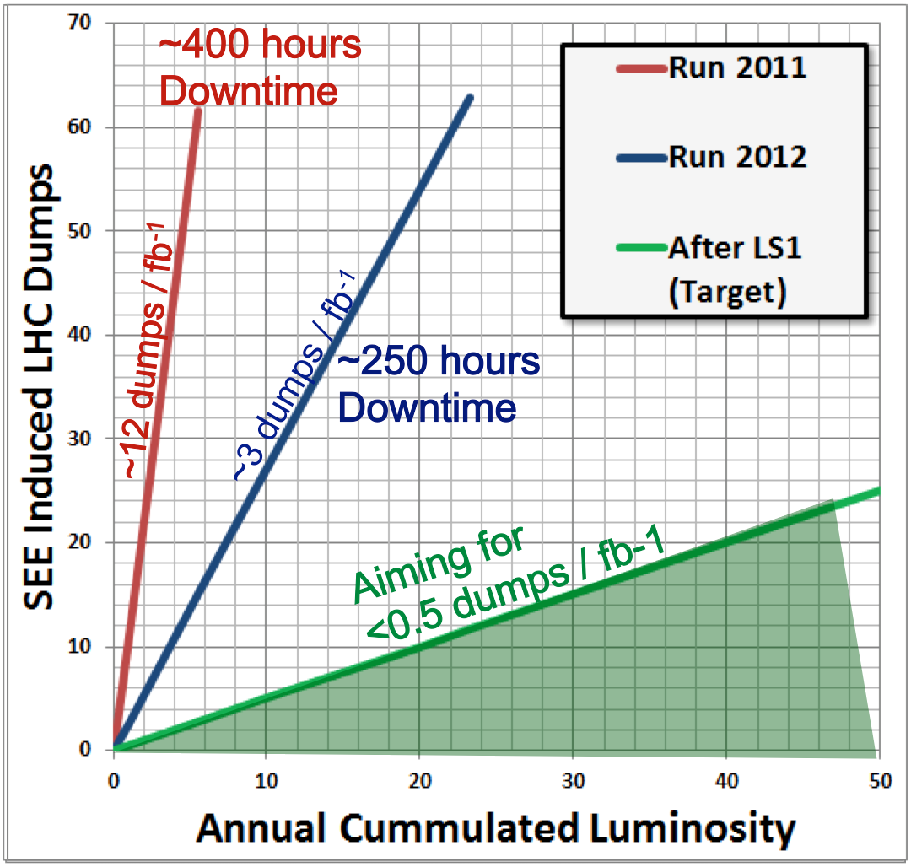
Recall some Run 1 challenges…
Beam induced heating
Local non-conformities (design, installation)
  Injection protection devices
  Sync. light mirrors
  Vacuum assemblies
Solutions deployed in LS1
UFOs
20 dumps in 2012
Timescale 50-200 µs
Conditioning observed
Worry about 6.5 TeV
Radiation to electronics
Concerted program of mitigation measures (shielding, relocation…)
Premature dump rate down from 12/fb⁻¹ in 2011
to 3/fb⁻¹ in 2012
Target 0.5/fb⁻¹ post LS1
Al
O

Slide 19
25 ns & electron cloud
SEY
200 eV
10 eV
2 keV
Beam screen
5 eV
25 ns
Typical e– densities10¹⁰–10¹² m^{–3}
Possible consequences:
  instabilities, emittance growth, desorption – bad vacuum
  excessive energy deposition in the cold sectors
Electron bombardment of a surface has been proven to reduce drastically the secondary electron yield (SEY) of a material. This technique, known as scrubbing, provides a mean to suppress electron cloud build-up.
Electron cloud significantly worse with 25 ns

Slide 20
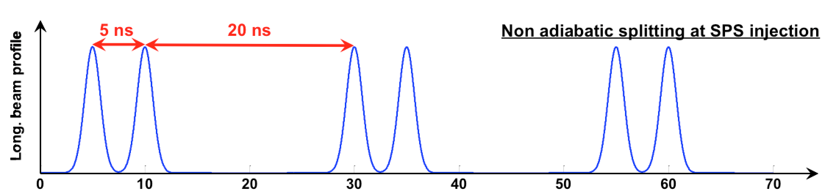
Electron cloud 2015
More scrubbing than in 2012 is mandatory
“Doublet” Scrubbing Beam (5+20) ns being developed in the SPS looks very attractive
A two stage scrubbing strategy is foreseen:
  Scrubbing 1 (50 ns and 25 ns) to allow for operation with 50 ns beams at 6.5 TeV
  Scrubbing 2 (25 ns and Doublet) to allow for operation with 25 ns beams at 6.5 TeV

Slide 21

Scrubbing stages
450GeV
6.5 TeV
Commissioning (low intensity / luminosity)
Vacuum conditioning 50 ns
(5-7 days)
50ns
intensity ramp up + physics
Scrubbing with 25ns
(2 days)
450GeV
6.5 TeV
25 ns scrubbing
(5 days)
Scrubbing qualification
25 ns test ramps
(5 days)
Scrubbing with doublet beams
(5 days)
6.5 TeV
25 ns
intensity ramp up + physics
G. Iadarola and G. Rumolo

Slide 22
2015 commissioning strategy I
Low intensity commissioning of full cycle – 2 months
First stable beams – low number of bunches
Special physics: LHCf and Van der Meer
Scrubbing for 50 ns (partially with 25 ns)
Intensity ramp-up with 50 ns
  Commissioning continued: system (instrumentation, RF, TFB etc.), injection, machine protection, instrumentation…
  Characterize vacuum, heat load, electron cloud, losses, instabilities, UFOs, impedance
Scrubbing for 25 ns
Ramp-up 25 ns operation – relaxed beta*
Commission lower beta*
25 ns operation

Slide 23
Commissioning strategy II
Keep it simple to start with
  Put focus on feasibility, stability and ease of commissioning. Allow comfortable margins for operation and avoid introducing too many untested features at once
Nominal optics with some tweaks and relaxed beta* in ATLAS and CMS
Leave more exotic options until later
  combined ramp and squeeze
  collide and squeeze
  beta* levelling
First: safety
Second: quality
Third: schedule

Slide 24
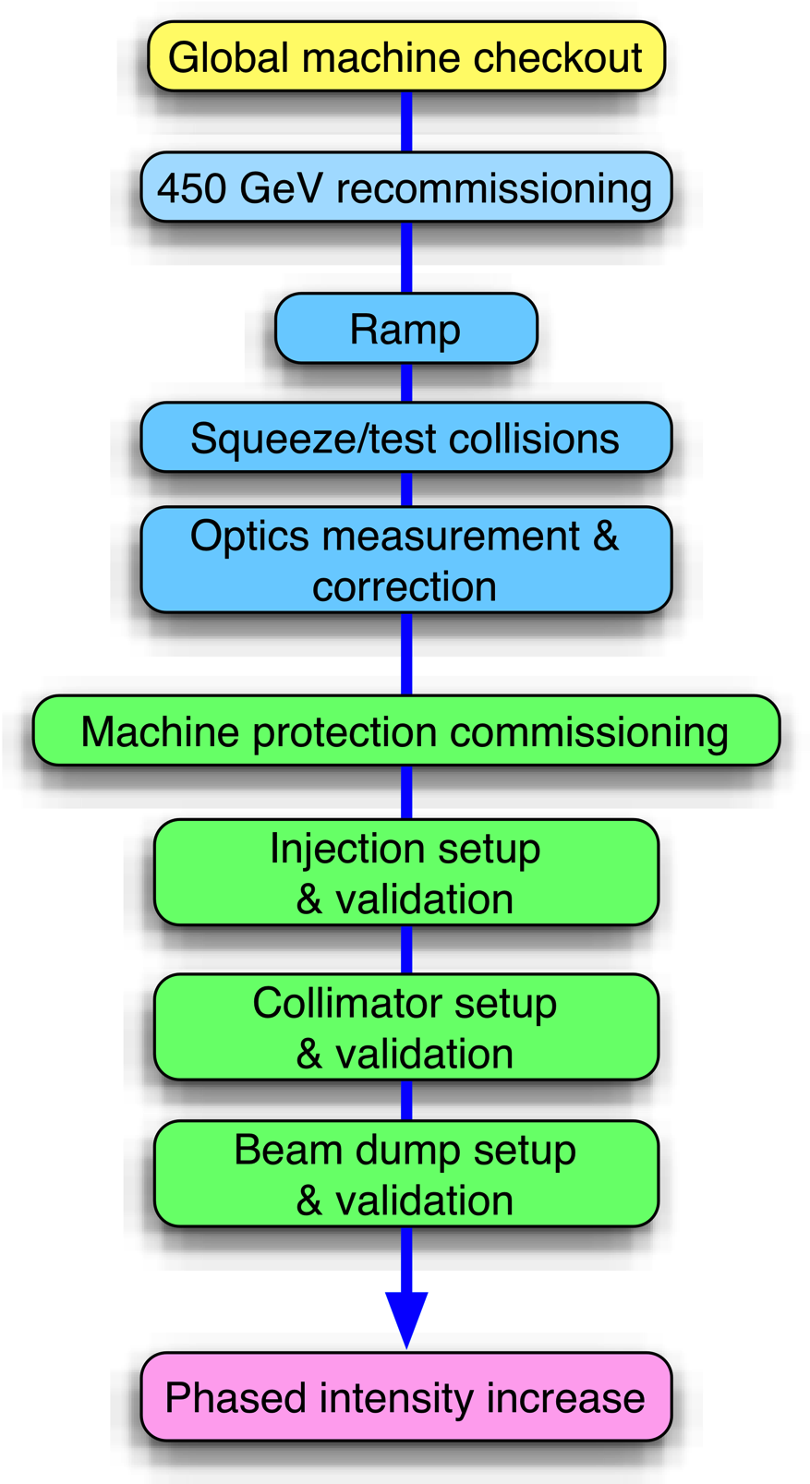
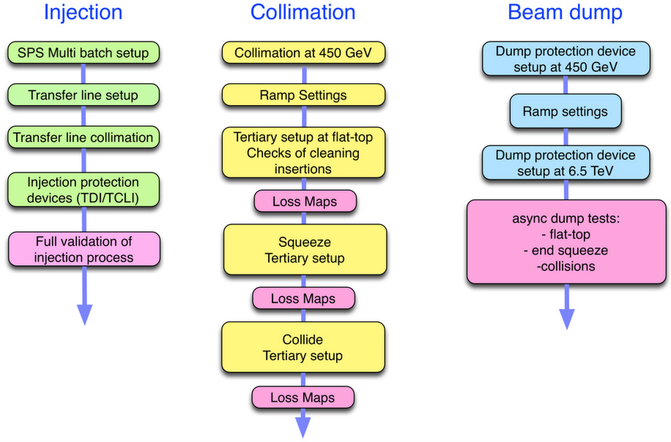
Initial commissioning
System commissioning
Transverse damper
RF
Beam instrumentation
Feedbacks
Injection, beam dumps
Beam based measurements
Optics meas. & correction
Magnet model meas. & correction
Aperture measurements

Slide 25
50 ns ramp-up
Step through something like:
  50, 100, 200, 400, 700, 900, 1200, 1380 bunches
One step every ~3 days ( no issues)
If we do not encounter show stoppers, we should be able to reach ~1000b regime which is a reasonable target.
The current plan is to stick to similar bunch intensities than for 25 ns beams (~1.210¹¹).
Ramp-up took all year in 2010, 4 months in 2011, 2 weeks in 2012
3 weeks on the 2014 schedule…

Slide 26
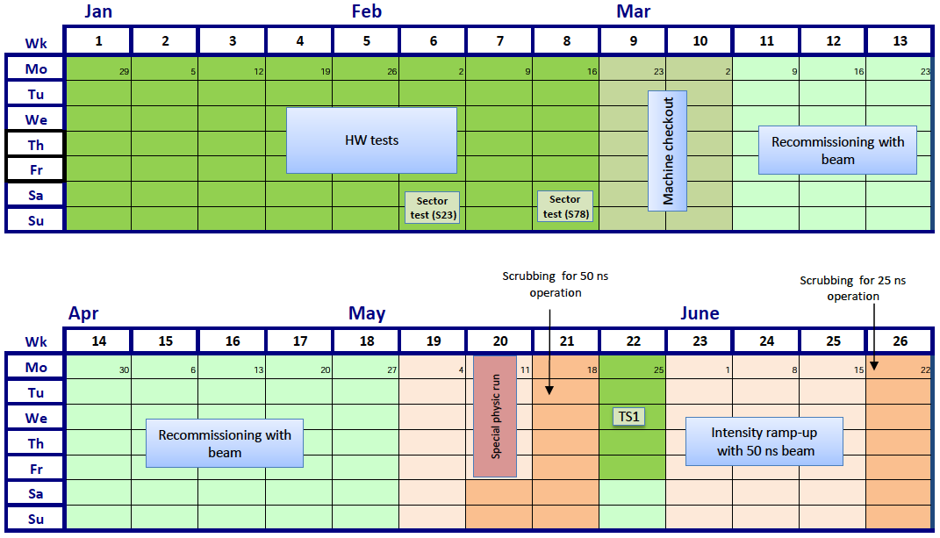
2015 Q1/Q2

Slide 27
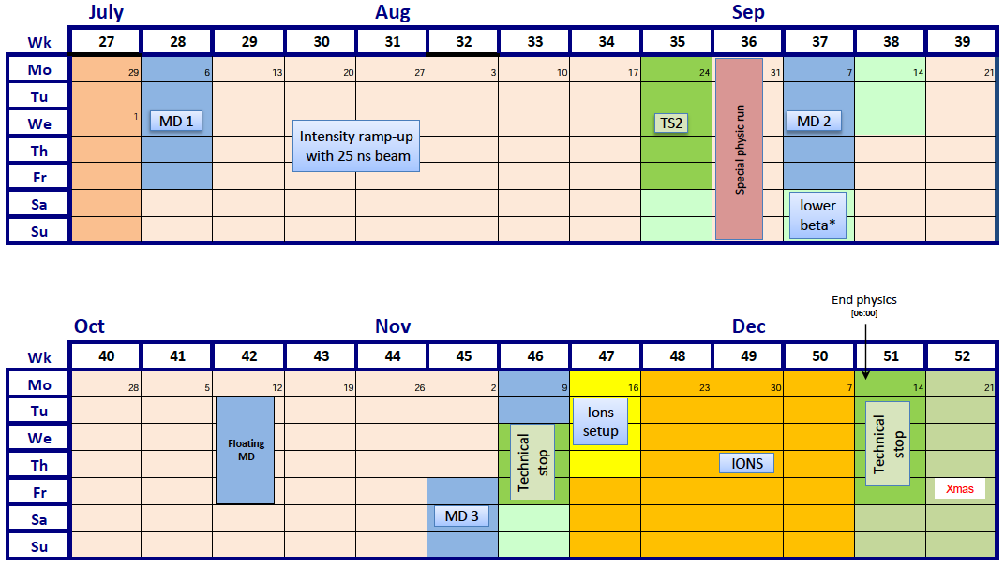
2015 Q3/Q4

Slide 28
2015 version 4.1
Phase | Days
Initial Commissioning | 56
Scrubbing | 23
Early special physics run (LHCf/VdM) | 5
Proton physics 50 ns | 7 + 21
Proton physics 25 ns – phase 1 | 44
Change in beta* | 5
Proton physics phase 2 (including ramp-up) | 46
Special physics runs (TOTEM/VdM) Note: TOTEM request ~2 weeks not included Intermediate energy run - to be scheduled | 7
Machine development | 19
Technical stops | 13
Technical stop recovery | 6
Ion setup/Ion run | 4 + 24
Total | 280 (40 weeks)

Slide 29
ATLAS and CMS performance
Conservative beta* to start
Conservative bunch population
Reasonable emittance into collisions
Assume same machine availability as 2012
 | Nc | Beta* | ppb | EmitN | Lumi [cm⁻²s⁻¹] | Days (approx) | Int lumi | Pileup
50 ns | 1300 | 80 | 1.2e11 | 2.5 | 4.6e33 | 21 | ~1 fb⁻¹ | 27
2015.1 | 2496 | 80 | 1.1e11 | 2.5 | 7.4e33 | 44 | 5.1 fb⁻¹ | 22
2015.2 | 2496 | 40 | 1.1e11 | 2.5 | 1.3e34 | 46 | 9.2 fb⁻¹ | 39
Usual caveats apply – 10 to 15 fb⁻¹ for the year

Slide 30
LHCb performance 2015
 | Nc | beta* [cm] | ppb | EmitN [um] | Virtual lumi [cm⁻²s⁻¹]
50 ns | 1260 | 300 | 1.2e11 | 2.5 | 1.2e33
25 ns | 2300 | 300 | 1.1e11 | 2.5 | 1.9e33
3x(8b+4e) | 1870 | 300 | 1.1e11 | 2.5 | 1.5e33
 | Levelled lumi [cm⁻²s⁻¹] | Days (approx) | Int lumi fb⁻¹ | Pileup
50 ns | 4e32 | 21 | 0.1 | 2.0
50 ns | 2.2e32 | 21 | 0.06 | 1.1
25 ns | 4e32 | 90 | 0.9 | 1.1
3x(8b+4e) | 4e32 | 90 | 0.9 | 1.3
Assume 30% physics efficiency (~36% in 2012)

Slide 31
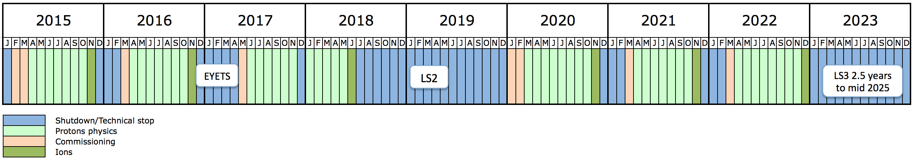
10 year plan
Long years – 13 weeks Christmas stop
Interspersed with long shutdown every 3 to 4 years
Ions very much part of the plan
Run 2: 13 to 14 TeV c.m. with peak luminosity of ~1.7x10³⁴ cm⁻² s⁻¹
Run 3: 14 TeV c.m. with peak luminosity of ~2x10³⁴ cm⁻² s⁻¹
EYETS ~5 months
Extended year end technical stop (CMS)
LS2: 18 months
Connection of LINAC4
LHC Injectors Upgrade
LS3: 30 months
High Luminosity LHC

Slide 32
Conclusions
LS1 went well – re-start looks OK so far
Goal is 25 ns at 6.5 TeV
  Scrubbing++ required – even then electron cloud could remain an issue
LHC has been pulled apart and put back together plus major system upgrades
“New machine”, lot of stuff to sort out but a lot of Run 1 experience
Non-aggressive parameter choice/strategy to start with, aim - re-establish stable operation
GPD luminosity goal: 10 to 15 fb⁻¹ for the year

