Slide 1
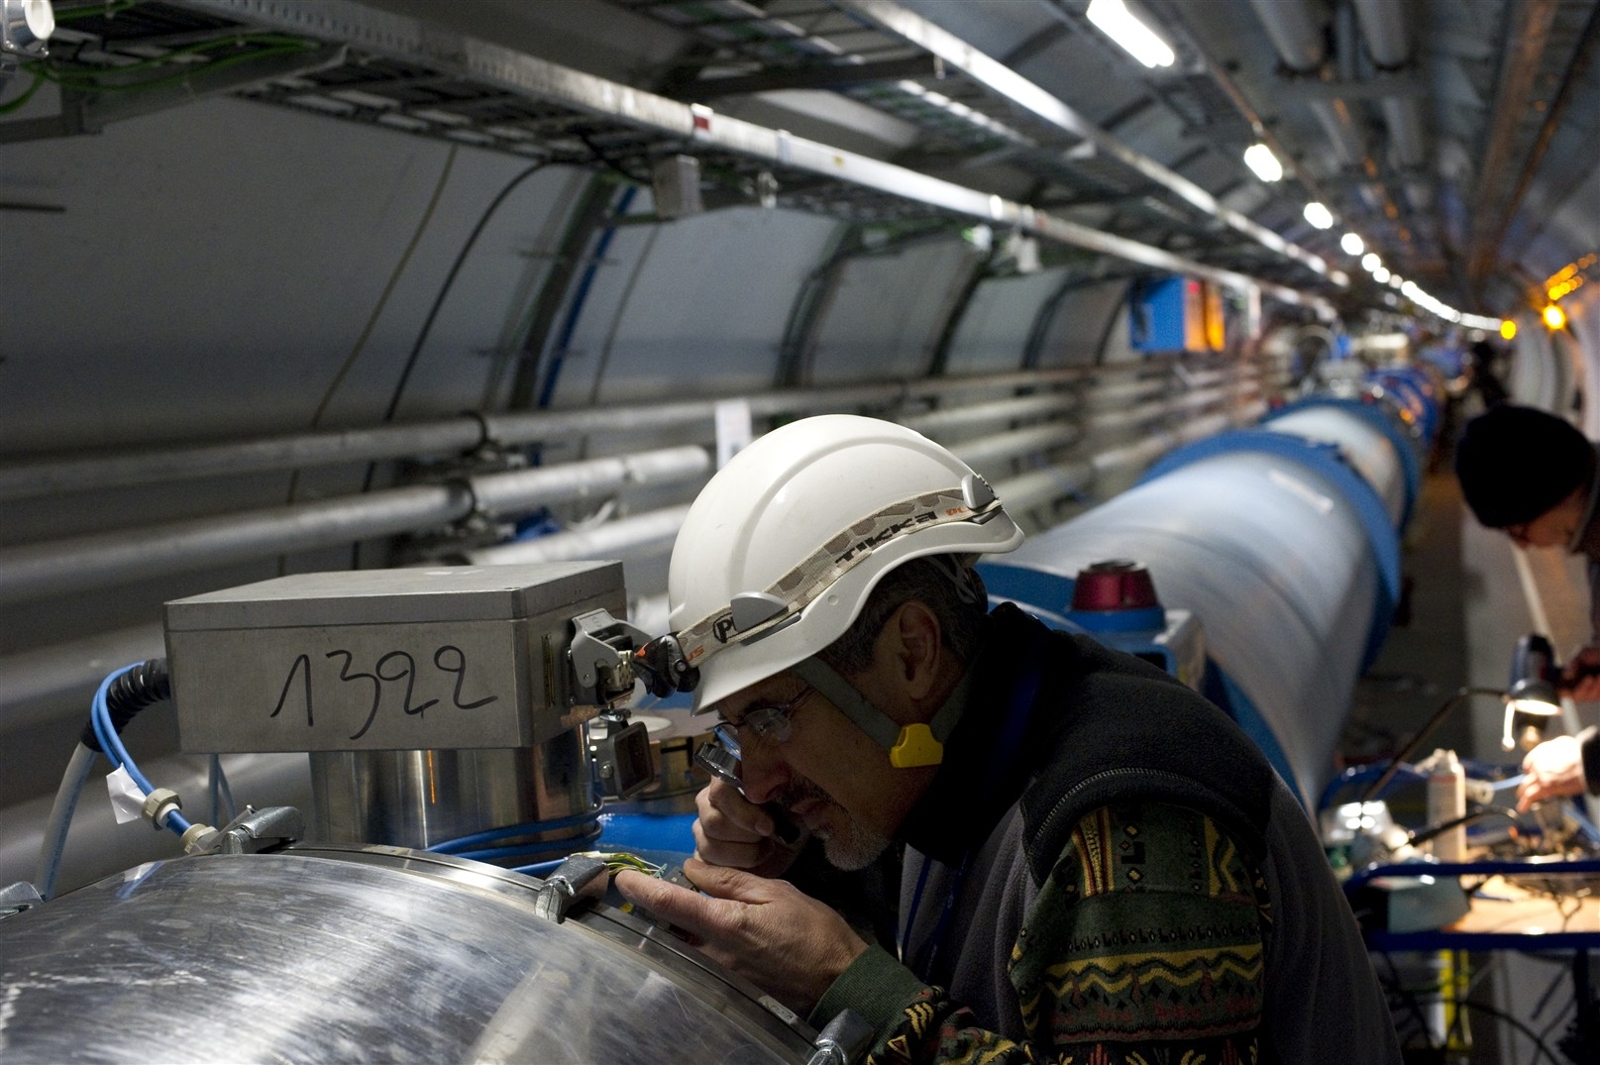
(n)QPS
LHC status and plans for 2011
Mike Lamont
for the LHC team

Slide 2
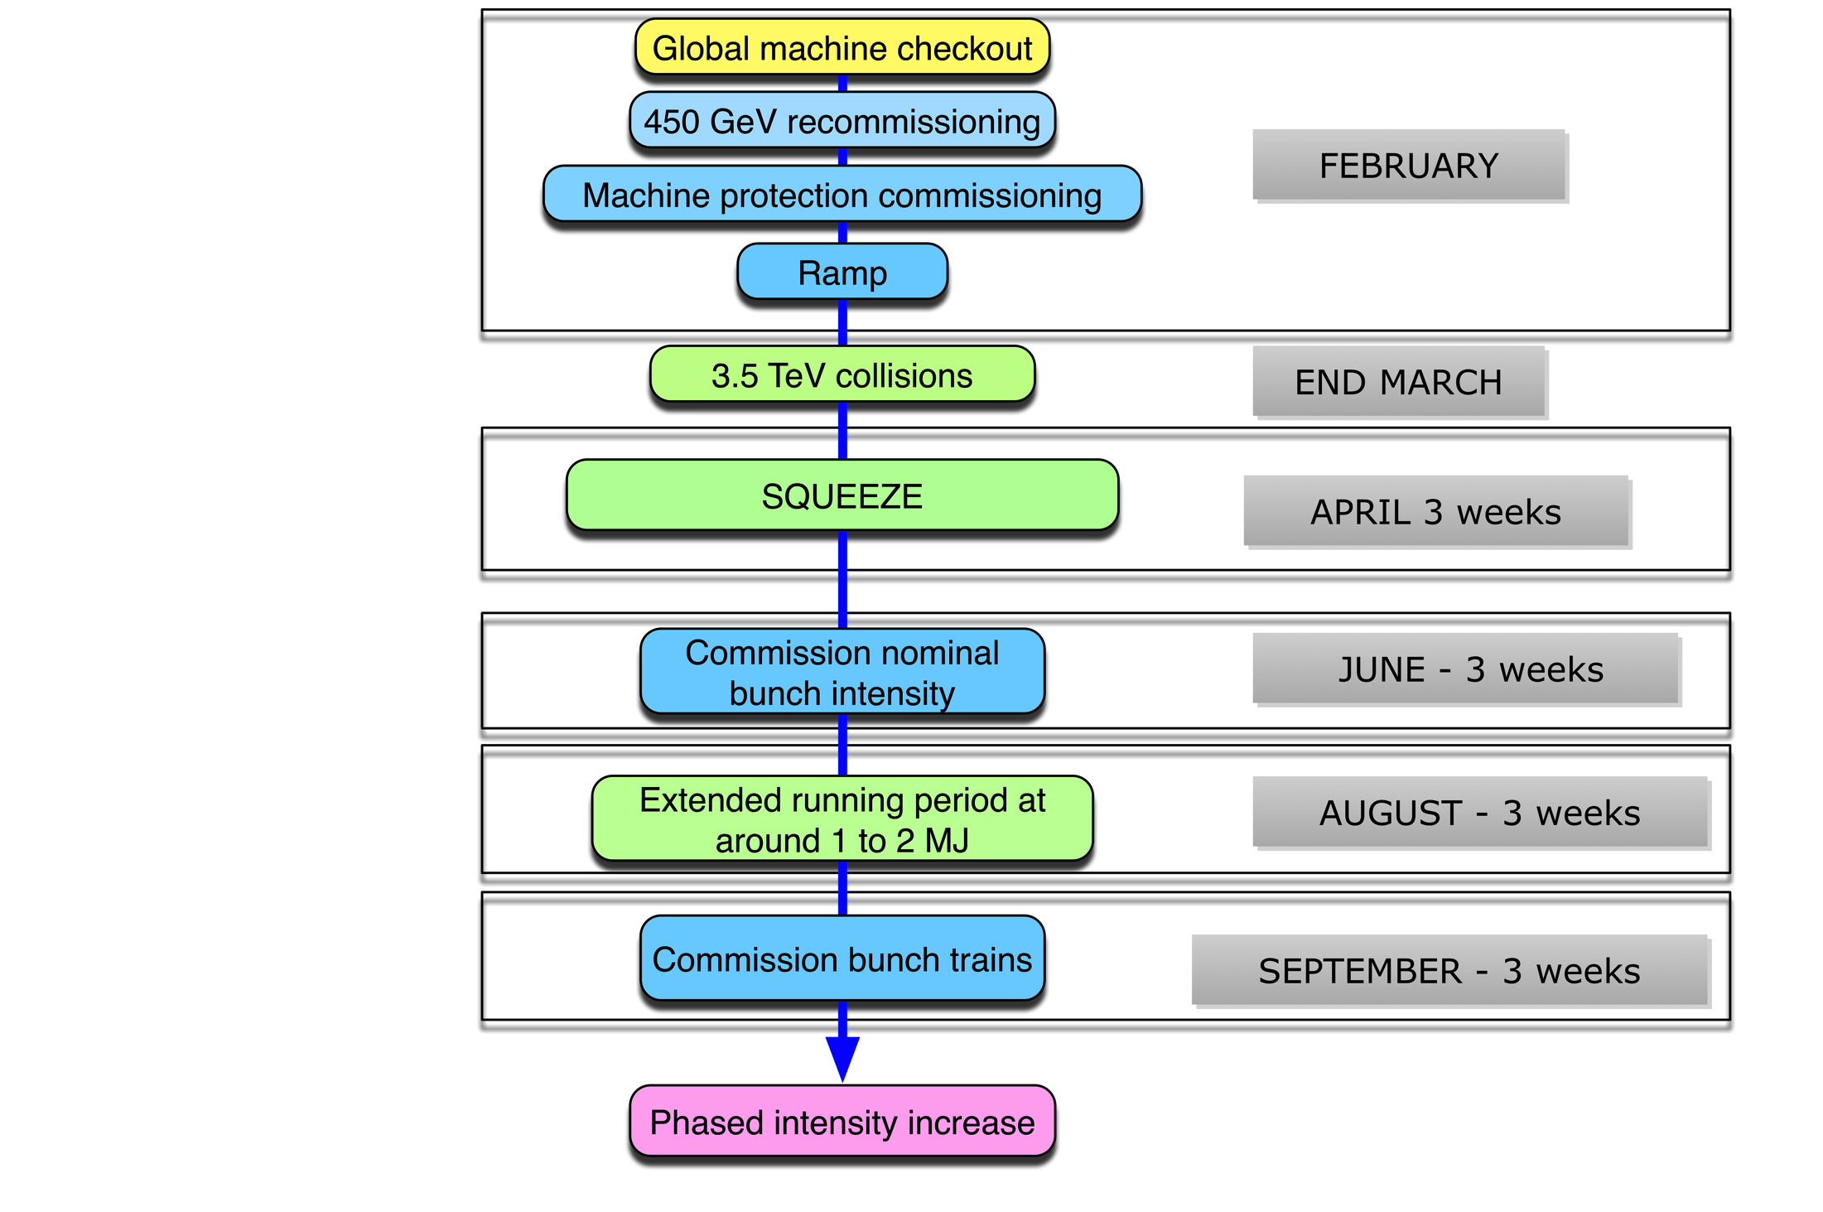




2010 - a long year…

Slide 3
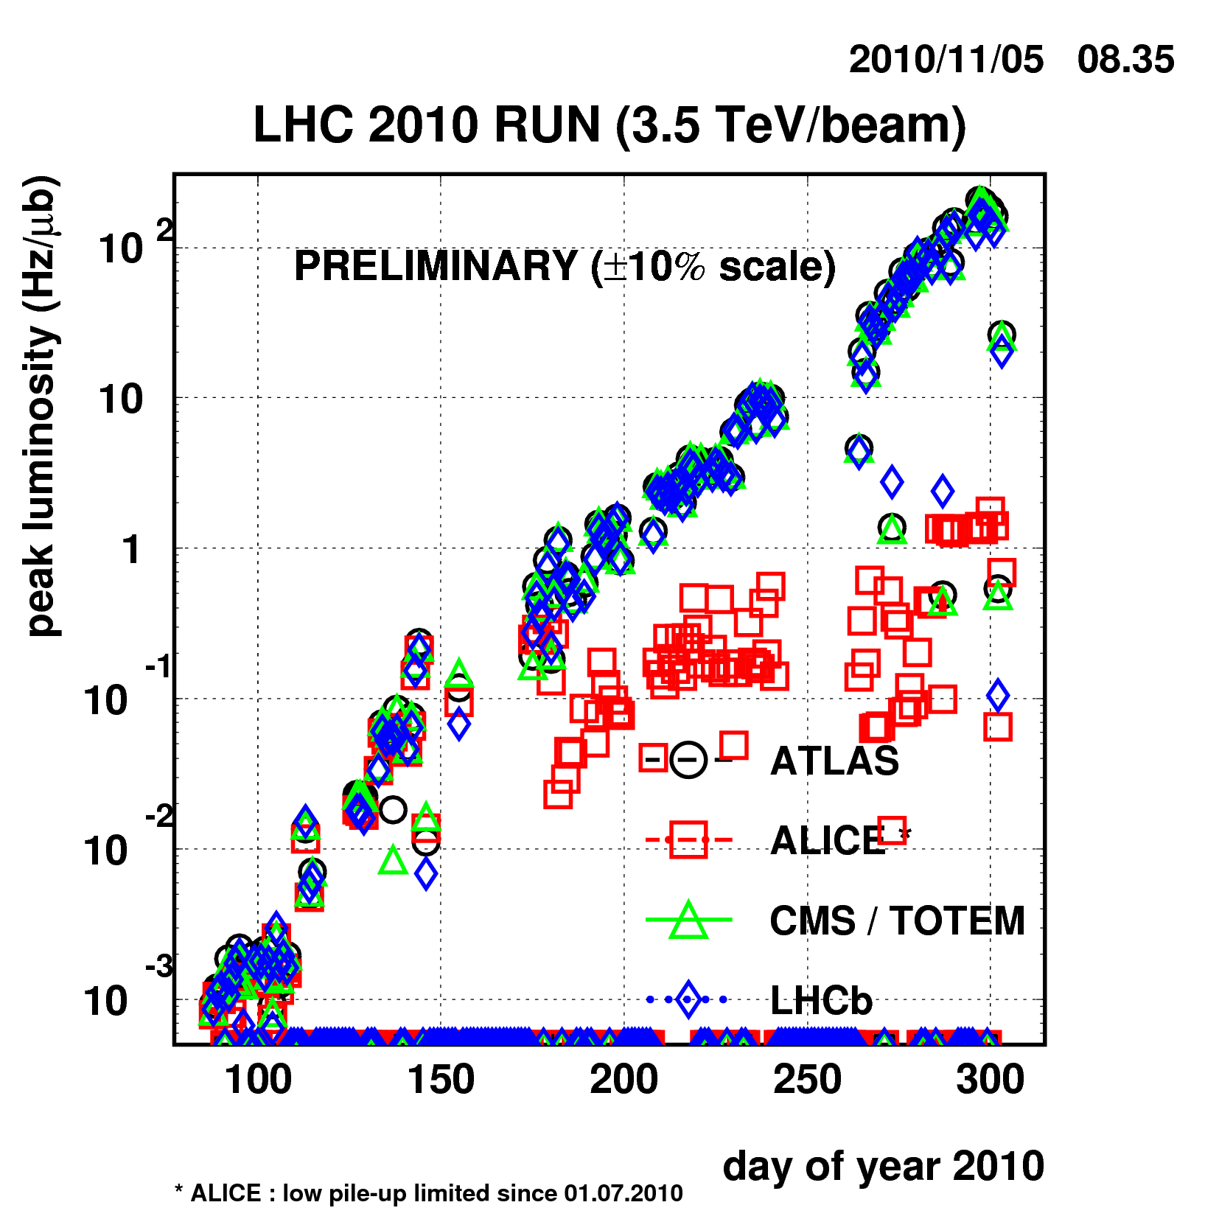
Nominal Bunch intensity
Bunch trains

Slide 4
Bunch intensity - bunch spacing
Started low before moving to nominal bunch intensity
  1.15 x 10¹¹
  Limit given by the predicted beam-beam limit
Worked in 2010 with a few (~50) widely spaced bunches to start with…before moving to 150 ns bunch trains
  Crossing angles on and pushed to 368 bunches
Beam | Np/bunch | Emittance H&V [mm.mrad] | No. of bunches from SPS
LHC150_SB | 1.1 x 10¹¹ | < 2.5 (1.6) | 1 – 4 x 12
LHC_75_SB | 1.2 x 10¹¹ | 2 | 1 – 4 x 24
LHC_75_DB | 1.2 x 10¹¹ (?) | 1.2 (?) | 1 – 4 x 24
LHC_50_SB | 1.45 x 10¹¹ | 3.5 | 1 – 4 x 36
LHC_50_DB | 1.15 x 10¹¹ (?) | 1.5 (?) | 1 – 4 x 36
LHC_25_DB | 1.15 x 10¹¹ | 3.6 | 1 – 4 x 72

Slide 5
2010 parameters
 | 2010 | Nominal
Energy [TeV] | 3.5 | 7
beta* [m] | 3.5, 3.5, 3.5, 3.5 m | 0.55, 10, 0.55, 10
Emittance [microns] | 2.0 – 3.5 start of fill | 3.75
Transverse beam size at IP [microns] | around 60 | 16.7
Bunch current | 1.2e11 | 1.15e11
Number of bunches | 368 348 collisions/IP | 2808
Stored energy [MJ] | 28 | 360
Peak luminosity [cm⁻²s⁻¹] | 2e32 | 1e34

Slide 6
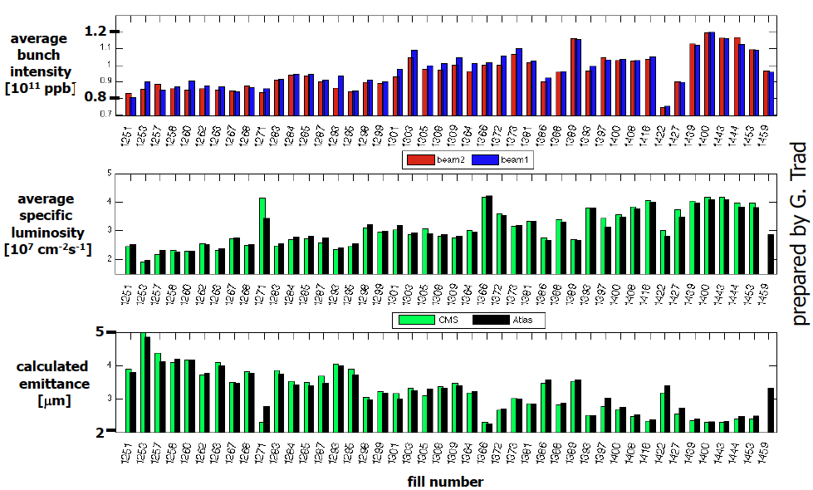
Lumi analysis: statistics across fills
Giulia Papotti

Slide 7
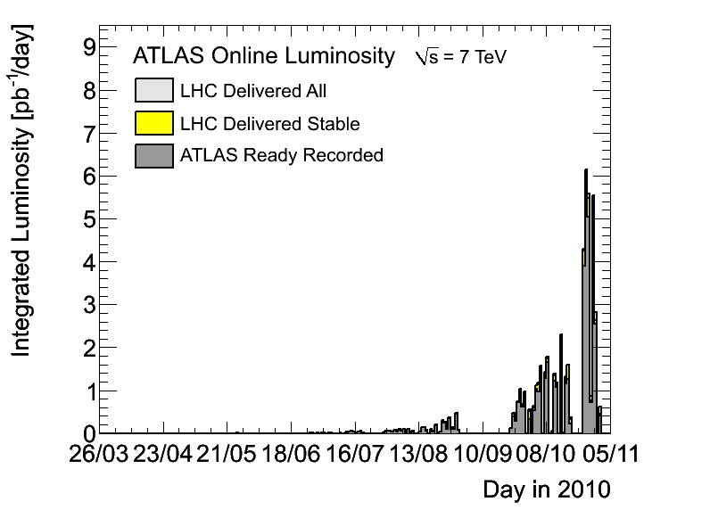

Slide 8
2010 - records
Peak stable luminosity delivered | 2.07 x 10³² cm⁻²s⁻¹
Maximum luminosity delivered in one fill | 6.3 pb⁻¹
Maximum luminosity delivered in one day | 5.98 pb⁻¹
Maximum luminosity delivered in 7 days | 24.6 pb⁻¹
Maximum colliding bunches | 348
Maximum average events per bunch crossing | 3.78
Longest time in Stable Beams for one fill | 30.3 hours
Longest time in Stable Beams for one day | 22.8 hours (94.9%)
Longest time in Stable Beams for 7 days | 69.9 hours (41.6%)
Fastest turnaround to Stable Beams | 3.66 hours (protons)
Courtesy Atlas

Slide 9
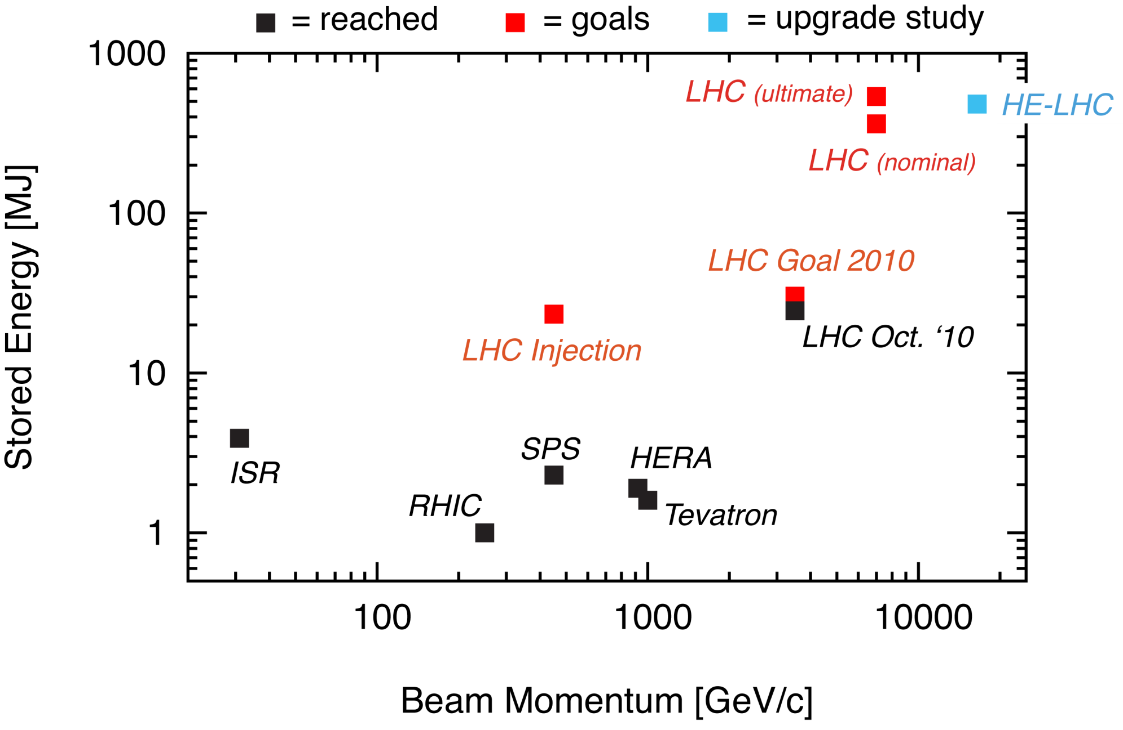
Status LHC Stored Energy
Stored energy reached at 3.5 TeV: 28.0 MJ
80 kg TNT
Ralph Assmann

Slide 10
Beam-beam tune shift
Design report
2010
… small lattice nonlinearities
Measurement of maximum attainable beam-beam parameter a high priority in 2011 operation
Tatiana Pieloni

Slide 11
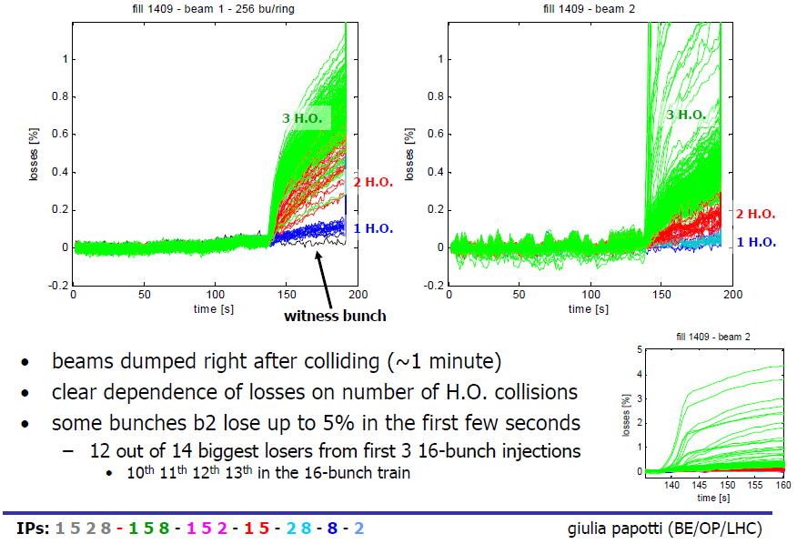
Beam-Beam: Bunch by bunch
Fill 1409: 12.10.2010
ε_{n} = 1.6 μm; N_{b} = 10¹¹; 256 bunches
➔ ξ = 7.7 10⁻³
➔ ΔQ_{tot} = 0.023!!
Fill lost during ‘adjust’!
11

Slide 12
Beam lifetime in general
Excellent single beam before collisions ~200 - 300 hours
Luminosity lifetime ~15 - 20 hours
  Reasonably well given by emittance growth and intensity decay
  Minimal drifts in overlap – beams very stable
Intensity lifetime ~90 hours
  Luminosity burn, losses on collimators
Emittance growth (x ~ 30 hours, y ~ 20 to 40 hours)
  IBS
  and something else – at least sometimes “the hump”

Slide 13
Ions - cunning wheeze – remembered Lorentz
Used the identical magnetic machine as used for protons until the very last moment in the cycle:
  Same ramp, squeeze to 3.5 m.
  Kept separation and crossing angles the same
Happily the BPMs gave similar readings for low intensity ions as those of high intensity protons
  Same reference orbit more-or-less
  Same collimator settings through ramp and squeeze
Brought crossing angles to desired positions when going into collision
  Set-up tertiary collimators in collision, validated with loss maps
  Collided and declared stable beams
Four days from first injection to first stable beams

Slide 14
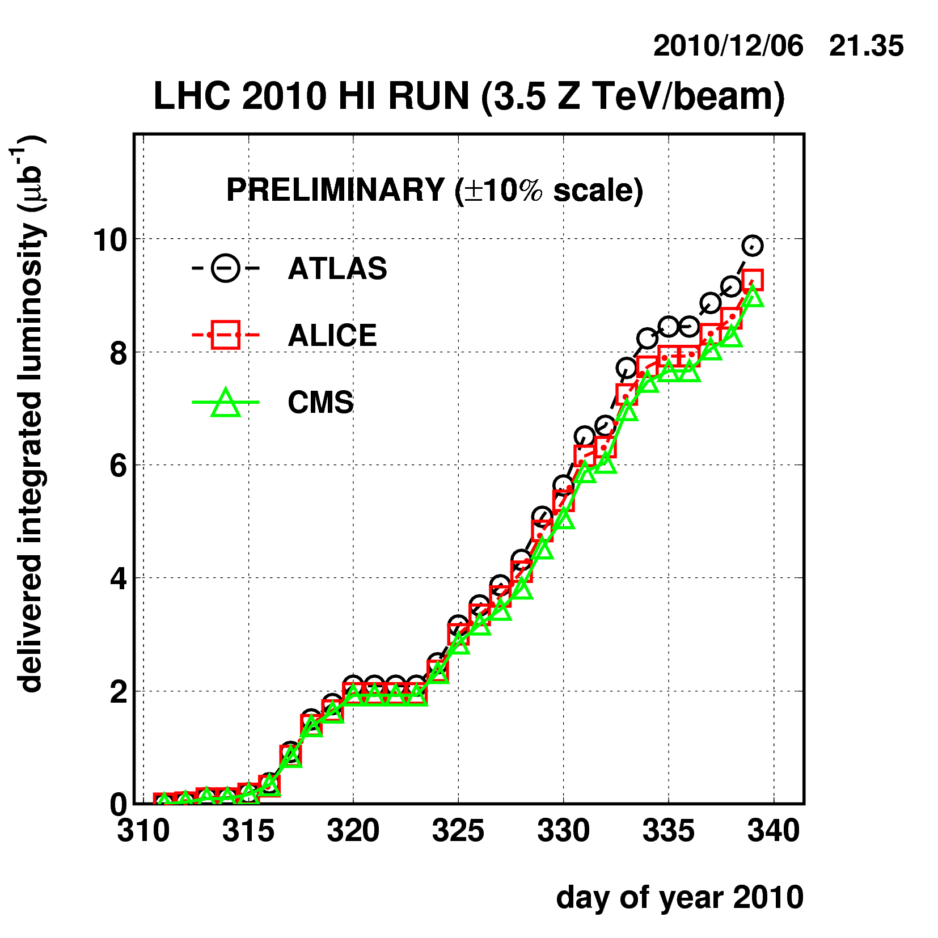
Ions
Protons
again
50 & 75 ns

Slide 15
2010 – main aims
Clear priority to lay the foundations for 2011 and the delivery of 1 fb⁻¹. Peak luminosity target 1x10³² cm⁻²s⁻¹
Gain solid operational experience of injecting, ramping, squeezing and establishing stable beams
Steady running at or around 1 MJ for an extended period
Perform a safe, phased increase in intensity with validation and a running period at each step
✔
✔-
✔
✔

Slide 16
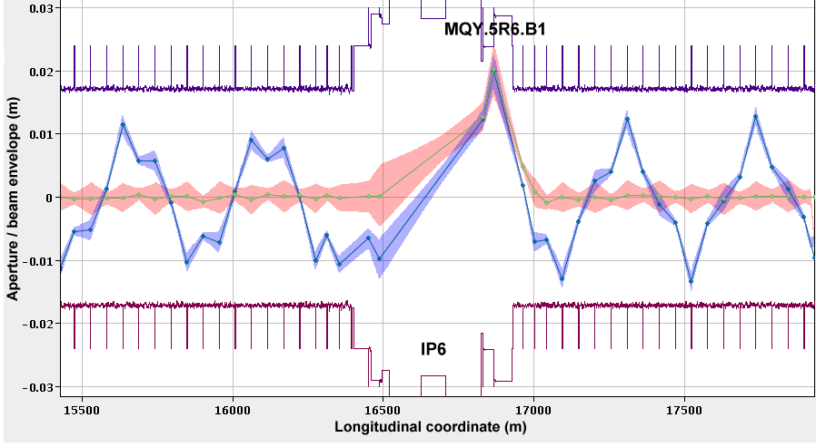
Aperture

Slide 17
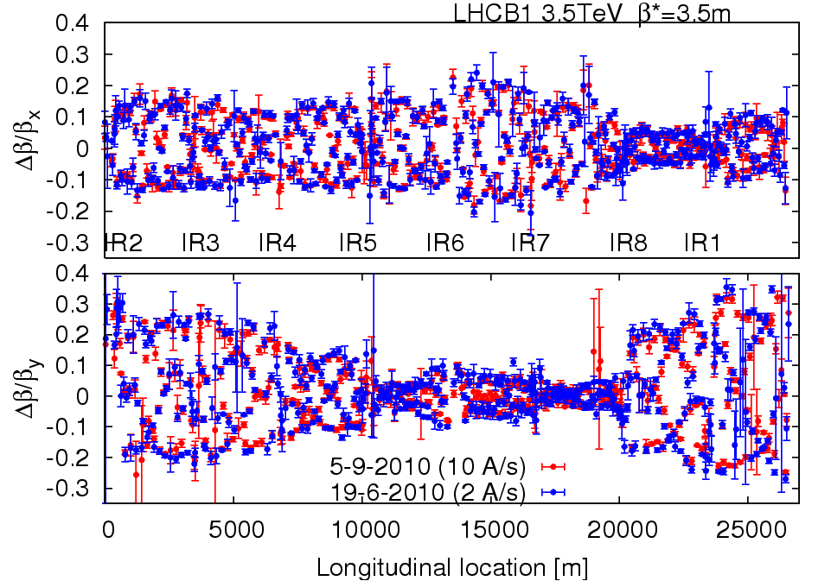
Optics & magnetic machine
Optics stunningly stable
Machine magnetically and optically well understood
  Excellent agreement with model and machine
Magnetically reproducible
  Important because set-up remains valid from fill to fill

Slide 18
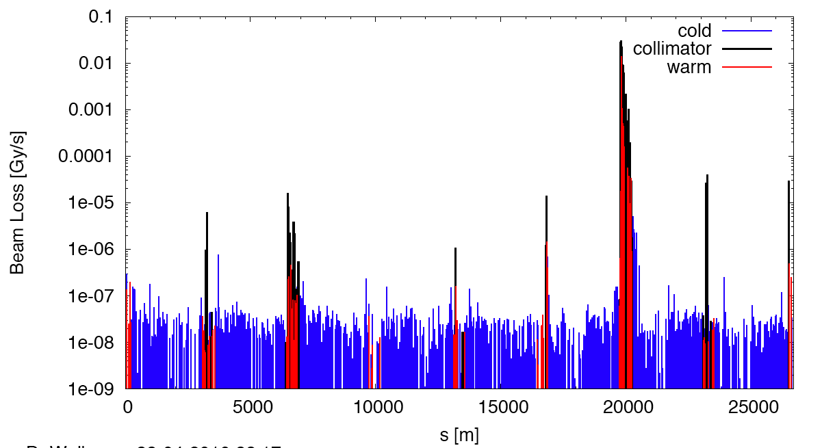
Measured Cleaning at 3.5 TeV
Making sure the hierarchy is respected
(beam1, vertical beam loss, intermediate settings)
Dump Protection Col.
Momentum Cleaning
IR1
IR8
IR2
IR5

Slide 19
Summary
Excellent single beam lifetime
Ramp & squeeze essentially without loss
  No quenches with beam above 450 GeV
  Excellent performance of Machine Protection
Optics close to model (and correctable)
Excellent reproducibility
Aperture as expected
Better than nominal from injectors
  Emittances, bunch intensity
Beam-beam: can collide nominal bunch currents
  With smaller that nominal emittances
And surprisingly good availability…

Slide 20
Probably the best typical month
Walter Venturini

Slide 21
Cryogenics - global performance monitoring
1 Refrigerator for 2 sectors at P6 & P8 (-8MW w.r.t HWC scenario, ≈ -3MCHF)
Upgraded turbine test at P6
90% +/-8% availability all included (since 1st April)
98.5% +/-1% outside TechStop (since 1st July)
Serge Claudet
From design, implementation to operation: it works, the dream comes true !!!

Slide 22
PROBLEMS – TWO OF them

Slide 23
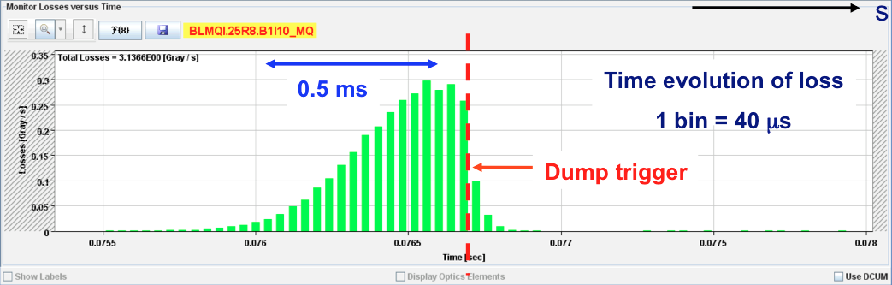
UFOs – unidentified falling objects
Many sudden local losses have been recorded.
No quench, but preventive dumps
Rise time around of the order 1 ms.
Potential explanation: dust particles falling into beam creating scatter losses and showers propagating downstream
Distributed around the ring – arcs, inner triplets, IRs

Slide 24
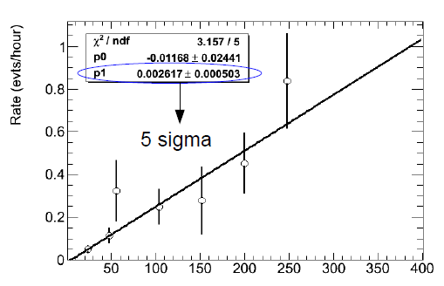


UFO: intensity dependence
Beam loss monitor thresholds have been raised at the appropriate timescales
Logging data mined for events not above threshold

Slide 25
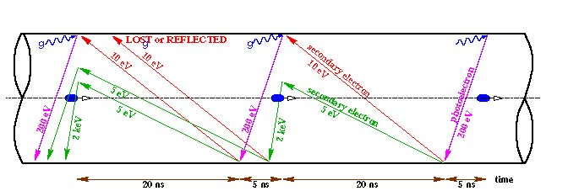
Electron cloud
Reflection
Secondary emission yield [SEY]
Schematic of electron cloud build up in LHC arc beam pipe due to photoemission and secondary emission [F. Ruggiero]

Slide 26
Electron cloud effects
Electron cloud effects occur both in the warm and cold regions.
Vacuum pressure rise (background in experiments)
Single-bunch instability
Multi-bunch instability
Interplay with impedance & beam-beam
Incoherent emittance growth
Heat load in cold arcs (quenches in the limit)
Perturbation of beam diagnostics

Slide 27
Experience in 2010
Vacuum activity started off in regions with common beam pipe at 450 GeV as we pushed up the number of bunches with 150 ns spacing
  Test solenoids cured problem – electron cloud
Tried 50 ns bunch spacing
  Things really kicked off
  High vacuum activity in warm regions (single beam pipe)
  Significant heat load in cold regions
  Instabilities and beam size growth observed
  Surface conditioning (‘scrubbing’) observed
    Gas desorption rates and SEY drop
    Time constant < 1 day
Situation a lot cleaner with 75 ns
  incoherent effects seen – emittance blow-up
  800+ bunches injected into both beams

Slide 28
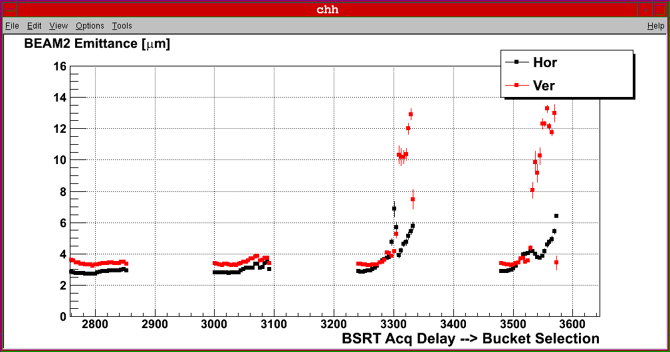
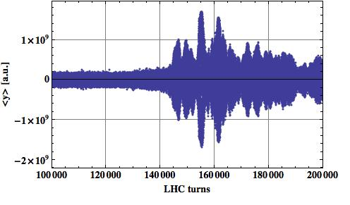
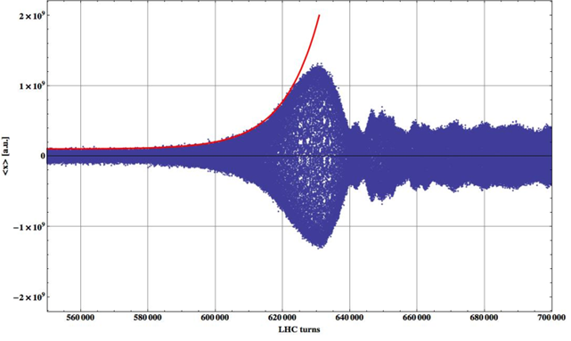
Beam stability at 450 GeV/c (50 ns)
Build-up of the electron cloud over more than one train leading to instabilities and emittance blow-up along the trains.
Compatible with electron cloud instability
F. Roncarolo
12+4x24 – 1.85 μs spacing
V: ~0.2 s rise time
H: ~1 s rise time
E. Métral

Slide 29
Strategy
One week’s scrubbing with 50 ns beam
  Good for 75 ns with 1.3e11 bunch intensity
Lots of wire is being wrapped around warm bits during the technical stop (solenoids)
Push 75 ns to a maximum of 930 bunches
Pushing 150 ns to a maximum of 450 bunches is a backup option
Keep 50 ns for machine development
2010 observations are certainly due to ~ 2 < SEY < ~ 2.5, whereas 1.7 was usually the max value studied in the past

Slide 30
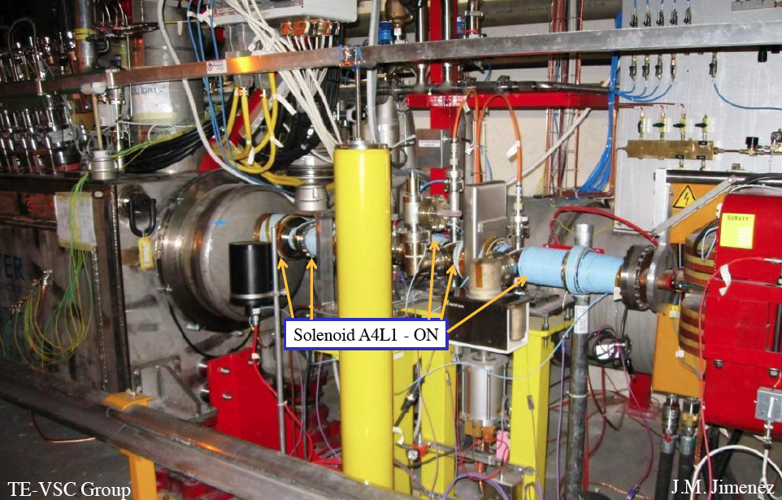
Solenoids between DFBX and D1 in IR1R

Slide 31
2011

Slide 32
Assumed beam parameters for Physics
Beam parameters
Energy | 3.5 TeV
β* : IP1 – 5 – 2 – 8 | 1.5 – 1.5 – 10 – 3 m for 2.5 μm
Separation (Injection) | ± 2 mm
Separation (Physics) | ± 0.7 mm (reduction during the ramp)
B1 ½ external crossing angles (Inj.) | ± 170 μrad (all IPs)
B1 ½ external crossing angles (Phys.) | +120 μrad (IP1&5); ± 80 μrad (IP2); - 235 μrad (IP8)
Beam parameters | 150 ns | 75 ns | 50 ns
Bunch intensity [e11 p/b] | 1.2 | 1.2 | 1.2
Normalised Emittance [μm] | 2.5 | 2.5 | 2.5
Colliding bunches | 368* | 936 | 1404
Malika Meddahi

Slide 33
Days for Luminosity operation
PHASE | Days
Total proton operation | 264
5 MDs (4 days) | - 20
6 TS (4+1 days) | - 30
Special physics runs | - 10
Commissioning | - 20 to -30
Intensity ramp up | - 30 to -40
Scrubbing run | - 10
Total High intensity | 124 to 144 (135 days for integrated L)

Slide 34
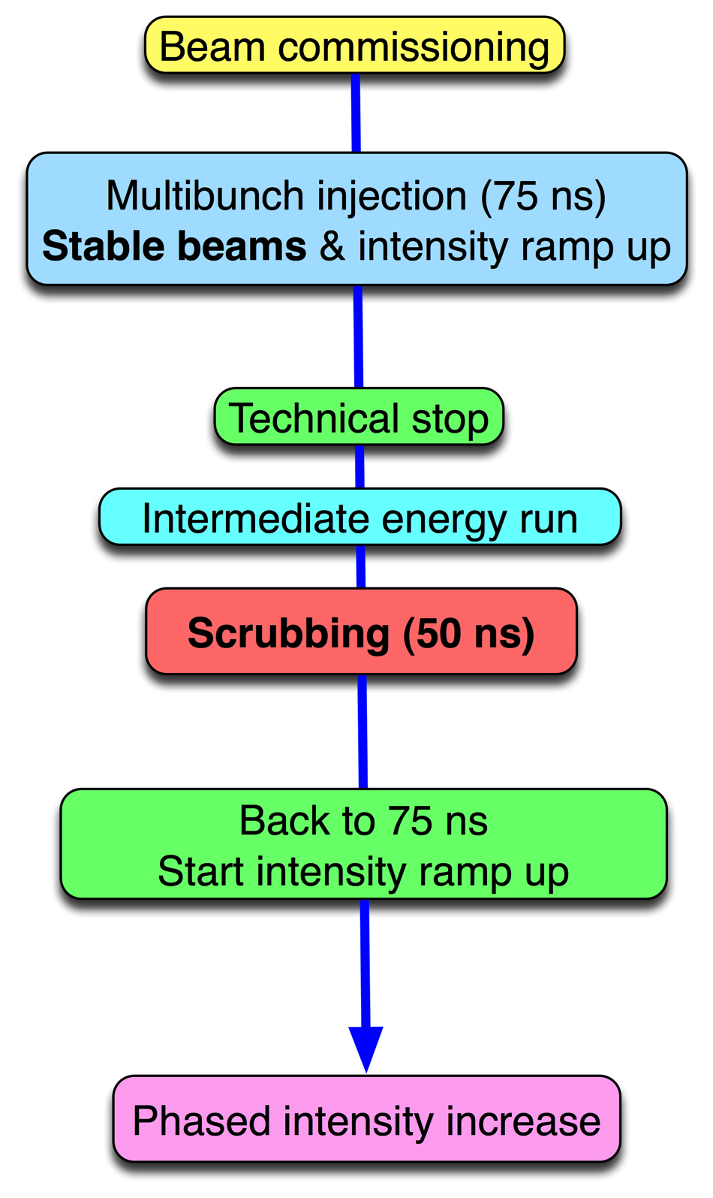
LHC 2011 - phase 1

Slide 35
Baseline scenario
Beam commissioning – 3 - 4 weeks
  Exit - stable beams with low number of bunches
Ramp-up to ~200 bunches (75 (or 150 ns)) – 2 weeks
  Multi-bunch injection commissioning continued
  Stable beams
Technical Stop – 5 days
[Intermediate energy run – 5 days]
Scrubbing run – 10 days including 50 ns injection comm.
Resume 75 ns operation and increase no. bunches - 3 weeks
  300 – 400 – 600 – 800 – 930 - MP and OP qualification
Physics operation 75 ns – 930 b

Slide 36
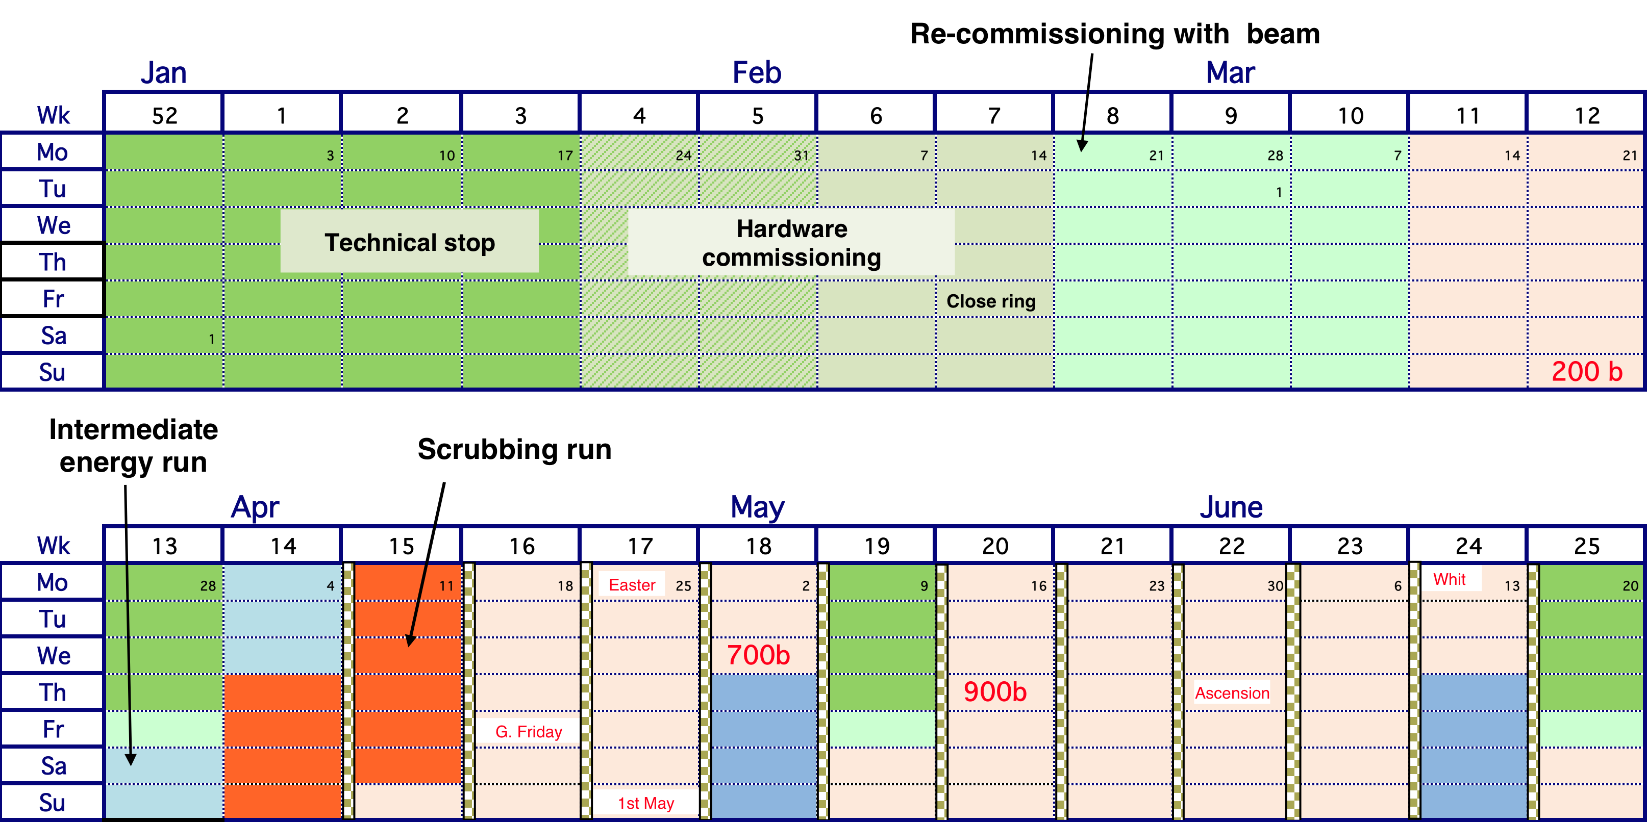
2011 LHC schedule Q1/Q2
Some dates to be confirmed

Slide 37
Estimated Peak and Integrated Luminosity
β* = 1.5 m, 3.5 TeV
days | H.F | Comm with | Fills with | kb | Nb e11 | ε μm | ξ/IP | L Hz/cm² | Stored energy MJ | L Int fb⁻¹
160 | 0.3 | 150 ns | 150 ns | 368 | 1.2 | 2.5 | 0.006 | ~5.2e32 | ~30 | ~1.9
135 | 0.2 | 75 ns | 75 ns | 936 | 1.2 | 2.5 2 1.8 | 0.006 0.007 0.008 | ~1.3e33 ~1.6e33 ~1.8e33 | ~75 | ~2.7 ~3.3 ~3.7
125 | 0.15 | 50 ns | 50 ns | 1404 | 1.2 | 2.5 | 0.006 | ~2e33 | ~110 | ~2.8
Malika Meddahi

Slide 38
2012 - ultimate reach
1.6 x10¹¹ ppb and emittance of 2 microns at 3.5 TeV respects the robustness limits of the collimation system (equivalent to ultimate intensity)
Ralph Assmann
4 TeV (?)
1400 bunches (50 ns)
2.5 micron emittance
1.5 x 10¹¹ protons/bunch
beta* = 2.0 m, nominal crossing angle
Hubner factor 0.2
Peak luminosity | 2.2 x 10³³
150 days | ~5 fb⁻¹
Stored energy | ~130 MJ
Usual warnings particularly apply – see problems, problems above

Slide 39
Conclusions 1/2
Injection, ramp and squeeze fully operational
LHC magnetic model, optics excellent
Beam instrumentation in good shape.
Beam cleaning and collimation works reliably with predicted efficiency.
Machine protection reliably catches failures etc.
Machine aperture looks good
Performance with beam (losses, lifetimes, luminosity, emittance growth etc.) is very encouraging

Slide 40
Conclusions 2/2
Machine availability is excellent – the hard work of numerous teams
There are problems
  UFOs somewhat worrying
  Electron cloud well understood – measures prepared
2011 – another long year ahead…
  75 ns. bunch spacing – up to 930 bunches
  Nominal intensities, beta* 1.5 m
  should be good for 5 to 10 x 10³² cm⁻²s⁻¹
  and 1 to 3 fb⁻¹
Will run in 2012
  Attempt to measure splice resistance in 2011/2012 might open the way to 4 TeV or higher

